Slide 1



IMS Learning Tools
Interoperability Update
Charles Severance, Ph.D.
IMS Global Learning Consortium (IMS GLC)
http://www.imsglobal.org/
http://www.dr-chuck.com/

Slide 2
Phased Roll Out
LTI 1.0 (formerly Basic LTI)n – May 2010
  Tool Launch and Common Cartridge 1.1
LTI 1.1 – 4Q2011
  Return Grades back to the LMS
LTI 1.2 – In Progress
  Automatic provisioning of URL, Key, Secret
  Expanded Grade Handling

Slide 3
Launch Overview
LTI 1.0 (Basic LTI)

Slide 4
LTI Sample Launch Data
lti_version=LTI-1p0
lti_message_type=basic-lti-launch-request
oauth_consumer_key=lmsng.school.edu
resource_link_id=120988f929-274612
user_id=292832126
roles=Instructor
lis_person_name_full=Charles R. Severance
lis_person_contact_email_primary = csev@umich.edu
context_id=456434513
context_title=SI301 – PHP
tool_consumer_instance_description=University of School

Slide 5
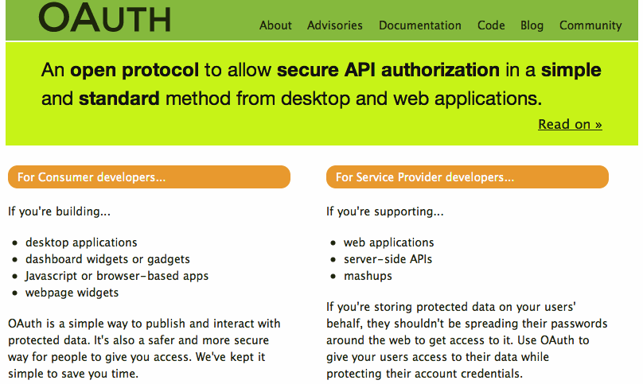

Slide 6
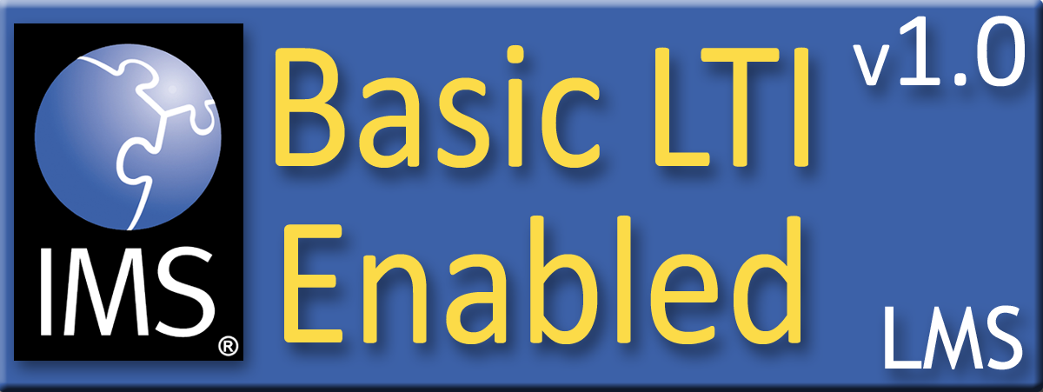









Certified – LTI 1.0
Desire2Learn Learning Environment v8.4.2 and v9.0
Blackboard 9.1SP4
Jenzabar JICS v7.2 and e-Racer v1.2
Learning Objects Campus Pack v4.2
Sakai v2.7
OLAT 7.0
GeNIE, Open-Source LMS v1.0
Moodle 1.9 Basic LTI Module
PowerLink for Blackboard WebCT v8
Canvas Instructure
http://www.imsglobal.org/cc/statuschart.html

Slide 7



Slide 8

Returning Grades
(LTI 1.1)
Seamlessly
connect
to learning
IMS Learning Tools
Interoperability (LTI)

Slide 9
Coming: Connecting to Learning Information Services (LIS)
TOOL CONSUMER
TOOL PROVIDER
BasicLTI Launch with LIS pointers
LIS
SERVICES
The TP calls LIS
services, if available.

Slide 10









Tool Consumer
Tool Provider
Profile
Tool
lis_result_sourcedid
Profile
Tool Proxy Runtime
replaceResult
Tool Proxy
readResult
Tool
Secret
Secret
deleteResult
TC
Admin
TP
Admin

Slide 11
Evolving Service Patterns
Legacy: RPC-Style Services with SOAP/WSDL
Transition: RPC-Style Services with XML/OAuth
Next Generation: Resource Style Services / REST
  Next IMS Quarterly Meeting: Commerce Texas
  November 7-10, 2011

Slide 12
<?xml version = "1.0" encoding = "UTF-8"?>
<imsx_POXEnvelopeRequest xmlns = "http://www.imsglobal.org/lis/oms1p0/pox">
<imsx_POXHeader>
<imsx_POXRequestHeaderInfo>
<imsx_version>V1.0</imsx_version>
<imsx_messageIdentifier>999999123</imsx_messageIdentifier>
</imsx_POXRequestHeaderInfo>
</imsx_POXHeader>
<imsx_POXBody>
<readResultRequest>
<resultRecord>
<sourcedGUID>
<sourcedId>3124567</sourcedId>
</sourcedGUID>
</resultRecord>
</readResultRequest>
</imsx_POXBody>
</imsx_POXEnvelopeRequest>

Slide 13
<?xml version="1.0" encoding="UTF-8"?>
<imsx_POXEnvelopeResponse xmlns = "http://www.imsglobal.org/lis/oms1p0/pox">
<imsx_POXHeader>
...
</imsx_POXHeader>
<imsx_POXBody>
<readResultResponse>
<result>
<resultScore>
<language>en-us</language>
<textString>0.91</textString>
</resultScore>
</result>
</readResultResponse>
</imsx_POXBody>
</imsx_POXEnvelopeResponse>

Slide 14
Certification Demo if Time Permits

Slide 15
IMS LTI 1.2
Transition to resource oriented models for services with RDF/REST Bindings
Tool registration – Great increase in convenience and support for App Store use cases
Richer grade exchange services
Improved abstraction in representing tools in cartridges

Slide 16
Questions
Seamlessly
connect
to learning
IMS – www.imsglobal.org
cseverance@imsglobal.org
http://www.imsglobal.org/developers/BLTI/
IMS Learning Tools
Interoperability (LTI)

