Slide 1



IMS Learning Tools
Interoperability
Charles Severance, Ph.D.
Affiliate Coordinator
IMS Global Learning Consortium (IMS GLC)
http://www.imsglobal.org/
http://www.dr-chuck.com/

Slide 2
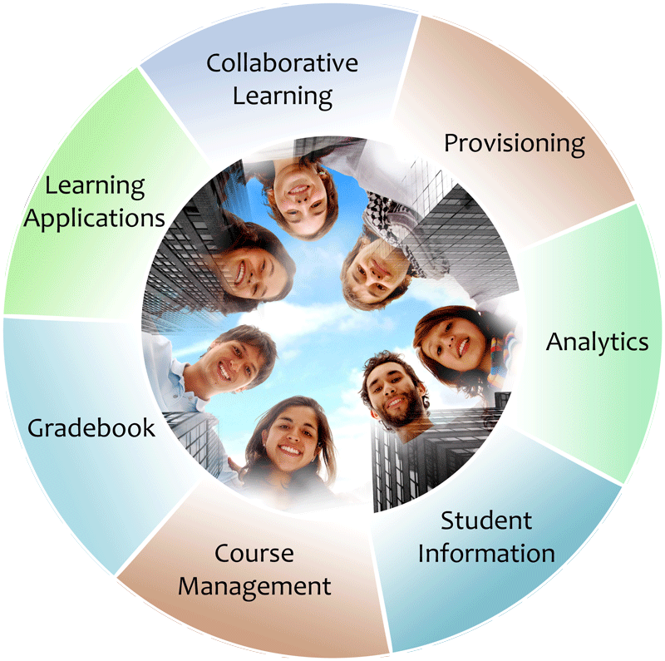


IMS: Digital Learning Standards
The information
architecture for
learning
Seamlessly
connect
to learning
Free the
content
IMS Common Cartridge
IMS Learning Tools
Interoperability (LTI)
IMS Learning Information
Services (LIS)

Slide 3









L
T
I
LEARNING
TOOL
...
PHP
Java
C#

Slide 4
Phased Roll Out
Basic LTI 1.0 – May 2010
  Tool Launch and Common Cartridge 1.1
LTI 1.1 – 4Q2011
  Return Grades back to the LMS
LTI 1.2 – In Progress
  Automatic provisioning of URL, Key, Secret
  Expanded Grade Handling

Slide 5
Launch Overview
LTI 1.0 (Basic LTI)

Slide 6
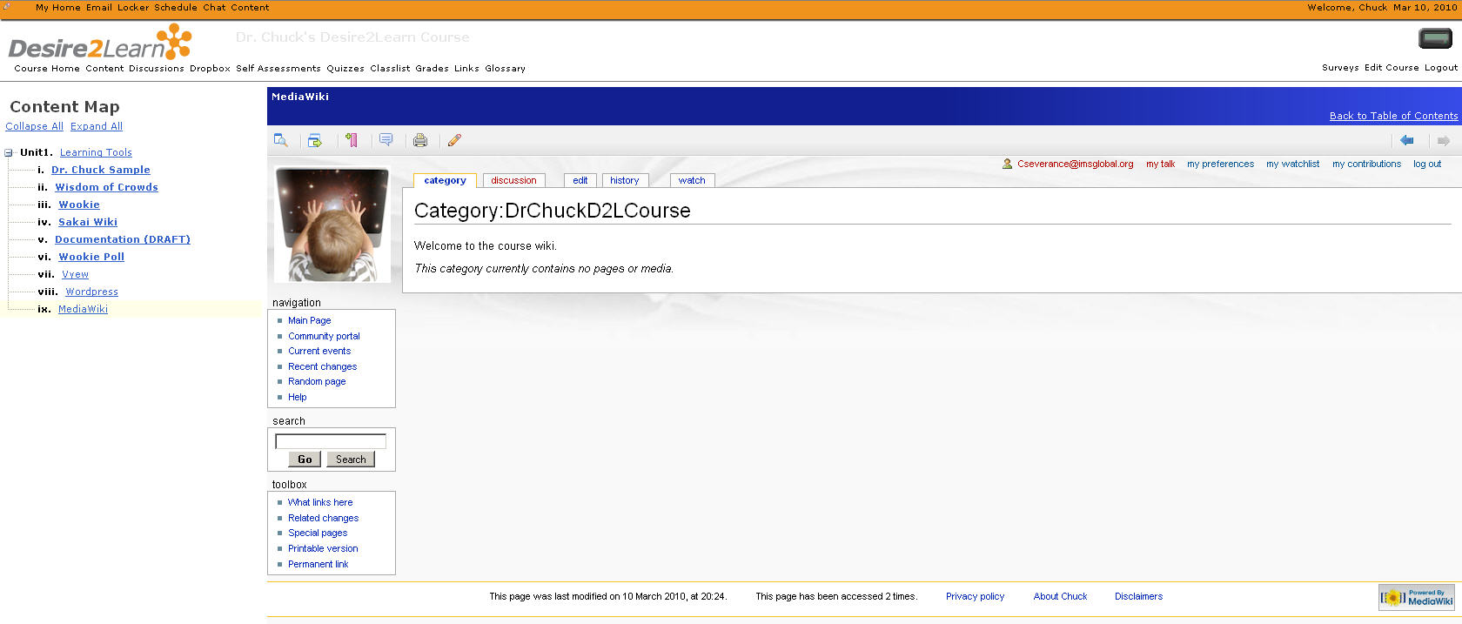

Slide 7
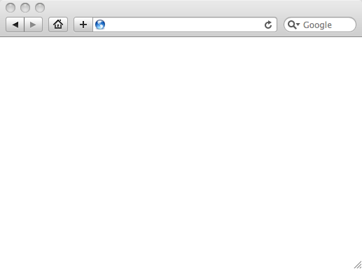
Integrated User Experience
Welcome
Local Resource
Local Resource
LTI Tool
Movie
© Copyright 2010 IMS Global Learning Consortium
All Rights Reserved.

Slide 8
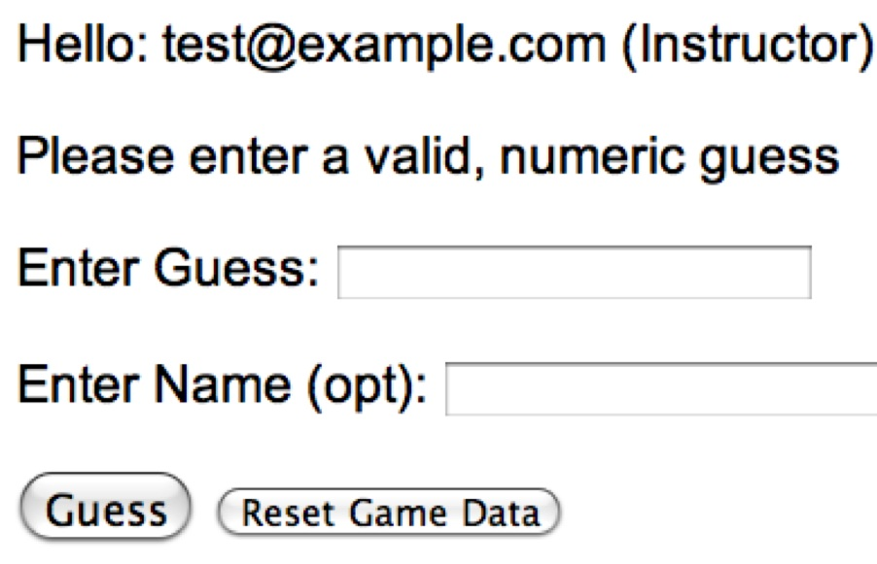
User Experience
Welcome
Local Resource
Lame iFrame
LTI Tool
Movie
© Copyright 2010 IMS Global Learning Consortium
All Rights Reserved.

Slide 9
LMS (LTI Consumer)
Again in slow motion…
LMS Looks up User and Course Information.
Information is signed using secret and OAuth
Week 1
Local Resource
Local Resource
LTI Tool
Movie
Form data sent to Browser
Tool (LTI Provider)
© Copyright 2010 IMS Global Learning Consortium
All Rights Reserved.

Slide 10
LMS (LTI Consumer)
Form is immediately auto-submitted using JavaScript.
<form action=”tool”/>
<input name=”user_id”
value=”2348d8dd” />
<input name=”oauth_token”
value=”abc.edu” />
</form>
Tool (LTI Provider)
Tool looks up secret and validates signature.
Tool provisions user, course, and session.
Tool sends redirect
© Copyright 2010 IMS Global Learning Consortium
All Rights Reserved.

Slide 11
LMS (LTI Consumer)
Browser follows redirect…
<head>
<meta redirect
page=”main.php”>
</head>
Tool (LTI Provider)
Tool produces
first page.
© Copyright 2010 IMS Global Learning Consortium
All Rights Reserved.

Slide 12
LMS (LTI Consumer)
Tool (LTI Provider)
© Copyright 2010 IMS Global Learning Consortium
All Rights Reserved.

Slide 13
LTI Sample Launch Data
lti_version=LTI-1p0
lti_message_type=basic-lti-launch-request
oauth_consumer_key=lmsng.school.edu
resource_link_id=120988f929-274612
user_id=292832126
roles=Instructor
lis_person_name_full=Charles R. Severance
lis_person_contact_email_primary = csev@umich.edu
context_id=456434513
context_title=SI301 – PHP
tool_consumer_instance_description=University of School

Slide 14
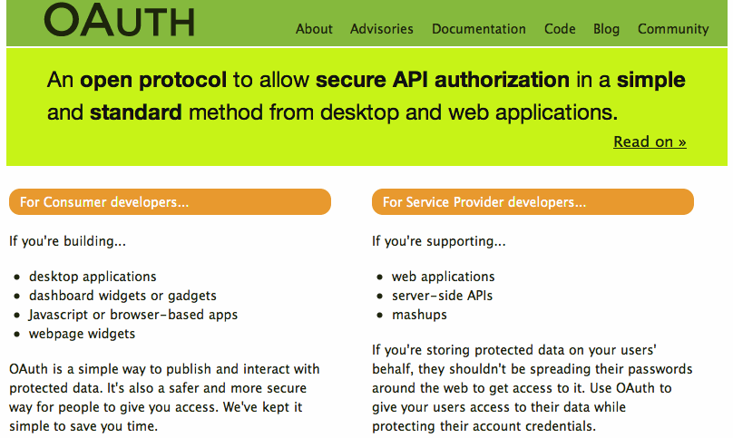

Slide 15


Purpose of Certification
Assure the end-user/purchaser that products will interoperate
Any certified Provider (Tool) should be able to interoperate with any certified Consumer (LMS)

Slide 16
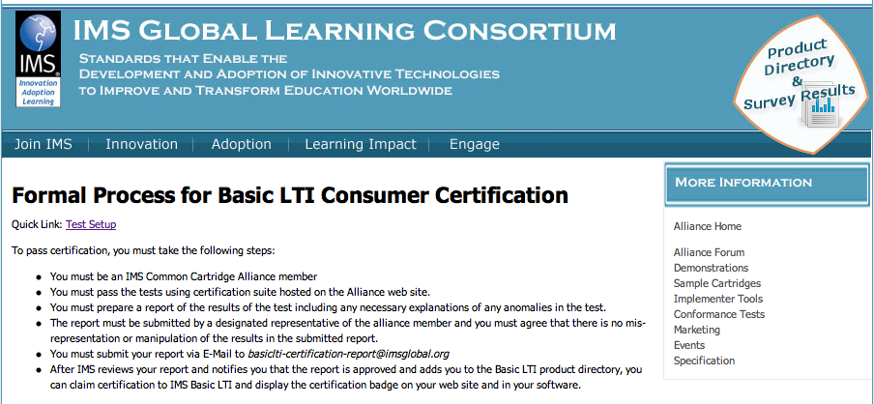
http://www.imsglobal.org/developers/alliance/lti/blti-cert/

Slide 17




Certified - LMS
Desire2Learn Learning Environment v8.4.2 and v9.0
Blackboard 9.1SP4
Jenzabar JICS v7.2 and e-Racer v1.2
Learning Objects Campus Pack v4.2
Sakai v2.7
OLAT 7.0
GeNIE, Open-Source LMS v1.0
Moodle 1.9 Basic LTI Module
PowerLink for Blackboard WebCT v8
Canvas Instructure
http://www.imsglobal.org/cc/statuschart.html

Slide 18



Slide 19
Returning Grades
(LTI 1.1)
Seamlessly
connect
to learning
IMS Learning Tools
Interoperability (LTI)

Slide 20
Coming: Connecting to Learning Information Services (LIS)
TOOL CONSUMER
TOOL PROVIDER
BasicLTI Launch with LIS pointers
LIS
SERVICES
The TP calls LIS
services, if available.

Slide 21









Tool Consumer
Tool Provider
Profile
Tool
lis_result_sourcedid
Profile
Tool Proxy Runtime
replaceResult
Tool Proxy
readResult
Tool
Secret
Secret
deleteResult
TC
Admin
TP
Admin

Slide 22
<?xml version = "1.0" encoding = "UTF-8"?>
<imsx_POXEnvelopeRequest xmlns = "http://www.imsglobal.org/lis/oms1p0/pox">
<imsx_POXHeader>
<imsx_POXRequestHeaderInfo>
<imsx_version>V1.0</imsx_version>
<imsx_messageIdentifier>999999123</imsx_messageIdentifier>
</imsx_POXRequestHeaderInfo>
</imsx_POXHeader>
<imsx_POXBody>
<readResultRequest>
<resultRecord>
<sourcedGUID>
<sourcedId>3124567</sourcedId>
</sourcedGUID>
</resultRecord>
</readResultRequest>
</imsx_POXBody>
</imsx_POXEnvelopeRequest>

Slide 23
<?xml version="1.0" encoding="UTF-8"?>
<imsx_POXEnvelopeResponse xmlns = "http://www.imsglobal.org/lis/oms1p0/pox">
<imsx_POXHeader>
...
</imsx_POXHeader>
<imsx_POXBody>
<readResultResponse>
<result>
<resultScore>
<language>en-us</language>
<textString>0.91</textString>
</resultScore>
</result>
</readResultResponse>
</imsx_POXBody>
</imsx_POXEnvelopeResponse>

Slide 24
Evolving Service Patterns
Legacy: RPC-Style Services with SOAP/WSDL
Transition: RPC-Style Services with XML/OAuth
Next Generation: Resource Style Services / REST
  Next IMS Quarterly Meeting: Commerce Texas
  November xx-yy

Slide 25
IMS LTI 1.2
Transition to resource oriented models for services with RDF/REST Bindings
Tool registration – Great increase in convenience and support for App Store use cases
Richer grade exchange services
Improved abstraction in representing tools in cartridges

Slide 26
LTI 1.0 (Basic)
Common Cartridge 1.1
Seamlessly
connect
to learning
IMS Learning Tools
Interoperability (LTI)

Slide 27
LTI 1.0 (Basic) and
IMS Common Cartridge 1.1
Welcome
HTML Resource
Folder
LTI Tool
Discussion
QTI Pool
Common Cartridge 1.1 includes the ability to define a Basic LTI resource and include that resource in course organizational structures

Slide 28
Common
Cartridge
L
M
S
Premium
Learning
Content
L
M
S
When LTI is combined with
the IMS Common Cartridge 1.1,
publishers can distribute cartridges containing active, authenticated links back to centrally hosted content.

Slide 29

Certified – CC
Blackboard (1.0, 1.1, import and export)
Desire2Learn (1.0, 1.1*)
Jenzabar e-Racer (1.0, 1.1*)
Atutor (1.0, 1.1*)
Moodle 1.9 (1.0*) 2.0 (1.0*, 1.1*)
Sakai 2.9 (1.0*, 1.1*)
* in progress
http://www.imsglobal.org/cc/statuschart.html

Slide 30
Summary
IMS Learning Tools Interoperability 1.0 (Basic Launch) is well adopted by LMS and Tool vendors
IMS CC 1.0 and 1.1 are appearing everywhere
IMS Learning Tools Interoperability 1.1 adds grade return

Slide 31
Questions
Seamlessly
connect
to learning
IMS – www.imsglobal.org
cseverance@imsglobal.org
http://www.imsglobal.org/developers/BLTI/
IMS Learning Tools
Interoperability (LTI)

Slide 32


Slide 33
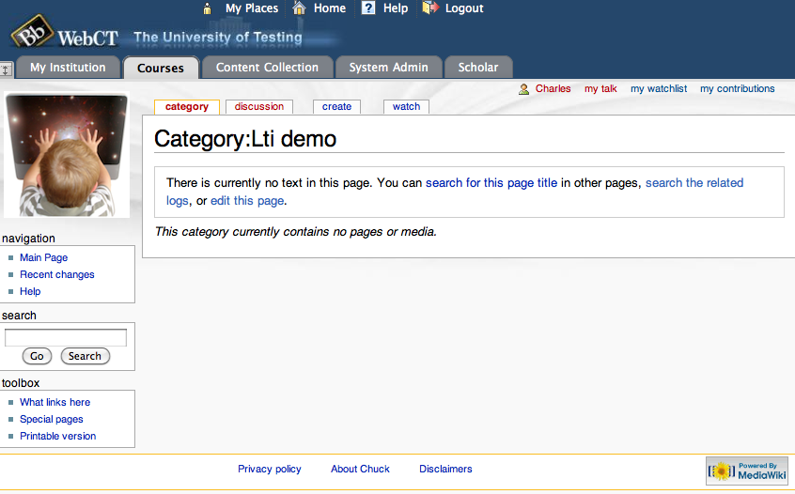

Slide 34
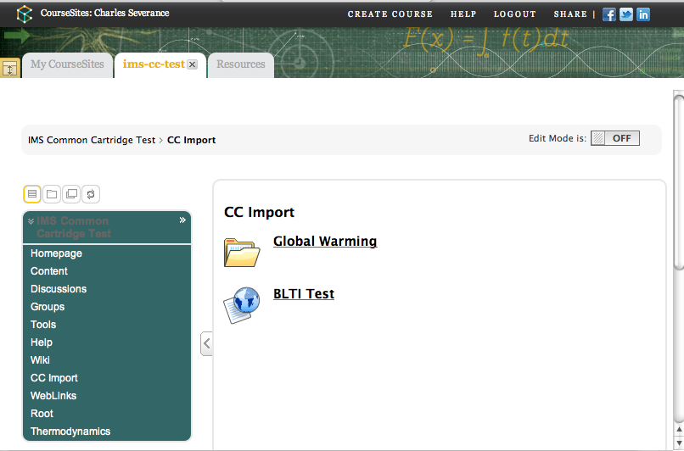

Slide 35
