Slide 1

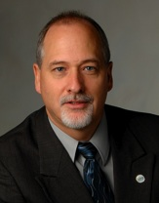

IMS Learning Tools Interoperability (LTI) Workshop
Charles Severance, Ph.D.
IMS Global Learning Consortium (IMS GLC)
University of Michigan
http://www.imsglobal.org/
http://www.dr-chuck.com/

Slide 2
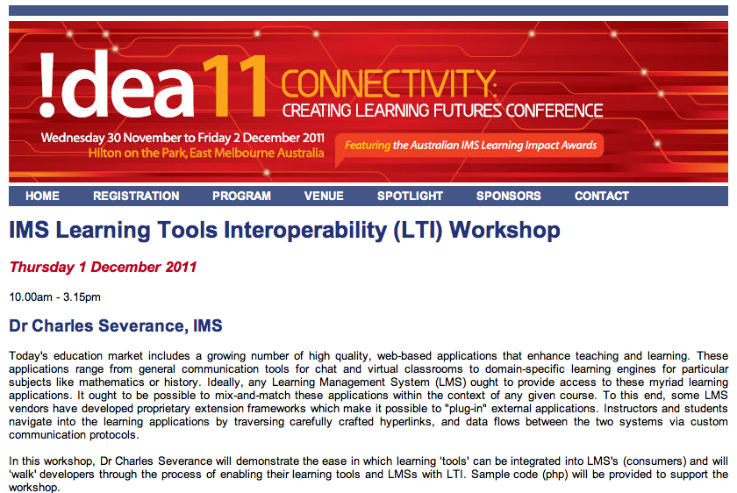

Slide 3
Start Light and Get Deeper
Talk: History / Motivation / High Level
Exercise: Playing with LMS and Tools
Talk: Technical Overview of LTI
Exercise: Playing with Certification
Become one with the code...
  Will need a PHP environment for this last bit

Slide 4
Download Materials From Here
http://www.dr-chuck.com/a/

Slide 5
Some URLs
http://www.imsglobal.org/developers/BLTI/
http://173.204.22.242/scriby/
http://173.204.22.242:8080/portal
http://173.204.22.242/lti/cert/toolsetup.php
http://173.204.22.242/lti/index.htm
http://173.204.22.242/lms/

Slide 6
Some URLs
http://www.imsglobal.org/developers/BLTI/
http://code.google.com/p/ims-dev/
http://173.204.22.242/scriby/
http://173.204.22.242:8080/portal
http://173.204.22.242/lti/cert/toolsetup.php
http://173.204.22.242/lti/index.htm
http://173.204.22.242/lms/

