Slide 1



IMS Learning Tools
Interoperability (1.1)
Charles Severance, Ph.D.
IMS Global Learning Consortium (IMS GLC)
http://www.imsglobal.org/
http://www.dr-chuck.com/

Slide 2
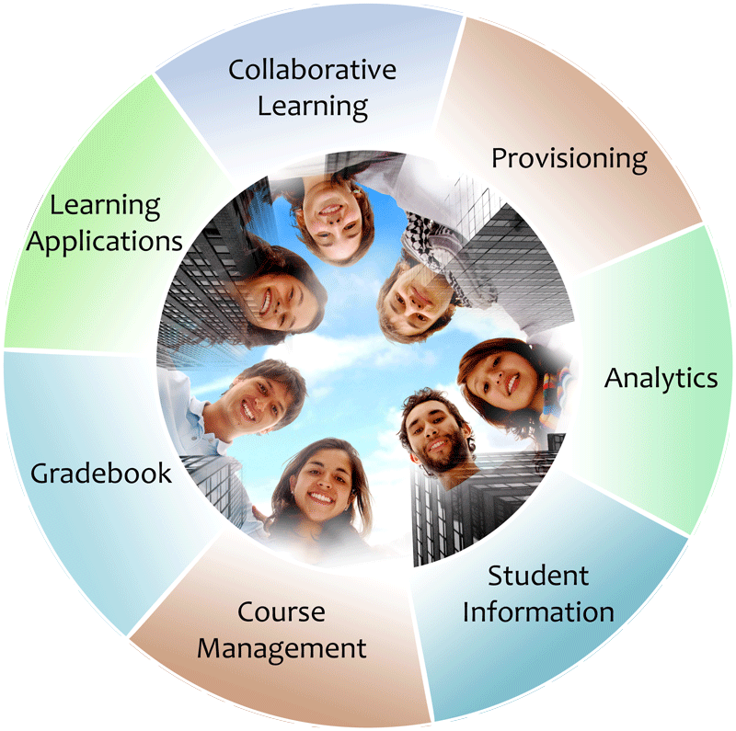


IMS: Digital Learning Standards
The information
architecture for
learning
Seamlessly
connect
to learning
Free the
content
IMS Common Cartridge
IMS Learning Tools
Interoperability (LTI)
IMS Learning Information
Services (LIS)

Slide 3
Too Many LMS Extension Points
Blackboard Building Blocks
Moodle Modules
Sakai Tools
WebCT PowerLinks
....

Slide 4









LEARNING
TOOL
...
?????
http://www.flickr.com/photos/lauradye/4917754427/

Slide 5

L
T
I
LEARNING
TOOL
...
PHP
Java
C#

Slide 6
No More "Basic LTI" / "Full LTI"
Strong directive from the IMS Board
  CALL IT "LTI"!
  ADD GRADES!
  PUBLISH IT YESTERDAY!
Will be a gradual roll out of functionality as the market can absorb it (LTI 1.0, LTI 1.1, LTI 2.0..)

Slide 7
Phased Roll Out
LTI 1.0 – May 2010
  Basic Tool Launch and Common Cartridge 1.1
LTI 1.1 – 4Q2011
  Return Grades back to the LMS
LTI 2.0 – In Progress
  Automatic provisioning of URL, Key, Secret
  Expanded Outcome Handling Service
  Deeper Cartridge Interactions – Abstraction layer

Slide 8
Launch Overview
LTI 1.0 (Basic LTI)

Slide 9
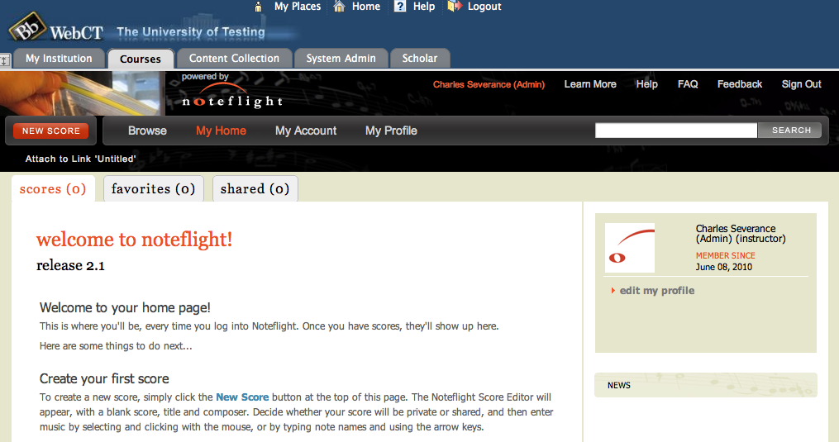
www.noteflight.com

Slide 10
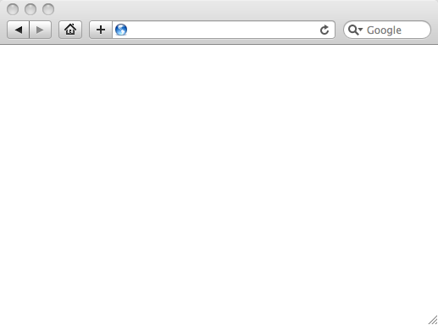
Integrated User Experience
Welcome
Local Resource
Local Resource
LTI Tool
Movie
© Copyright 2010 IMS Global Learning Consortium
All Rights Reserved.

Slide 11
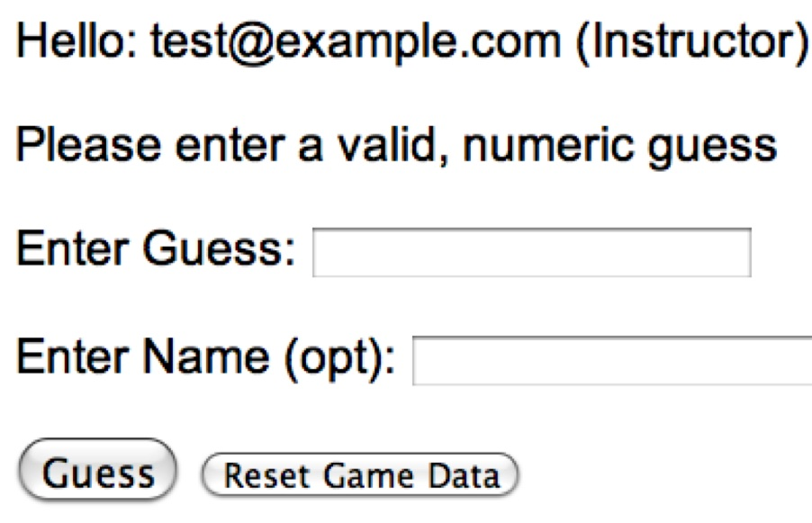
User Experience
Welcome
Local Resource
Lame iFrame
LTI Tool
Movie
© Copyright 2010 IMS Global Learning Consortium
All Rights Reserved.

Slide 12
LMS (LTI Consumer)
Again in slow motion…
LMS Looks up User and Course Information.
Information is signed using secret and OAuth
Week 1
Local Resource
Local Resource
LTI Tool
Movie
Form data sent to Browser
Tool (LTI Provider)
© Copyright 2010 IMS Global Learning Consortium
All Rights Reserved.

Slide 13
LMS (LTI Consumer)
Form is immediately auto-submitted using JavaScript.
<form action=”tool”/>
<input name=”user_id”
value=”2348d8dd” />
<input name=”oauth_token”
value=”abc.edu” />
</form>
Tool (LTI Provider)
Tool looks up secret and validates signature.
Tool provisions user, course, and session.
Tool sends redirect
© Copyright 2010 IMS Global Learning Consortium
All Rights Reserved.

Slide 14
LMS (LTI Consumer)
Browser follows redirect…
<head>
<meta redirect
page=”main.php”>
</head>
Tool (LTI Provider)
Tool produces
first page.
© Copyright 2010 IMS Global Learning Consortium
All Rights Reserved.

Slide 15
LMS (LTI Consumer)
Tool (LTI Provider)
© Copyright 2010 IMS Global Learning Consortium
All Rights Reserved.

Slide 16
LTI Sample Launch Data
lti_version=LTI-1p0
lti_message_type=basic-lti-launch-request
oauth_consumer_key=lmsng.school.edu
resource_link_id=120988f929-274612
user_id=292832126
roles=Instructor
lis_person_name_full=Charles R. Severance
lis_person_contact_email_primary = csev@umich.edu
context_id=456434513
context_title=SI301 – PHP
tool_consumer_instance_description=University of School

Slide 17
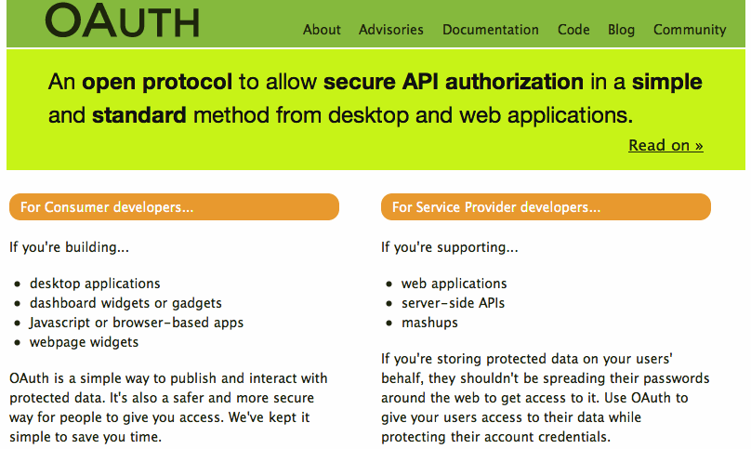

Slide 18


Purpose of Certification
Assure the end-user/purchaser that products will interoperate
Any certified Provider (Tool) should be able to interoperate with any certified Consumer (LMS)

Slide 19
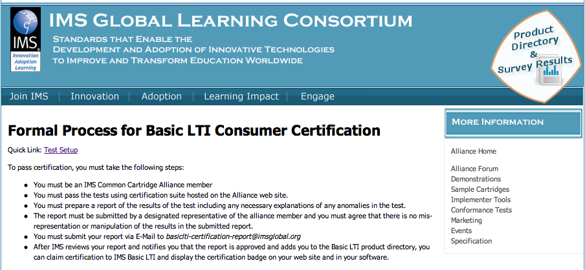
http://www.imsglobal.org/developers/alliance/lti/blti-cert/

Slide 20




Certified - LMS
Desire2Learn Learning Environment v8.4.2 and v9.0
Blackboard 9.1SP4
Jenzabar JICS v7.2 and e-Racer v1.2
Learning Objects Campus Pack v4.2
Sakai v2.7
OLAT 7.0
GeNIE, Open-Source LMS v1.0
Moodle 1.9, 2.0 Module
PowerLink for Blackboard WebCT v8
Canvas Instructure
http://www.imsglobal.org/cc/statuschart.html

Slide 21






Certified - Tool
CourseSmart ServiceHub 2.0
CafeScribe Building Block for Blackboard
Learning Objects Campus Pak v4.2
NoteFlight 2.1
Wimba Basic LTI Components v1.0.2
SoftChalk
Rustici Software (scorm.com)
Piazza.com (discussion board)
...
http://www.imsglobal.org/cc/statuschart.html

Slide 22
Returning Grades
(LTI 1.1)
Seamlessly
connect
to learning
IMS Learning Tools
Interoperability (LTI)

Slide 23
Coming: Connecting to Learning Information Services (LIS)
TOOL CONSUMER
TOOL PROVIDER
BasicLTI Launch with LIS pointers
LIS
SERVICES
The TP calls LIS
services, if available.

Slide 24









Tool Consumer
Tool Provider
Profile
Tool
lis_result_sourcedid
Profile
Tool Proxy Runtime
replaceResult
Tool Proxy
readResult
Tool
Secret
Secret
deleteResult
TC
Admin
TP
Admin

Slide 25
New Parameters for LTI 1.1
lis_outcome_service_url=https://...
  This is the service URL to be used to submit grade operations.
lis_result_sourcedid=838738
  This field is generated by the LMS to represent the course/grade book column/user in a single unique identifier. This field is opaque to the external tool.

Slide 26
OAuth Body Hashing
Messages are secured using OAuth Body Hashing
  Compute a SHA1 checksum of the body contents
  Add oauth_body_hash value
  Move the OAuth parameters into the Authorization header
http://oauth.googlecode.com/svn/spec/ext/body_hash/1.0/oauth-bodyhash.html

Slide 27
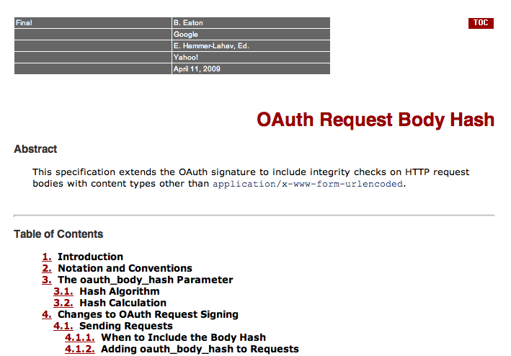

Slide 28
<?xml version = "1.0" encoding = "UTF-8"?>
<imsx_POXEnvelopeRequest xmlns = "http://www.imsglobal.org/lis/oms1p0/pox">
<imsx_POXHeader>
<imsx_POXRequestHeaderInfo>
<imsx_version>V1.0</imsx_version>
<imsx_messageIdentifier>999999123</imsx_messageIdentifier>
</imsx_POXRequestHeaderInfo>
</imsx_POXHeader>
<imsx_POXBody>
<replaceResultRequest>
<resultRecord>
<sourcedGUID>
<sourcedId>3124567</sourcedId>
</sourcedGUID>
<result>
<resultScore>
<language>en</language>
<textString>0.92</textString>
</resultScore>
</result>
</resultRecord>
</replaceResultRequest>
</imsx_POXBody>
</imsx_POXEnvelopeRequest>

Slide 29
<?xml version="1.0" encoding="UTF-8"?>
<imsx_POXEnvelopeResponse xmlns = "http://www.imsglobal.org/lis/oms1p0/pox">
<imsx_POXHeader>
<imsx_POXResponseHeaderInfo>
<imsx_version>V1.0</imsx_version>
<imsx_messageIdentifier>4560</imsx_messageIdentifier>
<imsx_statusInfo>
<imsx_codeMajor>success</imsx_codeMajor>
<imsx_severity>status</imsx_severity>
<imsx_description>Score for 3124567 is now 0.92</imsx_description>
<imsx_messageRefIdentifier>999999123</imsx_messageRefIdentifier>
<imsx_operationRefIdentifier>replaceResult</imsx_operationRefIdentifier>
</imsx_statusInfo>
</imsx_POXResponseHeaderInfo>
</imsx_POXHeader>
<imsx_POXBody>
<replaceResultResponse/>
</imsx_POXBody>
</imsx_POXEnvelopeResponse>

Slide 30
Service Patterns in Transition
IMS LIS 1.0: RPC-Style Services with SOAP/WSDL
IMS LTI 1.1: RPC-Style Services with XML/OAuth
IMS LTI 2.0: Resource Style Services / REST

Slide 31
Questions
Seamlessly
connect
to learning
IMS – www.imsglobal.org
cseverance@imsglobal.org
http://www.imsglobal.org/developers/LTI/test/
IMS Learning Tools
Interoperability (LTI)

