Slide 1
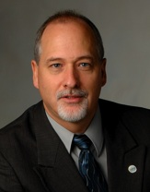
IMS Learning Tools Interoperability (LTI) Workshop
Charles Severance, Ph.D.
IMS Global Learning Consortium (IMS GLC)
University of Michigan
http://www.imsglobal.org/
http://www.dr-chuck.com/

Slide 2


Slide 3
Start Light and Get Deeper
Talk: Technical Overview of LTI – Album Version
Exercise: Playing with sample code and certification
Look at the sample code...
  Will need a PHP environment for this last bit

Slide 4
Download Materials From Here
http://www.dr-chuck.com/a/

Slide 5
Some URLs
http://www.imsglobal.org/developers/LTI/test/
http://173.204.22.242/lti/index.php
http://173.204.22.242:8080/portal
http://173.204.22.242/lti/cert/toolsetup.php
http://173.204.22.242/lti/cert/lmssetup.php

