Slide 1
xpLor Learning Objects Repository Demo
Charles Severance
Clinical Associate Professor, UM School of Information
Chief Sakai Strategist, Blackboard
Architect, IMS Global Learning Consortium

Slide 2




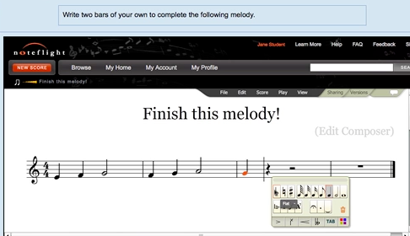







L
T
I
PHP
Java
C#
...
http://www.imsglobal.org/cc/statuschart.cfm

Slide 3
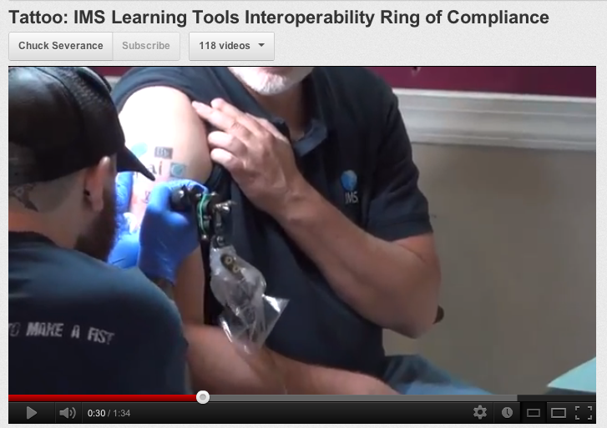
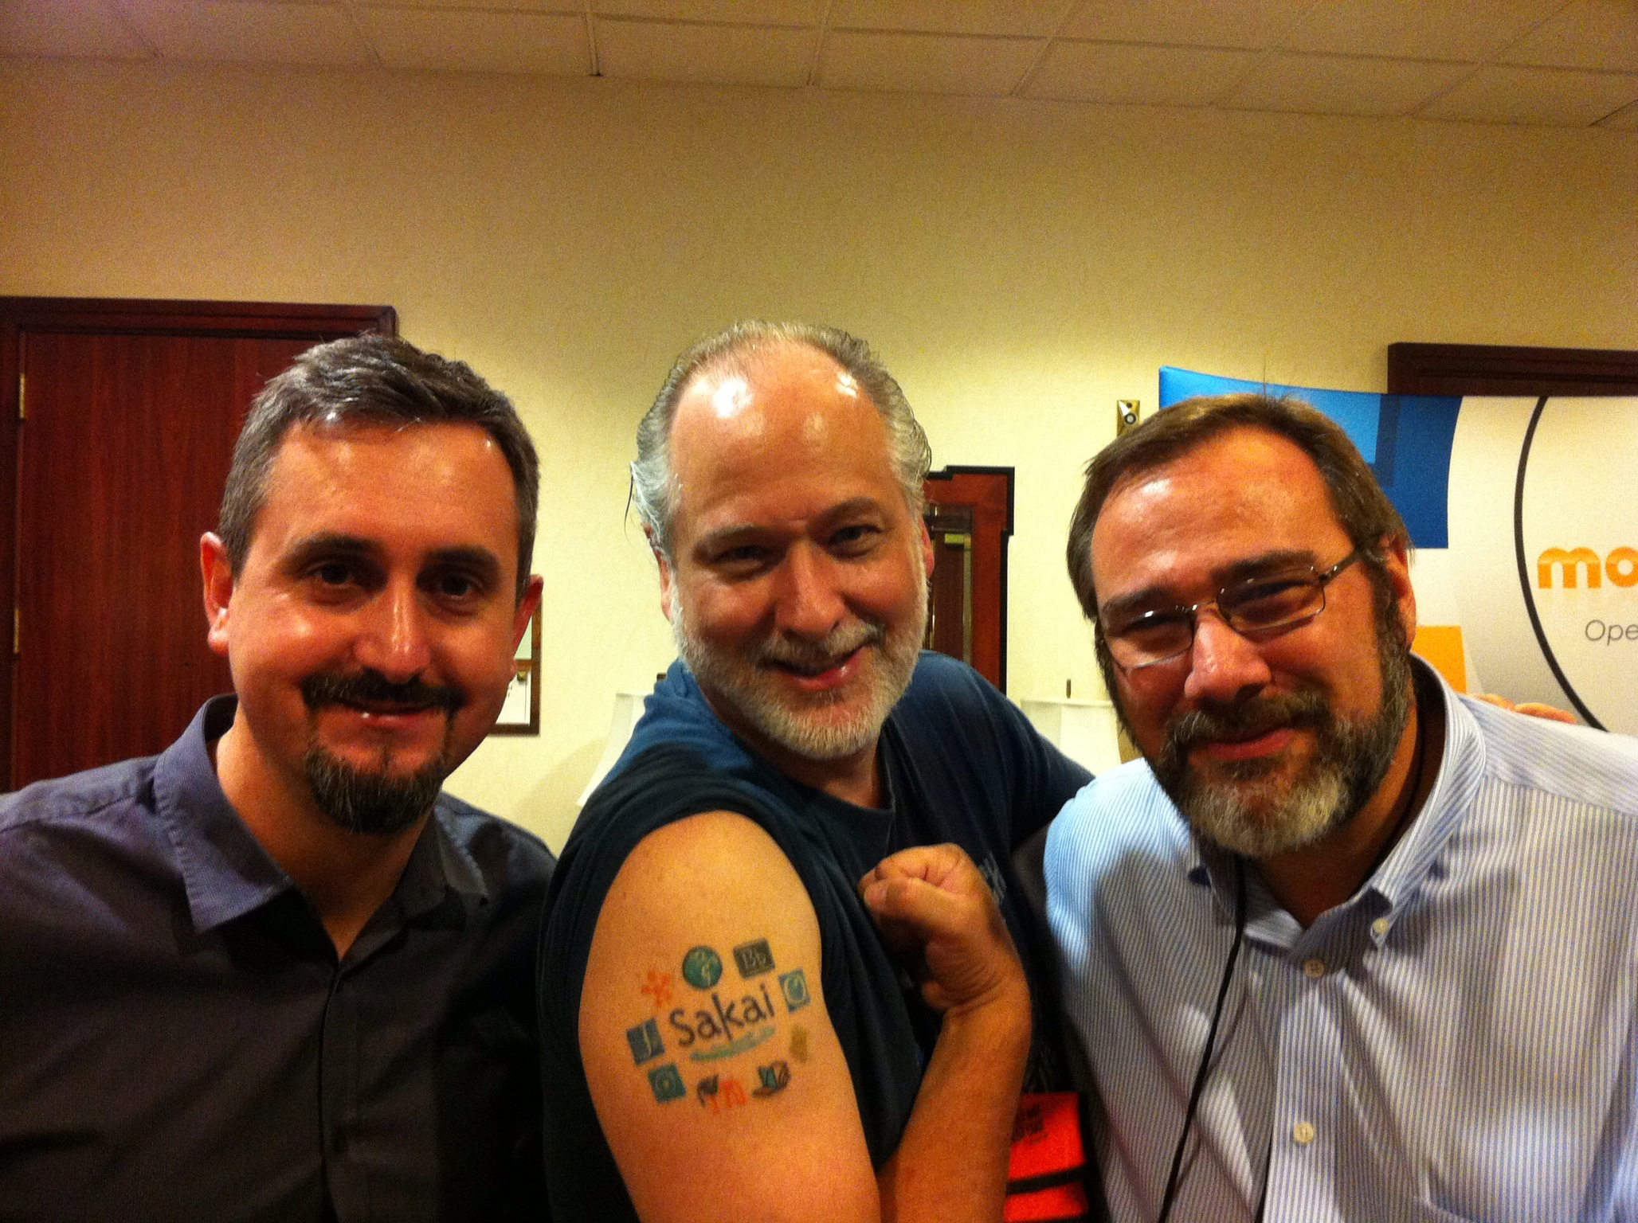

http://youtu.be/VY-Ogkc7Mnw

Slide 4
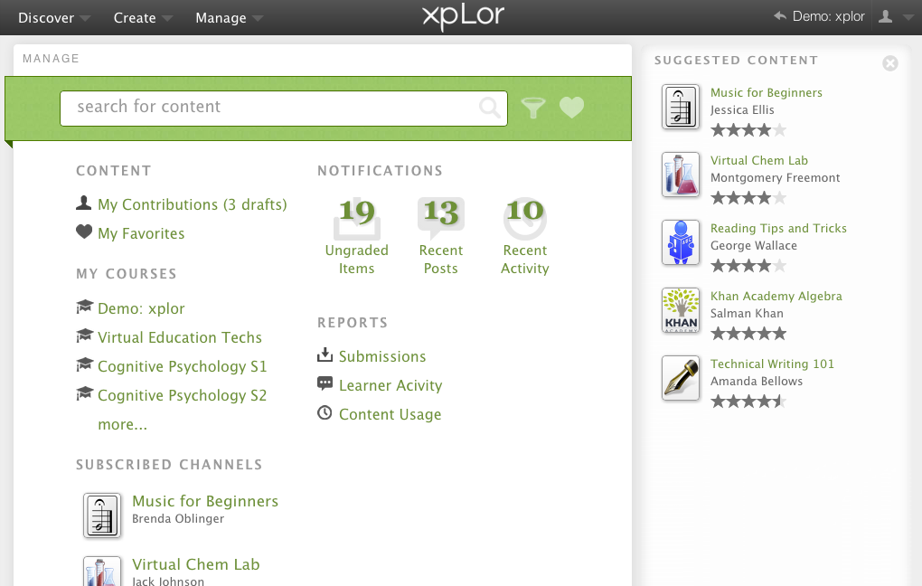

Slide 5
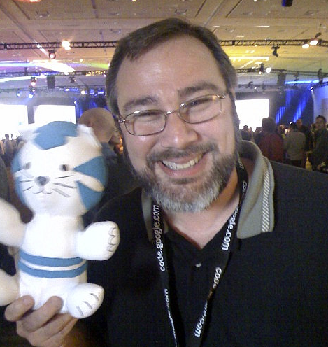
About xpLor
Cloud-hosted Learning Object Repository
Tight integration through LTI + Extensions
Learning Objects are based on the IMS Common Cartridge
First (and only) LOR that has
IMS specifications (LTI and CC)
designed in

Slide 6
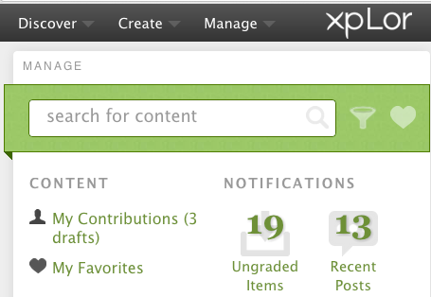
IMS LTI + LORI Extensions
???
...
xpLor can be used without the LORI Extensions with manual URL copying

Slide 7
Learning Object Repository Integration (LORI)
Simple extensions to IMS LTI
LMS allows the Learning Object Repository to
  Retrieve a list of courses taught by an instructor
  Retrieve the current content structure(a)
  Insert a IMS LTI launch at a point in content structure
  Insert a hierarchy of links into a content structure
REST/JSON based - aligned with LTI 2.0

Slide 8
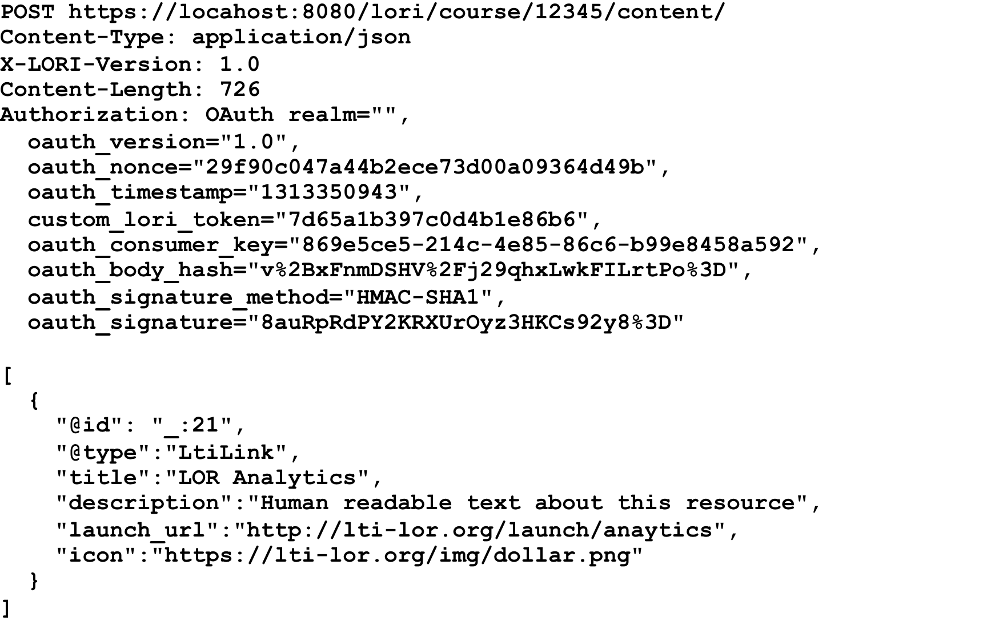
Blackboard Proprietary and Confidential – Draft, example only, not final, void where prohibited, your mileage may vary.

Slide 9



IMS Common Cartridge and xpLor
...
Publishers
CC
CC
...
http://www.imsglobal.org/cc/statuschart.cfm

Slide 10
IMS Common Cartridge and xpLor
...
CC
CC
...
http://www.imsglobal.org/cc/statuschart.cfm

Slide 11
Demo

Slide 12
Final Thoughts / Questions

