Slide 1


Advanced Issues in Building External LTI Tools
Charles Severance, Ph.D.
IMS Global Learning Consortium (IMS GLC)
http://www.imsglobal.org/
http://www.dr-chuck.com/

Slide 2



IMS: Digital Learning Standards
The information
architecture for
learning
Seamlessly
connect
to learning
Free the
content
IMS Common Cartridge
IMS Learning Tools
Interoperability (LTI)
IMS Learning Information
Services (LIS)

Slide 3

IMS (Simple) LTI Consumer for Moodle – Video From Marc
http://www.vimeo.com/7825070

Slide 4
Source Code - Download
Simple Sample Application – Classified Ads
  Classified Ad Software
  Key / Secret administration
  Basic LTI Utility Code
  http://www.dr-chuck.com/adlist/dist.zip
Launch from an LMS or test harness
  http://www.dr-chuck.com/lti/lms.php

Slide 5
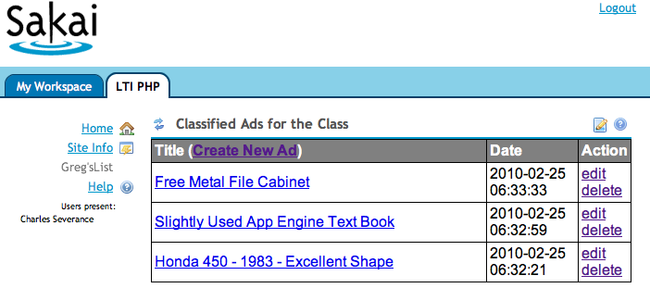
A Sample Tool – Classified Ads

Slide 6
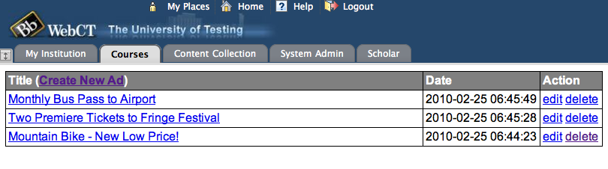
A Sample Tool – Classified Ads

Slide 7
Outline
Solving Multi-Tenancy
Handling the Basic LTI Launch and Context
Patterns for Simple Authorization

Slide 8

Multi-Tenancy
Multitenancy refers to a principle in software architecture where a single instance of the software runs on a server, serving multiple client organizations (tenants). Multitenancy is contrasted with a multi-instance architecture where separate software instances (or hardware systems) are set up for different client organizations. With a multitenant architecture, a software application is designed to virtually partition its data and configuration so that each client organization works with a customized/isolated virtual application instance.
http://en.wikipedia.org/wiki/Multitenancy

Slide 9
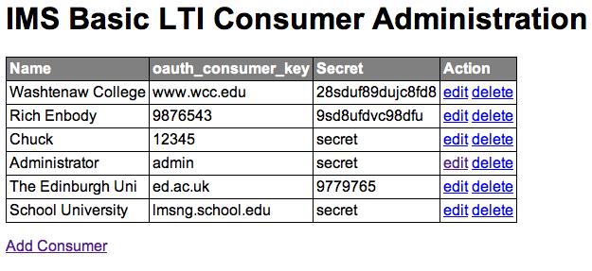
Administration Screen

Slide 10
Multi-Tenancy Data Model
create table blti_keys (
id MEDIUMINT NOT NULL AUTO_INCREMENT,
oauth_consumer_key CHAR(255) NOT NULL,
secret CHAR(255) NULL,
name CHAR(255) NULL,
context_id CHAR(255) NULL,
created_at DATETIME NOT NULL,
updated_at DATETIME NOT NULL,
PRIMARY KEY (id)
);

Slide 11
Advertisement Data Model

Slide 12
Multi-Tenancy Data Model
create table ads (
id MEDIUMINT NOT NULL AUTO_INCREMENT,
course_key CHAR(255) NOT NULL,
user_key CHAR(255) NULL,
user_name CHAR(255) NULL,
title CHAR(255) NULL,
description TEXT(2048) NULL,
created_at DATETIME NOT NULL,
updated_at DATETIME NOT NULL,
PRIMARY KEY (id)
);
Apologies to "3NF"

Slide 13
Multi-Tenancy Data
mysql> select id, left(course_key,25),left(user_key,25),left(title,20) from ads;
+----+---------------------------+---------------------------+----------------------+
| id | left(course_key,25) | left(user_key,25) | left(title,20) |
+----+---------------------------+---------------------------+----------------------+
| 6 | 12345:456434513 | 12345:292832126 | A Totally Sweet Titl |
| 7 | 12345:456434513 | 12345:292832126 | Another Awesome Titl |
| 8 | lmsng.school.edu:45643451 | lmsng.school.edu:29283212 | A TITLE |
| 9 | lmsng.school.edu:7601b0ed | lmsng.school.edu:f315ea76 | Honda 450 - 1983 - E |
| 10 | lmsng.school.edu:7601b0ed | lmsng.school.edu:f315ea76 | Slightly Used App En |
| 11 | lmsng.school.edu:7601b0ed | lmsng.school.edu:f315ea76 | Free Metal File Cabi |
| 12 | ed.ac.uk:lti_demo | ed.ac.uk:URN:X-WEBCT-b98f | Mountain Bike - New |
| 13 | ed.ac.uk:lti_demo | ed.ac.uk:URN:X-WEBCT-b98f | Two Premiere Tickets |
| 14 | ed.ac.uk:lti_demo | ed.ac.uk:URN:X-WEBCT-b98f | Monthly Bus Pass to |
+----+---------------------------+---------------------------+----------------------+
We must namespace the primary keys (user_id, context_id) with the oauth_consumer_key to isolate courses and users

Slide 14
Handling the Basic LTI Launch
A utility library is provided that intercepts and processes launches
require_once '../ims-blti/blti.php';
require_once("db.php");
$context = new BLTI(array('table' => 'blti_keys'));
if ( $context->complete ) exit();
if ( ! $context->valid ) {
print "Could not establish context: ".$context->message."\n";
exit();
}

Slide 15
Handling the Basic LTI Launch
The "context" is either taken from the launch or restored from the PHP session – like a filter
require_once '../ims-blti/blti.php';
require_once("db.php");
$context = new BLTI(array('table' => 'blti_keys'));
if ( $context->complete ) exit();
if ( ! $context->valid ) {
print "Could not establish context: ".$context->message."\n";
exit();
}

Slide 16
The Context
The context contains information from the launch
  Resource information
  User Information
  Course (aka context) information
  Organizational Information
  Launch Authentication Information

Slide 17
The Context – Supplied Methods
$context->getCourseKey() = 12345:456434513
$context->getCourseName() = SI182
$context->getUserKey() = 12345:292832126
$context->isInstructor() = true/false
$context->getUserEmail() = jane@school.edu
$context->getUserShortName() = jane@school.edu
$context->getUserName() = Jane Q. Public
$context->getConsumerKey() = 12345

Slide 18
Simple Authorization
With the data model, we need to know who can edit which ads in our table
mysql> select id, left(course_key,25),left(user_key,25),left(title,20) from ads;
+----+---------------------------+---------------------------+----------------------+
| id | left(course_key,25) | left(user_key,25) | left(title,20) |
+----+---------------------------+---------------------------+----------------------+
| 6 | 12345:456434513 | 12345:292832126 | A Totally Sweet Titl |
| 7 | 12345:456434513 | 12345:292832126 | Another Awesome Titl |
| 8 | lmsng.school.edu:45643451 | lmsng.school.edu:29283212 | A TITLE |
| 9 | lmsng.school.edu:7601b0ed | lmsng.school.edu:f315ea76 | Honda 450 - 1983 - E |
| 10 | lmsng.school.edu:7601b0ed | lmsng.school.edu:f315ea76 | Slightly Used App En |
| 11 | lmsng.school.edu:7601b0ed | lmsng.school.edu:f315ea76 | Free Metal File Cabi |
| 12 | ed.ac.uk:lti_demo | ed.ac.uk:URN:X-WEBCT-b98f | Mountain Bike - New |
| 13 | ed.ac.uk:lti_demo | ed.ac.uk:URN:X-WEBCT-b98f | Two Premiere Tickets |
| 14 | ed.ac.uk:lti_demo | ed.ac.uk:URN:X-WEBCT-b98f | Monthly Bus Pass to |
+----+---------------------------+---------------------------+----------------------+

Slide 19
Instructor:
SELECT * FROM ads WHERE id='7' AND
course_key='12345:456434513'
Student:
SELECT * FROM ads WHERE id='7' AND
course_key='12345:456434513 AND
user_key = '12345:292832126'
mysql> select id, left(course_key,25),left(user_key,25),left(title,20) from ads;
+----+---------------------------+---------------------------+----------------------+
| id | left(course_key,25) | left(user_key,25) | left(title,20) |
+----+---------------------------+---------------------------+----------------------+
| 6 | 12345:456434513 | 12345:292832126 | A Totally Sweet Titl |
| 7 | 12345:456434513 | 12345:292832126 | Another Awesome Titl |
| 8 | lmsng.school.edu:45643451 | lmsng.school.edu:29283212 | A TITLE |
| 9 | lmsng.school.edu:7601b0ed | lmsng.school.edu:f315ea76 | Honda 450 - 1983 - E |
| 10 | lmsng.school.edu:7601b0ed | lmsng.school.edu:f315ea76 | Slightly Used App En |
| 11 | lmsng.school.edu:7601b0ed | lmsng.school.edu:f315ea76 | Free Metal File Cabi |
| 12 | ed.ac.uk:lti_demo | ed.ac.uk:URN:X-WEBCT-b98f | Mountain Bike - New |
| 13 | ed.ac.uk:lti_demo | ed.ac.uk:URN:X-WEBCT-b98f | Two Premiere Tickets |
| 14 | ed.ac.uk:lti_demo | ed.ac.uk:URN:X-WEBCT-b98f | Monthly Bus Pass to |
+----+---------------------------+---------------------------+----------------------+

Slide 20
Show/Hide Buttons

Slide 21
Showing Buttons For Edit/Delete
<php
if ( $context->isInstructor() ||
$row['user_key'] == $context->getUserKey() ) { ?>
<a href="<self?>?action=edit&id=<row[id]?>">edit<a>
<a href="<self?>?action=delete&id=<row[id]?>">delete<a>
<php
}?>

Slide 22
Advanced Topic:
System and Course-Mapped Keys

Slide 23
Use cases
System-scoped key – The Consumer sends us a context_id which allows many different courses to use our tool independently – this is a typical approach
Course-mapped key – in this case, you ignore the consumer-provided context_id and specify the context_id inside of your (Producer) system

Slide 24
System-Scoped
Key=zap
cid=a1d2
cid=1234
cid=654
Producer
zap(sys)
fun(sys)
zap:a1d2
zap:1234
zap:654
fun:a1d2
fun:9876
fun:345
Key=fun
cid=a1d2
cid=9876
cid=345
Consumers

Slide 25
Course-Scoped Keys
Key=zap
cid=a1d2
cid=1234
Producer
zap(sys)
east (c=1555)
west(c=1555)
zap:a1d2
zap:1234
1555
Key=east
cid=a1d2
cid=1234
Key=west
cid=9876
With course-scoped keys, students from multiple contexts in multiple Consumers can meet and collaborate in the producer.
Consumers

Slide 26
Course-Scoped Keys
In the sample application, each key as a context_id field – if it is null, the key is a system-scoped key.
mysql> select id,oauth_consumer_key,secret,context_id from blti_keys;
+----+--------------------+--------+------------+
| id | oauth_consumer_key | secret | context_id |
+----+--------------------+--------+------------+
| 4 | 12345 | secret | NULL |
| 5 | admin | secret | 999999 |
+----+--------------------+--------+------------+

Slide 27
Configuration using resource_link_id

Slide 28
Use Case: Picking a Video
If our Producer is video archive and the purpose of each "placement" in a course is to play a particular video using BLTI to gain access to the video
Problem: How to place BLTI several places in the course but refer to different videos in each placement?

Slide 29
Goal State
Scene
1
Week 1
Video snippet
Discussion board
Week 2
Video snippet
Wiki
Week 3
Video Snippet
Midterm Exam
Scene4
Scene
9

Slide 30
Understanding resource_link_id
Key=987 cid=a1b2
Week 1
Video snippet
Discussion board
Week 2
Video snippet
Wiki
Week 3
Video Snippet
Midterm Exam
rlid=9c45
The resource_link_id is unique for each placement of Basic LTI in a course. When each of the resources is launched you get key, cid, and rlid. Resource_link_id is required on all launches.
rlid=23b5
rlid=1725

Slide 31
Using resource_link_id
Key=987 cid=a1b2
Week 1
Video snippet
Discussion board
rlid=9c45
You need a table in your application which maps from a key:resource_link_id (i.e. 987:9c45) to some local resource identified within your application. Until the Instructor selects a resource within your tool, it is "unconfigured"

Slide 32
Understanding resource_link_id
Key=987 cid=a1b2
Week 1
Video snippet
Discussion board
rlid=9c45
Not
Config
Pick
Video
Scene
1
Scene
1
Learner
Instructor
Learner
Instructor
Not configured
987:9c45 = matrix_scene_01

Slide 33
Custom Field Notes
In a Common Cartridge, Basic LTI Resource Links have a custom field which can be used for this purpose
The custom fields UI varies from LMS to LMS and may not even be available to the Instructor
Using resource_link_id keeps the configuration UX in the Producer and keeps from needing per-LMS documentation
A good practice is to use custom_fields in cartridges and if no custom field is present fall back to resource_link_id provisioning

Slide 34
Adding Basic LTI to an Existing Application

Slide 35
Adding Support for BLTI
Must deal with multi-tenancy gracefully – it will not look nice if your UI shows user names like fbbf213:29938jsha01929
Add a launch-point to provision courses, users, set roles, and provision a session and redirect to tool page
May want to come up with a UI with little or no outer navigation so it looks more like a "tool"

Slide 36
Open Issue - TODO
Cookies are getting less and less well supported inside frames
I should update this sample code to work through that

Slide 37
Questions....
IMS – www.imsglobal.org
IMS Basic LTI Video – www.vimeo.com/8073453
Marc's Dinosaur Video – www.vimeo.com/7825070
cseverance@imsglobal.org
www.dr-chuck.com

