Slide 1


IMS Learning Tools Interoperability on Mobile / TV / SetTop
Charles Severance, Ph.D.
IMS Global Learning Consortium (IMS GLC)
http://www.imsglobal.org/
http://www.dr-chuck.com/

Slide 2
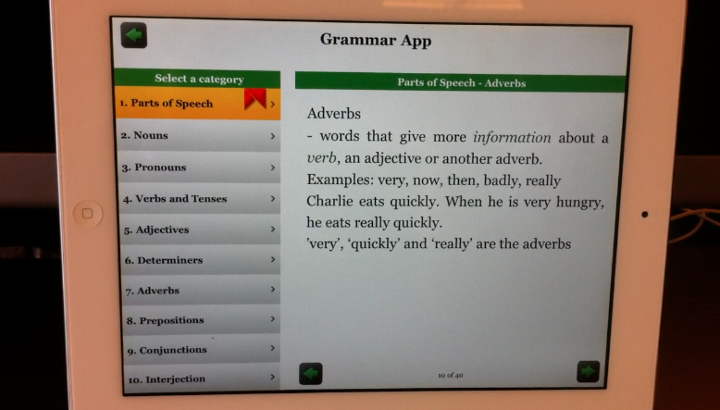
Education on Mobile / TV / SetTop

Slide 3
Education on Mobile / TV / SetTop
Tracking System
Provision user, course, role, session.

Slide 4
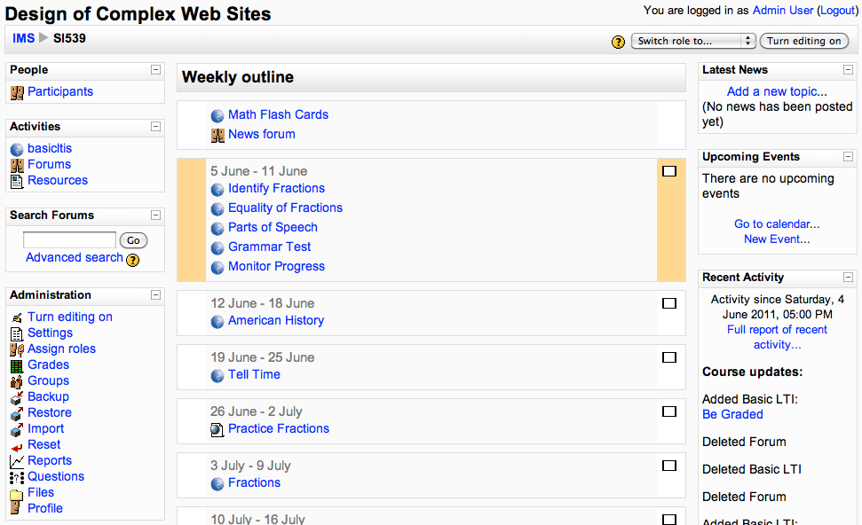

Slide 5
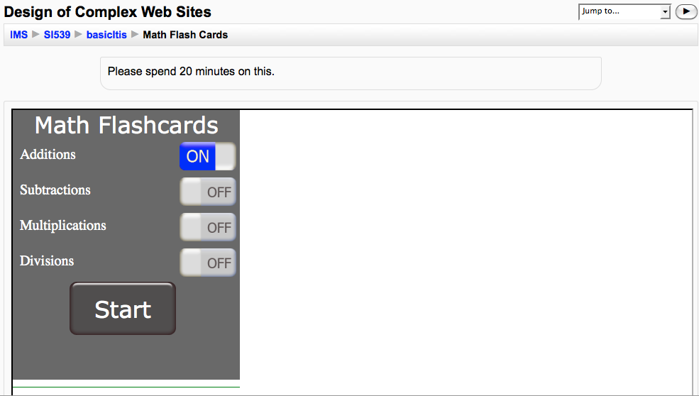

Slide 6
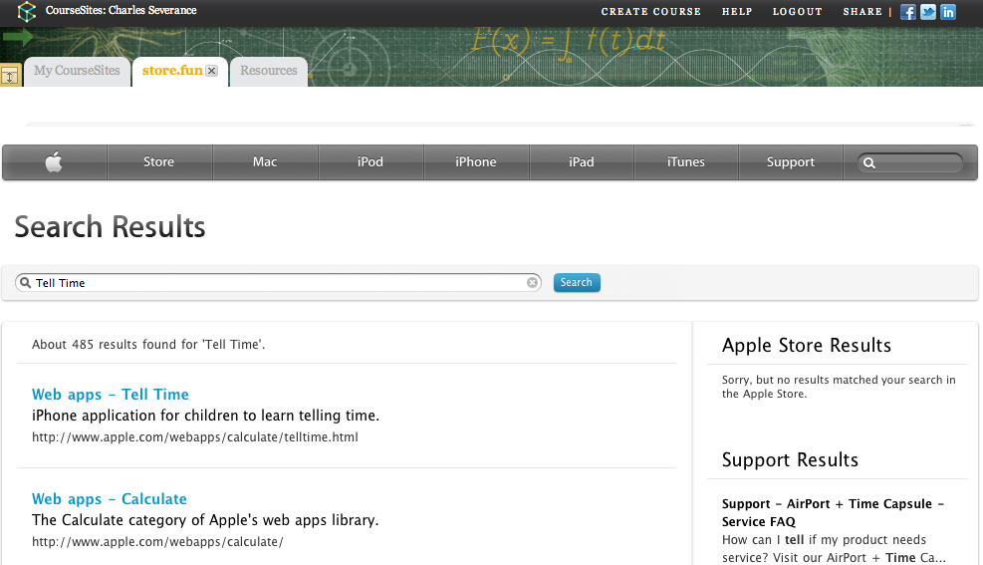
This also works in Blackboard
www.coursesites.com

Slide 7
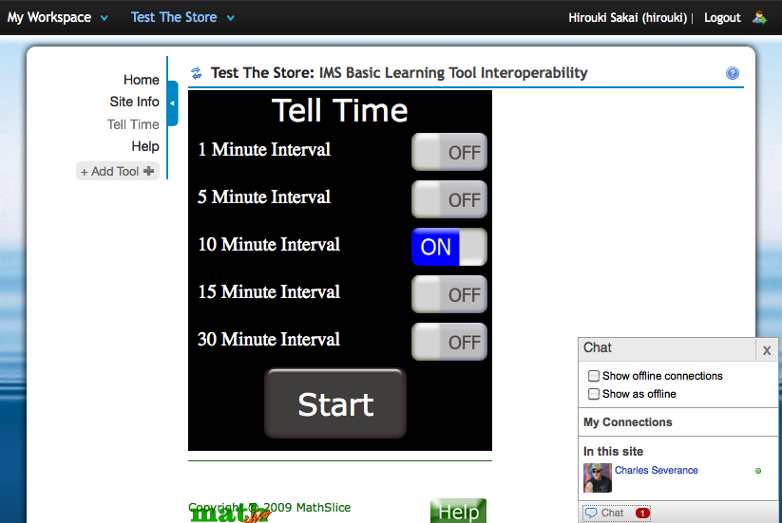
This also works in Sakai

Slide 9
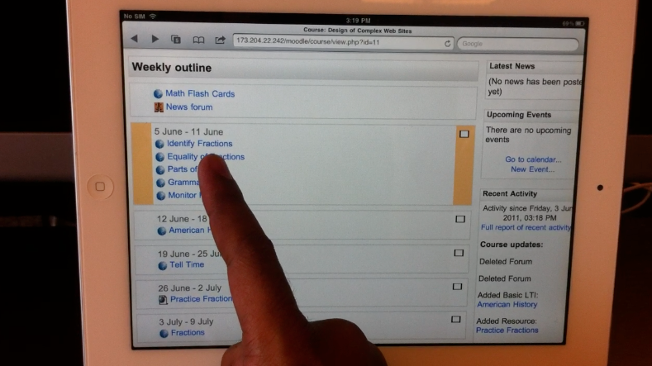
iPad Launch
Video Demo
http://www.vimeo.com/24699223

Slide 10
Technical Detail

Slide 11
I
P
A
D
S
a
f
a
r
i
Moodle Page
Click LTI Link
Intermediate System

Slide 12
I
P
A
D
S
a
f
a
r
i
LTI Launch to Browser
Browser Posts LTI Launch
Intermediate System

Slide 13
I
P
A
D
S
a
f
a
r
i
Intermediate System
Provision user, course, role, session.
Redirect ttl://grammar/lesson?sess=123

Slide 14
I
P
A
D
G
r
a
m
m
a
r
Intermediate System
Provision user, course, role, session.
Redirect ttl://grammar/lesson?sess=123
iPad Switches to Grammar App

Slide 15
I
P
A
D
G
r
a
m
m
a
r
Intermediate Sys.
Provision user, course, role, session.
Redirect ttl://grammar/lesson?sess=123
Tracking
Proprietary
iPad Switches to Grammar App

Slide 16
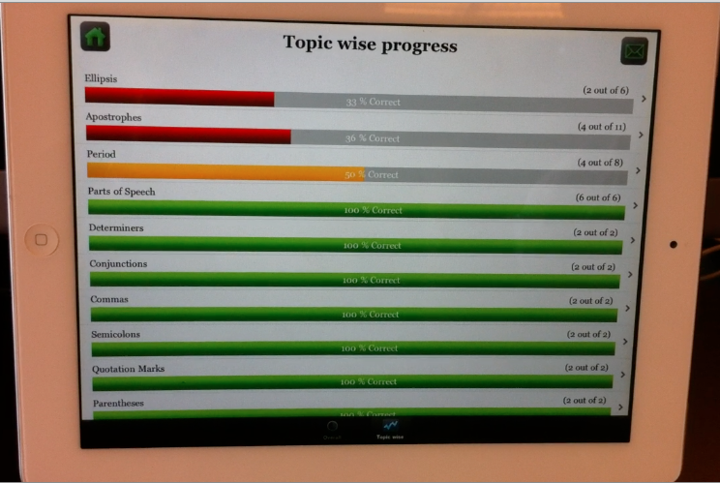

Slide 17
I
P
A
D
G
r
a
m
m
a
r
LTI 1.1 Outcomes
Intermediate Sys
Provision user, course, role, session.
Redirect ttl://grammar/lesson?sess=123
Tracking
Proprietary
iPad Switches to Grammar App

Slide 18
Questions...
http://www.vimeo.com/24699223

Slide 19
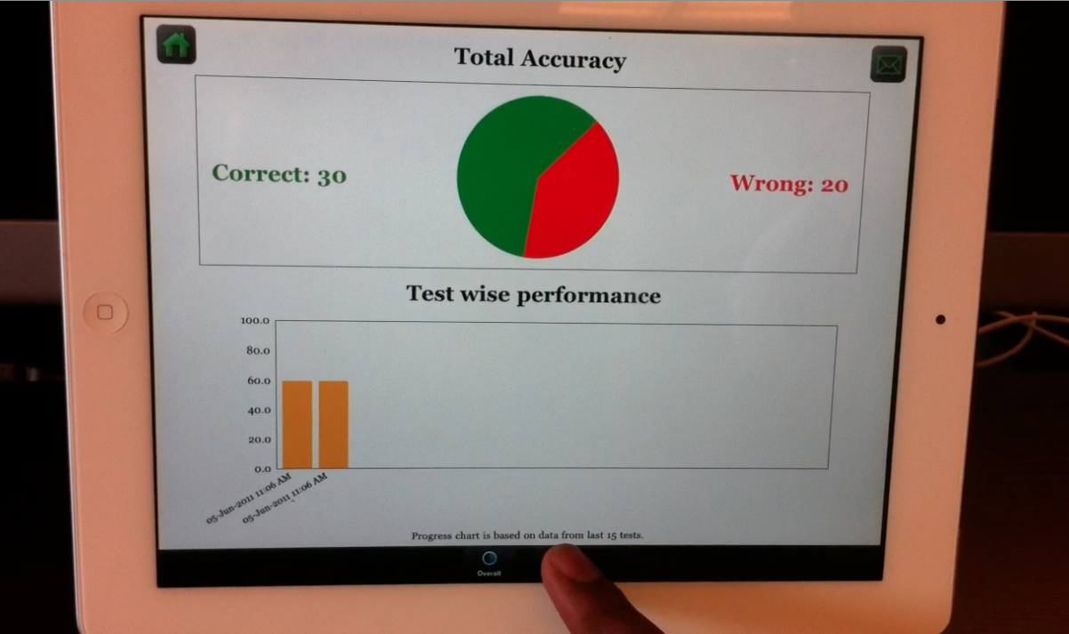

Slide 20





Students / Teachers
Users
Direct Login
IMS LTI for Launch and Grade Book
Your Tracking System

