Slide 1

Sakai 11
Charles Severance
University of Michigan
School of Information
Longsight, Inc.

Slide 3

Disclaimer...
What I am about to talk about is not an official direction or position of the University of Michigan, Longsight, nor IMS Global.

Slide 4
To Roadmap or not to Roadmap?
Historically we have avoided extensive roadmap discussions
Unpredictable resources
Governance layers / expectations / approvals
The governance of Sakai is clear
Commercial providers resources are more consistent

Slide 5
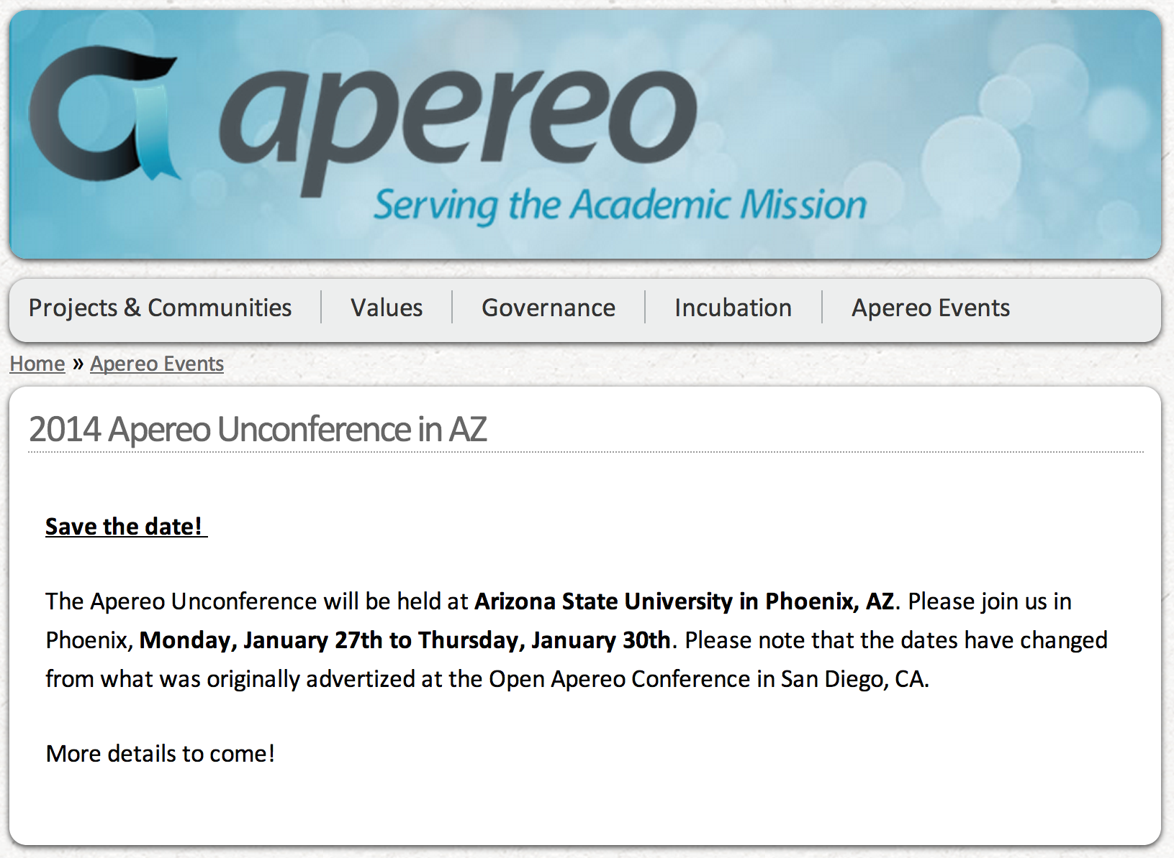
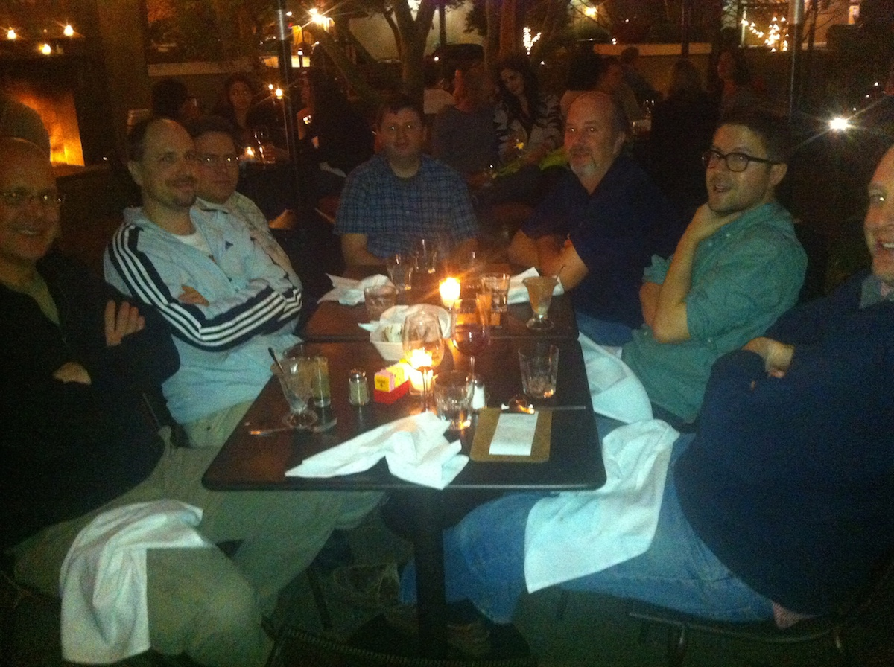

Slide 6
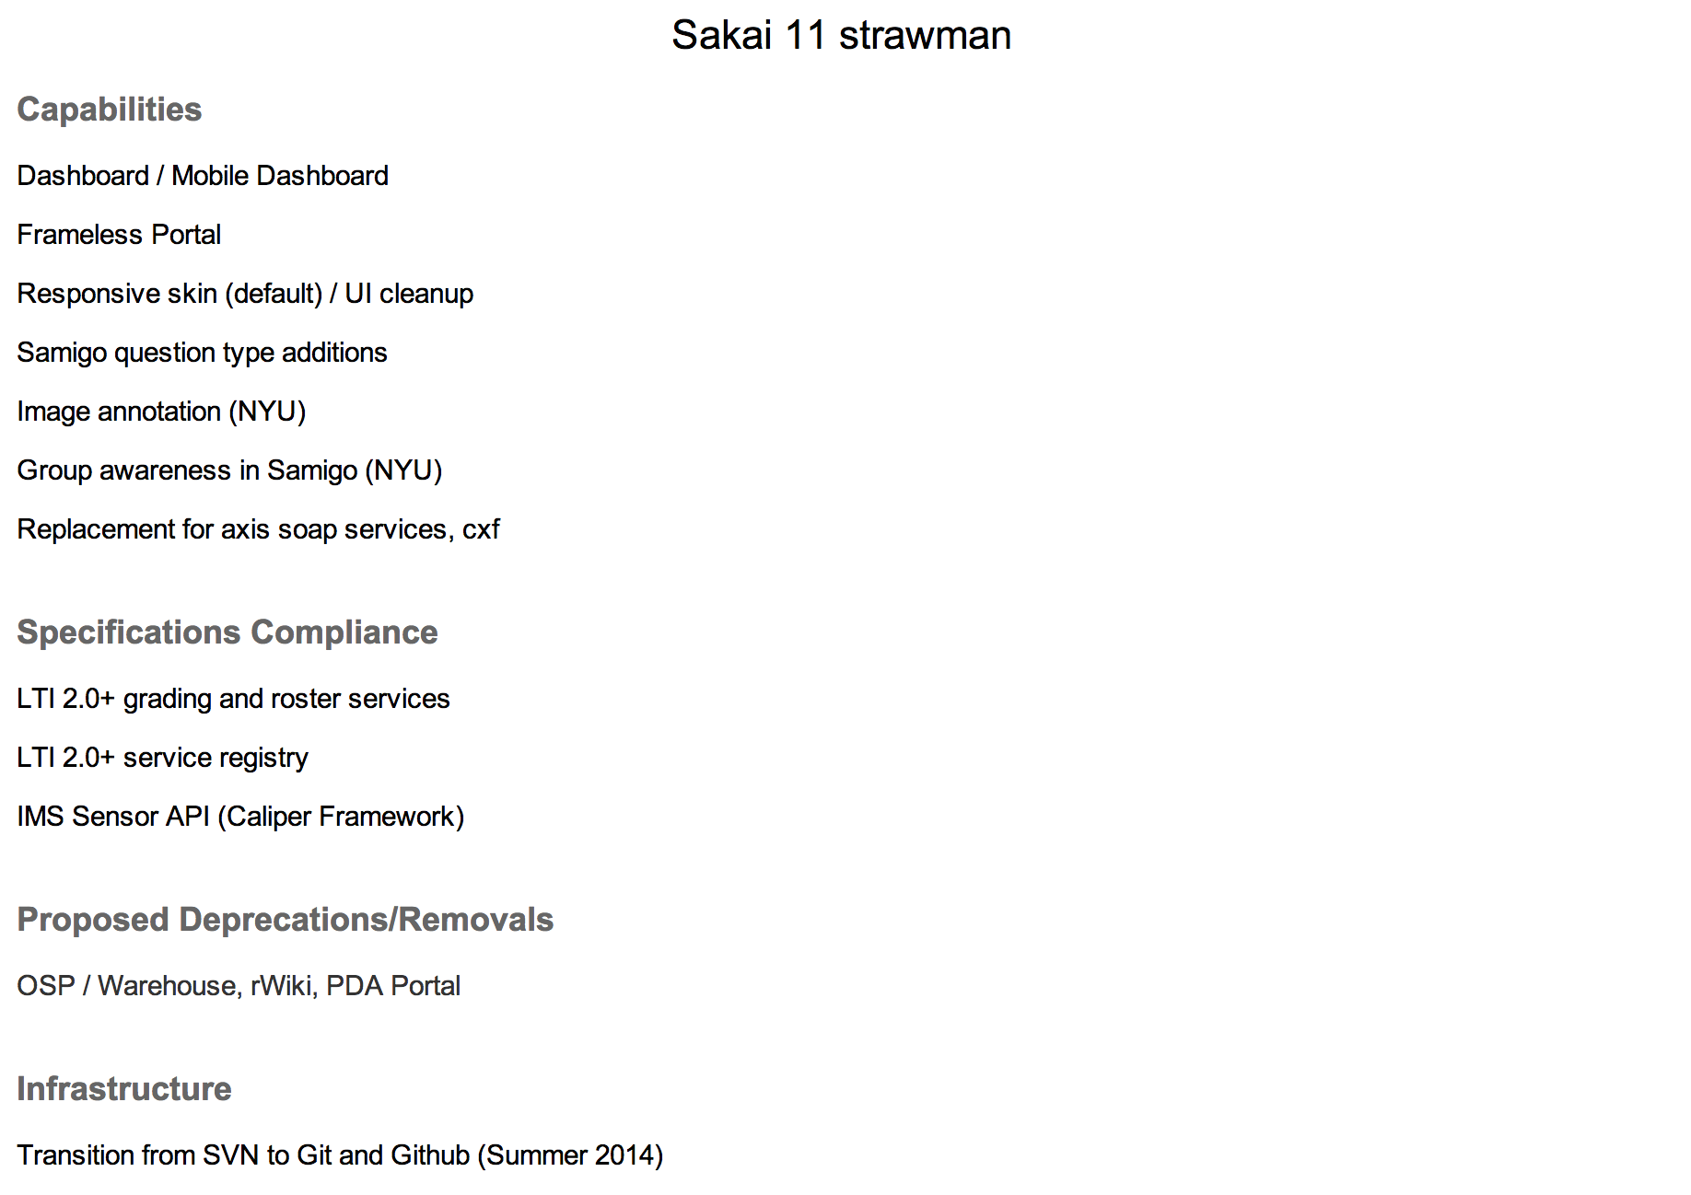
https://confluence.sakaiproject.org/display/REL/Sakai+11+straw+man

Slide 7
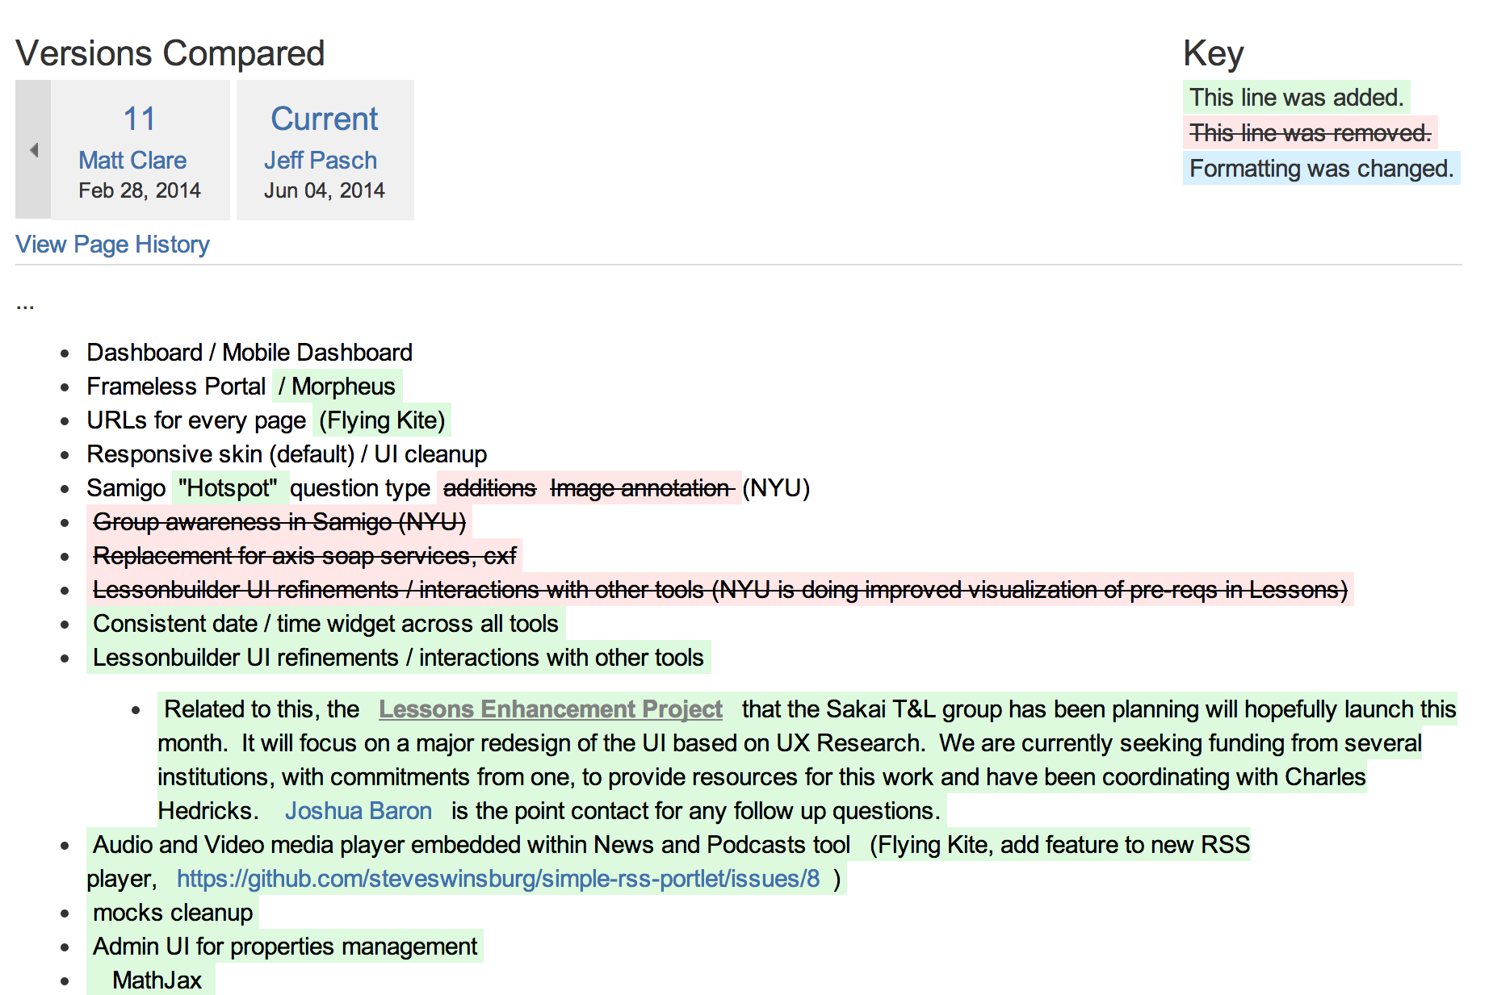
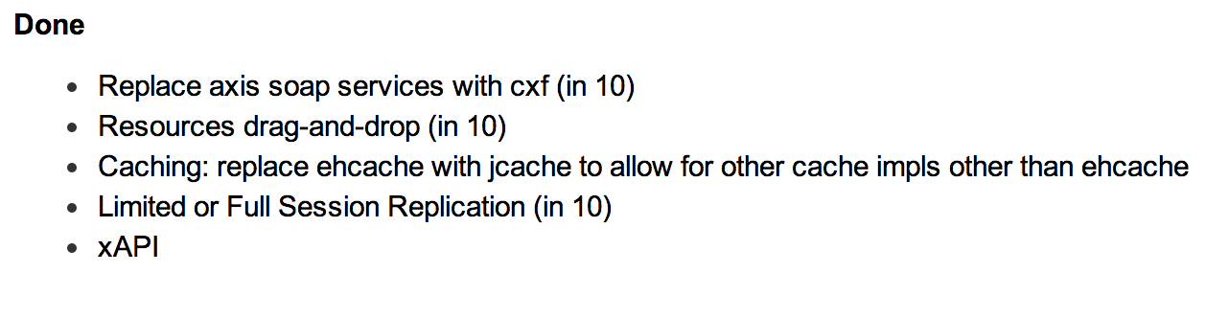
https://confluence.sakaiproject.org/display/REL/Sakai+11+straw+man

Slide 8
Sakai 11 Strawman
Frameless Portal / Responsive / Morpheus
Dashboard / Mobile Dashboard
Hotspot Question type
Lessons UI refine project
Admin UI for configuration properties
SNAPP integration for discussions
https://confluence.sakaiproject.org/display/REL/Sakai+11+straw+man

Slide 9
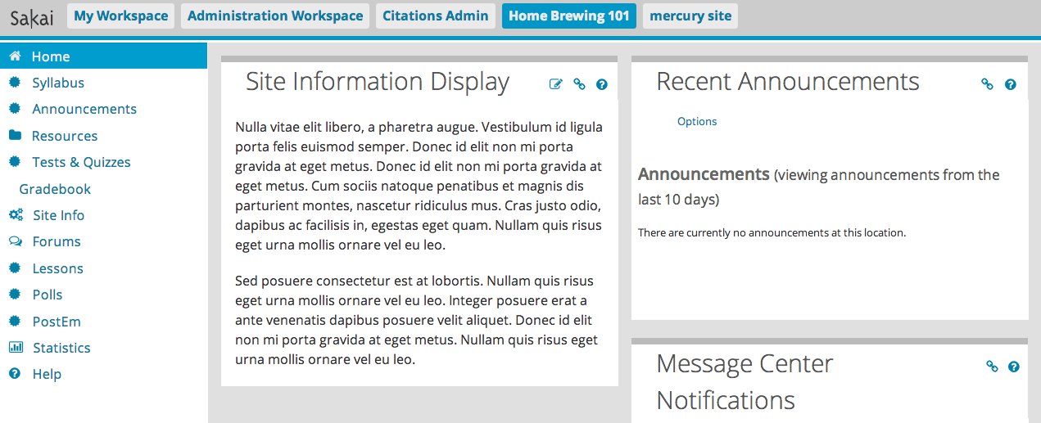

Slide 10
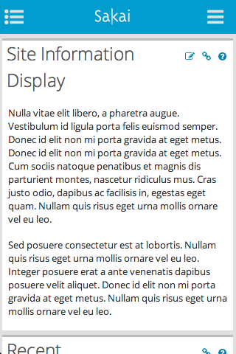
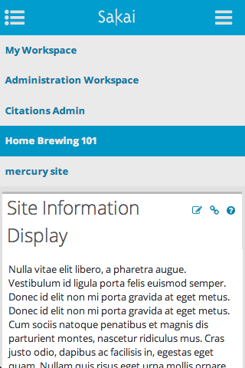
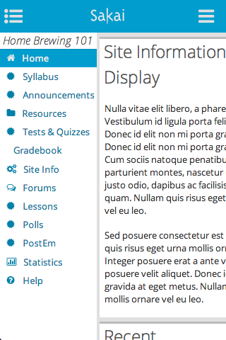

Slide 11
Sakai 11
LTI 2.0+ grading and roster services
LTI 2.0 service registry
IMS CC 1.3
IMS Sensor API (Caliper)
Move from SVN to GIT
https://confluence.sakaiproject.org/display/REL/Sakai+11+straw+man

Slide 12
Stretch Goals for Sakai 11
Support LTI picker in RTE / LTI App Store
Grade book rubrics
Grading new front end
Portfolio services to support Karuta
Google calendar
Forums tool cleanup
Forum topics embeddable
rWiki replacement
https://confluence.sakaiproject.org/display/REL/Sakai+11+straw+man

