Slide 1

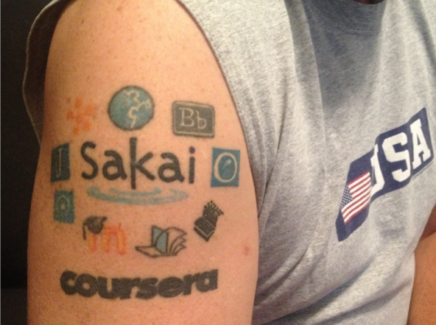
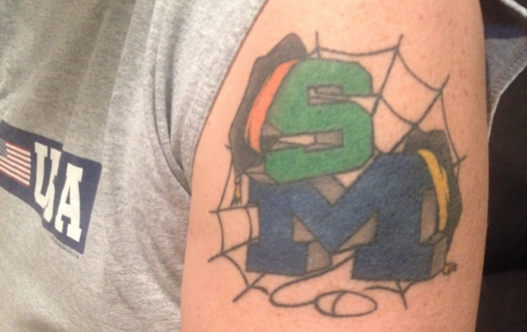
Looking for Disruptive EdTech in the Primordial Oooze
Dr. Charles Severance

Slide 2
