Slide 1
What's The LMS Of 2020
Look Like?
Charles Severance – University of Michigan
Rob Abel - IMS Global Learning Consortium
Scott Siddall - LONGSIGHT

Slide 2
THE LMS EVOLVES
Two decades of LMS development
Innovation and investment -> competition
Convergent evolution
Eportfolios
Authoring features
Attendance tracking
Embracing standards
Learning analytics

Slide 3
TRENDS
Toward a “learning ecosystem”……an open platform where faculty members are free to browse and embed the tools they want to use…
InsideHigherEd, July 2014

Slide 4
CORE TOOLS
Syllabus
Assignments
Assessments
Content repository
Grade book
Forums

Slide 5
COMMODIFICATION?
“….there’s a lot of parity between the systems.
You can almost throw a dart at a dartboard
and pick an LMS, and it won’t be that bad.”
InsideHigherEd, July 2014

Slide 6
What's The LMS Of 2020
Look Like?
Rob Abel - IMS Global Learning Consortium
Charles Severance - University of Michigan
Scott Siddall - Longsight

Slide 7

D'Arcy Norman's Law of eLearning Tool Convergance
Any eLearning tool, no matter how openly designed, will eventually become indistinguishable from a Learning Management System once a threshold of supported use-cases has been reached.
http://darcynorman.net/2013/02/15/normans-law-of-elearning-tool-convergence/

Slide 8

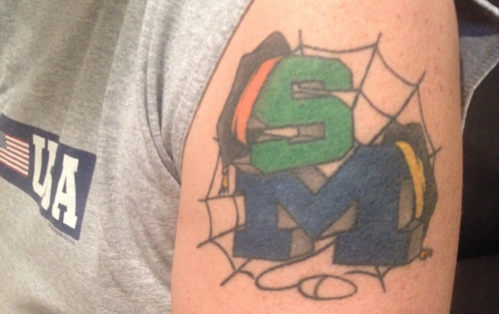
Learning Tattoos

Slide 9
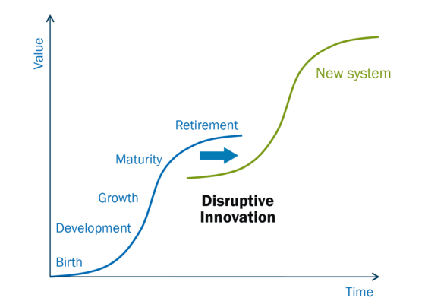

Disruptive Innovation
Now
2020

Slide 10
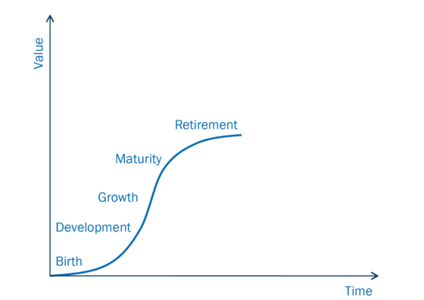






Disruptive Innovation
????
???
Now
2020

Slide 11
In the primordial ooze
Education at Massive Scale
Learning Object Repositories
Competency Based Education
Open Educational Resource
Redefining the Book
Education App Store
Analytics Dreams

Slide 12
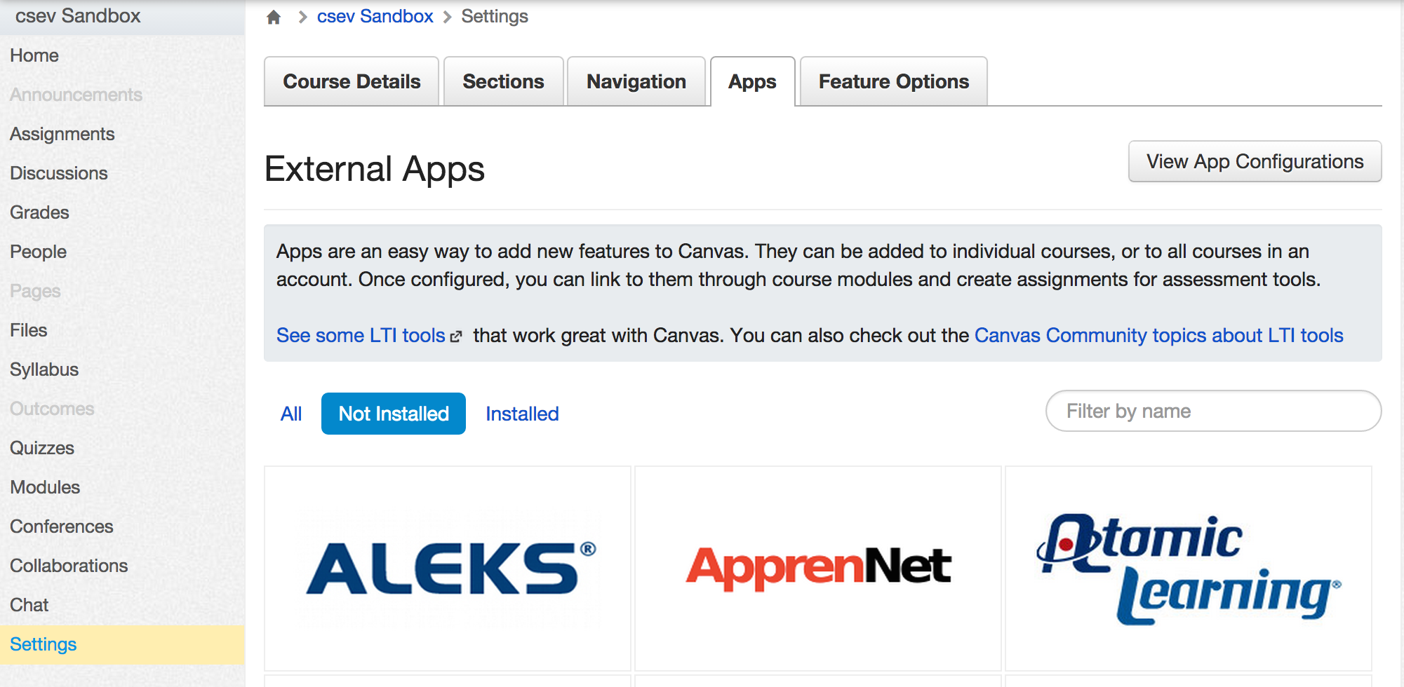
LMS + Educational App Store
Notes:
Juxtaposition of the Old and New

Slide 13
Standards Are Essential
IMS Learning Tools Interoperability 2.x
IMS LTI Services
(Roster, Gradebook, Content Item...)
IMS Caliper (Analytics)

Slide 14
LMS Operating System
In 2006, the State University of New York (SUNY) issued an RFQ for a "next generation learning management system" that was to allow the flexible composition of "best of breed" building building blocks..
It was a brilliant vision...
Notes:
I wrote a 26 page response – why it would not work – until we had standards and that what they should do was engage in Sakai and IMS and help move alng instead of just hoping for the vendors to provide...

Slide 15
Guessing about the Ooze
Someone will build an LMS Operating system from the ground up that is based on standards at the core. It will be simple, fast, scalable, and easy to use, install and deploy.
It will have no user interface (except perhaps a command line).
It will be based on and influence the future directions of standards
It will enable any number of user interfaces to be built.

Slide 16
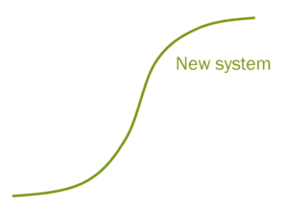

Don't Wait for the Vendors
Now
2020

Slide 17
D'Arcy Norman's Law of eLearning Tool Convergance
Any eLearning tool, no matter how openly designed, will eventually become indistinguishable from a Learning Management System once a threshold of supported use-cases has been reached.
http://darcynorman.net/2013/02/15/normans-law-of-elearning-tool-convergence/

Slide 18
Longsight, Inc.
www.longsight.com
information@longsight.com

Slide 19
Title
Default font is Gotham Light

