Slide 1
The GGF-7 Portal Summit
Charles Severance
University of Michigan

Slide 2
Context
MGRID - Michigan Grid Research and Infrastructure Development Center
  A center to develop, deploy, and sustain an institutional grid at Michigan common campus infrastructure
NEESGrid – The George E. Brown Network for Earthquake Engineering Simulation
  Condition of the award is to make equipment available for remote collaborators
CHEF – CompreHensive CollaborativE Framework
  A portal and framework based on Jetspeed, adds notion of groups of users, groups have customizable portal pages
  Adds notion that groups have customizable portals (i.e. group portal administrator)
  Pattern for portlets
    Presentation – Velocity mark-up
    Teamlets – Stateless GUI Components – JAVA
    Services – Persistant entities accessible by standardized JAVA API
  CourseTools – a set of tools to implement a course management system
  WorkTools – a set of tools services for support of scientific research teams
  The NEESGrid portal a Grid variant of WorkTools
Advertisement Page 1 of 4

Slide 3
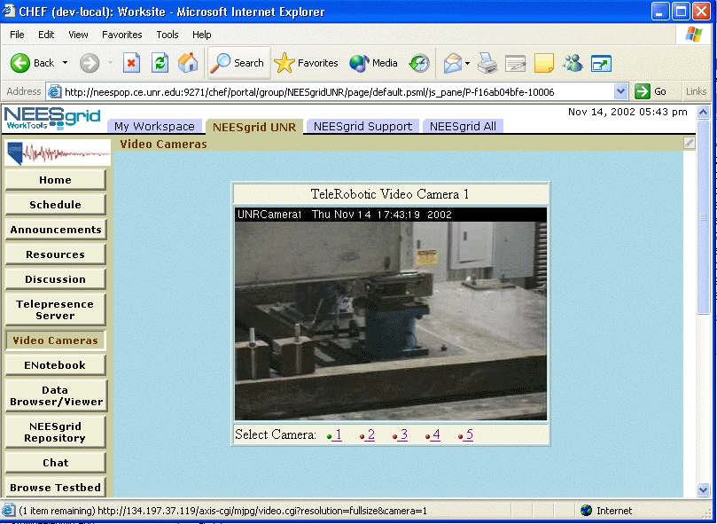
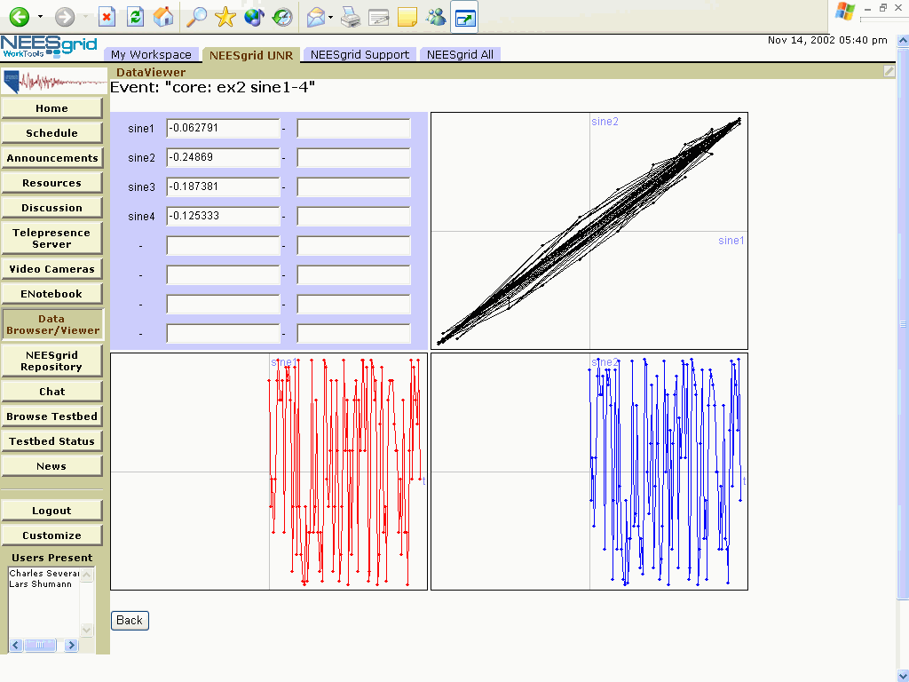
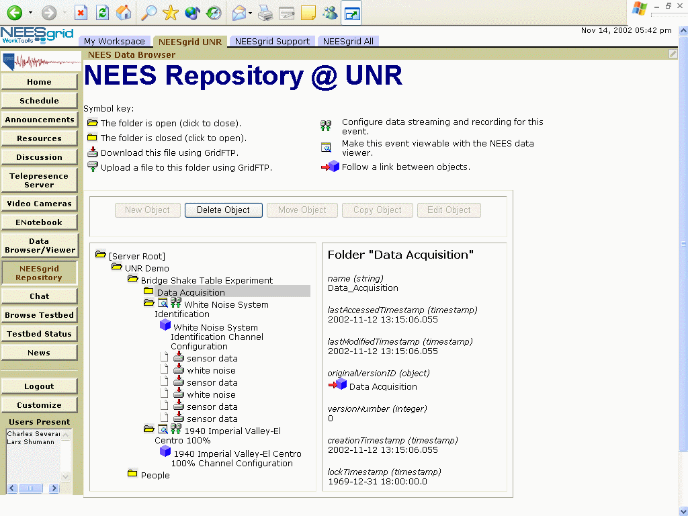
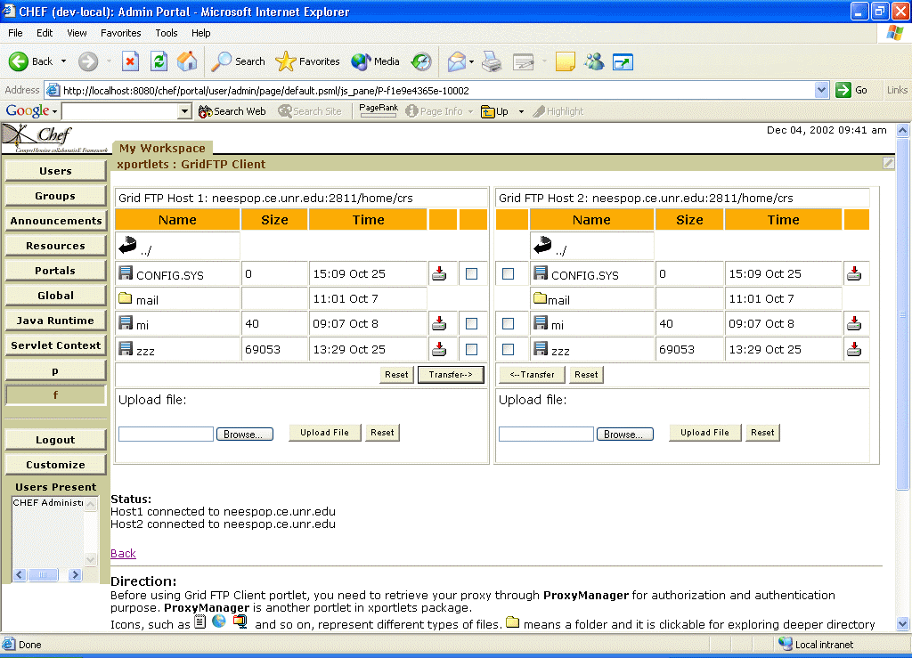

NEESGrid Examples
Advertisement Page 2 of 4

Slide 4
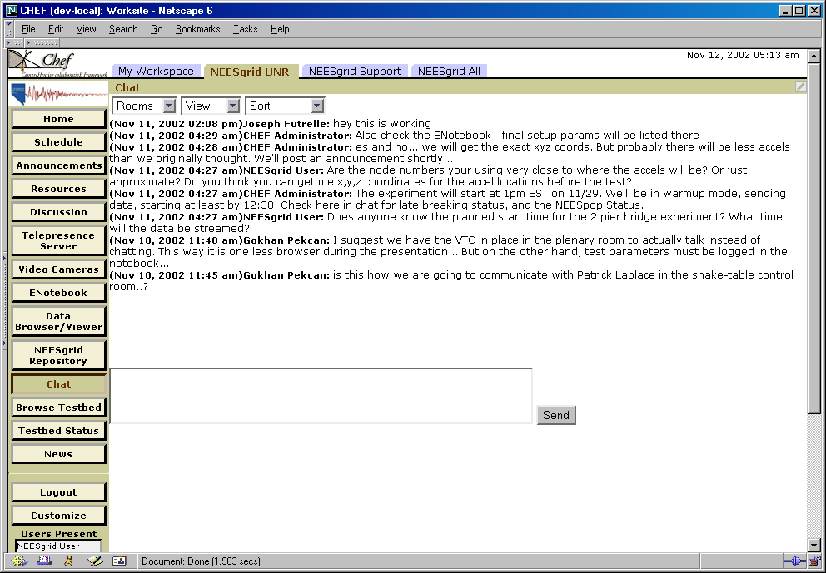
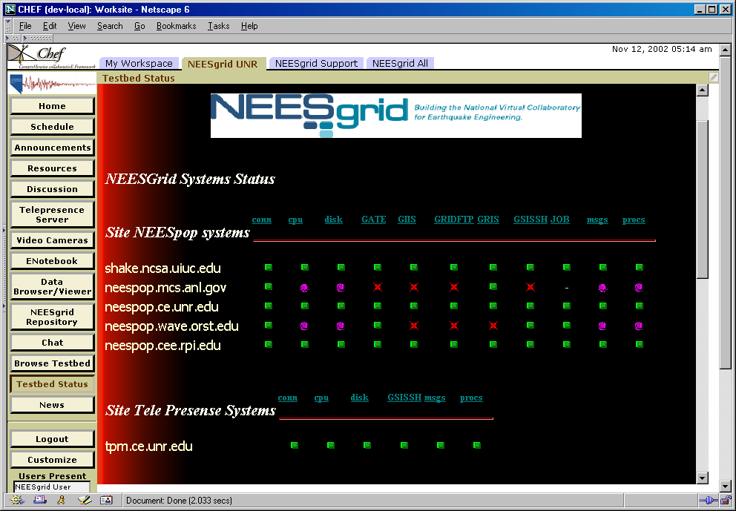
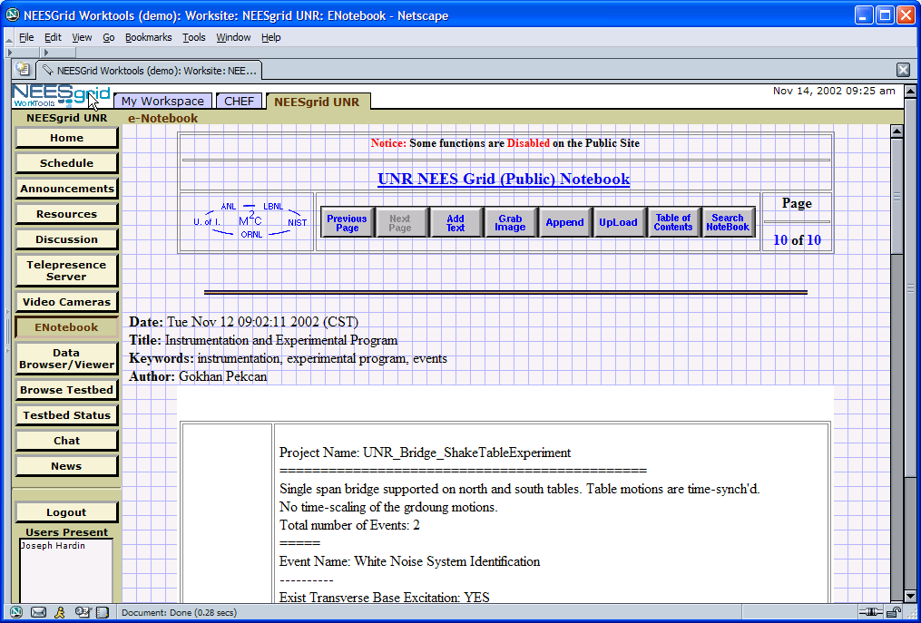
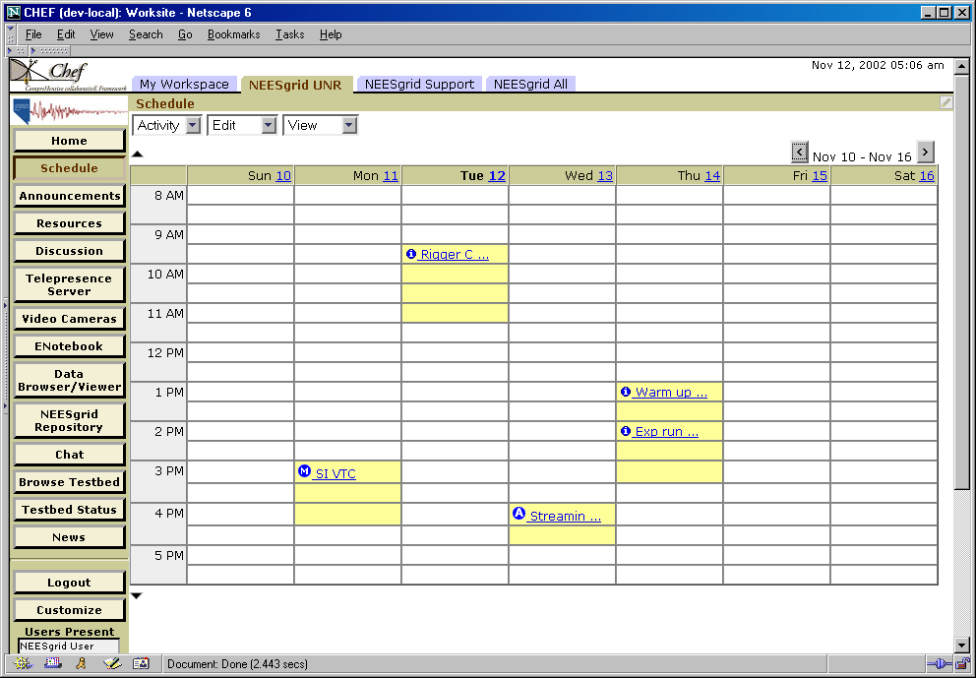
More NEESGrid Examples
Advertisement Page 3 of 4

Slide 5
Chef/Jetspeed/Grid/NEESGrid
CHEF
Grid
Service
Component
Grid Service API
Teamlets:
Jetspeed
MyProxy
NEES
Teamlet
OGSA
COG
Grid
UserDirectory
Provider
Service
UserDirectory
Provider
CHEF
UserDirectory
Service
Component
UserDirectory
COG
Jetspeed
Login
Existing CHEF
CHEF/Grid
User
IU Portlets
LDAP
GridFTP
Proxy
Existing GRID
Jetspeed
IU Code
Advertisement Page 4 of 4
Notes:
The UserDirectory and GroupDirectory services also use Turbine to find the
appropriate UserDirectoryProvider and GroupDirectoryProvider at run-time
using the same configuration mechanism as the Service API and Service
Components.

Slide 6
Questions From Dennis
Are the current portal frameworks, such as Jetspeed, sufficient for all our requirements? Yes and No. Jetspeed it sufficient for building tools and exploring problem space for now, but for ultimate buy-in – we will need implementations based portal-oriented standards like JSR-168/WSRP/WSIA. We also need to address portability for both HTML and non-HTML environments.
Is the portlet model the right one for Grid applications? Yes it provides discipline for implementers to work with others and truly build components rather than systems. No – assembled rectangles of HTML are not the future. HTML is not even the future – Sorry.
When is the Web “pull” model insufficient for Grid applications? It must be sufficient. When we have mechanisms where there are agents (points of subscription and notification) which are persistent while things are executing. The web pulls activity and status when the user is interested. We cannot “wave our hands” and pretend that running OGSA native apps on desktops solves this problem.

Slide 7
More Questions
What Grid services are needed to make Grid portals useful? Wallets / credential management – real world solutions (tired of hearing – just install Linux plus the Globus Toolkit on every computer on the planet and the put your credentials in ~/.globus with chmod 700).
Are the proposed OGSA core Grid services appropriate and useable by Grid portals? – Yes. What other Grid middleware implications are there for Grid portal interoperability? – We needs usable and stable APIs for things like GridFTP.
What are the requirements for a messaging and notification model to be used by Grid portals? Nothing special – these are adequate.
How do we build a GridShell? How does one create a user’s Grid Context? A GridShell GUI is a peer to Grid Portal – both should share the same underlying components ( high level powerful components – GridFTP API in COG 1.1 as counter example)

Slide 8
More Questions
How do we design a Grid portal architecture that best supports collaboration? Groups must go through the exercise of adopting each other’s stuff. Stuff must be of sufficient quality that it can be adopted without breaking other stuff. We must tell one another when stuff is not “adoptable” and work together to eliminate barriers to adoption. Tension between dependencies and reuse must be resolved together and standards developed.
Two important standard have emerged: WSIA (Web Services for Interactive Applications) and WSRP (Web Services for Remote Portals). Are these sufficient for the requirements of Grid Applications? Yes and no… We must provide tools for both the web and non-web environments. We must separate out the presentation layer …. hmmm this is a hard question to answer on one page…

Slide 9
WSRP *
Good stuff
  Web Services binding to API between Portal and Portlet – much more abstract than HTTPRequest/HTTPResponse
  Formalization of session and other contexts
  Simple lifecycle of GUI component – allows migration of functionality around
Hard stuff that is not yet done
  In the common practice which is shown, presentation is in the wrong place
* You may perceive some of my comments to indicate that I am not pleased with WSRP. This absolutely NOT the case – WSRP is superb as far as it goes.

Slide 10
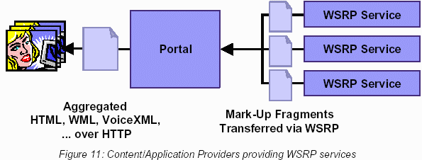
Looking at this picture, where does presentation happen? Where does the transformation from an abstract representation of the “output” happen? Where does the separate presentation output for HTML, WML, etc get generated? If you were a software architect, where do you think it should get generated?

Slide 11
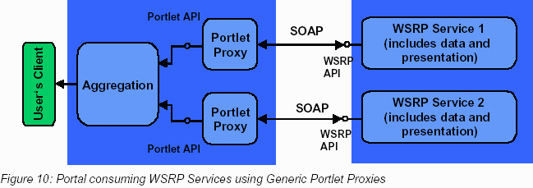
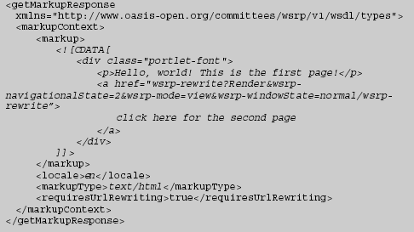
Wake up Neo…
“OUCH – after all this work and a whole new generation of non-upwards compatible portals and all we are doing is routing around HTML fragments inside SOAP with a standardized URL transformation convention?”

Slide 12
HTML
VoiceXML
WML
Who selects which presentation is used? How does the WSRP service know what the final mark up should be? How does the WSRP service know what color buttons should be in an HTML environment?

Slide 13
Switching gears: Chuck’s Web Presentation API (circa 11/2002)
The ultimate scope of the Presentation API will cover browser and non-browser environments.
Initially an API for a “Web Tool” presentation framework will be defined.
The API will be sufficiently abstract to cover both web and non-web applications but its focus is on web applications
Web Presentation Framework
Web Tool
Value Added
Services
Base Services
Other Base Services
This proposed API came out of discussions with OKI in the area of a presentation API and represents concepts as to how to formalize interactions and generalize presentation away from Jetspeed/Velocity.

Slide 14
Web Presentation Framework
Web Presentation Framework provides
  Presentation detail (look and feel, etc)
  Short term persistent information (i.e. session information)
  Authorization and authentication
  functionality as required by
  the web tool
  GUI aggregation across multiple web
  tools if appropriate
Web Tool

Slide 15
Web Tool Lifecycle
The web tool delegates all persistent information to other components
  Presentation – short-term persistence
  Services – long-term persistence
The tool should assume a trivial
life-cycle – it may be separately
instanced for each request
Web Tool

Slide 16
Web Tool Functionality
Web Tool provides
  The bulk of the “business logic”
  Sequencing (i.e. Step 3 of 5)
  Integration across services – marshalling and assembly
Early tools will not have access
to a wide range of robust
“composed” services so the
tools will be relatively “thick”
Web Tool

Slide 17
Web Tool Environment
Each tool has one or more “modes”
  Different GUI look
  Different XSL Template
  Different “form”
The tool controls which mode is active as part of response preparation
Each mode has one or more actions handled in event processing
  NEXT / BACK / CANCEL
Presentation Framework
Tool Presentation Mode B
Tool Presentation Mode A
Web Tool

Slide 18
Web Tool State
Tool state is a name/value Map (aka Context)
Distinct for every session / user / placement
Persistent for duration of session
  Across HTTP requests
  During transactions
Presentation Framework
Tool Presentation Mode A
Tool State
Web Tool

Slide 19
WSIA – Web Services for Interactive Applications
Charter (OASIS group – Chair is IBMer)
  Deliver web applications to end users through a diversity of deployment channels: directly to a browser or mobile device, indirectly through a portal, or by embedding into a 3rd party web application; and
  Create web applications that can be easily be modified, adapted, aggregated, coordinated, synchronized or integrated by simple declarative means to ultimately leverage a worldwide pallet of web application components
Seems to have two approaches
  Short term – work with WSRP (joint draft with WSRP)
  Long term – develop their own stuff
There is no draft for the long-term – but there are related documents
  WSUI – Mechanism to externalize presentation among http variants (wml, html, …) – pure transformation – no context - from Epicentric
  WSXL – The mother of all web service models – from IBM

Slide 20
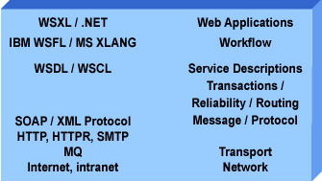
WSXL – Experience Language
Generalized Web Services Model
  Supports heavyweight lifecycle model
  External presentation (XML, CSS, others possible)
  Supports Generalized Events via WSDL (W3C DOM)
  Broad enough to support variety of web services
    Control | Presentation |
    Data
  Interesting “peer” –
  .NET is more than
  “experience”

Slide 21
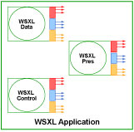

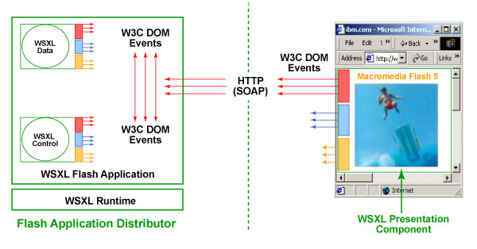
WSXL Pictures

Slide 22
Summary
 | WSRP | WSXL | Partlet | Jetspeed
Maturity (1-10) | 9 | 5 | 0.1 | 9
Uses Web Services | Yes | Yes | No | No
GUI Components Lifecycle | Trivial | Heavy* | Trivial | Trivial
Where is Context | External | Unknown | External | External
Events Model | Web | General* | General | Hybrid
Presentation Processing | Inside | External* | External | External
Presentation Flexibility | Weak | Excellent | Who knows? | Limited
* Indicates a flexible model

Slide 23
Is the winner obvious?
Yes – (WSXL + three years of consensus) = WSIA
  WSXL contains all of the others – plus a few things
  Would like to see the concept of “context” more explicit
No – A blank slate is a very very bad thing
  Just because we have the capability to decompose applications in a completely random and arbitrary fashion – it does not mean that we should
  Without a ton of “best practice”, WSXL will set us back before it will move us forward
  Jetspeed, WSRP, (and even) Partlet are examples of decompositions and patterns
Solution – We need to develop profiles of WSIA in parallel with its development – good news: we have time

Slide 24
Possible “Profiles” of WSXP
Patterns
  OGSA Service – Heavy lifecycle -statefull, No GUI, No Interactive events supported, Transaction-oriented, Light Context (Identity only)
  GUI Partlet Service – Trival lifecycle, external heavy context
  GUI Presentation Service – Trivial lifecycle, read only access to context, several standard variants (CSS, XSLT, WSUI..)
  HTML Portal Service – Maintains context, orchestrates presentation and Partlet services
Having standardized patterns and discipline
  Interchange of components and reusability – Saying “WSIA compliant” means about the same as “uses the x86 instruction set”

Slide 25
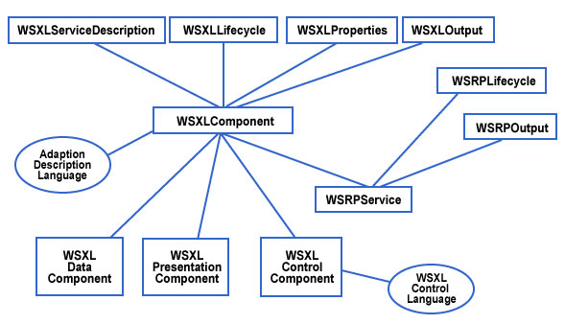
WSXL relating to WSRP or the start of WSXL Profiles?
OGSA?

Slide 26
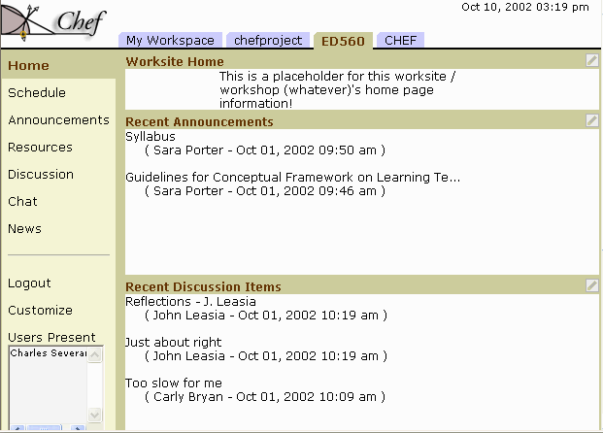
This is NOT a 3 (or N) layer Architecture
Produce
Consume
HTML
A WSIA
Service
HTML
OGSA
OGSA
WSPT
WSPT
WSRP
WSRP
Portal Framework
OGSA
Res
Res
Res
Res
Res
WS Protocol / Schema
Even though there are no distinct layers, there are patterns and discipline in terms of the components.
WSIA Profile – Which protocols and how used

Slide 27
Conclusion
JSR-168 – good for portal developers – helps marketplace
WSRP
  Application is limited to HTML portals
  Introduces standardized notion for Context
  Good decomposition pattern – except for that presentation thing
WSIA/WSXL
  Enable us to code generic GUI services which can be used in HTML and non-HTML applications
  No “best practices” for decomposition
  Overlap between OGSA and WSXL – should be easy to solve
Jetspeed/CHEF – A good sandbox with discipline and a clear pattern
  Good pattern for profiles: Aggregation / Presentation / Teamlet / Service
  JAVA API – Can go to WSDL “just like that”
Oh yeah – sooner or later we have to make all this stuff go fast too – maybe we could use the duality between JAVA APIs and WSDL in some way

