Slide 1
Ultimate Goal State
Standardization for interchange of two types of packaged components
  User Interface
    Multiple presentation
    components
  Portal Service
User Interface Package
<gui>
<wml blah…>
<html blah...>
<swing blah…>
<services-req’d blah…>
</gui>
Portal Service Package
<broker>
Blah
</broker>
User Interface
Component
WML
Component
Portal Service
Component
HTML
Component
Swing
Component

Slide 2
Hosting Framework
A portal will require a standardized hosting environment for both User Interface and Portal Service packages
  GUI Framework APIs
  Service Broker APIs
UI
WML
HTML
Swing
Standardized Hosting Framework
Service
GUI Framework
Service Broker
Service
UI
WML
HTML
Swing
Service
UI
WML
HTML
Swing

Slide 3
Assembling a Portal
A portal will require a standardized hosting environment for both User Interface and Portal Service packages
  Install GUI Framework APIs
  Install Service Broker APIs
UI
WML
HTML
Swing
Standardized Hosting Framework
Service
GUI Framework
Service Broker
Service
UI
WML
HTML
Swing
Service
UI
WML
HTML
Swing

Slide 4
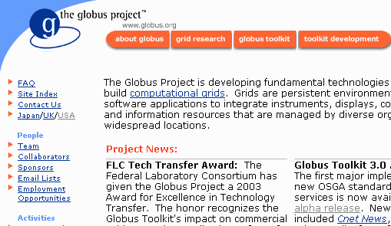

Portal At Run Time
The hosting framework provides services to all of the components
  User Interface
  Presentation
  Service
The components are connected using standardized APIs as appropriate by the hosting framework
Standardized Hosting Framework
GUI Framework
Service Broker
HTML
Component
User Interface
Component
Portal Service
Component
WML
Component

Slide 5
Presentation and Framework
Because of lack of standards, consensus, and experience in the space, we cannot standardize on portal and presentation approach at this time
  Jetspeed
  GridSphere
  Java Desktop Applications
  JSP
  Perl
  Command Line Interface
Each approach has strengths and weaknesses
Standardized Hosting Framework
GUI Framework
Service Broker
Presentation
Component
User Interface
Component
Portal Service
Component

Slide 6
Standardizing Services
All portal efforts need access to high-level, easy-to-use, user-oriented services
  Credential Management
  Data Management
  Job Submission
  Data discovery
These services can be built to be portable across multiple Grid environments (GT 2, GT3, …)
This area is ripe for standardization during the transition from GT2.2 to GT3.0
Standardized Hosting Framework
GUI Framework
Service Broker
Presentation
Component
User Interface
Component
Portal Service
Component

Slide 7
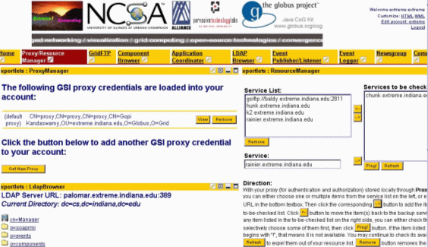

Services in HTTP Portals
Jetspeed Environment
Service Broker
Jetspeed
Jetspeed
Portlet
Portal Service
Component
Gridsphere Evironment
Service Broker
GridSphere
GridSphere
Portlet
Portal Service
Component
Components not standardized in phase 1

Slide 8
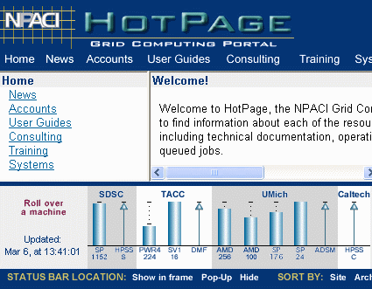
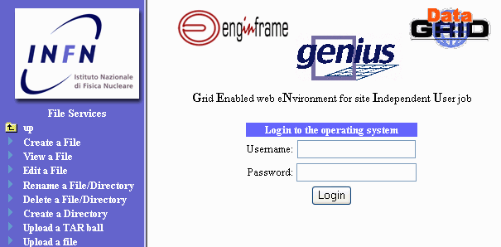
Using Services in Script Languages
Perl Environment
Service Broker
Perl Scripts
Portal Service
Component
JSP Environment
Service Broker
JSP Scripts
Portal Service
Component
Components not standardized in phase 1

Slide 9
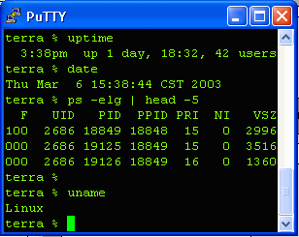
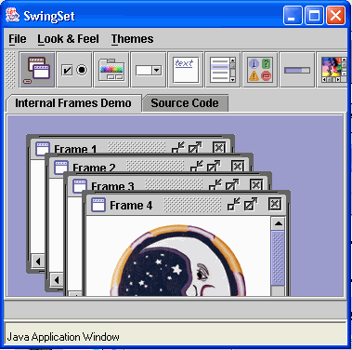
Services in non-HTTP Applications
VT-100 Environment
Service Broker
Grid Shell
Portal Service
Component
Swing Environment
Service Broker
Java
Desktop App
Portal Service
Component
Components not standardized in phase 1

Slide 10
Future State
Standardize full scope of hosting framework
Packages usable in multiple environments
HTML Framework
GUI
Broker
HTML
UI
Service
UI
WML
WML
HTML
Swing
SWING Framework
Service
GUI
Broker
SWING
UI
Service

Slide 11
Conclusion
Standardize Architecture
  Characterize needs at each API and look at possible standards efforts which might meet those needs
Develop Standards for Services
  Choose JAVA as base language
  Standardize Service Broker and Lifecycle
  Determine APIs to common services
  Provide bindings to other languages

