Slide 1
The Medium ITR:
A Global Grid-Enabled Collaboratory for Scientific Research

Slide 2
Summary
Grid Enabled Collaborative Environment
  Starts with the results of the NEESGrid portal effort
  Browsers is starting point and platform for launching a wide range of familiar applications (such as experiment analysis framework)
  Portal provides access to simple collaborative tools directly through the browser
  Single sign-on using Grid credentials
  Full access to all Grid services in portal applications
  Supports dynamic small group creation and interaction
  Focus on both synchronous and asynchronous communication
  Focused on persistence
    Collaborative applications are intended to be running on your desktop
    Collaborative activities are recorded as a natural side effect of tool usage
  Encourages culture of collaboration – when you work you collaborate
    Start with experiment management

Slide 3
Research Issues
  Language of access
    How to we manage so much closeness
    2000 people in one shared office
  What will be the effect once the tools have been adopted
    Activity past and present will be readily available
    People will have more ready awareness of all of the activities that they are involved in
    How will tools need to be designed in a high-usage environment

Slide 4
Phased Approach
First Year: “Delivering New Collaborative Capability”
  Deliver working prototype based largely on existing NEESGrid components plus easy value adds
  Begin significant requirements analysis (~20% of budget)
Second Year: “Augmenting Collaborative Capability”
  Adding new capabilities based on initial year of user requirements analysis
  Begin examining “research issues”
Third and Fourth Year: “Extending Dynamic Collaboration”
  Adding new capabilities driven by user analysis including the analysis of the use of the framework and tools in years one and two
  Enable collaboration between thousands of people and thousands of groups

Slide 5
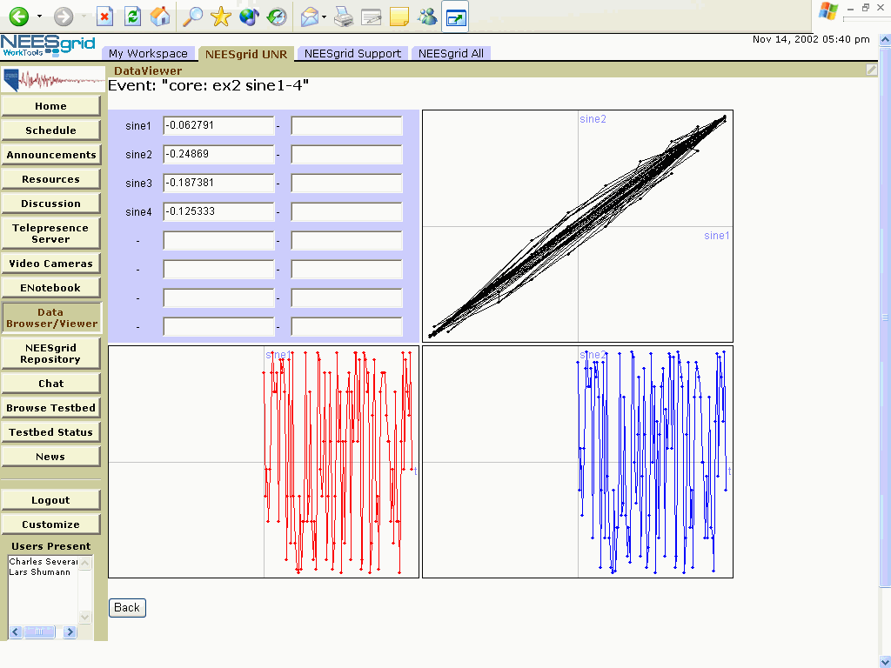
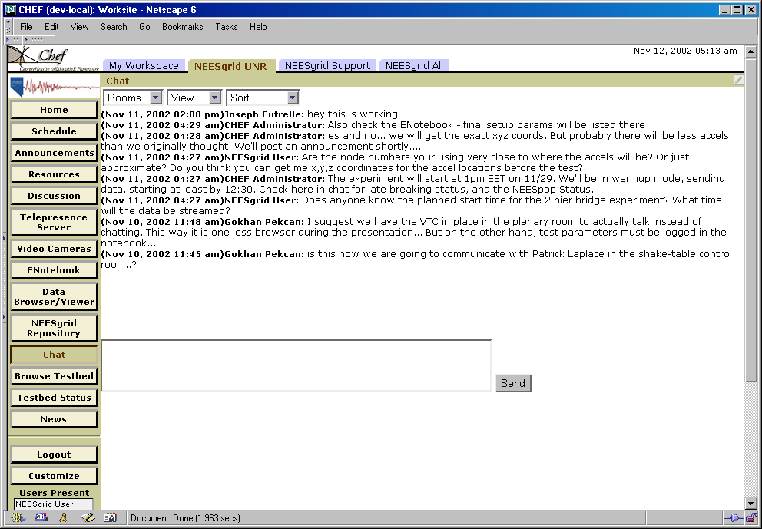
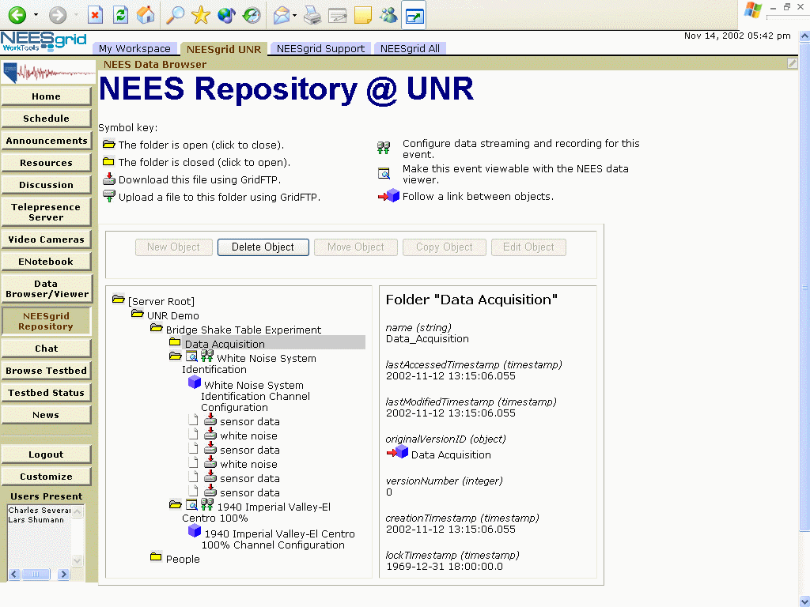
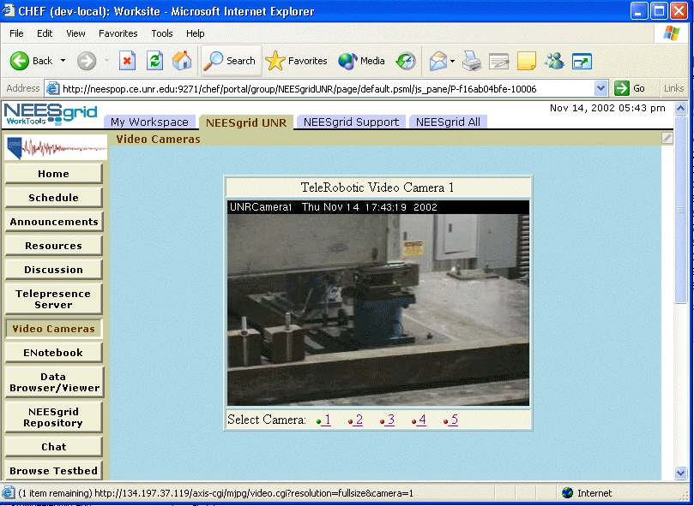
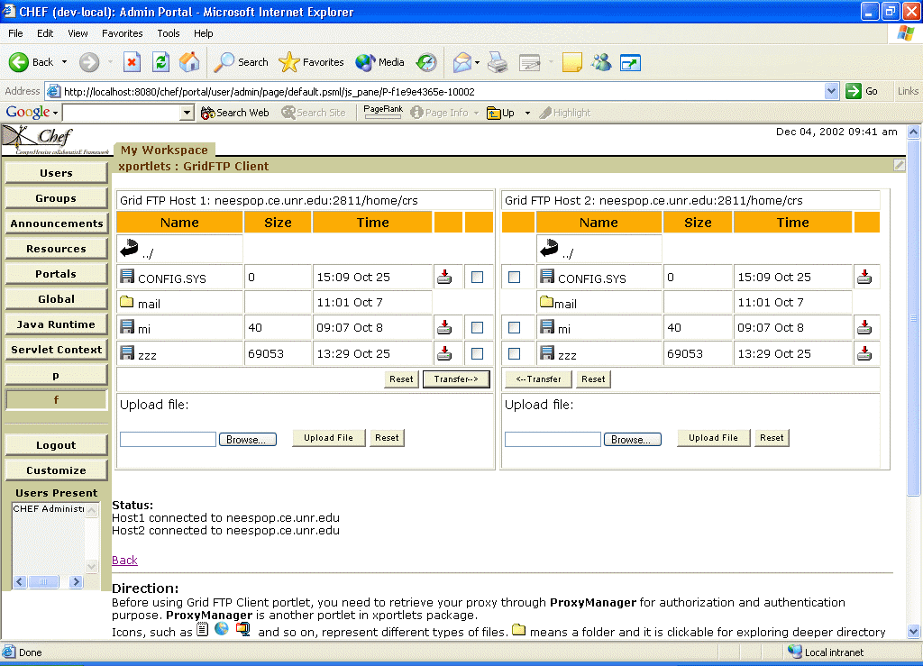

NEESGrid Examples

Slide 6
Writing Approach
Prepare to support the Large ITR
  We had the whole idea of dynamic workspaces in mind – synergy with idea of dynamic workspaces
Did not make the dependencies explicit
U. Michigan’s primary technical contribution
  Supporting the framework for the tool developers in the medium and large ITR
  The framework and core tool set already exists funded by NEESGrid
Significant new development effort at Caltech;
LBNL, UTA, Iowa, and Maryland/FNAL providing tools and subsystems to make the environment work

Slide 7
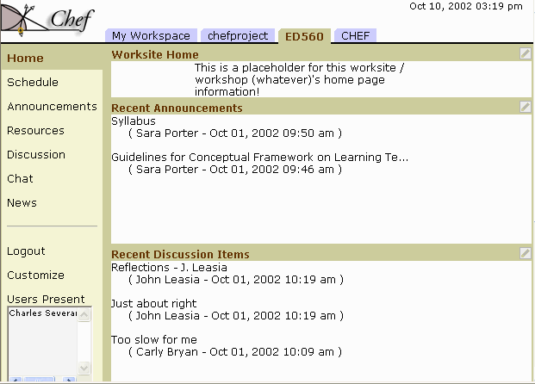
The unit of tool exchange is a “Portlet” – some JAVA code, and presentation templates and possibly some services. These drop into a portal framework which is based on Jakarta Jetspeed and has been enhanced to support the Grid and collaborative activities. Group owners configure “group sites” selecting a subset of the available tools.
Tools
Grid-Enhanced
Jetspeed
Portal

Slide 8
Tool Implementation Choices
There is a wide range of implementation choices which can have implicit Grid credentials
  Build a complete tool in JAVA using the Portal API
    The basic collaboration tools for NEESGrid are already built in this way
  Build a wrapper tool using the Portal API – perhaps wrapping a signed Applet
    NEESGrid data viewer operates this way
  Use JAVA Web Start to install and launch a JAVA Desktop Application with a Grid Credential
  Build an OGSA (Grid Web Service) Interface to an application and build a relatively thin Portlet which can interact via OGSA
There are other methods of integration without Grid Credentials using an iFrame or launching separate applications

Slide 9
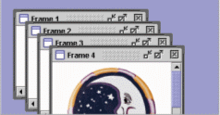
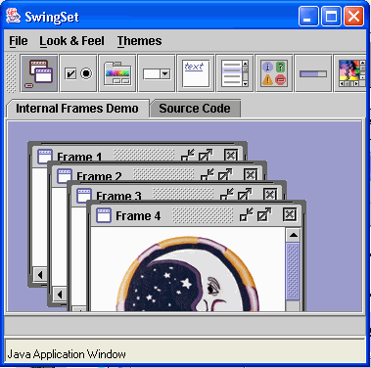
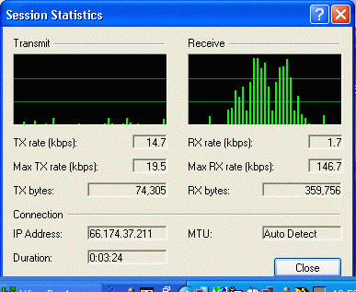
Native
Portlet
PORTAL
Applet
Portlet
Grid
And Other
Services
JAVA Web
Start
Portlet
Desktop
Launch
Portlet
Access
Portlet
Application
Which Supports
Grid Services
and/or Clarens
Clarens

Slide 10
VRVS Implementation
VRVS is a large and complex set of tools supporting many operating systems
  We will not re-implement all of this in the portal
  The portal will handle the administration, scheduling and starting of meetings
  Much like the current VRVS web site makes all of the arrangements and then launches pre-installed desktop applications to do the actual data transmission
New work
  Every group which is created will have their own “room” if they want one (i.e. meet me at our VRVS room at 15:30)
  New Portlet
    Room creation, management and launch
    Simplification of navigation
    Management of recording and playback
    Searching of media

Slide 11
Summary
The bulk of the Large ITR work is core CS work – data algorithms, etc. This can be implemented any number of ways.
Critical interfaces should be made available via standardized interfaces and web services
  (i.e. JINI, Mona Lisa, CAIGEE, OGSA)
The Medium ITR team can help with the design and support the implementation of viewing, dashboard, monitoring, or other UI components which can be placed in the portal framework which make use of those web services or launch tools.

