Slide 1
CHEF/Jetspeed/Grid/NEESGrid
Charles Severance
NPACI All Hands Meeting
March 21, 2003

Slide 2
Conclusion
Our next generation of portals needs to be architected with three layers
  Presentation
  Application logic (Portlets)
  Services
The future is very exciting for portals
  If we want to start now, we should use Jetspeed, and once you get started with Jetspeed take a look at CHEF/Grid
  Transition for UT’s GridPort
  That way we approach the future as a flock
Thanks for your time - csev@umich.edu

Slide 3
Outline
NEESGrid
CHEF and Jetspeed
Teamlets and Portlets
Jetspeed Presentation - Velocity Markup Language
Session State
  Portlet Code Demo
Services
Architecture: The Movie
Grid Authentication Architecture
Portal Standards – Present and Future
Conclusion

Slide 4
NEES – www.neesgrid.org
George E. Brown, Jr. Network for Earthquake Engineering Simulation
  Large Installations of physical equipment for earthquake experiments and simulations
  Part of the award is to make equipment available for remote collaborators
Focus is on collaboration and experimental equipment sharing in addition to access to computation

Slide 5
NEESGrid System Integration Team
Developing infrastructure to:
  access collaborative tools for experiment planning, execution, analysis, and publication.
  perform tele-observation and tele-operation of experiments;
  publish to and make use of a curated data repository using standardized markup;
  access computational resources and open-source analytical tools;
NCSA, ANL, USC/ISI, UMich, USC

Slide 6
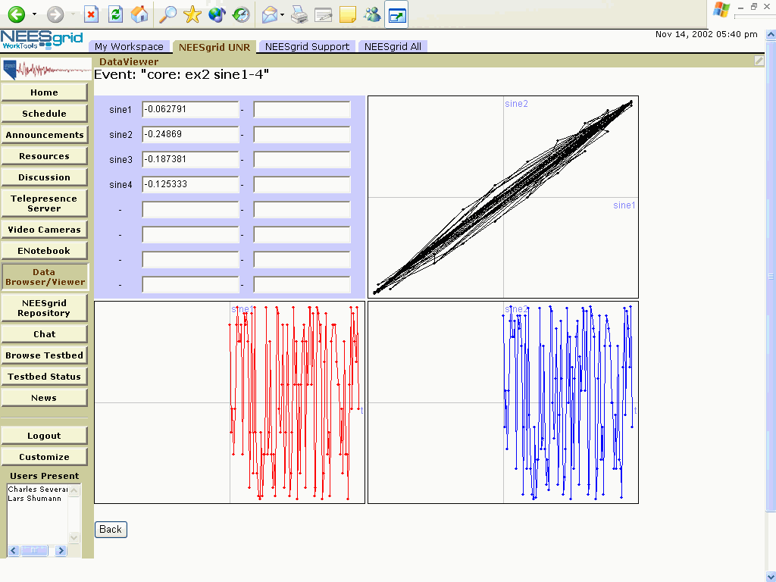
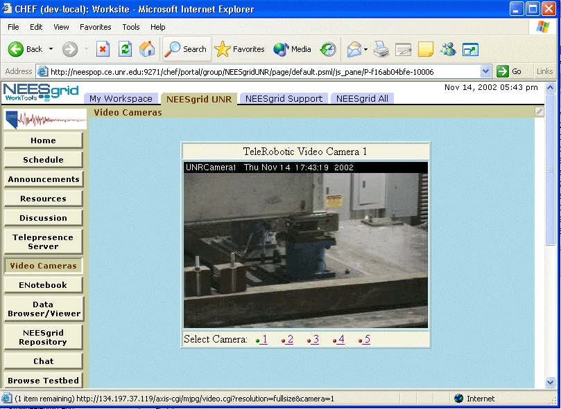
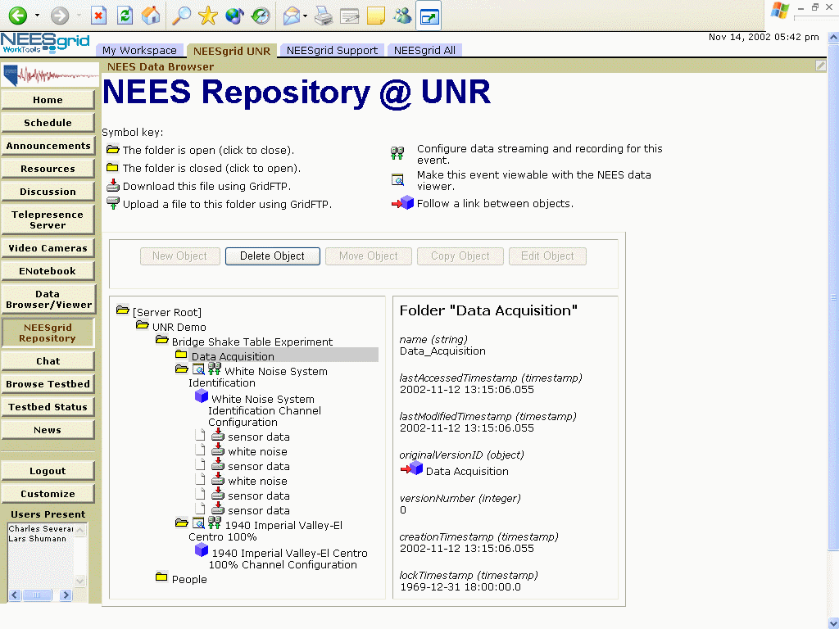
NEESGrid Examples

Slide 7
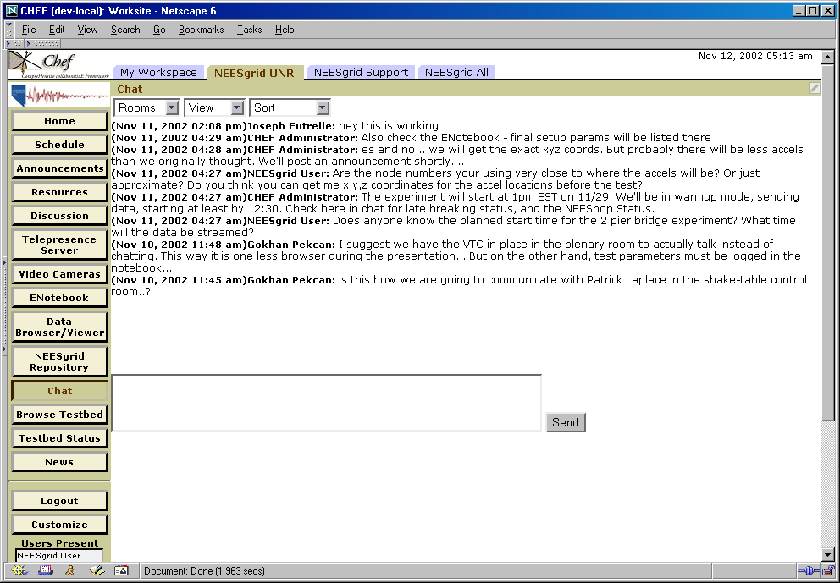
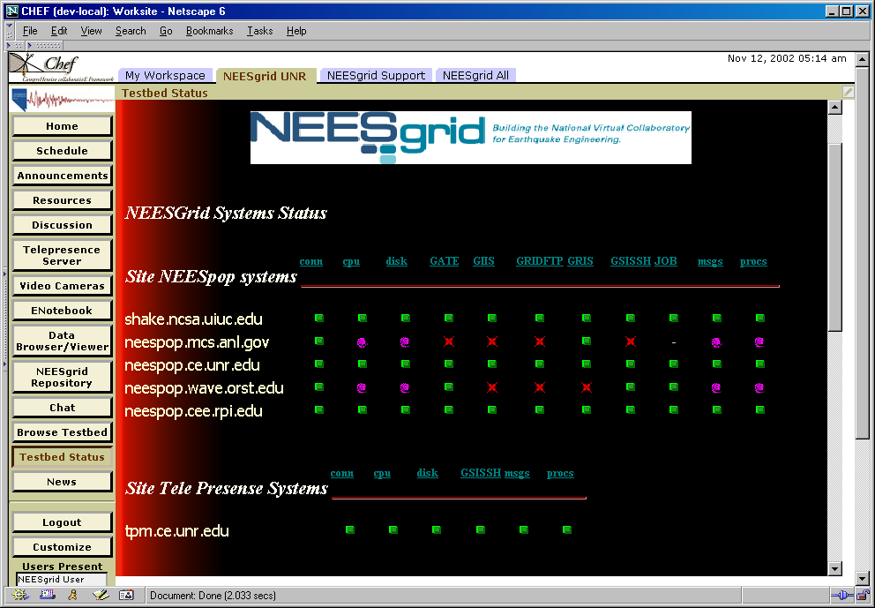
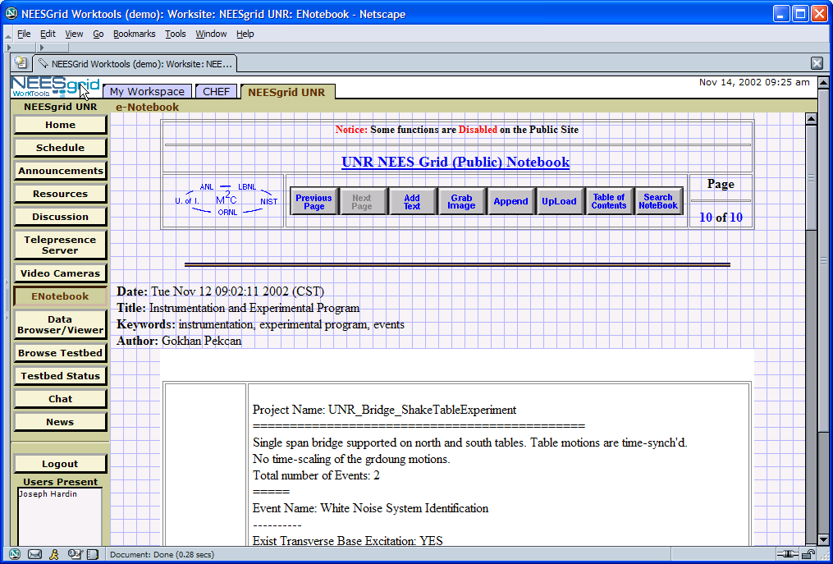
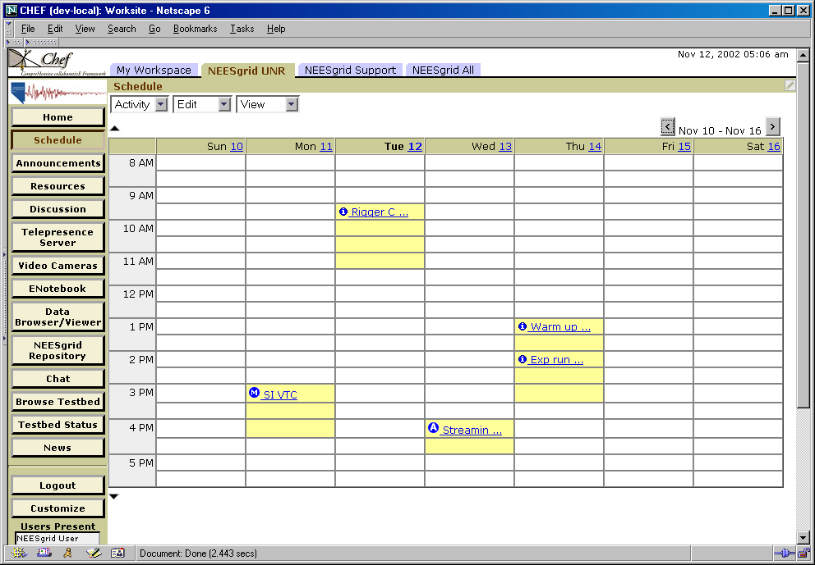

Slide 8

CHEF and Jetspeed
Service
Services API
Teamlet
Portal
Engine:
Jetspeed
Velocity
Web
Server:
Tomcat
Turbine
Teamlet
Service
Teamlet
….
Service
….
Teamlet
Portlet
A portal can be created by assembling a combination of teamlets and portlets.
….
Portlet
Notes:
This applies several places in the document that this is needed – it can be placed near
Inside the CHEF web application is a Portal engine, a set of tools, a set of services, and site configuration.

Slide 9
What is a Teamlet? (vs Portlet)
Teamlet is a specific decomposition of a Portlet
  Teamlet
    Application logic
    Presentation detail
  Service
    Any type of persistent information

Slide 10
Jetspeed Implementation Choices
CHEF
Services
Portal
Engine
And
Web
Server
Jetspeed
CHEF
Tomcat
Turbine
Velocity
Teamlet
Velocity
Adapter
XML
Teamlet
XML/
XSLT
Adapter
RSS
Teamlet
RSS
Adapter
I-Frame
Teamlet
HTML
Adapter
Portlet
HTML
Adapter
Notes:
Each tool is java code that runs in the CHEF server that follows the Portlet
API…..

Slide 11
Why Velocity-style Teamlets?
Separates presentation from application logic
  Velocity Markup Language
  JAVA classes for application logic
An abstract API that has potential for non-web applications
  Event model rather than a “post”
  Explicit separation of event processing from display preparation
We imagine that it could be implemented in any java-based portal framework – upwards compatibility (more later…)

Slide 12
Velocity Adapter Interactions
Velocity
Adapter
Template
Template
Teamlet Class
Action_Method
Action_Method
Action_Method
Action_Method
Build_Method
Build_Method
State
Event
State
Notes:
Each tool is java code that runs in the CHEF server that follows the Portlet
API…..

Slide 13
The Session State
The session state is a scratch space used for a teamlet – stored by the framework
There is a separate state for each teamlet/session combination
The framework and services allow the teamlet to be “stateless”
  Framework stores session information
  Services store any persistent information
Demo if Time is available

Slide 14
CHEF Architecture
Services
Persistent
System-wide
Multiple implementations of services
Configurable as to what implementation provides what service
Services API
Teamlets:
Written in JAVA
Responsible for GUI
Operate in the context of a session.
Rely on services for any persistent or “cross-user” information.
Portal
Engine:
Jetspeed
Velocity
CHEF
Web
Server:
Tomcat
Turbine
Servlets:
Access services outside of the portal engine: AccessServlet and WebDavServlet
Non-HTTP Components (i.e. E-Mail)
Notes:
This applies several places in the document that this is needed – it can be placed near
Inside the CHEF web application is a Portal engine, a set of tools, a set of services, and site configuration.

Slide 15
Services
Long-term lifecycle
One instance
  Must be aware that multiple users can use service
  Can use memory resident information
Contains as much of the implementation as possible
Pluggable implementations
  Memory version
  XML implementation
  Web services implementation
  Database implementation

Slide 16
Service Implementations
Service
Implementation
Service API
Teamlet
Portal
Engine
Service
Implementation
Service
Implementation
The API is an Interface – There can be any number of different service implementations which implement the Interface.
Notes:
There are three elements to CHEF services which a teamlet interacts with:
The Service API which defines the properties and methods of the service.
The Service Component which is the actual implementation of the service.
Core Components are the objects which are exchanged between the services and the teamlets.
The properties file determines which Service Components are user for each Service API. At runtime, the Teamlet consults Turbine to get the Service API to the appropriate Service Component.

Slide 17
Configuring and Finding Services
chef.properties
Turbine Service
Broker
Service
Components
Service API
Teamlet
Portal
Engine
The chef.properties file associates a particular service implementation with its service API at run-time. The teamlet uses Turbine to find the service at runtime.
Notes:
There are three elements to CHEF services which a teamlet interacts with:
The Service API which defines the properties and methods of the service.
The Service Component which is the actual implementation of the service.
Core Components are the objects which are exchanged between the services and the teamlets.
The properties file determines which Service Components are user for each Service API. At runtime, the Teamlet consults Turbine to get the Service API to the appropriate Service Component.

Slide 18
In the beginning, we have the framework which includes Tomcat, Turbine, and Jetspeed….
Framework
Tomcat
Turbine
Jetspeed
Notes:
This applies several places in the document that this is needed – it can be placed near
Inside the CHEF web application is a Portal engine, a set of tools, a set of services, and site configuration.

Slide 19
When the framework starts up, it reads the properties file and starts the desired services…
properties
Framework
Service A
API
Service B
API
Service C
API
Notes:
This applies several places in the document that this is needed – it can be placed near
Inside the CHEF web application is a Portal engine, a set of tools, a set of services, and site configuration.

Slide 20
Each service implements a particular standardized API and will remain persistent as long as the framework stays up.
properties
Framework
Service A
API
Service B
API
Service C
API
Service D
API
Service E
API
Notes:
This applies several places in the document that this is needed – it can be placed near
Inside the CHEF web application is a Portal engine, a set of tools, a set of services, and site configuration.

Slide 21
Then the framework reads the xreg files and registers the teamlets and portlets and as appropriate.
xreg files
Framework
T1
T2
Service A
API
Service B
API
Service C
API
Service D
API
Service E
API
Notes:
This applies several places in the document that this is needed – it can be placed near
Inside the CHEF web application is a Portal engine, a set of tools, a set of services, and site configuration.

Slide 22
The teamlets are not running, they may not even be constructed – they are just waiting…
xreg files
Framework
T1
T2
T3
Service A
API
Service B
API
Service C
API
Service D
API
Service E
API
Notes:
This applies several places in the document that this is needed – it can be placed near
Inside the CHEF web application is a Portal engine, a set of tools, a set of services, and site configuration.

Slide 23
Waiting for the user to log in. Based on their screen layout, one or more teamlets is created and jumps into action, talking to services, state, and a portion of the user’s screen.
Framework
T1
T2
T3
S1
T1
Service A
API
T2
S2
Service B
API
Service C
API
Service D
API
Service E
API
Notes:
This applies several places in the document that this is needed – it can be placed near
Inside the CHEF web application is a Portal engine, a set of tools, a set of services, and site configuration.

Slide 24
While the user looks at the screen, the teamlets are quietly waiting (they may not even “exist”) and the framework is storing the session state waiting…
Framework
T1
T2
T3
S1
Service A
API
S2
Service B
API
Service C
API
Service D
API
Service E
API
Notes:
This applies several places in the document that this is needed – it can be placed near
Inside the CHEF web application is a Portal engine, a set of tools, a set of services, and site configuration.

Slide 25
Waiting for the user to press a button. Then the teamlets are woken back up, fed the session state, process the input, possibly updating a service and/or state, produce their output and then again they wait….
Framework
T1
T2
T3
S1
T1
Service A
API
T2
S2
Service B
API
Service C
API
Service D
API
Service E
API
Notes:
This applies several places in the document that this is needed – it can be placed near
Inside the CHEF web application is a Portal engine, a set of tools, a set of services, and site configuration.

Slide 26
Wait for the user.
Framework
T1
T2
T3
S1
Service A
API
S2
Service B
API
Service C
API
Service D
API
Service E
API
Notes:
This applies several places in the document that this is needed – it can be placed near
Inside the CHEF web application is a Portal engine, a set of tools, a set of services, and site configuration.

Slide 27
Wait for the user. But before she can press a button, another user logs in…
Framework
T1
T2
T3
S1
Service A
API
S2
Service B
API
Service C
API
Service D
API
Service E
API
Notes:
This applies several places in the document that this is needed – it can be placed near
Inside the CHEF web application is a Portal engine, a set of tools, a set of services, and site configuration.

Slide 28
This new user has a different screen layout which causes different teamlets to jump into action. Teamlet T1 is the same teamlet, but working in a different “context” (i.e. copy of session state). Once we deliver the screen to the user, we again wait.
Framework
T1
T2
T3
S1
Service A
API
S2
Service B
API
S1
Service C
API
T1
Service D
API
T3
S3
Service E
API
Notes:
This applies several places in the document that this is needed – it can be placed near
Inside the CHEF web application is a Portal engine, a set of tools, a set of services, and site configuration.

Slide 29
This new user has a different screen layout which causes different teamlets to run. Teamlet T1 is the same teamlet, but working in a different “context” (i.e. copy of session state). Once we deliver the screen to the user, we again wait.
Framework
T1
T2
T3
S1
Service A
API
S2
Service B
API
S1
Service C
API
Service D
API
S3
Service E
API
Notes:
This applies several places in the document that this is needed – it can be placed near
Inside the CHEF web application is a Portal engine, a set of tools, a set of services, and site configuration.

Slide 30
So, in general, there are some number of users, each with their set of session states stored in the framework waiting for some user to take some action….
Framework
T1
T2
T3
Service A
API
Service B
API
Service C
API
….
Service D
API
Service E
API
Notes:
This applies several places in the document that this is needed – it can be placed near
Inside the CHEF web application is a Portal engine, a set of tools, a set of services, and site configuration.

Slide 31
When the user takes some action, teamlets are brought into being, fed the state information, asked to do their processing, update the state, and then go away…
Framework
T1
T2
T3
Service A
API
Service B
API
Service C
API
….
Service D
API
T1
S1
Service E
API
T3
S3
Notes:
This applies several places in the document that this is needed – it can be placed near
Inside the CHEF web application is a Portal engine, a set of tools, a set of services, and site configuration.

Slide 32
And the system goes back to waiting for the next operation….
Framework
T1
T2
T3
Service A
API
Service B
API
Service C
API
….
Service D
API
Service E
API
Notes:
This applies several places in the document that this is needed – it can be placed near
Inside the CHEF web application is a Portal engine, a set of tools, a set of services, and site configuration.

Slide 33
Because we all use the same teamlet, and it is created as needed, we can easily create clustered solutions by associating users with framework systems in a round-robin/load balanced fashion without requiring any changes to teamlets.
Framework 1
Framework 2
Notes:
This applies several places in the document that this is needed – it can be placed near
Inside the CHEF web application is a Portal engine, a set of tools, a set of services, and site configuration.

Slide 34
Services are trickier however. For many services, we simply use a shared database backend. For others we must split them into a thin service which contacts the “single service” through web-services.
Framework 1
Service A
API
T3
T1
WS B
API
T2
Service B
WS
Framework 2
WS B
API
T3
T1
Service A
API
T2
Notes:
This applies several places in the document that this is needed – it can be placed near
Inside the CHEF web application is a Portal engine, a set of tools, a set of services, and site configuration.

Slide 35
Architecture Summary
Portal
  Provides session and state information
Teamlets
  Stateless user interface components
  Presentation
  Application logic
Services
  Long-term persistence
  Pluggable components

Slide 36
CHEF Grid Authentication
GRID
UserDirectory
Provider
Service
UserDirectory
Provider
CHEF
UserDirectory
Service
Component
UserDirectory
Teamlets
services.org.chefproject.service.UserDirectoryService.classname=
org.chefproject.service.component.XmlFileUserService
services.org.chefproject.service.UserDirectoryService.provider=
org.chefproject.service.component.GridUserDirectoryProvider
services.org.chefproject.service.UserDirectoryService.authenticationorder=
provider-first
Notes:
The UserDirectory and GroupDirectory services also use Turbine to find the
appropriate UserDirectoryProvider and GroupDirectoryProvider at run-time
using the same configuration mechanism as the Service API and Service
Components.

Slide 37
Extending CHEF (More detail)
Grid
Service
Component
Grid Service API
Teamlets:
MyProxy
COG
Grid
Teamlet
OGSA
COG
Grid
UserDirectory
Provider
Service
UserDirectory
Provider
CHEF
UserDirectory
Service
Component
UserDirectory
Existing CHEF
CHEF/Grid
Existing GRID
Notes:
The UserDirectory and GroupDirectory services also use Turbine to find the
appropriate UserDirectoryProvider and GroupDirectoryProvider at run-time
using the same configuration mechanism as the Service API and Service
Components.

Slide 38
Even More Authentication Detail
CHEF
Grid
Service
Component
Grid Service API
Teamlets:
Jetspeed
MyProxy
COG
NEES
Teamlet
OGSA
COG
Grid
UserDirectory
Provider
Service
UserDirectory
Provider
CHEF
UserDirectory
Service
Component
UserDirectory
Jetspeed
Login
Existing CHEF
CHEF/Grid
User
IU Portlets
LDAP
GridFTP
Proxy
Existing GRID
Jetspeed
IU Code
Notes:
The UserDirectory and GroupDirectory services also use Turbine to find the
appropriate UserDirectoryProvider and GroupDirectoryProvider at run-time
using the same configuration mechanism as the Service API and Service
Components.

Slide 39
Release 0.9
Still more boxes
PERL-GridPort
Perl-CGI
Apache
Credentials
CHEF
Grid
Service
Component
Grid Service API
Teamlets:
Jetspeed
MyProxy
COGs
NEES
Teamlet
UserDirectory
Provider
UserDirectory
OGSA
Grid
UserDirectory
Provider
Service
CHEF
UserDirectory
Service
Component
Jetspeed
Login
Existing CHEF
UM Code
User
IU Portlets
LDAP
GridFTP
Proxy
Existing GRID
Jakarta
IU Code
UT Code
Notes:
The UserDirectory and GroupDirectory services also use Turbine to find the
appropriate UserDirectoryProvider and GroupDirectoryProvider at run-time
using the same configuration mechanism as the Service API and Service
Components.

Slide 40
A Perl-GridPort
View
PERL-GridPort
Perl-CGI
Apache
Credentials
COG
Jetspeed
MyProxy
New
Portlets
??
GridPort
Jetspeed
Login
Jakarta
Perl-GridPort
Notes:
The UserDirectory and GroupDirectory services also use Turbine to find the
appropriate UserDirectoryProvider and GroupDirectoryProvider at run-time
using the same configuration mechanism as the Service API and Service
Components.

Slide 41
An Alliance/IU
View
Jetspeed
MyProxy
COG
IU
Jetspeed
Login
User
IU Portlets
LDAP
GridFTP
Proxy
Jetspeed
IU Code
Notes:
The UserDirectory and GroupDirectory services also use Turbine to find the
appropriate UserDirectoryProvider and GroupDirectoryProvider at run-time
using the same configuration mechanism as the Service API and Service
Components.

Slide 42
Dr. Chuck’s View
PERL-GridPort
Perl-CGI
Apache
Credentials
CHEF
Grid
Service
Component
Grid Service API
Teamlets:
Jetspeed
MyProxy
COGs
NEES
Teamlet
UserDirectory
Provider
UserDirectory
OGSA
Grid
UserDirectory
Provider
Service
CHEF
UserDirectory
Service
Component
Jetspeed
Login
Existing CHEF
UM Code
User
IU Portlets
LDAP
GridFTP
Proxy
Existing GRID
Jakarta
IU Code
UT Code
Notes:
The UserDirectory and GroupDirectory services also use Turbine to find the
appropriate UserDirectoryProvider and GroupDirectoryProvider at run-time
using the same configuration mechanism as the Service API and Service
Components.

Slide 43
“Portal” Standards
JSR-168 – good for portal developers – helps marketplace
  http://www.jcp.org/
  Web oriented – like servlet
  Influenced by IBM WebSphere
  Available “real soon now” for about 1.5 years
WSRP – Web Services For Remote Portals
  http://www.oasis-open.org/
  Influenced by IBM
  Application is limited to HTML portals
  Introduces standardized notion for remote State
  Good decomposition pattern – except for too html-centric
  Pretty mature – evolutionary not revolutionary

Slide 44
Portal Standards (cont.)
WSIA – Web Services for Interactive Applications / WSXL Web Services Experience Language
  http://www.oasis-open.org/
  IBM’s answer to .NET
  Enable us to code generic GUI services which can be used in HTML and non-HTML applications
  No “best practices” for decomposition
  Several years out
Jetspeed/CHEF – A good sandbox with discipline and a clear pattern
  Any real and interesting standard in this space is at least two years out with a number of risk factors
  Good pattern for profiles: Aggregation / Presentation / Teamlet / Service
  In the future, we can envision Velocity adapters to other portal environments
  GGF/CGE/OGCE Needs to focus on the service level APIs

Slide 45
Ultimate Goal State
Standardization for interchange of two types of packaged components
  User Interface
    Multiple presentation
    components
  Portal Service
User Interface Package
<gui>
<wml blah…>
<html blah...>
<swing blah…>
<services-req’d blah…>
</gui>
Portal Service Package
<broker>
Blah
</broker>
User Interface
Component
WML
Component
Portal Service
Component
HTML
Component
Swing
Component

Slide 46
Hosting Framework
A portal will require a standardized hosting environment for both User Interface and Portal Service packages
  GUI Framework APIs
  Service Broker APIs
UI
WML
HTML
Swing
Standardized Hosting Framework
Service
GUI Framework
Service Broker
Service
UI
WML
HTML
Swing
Service
UI
WML
HTML
Swing

Slide 47
Assembling a Portal
A portal will require a standardized hosting environment for both User Interface and Portal Service packages
  Install GUI Framework APIs
  Install Service Broker APIs
UI
WML
HTML
Swing
Standardized Hosting Framework
Service
GUI Framework
Service Broker
Service
UI
WML
HTML
Swing
Service
UI
WML
HTML
Swing

Slide 48
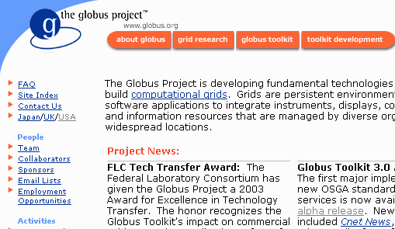

Portal At Run Time
The hosting framework provides services to all of the components
  User Interface
  Presentation
  Service
The components are connected using standardized APIs as appropriate by the hosting framework
Standardized Hosting Framework
GUI Framework
Service Broker
HTML
Component
User Interface
Component
Portal Service
Component
WML
Component

Slide 49
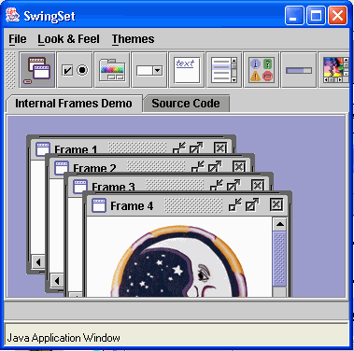
Future State
Standardize full scope of hosting framework
Packages usable in multiple environments
HTML Framework
GUI
Broker
HTML
UI
Service
UI
WML
WML
HTML
Swing
SWING Framework
Service
GUI
Broker
SWING
UI
Service

Slide 50
Jetspeed Architecture
Separation of presentation from logic
Container structure for interchange of portlets with some manual configuration
Portal GUI Assembly

Slide 51
CHEF Architecture
Ability to exchange portlets, teamlets, or service components
Flexible architecture allows easy integration of existing components while giving framework for developing new-style components
Ways for all of us to build tools we find interesting while taking full advantage of the rest of the (already built) infrastructure.
Long term viability of development efforts through ultimate standardization

Slide 52
Current Status CHEF/Grid
http://www.chefproject.org/project/src/NEESGrid/
Version 0.5 released – 10/11/2002
Version 0.8 Alpha released – 01/06/2003
  COG 0.9.13 OGSA Technology Preview 3
Version 0.9 release “Beta” – Few weeks from now
  Three variants will be maintained
    COG 0.9.13 - (GT 2 / OldMyproxy)
    COG 1.0 - (GT2 / NewMyProxy)
    COG 1.1 OGSA GT3 Alpha (January) + OGCE Compatibility Module
  Modified IU Code
  Implicit GridPort Authentication (likely)
Version 1.0 Release Bug Fixes Primarily

Slide 53
Conclusion
Our next generation of portals needs to be architected with three layers
  Presentation
  Application logic (Portlets)
  Services
The future is very exciting for portals
  If we want to start now, we should use Jetspeed, and once you get started with Jetspeed take a look at CHEF/Grid
  Transition for UT’s GridPort
  That way we approach the future as a flock
Thanks for your time - csev@umich.edu

