Slide 1
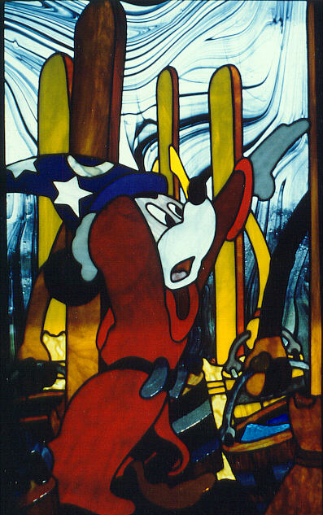
CHEF Architecture
Charles Severance
CHEF Architect’s
Apprentice

Slide 2

CHEF Architecture
Services
Persistent
System-wide
Multiple implementations of services
Configurable as to what implementation provides what service
Services API
Teamlets:
Written in JAVA
Responsible for GUI
Operate in the context of a session.
Rely on services for any persistent or “cross-user” information.
Portal
Engine:
Jetspeed
Velocity
CHEF
Web
Server:
Tomcat
Turbine
Servlets:
Access services outside of the portal engine: AccessServlet and WebDavServlet
Non-HTTP Components (i.e. E-Mail)
Notes:
This applies several places in the document that this is needed – it can be placed near
Inside the CHEF web application is a Portal engine, a set of tools, a set of services, and site configuration.

Slide 3
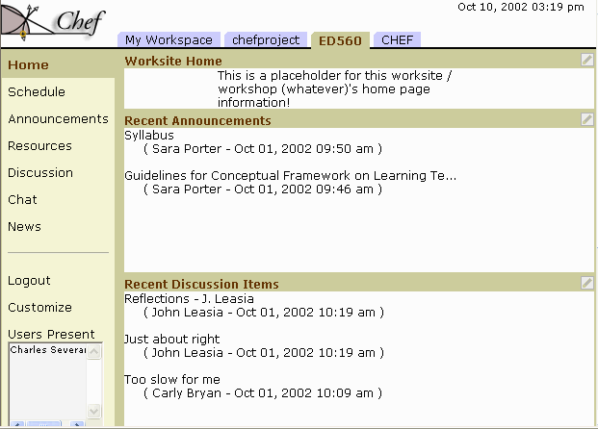
CHEF: Portal Page Navigation
Jetspeed
Portal
Teamlets (3)
CHEF: Tool selection
Notes:
Insert this near:
Different Portal Pages can be defined in a CHEF site. Each user has access to a "Workspace". Each group (work group, class, etc) has access to a "Worksite". Both are portal pages. Portal pages are collections of tools configured into sets of layouts.

Slide 4
CHEF and Jetspeed
Service
Services API
Teamlet
Portal
Engine:
Jetspeed
Velocity
CHEF
Web
Server:
Tomcat
Turbine
Teamlet
Service
Teamlet
….
Service
….
Teamlet
Portlet
A portal can be created by assembling a combination of teamlets and portlets.
….
Portlet
Notes:
This applies several places in the document that this is needed – it can be placed near
Inside the CHEF web application is a Portal engine, a set of tools, a set of services, and site configuration.

Slide 5
What is a Teamlet? (vs Portlet)
Teamlet is a specific decomposition of a Portlet
  Teamlet
    Application logic
    Presentation detail
  Service
    Any type of persistent information

Slide 6
Jetspeed Implementation Choices
CHEF
Services
Portal
Engine
And
Web
Server
Jetspeed
CHEF
Tomcat
Turbine
Velocity
Teamlet
Velocity
Adapter
XML
Teamlet
XML/
XSLT
Adapter
RSS
Teamlet
RSS
Adapter
I-Frame
Teamlet
HTML
Adapter
Portlet
HTML
Adapter
Notes:
Each tool is java code that runs in the CHEF server that follows the Portlet
API…..

Slide 7
Why Velocity-style Teamlets?
Separates presentation from application logic
  Velocity Markup Language
  JAVA classes for application logic
An abstract API that has potential for non-web applications
  Event model rather than a “post”
  Explicit separation of event processing from display preparation
We imagine that it could be implemented in any java-based portal framework – upwards compatibility (more later…)

Slide 8
Velocity Adapter Interactions
Velocity
Adapter
Template
Template
Teamlet Class
Action_Method
Action_Method
Action_Method
Action_Method
Build_Method
Build_Method
Context
Event
Context
Notes:
Each tool is java code that runs in the CHEF server that follows the Portlet
API…..

Slide 9
The Context
The context is a scratch space used for a teamlet
There is a separate context for each teamlet/session combination
The context, coupled with services allows the teamlet to be “stateless”
  Context contains the session information
  Services store any persistent information

Slide 10
Services
Long-term lifecycle
One instance
  Must be aware that multiple users can use service
  Can use memory resident information
Pluggable implementations
  Memory version
  XML implementation
  Web services implementation
  Database implementation

Slide 11
Service Implementations
Service
Implementation
Service API
Teamlet
Portal
Engine
Service
Implementation
Service
Implementation
The API is an Interface – There can be any number of different service implementations which implement the Interface.
Notes:
There are three elements to CHEF services which a teamlet interacts with:
The Service API which defines the properties and methods of the service.
The Service Component which is the actual implementation of the service.
Core Components are the objects which are exchanged between the services and the teamlets.
The properties file determines which Service Components are user for each Service API. At runtime, the Teamlet consults Turbine to get the Service API to the appropriate Service Component.

Slide 12
Configuring and Finding Services
chef.properties
Turbine Service
Broker
Service
Components
Service API
Teamlet
Portal
Engine
The chef.properties file associates a particular service implementation with its service API at run-time. The teamlet uses Turbine to find the service at runtime.
Core
Components
Notes:
There are three elements to CHEF services which a teamlet interacts with:
The Service API which defines the properties and methods of the service.
The Service Component which is the actual implementation of the service.
Core Components are the objects which are exchanged between the services and the teamlets.
The properties file determines which Service Components are user for each Service API. At runtime, the Teamlet consults Turbine to get the Service API to the appropriate Service Component.

Slide 13
CHEF Architecture
Services
Persistent
System-wide
Multiple implementations of services
Configurable as to what implementation provides what service
Services API
Teamlets:
Written in JAVA
Responsible for GUI
Operate in the context of a session.
Rely on services for any persistent or “cross-user” information.
Portal
Engine:
Jetspeed
Velocity
CHEF
Web
Server:
Tomcat
Turbine
Servlets:
Access services outside of the portal engine: AccessServlet and WebDavServlet
Non-HTTP Components (i.e. E-Mail)
Notes:
This applies several places in the document that this is needed – it can be placed near
Inside the CHEF web application is a Portal engine, a set of tools, a set of services, and site configuration.

Slide 14
Architecture Summary
Portal
  Provides session and context information
Teamlets
  Stateless user interface components
  Presentation
  Application logic
Services
  Long-term persistence
  Pluggable components

Slide 15
Authentication Architecture
Authentication is always a complex issue in any system
CHEF uses a very plug-in centric view if authentication
Even the plug-ins have plug-ins

Slide 16
User and Group Service Providers
chef.properties
Turbine Service
Broker
UserDirectory
Provider
Service
Component(s)
UserDirectory
Provider
Base
UserDirectory
Service
Component
UserDirectory
Teamlet
GroupDirectory
Provider
Service
Component(s)
GroupDirectory
Provider
Base
GroupDirectory
Service
Component
GroupDirectory
Notes:
The UserDirectory and GroupDirectory services also use Turbine to find the
appropriate UserDirectoryProvider and GroupDirectoryProvider at run-time
using the same configuration mechanism as the Service API and Service
Components.

Slide 17
CHEF Grid Authentication
GRID
UserDirectory
Provider
Service
UserDirectory
Provider
CHEF
UserDirectory
Service
Component
UserDirectory
Teamlets
Notes:
The UserDirectory and GroupDirectory services also use Turbine to find the
appropriate UserDirectoryProvider and GroupDirectoryProvider at run-time
using the same configuration mechanism as the Service API and Service
Components.

Slide 18
Extending CHEF (More detail)
Grid
Service
Component
Grid Service API
Teamlets:
MyProxy
Grid
Teamlet
OGSA
COG
Grid
UserDirectory
Provider
Service
UserDirectory
Provider
CHEF
UserDirectory
Service
Component
UserDirectory
COG
Existing CHEF
CHEF/Grid
Existing GRID
Notes:
The UserDirectory and GroupDirectory services also use Turbine to find the
appropriate UserDirectoryProvider and GroupDirectoryProvider at run-time
using the same configuration mechanism as the Service API and Service
Components.

Slide 19
Even More Detail
CHEF
Grid
Service
Component
Grid Service API
Teamlets:
Jetspeed
MyProxy
NEES
Teamlet
OGSA
COG
Grid
UserDirectory
Provider
Service
UserDirectory
Provider
CHEF
UserDirectory
Service
Component
UserDirectory
COG
Jetspeed
Login
Existing CHEF
CHEF/Grid
User
IU Portlets
LDAP
GridFTP
Proxy
Existing GRID
Jetspeed
IU Code
Notes:
The UserDirectory and GroupDirectory services also use Turbine to find the
appropriate UserDirectoryProvider and GroupDirectoryProvider at run-time
using the same configuration mechanism as the Service API and Service
Components.

Slide 20
“Portal” Standards
JSR-168 – good for portal developers – helps marketplace
  http://www.jcp.org/
  Web oriented – like servlet
  Influenced by IBM WebSphere
  Available “real soon now” for about 1.5 years
WSRP – Web Services For Remote Portals
  http://www.oasis-open.org/
  Influenced by IBM
  Application is limited to HTML portals
  Introduces standardized notion for remote Context
  Good decomposition pattern – except for too html-centric
  Pretty mature – evolutionary not revolutionary

Slide 21
Portal Standards (cont.)
WSIA – Web Services for Interactive Applications / WSXL Web Services Experience Language
  http://www.oasis-open.org/
  IBM’s answer to .NET
  Enable us to code generic GUI services which can be used in HTML and non-HTML applications
  No “best practices” for decomposition
  Several years out
Jetspeed/CHEF – A good sandbox with discipline and a clear pattern
  Any real and interesting standard in this space is at least two years out with a number of risk factors
  Good pattern for profiles: Aggregation / Presentation / Teamlet / Service
  In the future, we can envision Velocity adapters to other portal environments

Slide 22
CHEF Architecture
Widely dispersed teams with varying levels of interaction / dependence
Ways to reuse tools and/or services
Ways for all of us to extend functionality we find interesting while taking full advantage of the rest of the infrastructure.
These changes can change the core infrastructure as well.
Long term viability of development efforts

