Slide 1
Ultimate Goal State
Standardization for interchange of two types of packaged components
  User Interface
    Multiple presentation
    components
  Service
User Interface Package
<gui>
<wml blah…>
<html blah...>
<swing blah…>
<services-req’d blah…>
</gui>
Portal Service Package
<broker>
Blah
</broker>
User Interface
Component
WML
Component
Portal Service
Component
HTML
Component
Swing
Component

Slide 2
Assembling a Portal
A portal will require a standardized hosting environment for both User Interface and Portal Service packages
  Install GUI Framework APIs
  Install Service Broker APIs
UI
WML
HTML
Swing
Standardized Hosting Framework
Service
GUI Framework
Service Broker
Service
UI
WML
HTML
Swing
Service
UI
WML
HTML
Swing

Slide 3
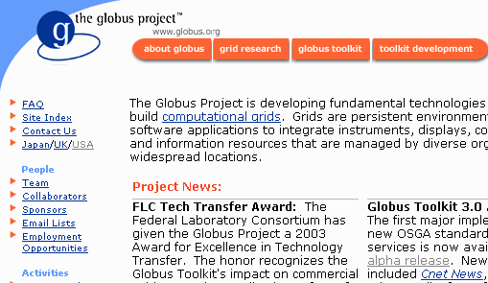

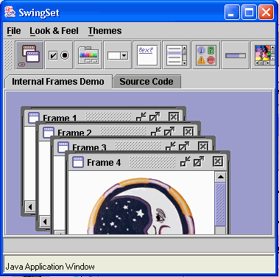
Future State of Reusable Components
Standardize full scope of hosting framework
Packages usable in multiple environments
HTML Framework
GUI
Broker
HTML
UI
Service
UI
WML
WML
HTML
Swing
SWING Framework
Service
GUI
Broker
SWING
UI
Service

Slide 4
APIs – Most not Standardized
Service Component API (OKIP Standards)
Service Broker to Service API
Service Broker to Tool API
GUI Framework to Tool API
GUI Framework to Presentation API
Presentation Component API
Standardized Hosting Framework
GUI Framework
Service Broker
Presentation
Component
User Interface
Component
Portal Service
Component

Slide 5
Possible “Presentation” Standards
JSR-168 – good for portal developers – helps marketplace
  http://www.jcp.org/
  Web oriented – like servlet
  Influenced by IBM WebSphere
  Available “real soon now” for about 1.5 years
WSRP – Web Services For Remote Portals
  http://www.oasis-open.org/
  Influenced by IBM
  Application is limited to HTML portals
  Introduces standardized notion for remote State
  Good decomposition pattern – except for too html-centric
  Pretty mature – evolutionary not revolutionary

Slide 6
Presentation Standards (cont.)
WSIA – Web Services for Interactive Applications / WSXL Web Services Experience Language
  http://www.oasis-open.org/
  IBM’s answer to .NET
  Enable us to code generic GUI services which can be used in HTML and non-HTML applications
  No “best practices” for decomposition
  Several years out
Jetspeed/CHEF – A good sandbox with discipline and a clear pattern
  Any real and interesting standard in this space is at least two years out with a number of risk factors
  Good pattern for profiles: Aggregation / Presentation / Teamlet / Service
  In the future, we can envision Velocity adapters to other portal environments
  GGF/CGE/OGCE Needs to focus on the service level APIs

Slide 7
CHEF Architecture
Ability to exchange portlets, teamlets, or service components
Flexible architecture allows easy integration of existing components while giving framework for developing new-style components
Ways for all of us to build tools we find interesting while taking full advantage of the rest of the (already built) infrastructure.
Long term viability of development efforts through ultimate standardization

Slide 8
Conclusion
Our next generation of portals needs to be architected with three layers
  Presentation
  Application logic (Portlets)
  Services
The future is very exciting for portals
  If we want to start now, we should use Jetspeed, and once you get started with Jetspeed take a look at CHEF/Grid
  Transition for UT’s GridPort
  That way we approach the future as a flock
Thanks for your time - csev@umich.edu

