Slide 1
Using the Collaborative Tools in NEESgrid
Charles Severance
University of Michigan

Slide 2
Outline
Creating the NEESpop
CHEF Overview
CHEF Collaborative Tools
Adapting CHEF to to the Grid
  Plug In Architecture
  Design Patterns - Teamlet / Servlet / Applet
The NMI Grid Portal

Slide 3
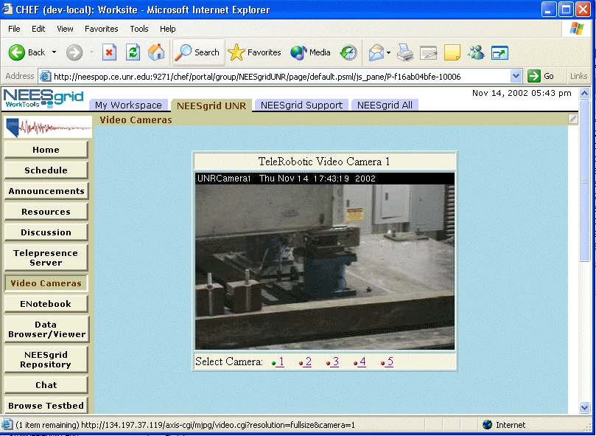
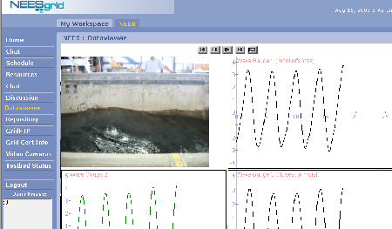
Creating the NEESpop
OGSA
Globus
COG
NEESPOP
Dist
System
Integration
CHEF
Toolkit
Open
Sees
Telepresense
New
Development
Testing

Slide 4
CHEF: A Collaboration Toolkit
Developed at University of Michigan
  CourseTools - A course management system
  WorkTools - A small-group collaborative system for researchers / scientists
All JAVA - Open Source
  Jakarta Jetspeed Portal
  Jakarta Tomcat Servlet Container
  Jakarta Turbine Service Container
Build community of developers through workshops and outreach

Slide 5
CHEF Goals
Provide a mechanism for software development which will allow organizations to share and re-use each other’s work
Utilize existing technologies wherever possible and add value rather than invent all new
Provide core toolset so that domain-specific tools can be added to add value
Desire to compose tools in a flexible manner on the web leads to portal technology - Jetspeed

Slide 6
Not “just” a portal
Portals are a framework to flexibly deploy tools (aka rectangles) and focus on how the user wants to arrange their own “rectangles”
While CHEF technically is a portal, the goal is for the tools to work together closely and seem to really be parts of a larger “tool”
CHEF has a lot of features, (services, presence, notification, etc..) which bridge the gap between portal and application framework

Slide 7
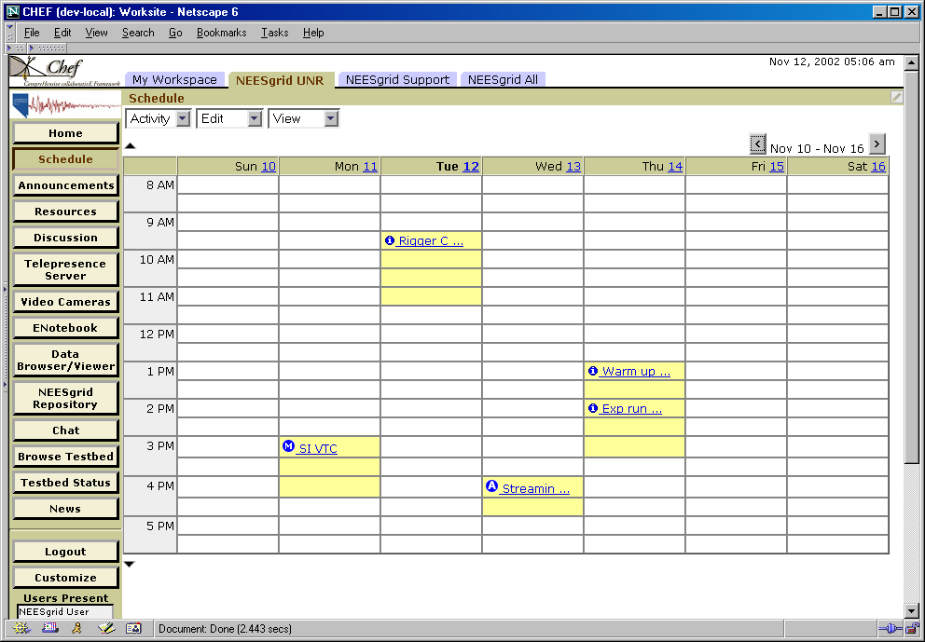
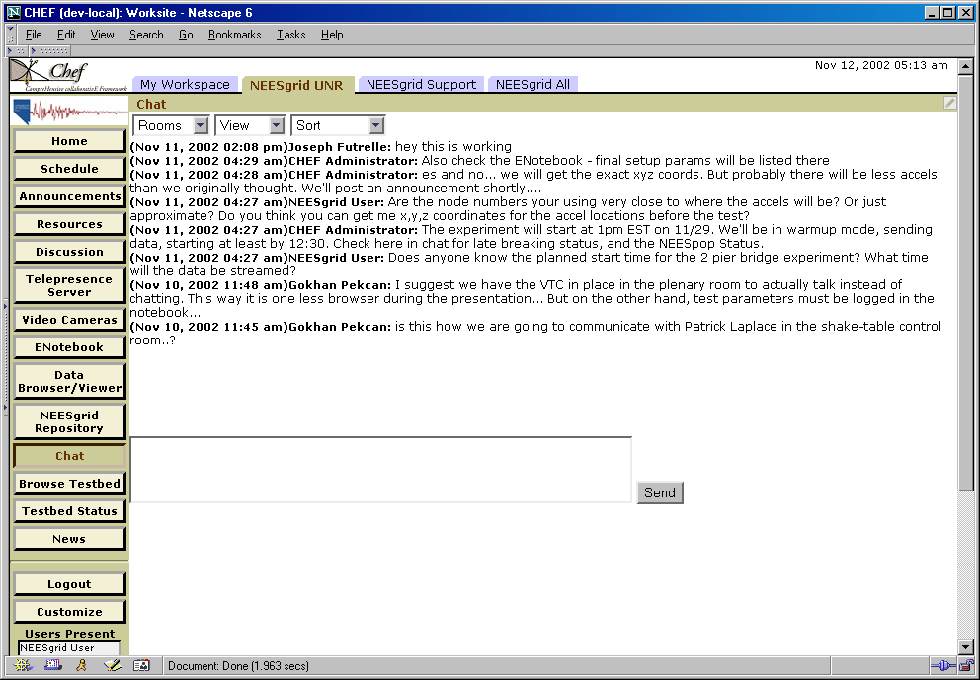
CHEF General Tools
  Announcements
  Chat
  Threaded Discussion
  Calendar
  Schedule
  E-Mail Archive
  Resources (including WebDav)
  Web-Frame
  Worksite Setup
  Profile
  Notifications / Subscriptions
  Public View
  Anonymous Comment

Slide 8
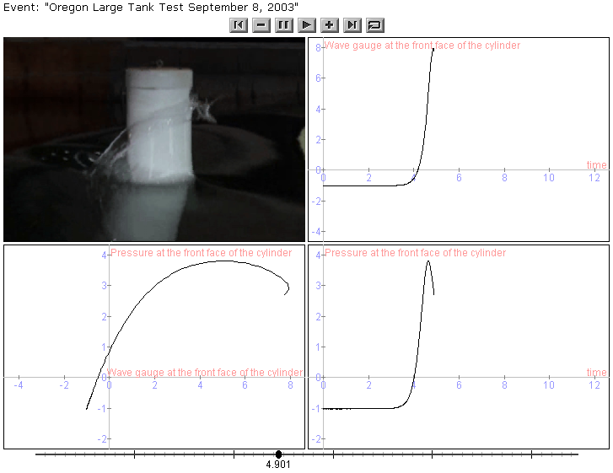
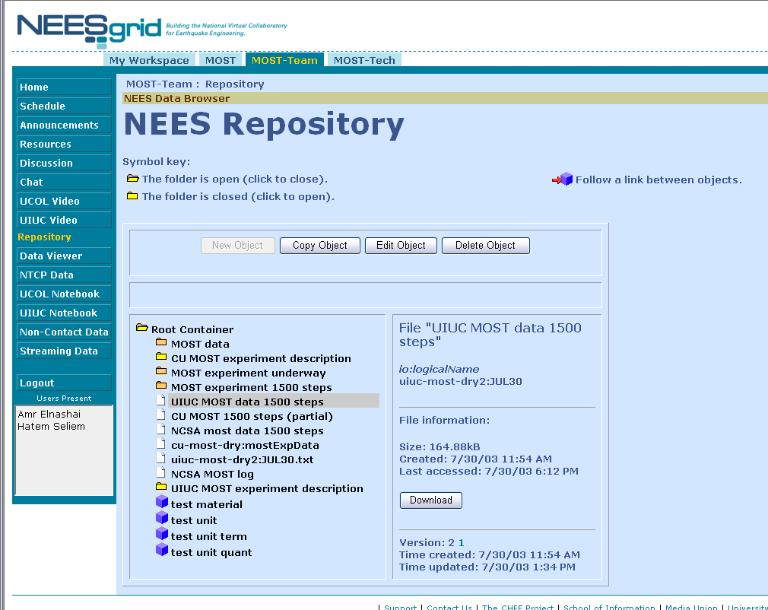
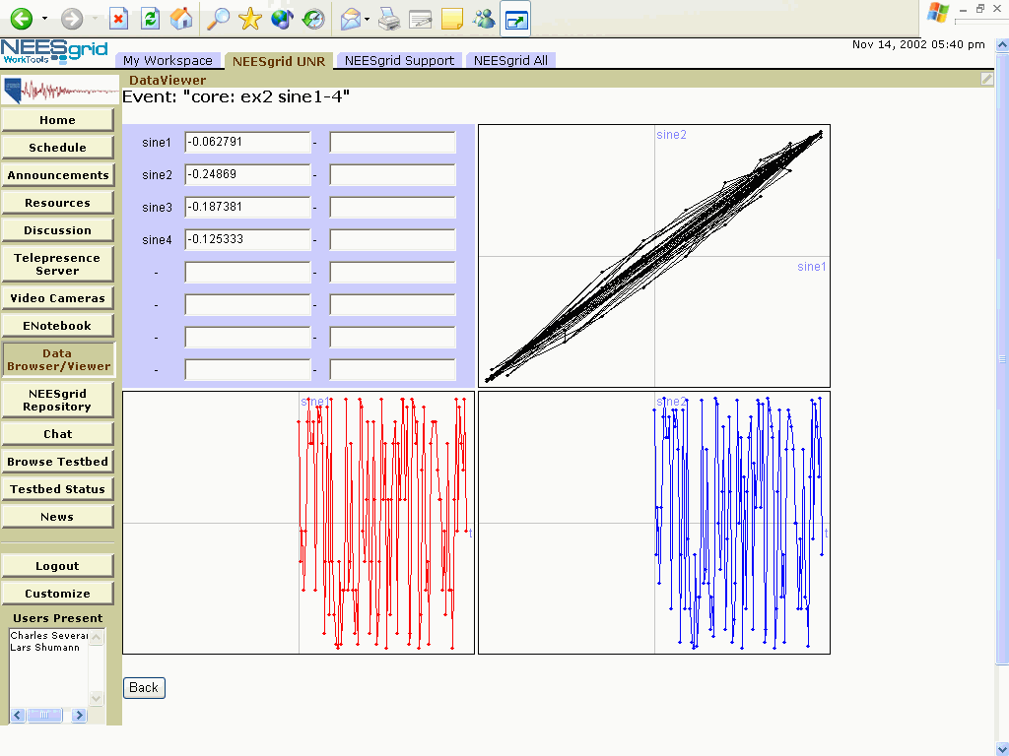
CHEF - More tools
NEES Tools
  Data Viewers (Live/Stored)
  Telepresense
  Video as Data
  Electronic Notebook
  Data/Metadata Repository
Grid Technologies
  Grid sign on using myproxy
  Grid computational portal
  GridFTP
  ..Many more

Slide 9
CHEF Implementation Architecture
Tomcat Servlet Container
Jetspeed Portal
Velocity
CSS
Tool
(Portlet)
Servlet
Turbine Framework
Turbine
Service
Turbine
Service
Turbine
Service
In CHEF presentation details are handled in Velocity and tools make use of services to access any type of persistent information. Which service implementation is used is determined at run-time so we “plug-in” new personalities without changing any of the tools.

Slide 10
Adding Grid Infrastructure to CHEF
Grid Service API
Tools
Jetspeed
Tomcat / Apache
CHEF
Grid
Service
Component
MyProxy
COGs
Grid
UserDirectory
Provider
Service
UserDirectory
Provider
CHEF
UserDirectory
Service
Component
UserDirectory
Jetspeed
Login
Existing CHEF
New Code
User
IU Portlets
LDAP
GridFTP
Proxy
Existing GRID
IU Code
Notes:
The UserDirectory and GroupDirectory services also use Turbine to find the
appropriate UserDirectoryProvider and GroupDirectoryProvider at run-time
using the same configuration mechanism as the Service API and Service
Components.

Slide 11
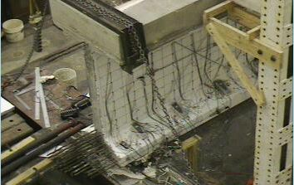
CHEF Design Pattern
To enable browser-based applets to perform GRID operations we used a combination of the Teamlet (tool) which generated the HTML, an Applet which runs in the browser with access to the session cookie, and a Servlet which uses session information to retrieve the proper credential to perform GRID operations.
HTML
Applet
Session
Cookie
<
+
>
Tomcat
Jetspeed
Viewer
Tool
Servlet
Session
Service
Framework
Credential
Grid
Service
Credential
….
Credential
GRID

Slide 12
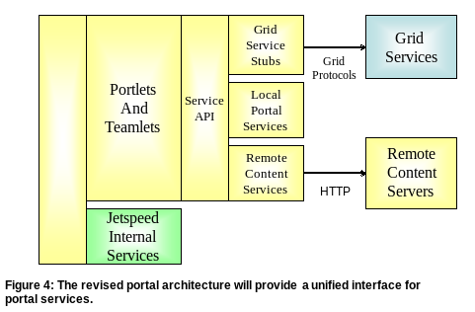
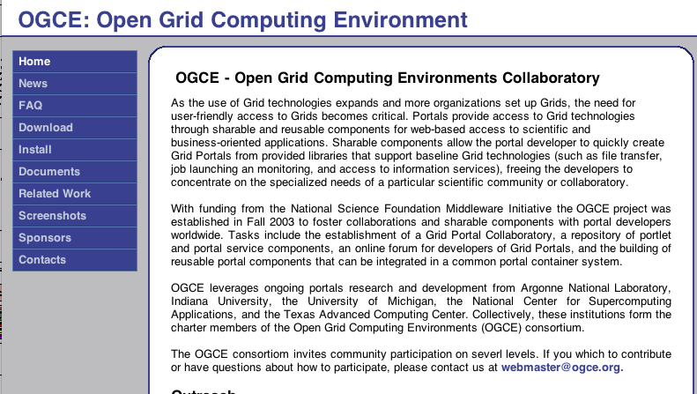
NMI / OGCE
www.ogce.org
NSF National Middleware Iniative
Indiana, UTexas, ANL, UM, NCSA

Slide 13
Creating the NEESpop
OGSA
Globus
COG
NEESPOP
Dist
System
Integration
CHEF
Toolkit
Open
Sees
Telepresense
New
Development
Testing

Slide 14
NMI Grid Portal
OGSA
Globus
COG
NMI
Dist
System
Integration
CHEF
Toolkit
Gridport
Alliance
Portal
Testing
Workflow
Presentation Thursday at 4:30

Slide 15
Summary
By using the basic collaboration tools provided by CHEF, NEESgrid has been able to focus development effort on the new software elements for NEESgrid
Because CHEF is based on Jetspeed, we have been able to use other Jetspeed components from ANL and Indiana
By using a modular component-based approach to adding GRID capability to CHEF we have been able use this technology to create the first release of the NMI Grid Portal.
URLs
  http://www.neesgrid.org/
  http://www.chefproject.org/

