Slide 1
Sakai Architecture
Mellon Retreat
Charles Severance
University of Michigan

Slide 2
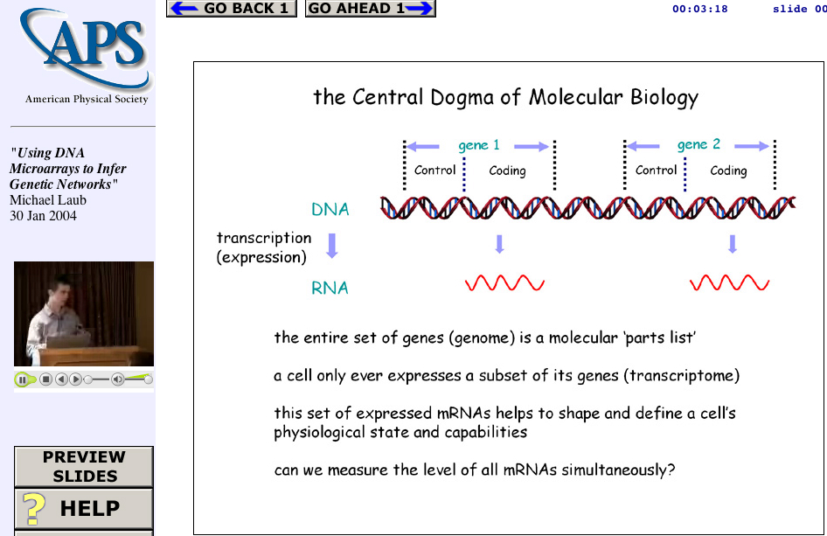
Secret plan: Someday, I want to write one tool and have a place to publish it!
Web Lecture
Archive
Project
www.wlap.org
Tools
And
Technologies
Tools
And
Technologies
Lecture
Object

Slide 3
Sakai Deliverables (with names)
Tool Portability Profile - A book on how to write Sakai-compliant services (Chuck)
Tool Functionality Profile - A book on the features of the Sakai-developed tools (Rob)
Sakai Technology Release - O/S LMS (Glenn)
  Sakai Technology Framework
  Sakai Tools and Services
  Integration, QA, and Release Management

Slide 4
Portability Profile Components
Tools
  JSF Faces GUI Layer (replacing XUL…)
  JSR 168 Portlet
  JSR Servlet Standard
Services
  Level 1-3 Inversion of Control (dependency injection)
  Spring, Pico, OKI, Avalon, Turbine,
Storage / Caching / Scaling
  J2EE / EJB / Jboss - Stateless Session / Entity Beans
  Hibernate (maybe)
  Need to support RDF and URI across all services
This is in progress and evolving - This is also a “sales job”

Slide 5
Sakai Architecture
Portal
Configuration
Implementations
Portal Technology
uPortal 3.0
JSR-168 Technology
Legacy
JSF GUI
Portable code
Sakai Service Layer
Channels,
Teamlets
JSR-168
Portlets
Sakai
Portlet
Sakai GUI Layer
Mega-portable code
CHEF
Services
OKI
Services
Sakai
Services

Slide 6
GUI: Java Server Faces
tool_bean
view
get…()
Service API (OSID)
Render
set…()
processAction…()

Slide 7
Sakai: Thorny Issues
How to store information in a way that is both efficient/fast and flexible/reusable - perhaps RDF/URI is a unifying approach to finding and reusing content? (this must be fast)
How to handle many repositories (Dspace, Fedora, JSR-170) though one API?
How to take the OKI APIs and add sufficient detail (out-of-band-agreements) so as to make it clear how to write tools?
How to make AUTHZ scalable, fast, portable, and interoperable?

Slide 8
Use an Object Store?
External
Portfolio
Tool
Chandler
Tool
DRAPI
AUTHZ
AUTHN
Object Store
RDF/URI

Slide 9
Use RDBMS?
External
Portfolio
Tool
Chandler
Tool
DRAPI
AUTHZ
AUTHN
RDBMS
????
RDF/URI

Slide 10
RDBMS + “RDF” APIs
External
Portfolio
Tool
Chandler
Tool
DRAPI
AUTHZ
AUTHN
RDF/URI
RDBMS
Until we are sure based on development experience - this will be TBD - One thing for sure - we will not sacrifice performance for architectural elegance

Slide 11
“Out-Of-Band Agreements”
OKI does not specify many schema details for lots of objects to maintain flexibility. The OKI API leaves these details to be worked out between the tool developers and the OSID implementers. The Sakai project will decide on these schema-like issues and publish them. But dealing with schema’s directly is often painful and leads to thick and hard-to-modify tools….
Tool
DRAPI
AUTHZ
AUTHN
Object Store

Slide 12
Federated Interfaces
OKI/Sakai
Tool I
Federated
DR API
Local
DR API
Fedora
DR API
…
DSpace
DR API
DB
Fedora
DSpace

Slide 13
Façade/Schema/Semantic Layer
Sakai will define build convenience classes (facades …) which enforce semantic details of the Sakai out-of-band agreements on the OKI APIs. Not all OKI APIs will have facades, Applications will be able to communicate directly with the OKI APIs as necessary, the façade mapping may not always be one-to-one. Specs like IMS and LOM will influence these schema decisions within Sakai. The goal is to keep tools easy, clean, and portable. Because the façade classes use OKI APIs, they can move into non-Sakai OKI compliant environments.
Tool
org.sakai
org.sakai
DRAPI
AUTHZ
AUTHN
Object Store

Slide 14
Fast, Flexible, Portable, Modular AUTHZ
And then a miracle happens…
P.S. This is intimately related to the repository choice…
P.P.S. There is an amazing number of repository projects where access control is in the next release.

Slide 15
Sakai 1.0 Contents
Complete Framework including JSF to Portlet Rendering and JSR-168 uPortal (2.3, 3.0)
All of the CHEF tools and services in legacy mode
Three new TPP compliant tools: Navigo (Assessment), DR Tool, and Gradebook(tbd).
Seamless look and feel between legacy and TTP-compliant tools
Complete Portability Profile “book”
Ready to deploy as LMS
Ready to use as a development platform with rich sample applications
Nearly complete implementation of OKI OSIDs, façade classes, and full interoperability with CHEF services

Slide 16
Sakai Milestones
2/15 Framework Technology (SFT) - Tech Preview 1
2/19 All Hands Workshop + Portability Profile (TPP) D2
2/27 SEPP: SFT TP1 + TPP D2 + Tool Functionality (TFS) D1
3/27 SFR Beta 1 + TPP Beta + TFS D2
4/30 TFS D2 + non-TPP Navigo Released
5/1 Sakai 1.0 Beta 1
5/12 SEPP: Sakai Beta
Final form except for partial TPP Navigo
6/15 SEPP: Workshop + Public Beta
7/15 Sakai 1.0 Public Release
CHEF Tools (12) + TPP Navigo + TPP tools (2)
8/15 Pilot efforts begin at partner institutions
9/1 Sakai 2.0 Development Begins
6/1/2005 Sakai 2.0 Released (many interim releases)

Slide 17
Sakai 2.0
Complete replacement of legacy tools
  TPP Compliant, using OKI and Sakai APIs
  Specs based on the TFS - tools will be richer and deeper
  Each partner institution will focus on a set of tools to develop
SEPP partners will be involved in the new tool development based on ability and commitment.

Slide 18
If I were in charge… *
uPortal, OSPI, OKI, AAM, Navigo - Already locked-on
Dspace, Fedora, DL, LionShare, Chandler
  Federation, OKI DR API, JSR-170, help in the endless search for DR performance
Lionshare - Understand/explore horizontal collections
Shibboleth /Pubcookie - Anonymity is not the only goal of a WEBISO technology, we need more than just a single sign-on - we need a way to validate credentials that we hold - as we move from the browser to the desktop (WebDAV …) we need genuine credentials in applications
Chandler - Pick integration technologies (iCal, Jabber, … ) lets work together on understanding façade requirements - lets work together on the cross-parcel chrome even though you are Python/XUL and we are Java/JSF - common skin across Sakai / uPortal / Chandler…
Chandler/PKI - Look at the new WS-Resource and WS-Notification work just initiated by IBM/HP/Globus
All: Look closely at JENA, Protégé-2000 and RDF for data model definition, searching, indexing and arms-length read-only reuse - at least spend 2 weeks, build and parse a data model before discarding it.
* These would only be suggestions…

Slide 19
Institutional Lens *
* Lens metaphor borrowed liberally from Carl Jacobsen :)

Slide 20
Individual Lens
Institutional Lens
* Lens metaphor borrowed liberally from Carl Jacobsen :)

Slide 21
* Lens metaphor borrowed liberally from Carl Jacobsen :)

Slide 22

Individual Lens
Sophomore Physics Lens
* Lens metaphor borrowed liberally from Carl Jacobsen :)

Slide 23
Summary
We have a long way to go and a short time to get there…
The team we have assembled is the key - each institution brings deep and complimentary skills to the table
Previous collaboration (Navigo, OKI) over the past few years has developed respect, teamwork, and trust from the first day of Sakai
We are taking some time at the beginning to insure genuine consensus and that we truly make the right choices in the framework area.
We understand that we may make mistakes along the way and have factored this into our approach and resource allocation.
So far everyone has had an open mind and understands the “good of the many…”

Slide 24
A Vision
We will create a open-source learning management system which is competitive with commercial offerings, but at the same time create a framework, market, clearinghouse, cadre of skilled programmers, and documentation necessary to enable many organizations to focus their energy in developing capabilities/tools which advance the pedagogy and effectiveness of technology-enhanced teaching, learning, and collaboration rather than just building another threaded discussion tool as a LMS.

