Slide 1
Sakai Architecture
Charles Severance
University of Michigan

Slide 2
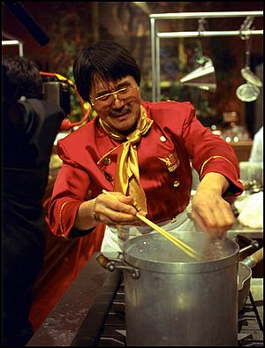
SAKAI Basics
U Michigan, Indiana U, MIT, Stanford, uPortal
  All have built portals / course management systems
  JSR-168 portlet standard requires us all to re-tool and look at new approach to portals
Course Management System Standards
  Open Knowledge Iniative (OKI) needed full implementation
  IMS standard such as Question and Testing Interoperability (QTI)
  SCORM Course Content Standard
Why not coordinate this work , do the work once, and share each others solutions?
Integrate across projects and adopt relevant standards
Collaboration at the next frontier - implementation
Tool Portability Profile (TPP)
  Truly portable tools and services
  Tools built at different places look and feel the same and share data and services
  This is difficult - Interoperability is harder than portability
Mellon Foundation funding

Slide 3
Sakai Organization
To some, the real innovation is the organization
To get these schools/institutions to adopt a central authority (Sakai Board) for resource allocation of internal as well as grant resources
Goes beyond resources from grant
Required for closely coupled open source development, the ‘seed’ software?
Part of the open source experimentation

Slide 4
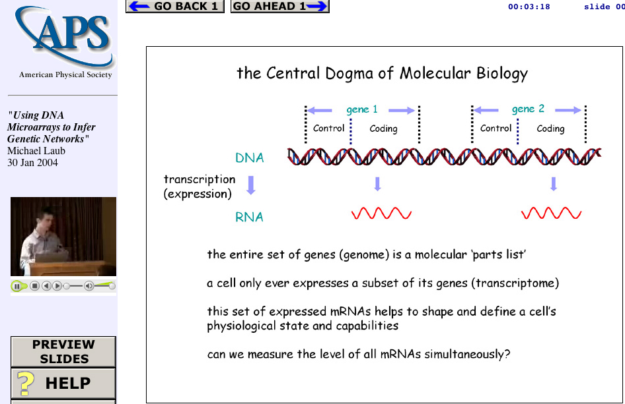
Secret plan: Someday, I see my masterpiece come to life!
Web Lecture
Archive
Project
www.wlap.org
Tools
And
Technologies
Tools
And
Technologies
Lecture
Object

Slide 5
Board
Joseph Hardin, UM, Chair & Project Manager
Brad Wheeler, IU, Vice Chair
Jeff Merriman, MIT-OKI
Amitava ’Babi’ Mitra, MIT- AMPS
Carl Jacobson -JASIG
Lois Brooks, Stanford
Tools
Rob Lowden
Technical Coord. Committee Chair
Chuck Severance
Architecture
Glenn Golden
Local Teams
Local Members
Indiana Univ.
Stanford
U of Michigan
MIT
Stanford
uPortal
Indiana Univ.
U of Michigan
MIT
uPortal

Slide 6
Open/Open Licensing
“..all work products under the scope of the Sakai initiative for which a member is counting matching contribution and any Mellon Sakai funding” will be open source software and documentation licensed for both education and commercial use without licensing fees.
Significant difference between a “product” and a “component”
Unlimited redistribution is an important aspect of a license.

Slide 7
SAKAI Overview
Jan 04
July 04
May 05
Dec 05
Activity:
Maintenance &
Transition from a
project to
a community
Michigan
CHEF Framework
CourseTools
WorkTools
Indiana
Navigo Assessment
Eden Workflow
Oncourse
MIT
Stellar
Stanford
CourseWork
Assessment
OKI
OSIDs
uPortal
SAKAI 1.0 Release
Tool Portability Profile
Framework
Services-based Portal
Refined OSIDs
& implementations
SAKAI Tools
Complete CMS
Assessment
SAKAI 2.0 Release
Tool Portability Profile
Framework
Services-based Portal
SAKAI Tools
Complete CMS
Assessment
Workflow
Research Tools
Authoring Tools
"Best of"
Refactoring
Activity: Ongoing implementation work at local institution…
Primary SAKAI Activity
Architecting for JSR-168 Portlets,
Refactoring “best of” features for tools
Conforming tools to Tool Portability Profile
Primary SAKAI Activity
Refining SAKAI Framework,
Tuning and conforming additional tools
Intensive community building/training

Slide 8
Sakai Deliverables
Tool Portability Profile - A book on how to write Sakai-compliant services
Tool Functionality Profile - A book on the features of the Sakai-developed tools
Sakai Technology Release - O/S LMS
  Sakai Technology Framework
  Sakai Tools and Services
  Integration, QA, and Release Management

Slide 9
Portability Profile Components
Tools
  JSF Faces GUI Layer
  JSR 168 Portlet
  JSR Servlet Standard
Services
  Level 1-3 Inversion of Control (dependency injection)
  Spring, Pico, OKI, Avalon, Turbine,
Storage / Caching / Scaling
  J2EE / EJB / Jboss - Stateless Session / Entity Beans
  Hibernate (maybe)
  Need to support RDF and URI across all services
This is in progress and evolving

Slide 10
Sakai Architecture
Portal
Configuration
Implementations
Portal Technology
uPortal 3.0
JSR-168 Technology
Legacy
JSF GUI
Portable code
Sakai Service Layer
Channels,
Teamlets
JSR-168
Portlets
Sakai
Portlet
Sakai GUI Layer
Mega-portable code
CHEF
Services
OKI
Services
Sakai
Services

Slide 11
GUI: Java Server Faces
tool_bean
view
get…()
Service API (OSID)
Render
set…()
processAction…()

Slide 12
Sakai: Thorny Issues
How to handle many repositories (Dspace, Fedora, JSR-170) though one API?
How to store information in a way that is both efficient/fast and flexible/reusable - perhaps RDF/URI is a unifying approach to finding and reusing content?
How to take the OKI APIs and add sufficient detail (out-of-band-agreements) so as to make it clear how to write tools?
How to make AUTHZ scalable, fast, portable, and interoperable?

Slide 13
Federated Interfaces
OKI/Sakai
Tool I
Federated
DR API
Local
DR API
Fedora
DR API
…
DSpace
DR API
DB
Fedora
DSpace

Slide 14
Use an Object Store?
External
Portfolio
Tool
Tool
DRAPI
AUTHZ
AUTHN
Object Store
RDF/URI

Slide 15
Use RDBMS?
External
Portfolio
Tool
Tool
DRAPI
AUTHZ
AUTHN
RDBMS
????
RDF/URI

Slide 16
RDBMS + “RDF” APIs
External
Portfolio
Tool
Tool
DRAPI
AUTHZ
AUTHN
RDF/URI
RDBMS
Until we are sure based on development experience - this will be TBD - One thing for sure - we will not sacrifice performance for architectural elegance

Slide 17
“Out-Of-Band Agreements”
OKI does not specify many schema details for lots of objects to maintain flexibility. The OKI API leaves these details to be worked out between the tool developers and the OSID implementers. The Sakai project will decide on these schema-like issues and publish them. But dealing with schema’s directly is often painful and leads to thick and hard-to-modify tools….
Tool
DRAPI
AUTHZ
AUTHN
Object Store

Slide 18
Façade/Schema/Semantic Layer
Sakai will define build convenience classes (facades …) which enforce semantic details of the Sakai out-of-band agreements on the OKI APIs. Not all OKI APIs will have facades, Applications will be able to communicate directly with the OKI APIs as necessary, the façade mapping may not always be one-to-one. Specs like IMS and LOM will influence these schema decisions within Sakai. The goal is to keep tools easy, clean, and portable. Because the façade classes use OKI APIs, they can move into non-Sakai OKI compliant environments.
Tool
org.sakai
org.sakai
DRAPI
AUTHZ
AUTHN
Object Store

Slide 19
Fast, Flexible, Portable, Modular AUTHZ
And then a miracle happens…

Slide 20
Sakai 1.0 Contents
Complete Framework including JSF to Portlet Rendering and JSR-168 uPortal
All of the CHEF tools and services in legacy mode
Three new TPP compliant tools: Navigo (Assessment), DR Tool, and Gradebook(tbd).
Seamless look and feel between legacy and TTP-compliant tools
Complete Portability Profile “book”
Ready to deploy as LMS
Ready to use as a development platform with rich sample applications
Nearly complete implementation of OKI OSIDs, façade classes, and full interoperability with CHEF services

Slide 21
Sakai Milestones
2/15 Framework Technology (SFT) - Tech Preview 1
2/19 All Hands Workshop + Portability Profile (TPP) D2
2/27 SEPP: SFT TP1 + TPP D2 + Tool Functionality (TFS) D1
3/27 SFR Beta 1 + TPP Beta + TFS D2
4/30 TFS D2 + non-TPP Navigo Released
5/1 Sakai 1.0 Beta 1
5/12 SEPP: Sakai Beta
Final form except for partial TPP Navigo
6/15 SEPP: Workshop + Public Beta
7/15 Sakai 1.0 Public Release
CHEF Tools (12) + TPP Navigo + TPP tools (2)
8/15 Pilot efforts begin at partner institutions
9/1 Sakai 2.0 Development Begins
6/1/2005 Sakai 2.0 Released (many interim releases)

Slide 22
Sakai 2.0
Complete replacement of legacy tools
  TPP Compliant, using OKI and Sakai APIs
  Specs based on the TFS - tools will be richer and deeper
  Each partner institution will focus on a set of tools to develop
SEPP partners will be involved in the new tool development based on ability and commitment.

Slide 23
Summary
We have a long way to go and a short time to get there…
The team we have assembled is the key - each institution brings deep and complimentary skills to the table
Previous collaboration (Navigo, OKI) over the past few years has developed respect, teamwork, and trust from the first day of Sakai
We are taking some time at the beginning to insure genuine consensus and that we truly make the right choices in the framework area.
We understand that we may make mistakes along the way and have factored this into our apprach and resource allocation.
So far everyone has had an open mind and understands the “good of the many…”

Slide 24
A Vision
We will create a open-source learning management system which is competitive with commercial offerings, but at the same time create a framework, market, clearinghouse, cadre of skilled programmers, and documentation necessary to enable many organizations to focus their energy in developing capabilities/tools which advance the pedagogy and effectiveness of technology-enhanced teaching, learning, and collaboration rather than just building another threaded discussion tool as a LMS.

