Slide 1
Sakai Project Overview
Charles Severance
University of Michigan
Feb 12, 2004

Slide 2
Pre-Sakai History
Many “competing” mature production, well-liked course management systems
  MIT Stellar (JAVA)
  Indiana University OnCourse (ASP)
  University of Michigan CTNG (Java/Jetspeed)
  Stanford CourseWorks (Java)
Differing approaches to Portals
  Indiana University (JAVA - home grown)
  UM CTNG - Jetspeed

Slide 3
More History
Different outreach approaches
  UM Workshops since 2002 - 30 sites attended
  CourseWorks adopted at 5 sites
Mellon-funded technology projects nearing completion
  uPortal - highly successful - 300 installations
  OKI - Community development of LMS API specifications

Slide 4
OKI - Specifications (not an LMS)
Strengths
  Specifications complete
  Community built
  Test implementations progressing
  Excellent “brand recognition”
Weaknesses
  Specifications too abstract - not enough detail to write truly portable code
  No production implementations by the end of the project and nothing on the horizon

Slide 5
More History
Indiana was itchin’ to rewrite their OnCourse in JAVA
Michigan was demonstrating the possibility of connecting the teaching/learning world to the research/small group collaboration world (NEESgrid, NMI and WTNG)
IU / Michigan / Stanford work on the Navigo project - got to know one another but not able to produce unified code because of the conflict between shared goals and local timelines and resources.
UM / CHEF and uPortal were getting to know one another by going to each other’s meetings, enocouraged quietly by the Mellon Foundation

Slide 6
Things were tranquil…
The world of locally developed course management systems seems pretty quiet and contented.. Except for that small cloud on the horizon.

Slide 7

Then a Butterfly Flaps its Wings
The JSR-168 Portlet Specification was released
  It solved the portable GUI problem for OKI
  It made Jetspeed/CTNG, OneStart, and uPortal instant antiques as software frameworks
  Everyone had to rethink their strategies at about the same time because of JSR-168
But this time - something was (or at least could be) different…

Slide 8
Sakai: A Perfect Storm
Because of a combination of JSR-168 release and the ending of the OKI and uPortal funding, five projects were forced to think strategically all about the same time
Because they already knew one another, they thought strategically together

Slide 9
Sakai: A Perfect Storm
Because of a combination of JSR-168 release and the ending of the OKI and uPortal funding, five projects were forced to think strategically all about the same time
Because they already knew one another, they thought strategically together
They put their magic administrator rings together and became the “learning management superteam”

Slide 10
Sakai: A Perfect Storm
Because of a combination of JSR-168 release and the ending of the OKI and uPortal funding, five projects were forced to think strategically all about the same time
Because they already knew one another, they thought strategically together
They put their magic administrator rings together and became the “learning management superteam”
First thought: “lets have a meeting about some funding”

Slide 11
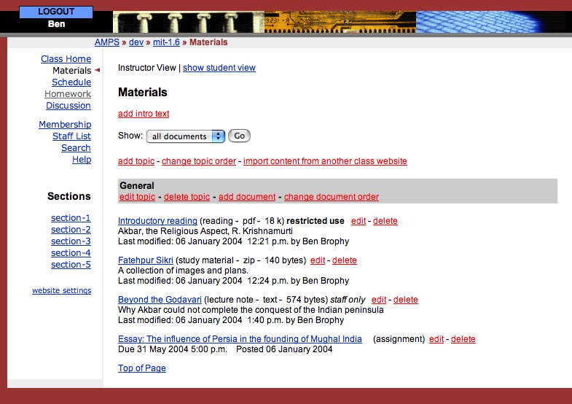
MIT’s Stellar

Slide 12
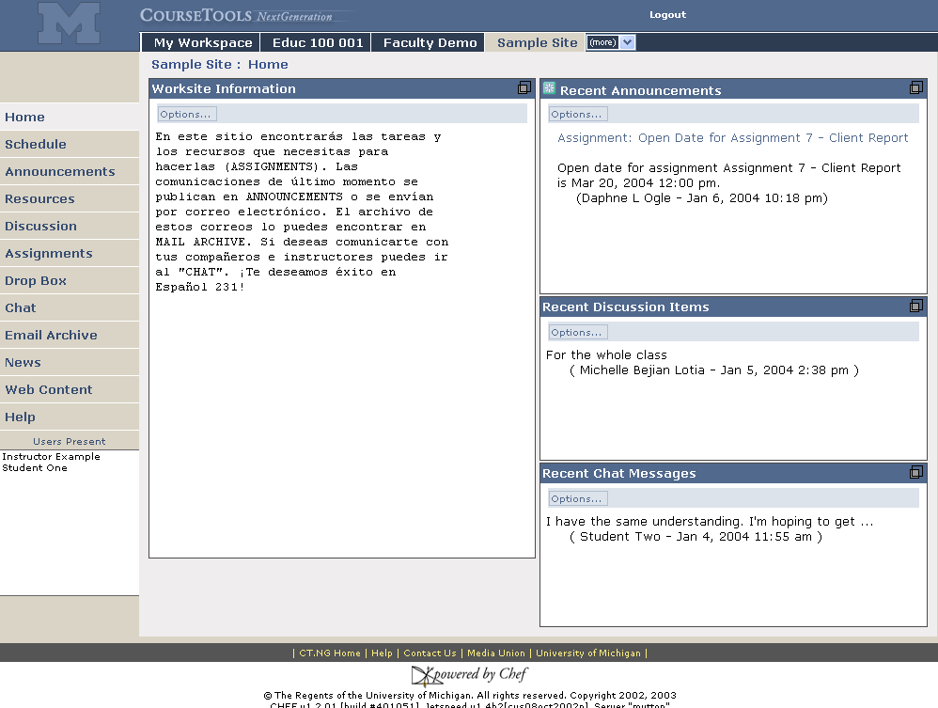
Sites are accessed via their tab
Michigan’s CTNG
Foreign Language support
Synoptic views
Customizable page menu
Presence

Slide 13
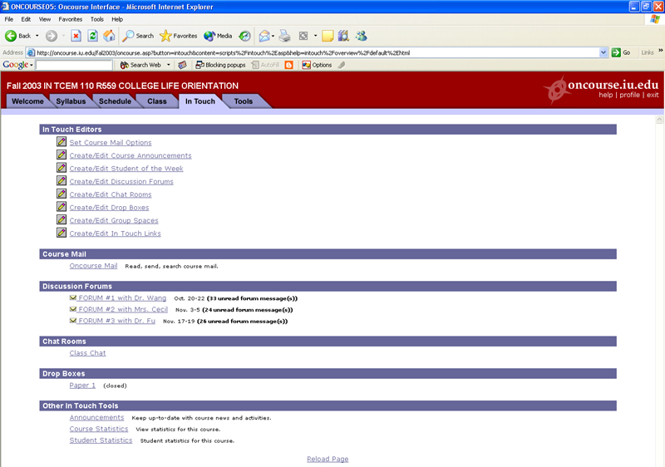
Indiana’s OnCourse

Slide 14
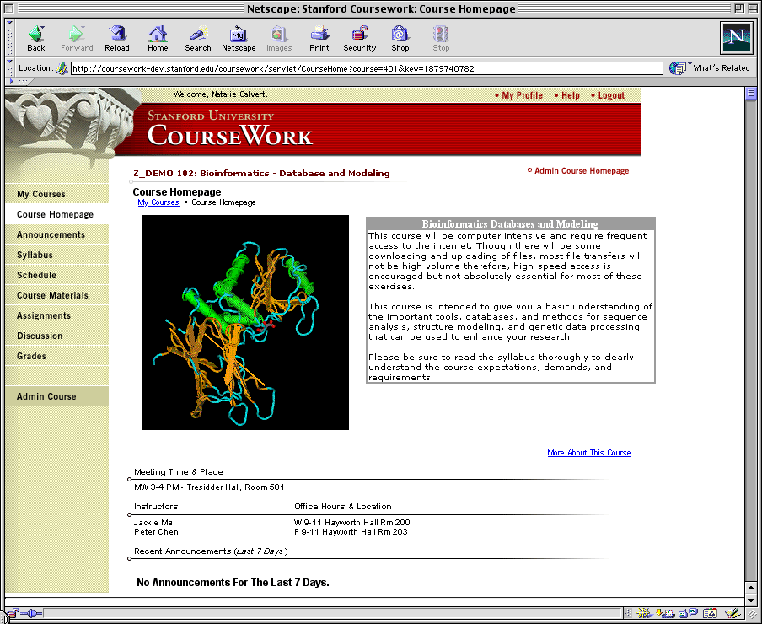
Stanford’s CourseWork

Slide 15
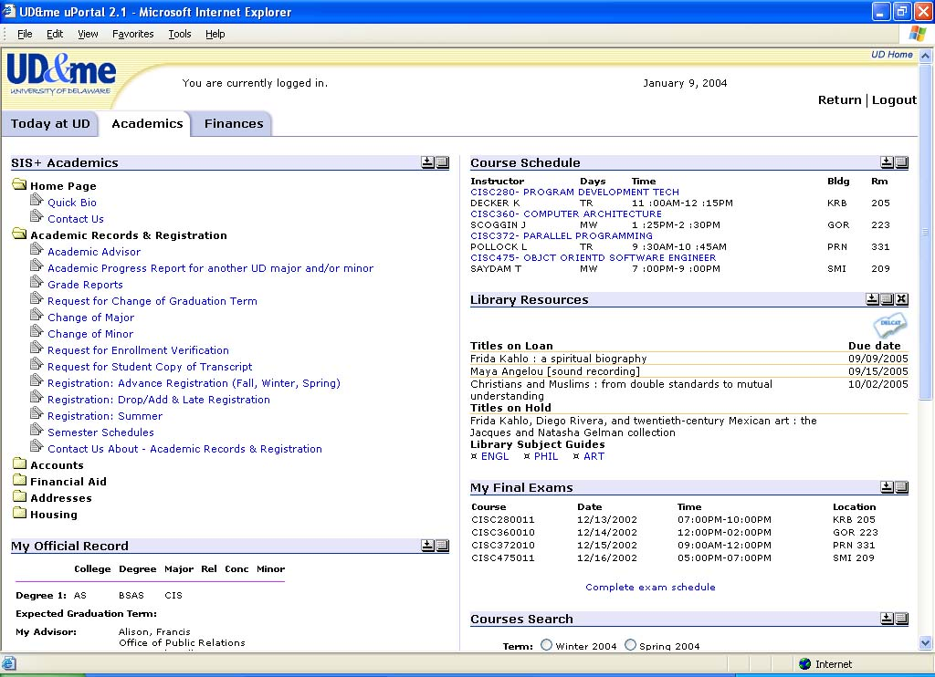
uPortal

Slide 16
OKI

Slide 17
SAKAI Picture
Jan 04
July 04
May 05
Dec 05
Activity:
Maintenance &
Transition from a
project to
a community
Michigan
CHEF Framework
CourseTools
WorkTools
Indiana
Navigo Assessment
Eden Workflow
Oncourse
MIT
Stellar
Stanford
CourseWork
Assessment
OKI
OSIDs
uPortal
SAKAI 1.0 Release
Tool Portability Profile
Framework
Services-based Portal
Refined OSIDs
& implementations
SAKAI Tools
Complete CMS
WorkTools
Assessment
SAKAI 2.0 Release
Tool Portability Profile
Framework
Services-based Portal
SAKAI Tools
Complete CMS
Assessment
Workflow
Research Tools
Authoring Tools
"Best of"
Refactoring
Activity: Ongoing implementation work at local institution…
Primary SAKAI Activity
Architecting for JSR-168 Portlets,
Refactoring “best of” features for tools
Conforming tools to Tool Portability Profile
Primary SAKAI Activity
Refining SAKAI Framework,
Tuning and conforming additional tools
Intensive community building/training

Slide 18

SAKAI Value Proposition
U Michigan, Indiana U, MIT, Stanford, uPortal
  All have built portals / course management systems
  JSR-168 portlet standard requires us all to re-tool and
  look at new approach to portals
Course Management System Standards
  Open Knowledge Initiative (OKI) needed full implementation
  IMS standard such as Question and Testing Interoperability (QTI)
Why not coordinate this work , do the work once, share each others solutions?
Integrate across projects and adopt relevant standards
Collaboration at the next frontier - implementation
Tool Portability Profile (TPP)
  Truly portable tools and services
  Tools built at different places look/feel the same, share data and services
  This is difficult - Interoperability is harder than portability

Slide 19
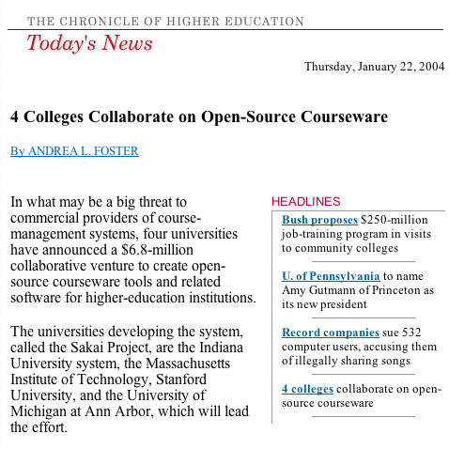

Slide 20
Sakai Deliverables
Tool Portability Profile - A book on how to write Sakai-compliant services
Tool Functionality Profile - A book on the features of the Sakai-developed tools
Sakai Technology Release - O/S CMS/LMS
  Sakai Technology Framework
  Sakai Tools and Services
  Integration, QA, and Release Management
  Developer, Single course, Small college, Enterprise
  Clean out-of-the-box experience

Slide 21
Sakai Organization
To some, the real innovation is the organization
To get these schools/institutions to adopt a central authority (Sakai Board) for resource allocation of internal as well as grant resources
Goes beyond resources from grant
Required for closely coupled open source development (the ‘seed’ software?)
Part of the open source experimentation

Slide 22
Board
Joseph Hardin, UM, Chair & Project Manager
Brad Wheeler, IU, Vice Chair
Jeff Merriman, MIT-OKI
Amitava ’Babi’ Mitra, MIT- AMPS
Carl Jacobson -JASIG
Lois Brooks, Stanford
Tools
Rob Lowden
Technical Coord. Committee Chair
Chuck Severance
Architecture
Glenn Golden
Local Teams
Local Members
Indiana Univ.
Stanford
U of Michigan
MIT
Stanford
uPortal
Indiana Univ.
U of Michigan
MIT
uPortal

Slide 23
Sakai Project Core Universities
Each Makes Commitments
  5+ developers/architects, etc. under project leadership – no local responsibility for 2 years
  Public commitment to implement Sakai
  Open/Open licensing
Project
  $4.4M in institutional staff (27 FTE)
  $2.4M Mellon Foundation
  Additional investment through partners

Slide 24
Open/Open Licensing
“..all work products under the scope of the Sakai initiative for which a member is counting matching contribution and any Mellon Sakai funding” will be open source software and documentation licensed for both education and commercial use without licensing fees.
Significant difference between a “product” and a “component”
Unlimited redistribution is an important aspect of a license.

Slide 25
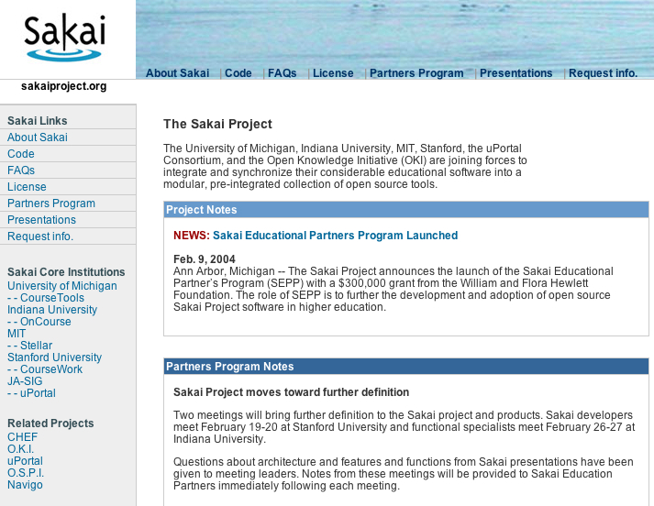

Slide 26
Sakai Educational Partner’s Program
Membership Fee: US$10K per year, 3 years
Access to SEPP staff
  Community development manager
  SEPP developers, documentation writers
Knowledgebase
Developer training for the TPP
Exchange for partner-developed tools
Strategy and implementation workshops
Early access to pre-release code
Notes:
Official launch date for SEPP services is 1 March 2004. The Core Sakai institutions will develop ensure the project deliverables are met during the 2 years of the Sakai Project. The SEPP is the long-term community to ensure Sakai’s continuing evolution and value.
Over a dozen partner institution commitments already committed to SEPP as of January 2004 (announcements soon).
Note that some estimate licensing costs of a course management system are approximately 20% of the total cost of ownership. The open source nature of Sakai means that any institution can use the Sakai software with no licensing costs or any fees whatsoever for the code. The Sakai Educational Partner’s Program provides a community to help address the other 80% of the cost of a CMS or other Sakai tool.

Slide 27
Hewlett Grant Announcement
Partners – Feb 9, 2004
Carnegie Mellon University
Columbia University
Cornell University
Foothill-DeAnza Community Colleges
Harvard University
Northwestern University
Princeton University
Tufts University
University of Colorado
University of California-Berkeley
University of California-Davis
University of California-LA
University of California-Merced
University of Hawaii
University of Oklahoma
University of Virginia
University of Washington
University of Wisconsin-Madison
Yale University
sakaiproject.org

Slide 28
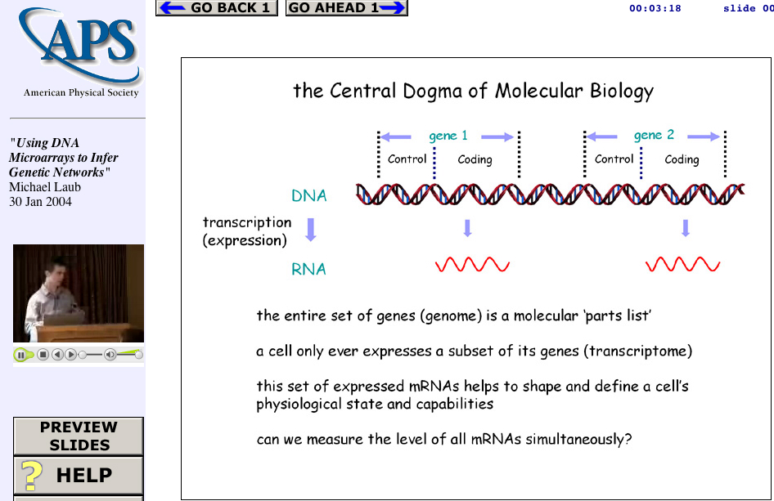
Secret plan: Someday, I want to write one tool and have a place to deploy it!
Web Lecture
Archive
Project
www.wlap.org
Tools
And
Technologies
Tools
And
Technologies
Lecture
Object

Slide 29
Summary
We have a long way to go and a short time to get there…
The team we have assembled is the key - each institution brings deep and complimentary skills to the table
Previous collaboration (Navigo, OKI) over the past few years has developed respect, teamwork, and trust from the first day of Sakai
We are taking some time at the beginning to insure genuine consensus and that we truly make the right choices in the framework area.
We understand that we may make mistakes along the way and have factored this into our approach and resource allocation.
So far everyone has had an open mind and understands the “good of the many…”

Slide 30
A Vision
We will create a open-source learning management system which is competitive with commercial offerings, but at the same time create a framework, market, clearinghouse, cadre of skilled programmers, and documentation necessary to enable many organizations to focus their energy in developing capabilities/tools which advance the pedagogy and effectiveness of technology-enhanced teaching, learning, and collaboration rather than just building another threaded discussion tool as a LMS.

