Slide 1
Sakai Project Plan
Charles Severance
University of Michigan

Slide 2
A Diverse Team
Learn from each institution’s strengths
  OKI - Life in the public eye
  UM / uPortal - Building for others to use
  MIT - Content focused CMS approach
  MIT - Experience with OCW and OKI
  Stanford - Assessment
  IU / Stanford - Requirements and design methodology
  IU - Open Source Profile Initiative

Slide 3
Project Philosophies
Consensus decision making - hopefully the right answer will previal through open discussion
Board is the “court of last resort”
We are a 30+ person startup for the next two years
We will make pragmatic decisions to move forward toward our goals
Success = a product which is equal to or better than commercial products

Slide 4
The good of the many…
This is not about foisting existing solutions across the partners
Each university will let go of their CMS by 2005 (really)
Indiana is dropping their University portal effort (OneStart)
uPortal is changing their whole portal to use JSR-168 - Their current interface will be an “adapter”

Slide 5
Major Project Phases
Architecture and Technology Research (12/03 - 03/04)
  Small group (~8) lots of communication
  Selecting, testing, and gluing underlying components
Early Development (03/04 - 06/04)
  Medium sized group (~16)
  Development of 2-3 tools with a focus on validating the architecture and technology components
  Full development of requirements begins
  Deep research into DR AUTHN and AUTHZ single implementations
Full Development (07/04 - 12/05)
  Full group compliment (30 - 50)
  Development driven by requirements in “steady-state” mode
  All tools rebuilt and new tools built
  SEPP members will volunteer for and begin building tools

Slide 6
Distributing Work Among Partners
The programming teams at each university will develop specific tools and services
As an example, instead of Michigan developing 20 tools in CTNG, they will develop 5 tools
The specifications for the tools will come from the cross-university specification team
There will be a team of integration and release led by Glenn

Slide 7
Board
Joseph Hardin, UM, Chair & Project Manager
Brad Wheeler, IU, Vice Chair
Jeff Merriman, MIT-OKI
Amitava ’Babi’ Mitra, MIT- AMPS
Carl Jacobson -JASIG
Lois Brooks, Stanford
Tools
Rob Lowden
Technical Coord. Committee Chair
Chuck Severance
Architecture
Glenn Golden
Local Teams
Local Members
Indiana Univ.
Stanford
U of Michigan
MIT
Stanford
uPortal
Indiana Univ.
U of Michigan
MIT
uPortal

Slide 8
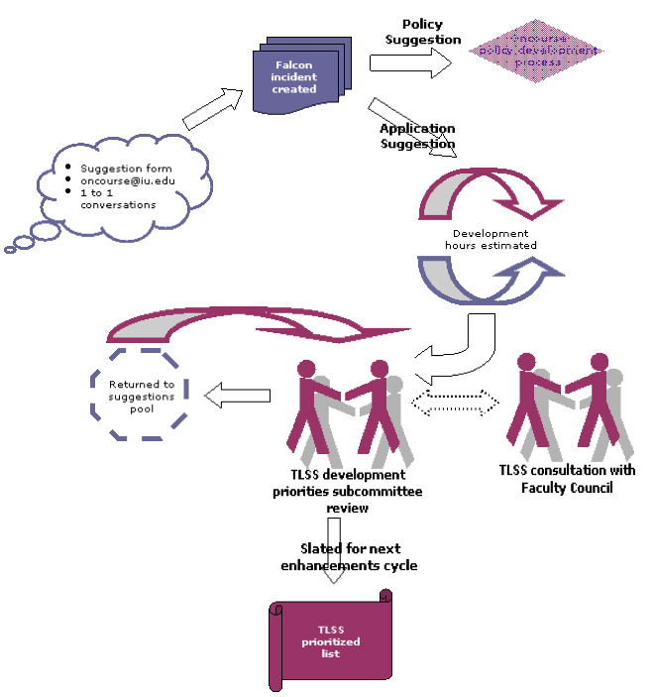
The Indiana
Requirements
Methodology
Rob Lowden
https://oncourse.iu.edu/development/enhancements.html

Slide 9
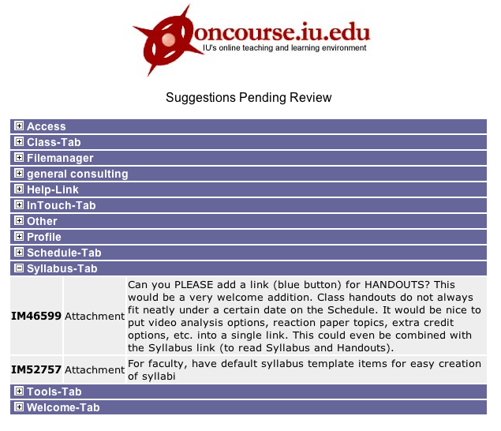
Public
tracking,
publishing,
and
notification
of requirements.
http://oncourse.iu.edu/octeam/developmentProcess/suggestion.asp

Slide 10
Overall Flow (R/D Phase)
SEPP (Mark?)
Requirements (Rob)
Chuck
Chuck
Architecture/Developer (Glenn)
Chuck

Slide 11
Overall Flow (Steady State)
Local
Production
Teams
Requirements
Team (Rob)
Architecture/
Project Management
Team (Chuck/Mark)
Framework,
Integration and
Release
Team (Glenn)
Developer Teams (+ SEPP)

Slide 12
Sakai Release Approach
Cautious during the R/D Phases
  Small, localized releases
    First to core partners
    Then to SEPP members
  We may find problems that necessitate change
Public releases will be conservative
  Good documentation
  Tested by partners and SEPP
Once components are relatively stable we will move them to a Sourceforge-style CVS
  There will always be some new (rugged) work that won’t yet be in Sourceforge

Slide 13
Sakai Milestones
2/15 Framework Technology (SFT) - Tech Preview 1
2/19 All Hands Workshop + Portability Profile (TPP) D2
2/27 SEPP: SFT TP1 + TPP D2 + Tool Functionality (TFS) D1
3/27 SFR Beta 1 + TPP Beta + TFS D2
4/30 TFS D2 + non-TPP Navigo Released
5/1 Sakai 1.0 Beta 1
5/12 SEPP: Sakai Beta
Final form except for partial TPP Navigo
6/15 SEPP: Workshop + Public Beta
7/15 Sakai 1.0 Public Release
CHEF Tools (12) + TPP Navigo + TPP tools (2)
8/15 Pilot efforts begin at partner institutions
9/1 Sakai 2.0 Development Begins
6/1/2005 Sakai 2.0 Released (many interim releases)

Slide 14
Sakai 0.5 Contents (02/04)
Complete Service Framework
JSF Support in Servlet-only mode
Some/Most CHEF services ported
All OKI RC6 OSID Interfaces
At least one (AUTHN) OKI OSID implemented which interoperates with CHEF service
Goal: Begin strong development of OKI OSID implementations AUTHN, AUTHZ, and DR
Goal: Begin developing new tools and exercising JSF

Slide 15
Sakai 1.0 Contents (07/04)
Complete Framework including JSF to Portlet Rendering and JSR-168 version of uPortal
All of the CHEF tools and services in legacy mode
Three new TPP compliant tools: Navigo (Assessment), DR Tool, and Gradebook(tbd).
Seamless look and feel between legacy and TTP-compliant tools
Complete Portability Profile “book”
Ready to deploy as LMS (looks a lot like CHEF 1.2 plus)
Ready to use as a development platform with rich sample applications
Nearly complete implementation of OKI OSIDs, façade classes, and full interoperability with CHEF services
Goal: Deployable in production at UM, Pilot at the other institutions

Slide 16
Sakai 2.0 (2Q05)
Complete replacement of legacy tools
  TPP Compliant, using OKI and Sakai APIs
  Specs based on the TFS - tools will be richer and deeper
  Each partner institution will focus on a set of tools to develop
SEPP partners will be involved in the new tool development based on ability and commitment.

Slide 17
Sakai @ UM
CHEF is not deprecated at all until Summer
  Most of the developers will continue to work on CHEF
  Improving tools, improving performance
  Perhaps a slight change in priorities: Delay the “big” things
  We may go from 2 to 3 Sakai Developers in March
  Between March and July the primary purpose of TPP - compliant tool building is to force us to test the TPP, not to build a bunch of new tools.
  Note: IU and Stanford will be working on the non-TPP Navigo until at least the end of April
  NEESGrid will stay with CHEF 1.2 until at least 2005
  NMI will stay with CHEF 1.0.7 until 2005
When the time is right, we can begin to move more developers to Sakai - we must wait for requirements
Sakai 1.0 will be running as ctng.ummu,umich.edu Fall 2004

Slide 18
Summary
Our project plan tries to move quickly and minimize the impact of any mistakes made early in the process (i.e. early on we can adjust)
Milestones have been designed to both be useful and at the same time achievable
We will be able to bring focused attention

