Slide 1
To Do
Check to see if new CSS got done
Take images with the multi-skin look
Get new partner list
Send Board Note about LaCMS

Slide 2

Open Source Learning and Collaboration Management Systems: The
CHEF Project and The Sakai Project
Charles Severance
www.chefproject.org
www.sakaiproject.org
csev@umich.edu
KYOU / sakai
Boundary, Situation

Slide 3
LaCMS: Learning and Collaboration Management System
Learning management systems are really just a form of collaboration
  Freshman Calculus
  Chess Club
  Group of 5 faculty members working on curriculum
  2000 physics researchers collaborating across the world on a 15-year physics experiment

Slide 4
Sakai Core Members
Universities
  Indiana
  Michigan
  MIT
  Stanford
Projects
  Open Knowledge Initiative (OKI)
  uPortal - JaSIG
Funding
  Mellon Foundation
  Hewlett Foundation
  Partners Program

Slide 5
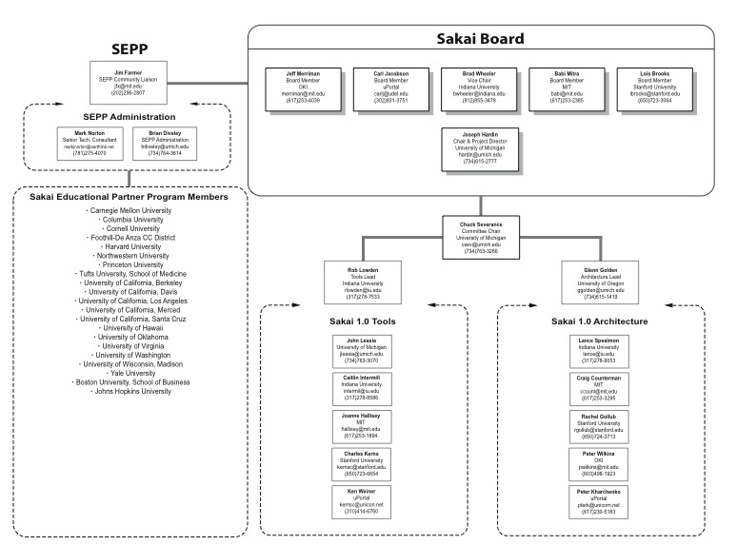

Slide 6
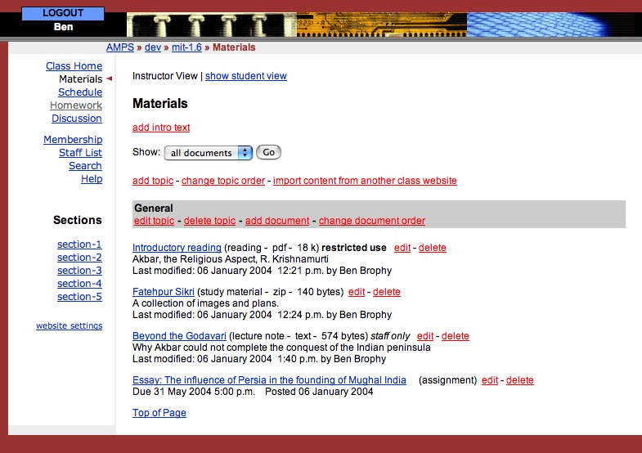
MIT’s Stellar
1998-2004
5000 Users
Used to drive early
OKI specs.

Slide 7
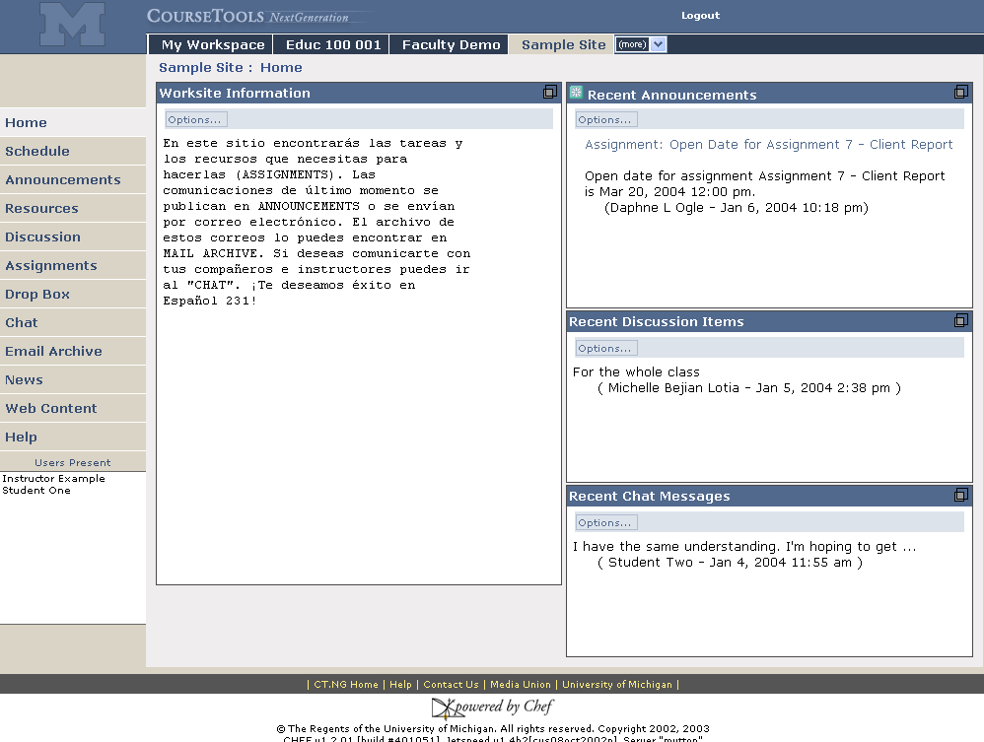
Sites are accessed via their tab
Michigan’s CHEF
1999 - 2004
20,000 Users
20 sites
Second Generation LaCMS
Foreign Language support
Customizable page menu
Presence

Slide 8
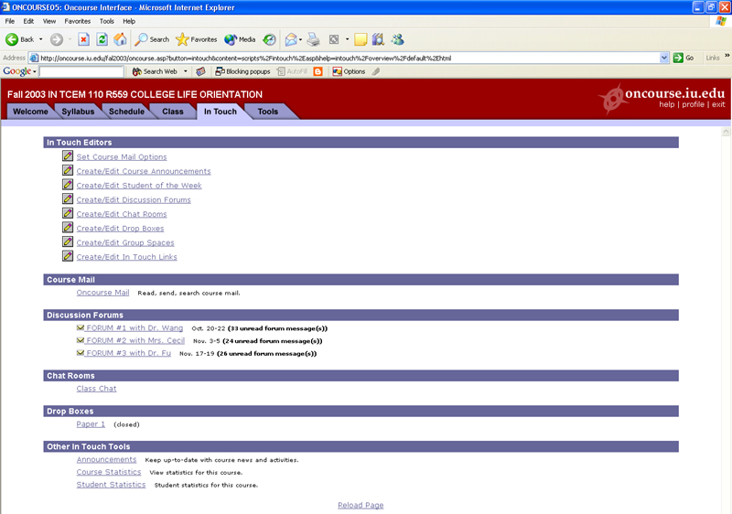
Indiana’s OnCourse
1996 - 2004
80,000 Users
Spawned Angel (1998)

Slide 9
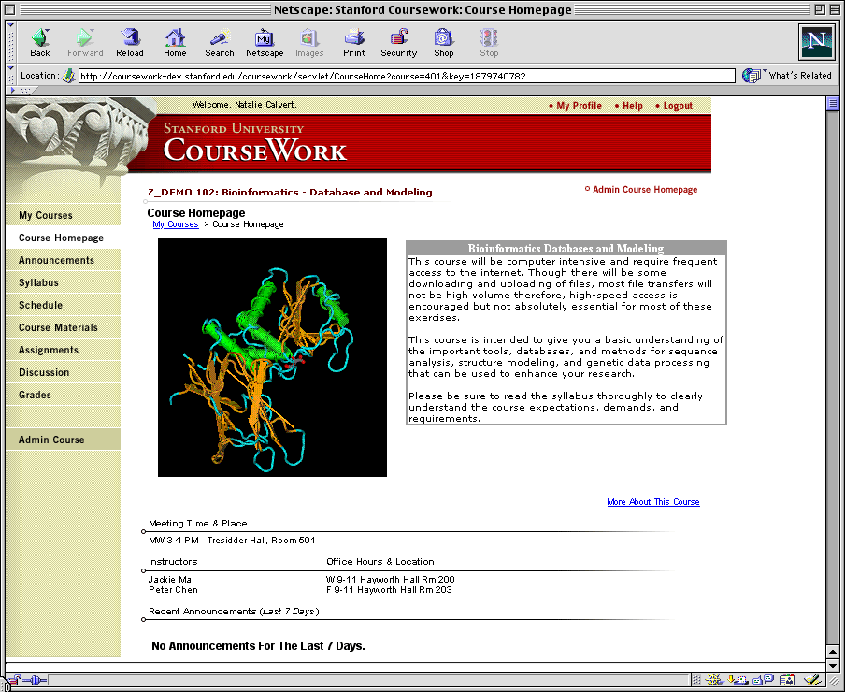
Stanford’s CourseWork
1996-2004
20,000 Users
5 Sites

Slide 10
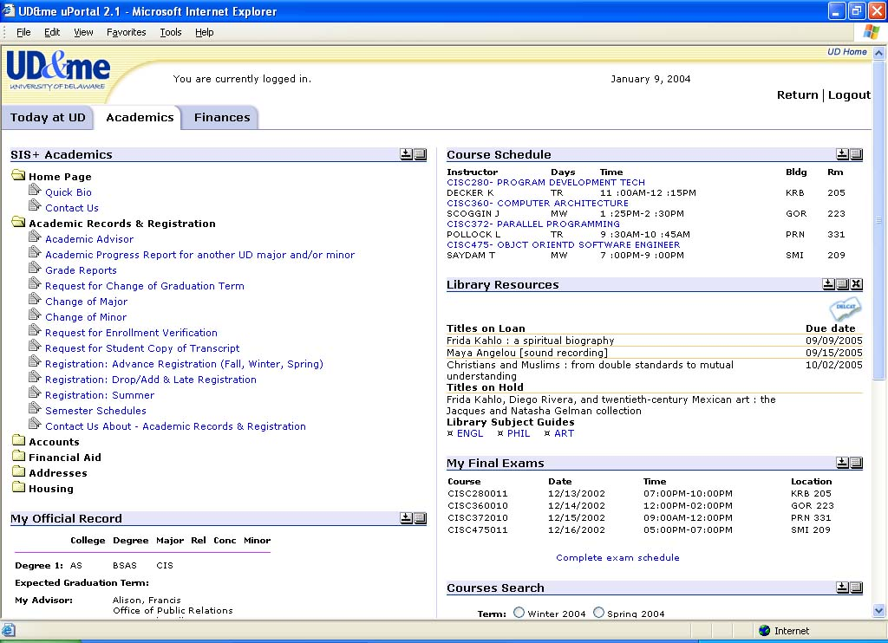
uPortal
1999 - 2004
200 Installations
1 Million daily users
Rated as the #3 portal in
market penetration.

Slide 11
OKI
1999 - 2004
Leading Learning Management
API Specifications

Slide 12
SAKAI Picture
Jan 04
July 04
May 05
Dec 05
Activity:
Maintenance &
Transition from a
project to
a community
Michigan
CHEF Framework
CourseTools
WorkTools
Indiana
Navigo Assessment
Eden Workflow
Oncourse
MIT
Stellar
Stanford
CourseWork
Assessment
OKI
OSIDs
uPortal
SAKAI 1.0 Release
Tool Portability Profile
Framework
Services-based Portal
Refined OSIDs
& implementations
SAKAI Tools
Complete CMS
WorkTools
Assessment
SAKAI 2.0 Release
Tool Portability Profile
Framework
Services-based Portal
SAKAI Tools
Complete CMS
Assessment
Workflow
Research Tools
Authoring Tools
"Best of"
Refactoring
Activity: Ongoing implementation work at local institution…
Primary SAKAI Activity
Architecting for JSR-168 Portlets,
Refactoring “best of” features for tools
Conforming tools to Tool Portability Profile
Primary SAKAI Activity
Refining SAKAI Framework,
Tuning and conforming additional tools
Intensive community building/training

Slide 13
Releases
CHEF
  Version 1.2 04/2004
    Frozen except for bug fixes
    In production at UM since 09/2003
Sakai
  Beta 1.0 06/2004
    Released only to the core and partners
  Production 1.0 07/2004
    Full public release including open source
  Production 2.0 2Q05

Slide 14
Sakai Deliverables
Sakai 1.0
  CHEF + IU/MIT/Stanford needs (41 gaps)
  New tools: Gradebook and QTI Assessment
  uPortal
  Will be in production at UM (30,000), large pilot at IU (10,000), and pilots at MIT and Stanford
  Mid July release suggests only pilot use outside UM for Fall 2004
Sakai 2.0
  Will go through ground-up specification process
  SEPP partners will be encouraged to contribute tools
  Full partner and SEPP production deployment expected

Slide 15
IU/OnCourse
Requirements and Features Flow
Calendar
Chat
Assessment
Standards
Sakai 1.0
Architecture
Calendar
UM/CHEF
Chat
Calendar
Assessment
Chat
Assessment
Standards
Standards
Architecture
Architecture
Stanford/CourseWork
Rethink
Respec
Rebuild
Calendar
Chat
Assessment
Standards
Sakai 2.0
Architecture
Calendar
MIT/Stellar
Chat
Calendar
Assessment
Chat
Standards
Assessment
Standards
Architecture
Architecture

Slide 16
Commercialize Sakai?
In a word, “No”
  Source code licensing and development effectively makes it virtually impossible to get an “exclusive” license
Commercial Aspects
  Portions of Sakai can be freely incorporated into commercial products
  Companies selling services and support around Sakai
We fully expect that by the end of 2005, commercial systems will have no choice but to be compliant with OKI and Sakai
Sakai then becomes the open source reference implementation Learning and Course Management System

Slide 17
Sakai and CHEF Architecture
Sakai and CHEF break functionality into three elements
  Presentation code giving the look, feel, and layout
  Tool code managing the interactions with the user
  Service code for business logic and persistence
Services implement, standardized, published and documented APIs
This is a common approach often called “Model-View-Controller”
Framework
View
…
View
Tool
Service
Service

Slide 18
Service Implementations
Because tools program to interfaces and not implementations, the framework can be configured to substitute different implementations depending on site needs
Authentication
  LDAP
  Kerberos
  Active Directory
  …
As long as the implementation satisfies the interface, the tool works seamlessly with no required changes
Framework
View
…
View
Tool
Service
Authorization
Service
Umich
Kerberos
Authorization
Service
LCC
LDAP
Authorization
Service

Slide 19
Skins and Look/Feel
On top of the GUI components, the system applies skins for branding look and feel.
The architecture has been designed to allow local customization to last across multiple versions
Local customization is something that is expected and designed for
Insert graphics here
Skin / CSS / Look and Feel
Framework
View
…
View
Tool
Service
Service

Slide 20
Which Version To Choose?
CHEF 1.2
  Solid, documented, production hardened, available now
  Tool development will always be “legacy” in Sakai
Sakai 1.0
  Most tools will look a lot like a CHEF “2.0”
  New tools: Assessment/Gradebook
  Service Interfaces will provide Legacy CHEF and OKI versions - The legacy versions will be a layer on top of the OKI Versions
  Will include uPortal - Skinnning will be different than CHEF
  Arrives too late for production Fall 04 outside UM
  Ready to develop new Sakai-tools
  Local customization service code for CHEF will need changes as APIs are aligned with OKI

Slide 21
Which Version to Choose?
Sakai 2.0
  Arrives too late for Fall 2004
  Arrives in plenty of time for Fall 2005
  Powerful and complete tool set
  Full OKI reference implementation
  Will likely contain significant SEPP contributions and requirements

Slide 22
Sakai Educational Partner’s Program
Membership Fee: US$10K per year, 3 years
Access to SEPP staff
  Community development manager
  SEPP developers, documentation writers
Developer training
Exchange for partner-developed tools
Strategy and implementation workshops
Early access to pre-release code
It is a way to be a part of the implementation team even if an organization was not part of the original grant.
No commercial partners - but companies acting on behalf of educational institutions are OK
Notes:
Official launch date for SEPP services is 1 March 2004. The Core Sakai institutions will develop ensure the project deliverables are met during the 2 years of the Sakai Project. The SEPP is the long-term community to ensure Sakai’s continuing evolution and value.
Over a dozen partner institution commitments already committed to SEPP as of January 2004 (announcements soon).
Note that some estimate licensing costs of a course management system are approximately 20% of the total cost of ownership. The open source nature of Sakai means that any institution can use the Sakai software with no licensing costs or any fees whatsoever for the code. The Sakai Educational Partner’s Program provides a community to help address the other 80% of the cost of a CMS or other Sakai tool.

Slide 23
Hewlett Grant Announcement
Partners – Feb 9, 2004
Carnegie Mellon University
Columbia University
Cornell University
Foothill-DeAnza Community Colleges
Harvard University
Northwestern University
Princeton University
Tufts University
University of Colorado
University of California-Berkeley
University of California-Davis
University of California-LA
University of California-Merced
University of Hawaii
University of Oklahoma
University of Virginia
University of Washington
University of Wisconsin-Madison
Yale University
sakaiproject.org

Slide 24
Summary
We expect that Sakai will be in the top three LaCMS systems by Fall 2005
The interim releases are intended to allow a gradual alignment across the LaCMS space (both commercial and non-commercial)
The Sakai project is focused on forming a community development paradigm that will continue well after the first two years of the project.

Slide 25
