Slide 1

Sakai and uPortal: Taking Collaboration to the Next Level
Charles Severance
www.sakaiproject.org
csev@umich.edu / www.dr-chuck.com
KYOU / sakai
Boundary, Situation

Slide 2
Outline
History
Sakai Overview
Sakai and uPortal
Sakai and JISC
Sakai and OKI
Sakai Technologies
Sakai Educational Partners
Summary

Slide 3
A long time ago… *
I was an architect on a project called CHEF which used a portal called Jetspeed to implement a learning management system and people kept telling me about this cool tool called uPortal - so I came to a meeting in Denver to check it out…
* 2003

Slide 4
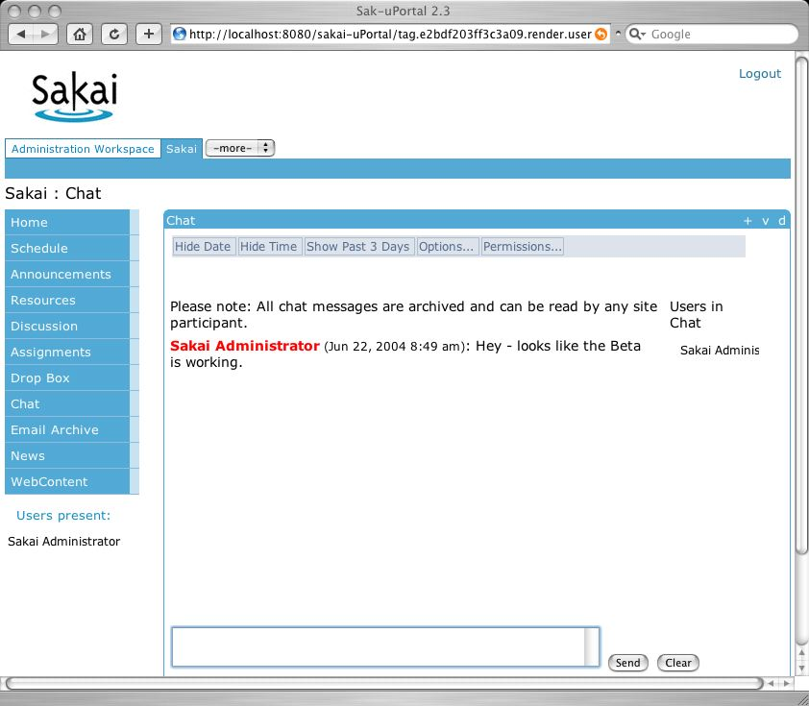
One year, one grant, six core partners, 30 collaborating partners, lots of airline miles, later…

Slide 5
Sakai Beta “Channels”
Admin: Alias Editor (chef.aliases)
Admin: Archive Tool (chef.archive)
Admin: Memory / Cache Tool
(chef.memory)
Admin: On-Line (chef.presence)
Admin: Realms Editor (chef.realms)
Admin: Sites Editor (chef.sites)
Admin: User Editor (chef.users)
Announcements (chef.announcements)
Assignments (chef.assignment)
C. R. U. D. (sakai.crud)
Chat Room (chef.chat)
Discussion (chef.discussion)
Discussion (chef.threadeddiscussion)
Dissertation Checklist (chef.dissertation)
Dissertation Upload
(chef.dissertation.upload)
Drop Box (chef.dropbox)
Email Archive (chef.mailbox)
Help (chef.contactSupport)
Membership (chef.membership)
Message Of The Day (chef.motd)
My Profile Editor (chef.singleuser)
News (chef.news)
Preferences (chef.noti.prefs)
Recent Announcements
(chef.synoptic.announcement)
Recent Chat Messages (chef.synoptic.chat)
Recent Discussion Items
(chef.synoptic.discussion)
Resources (chef.resources)
Sample (sakai.module)
Schedule (chef.schedule)
Site Browser (chef.sitebrowser)
Site Info (chef.siteinfo)
Web Content (chef.iframe)
Worksite Setup (chef.sitesetup)
WebDAV

Slide 6
Pre-Sakai History
Many “competing” mature production, well-liked course management systems
  MIT Stellar (JAVA)
  Indiana University OnCourse (ASP)
  University of Michigan CTNG (Java/Jetspeed)
  Stanford CourseWorks (Java)
Differing approaches to Portals
  Indiana University (JAVA - home grown)
  UM CTNG - Jetspeed
  uPortal - Built from scratch - iChannel

Slide 7
More History
Different outreach approaches
  UM/CHEF Workshops since 2002 - 30 sites attended
  CourseWork adopted at 5 sites
Mellon-funded technology projects nearing “completion”
  uPortal - highly successful - 300 installations
  OKI - Community development of LMS API specifications

Slide 8
More History
Indiana was itchin’ to rewrite their OnCourse in JAVA
Michigan was demonstrating the possibility of connecting the teaching/learning world to the research/small group collaboration world (NEESgrid, NMI and WTNG)
IU / Michigan / Stanford work on the Navigo project - got to know one another but not able to produce unified code because of the conflict between shared goals and local timelines and resources.
UM / CHEF and uPortal were getting to know one another by going to each other’s meetings, encouraged quietly by the Mellon Foundation

Slide 9
Things were tranquil…
The world of locally developed course management systems seems pretty quiet and contented.. Except for that small cloud on the horizon.

Slide 10

Then a Butterfly Flaps its Wings
The JSR-168 Portlet Specification was released
  It solved the portable GUI problem for OKI
  It made Jetspeed/CTNG, OneStart, and uPortal instant antiques as software frameworks
  Everyone had to rethink their strategies at about the same time because of JSR-168
But this time - something was (or at least could be) different…

Slide 11
Sakai: A Perfect Storm
Because of a combination of JSR-168 release and the ending of the OKI and uPortal funding, five projects were forced to think strategically all about the same time
Because they already knew one another, they thought strategically together

Slide 12
Sakai: A Perfect Storm
*
Because of a combination of JSR-168 release and the ending of the OKI and uPortal funding, five projects were forced to think strategically all about the same time
Because they already knew one another, they thought strategically together
They put their magic administrator rings together and became the “learning management super team” - amd wrote a proposal
* For those in the audience who are “kid-pop-culture” challenged, these are the Mighty Morphing Power Rangers - who together become a team of super heroes when some danger (usually from bad guys living on the Moon) arrives to threaten the Earth - which seems to happen conveniently once per week.

Slide 13
SAKAI Picture
Jan 04
July 04
May 05
Dec 05
Activity:
Maintenance &
Transition from a
project to
a community
Michigan
CHEF Framework
CourseTools
WorkTools
Indiana
Navigo Assessment
Eden Workflow
Oncourse
MIT
Stellar
Stanford
CourseWork
Assessment
OKI
OSIDs
uPortal
SAKAI 1.0 Release
Tool Portability Profile
Framework
Services-based Portal
Refined OSIDs
& implementations
SAKAI Tools
Complete CMS
WorkTools
Assessment
SAKAI 2.0 Release
Tool Portability Profile
Framework
Services-based Portal
SAKAI Tools
Complete CMS
Assessment
Workflow
Research Tools
Authoring Tools
"Best of"
Refactoring
Activity: Ongoing implementation work at local institution…
Primary SAKAI Activity
Architecting for JSR-168 Portlets,
Refactoring “best of” features for tools
Conforming tools to Tool Portability Profile
Primary SAKAI Activity
Refining SAKAI Framework,
Tuning and conforming additional tools
Intensive community building/training

Slide 14
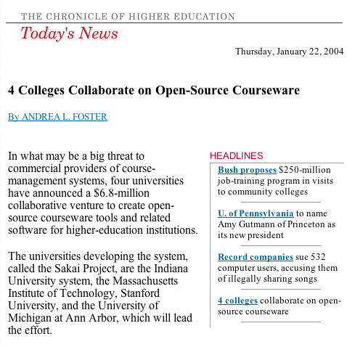

Slide 15
Sakai Core Members
Universities
  Indiana
  Michigan
  MIT
  Stanford
Projects
  Open Knowledge Initiative (OKI)
  uPortal - JaSIG
Funding ($6.8M - 2 Years)
  Mellon Foundation
  Hewlett Foundation
  Partners Program
  Core member match

Slide 16
What we agreed to build…
A Collaborative Learning Environment
  Open Source
  Uses OKI (Open Knowledge APIs)
  Uses uPortal as its portal framework
Similar to
  Blackboard
  WebCT
And all four core institutions would deploy the commonly developed software

Slide 17
Collaboration and Learning Environment
Learning management systems are really just a form of collaboration
  Freshman Calculus
  Chess Club
  Group of 5 faculty members working on curriculum
  2000 physics researchers collaborating across the world on a 15-year physics experiment

Slide 18
Open/Open Licensing
“..all work products under the scope of the Sakai initiative for which a member is counting matching contribution and any Mellon Sakai funding” will be open source software and documentation licensed for both education and commercial use without licensing fees.
Significant difference between a “product” and a “component”
Unlimited redistribution is an important aspect of a license.

Slide 19
Committed…
This is not about foisting existing solutions across the partners
Each university will let go of their CMS by 2005 (really)
Indiana is dropping their University portal effort (OneStart)
uPortal is changing their whole portal to use JSR-168 - Their current interface will be an “adapter”

Slide 20
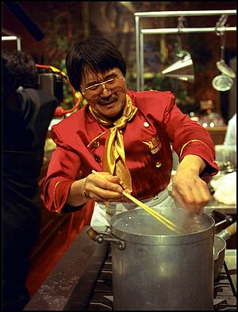
Aside: Hiroyuki Sakai
Iron Chef French – Fusion Cuisine

Slide 21




KYOU / sakai
Boundary, Situation
Gyakkyou – adversity, adverse circumstances
Henkyou – frontier, remote area
Shinkyou – frame of mind, mental state
Fits well, since we are embarking on a difficult project that will cross important frontiers, taking us into remote areas, and that will require determination and clarity in our thinking.

Slide 22
Community Source
Community source describes a model for the purposeful coordinating of work in a community. It is based on many of the principles of open source development efforts, but community source efforts rely more explicitly on defined roles, responsibilities, and funded commitments by community members than some open source development models.

Slide 23
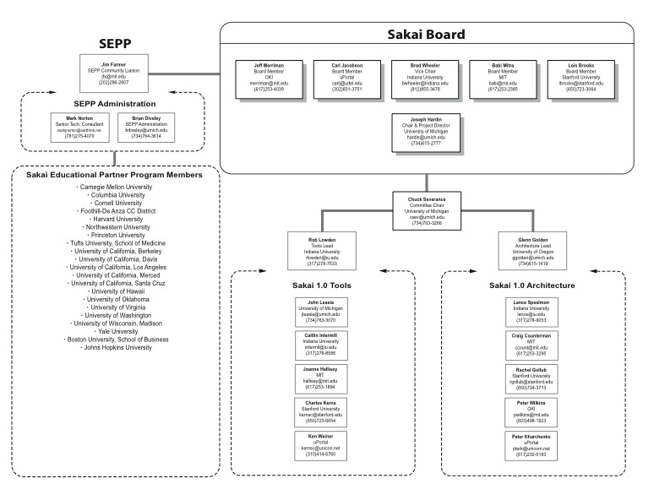

Slide 24
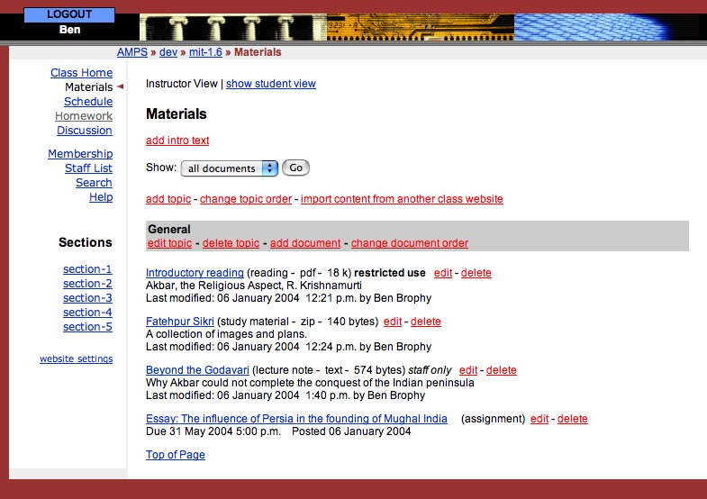
MIT’s Stellar
2001-2004
5000 Users
Used to drive early
OKI specs.

Slide 25
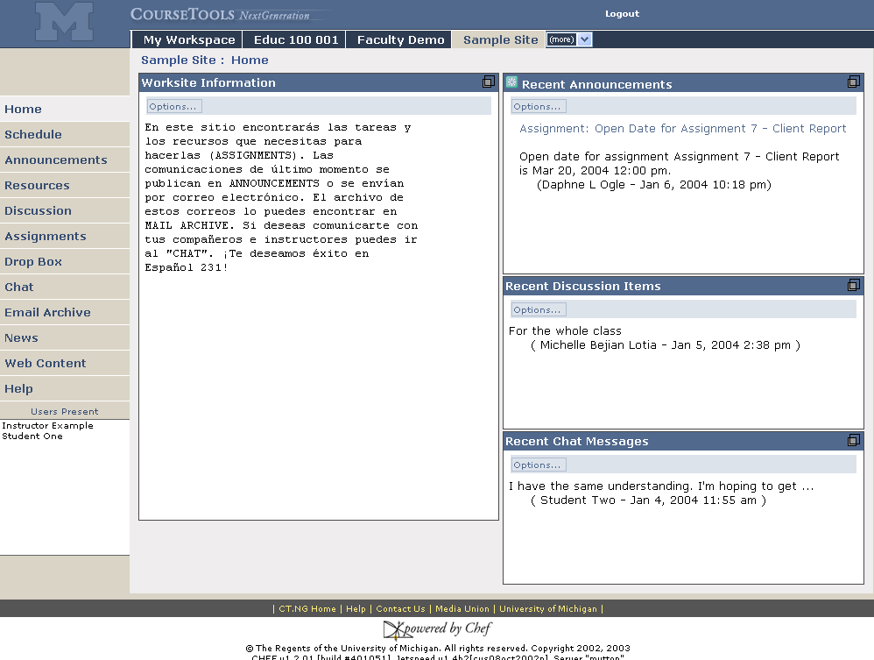
Sites are accessed via their tab
Michigan’s CHEF
1999 - 2004
20,000 Users
20 sites
Second Generation LaCMS
Foreign Language support
Customizable page menu
Presence

Slide 26
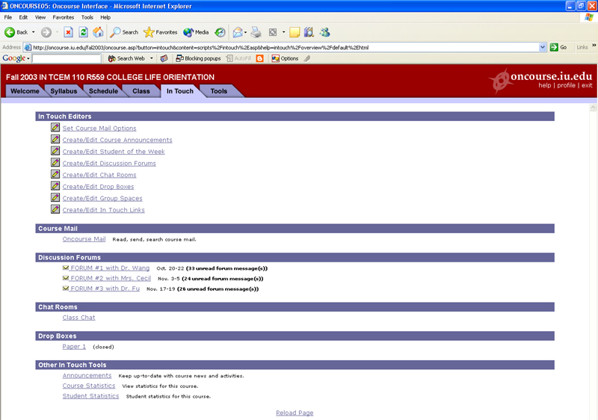
Indiana’s OnCourse
1996 - 2004
80,000 Users
Spawned Angel (1998)

Slide 27
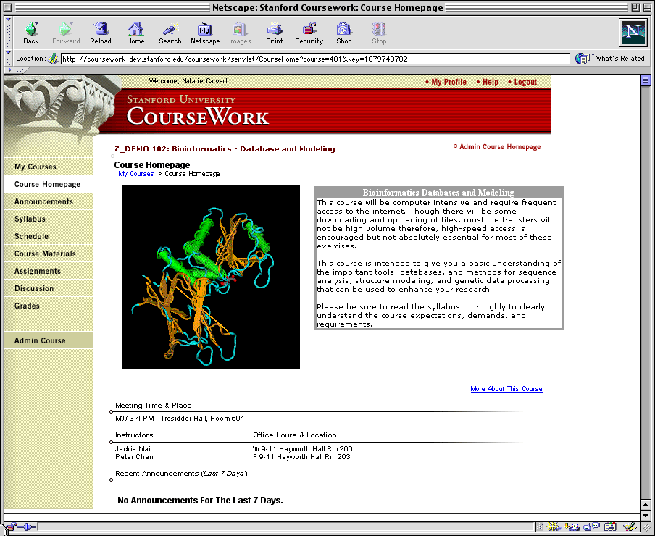
Stanford’s CourseWork
1996-2004
20,000 Users
5 Sites

Slide 28
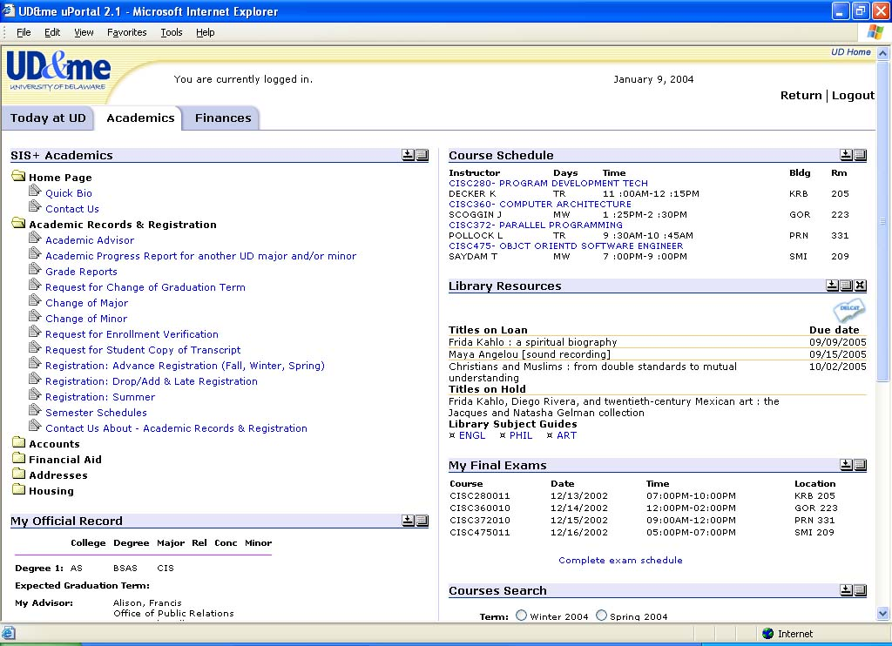
uPortal
1999 - 2004
200 Installations
1 Million daily users
Rated as the #3 portal in
market penetration.

Slide 29
OKI
2001 - 2004
Leading Learning Management
API Specifications

Slide 30
IU/OnCourse
Requirements and Features Flow
Calendar
Chat
Assessment
Standards
Sakai 1.0
Architecture
Calendar
UM/CHEF
Chat
Calendar
Assessment
Chat
Assessment
Standards
Standards
Architecture
Architecture
Stanford/CourseWork
Rethink
Respec
Rebuild
Calendar
Chat
Assessment
Standards
Sakai 2.0
Architecture
Calendar
MIT/Stellar
Chat
Calendar
Assessment
Chat
Standards
Assessment
Standards
Architecture
Architecture

Slide 31
Sakai 1.0 Contents (07/04)
Framework for building new Sakai tools
  Javaserver Faces
  Sakai GUI widgets
Framework for development of Sakai APIs
Sakai Service APIs: framework, common, shared, authentication, authorization
Two new sample Sakai toolk
Legacy Service APIs from CHEF
Legacy tools from CHEF (with gaps addressed)
Seamless look and feel between legacy and Sakai tools
Ready to deploy as LMS (looks a lot like CHEF 1.2 in uPortal
Sakai 1.1: 09/04 (additional tools, improvements, and Sakai APIs)
Sakai 1.2: 11/04 (additional tools, improvements, and Sakai APIs)

Slide 32
Sakai 2.0 (2Q05)
Significant replacement of legacy tools
  TPP Compliant, using OKI and Sakai APIs
  New and improved tools based on Sakai-wide requirements process
  Each partner institution will focus on a set of tools to develop
SEPP partners will be involved in the new tool development based on ability and commitment.
Hopefully - Hierarchical navigation with uPortal 3.1

Slide 33
Aside: Why JSR-168/WSRP ?
A slightly paraphrased conversation November 2003 at a Grid Portal meeting at Indiana University.
Charles Severance: (using his best expert from out-of-town voice) The architecture team from the CHEF project has done an evaluation of JSR-168 as best we can figure it out and have concluded that it is a bit too “HTML-oriented” - we want tools that are relevant beyond the web environment.
Geoffrey Fox (Indiana University): JSR-168 and WSRP will be standards - people will use them regardless of your opinion or your software.

Slide 34
Aside: Why JSR-168/WSRP ?
A slightly paraphrased conversation November 2003 at a Grid Portal meeting at Indiana University.
Charles Severance: (using his best expert from out-of-town voice) The architecture team from the CHEF project has done an evaluation of JSR-168 as best we can figure it out and have concluded that it is a bit too “HTML-oriented” - we want tools that are relevant beyond the web environment.
Geoffrey Fox (Indiana University): JSR-168 and WSRP will be standards - people will use them regardless of your opinion or your software.
Charles Severance: (pause) Good point. Thanks.

Slide 35
Relationship to Other Efforts
OKI
uPortal
JSF
Tomcat
IMS
IEEE
Sakai - A Profile + Implementation
Sakai is a consumer of standards, and technologies to be assembled into an implementation and a profile with some Sakai-specific value add in certain areas. As we work through development issues, we may identify new ideas/problems/extensions that we will suggest back to these groups by participating in those groups as a participant. Even though uPortal and OKI have received funding as part of the Sakai project it does not change the basic relationship between the projects.

Slide 36


uPortal Portlet Roadmap
uPortal 2.3
uPortal 3.0
uPortal 2.3
  Support Portlets (JSR-168) via adapter
uPortal 3.0
  Implement Portlet Specification (JSR-168)
  Support IChannel via adapter
Framework
Chan
Chan
Framework
Pluto
Chan
Chan
Portlet
Portlet
Adapter
Portlet
Portlet
Pluto
Adapter
Portlet
Portlet
Chan
Chan
Feb 19, 2004
SAKAI Developer’s Workshop, Stanford University

Slide 37
Portal => Application Framework
Portals are a framework to deploy tools (aka rectangles) and focus on how the user wants to arrange their own “rectangles”
While Sakai has chosen to use a portal as a component integration technically, the goal is for the tools to work together closely and seem to really be parts of a larger “tool”
Sakai has a lot of features, (services, presence, notification, etc..) which bridge the gap between portal and application framework

Slide 38
Sakai 1.0 and uPortal
The embedded version where the entire Sakai tool set appears as a single channel much like the “SuperChannel”. This can be installed in any standard uPortal environment.
The “injected” version which uses a modified version of uPortal 2.3 with two-level navigation and configuration information coming from Sakai. This is pretty much a stand-alone learning management system using uPortal. The uPortal theme and structure will be altered to precisely display the hierarchical navigation needed by Sakai.

Slide 39
Sakai 1.0: Embedded Version
(uPortal 2.3)
Home
Athletics
Sakai
CS101
EE499
EE499-Sec01
Chess
Motor
Help
Single Channel
Fred: He will move P-K4
Joe: Nah - he did that last time
Mary: It does not matter what he does - I will beat him again
Play
FAQ
Meeting
Admin
Watch me now mary!
Send

Slide 40
Sakai 1.0: Injected Version (uPortal 2.3)
Home
CS101
EE499
EE499-s01
Chess
Home
CS101
EE499
EE499-s01
Chess
Help
Help
Play
FAQ
Meeting
Admin
Fred: He will move P-K4
Joe: Nah - he did that last time
Mary: It does not matter what he does - I will beat him again
Play
Fred: He will move P-K4
Joe: Nah - he did that last time
Mary: It does not matter what he does - I will beat him again
FAQ
Meeting
Admin
Watch me now mary!
Send
Watch me now mary!
Send

Slide 41
Sakai 2.0 and uPortal
The integrated version where Sakai tools simply are part of the set of channels which can be added to any uPortal environment. By placing a Sakai tool anywhere within the navigation hierarchy of uPortal, it becomes a collaborative element at that location.
This is more complex than it sounds and as such will only work within uPortal and will require some modifications to uPortal that the Sakai effort is undertaking and contributing to the uPortal project.

Slide 42
The Hierarchy Challenge
Sakai
EE499
Access
Control
List
Chess
Motor
Access
Control
List
CS101
Access
Control
List
Sec01
Sec02
Play
Help
Folders
Access
Control
List
Chat
Folders
Game
Chat
FAQ
Chat
Chat
Folders
Chat
Folders
Portlets/Channels need to know “where” they fit for inherited access control and to know the “context” in which they operate - “I am the Chat for CS101”. There are fragment administration issues. This is not specified in the JSR-168 spec. SuperChannel and Sakai Embedded are solutions which hide the hierarchy from the portal - but this is less than ideal because it would be nice to drop a context-sensitive “chat” tool anywhere in the portal.

Slide 43
Sakai 2.0: Integrated
MyPage
Athletics
Events
Courses
MyPage
Athletics
Events
Courses
+ CS101
+ EE499
+ Main
- Sec01
Help
Chat
FAQ
Meeting
+ Sec02
+ Chess
+ Motor
EE499 -> Sec01
Fred: He will move P-K4
Joe: Nah - he did that last time
Mary: It does not matter what he does - I will beat him again
Joe: What if he pulls his goalie?
New Course
New Section
Help
Fred: He will move P-K4
Joe: Nah - he did that last time
Mary: It does not matter what he does - I will beat him again
Joe: What if he pulls his goalie?
Chat
FAQ
Watch me now mary!
Meeting
Send
Admin
Watch me now mary!
Send

Slide 44
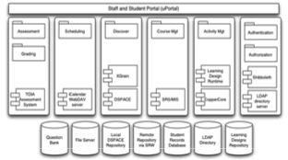
Relationship to JISC eLearning Program
Similar in scope but very complimentary
Sakai
  Conservative, production oriented, Java APIs, little new pedagogy, large project
JISC eLearning
  Research oriented, web services and multiple languages, explores pedagogy,
  series of small projects
http://www.jisc.ac.uk/funding_elearning_demos.html

Slide 45
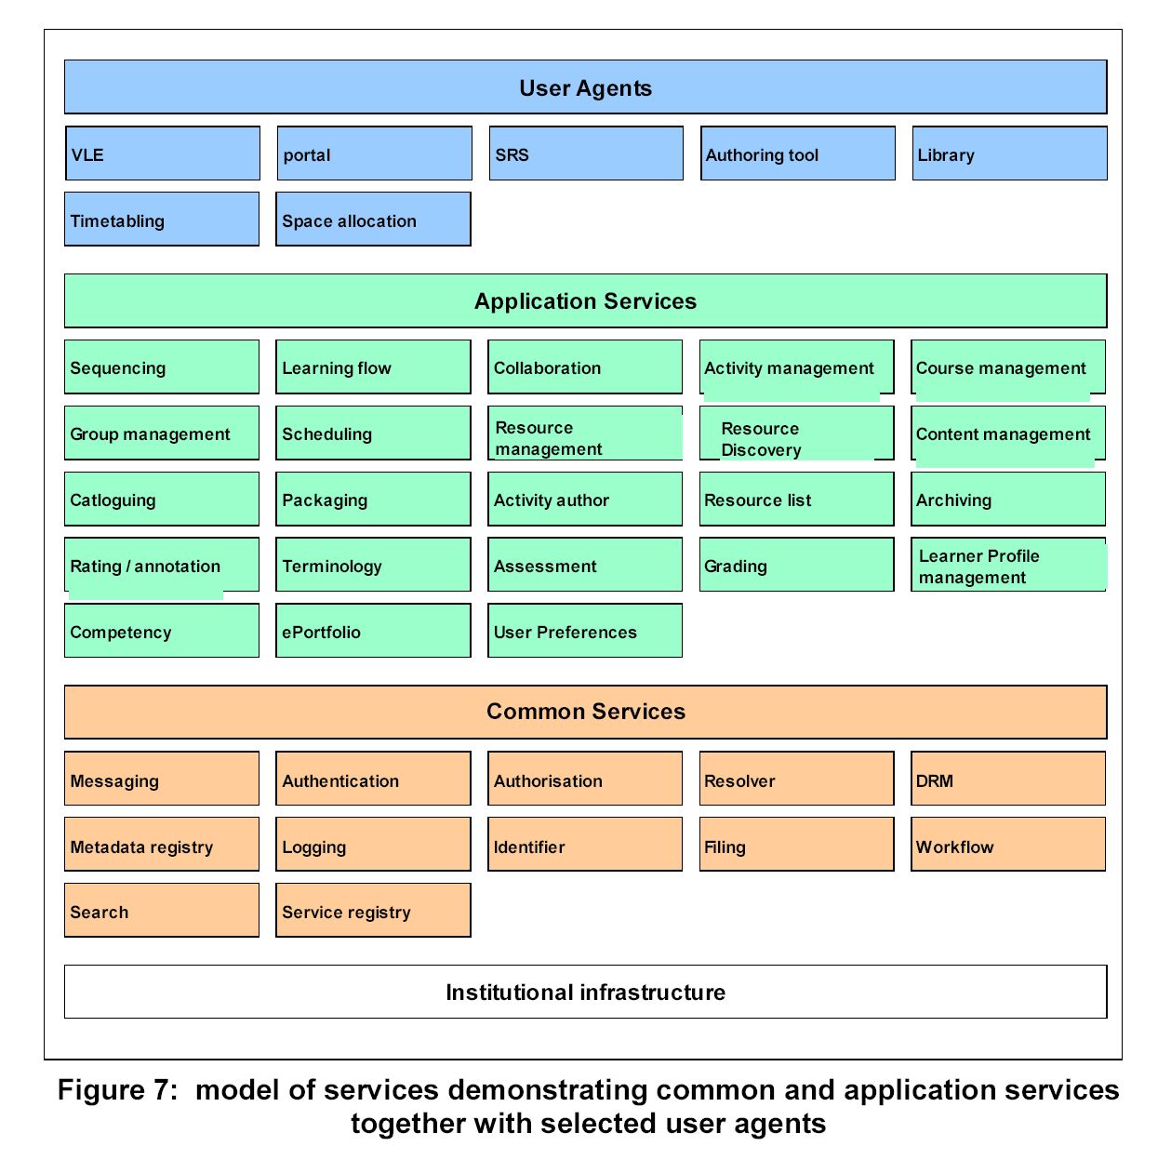
JISC
Function
Mappings –
Starting
points for
coordination
within
Sakai
Notes:
Introduce JISC functional model as starting point for thinking about DGs. VLE will need expansion and clarifying; reference site and Norton paper

Slide 46
Sakai and OKI
OKI has produced a series of APIs for Learning Management System Portability
  Enterprise Integration
  Tool Portability
The OKI APIs are very flexible allowing for out-of-band agreements
The Sakai APIs will take the OKI APIs and focus them down to a Sakai-only context and “bind down” out-of-band agreements into methods

Slide 47
OSIDs and APIs
Sakai has interface requirements above and beyond the OKI OSIDs
There is no way to cleanly extend the OKI OSIDs
Therefore, Sakai will create a set of APIs that correspond as closely as possible to the OSIDs

Slide 48
Sakai Application Programming Interfaces (APIs)
Make tool development easier
Promote portability between Sakai environments
Hide some data management details
Error handling
Provide re-usable system and application services to tool developers

Slide 49
The Sakai Layered Architecture
uPortal
JavaServer Faces
OKI Tools
Sakai Tools
Legacy Tools
Sakai Services
Legacy Services
OKI Plug-ins
OKI Info
Sakai Data
Legacy Data

Slide 50
The Sakai Framework
OKI TOOL
Sakai Tool
Legacy Tool
OKI API
Sakai
API
Leg API
Sakai API Impls
Sakai
Legacy
Impls
OKI Plug-In
OKI API
OKI 2.0
impls
OKI 2.0
impls
Sakai
Data
Legacy
Data
migration
OKI Info

Slide 51
Sakai Technology Portability Profile - Java Version
Tools
  JSF GUI Layer
  JSR 168 Portlet
Services
  Setter dependency injection and service location
  Spring Managed Beans
Enterprise Storage Technology
  Hibernate

Slide 52
Sakai Architecture
Break functionality into three elements
  Presentation code giving the look, feel, and layout
  Tool code managing the interactions with the user
  Service code for business logic and persistence
Services implement, standardized, published and documented APIs
This is a common approach often called “Model-View-Controller”
Framework
View
…
View
Tool
Service
Service

Slide 53
The Slide.
uPortal / JSR - 168
Sakai Framework/Config
JSF Render
JSP Layout
JSP Layout
…
<sakai:toolbar>
< …
<sakai:toolbar>
< …
Tool
Config Beans
View Beans
Action
Action
Service
Service
Method
Method
Method
Method
Config Beans
Config Beans

Slide 54
Service Implementations
Because tools program to interfaces and not implementations, the framework can be configured to substitute different implementations depending on site needs
Authentication
  LDAP
  Kerberos
  Active Directory
  …
As long as the implementation satisfies the interface, the tool works seamlessly with no required changes
Framework
View
…
View
Tool
Service
Authorization
Service
Umich
Kerberos
Authorization
Service
LCC
LDAP
Authorization
Service

Slide 55
Why not Web Services?
Web services would be great if they were secure in a general fashion
Web services are great for “point solutions” but are painful as a framework right now
Short term: Sakai API implementations can use Web Services hidden behind the API (collecting point solutions)
Web services are changing right now
  WSRF - Web Services Resource Framework - Thing of this as “The Grid Meets .NET”
  Generic Security Services Application Program Interface (GSS-API) defined in RFC 2853 and JDK 1.4.2
Service Injection means that it is “Possible” to build a Sakai Web-Services Framework without changing services code.

Slide 56
Sakai Educational Partner’s Program
Membership Fee: US$10K per year, 3 years
Access to SEPP staff
  Community development manager
  SEPP developers, documentation writers
Knowledgebase
Developer training for the TPP
Exchange for partner-developed tools
Strategy and implementation workshops
Early access to pre-release code
Notes:
Official launch date for SEPP services is 1 March 2004. The Core Sakai institutions will develop ensure the project deliverables are met during the 2 years of the Sakai Project. The SEPP is the long-term community to ensure Sakai’s continuing evolution and value.
Over a dozen partner institution commitments already committed to SEPP as of January 2004 (announcements soon).
Note that some estimate licensing costs of a course management system are approximately 20% of the total cost of ownership. The open source nature of Sakai means that any institution can use the Sakai software with no licensing costs or any fees whatsoever for the code. The Sakai Educational Partner’s Program provides a community to help address the other 80% of the cost of a CMS or other Sakai tool.

Slide 57
Hewlett Grant Announcement
Partners – Feb 9, 2004
Carnegie Mellon University
Columbia University
Cornell University
Foothill-DeAnza Community Colleges
Harvard University
Northwestern University
Princeton University
Tufts University
University of Colorado
University of California-Berkeley
University of California-Davis
University of California-LA
University of California-Merced
University of Hawaii
University of Oklahoma
University of Virginia
University of Washington
University of Wisconsin-Madison
Yale University
sakaiproject.org

Slide 58
Current Models
Sakai Project Core
  Board assigns staff to prioritized projects
Ad-hoc Alliances
  SEPP members or others commit to working on specific projects and leverage SEPP infrastructure and coordination/communication model
Volunteers
  Someone makes known their intent to work on a particular project – ready to commit
    Project of their own – no help requested
    Already existing project – volunteering resources
    Desire assistance – see Ad Hoc Alliances above
Notes:
??? Need example

Slide 59
Post 2005 - Possible Model
Paid membership
Board of Directors
Core of supported and dedicated staff supported by SEPP and contributed in-kind by community - integration, architecture, institutional memory, organization
Closely aligned project oriented teams/alliances
Independent open source workers

Slide 60
Sakai: Some Innovations
New approach to Learning Management Systems: Not just for classes any more
New approach to Portal Technology: Application Development Platform
New Approach to web application development: Code to work on desktop (someday)
New form of development: Community Source

Slide 61
Summary
We expect that Sakai will be in the top five Collaborative and Learning Environments by Fall 2005
The interim releases are intended to allow a gradual alignment across the CLE space (both commercial and non-commercial)
The Sakai project is focused on forming a community development paradigm that will continue well after the first two years of the project.
From uPortal perspective - this is a bunch of new channels, some helpful developers and possibly hundreds of new adopters
What if this project actually works, and the concept of community source and community development catches on? Imagine what we could do if we could get 5 programmers from each of 100 educational institutions working together. How about 10 or 20 programmers.

Slide 62
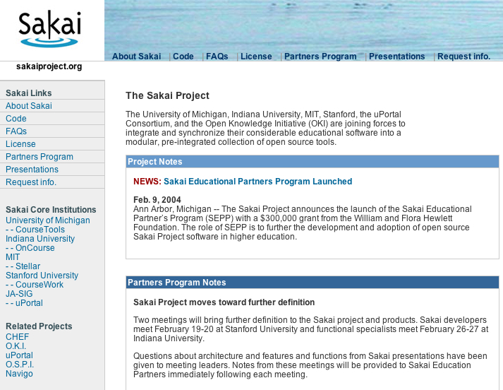

Slide 63
FAQ: uPortal and Sakai
Is Sakai telling uPortal what to do because uPortal receives funding through the Sakai project
  A little bit - JSR-168 is critical to the Sakai project so Sakai has requested JSR-168 support as part of uPortal’s version 2.3 and 3.0
  Note 1: That request assumed that supporting JSR-168 would be part of the strategic direction of uPortal whether or not Sakai existed. We feel that without JSR-168 support uPortal’s complete dominance of the open-source portal space would erode rather rapidly

Slide 64
uPortal / Sakai FAQ (cont)
Is Sakai telling uPortal what to do because uPortal receives funding through the Sakai project?
  No - The entire implementation detail of uPortal’s JSR-168 is up to uPortal and every other design decision regarding uPortal is made in the same manner as it has always been done in uPortal - Sakai acts as just another member of the uPortal community in that respect
  Note: Part of the reason that uPortal is a partner in Sakai is because of its strong open source process and strong community of users. Sakai hopes to learn best practices in running an open source project from the uPortal group.

Slide 65
uPortal / Sakai FAQ (cont)
Will uPortal drop support or break the iChannel, cWebProxy interface?
  Absolutely not - The iChannel interface and all of the Channel implementations which already exist in the uPortal community are highly valued as Sakai explores the blending of collaborative/learning management systems with enterprise portals.
Any other thoughts on uPortal?
  Yes - there are a number of elements of uPortal which Sakai feels are unique advantages of uPortal compared other portals: The flexible skinning using XML/XSLT, the ground breaking work on building an internationalized portal, the flexibility of the portal presentation beyond just images and skins (tab/column, tree-view, etc..)

Slide 66
FAQ: Educational Partners
Is the SEPP program buying access to the source code?
  No - the source code will be published openly and freely according to the Sakai project plan. SEPP partners will see the releases several weeks before the public release so they can review, comment, and generally help with the release process. SEPP members will be invited to a pre-release workshop to examine the release and interact directly with the Sakai core team.
Is the SEPP program buying a “vote” in the governance of Sakai or the consensus process developing specification for Sakai?
  No - as specifications are developed and initial versions are released comments are welcome from anyone. We hope that there is never a “vote” throughout the entire Sakai project - we hope that this is about making the right technical choices and that the proper choice will bubble up through active discussion with as wide a range of people as possible. As the governance evolves, this may change.

Slide 67
SEPP FAQ Continued..
So, I don’t need to pay for source and I am not buying a vote - sounds like I should not join the SEPP
  Wrong - By joining the SEPP, you become an active part of the Sakai team
  The SEPP staff will keep you apprised of all Sakai activities and bring important issues to your attention.
  The SEPP staff attend all major meetings and if you let them know your requirements, and needs, the SEPP staff will make sure that your requirements are considered at the exact moment that the discussions and decisions are being made
I know members of the Sakai core team - they are nice people - why don’t they just do this instead of making a big fuss about the SEPP?
  Yes - you are right about them being nice people. But they need to focus on the outrageous timeline forced upon them by the funding agency and the (really mean) Sakai board. Given that pressure, even nice people might conveniently forget about your requirements at crunch time. By having SEPP staff who have no line project responsibility, they remain focused on the needs of the SEPP members - even when things get a little hectic.
  Running a project with as much public interest as Sakai requires dedicated resources for communication or the project is in danger of failing - depending on developers to perform this role is very dangerous.

Slide 68
SEPP FAQ Continued… (last slide)
So does this mean that the Sakai core team is sequestered and that I as a SEPP member never get to talk to the core team?
  Again, you are incorrect - the Sakai team is interested in interacting with anyone who has a significant comment, problem or issue so that it can be resolved as quickly as practical. We are all motivated for the Sakai product to be “right” - if something is wrong we need to hear about it quickly and directly. The SEPP staff will bring in the relevant members of the core team into the discussion whenever it is appropriate. (Because the SEPP is part is every significant meeting, they know exactly who is the lead in any area of the project at any given moment)
  The Sakai core team engages in discussions with anyone who can shed light on issues regardless of whether or not they are in the SEPP - the difference for SEPP members is that you are kept in the loop in terms of what the current questions are.
Is this about the money?
  No. The expected revenue from the SEPP funds is somewhere between 5% and 2% of the expected expenditures in the project (depending on whether you look at minimum required match or the approximate expected match respectively)

Slide 69
The Slide.
uPortal / JSR - 168
Sakai Framework/Config
JSF Render
JSP Layout
JSP Layout
…
<sakai:toolbar>
< …
<sakai:toolbar>
< …
Tool
Config Beans
View Beans
Action
Action
Service
Service
Method
Method
Method
Method
Config Beans
Config Beans

