Slide 1
Grid Portals: Putting the User Interface on the Grid and Virtual Organizations
Charles Severance
University of Michigan
NEESGrid project, OGCE Project, Sakai Project
www.dr-chuck.com
csev@umich.edu

Slide 2
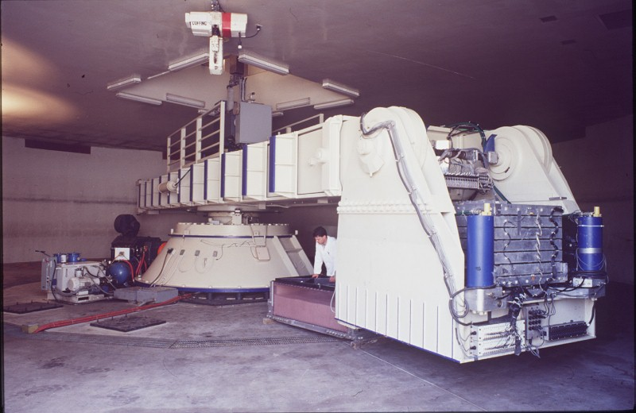
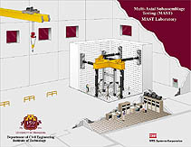
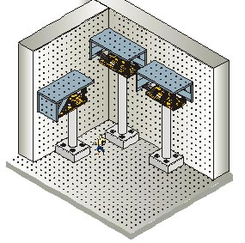
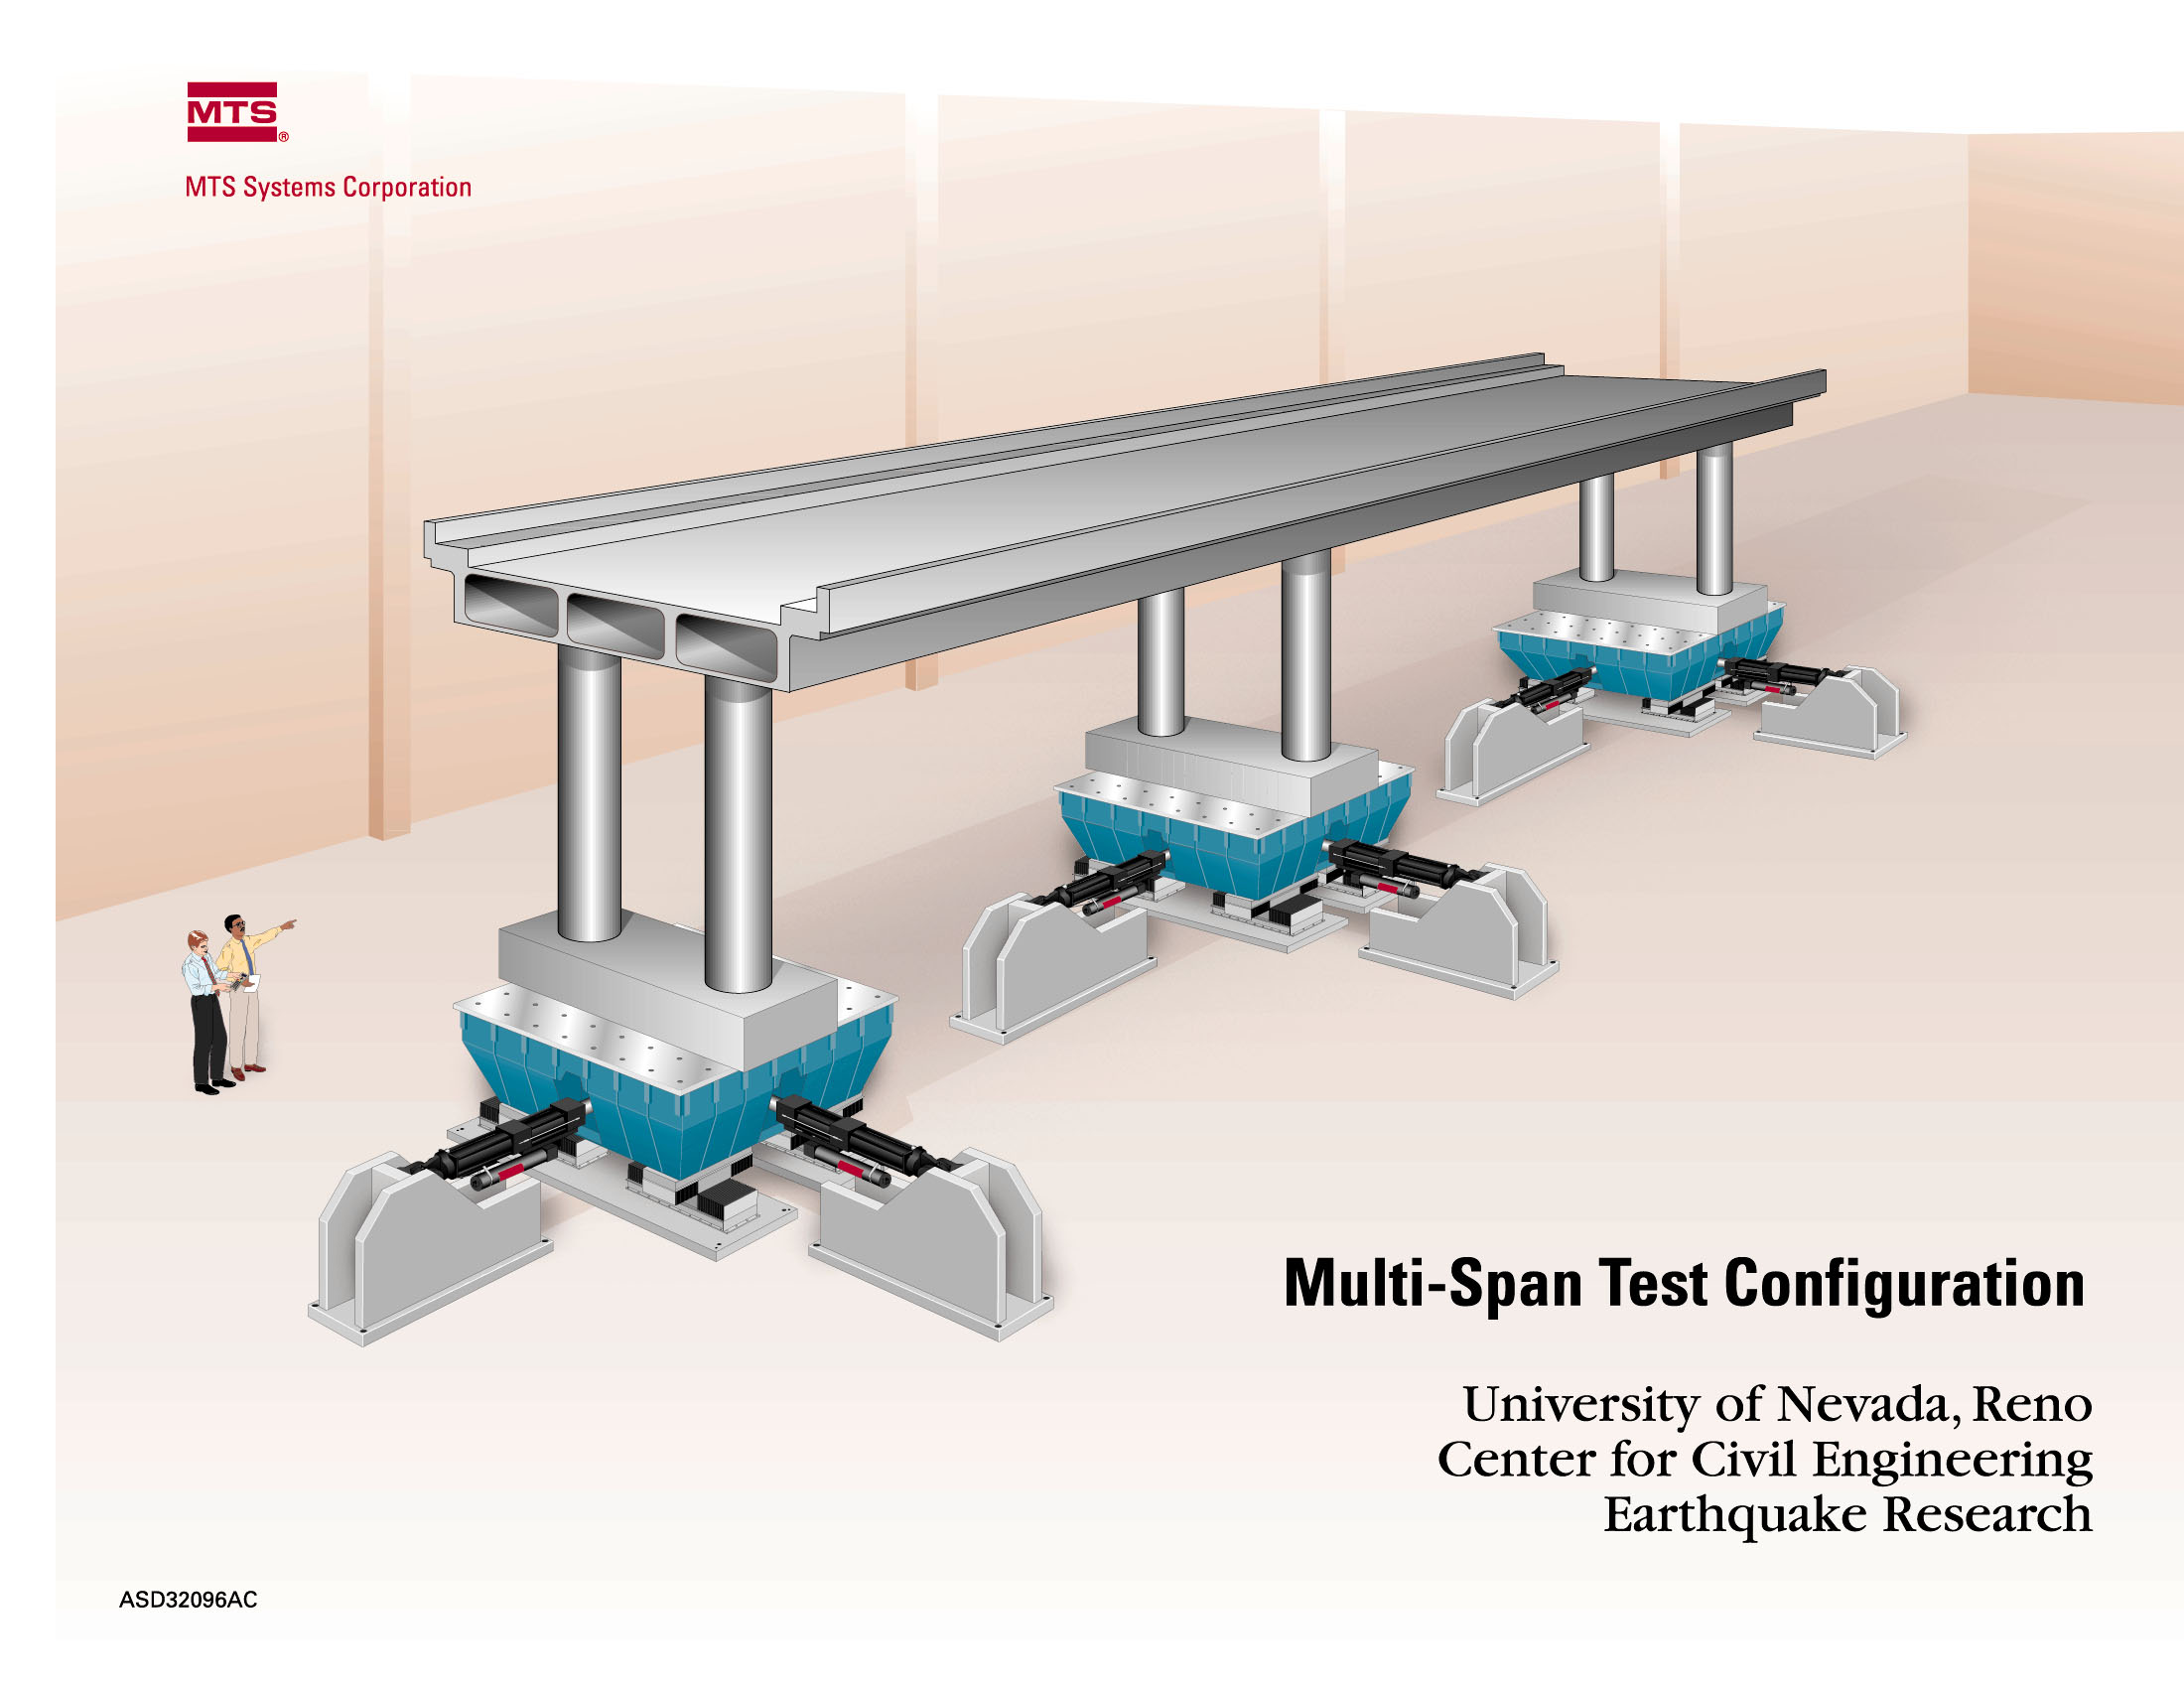
Grid: A collection of “things” (people, equipment, etc) which need to work together to accomplish some task
NEESGrid: $200M, 13 years, 30+ organizations, 300+ people, a NEES non-profit consortium, 16 geographically distributed experimental sites all combine using the global public Internet to produce one national experimental laboratory which will enable fundamental advances in earthquake earthquake engineering.
Note: In this story (like all good stories) everything sounds very good but there is a flaw - look for it… See if you can figure out what the flaw is before it is revealed at the end of the story…

Slide 3
Making a Grid: Step 1 - Invent a Grid Toolkit with protocols
The Globus Toolkit

Slide 4
Making a Grid: Step 2 - Add those protocols to the “things” that need to work together…
The Globus Toolkit

Slide 5
Making a Grid: Step 3 - Plug it all in…
The Globus Toolkit
Note: By now you have seen the flaw several times - you should be forming a hypothesis about the flaw right about now….

Slide 6

Making a Grid: Step 3 - Viola! NEESGrid is connected together.

Slide 7
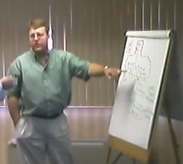
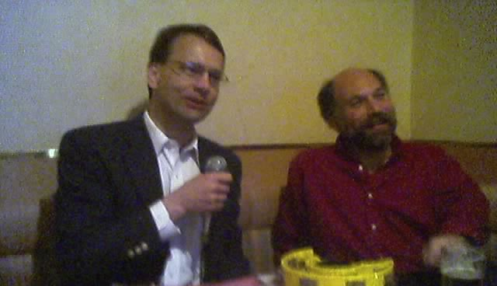
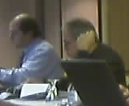

Making a Grid: Just connecting gadgets to a fabric is not sufficient for a Grid - there are “virtual organizations” with rights and permissions
Dan
Manages
Can_use
PI_of
PI_of
Can_use
Can_watch
Architect_of
Billie
Manages
PI_of
Sings
Carl
Gokhan
Andre
Works_with
Does_NOT_sing

Slide 8
Grid Technology + Virtual Organization = a Real-Live Grid

Slide 9
Making a Grid: Back to the flaw (aka challenge) - it is in this picture somewhere….
The Globus Toolkit

Slide 10
Making a Grid: Hint - Which of these six elements is the most difficult to connect to the Grid….
The Globus Toolkit

Slide 11
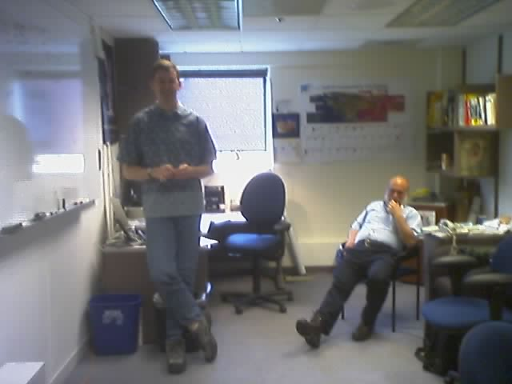
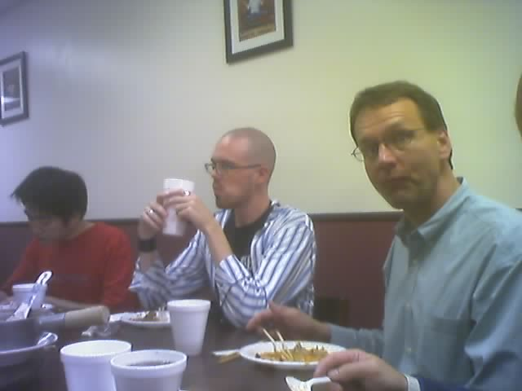
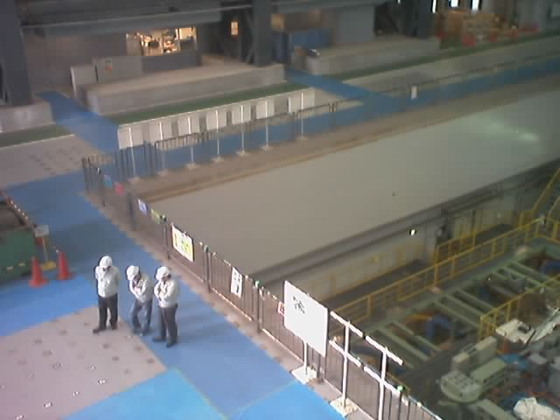
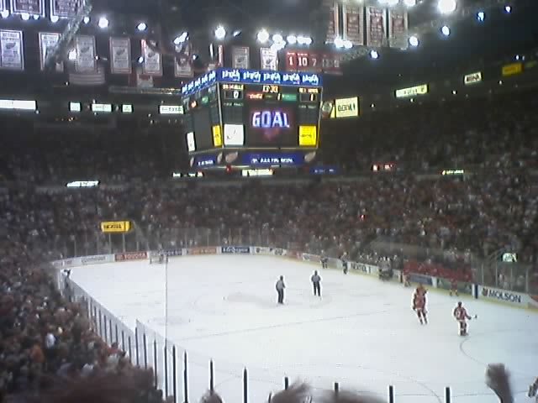
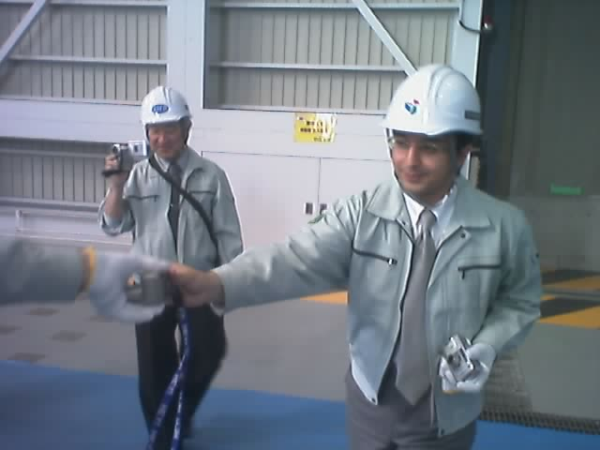
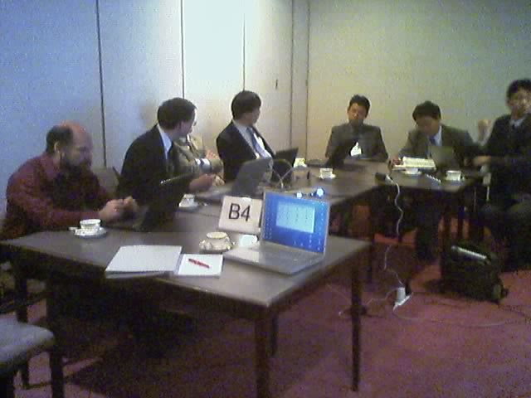
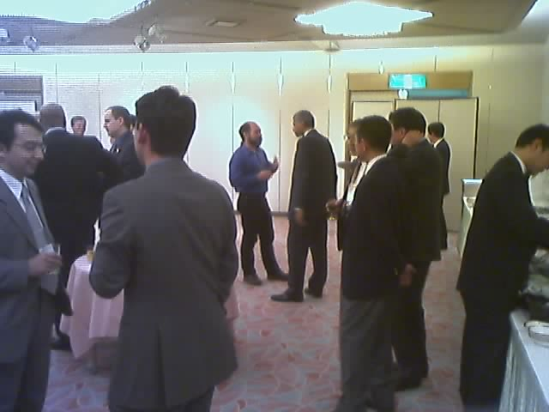
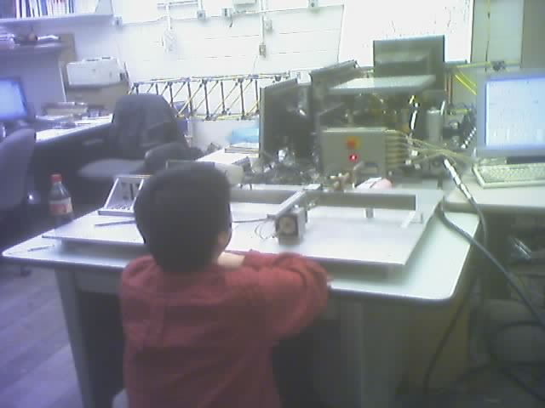

Making a Grid: The hard part is that people won’t stand still long enough to install the Globus toolkit on them…

Slide 12
Making a Grid: People are more complex than computers.
The Globus Toolkit
What to do ??

Slide 13
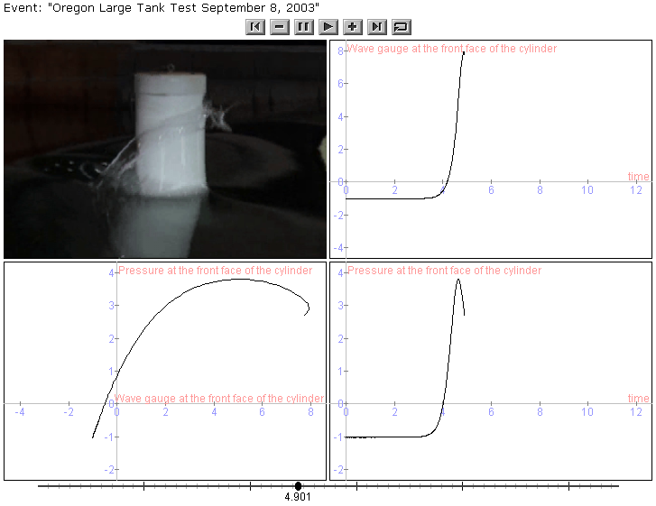
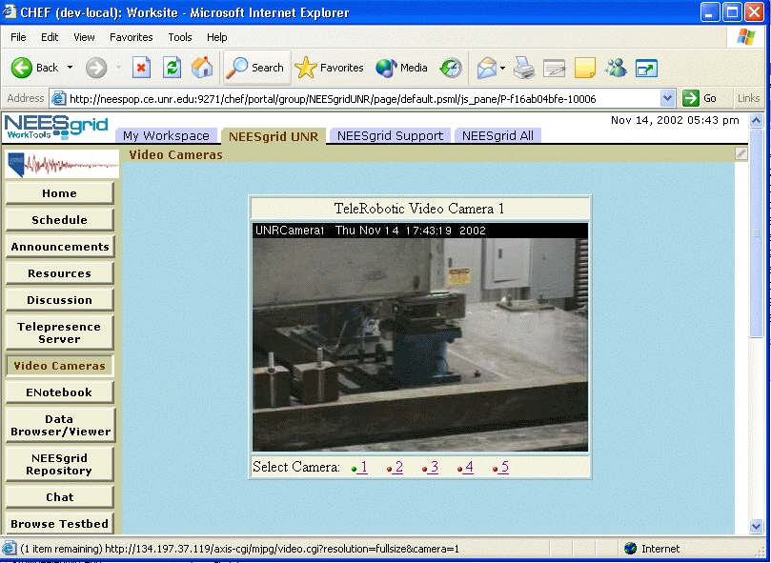
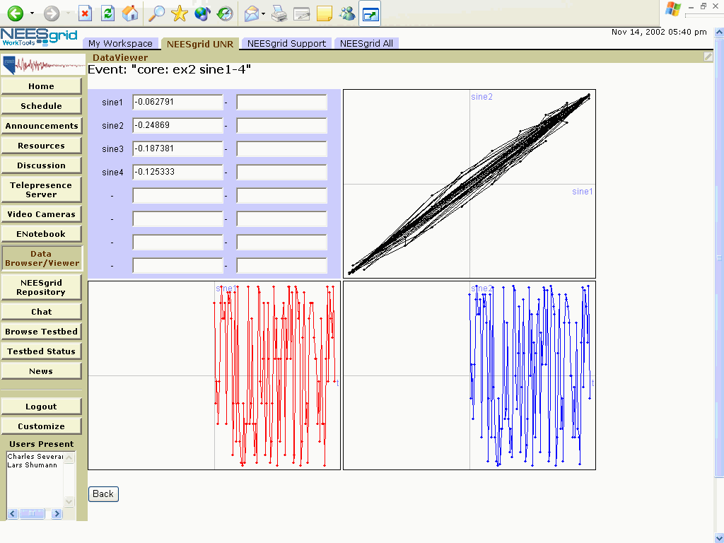
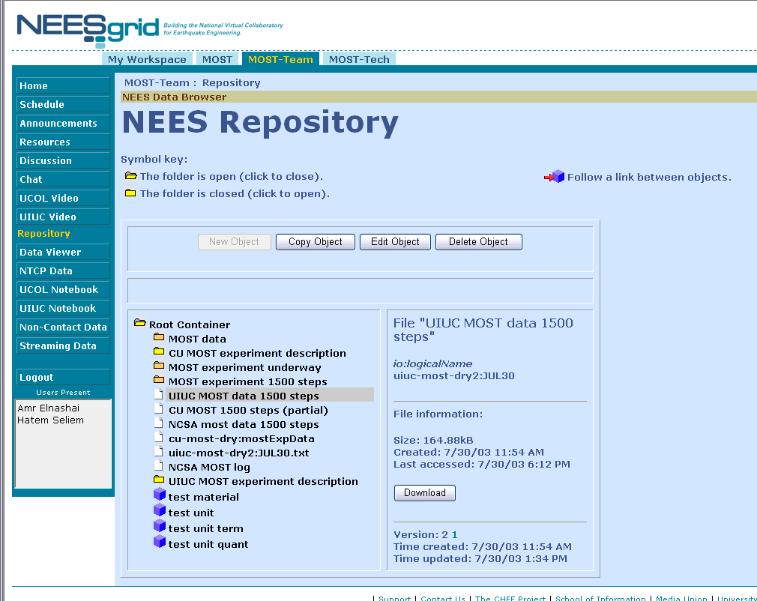
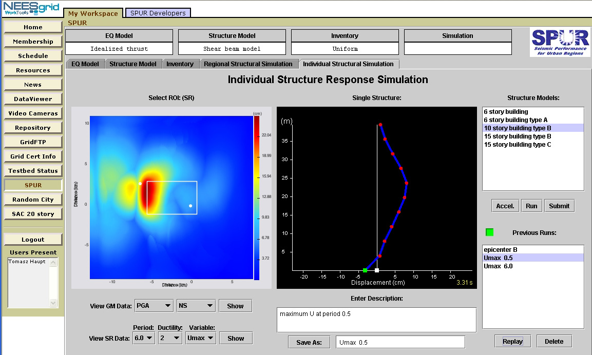
Making a Grid: Grid Portals bridge the gap creating a familiar browser-based user interface to their Grid
The Grid
Portal
Technologies
Sakai
http + browser
COG
uPortal
GridPort
CHEF
Open Grid Computing Environment
GridSphere

Slide 14
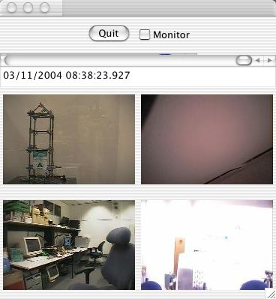
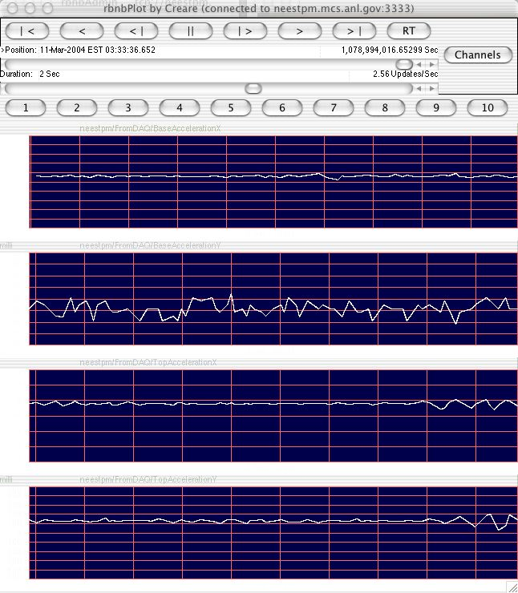
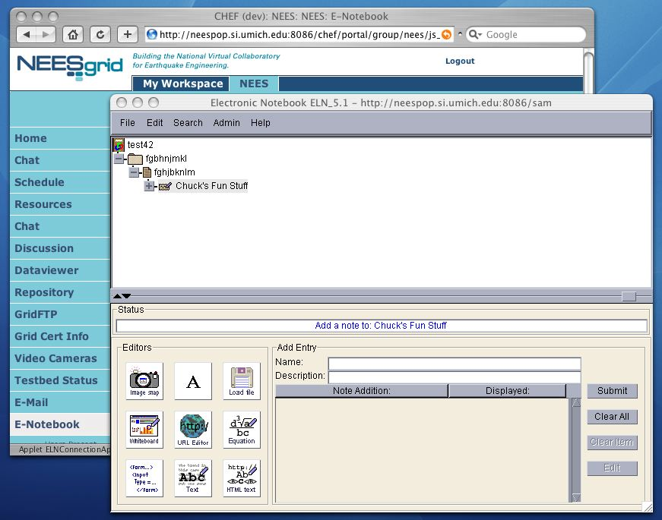
Making a Grid: Grid moving towards the desktop
While Grid Portals allow everyone to use Grid resources, and provide and excellent ways to collect and trivially distribute functionality, with the emergence of a well supported desktop Java and Java-based GT3 and GT4, it is more and more practical to make a standard Mac, PC, or UNIX desktop a true peer within the Grid with full credentials and desktop applications with higher-functionality interfaces and higher performance.
Grid portals still have a role in this work for those who can’t or won’t alter their personal system or move from computer to computer. We can also develop common APIs between portals and desktop tools so as to maximize reuse of non-display aspects of software.
The Grid

Slide 15
Grid Portals
Provide single installation of Globus for many people - many of whom cannot install software on servers or their desktop
Provide access to and help manage users credentials
Provide a single-point of contact to allow many elements of an application to be assembled

Slide 16

Chalk Talk:School of Portals
NEES 1.1
NEES 3.0
NEES 4.0
CHEF
OGCE 1.2 ?
Jetspeed
OGCE 1.1
OGCE 2
Sakai
GridPort 2
GridPort 3
GridPort
Alliance
uPortal
GridSphere
XCAT
Competition
Collaboration
Convergence

Slide 17
What is a Portal?
Properly done, a portal allows a “marketplace” of portlets. One can assemble a portal from available portlets. Portals allow reuse of portlets with general capabilities and development of specific capabilities.
Home
Athletics
Sakai
Portal
controls
navigation
and
layout
CS101
EE499
EE499-Sec01
Chess
Motor
Help
Fred: He will move P-K4
Joe: Nah - he did that last time
Mary: It does not matter what he does - I will beat him again
Play
FAQ
Meeting
Admin
Portal
manages
components
and calls
them when
output is
needed.
Watch me now mary!
Send
Chess
Portlet
Chat
Portlet

Slide 18
How Do You Write a Portlet?
Old way:
  Write/Adapt some Perl - Gridport
  Pick a Portlet API from: Jetspeed, CHEF, WebSphere, Plumtree, uPortal, Oracle, Microsoft (several versions), GridSphere
  Have your code run on < 10% of the portals on the planet with little or no portability
New Way:
  Write JSR-168 (Portlet API) or WSRP (Web Services for Remote Portals)

Slide 19
Aside: Why JSR-168/WSRP ?
A slightly paraphrased conversation November 2003 at a Grid Portal meeting at Indiana University.
Charles Severance: (using his best expert from out-of-town voice) The architecture team from the CHEF project has done an evaluation of JSR-168 as best we can figure it out and have concluded that it is a bit too “HTML-oriented” - we want tools that are relevant beyond the web environment.
Geoffrey Fox (Indiana University): JSR-168 and WSRP will be standards - people will use them regardless of your opinion or your software.

Slide 20
Aside: Why JSR-168/WSRP ?
A slightly paraphrased conversation November 2003 at a Grid Portal meeting at Indiana University.
Charles Severance: (using his best expert from out-of-town voice) The architecture team from the CHEF project has done an evaluation of JSR-168 as best we can figure it out and have concluded that it is a bit too “HTML-oriented” - we want tools that are relevant beyond the web environment.
Geoffrey Fox (Indiana University): JSR-168 and WSRP will be standards - people will use them regardless of your opinion or your software.
Charles Severance: (pause) Good point. (sits down)

Slide 21
How do you write a portlet?
What presentation approach - raw HTML, XSLT, JavaBean-style presentation?
Thick or thin?
Do tools talk to a database?
Web/Grid Services?
Use an Applet?
Use a Servlet?
Is each portlet a stovepipe or do they cooperate?
Do you rely on Portlet Services outside the standard or make your own cover API?
What packages do you import?

Slide 22
Portlet Design Patterns - Presentation Layer - the old ways
The Portal API
HTML Req/Resp
HTML
Req
HTML
Resp
HTML
Req
HTML
Resp
XSLT with pluggable templates
Velocity templates
The I don’t need no presentation layer. I can handle, accessibility, multiple languages, browser compatibility, and common look and feel all in my own code portlet!
XML
Context
The almost abstract but somewhat asymmetric portlet… (aka the Half-abstract portlet)
A Jetspeed Portlet

Slide 23
Portlet Design Patterns - Symmetric Presentation Layers - the wave of the future
The Portal API
HTML Req/Resp
HTML Req/Resp
HTML Req/Resp
Java Server Faces
Renderer
Sakai / JSF
Renderer + Widgets
GridSphere
Renderer + Widgets
Display JavaBean with output and input symmetry.
Display JavaBean with output and input symmetry.
Display JavaBean with output and input symmetry.
Java Server Faces
Portlet
Sakai
Portlet
GridSphere
Portlet

Slide 24
Portlet Design Patterns - Where does the information come from / go to?
The Portlet API
Presentation
Presentation
WSRP (Web Services for Remote Portals)
WSRP (Web Services for Remote Portals)
The monolithic, stovepipe
“whole
enchilada”, I don’t need anyone else, leave me alone, I am an island portlet! Usually written by a lone programmer.
The “thin layer” on top of Grid services
Direct implementation of the WSRP protocol in a remote portlet.
Remote “glue” which transforms the WSRP back into the Portlet API.
Grid web services
Presentation
Grid services implemented remotely which implement significant functionality.
TCP/IP, JDBC, File-system, low-level web services, etc…
A standard portlet which happens ot be installed and running on an other system.

Slide 25
Portlet Design Patterns - Where does the information come from / go to?
The Portal API
Presentation
Presentation
Presentation
The medium-thin portlet which depends on a locally instance standardized API for all persistence, communication, etc.
Portlets handle interaction patterns, event handling, and state management.
Portlets use many different APIs (there is not a 1-to-1 crrespondence) between portlet and API components.
Strong layer with many APIs with a pluggable implementation capability for each API allowing for significant reconfiguration and reorientation of the portal without modifying tools.
TCP/IP, JDBC, File-system, low-level web services, grid-services etc…

Slide 26
Portlet Design Choices
All of these decompositions are useful given the constraints of the portlet implementation environment.
There is a general trade-off between interdependence and reuse of code.
Interesting questions
  Do portlets hide behind an opaque API (Sakai-style)?
  Where is the tradeoff between a portlet orchestrating a lot of web services and simply using WSRP?
  Is it ever a good idea to write code directly to WSRP or should we just use JSR-168?
In reality, given that a portal will be (should be) built from components from many sources - all variants are likely.

Slide 27
Exciting possibilities
If the WSRP to JSR-168 API works out well (there is much left to understand), each portal should both be a WSRP producer and consumer.
This leads to significant opportunities for creating federated portals with seamless ability to place functionality and integrate it in different ways.
There is much work to do in this area to fully relalize this potential - it may lead to the need to a much richer WSRP based more on Grid concepts than web services concepts.

Slide 28


uPortal Portlet Roadmap
uPortal 2.3
uPortal 3.0
uPortal 2.3
  Support Portlets (JSR-168) via adapter
uPortal 3.0
  Implement Portlet Specification (JSR-168)
  Support IChannel via adapter
Framework
Chan
Chan
Framework
Pluto
Chan
Chan
Portlet
Portlet
Adapter
Portlet
Portlet
Pluto
Adapter
Portlet
Portlet
Chan
Chan
Feb 19, 2004
SAKAI Developer’s Workshop, Stanford University

Slide 29
What is next…
Sakai Discussion - Building a portal with highly collaborative portlets with very strong presentation and API layering requirements.
NEESGrid Discussion - Building a real-life Grid portal with software from many collaborators and solving the problems of a community of scientists…

