Slide 1
Using Collaborative Tools in NEESGrid
Charles Severance
University of Michigan
NEESGrid System Integration Team
www.neesgrid.org

Slide 2
Authors
Tom Finholt, Joseph Hardin, Dan Horn
School of Information, University of Michigan, Ann Arbor, MI
finholt@umich.edu, hardin@umich.edu, danhorn@umich.edu
Glenn Golden, Jim Eng, Charles Severance, Terry Weymouth
University of Michigan Ann Arbor, MI
ggolden@umich.edu, jimeng@umich.edu,
csev@umich.edu, weymouth@umich.edu
Joe Futrelle
National Center for Supercomputing Applications,
University of Illinois at Urbana-Champaign, Champaign, IL
futrelle@ncsa.uiuc.edu
Paul Hubbard
Argonne National Laboratory, Argonne, IL
hubbard@mcs.anl.gov
James D. Myers
Pacific Northwest National Laboratory
jim.myers@pnl.gov

Slide 3
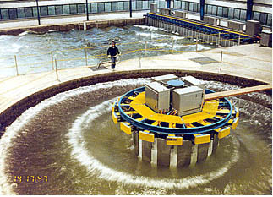
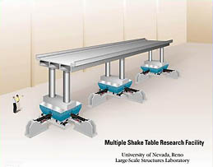
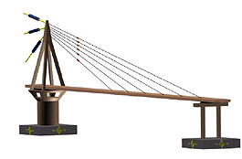
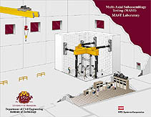
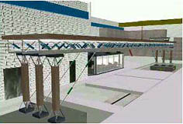
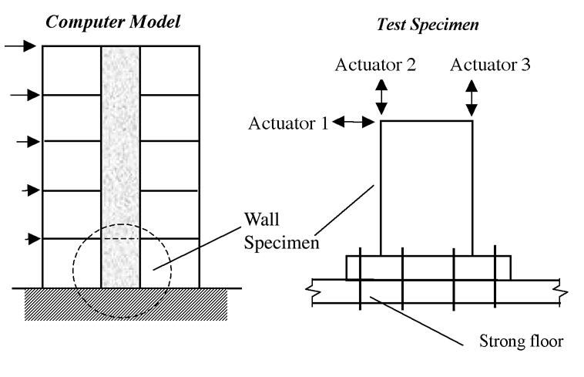
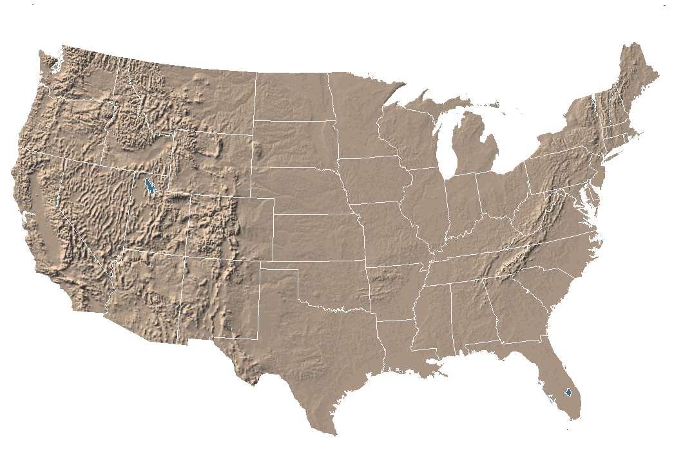
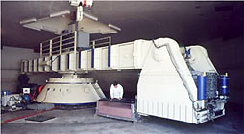
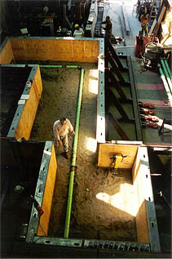
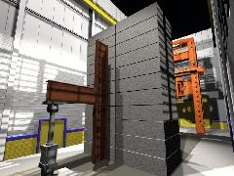
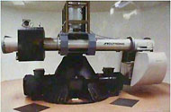
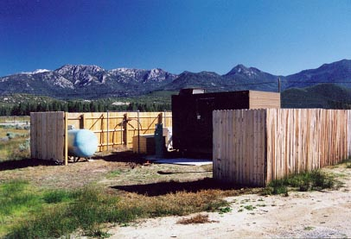
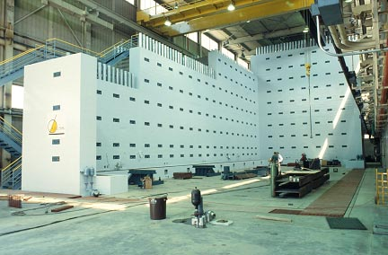
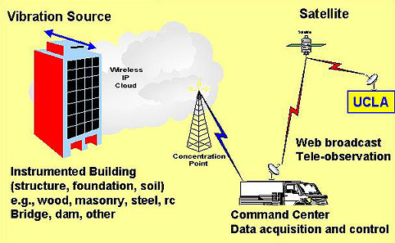
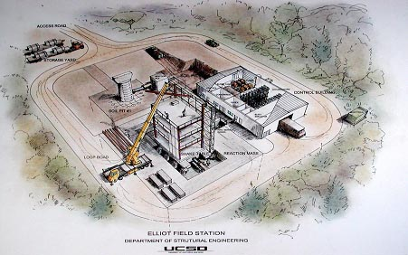
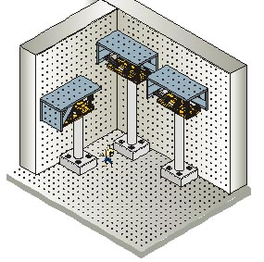
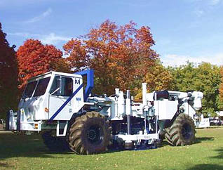

Slide 4
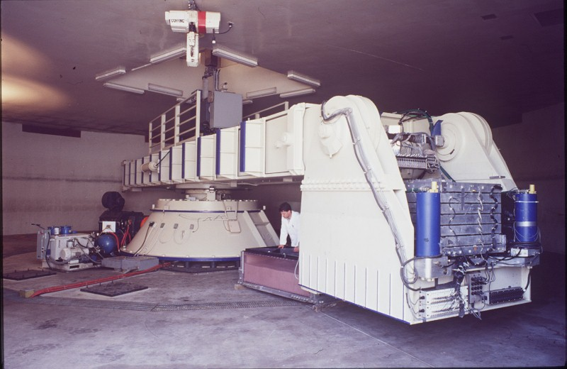
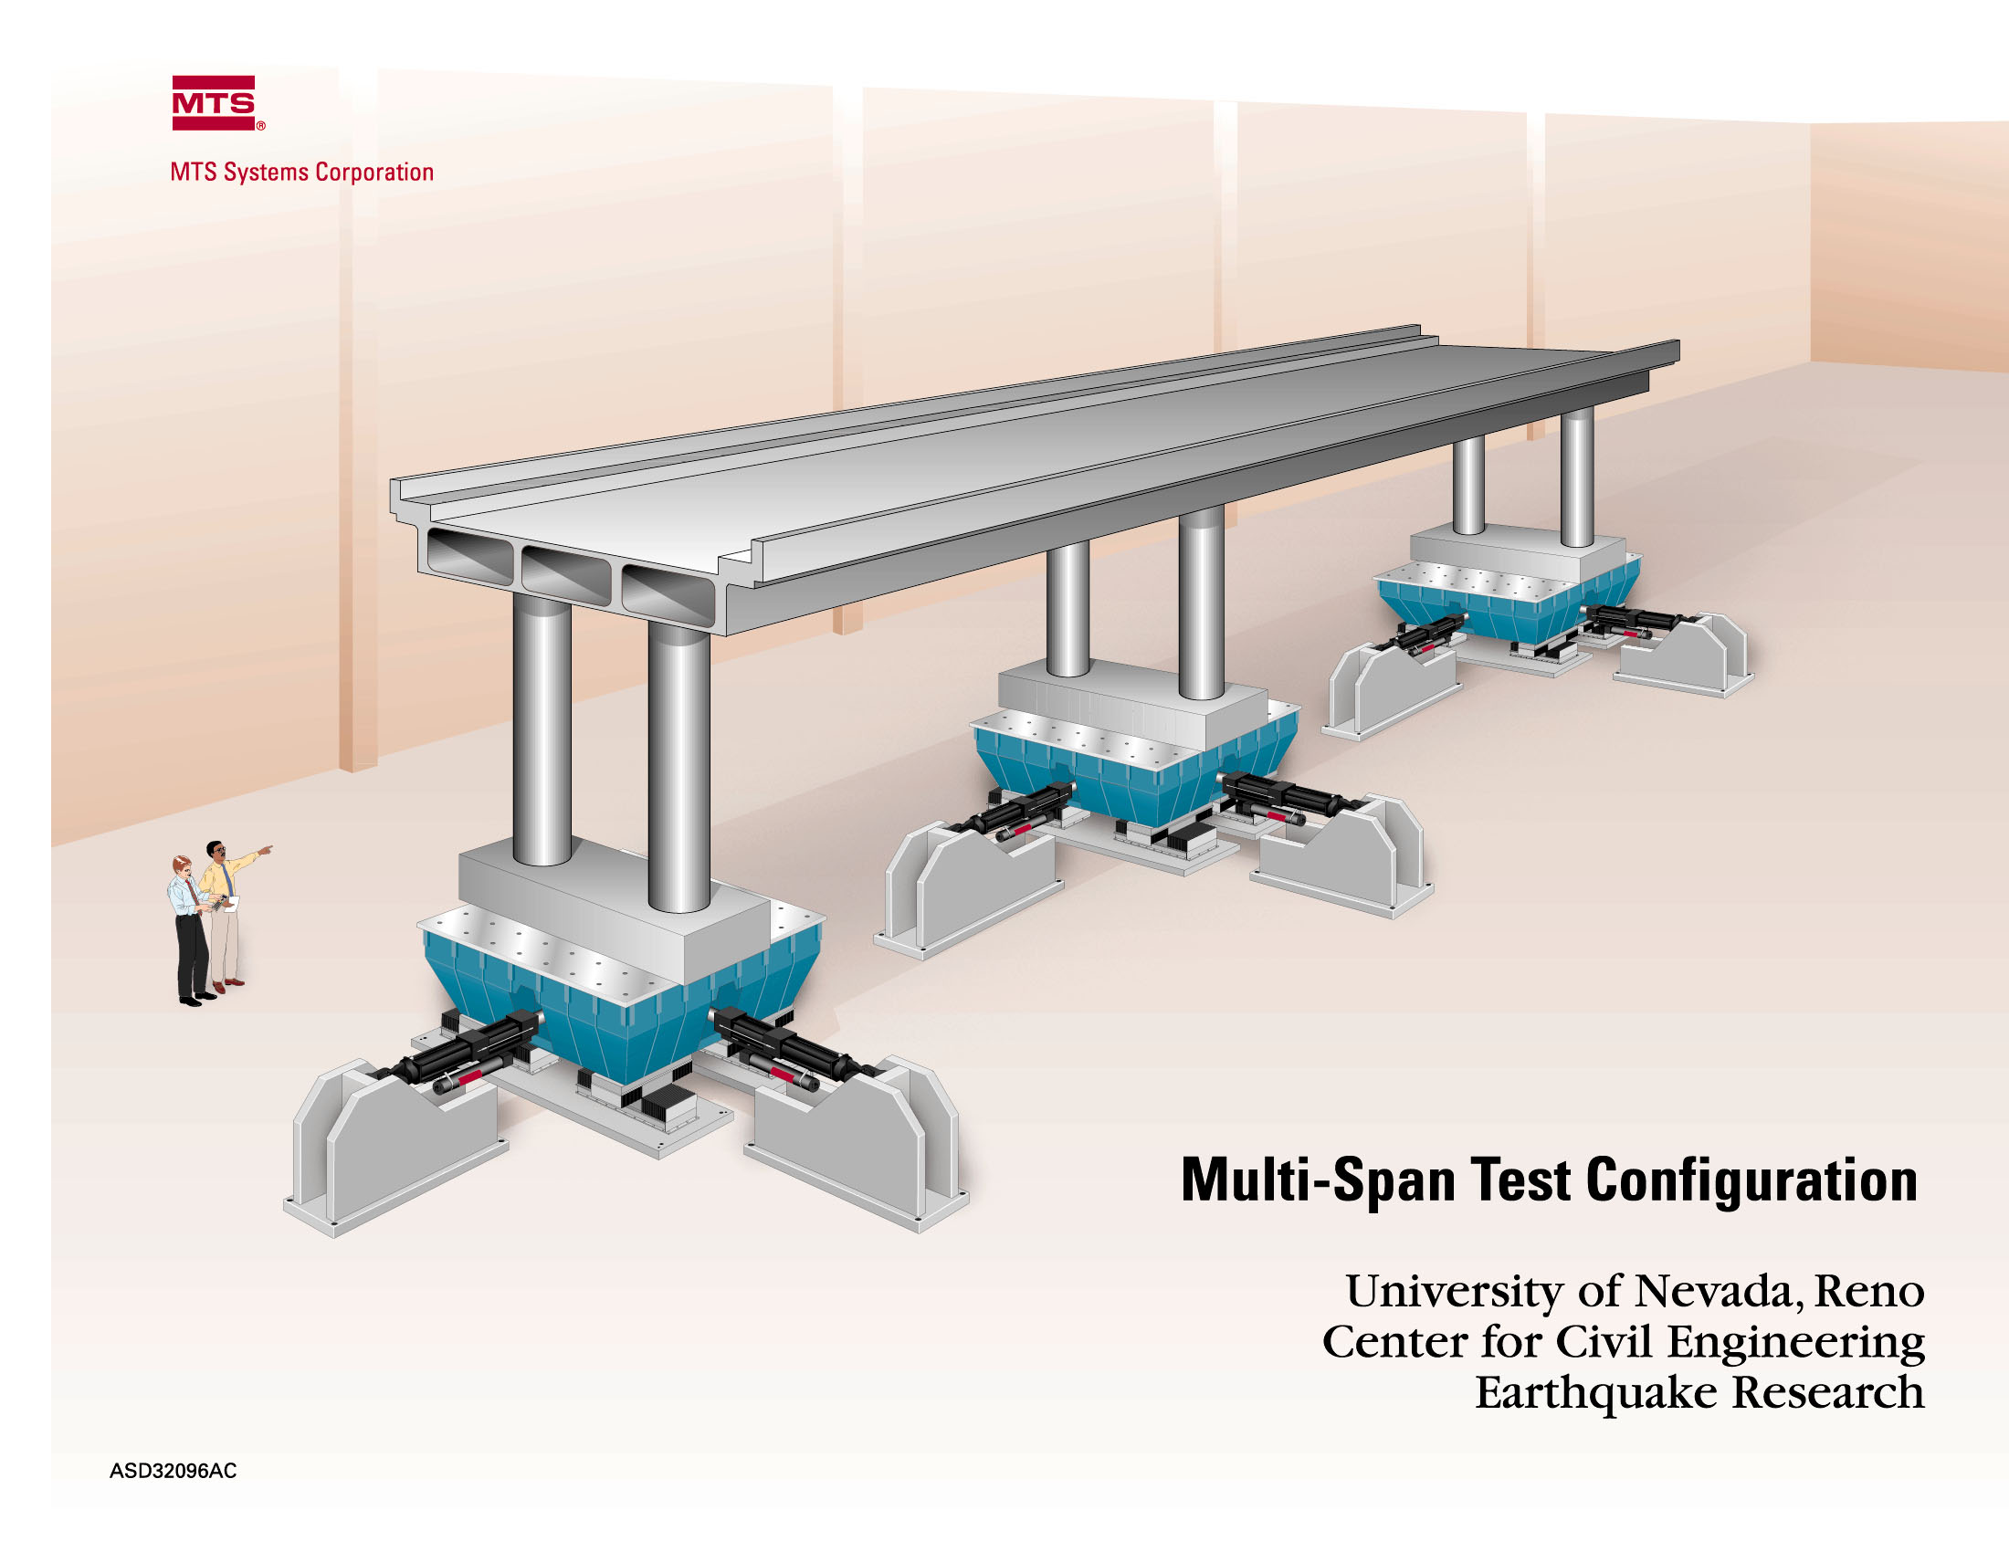
Grid: A collection of “things” (people, equipment, etc) which need to work together to accomplish some task
You have three years to deploy software so as to make this all seem like one single experimental site…. Seems easy enough.

Slide 5
Making a Grid: Step 1 - Start with a Grid Toolkit
The Globus Toolkit

Slide 6
Making a Grid: Step 2 - Add those protocols to the “things” that need to work together…
The Globus Toolkit

Slide 7
Making a Grid: Step 3 - Plug it all in…
The Globus Toolkit

Slide 8

Making a Grid: Step 3 - A miracle happens! NEESGrid is connected together.

Slide 9
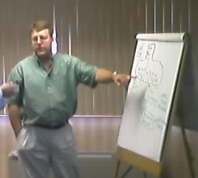
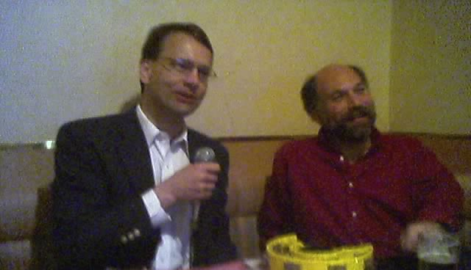
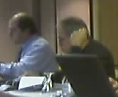

Making a Grid: Just connecting gadgets to a fabric is not sufficient for a Grid - there are “virtual organizations” with rights and permissions
Dan
Manages
Can_use
PI_of
PI_of
Can_use
Can_watch
Architect_of
Bill
Manages
PI_of
Sings
Carl
Gokhan
Andre
Works_with
Does_NOT_sing

Slide 10
Grid Technology + Virtual Organization = a Real-Live Grid

Slide 11
Making a Grid: One of the elements shown below is more difficult to connect to the grid than the others…
The Globus Toolkit

Slide 12
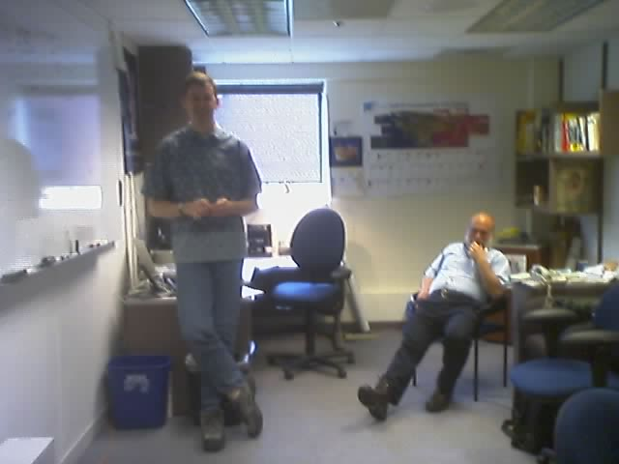
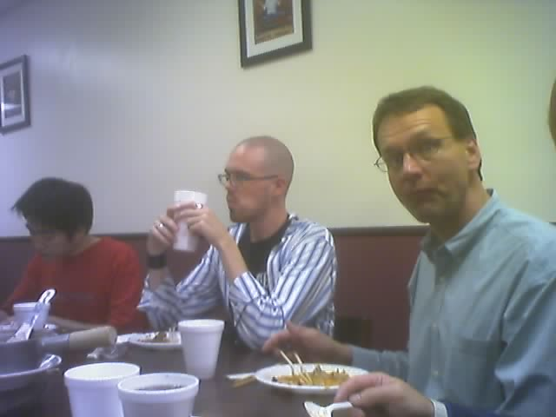
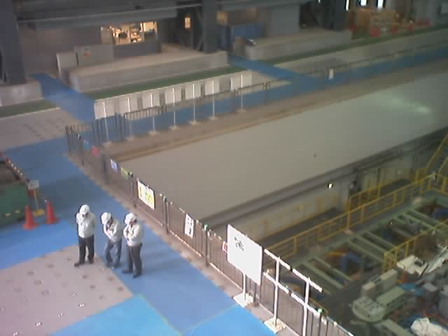
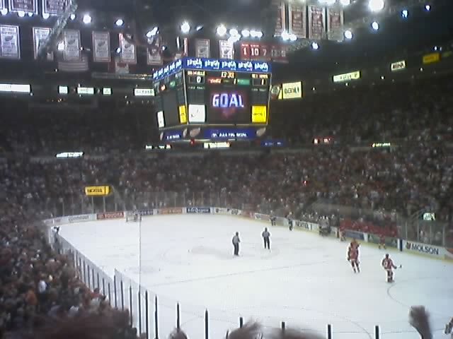
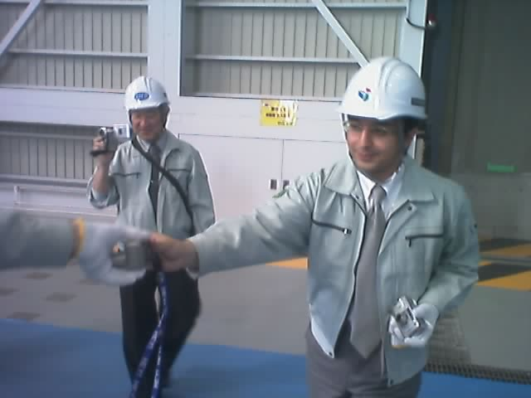
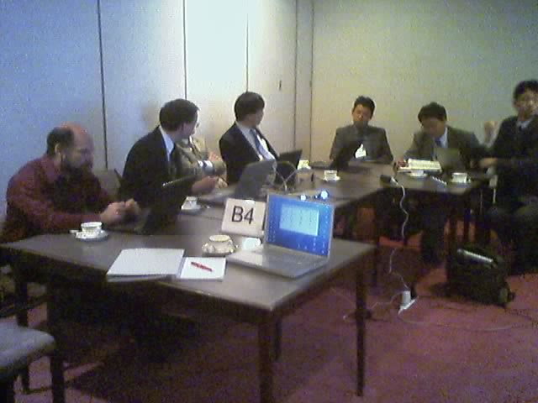
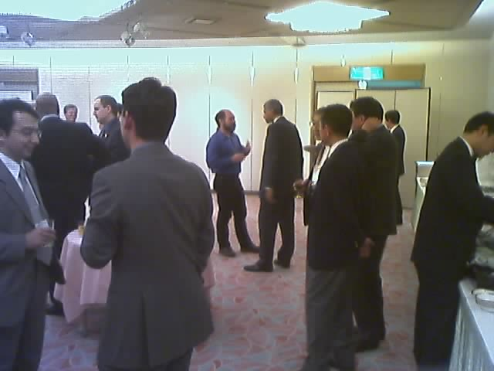
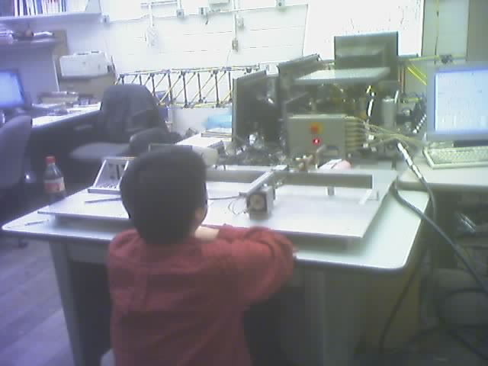
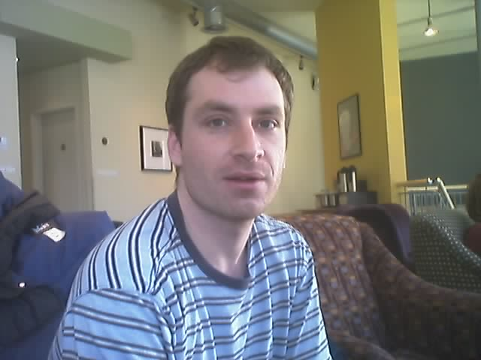
Making a Grid: The hard part is that people won’t stand still long enough to install the Globus toolkit on them…

Slide 13
Making a Grid: People are more complex than computers.
The Globus Toolkit
What to do ??

Slide 14
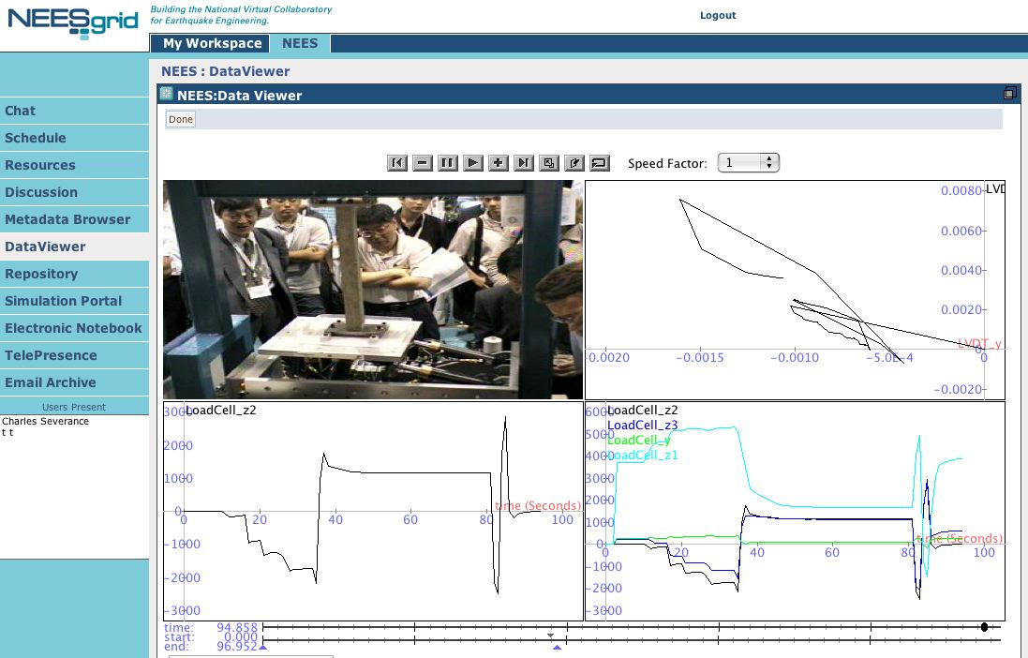
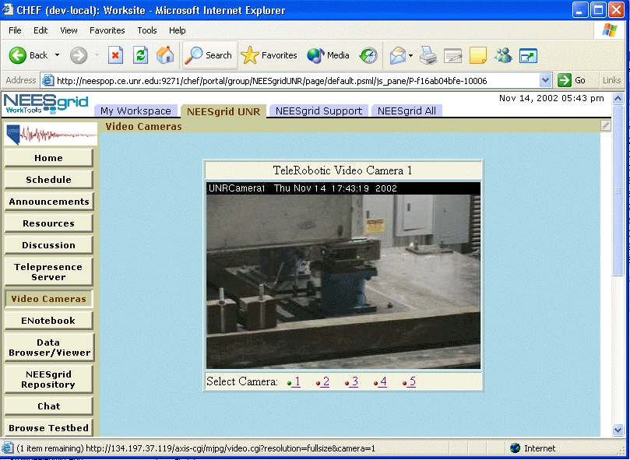
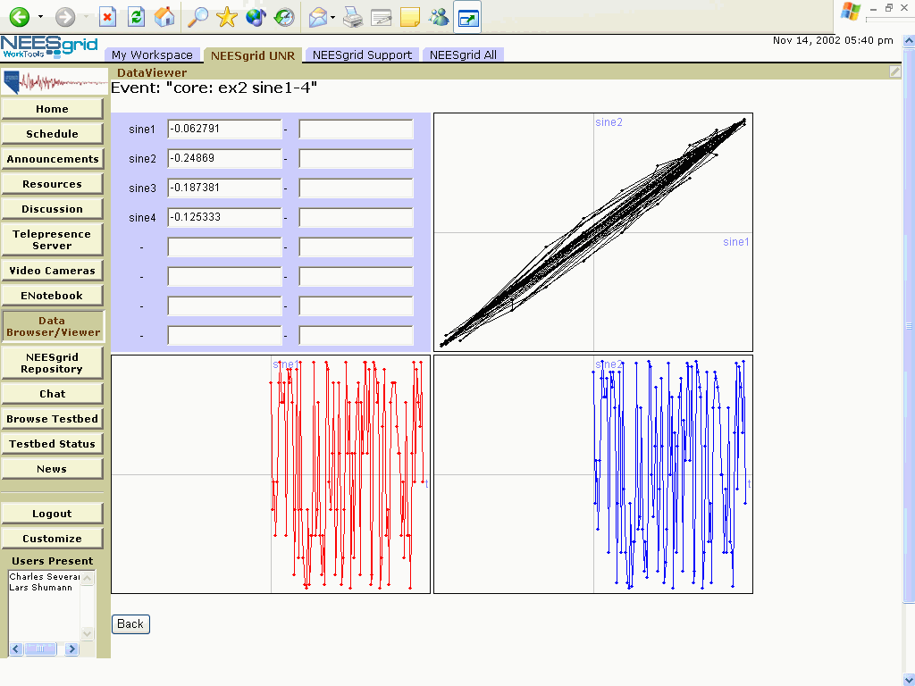
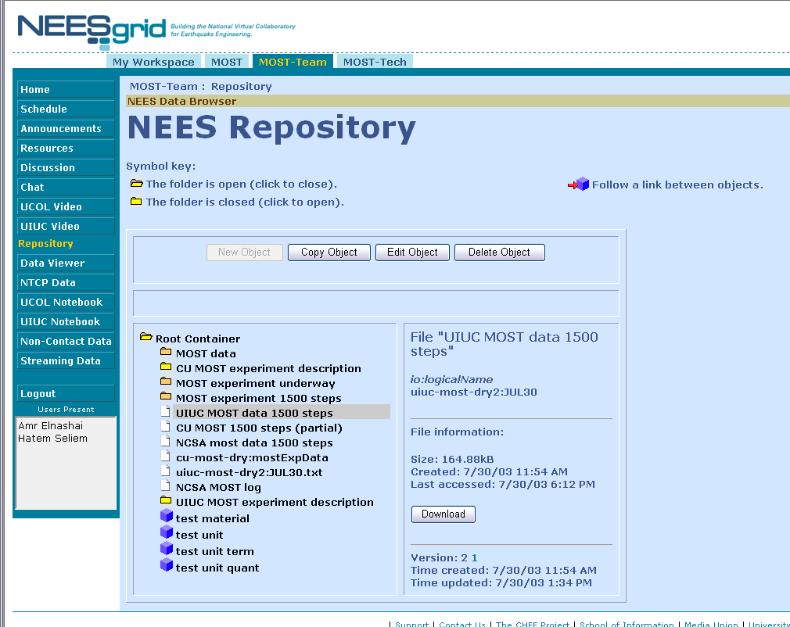
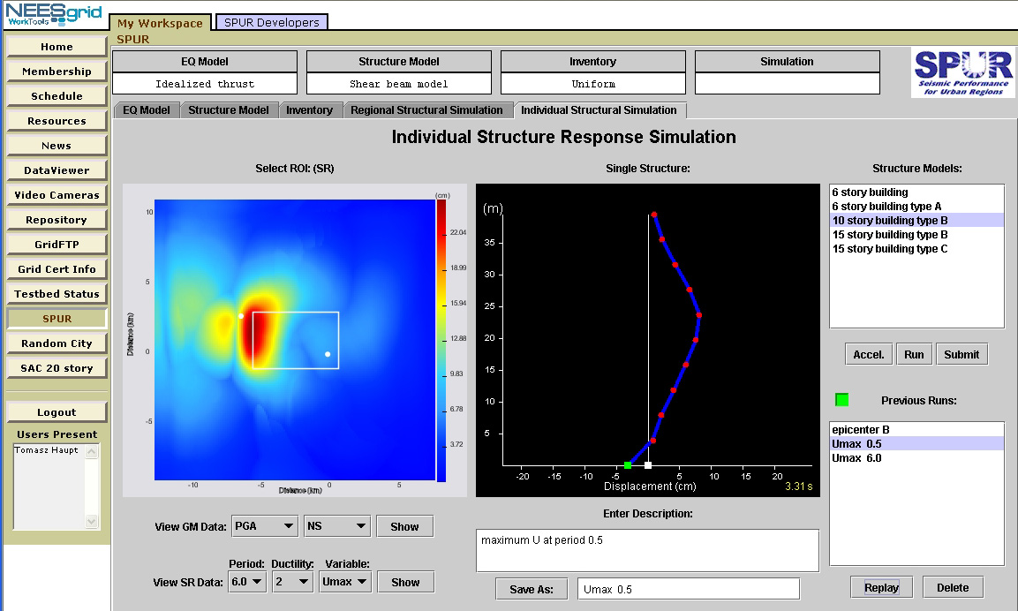
Making a Grid: Grid Portals bridge the gap creating a familiar browser-based user interface to their Grid
The Grid
Portal
Technologies
Sakai
http + browser
COG
uPortal
GridPort
CHEF
Open Grid Computing Environment
GridSphere

Slide 15
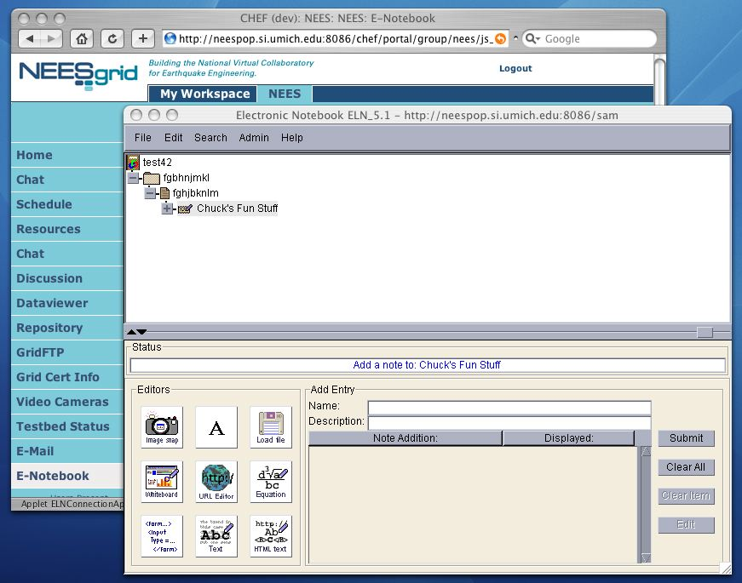
NEESGrid: From a user perspective things look a little different - sites now have equipment, data, people, and a portal..
Data
Data
Data
Data

Slide 16
Issues
Within site
  The portal provides the user interface to the site including collaborative software for working together
Cross site
  By basing NEESgrid on Grid technologies, we get a flexible distributed single sign-on and the ability to provide access control to equipment and information across sites

Slide 17
Within-Site Software
The collaborative portal for each experimental sites can support many groups
  Shared calendar
  Shared disk space
  Chat
  Threaded discussion
  E Mail
  Data analysis and display tools
  Metadata entry and search tools
  Data repository tools
  Shared electronic notebook
This software can be used so that groups can plan and monitor experiments, prepare proposals, coordinate efforts, etc…

Slide 18
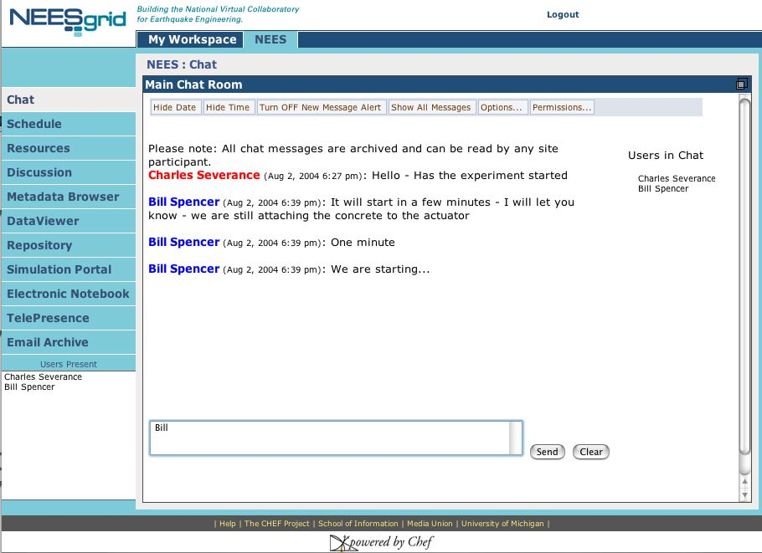
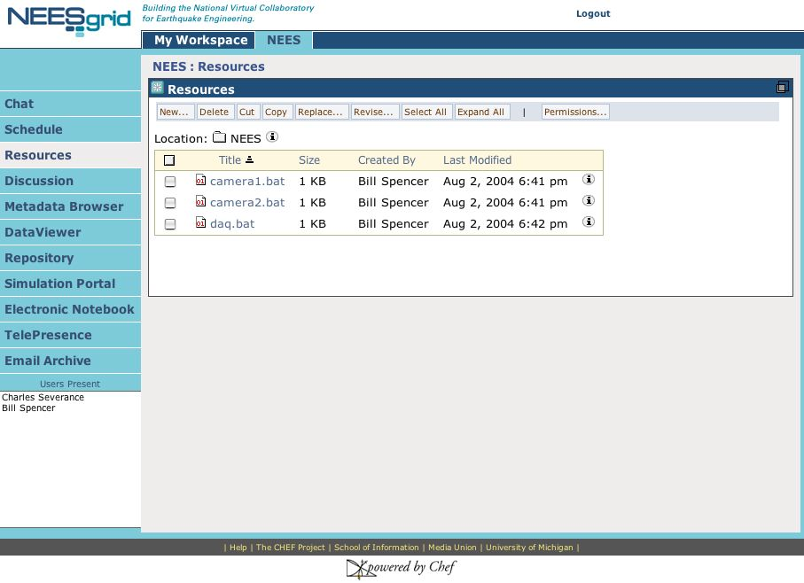
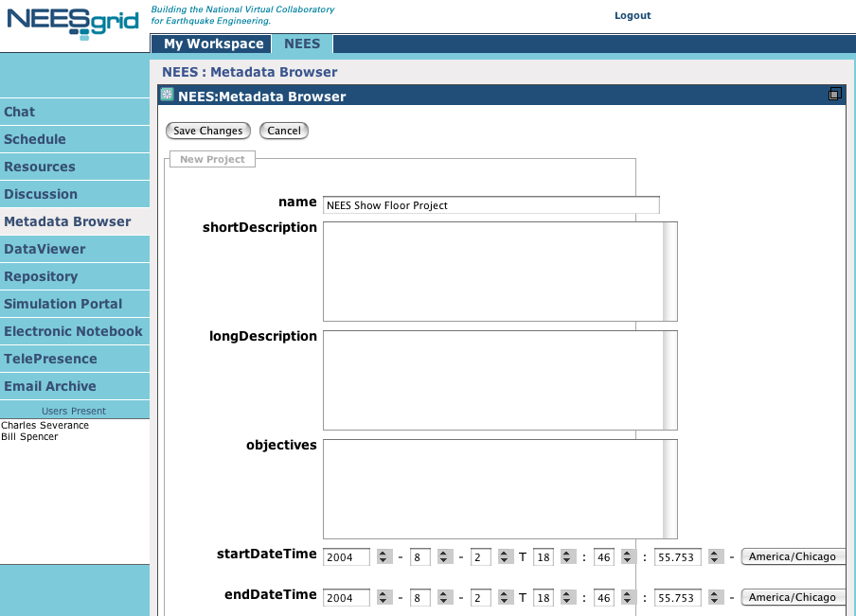

Slide 19
Across Site Security
Single sign-on across all of the NEES portals using Grid credentials while still retaining local control of accounts
Single access-control space using Grid credentials for data repositories - allows for the secure federation of data across multiple repositories

Slide 20
NEESGrid: Delivering a solution which can securely connect people, simulations, data, and equipment
Data
Data
Data
Data

Slide 21
Future Directions
There is significant effort going forward in developing software to support virtual organizations both at a foundation and user interface level
  NSF National Middleware Grid Portal - www.ogce.org
  Sakai Project - www.sakaiproject.org
The NEESgrid experience has had a significant impact on both of these efforts and is well positioned to leverage the work of these efforts going forward.

Slide 22
Conclusion
The NEESgrid software provides a framework to enable and encourage collaboration
  Collaborative end user software and tools
  Grid protocols provide distributed security infrastructure to allow collaboration at the data and equipment levels
The code is available for download now and can be used outside of NEES sites - see www.neesgrid.org

Slide 23
Questions…

