Slide 1
NEESGrid: Early Experiences in CyberInfrastructure
Charles Severance
University of Michigan
Sakai Project, NEESGrid Project, OGCE Project
www.dr-chuck.com
csev@umich.edu

Slide 2
NEES Founding
George E. Brown, Jr. Network for Earthquake Engineering Simulation (NEES).
Funded in 1999 - > $100M
Goal: Transform the nation’s ability to carry out earthquake engineering research, to obtain information vital to develop improved methods for reducing the nation’s vulnerability to catastrophic earthquakes, and to educate new generations of engineers, scientists and other specialists committed to improving seismic safety.
Completed: October 2004

Slide 3
NEESgrid facilitates research capabilities previously unavailable
NEESgrid links earthquake researchers across the U.S. with leading-edge computing resources and research equipment and allowing collaborative teams (including remote participants) to plan, perform, and publish their experiments
NEESgrid is a coordinated and secure architecture/environment
NEESgrid is a modular and extensible environment with a customizable user interface
NEESgrid provides common tools that allow leveraging resources and experiences
Rather than having to worry about the required cyber infrastructure, NEESgrid allows researchers to focus on the earthquake engineering challenges at hand
The goal of the System Integrator (SI) is to develop NEESgrid as the Cyber Infrastructure that will facilitate this next generation of experimentation/simulation in earthquake engineering

Slide 4
Transforming Earthquake Engineering using CyberInfrastructure
NEES and NEESgrid were not just another experiment in collaboration. It was a profound redirection of research investment for the entire field of Earth Quake Engineering. They “bet the field” on CyberInfrastructure.
NEES and
NEESGrid
Uncoordinated
Efforts
Building
NEES
Coordinated
field-wide efforts
2004
1999

Slide 5
NEES Components
New experimental facilities (15)
  Oregon State University, Rensselaer Polytechnic Institute, University of Buffalo, University of Colorado at Boulder, University of Minnesota, University of Nevada at Reno, University of Texas at Austin, and the University of California campuses at Berkeley, Davis and Los Angeles
Collaboratie Software System: NEESGrid
  Collaboration
  Data capture and sharing
  Tele-presense and Tele-operation
  Simulation
  Support for Hybrid Simulation and Physical Experiments

Slide 6
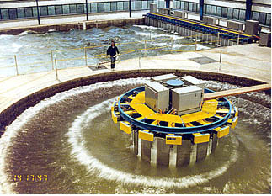
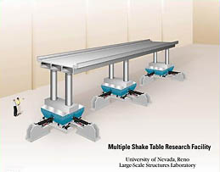
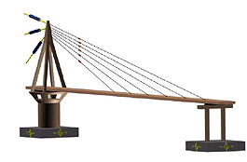
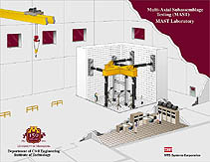
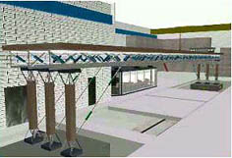
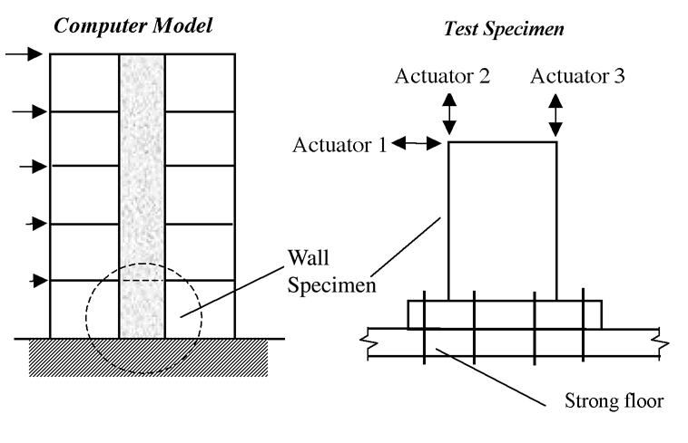
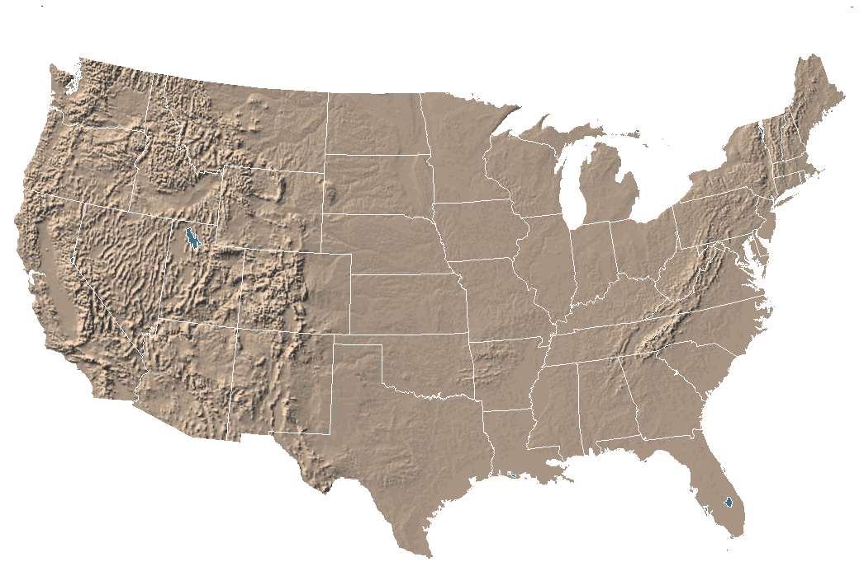
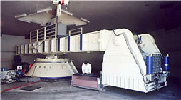
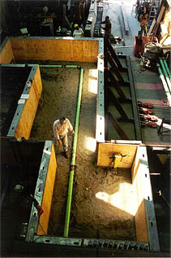
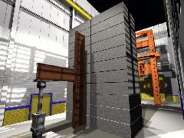
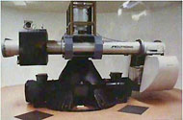
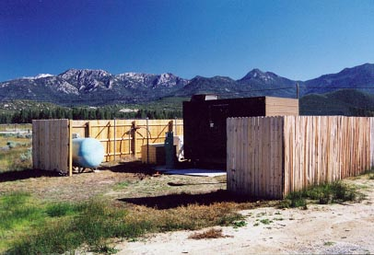
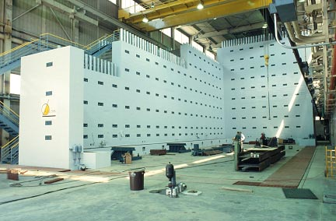
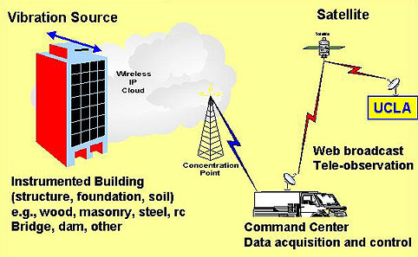
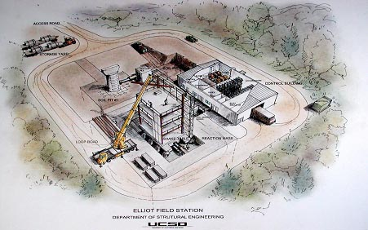
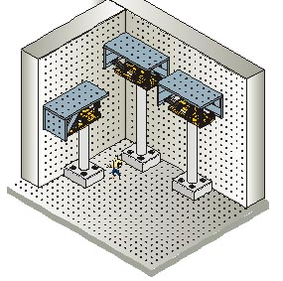
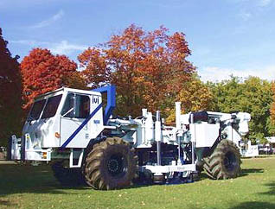

Slide 7
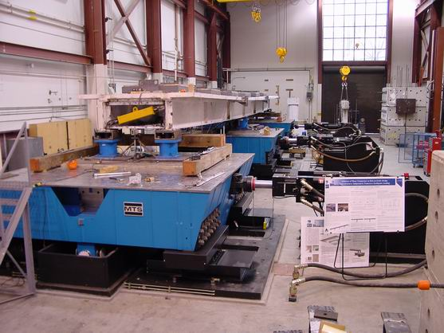
Shake table: Nevada, Reno

Slide 8
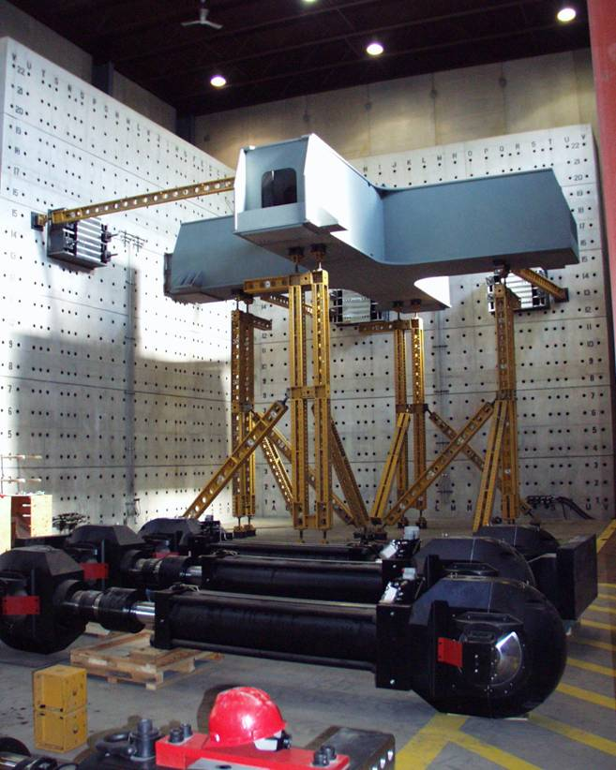
Reaction wall: Minnesota

Slide 9
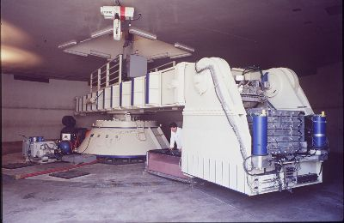
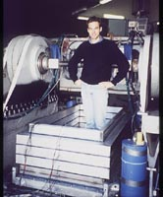
Centrifuge: UC Davis

Slide 10
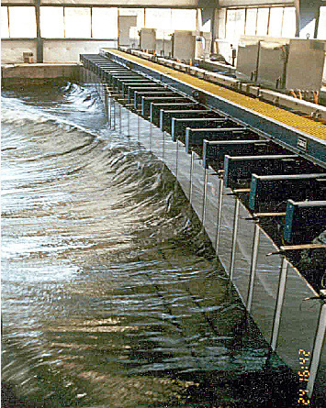
Wave basin: Oregon State

Slide 11
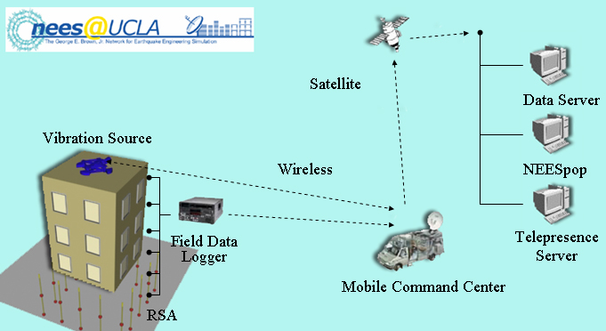
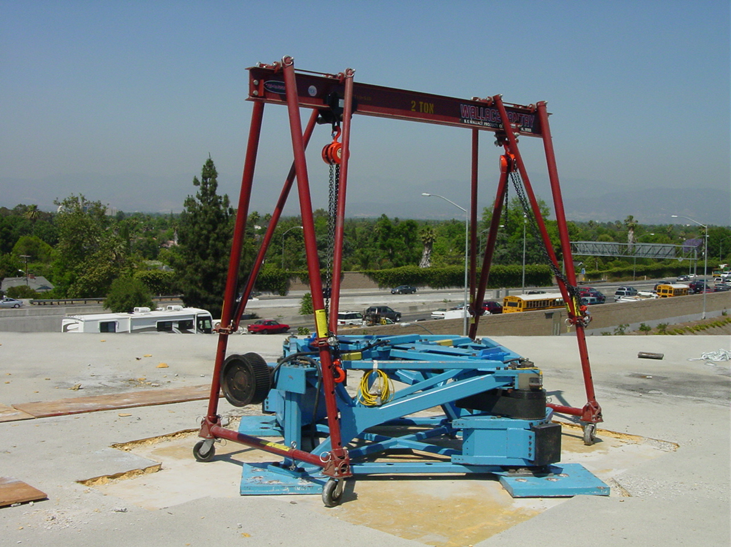
Field structural: UCLA

Slide 12
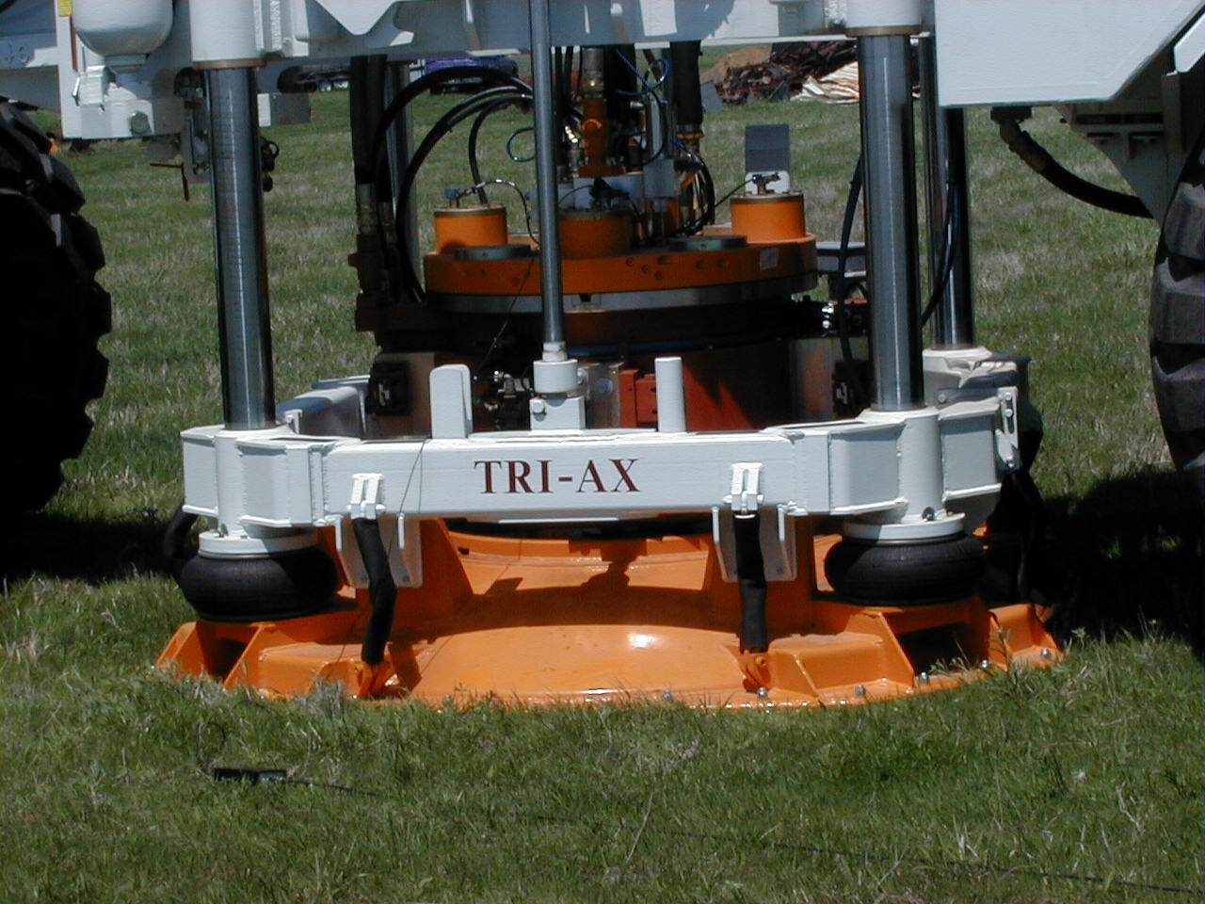
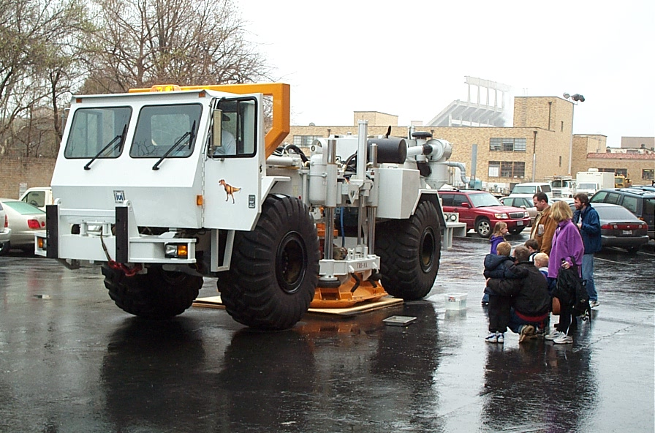
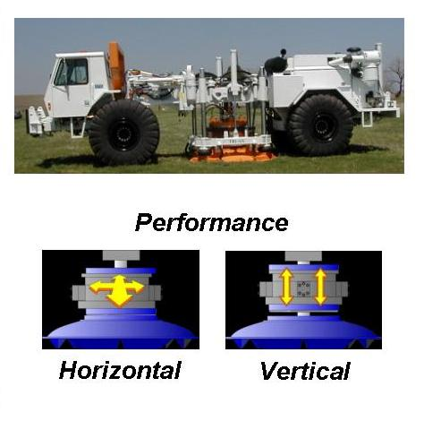
Field geotechnical: Texas

Slide 14
If we build it, they will collaborate
Data and access to data represent fundamental barriers to dispersed collaboration
Efficient movement of vast amounts of data is a prime rationale for cyberinfrastructure
Federating, visualizing and mining data are principle challenges

Slide 15
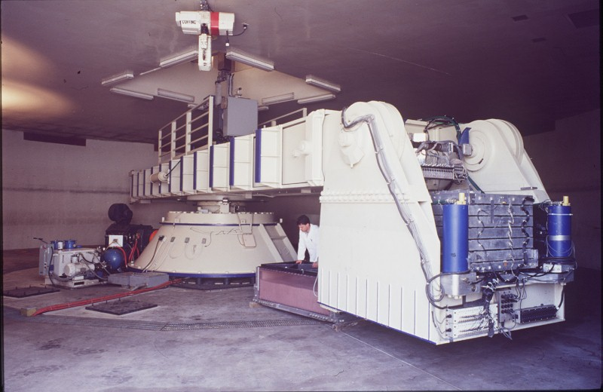
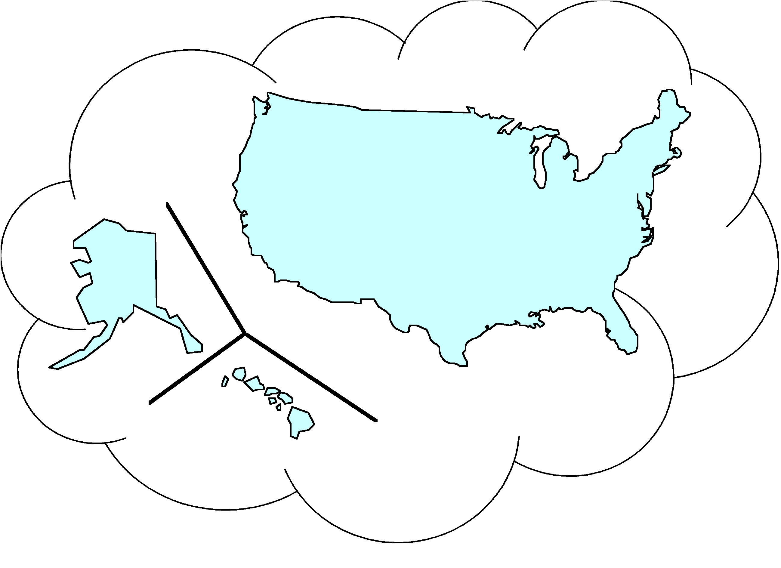

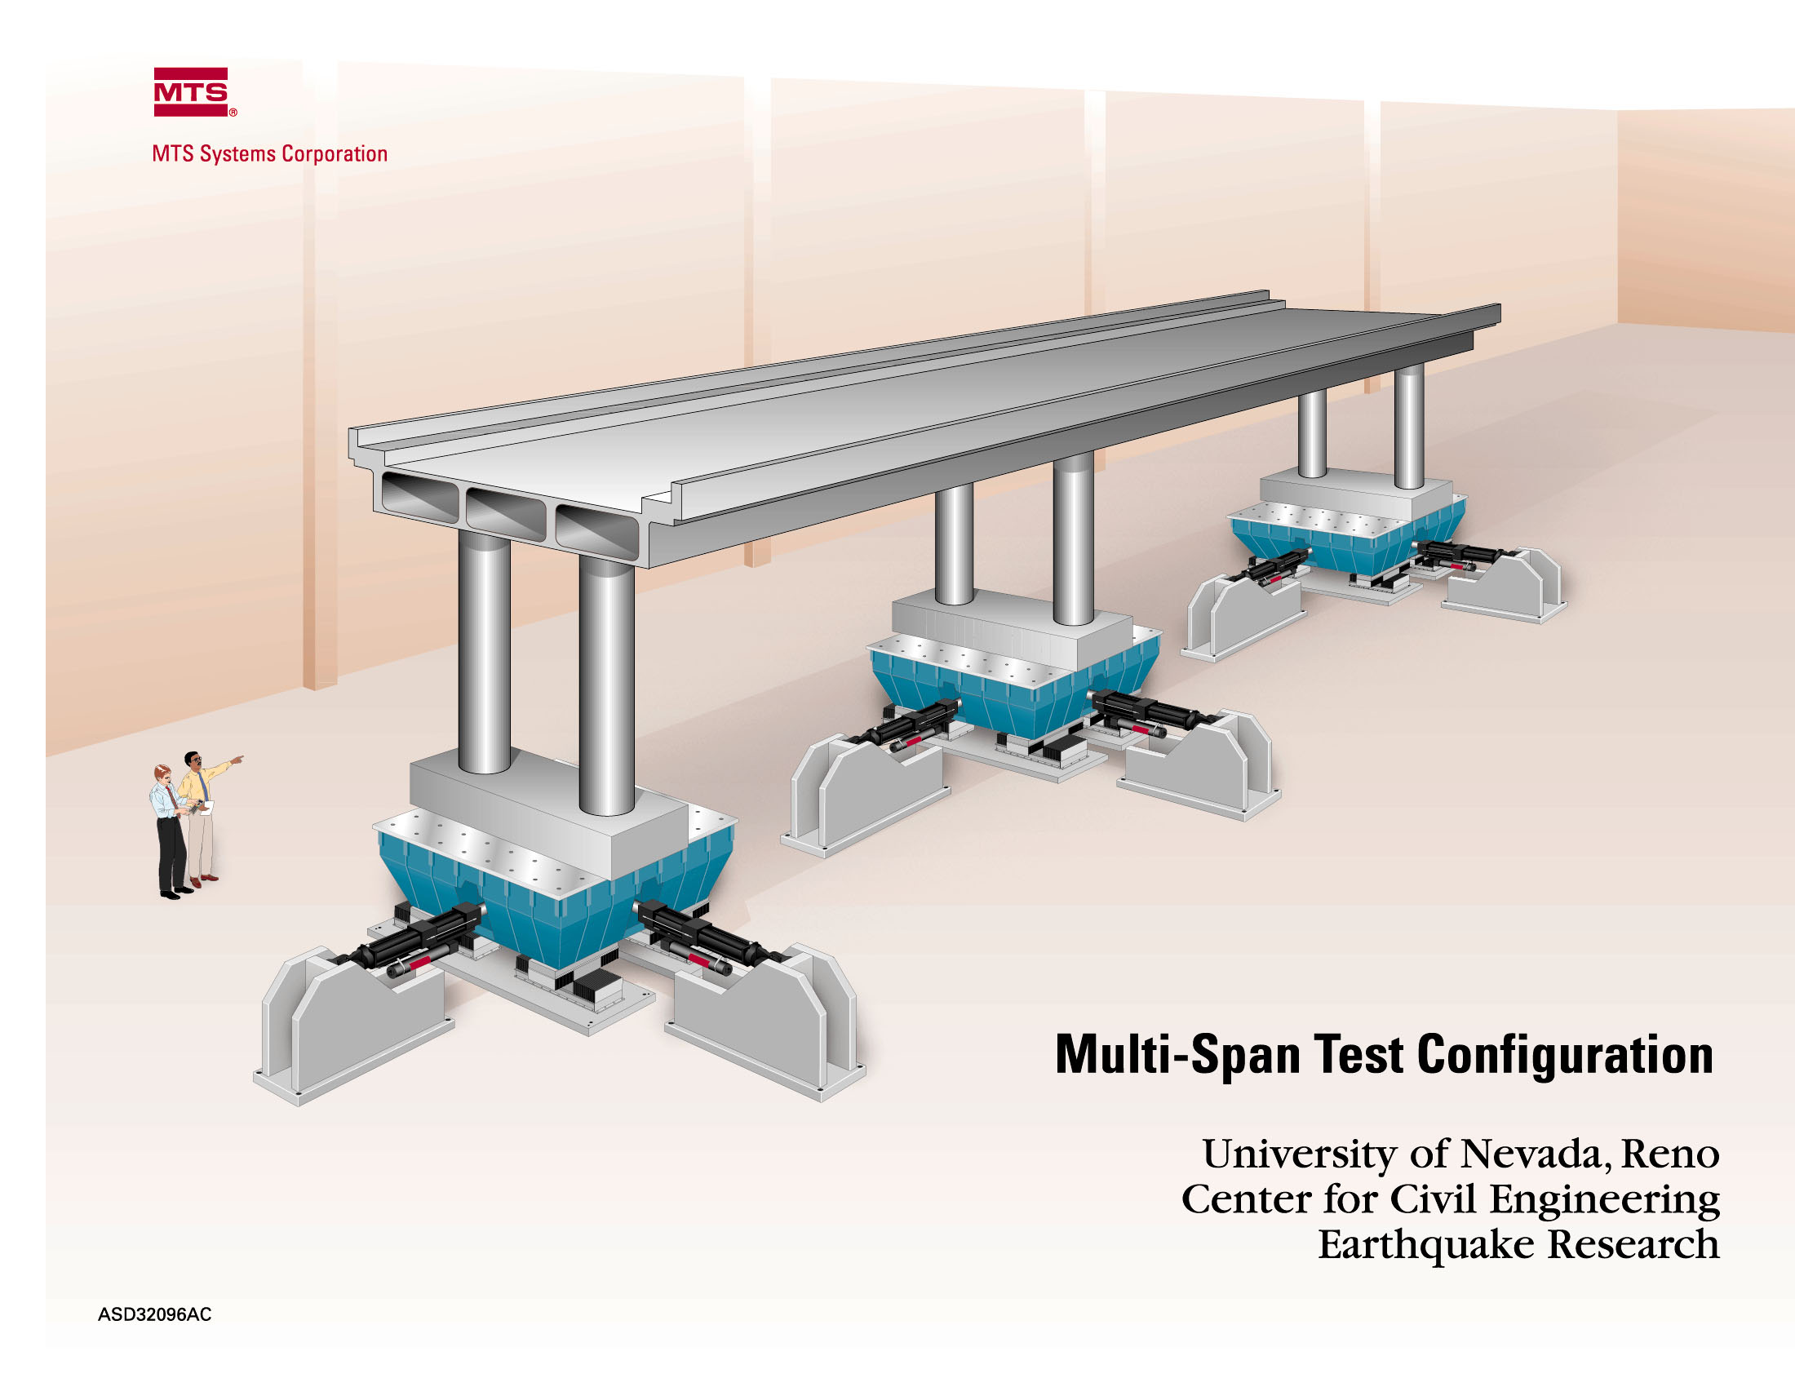
Remote Users
NEES Resources
(Faculty, Students, Practitioners)
Instrumented Structures and Sites
Simulation Tools Repository
Laboratory Equipment
Field Equipment
Curated Data Repository
Leading Edge Computation
Global Connections
Remote Users: (K-12 Faculty and Students)
Laboratory Equipment

Slide 16
NEESGrid Software
Founding NMI Technologiess
  Globus Toolkit
  OGCE Collaboration Toolkit (CHEF/Sakai based)
New Work
  Data and Metadata Repository - NCSA
  Data Acquisition, Storage, and Visualization
  Simulation Portal
  Synchronized data and video (live and stored)

Slide 17
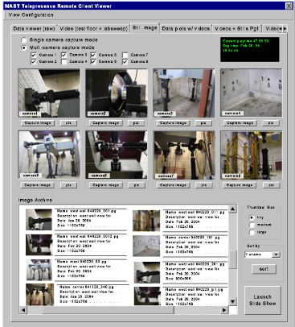
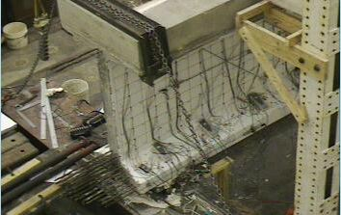
Video and
Data Tivo
Thumbnail + Audio + Data
<
>
+

Slide 18
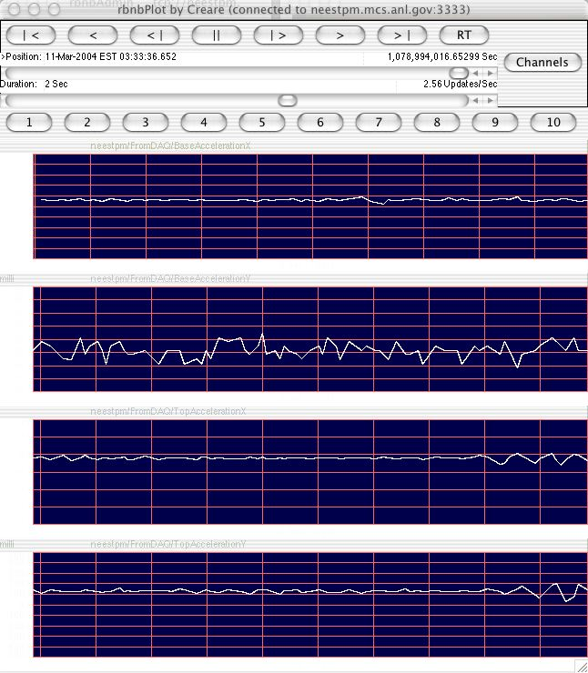

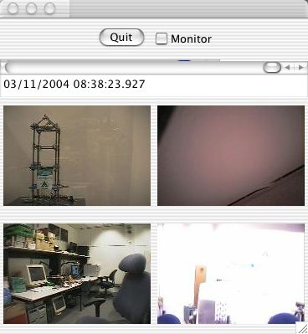
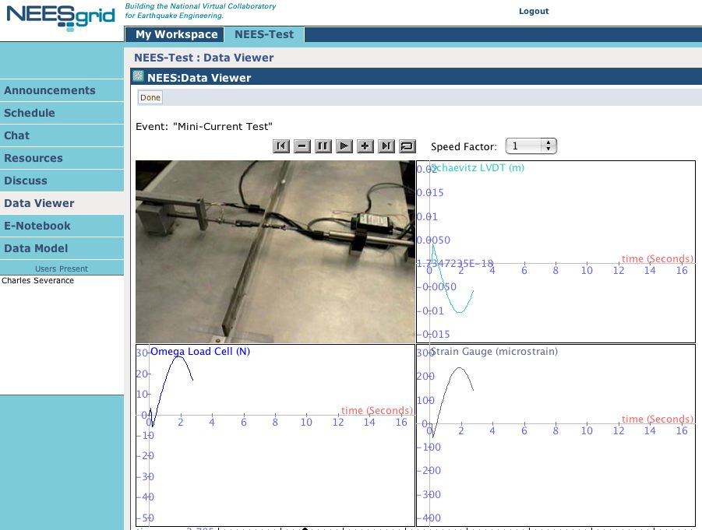
Sample
Experiment
Setup
Comp
Sim
NTCP
Server
NTCP
Server
Simulation
Coordinator
DAQ
DAQ
Live
Extractor
DAQ Data
Data
Repository
Quicktime

Slide 19
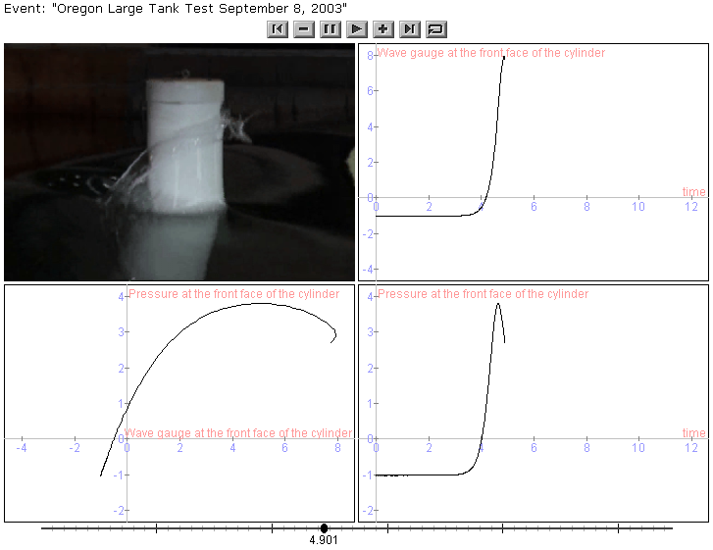
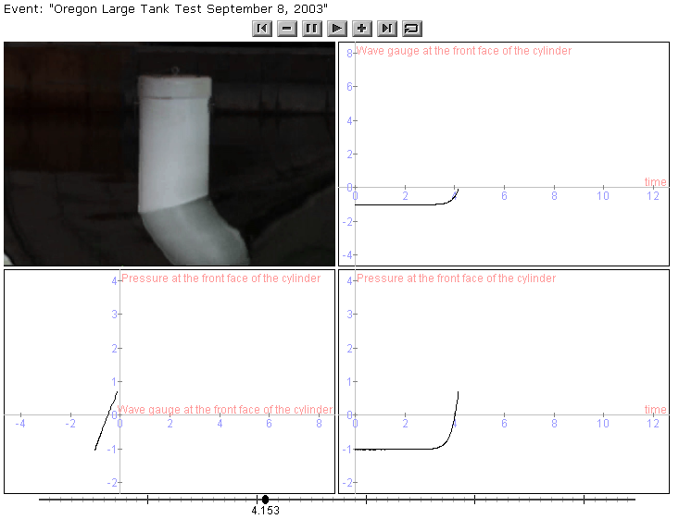

Slide 20
Data Models
Data models are developed in RDF
Local repository supports multiple simultaneous data models with cross-model linkages
Metadata browser (aka Project browser) becomes the Project Browser, Notebook Browser, Site Specification Database Browser
Metadata browser can federate multiple sources of Metadata

Slide 22
Overall Data Modeling Efforts
NEES
Site
Site A
Site B
Site C
Specifications
Database
Equipment
People
Equipment
People
Project
Description
Experiments
Trials
Experiments
Trials
Domain
Tsnumai
Shake Table
Centrifuge
Specific
Geotech
models
Specimen
Specimen
Specimen
Specimen
Common
Elements
Units
Sensors
Descriptions
Data /
Data
Data
Data
Observations
Ref. Source: Chuck Severance

Slide 23
Lessons Learned in NEESGrid (Chuck’s views)
A collaborative environment *must* have a user interface
Just asking about requirements is a tiny part of the problem - CS developers must learn to “walk in the shoes” of the scientists.
Scientists know a lot about Computer Science - listen to them and involve them
The real work begins after software is “delivered” - Version 1.0 is usually just a conversation starter - but a very important step
There are some things that are useful across fields - but the most valuable elements are field-unique
Data models, data repositories, and long-term curation is difficult!

