Slide 1

Architecture Report
Charles Severance
Project Sakaiatrist
csev@umich.edu
KYOU / sakai
Boundary, Situation

Slide 2
Outline
Status as of now
Schedule
Sakai Style Guide
Sakai Java Framework
IMS Tool Interoperability Profile
Portal Directions
Framework Directions
Concerns

Slide 3
Overall Project Status
Even though there is no “schedule” - we are 4-6 months behind where I though we should have been.
Joint F2F meetings between architecture and tools every 6-8 weeks
Getting closure on gaps, beginning to look forward to opportunities during 05
IMS has become very important for cross-vendor and cross-language
Release 1.5 is in “final approach”
There is a LOT to do in 2005 - Framework II
Bug tracking system will be increasingly important

Slide 4

Sakai 1.0
Sakai 1.0 Accomplishments
  Replace Jetspeed with simple renderer
  Replace Turbine with Spring
  Cross-web application communication and injection
  Generic Worksite Setup
  The user-visible tools all from CHEF using Velocity connection to the renderer
  APIs and implementations from CHEF (FW I)
  Significant performance improvement beyond CHEF (DB structure, render, Tomcat 5)
  Development environment for new TPP/JSF tools
  Quickstart installation process

Slide 5
Review of Sakai 1.0
Good News
  Pretty solid out of the box - No known bugs
  Very usable for organic/small groups
  Decent plugin support for AUTHN
Bad News
  JSF/TPP support was weak (hacked, 1.0, did not allow non-TPP to work in same JVM)
  Poor developer documentation for the TPP
  No plugins for SIS data or AUTHZ

Slide 6
Sakai 1.5
First Freeze 12/3 - Release 1Q05
  FW I “complete” (performance, memory, legacy support)
  New Sakai APIs implemented in Hibernate
  Hierarchy support (only a few tools)
  Syllabus, Help, Broadcast, and Profile tools (JSF/TPP)
  Improved Worksite Setup
  Simple plug in for SIS data
  iFrame rectangle support
  Enhanced RSS

Slide 7
Sakai 1.5 Issues
Connection between the legacy APIs and new Sakai APIs still to be done
Gradebook probably won’t arrive for 1.5
Samigo arrives in January
Landing the gaps
Important: 1.5 is a transition release

Slide 8
Sakai Style Guide
The Sakai Style Guide is proscriptive - you can comply to it
Sakai Tools team chaired by Rob Lowden (IU) is developing this
It is about look and feel and applies to all tools regardless of language, technology, etc.
It is how integration can happen over a wide range of technologies and still maintain a clean look and feel.
The Sakai TPP will include a set of JSF tags that comply to the style guide so tool developers do not need to worry about many of the details of the style guide.

Slide 9
Style Guide Page Layout

Slide 10
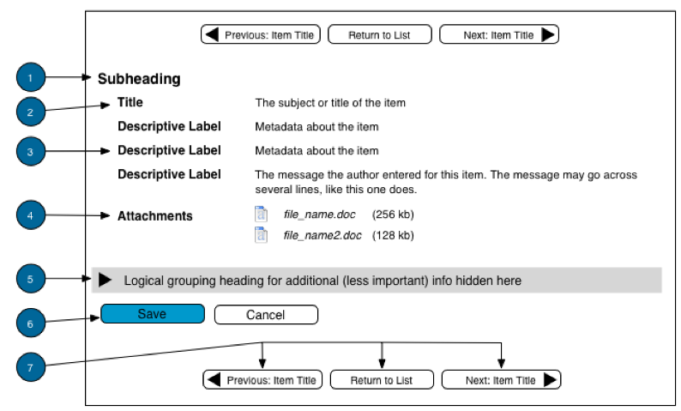
Style - Page

Slide 11
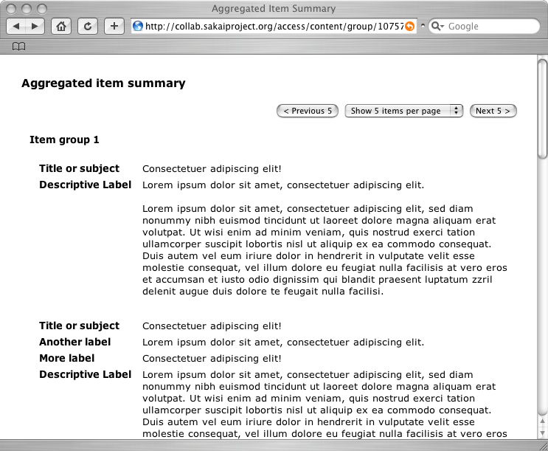
WireFrames
http://www.sakaiproject.org/hiFiWireframes/agg-item-summary.php

Slide 12
Sakai Style Guide
Read and track this document
It is the real future of the “Sakai product”
It is the big picture

Slide 13
What is a Framework?
A “framework” is like a “hosting environment”
It is the stuff that “surrounds” the user-programmable parts “inside”
If we were really mature (say like Tomcat), we would not talk about the framework explicitly because we would have specs and APIs which abstract the framework
The Sakai Framework
Sakai
TPP Tool
Sakai
TPP Tool
Sakai
TPP Tool
Sakai
Service
Sakai
Service
Sakai
Service
Sakai
Service

Slide 14
What is an
Architecture?
Client
The Abstract Sakai Environment
Aggregator
Very abstract
Vague
That part that does not “change”
Defines common terminology
Usually not heavily debated
Is not the implementation detail at all
Presentation
Tools
Services
System

Slide 15
Architecture .vs. Framework
Architecture
External
Aggregator
Client
The Sakai Framework
Internal
Aggregator
The Abstract Sakai Environment
Aggregator
Presentation
Support
The Sakai Tool Environment
Presentation
Sakai Tool
Presentation
Tools
Sakai
Tool Code
Application
Services
Services
Framework
Services
System
Framework
System

Slide 16
The Sakai Java Framework
uPortal via
WSRP
The Sakai Framework
iFrame Based
Aggregator
One particular instance of a Sakai Framework
The one that the Sakai team is writing (1.0, 1.5, 2.0 …)
There is some debate here :)
Sakai JSF
Widget Set
The Sakai Tool Environment
GUI layout
(JSF/JSP)
Schedule
Tool (Java)
Schedule
API (Java)
OSID Agent
API
System

Slide 17
Sakai Java Frameworks
Framework I
  Done in a hurry - Complete in 1.0
  Legacy APIs (from CHEF)
  Legacy Tools (Velocity based from CHEF)
  iFrame Aggregation
  Sakai TPP Tools supported for initial development
Framework II
  Some aspects coming in 1.5, more will arrive in 2.0
  General improvement
  Sakai APIs, OSID support
  Non-iFrame Aggregation
  WSRP Aggregation

Slide 18
Sakai Tool Integration
Three approaches (perhaps there will be more)
  Velocity legacy (not recommended for new tools)
  Sakai Tool Portability Profile (TPP) - new tools specifically dependent on Sakai - plugins/addons (Think Building Blocks)
  Java tool in the same JVM
  Tool on some other system in some other language (short and long term)

Slide 19
Legacy
Velocity
Support
Sakai
Stand-Alone
uPortal via
iFrame
The Sakai Framework
iFrame Based
Aggregator
Sakai Velocity
Support Layer
Sakai JSF
Widget Set
The Sakai Legacy Environment
The Sakai Tool Environment
Velocity
Templates
Java Server
Faces in JSP
Sakai Legacy
Tools
Java Tool Logic
Java Beans
Sakai Legacy
Services
OKI OSID
Legacy Covers
Sakai Application
Services
Sakai
Framework APIs
Hibernate
OKI OSIDs

Slide 20
Why Make a TPP at All?
Parts of the Sakai team are making a set of tools that are a part of a whole application - within that set of tools we only want to do something once and then reuse it.
Other may want to make relatively small and focused extensions to Sakai that look, feel, and behave exactly like the other Sakai tools
When you write a TPP App, you do not worry about a wide range of presentation details (first-order accessibility, aggregation model, style guide compliance, etc..)
The primary difference between a TPP application and a Java Application in the same JVM is the rules for presentation.

Slide 21
TPP handles presentation details
Sakai
Stand-Alone
Portals via
iFrame
uPortal via
JSR-168
uPortal via
WSRP
PDA
The Sakai Framework
Servlet/HTML
Renderer
JSR-168
Renderer
WSRP
Renderer
PDA
Renderer
Sakai JSF
Widget Set
The Sakai Tool Environment
Java Server
Faces in JSP
Java Tool Logic
Java Beans
Sakai Application
Services
Sakai/OKI
APIs

Slide 22
When to Avoid Writing to the TPP
When the tool might want to operate outside of Sakai and inside of Sakai
  Existing open source LMS, BlackBoard, WebCT, stand-alone
The TPP is a big step - sometimes a gradual transition is nice
Nice risk reduction approach in case Sakai takes longer than we expected :)

Slide 23
In-JVM Java
Integration
Sakai
Stand-Alone
uPortal via
iFrame
JVM
The Sakai Framework
iFrame Based
Aggregator
Sakai JSF
Widget Set
Sakai WebApp
Gateway
Non-Sakai Web Application
The Sakai Tool Environment
Java Server
Faces in JSP
Presentation
Java Tool Logic
Java Beans
Sakai API Gateway
Java Tool Logic
Sakai Application
Services
Application
Services
Sakai/OKI
APIs

Slide 24
In JVM Integration
General Disadvantage
  Writing in Java is icky (Tom - you know who you are…)
Advantages over TPP
  Presentation flexibility - go ahead and use Struts, XLST, or Response.write(“<table>”)
Disadvantages relative to TPP
  Presentation has full responsibility for style guide compliance and multi-rendering capabilities (we are planning on providing Sakai JSF tags to JSF apps)
Advantage over “Outside JVM” integration
  Can call all of the Sakai APIs directly and be quite lazy/chatty - can expect the same performance as Sakai TPP applications

Slide 25
Having your Cake and Eating It Too!
Sakai WebApp Gateway
Web Application Container (Tomcat)
Group
Provider
Group
Provider
Presentation
Presentation
Java Tool Logic
Java Tool Logic
Application
Services
Application
Services
Group
Provider
Group
Provider
AUTHN
Provider
AUTHZ
Provider
Group
Provider
AUTHN
Provider
AUTHZ
Provider
Group
Provider
Sakai API Gateway
Storage
Storage
Stand Alone Operation
Operating Within Sakai

Slide 26
Approach For Large Java Tools
Use JSF with Sakai Tags and other tags you define
Refactor your own code to use internal plug-ins (within your webapp - driven by configuration files/properties)
Develop Sakai and non-Sakai versions of your plugins
Isolate Sakai-specific code to the Sakai versions of the plugins
Samigo is taking this approach

Slide 27
Integration from a Distance
Only connection is web-services and http
Language agnostic
Allows commercial tools/services to cleanly integrate - (testing or subscription content)
Needs some reengineering for performance
Initially driven by the IMS Tool Interoperability demonstration effort

Slide 28
IMS Tool Portability Project
Started as an IMS SIG for Sakai to interact with commercial LMS companies
Approved by IMS 11/2004
Blackboard, CETIS, MIT, Sun, Indiana, WebCT, University of Michigan …
Goal: By Alt-I-lab in July 2005 to have demonstrated a single application working in Blackboard, WebCT, and Sakai.

Slide 29
By July 2005 - Demonstrate
Welcome to Sakai
Welcome to WebCT
Welcome to BlackBoard
Button
Button
Button
Button
Button
Button
Samigo
Button Button Button Button Button Button Button Button
Samigo
Samigo
Button Button Button Button Button Button Button Button
Sakai
WebCt
Black
Board
Samigo
HTML/HTTP
Web Services

Slide 30
How it
Works
Header
Button
Button
Button
Button
Button
Button
Tool Area
6
1
5
CLE Environment
7
External Web Application
Web
Services
Application
Code
Launch
Control
4
Session
And Services
Bootstrap
HTML/HTTP
3
2
Web Services

Slide 31
Issues with the IMS effort
Who the heck came up with the schedule :)
Will WebCT and BlackBoard really participate fully?
Will we get to see the PowerLinks/ChalkBox documentation for the work group’s work?
Web Services are different - an RPC version of the Sakai (or any) API will likely perform poorly
  Fine-grained security is best done locally with an exchange of security context in a single web transaction
  Roles are mapped to fine grained authorizations separately in each application
The design of the WSDL will take separate engineering - looking for best practice.. (IMS Ent??)

Slide 32
Framework II
Developing a “legacy free zone”
Evolutionary, not revolutionary
Ground-up evaluation and review of the framework implementation delivered in 1.0
Support the long-term goals of Sakai
Support the Style Guide
Supply a productive development environment
Support of OKI OSIDs
Lead by Craig Counterman, MIT
Some of the Framework II thinking is already in 1.5 and in this presentation

Slide 33
FW-II Some parts are done
Re-working JSF Support (Thanks Jon Anderson)
  Move to JSF 1.1 without needing “features” dropped into the Sun jars.
  Move jars from shared to the WebApp - allows TPP and non-TPP JSF to coexist
Reworking the ThreadLocal bootstrap process within servlets from re-dispatch to ServletFilters
  Simplifies and cleans up URL processing and enables non-TPP tools to talk to Sakai APIs without modification to the source code.
Component registration using a context listener rather than a servlet

Slide 34
FW-II: Foundation APIs
The Sakai Foundation APIs
  High Performance Implementations - Hibernate based
  Implementations may “violate” pure separation of concerns

Slide 35
Sakai Foundation Services
Definition / Background
  Low-level, “operating system like” services
  Service Oriented Architecture (SOA)
  Implementations transcend separation of concern (SOC) boundaries.
  Performance
    Joins / Filters
Status

Slide 36
SFS Logical Architecture

Slide 37
Sakai Foundation Services Status
UUID
  Complete
Types
  Functional; minor changes may be necessary.
AuthN / Agent / Groups
  Functional; plug-in providers needed.

Slide 38
Sakai Foundation Services Status
AuthZ
  Functional including inheritance
  Supports transitive closure of all Group memberships and all Hierarchy parents.
  Needs more work on Functions (the “what” or verb)
Hierarchy
  Functional

Slide 39
Sakai Foundation Services Status
Byte Store
  50% complete
  Porting implementation from SAMigo
  Versioning?
Aliases
  Not started; will be part of SFS

Slide 40
FW-II: New Aggregation Approaches
WSRP
Non-Frame based Rendering
  Accessibility
  Back Button
Friendly URLs (partially done)

Slide 41
FW-II Aggregation, Presentation, Tool Layers
Aggregation - primarily aggregation into single frame (non-iframe)
Flexible, user-friendly URL support
Presentation - JSF continues to improve, but has a way to go
Tools - clarified registration system
Tools - WSRP, JSR-168, and Servlet

Slide 42
FW-II Service layer
Service Injection - continues to be based on Spring Framework
Considering JSF-Spring compatibility
JNDI service location (probable)
Services APIs in flux for first half of 2005, expect deprecation and new methods.
Increasing alignment with OKI OSIDs, demonstration of infrastructure integration and portability

Slide 43
OKI OSID Approach
Tools
A set of OKI OSID implementations and out-of-band agreements will be produced to give tools access to Sakai capabilities using OSIDs
OSID Plug ins will be developed so as to allow for enterprise information (AUTHN, Repository, AUTHZ, CourseManagement)
Work lead by Peter Wilkins, MIT
Part of a 2.0 deliverable
Will be in flux in CVS as OSIDs track emergent Sakai APIs
OSID APIs
Sakai OBAs
Sakai APIs
OSID
Plug Ins
Enterprise
Information

Slide 44
FW-II Summary
We expect FW-II to continue to evolve after version 2.0, but more slowly
A key goal is to make FW-II complete enough to allow a set of tools to be written that *only* use FW-II (i.e. no legacy APIs)
Once FW-II is solid, many of the the legacy APIs will become covers on top of the FW-II APIs for compatibility.
FW-I will truly then be “legacy”

Slide 45
Portal Integration Directions
About 6 months ago, we were encouraged by uPortal management and others to switch from a path where we would begin doing unique non-standard stuff within uPortal to an approach which is portal-agnostic first.
Outline
  Sakai 1.0 internal aggregator with iFrames
  Sakai 1.5 - iFrames
  Sakai 2.0 - WSRP
  Post 2.0 - uPortal in the same JVM

Slide 46
Sakai Priorities
While the Sakai Board sets and can change development priorities at any time, the following are the priorities as of the writing of this document with respect to Sakai’s portal integration strategy
  Phase I - Designed, and scheduled
    First Priority: Build a Sakai stand-alone web application
    Second Priority: Provide flexible integration to a wide range of portals using iFrames
    Third Priority: Provide flexible integration to a wide range of portals using WSRP with an “Sakai-internal” WSRP Producer
  Phase II - Further design required, and co-development will be necessary
    Fourth Priority: Integrate Sakai tools as JSR-168 Portlets
    Fifth Priority: Integrate uPortal as the provider for Sakai navigation
These priorities can change and as new information or technologies arrive, these priorities may change

Slide 47
Phase I - Deployment
In Phase I, Sakai and uPortal will be deployed separately - they will be either in different JVMs or on different servers.
Integration will be based on iFrames in uPortal pointing at Sakai or WSRP pointing at Sakai
This integration will work between Sakai and any portal product which supports iFrames
The management and administration will be done separately for Sakai and uPortal

Slide 48
Phase II - Deployment
In Phase II the goal is to get uPortal and Sakai into the same JVM with uPortal handling navigation and layout for Sakai.
Sakai portlets will produce JSR-168 and be integrated into uPortal as JSR-168 portlets.
In a Phase II deployment Sakai will continue to interoperate with other portals using WSRP and iFrames with uPortal acting as the WSRP producer.
There are many technical challenges for this to be completed. This requires significant co-engineering for both uPortal and Sakai.

Slide 49
Aligning Roadmaps
uPortal
JSR-168
WSRP
Consumer
Navigation
Improvements
Well
Understood
WSRP
Producer
Phase I
Phase II
Single JVM /
Shared Navigation
uPortal
Integration
JSR-168
Support
WSRP
Producer
iFrame
“Producer”
Design Issues
Remain
Sakai

Slide 50
iFrames (Phase I)
While iFrames are inelegant, they provide a basic mechanism for integrating with a wide range of portals and other aggregation frameworks.
The Sakai internal aggregator will produce iFrames of various elements ranging from the Sakai page minus the header, a single Sakai site, and a page within a Sakai site.
This capability is scheduled to be part of the 1.5 release of Sakai.

Slide 51
WSRP Producer within Sakai
(Phase I)
Initial design evaluation has been completed on the feasibility of WSRP as a connection between Sakai and portals (see slide later)
This will be accomplished by adding a WSRP producer to Sakai
The expectation is that integration can be done without requiring modifications to WSRP.
A key point is that the tools will be instanced within Sakai using standard Sakai management tools. WSRP Producer will be able to access tool or site instances but not create new instances in the initial release.
The first integration between Sakai and uPortal using WSRP should be in the Sakai 2.0 release.

Slide 52
General Issue: JSR-168 (Phase II)
Sakai has some requirements which simply do not fit within JSR-168 - this primarily has to do with the need for a Sakai tool as a Portlet to be able to query its placement in the navigational hierarchy - JSR-168 does not even have the notion of a hierarchy - all portlets are isolated “islands”
Based on initial design analysis, we believe that we can accomplish the necessary requirements as part of the provisioning process of the Portlets. In effect this will be an “out-of-band” agreement with the JSR-168 container. This is something that will have to be dealt with as the Portlets move from one container to another although we hope that some capabilities will work in all JSR-168 portals.
The priority will be for Sakai to work with uPortal first on JSR-168.
One other option is to have all of the Sakai tools, organized into sites within a single JSR-168 Portlet. This would maintain portability while sacrificing flexibility and usability - this is not a likely direction because it reduces flexibility and usability.
These are likely solvable problems with some engineering investment.

Slide 53
uPortal Issue: Navigation Improvements
(Phase II)
The issue here is to allow Sakai to delegate all of its navigation issues to uPortal.
It is important that Sakai not require a Sakai specific uPortal Theme/Style.
This means that some Sakai navigational capabilities must be generically supported below the level of Theme/Style.
This is expected to be accomplished by joint design and development work by the Sakai team and uPortal developers
To move Sakai completely “into” uPortal requires solving the JSR-168 issues
This is currently not scheduled

Slide 54
Issue: WSRP Producer Within uPortal
(Phase II)
The final capability needed to completely move Sakai “into uPortal” will be the the capability for uPortal to act as a WSRP Producer container for any tool.
This is different from simply making the stand-alone Sakai to function as WSRP producer.
  To solve the “Sakai as WSRP Producer”, Sakai can configure WSRP4J specifically as needed through stock WSRP APIs to meet only the needs of Sakai.
  To completely move Sakai into uPortal, uPortal will need to support a completely generalized WSRP producer which supports the full range of Portlets supported by uPortal - this is a more challenging task
This is necessary to meet the requirement of Sakai to operate in many portals using WSRP.

Slide 55
Recent Work on URLs in Sakai
http://localhost:8080/portal - View Sakai as it currently stands.
http://localhost:8080/gallery - View the default site and show site navigation but without branding.
http://localhost:8080/site/JA-SIG - View just a site (no site navigation). This is a Sakai site, not an external web site.
http://localhost:8080/page/1102305173230-1 - View a particular page in a site without seeing the site itself.
http://localhost:8080/tool/1102303862142-8 - View only a single tool from a page (e.g. just a chat room).
These forms can be combined (e.g. http://localhost:8080/site/JA-SIG/page/1102305173230-1) so that the user can be "pre-navigated" to a particular page on a particular site and still get to choose other pages within the site.
Thanks to David Haines

Slide 56
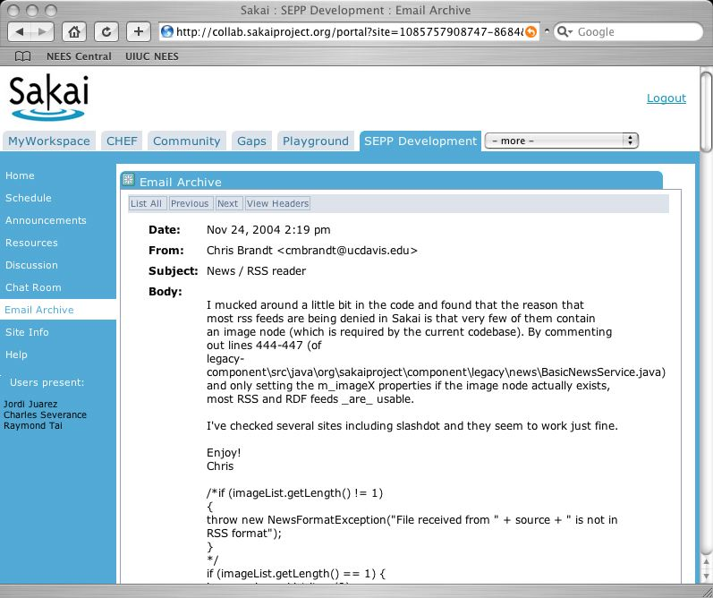
BookMarking allows direct launching into Sakai, pre-navigated
http://localhost:8080/portal/322305714341-2/page/1102305173230-1

Slide 57
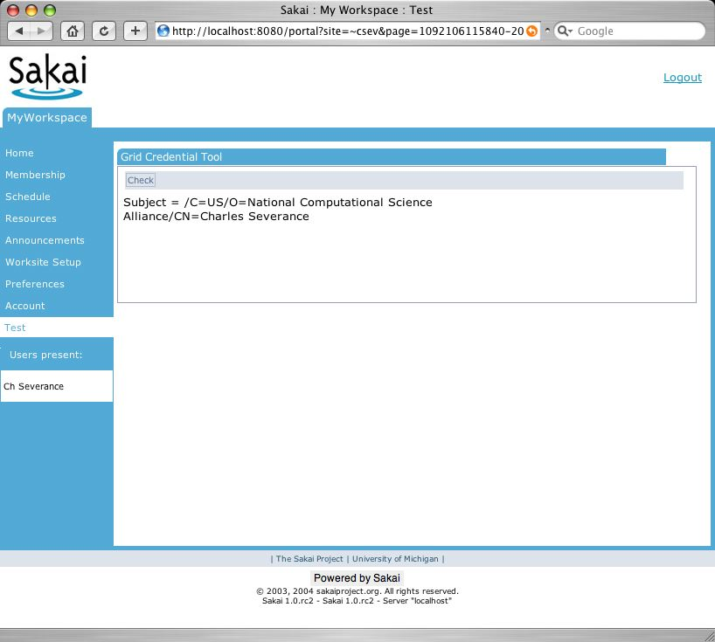
“Concentric Rectangles”
http://sakai.edu/portal
http://sakai.edu/page/1102305173230-1
http://sakai.edu/tool/110203682142-8
http://sakai.edu/site/JA-SIG/
http://sakai.edu/gallery

Slide 58
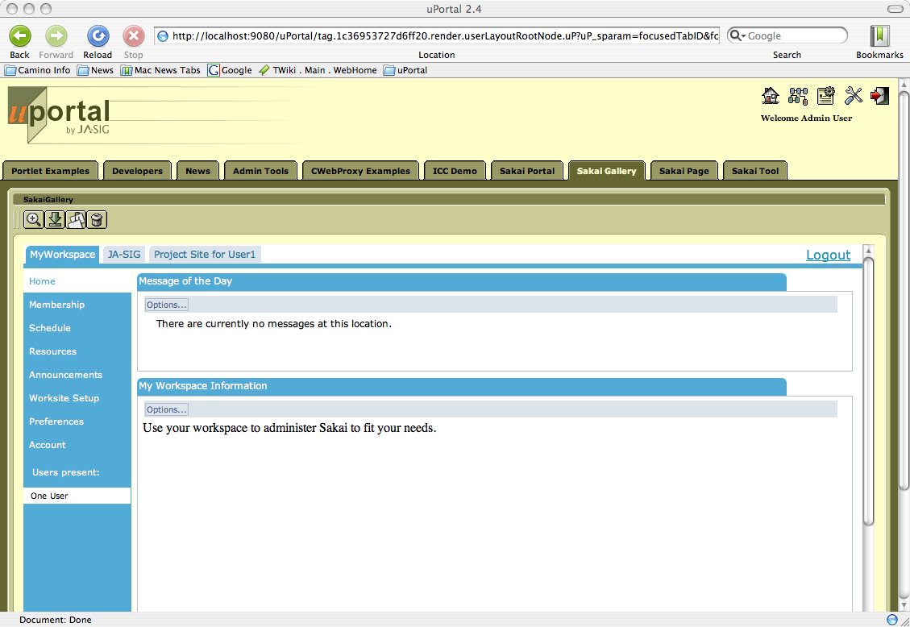
Gallery – site without branding

Slide 59
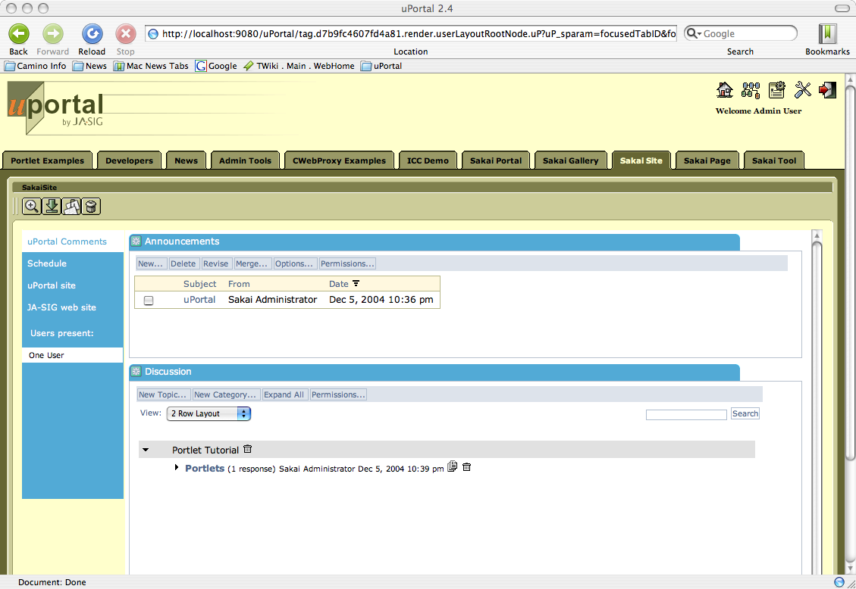
Site

Slide 60
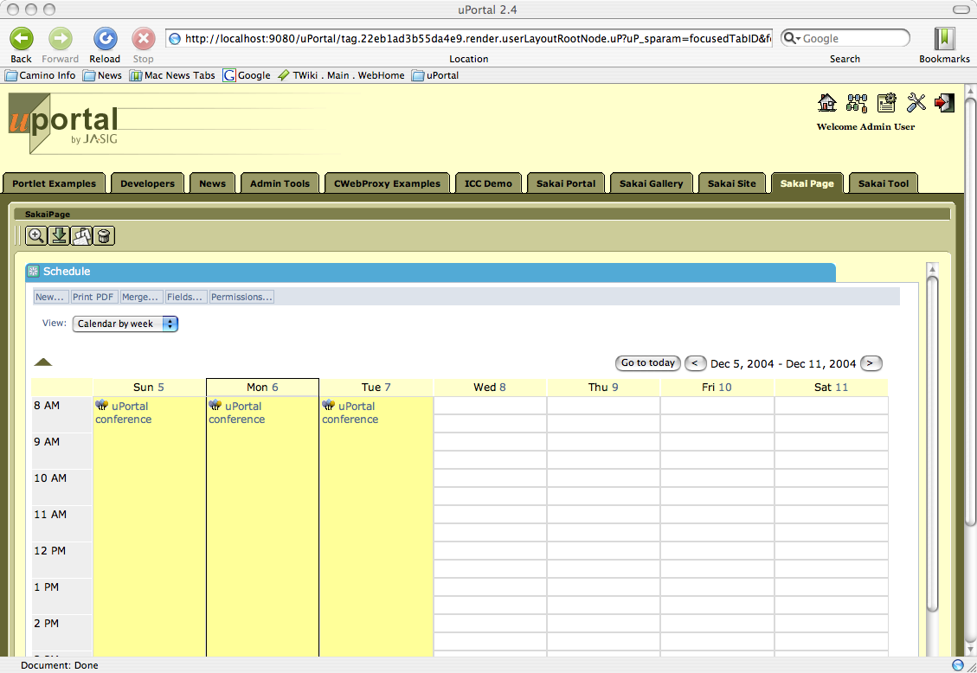
Page

Slide 61
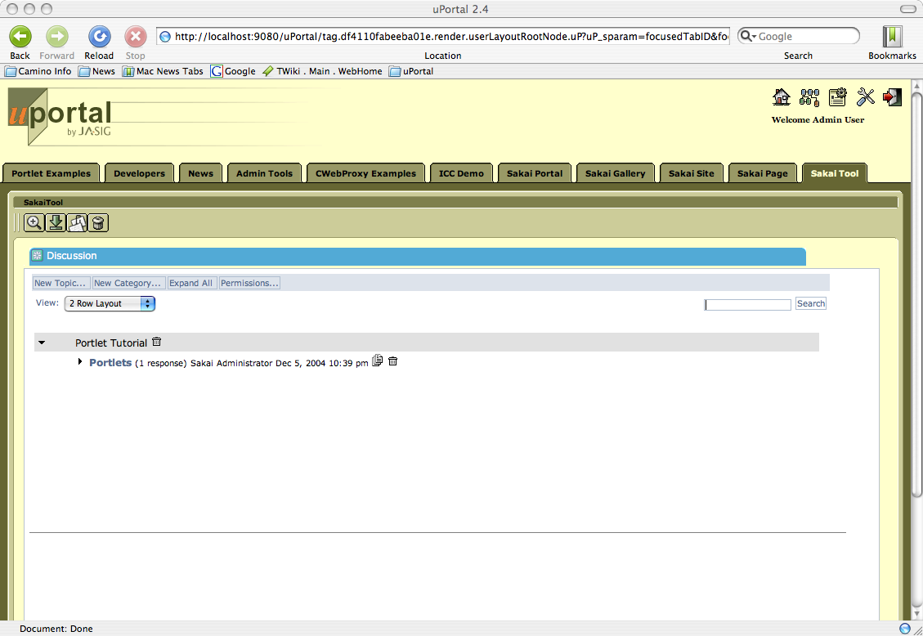
Tool

Slide 62
Quick iFrames Advertisement
iFrames are “evil”, but they have a certain charm…
Every portal system on the planet will work with them
Sakai can now work within a static HTML site, PHP site, or any site
Sakai 1.x tools *love* iFrames and don’t suffer from the “refresh = reset” problem

Slide 63
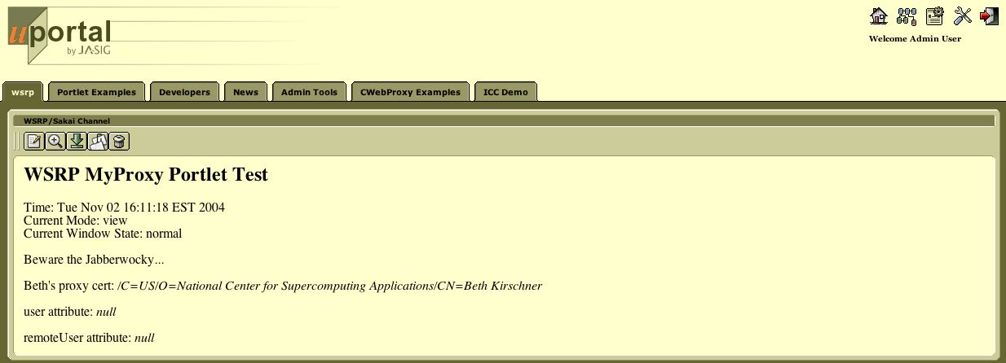
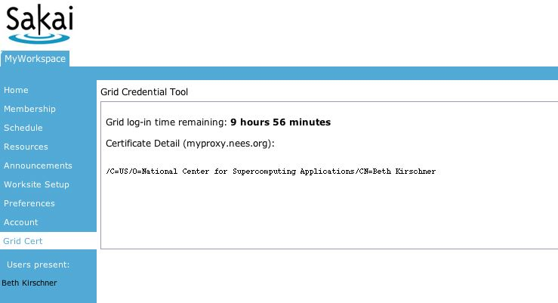
Initial Test
WSRP
Integration
WSRP
Some very early testing has been done to explore the feasibility of WSRP connections which has proved fruitful. This is just a development test and there is still significant work to do before the systems are fully integrated.

Slide 64
Direct viewing
In a browser
iFrame and
Single-sign-on
WSRP in portal
Portal
Portal
HTTP
HTTP
WSRP
Sakai
/site servlet
/app servlet
WSRP4J servlet
JSF
JSF
JSF
Vel
tool
tool
tool
legacy
tool

Slide 65
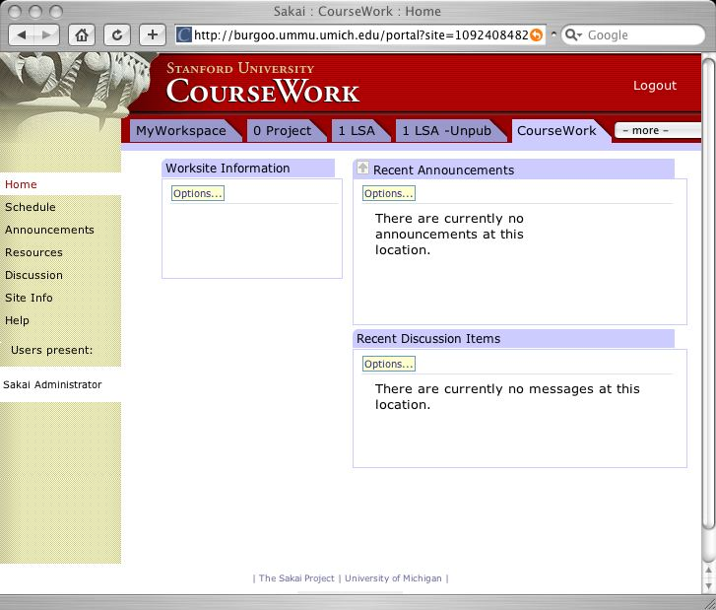
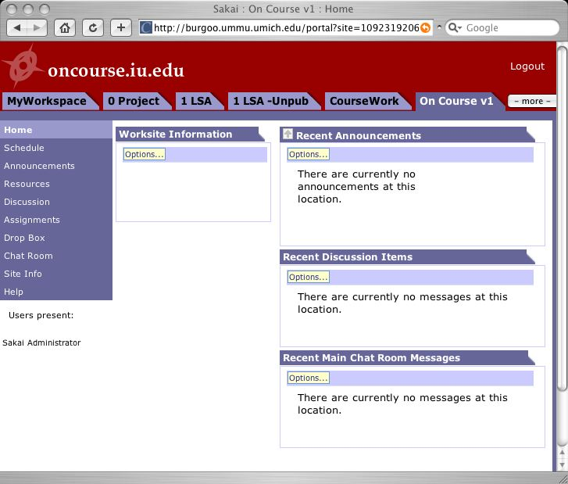
Using WSRP and uPortal to Federate across Sakai sites and provide extreme user flexibility in presentation
Portal
Non-Sakai
Tool
Non-Sakai
Non-Java Tools
tool
tool
WSRP
WSRP
WSRP
WSRP
HTTP
HTTP
HTTP
Sakai
Sakai
Sakai
tool
tool
tool
tool
tool
tool

Slide 66
Portal Plans Summary
While integration between Sakai and uPortal was not as simple as we had hoped (i.e. “JSR-168” is a magic wand), there is still a roadmap for integration which will deliver on the original goals of Sakai.
Design and priority choices focus early effort on the biggest wins with the lowest risk so that customers can deploy maximal capability as early as possible.
The second half of the roadmap is still in flux and will require some co-design / co-implementation between the Sakai and uPortal teams - this work will be started late in the second quarter of 2005 unless Sakai priorities are shifted.

Slide 67
Development Details
Bug Tracking
Build Processes
CVS
Release Process

Slide 68
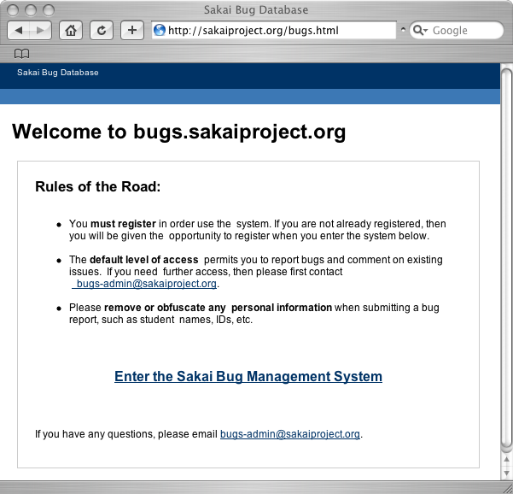
Bug Tracking
Full-time bug manager (Peter Knoop)
bugs-admin@sakaiproject.org
bugs@sakaiproject.org
bugs.sakaiproject.org
Open to the public to view and submit
Will increasingly be the focus of new work assignments

Slide 69
CVS Process
Server: cvs.sakaiproject.org
CVS Structure
  Sakai module - Should always be a “workable Sakai”
  Samigo module
  Gradebook module
  Scratch module - emerging code (e.g. fw2)
  UM / IU - etc modules - local configuration stuff
CVS Head
  Someone “has the pumpkin” for the “Sakai” module

Slide 70
CVS (cont)
Tagging
  Allows production at sites to stabilize while head moves forward
Permission - wide open - within team trust
Future
  Re-factor the Sakai directory so as to produce a more pure framework
  Move “optional” parts into modules
  Move toward mechanism to assemble the “basic Sakai release” from multiple modules - probably Maven

Slide 71
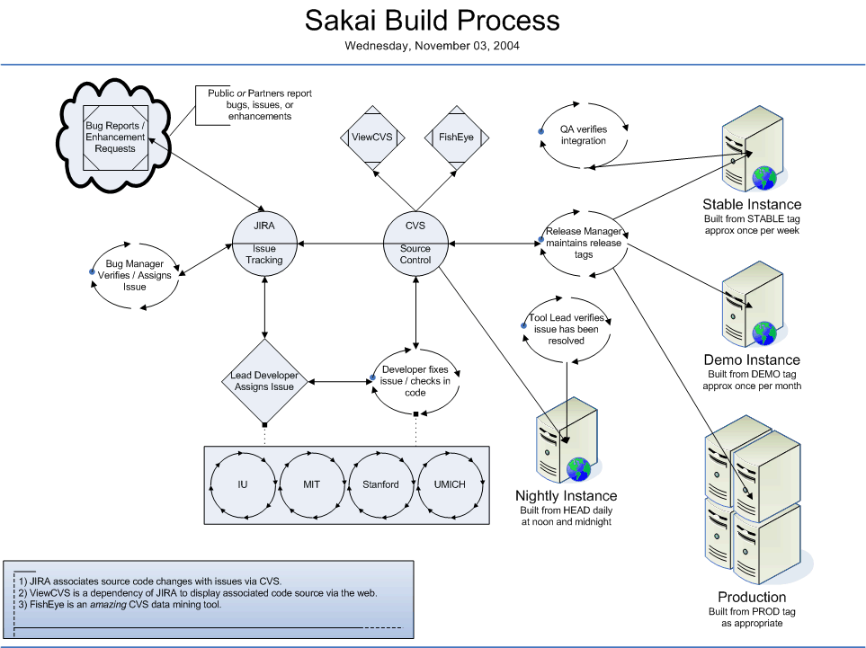
Build Process
Slide From Rob/Lance
Thanks to
Lance Speelmon

Slide 72
Release Approach
Production first - release second
This may change after framework code becomes more complete
Think 3-4 weeks after production issues ironed worked out
The “pumpkin” concept… Glenn, Lance, ???

Slide 73
Sakai 2.0
Will be perfect
Will be on time
Will have everything everyone ever wanted

Slide 74
A Few Concerns
Change Courier to be Accessible, Accessible Rendering, Integrate hierarchy throughout - both features and throughout the legacy services - change context from "Site Id" to "Hierarchy Position" throughout, Url Mapping and a site navigator which shows children recursively, Build Sakai Filing and Repository APIs, Performance test hibernate for clustered applications, Build OSID covers for Sakai APIs and document OBAs, WSRP Integration, IMS Tool Portability - develop spec, write reference implementation, IMS Content Import throughout as necessary, IMS Enterprise support?, Gradebook - Finish / Rewrite, Samigo - Finish - Integrate with Gradebook, Refactor CVS to make solid core module and more optional modules - build and make process to assemble these automatically to make a release, Build connections between legacy and Sakai APIs - understand and solve impedance mismatches, Course Management API throughout, Hierarchy Management tools and building, Build OKI OSID plug in capabilities, Sakai APIs need to support plugins, Review and Revise Framework Further, Make sure to use Servlet Filters throughout and eliminate tunneling, Wholistic review of site info and worksite setup in terms of flow and usability, Re-Evaluate the use of locks (especially Site edit ting, Worksite setup, and all the admin tools), Evaluate legacy APIs for possible promotion, Support Search Throughout, Internationalization, Rewriting old tools, Accessibility throughout, Design and implement Helper Mode in JSF Tools - "cross-tool navigation”, Support for MS-SQL, Support for DC, and LOM and generic Metadata throughout with configurable Metadata editor and metadata editor helper, Take some time and get to the point where we truly bake in RDF, Design the low level resource model, Enhance the development, and debugging process.

Slide 75
The Future Model > 2006 (*)
Core
30
SEPP (200)
Sakai (500)
Sakai
Core
30
Staff
10
* One person’s opinion - nothing more

Slide 76
Other APIs
Sakai CMS API
Other App Services
Content Management Service
Others
Slide Store
WebDAV
Other APIs
Sakai Repository API
Agent/Group
Hierarchy
AuthN, AuthZ
Repository w/
Metdata, AuthZ
Other
Repositories
Sakai Filing API
Data Store w/
Blobs, Folders
The Sakai Service Framework (SakaiOS)

Slide 77
Summary
At the one year point, we are in the middle of a journey.
Last October, we had a napkin and some ideas
This October we have a release that is pretty darn cool, and a real todo list a mile long
Can we just turn on the Tivo, take a nap, then wake up and fast forward to next October?
Notes:
We are not planting trees - we are inventing dirt.
We are not making light bulbs - we are building a generator.

Slide 78
Observations
Hype does not last - Sakai must deliver solid software before the Sakai hype starts to fade
The management and leadership within Sakai are very driven - we have a structure where the board is made up of very active customers
I doubt that we will be slowing down any time soon
Notes:
We know that time is ticking away.

Slide 79
The Song of Sakai… (*)
We read the specs
We wrote the code
We tested it out
And checked it all in
Bugs and mistakes
We've made a few
We've read our share of strange specs
and in the end we fixed a few gaps
We are developers of Sakai
And we'll keep coding till the freeze
We are developers
We are developers
No time for meetings
`Cause we are developers of Sakai
We've read the e-mails
And answered a few
Sites joined the partners program
and everything that goes with it
We thank them all
But its been no bed of roses
where is the real TPP?
We consider it a challenge before the board and SEPP
to finish the release
We are developers of Sakai
And we'll keep coding till the freeze
We are developers
We are developers
No time for meetings
`Cause we are developers of Sakai
We are developers of Sakai
And we'll keep coding till the freeze
We are developers
We are developers
No time for meetings
`Cause we are developers of Sakai
Sung to “We are the champions” by Queen. Words and by Dr. Chuck.
To replay, see www.dr-chuck.com
(*) On the occasion of Sakai’s first birthday - this work was in no way sanctioned by the Sakai project - it is just a personal artistic expression.

Slide 80
Questions

