Slide 1
Software to Fit T&L Practices
Charles Severance
Sakai Project
University of Michigan
www.dr-chuck.com

Slide 2
Sakai Project Summary
Building Open Source Collaboration and Learning Environment (CLE)
Indiana, MIT, U. Michigan, Stanford, Berkeley, Foothill
Funded from Mellon Foundation through 2005
Releases 1.0 10/04, 1.5 1Q05, 2.0 2Q05
Goal: Version 2.0 will be comparable to commercial offerings

Slide 3
Sakai’s Goals (per Chuck)
Stop institutions from writing “yet another” local CLE
Provide Open Source reference implementation of a CLE
Encourage portability between commercial and non-commercial CLE’s
Ultimately: Act as base for true innovation in T & L

Slide 4
Review: States of Water…
Gas - Freely flows throughout entire space - space is evenly filled
Boiling Point
Temperature -->
Liquid - Fluid flows, but often downhill - cannot fill all of the space - tends to pool at minimum energy - surface tension exists
Melting Point
Frozen - Vibrating and stuck In a Crystal Structure
Time / “Heat” Applied --->

Slide 5
Latent Heat of CLE Innovation
Boiling Point
Better -->
Melting Point
Frozen - Many different “imperfect” CLEs and LMSs
For the past 10 years we have all been all “stuck”, vibrating in place, seemingly with no flexibility, but with plenty of energy.
Time / “Heat” / Money / Energy Applied --->
Notes:
Where are we now?

Slide 6
Latent Heat of CLE Innovation
Building a reference implementation of a conventional CLE…
Boiling Point
Liquid - We can tend toward common CLEs, and/or portability makes the choice of CLE irrelevant
Better -->
Melting Point
Frozen - Many different “imperfect” CLEs and LMSs
Time / “Heat” / Money / Energy Applied --->
Notes:
Where are we now?
During melting, much heat must be applied with no “improvement”. Mellon is supplying part of that heat for two years.
Note that this is a time where we must be careful of hype - because the world wants to think that a project is done the instant it is started.
Also things are not as simple as they appear.

Slide 7
Latent Heat of CLE Innovation
Safe base level functionality empowers new thinking, approaches, and standards, (i.e. good chaos). We enter a period of chaotic freedom.
Boiling Point
Liquid - We can tend toward common CLEs, and/or portability makes the choice of CLE irrelevant
Better -->
Melting Point
Frozen - Many different “imperfect” CLEs and LMSs
Time / “Heat” / Money / Energy Applied --->
Notes:
Where are we now?

Slide 8
Latent Heat of CLE Innovation
Gas - Innovation can spread to cover the space of T & L practices
True change in T & L happens in ways can not anticipate. CLE/LMS’s can take completely new forms and directions…
Boiling Point
Liquid - We can tend toward common CLEs, and/or portability makes the choice of CLE irrelevant
Better -->
Melting Point
Frozen - Many different “imperfect” CLEs and LMSs
Time / “Heat” / Money / Energy Applied --->
Notes:
Where are we now?

Slide 9
T&L Innovation: Point Solutions
There is a wide diversity of opinion when it comes to Teaching and Learning Practice and how technology is best used
Those at the innovation front for T&L almost always evolve their own “point solutions”
There is an impedance mismatch between these “point solutions” and conventional LMS Systems
Until point solutions mature and become “conventional”, LMS flexibility and standards for building/integrating many different tools is necessary

Slide 10
Anatomy of a Point Solution for T & L
Point solutions are by nature deep explorations down a possibly fruitful path by a passionate person or small group.
Hard to get traction because it is not a “complete” solution
Often projects end up starving to death for lack of attention
Often it is a situation where a poet is ahead of their time

Slide 11
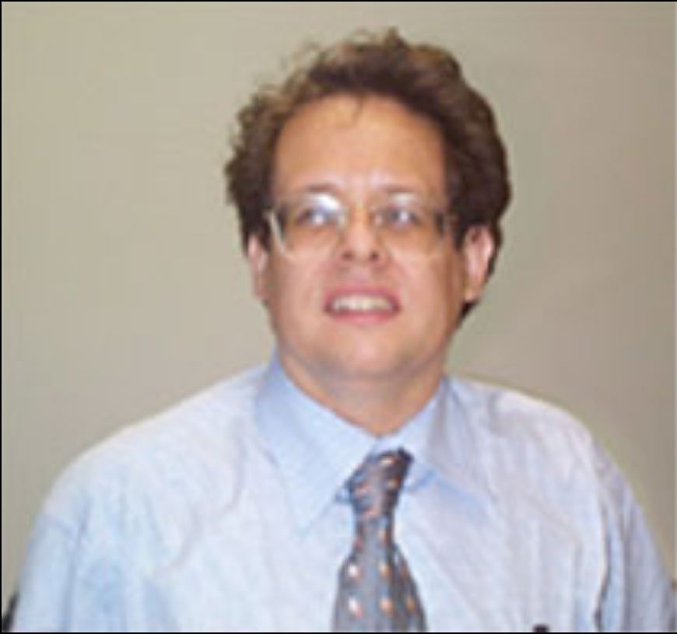
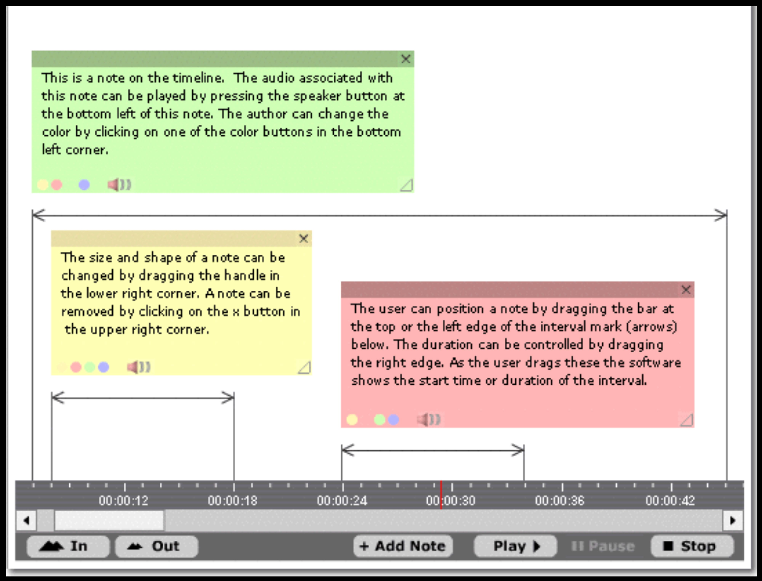
One Point Solution: ProjectPad Audio Annotation
Notes:
Jonathan Smith of Northwestern
Is this a learning management system? What percentage of the T & L scope does this cover? If you had to choose between ProjectPad and WebCT, which would you choose?
The best stuff is never a complete solution.

Slide 12
ProjectPad Details
Jonathan Smith, Northwestern University (jas@northwestern.edu)
www.at.northwestern.edu/spoken/

Slide 13
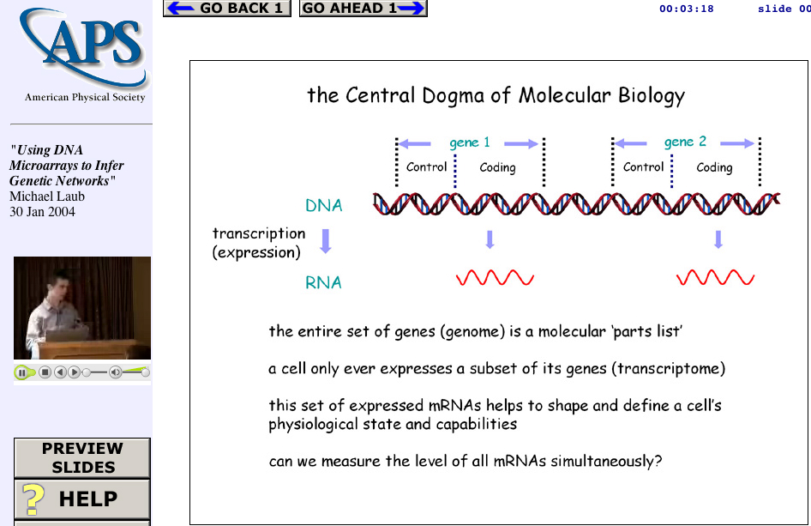
A Story of a Point Solution
Web Lecture
Archive
Project
www.wlap.org
syncomat.com
Tools
And
Technologies
Tools
And
Technologies
Lecture
Object

Slide 14
Sad Story
1996 - Invented Sync-O-Matic (Real Media)
1997 - 1999 Gave continuous talks / demos at conferences
1998 - Tried to commercialize product through my job (It was the 90’s after all)
1999 - Switched jobs (partially due to bitter experience with intellectual property folks)
1999-2001 Re-Invented the idea in ClipBoard-2000 (Quicktime/Apple)

Slide 15
More Sad Story…
2001 - Switched jobs to the private sector to commercialize technology and deploy into the M.L.T.
2001 - Microsoft dropped M.L.T.
2003 - Switched jobs again to work on open source CLE (CHEF)
2004 - Became part of Sakai (broader open source CLE)

Slide 16
The Future of my Sad Story (?)
2005 - Sakai completes and is installed at 20 universities :)
2006 - I take a few months, reinvent ClipBoard and integrate it into Sakai so people can *finally* truly use it
2007 - Hundreds of people try my idea and it turns out it was a bad idea - so I invent something else…
Moral: I have been waiting 10 years, and changed three jobs to find a framework to deploy my idea so people could use it. Turns out the only way it was going to happen was to help build it myself.

Slide 17
Chuck’s Hierarchy of T & L Needs
We must learn to walk before we fly. And we
must start at the
bottom and work
upwards…
Version ???
The
Future
Version 3.0
Content Management
Version 2.0
Assessment and Gradebook
Version 1.0
Chat Room and Threaded Discussion
Syllabus on an Web site and an E-Mail List

Slide 18
Sakai: Empowering Point Solutions
By providing a stable base of (possibly boring) capabilities, Sakai will empower and support the activities of innovative point solutions.
Though the Sakai Educational Partners Program (SEPP) point solutions can begin to cluster together and form new stable bases for new innovation to launch from
With sufficient standards, the choice of a LMS/CLE will not be so crucial

Slide 19
IMS Tool Portability Project
Started as a SIG for Sakai to interact with commercial LMS companies
Approved 11/2004
Blackboard, CETIS, MIT, Sun, Indiana, WebCT, University of Michigan …
Goal: By Alt-I-lab in July 2005 to have demonstrated a single application working in Blackboard, WebCT, and Sakai.

Slide 20
By July 2005 - Demonstrate
Welcome to CLE 1
Welcome to CLE 2
Welcome to CLE 3
Button
Button
Button
Button
Button
Button
External
Application
Button Button Button Button Button Button Button Button
External
Application
External
Application
Button Button Button Button Button Button Button Button
CLE 1
CLE 2
CLE 3
External
Application
HTML/HTTP
Web Services

Slide 21
How it
Works
Header
Button
Button
Button
Button
Button
Button
Tool Area
6
1
5
CLE Environment
7
External Web Application
Web
Services
Application
Code
Launch
Control
4
Session
And Services
Bootstrap
HTML/HTTP
3
2
Web Services

Slide 22
Summary
Sakai is “unfreezing” the LMS market in a number of important ways
By gathering open source efforts together, we collectively “show up on radar”.
By solving the basics of the CLE space, Sakai provides a launch platform for true innovation in approaches to T & L
By investing in standards efforts, Sakai insures the the forward progress will be across-the-board and not just for the adopters of Sakai.
Notes:
We are not planting trees - we are inventing dirt.
We are not making light bulbs - we are building a generator.

Slide 23
Observations
Hype does not last - Sakai must deliver solid software before the Sakai hype starts to fade
The management and leadership within Sakai are very driven - we have a structure where the board is made up of very active customers
Notes:
We know that time is ticking away.

Slide 24
Thank you for your time..
www.sakaiproject.org
csev@umich.edu

