Slide 1
Connecting MOOCs and Employment through Open-Source Projects
DRAFT
Dr. Charles R. Severance
University of Michigan School of Information
Sakai Project (www.sakailms.org)
Tsugi Project (www.tsugiproject.org)

Slide 2
MOOCs, Education, and Employment (Prototype efforts)

Slide 3
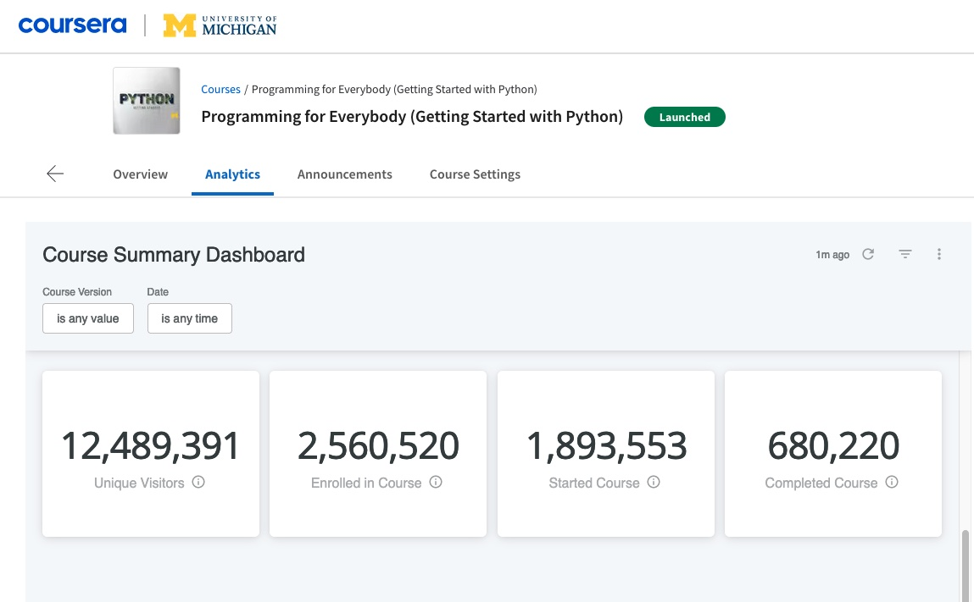
www.py4e.com

Slide 4
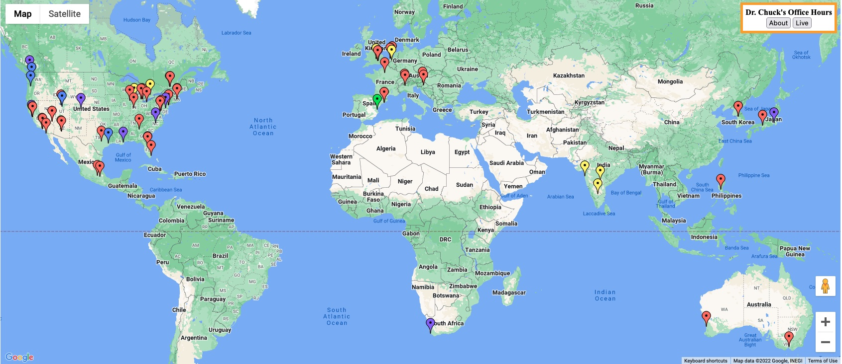
https://www.dr-chuck.com/office/

Slide 5
A Decade of MOOC Success
AGE | Persona | Scenarios | Results
13-18 | Eager learner | Advanced courses, college preparation | ✅ ✅
18-25 | College Student | Supplement on-campus offerings, "pre-learn" challenging material, broaden learning, summer learning | ✅
25-50 | Career Switch | Can learn and retain job, can switch from mid-level job on one field to entry level job in higher-paying field | ✅
25-50 | Promotion / Advancement | Supplement missing skills from college. Update knowledge. Can learn while working and apply new skills almost immediately. In time new opportunities present themselves. | ✅ ✅ ✅
25+ | Grow Intellectually | Often very successful in a career. Looking for more. Perhaps feel like they picked the wrong career and wonder... | ✅
18-30 | High-School Graduate | Motivated learners. Have time to learn. Take many MOOCs and do quite well.

Slide 6
A Decade of MOOC Success
AGE | Persona | Scenarios | Results
13-18 | Eager learner | Advanced courses, college preparation | ✅ ✅
18-25 | College Student | Supplement on-campus offerings, "pre-learn" challenging material, broaden learning, summer learning | ✅
25-50 | Career Switch | Can learn and retain job, can switch from mid-level job on one field to entry level job in higher-paying field | ✅
25-50 | Promotion / Advancement | Supplement missing skills from college. Update knowledge. Can learn while working and apply new skills almost immediately. In time new opportunities present themselves. | ✅ ✅ ✅
25+ | Grow Intellectually | Often very successful in a career. Looking for more. Perhaps feel like they picked the wrong career and wonder... | ✅
18-30 | High-School Graduate | Motivated learners. Have time to learn. Take many MOOCs and do quite well. Unable to get any first job in the field of their choice. | ❌

Slide 7
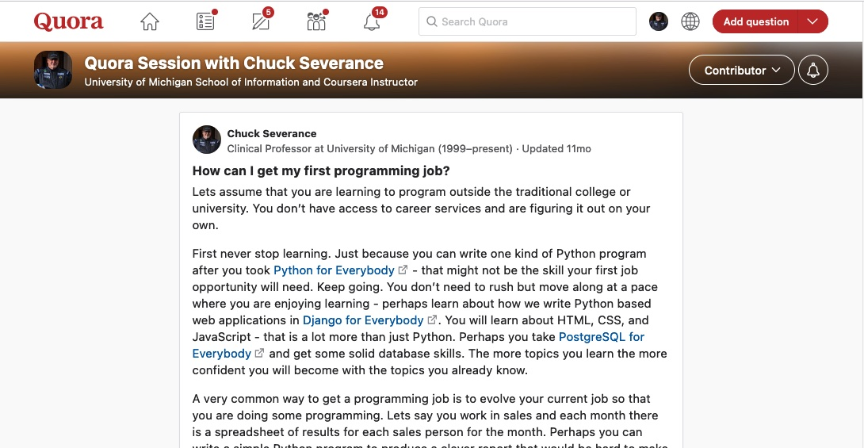
https://qr.ae/pvHMmw

Slide 8
First Job Challenges
No experience – a resume is just words
No portfolio in the real world
No evidence of people skills / meetings / deadlines, etc.
Certificates? Too few (low skill?) Too many (Must be a NERD!!!)
No network - Entry level jobs are often word of mouth (too many applicants)
No recommendations other than teachers (meh)

Slide 9
A Good College Makes it Easier
Job fairs
Alumni networks
Practical project classes
Nice but not enough on their own
Internships at strong companies
People skills
Real work product in your portfolio
People who can write real recommendations
This works best at large / prestigious schools

Slide 10
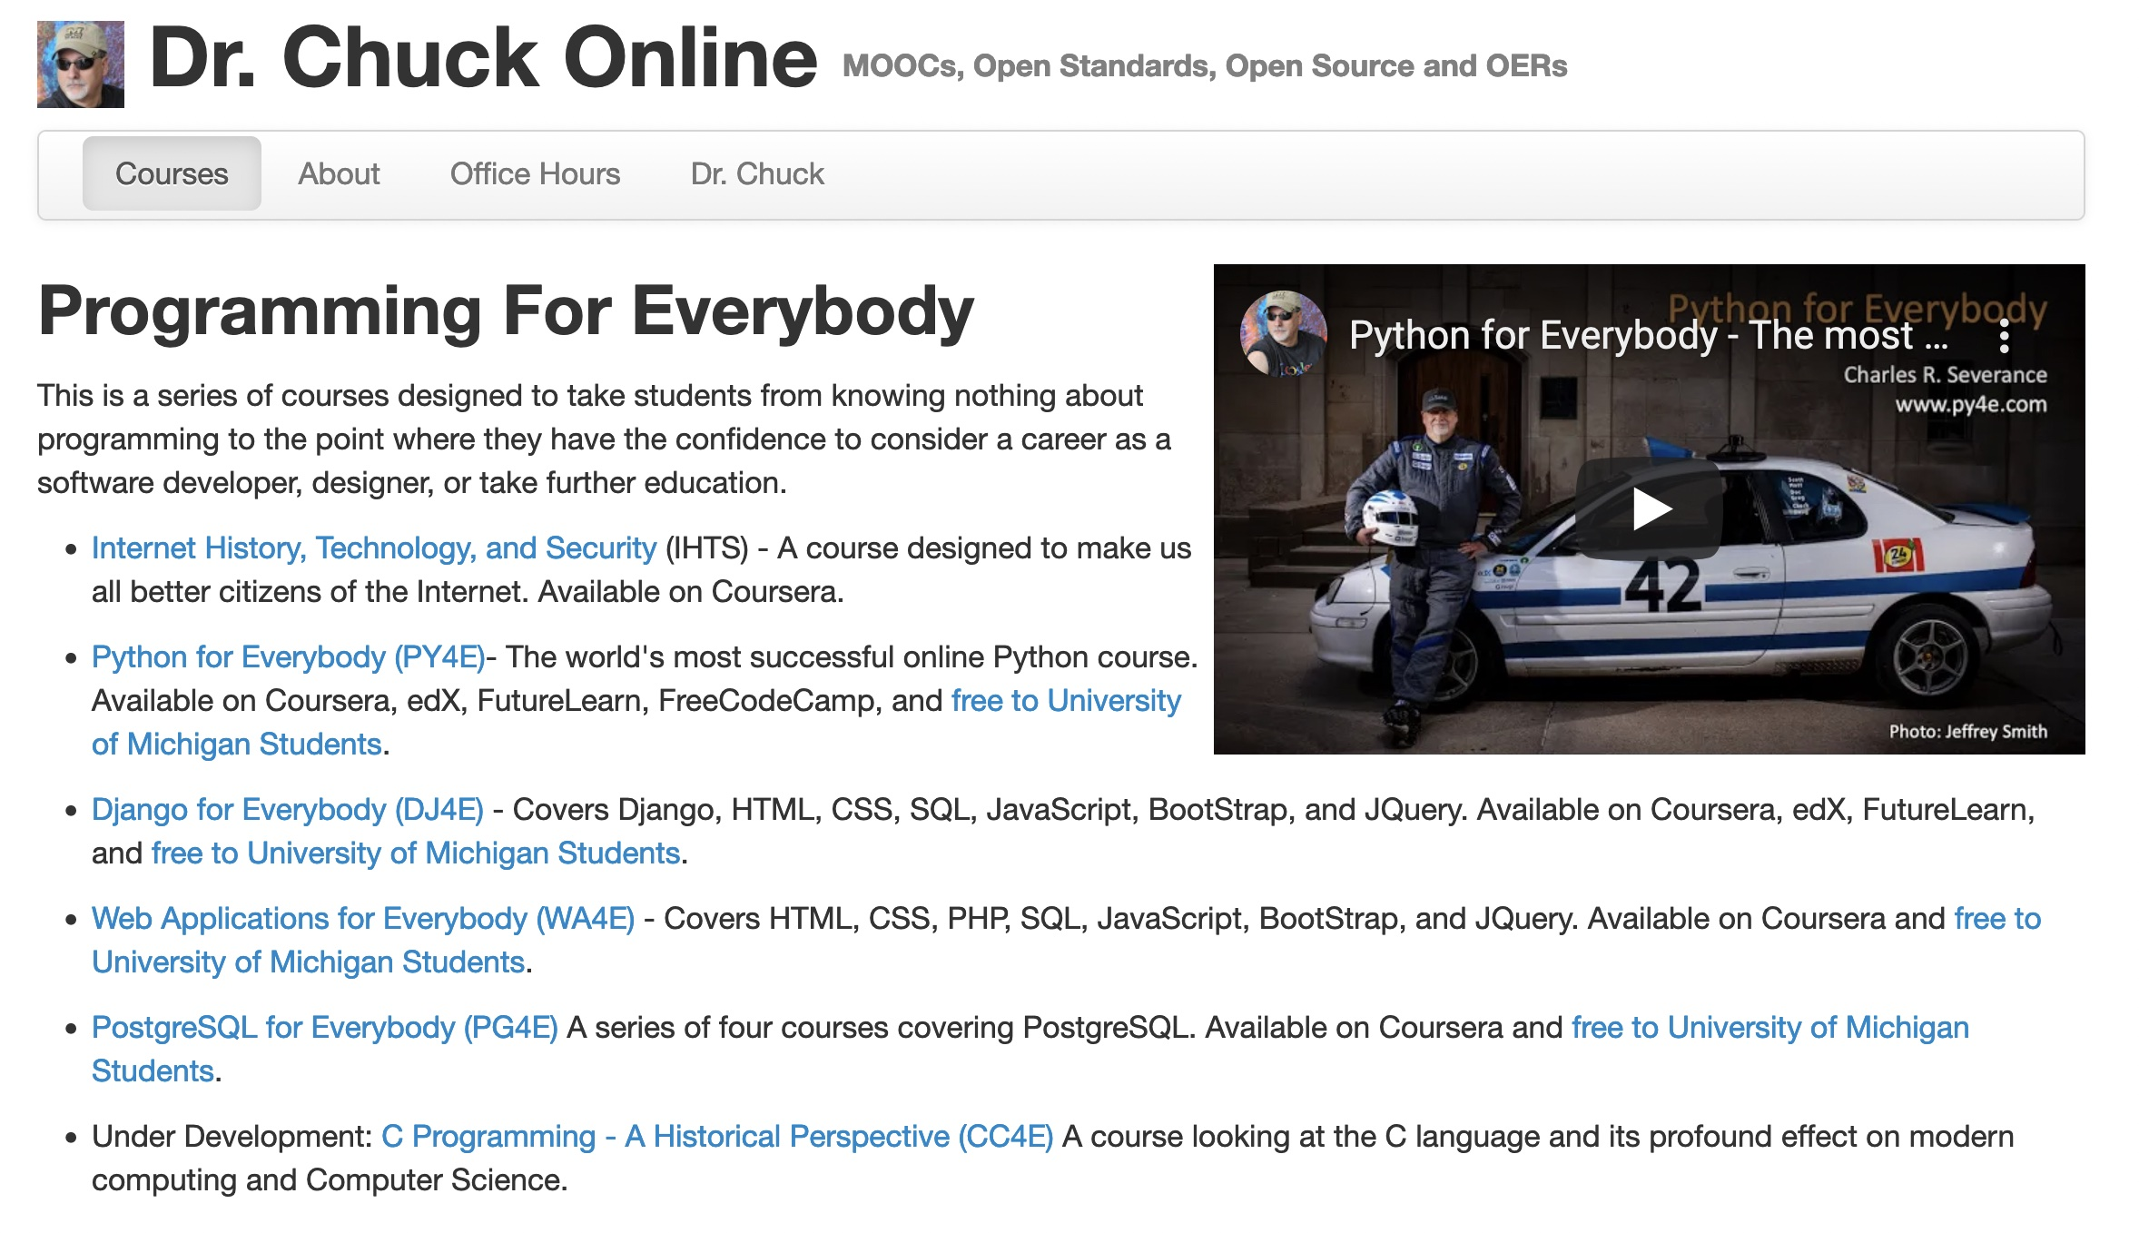
https://online.dr-chuck.com/

Slide 11

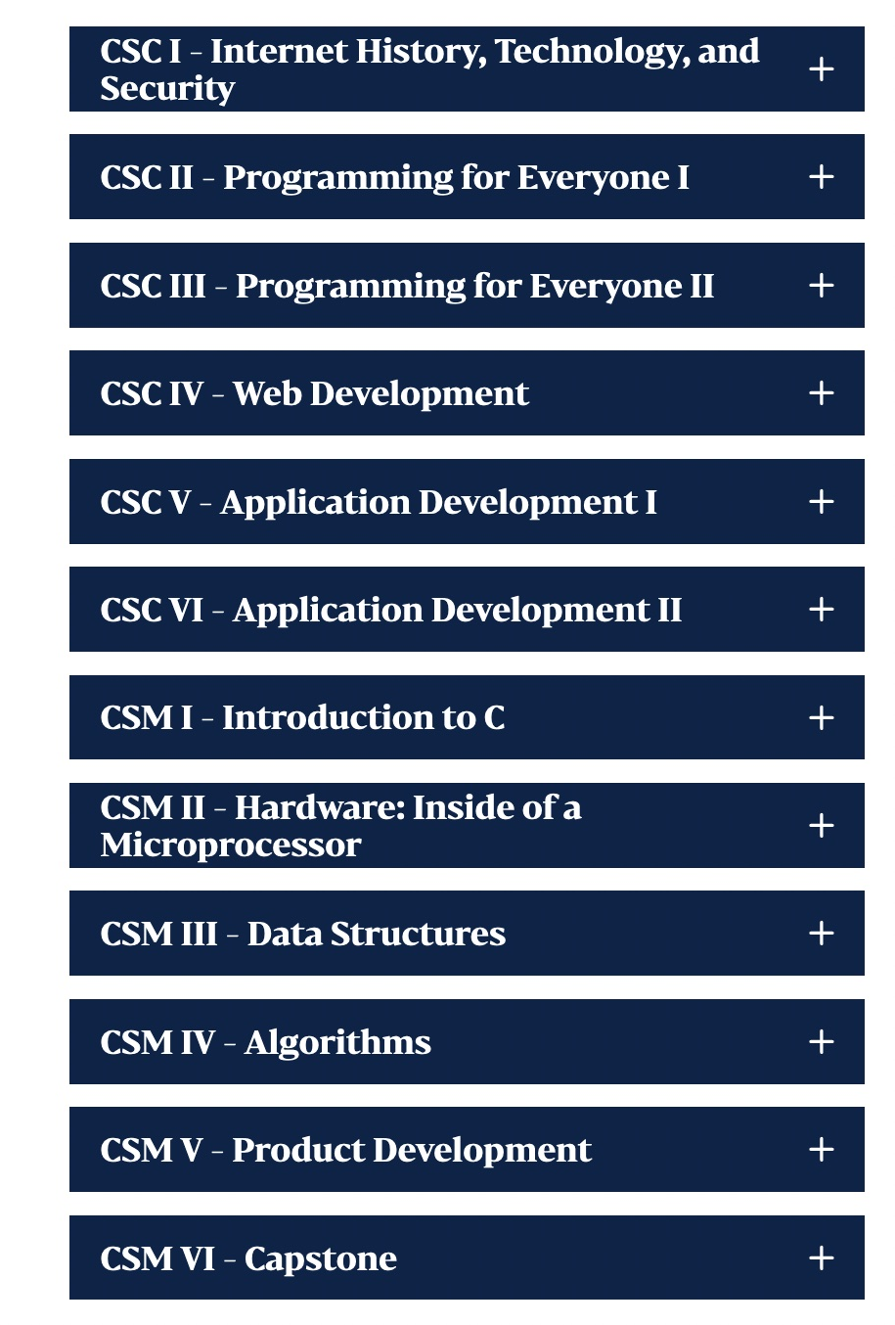
https://www.thelcmc.org/programs/computer-science

Slide 12
Smaller School Internship Challenges
National companies focus on "big name" schools
Smaller, local companies find it difficult to run internship programs
Even "capstone" courses are a little "thin"
Only 15 weeks long
Have high expectations – "write a mobile app from scratch"
Often students already have jobs and are part-time
Internships often don't pay well, require a move, and expect full time
Not so good for those with less means

Slide 13
Open-Source Projects

Slide 14
Open-Source Projects
Worldwide
Part time
Always need help
Quality Assurance / Testing
Documentation
Issue tracking and curation
Translation
Short on staff - senior team members are busy and don't really have time for extensive mentoring of newcomers

Slide 15
Need to Streamline Onboarding
Find a task anyone can do – in Sakai it is Quality Assurance
Make sure onboarding is smooth
Have a single web page to welcome new community members
Give them a checklist and contacts
Get them on mailing lists and invited to meetings
Get your initial task well enough documented that folks can be productive quickly.
Make sure that there is one "welcoming contact" to ask questions and get "unstuck"

Slide 16
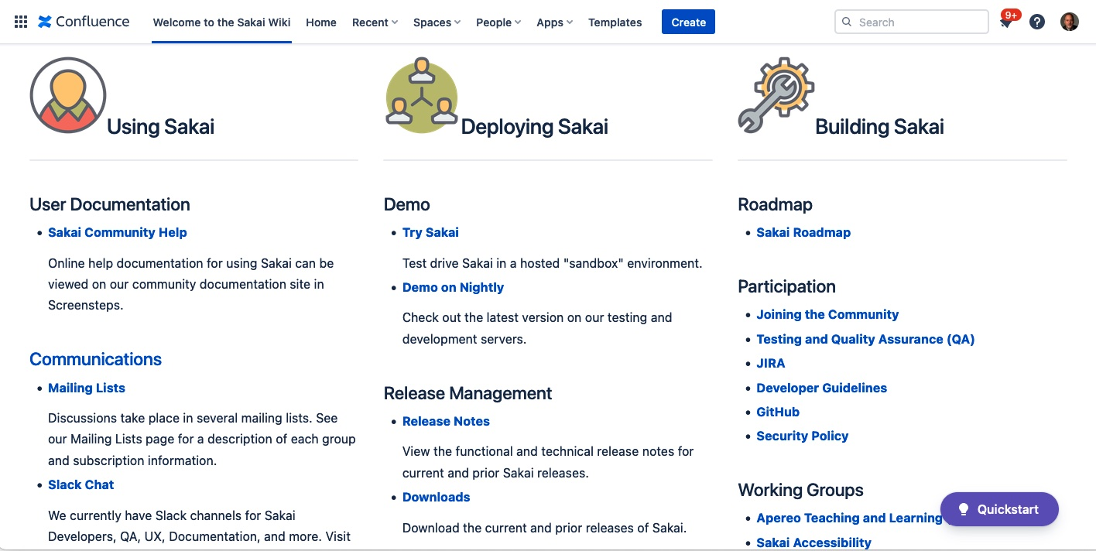
https://sakaiproject.atlassian.net/wiki/spaces/CONF/overview

Slide 17
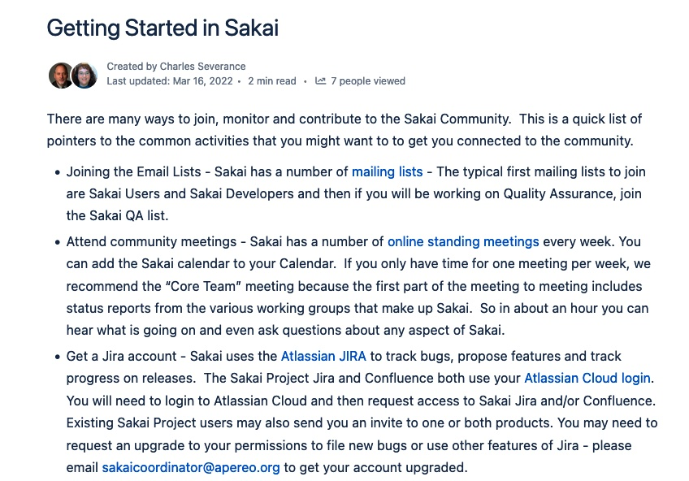

Slide 18
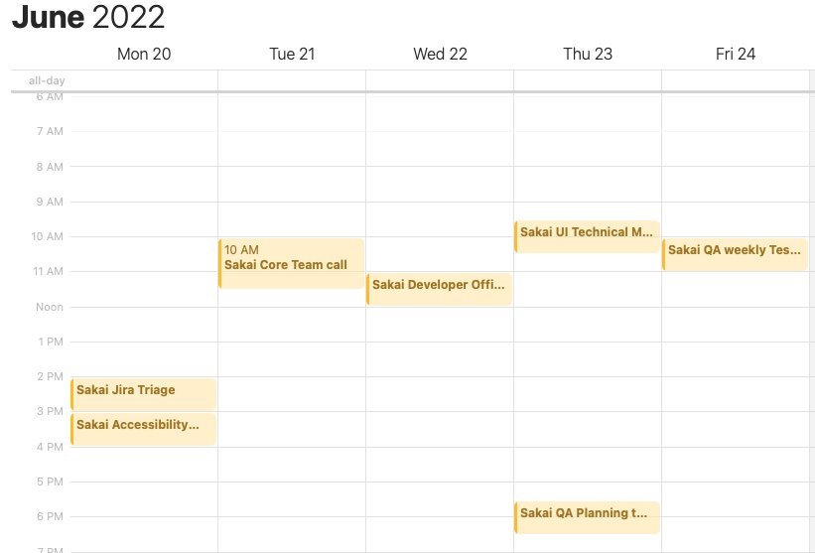
Sakai Meetings

Slide 19
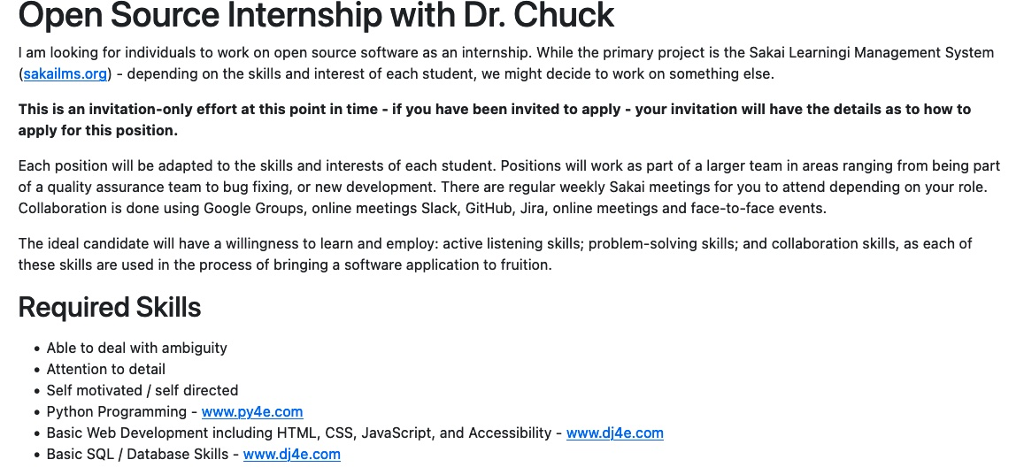
https://www.dr-chuck.com/osis/

Slide 20
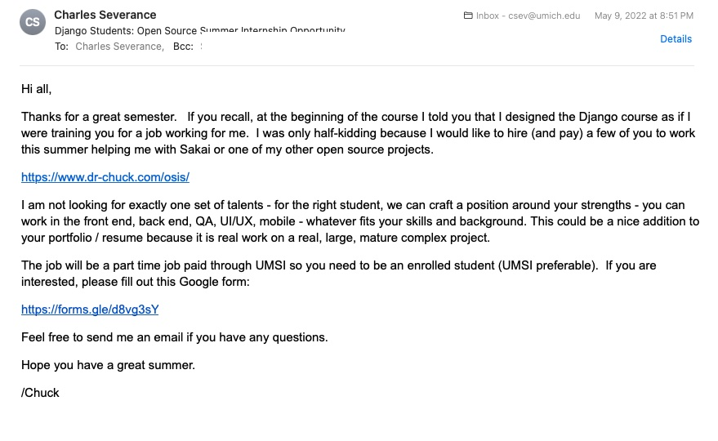

Slide 21
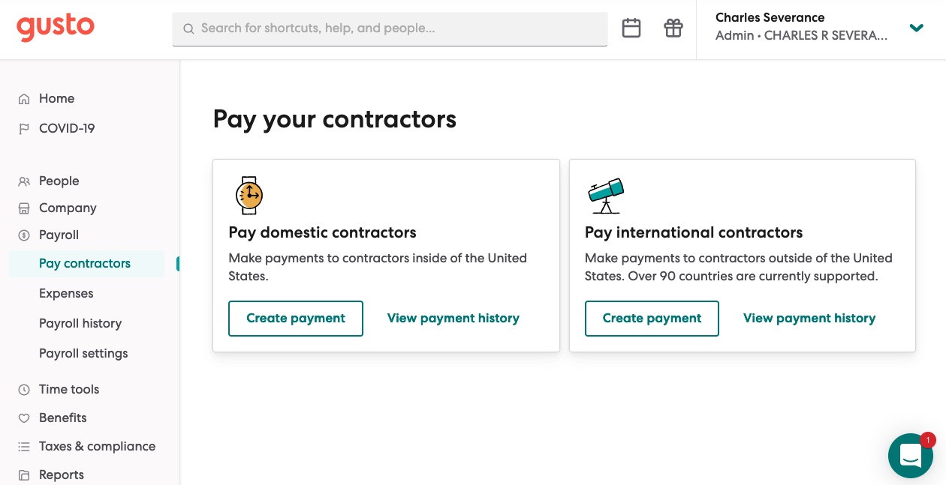
Paid Internships – www.gusto.com

Slide 22
It is Early Days
Sakai has been streamlining its QA onboarding processes
One paid intern from University of Michigan
One paid intern from a MOOC course contact
It is going very well – but not at scale
Each new intern has a goal to make the process better

Slide 23
Goals / Dreams
Get the processes running smoothly in Sakai
Have paid 5-10 interns in Sakai – all the time
Would like to liaison with other Open-Source projects to generalize the approach and learn from each other
If this becomes a multi-project effort and is running smoothly for the projects and students – raise some funds and increase scale

