Slide 1


Building Scalable IMS LTI Tools Using the TSUGI Framework
Charles Severance
www.dr-chuck.com
www.tsugi.org

Slide 2
Project Tsugi
Tool Hosting Container (i.e. Like a B2)
PHP now, Java and Node in development
Based on IMS Specifications
LTI 1.x / LTI 2.x / IMS Settings / Common Cartridge / Caliper / CASA / Roster / Gradebook / ....
Tools can run on a campus hosting platform or commercial provider or cloud
Tools are "installed" into hosting containers

Slide 3
Standards are Getting Complex
LTI 1.x – Three pages of spec and some "hello world" code
LTI 2.x – Several specs – multiple interactions
We will need to share common implementations across instructions
And what about Caliper, Outcomes, OneRoster, Memberships, Casa, xAPI, etc. ??

Slide 4
PHP Tsugi
Reduce the barriers to tool development
Easy to learn, easy to deploy
Enable lots of small, learning-focused tools
Install / Configuration similar to Moodle
Multi-tenant
Cookie free (i.e. loves iframes)
Auto-ddl feature to upgrade schema

Slide 5
Sample PHP Tsugi Tools
Google Map
Attendance Tool
GIFT Quiz
Peer-graded drop box
App Store
Sample auto graders
Python
PHP
SQL
HTML

Slide 6
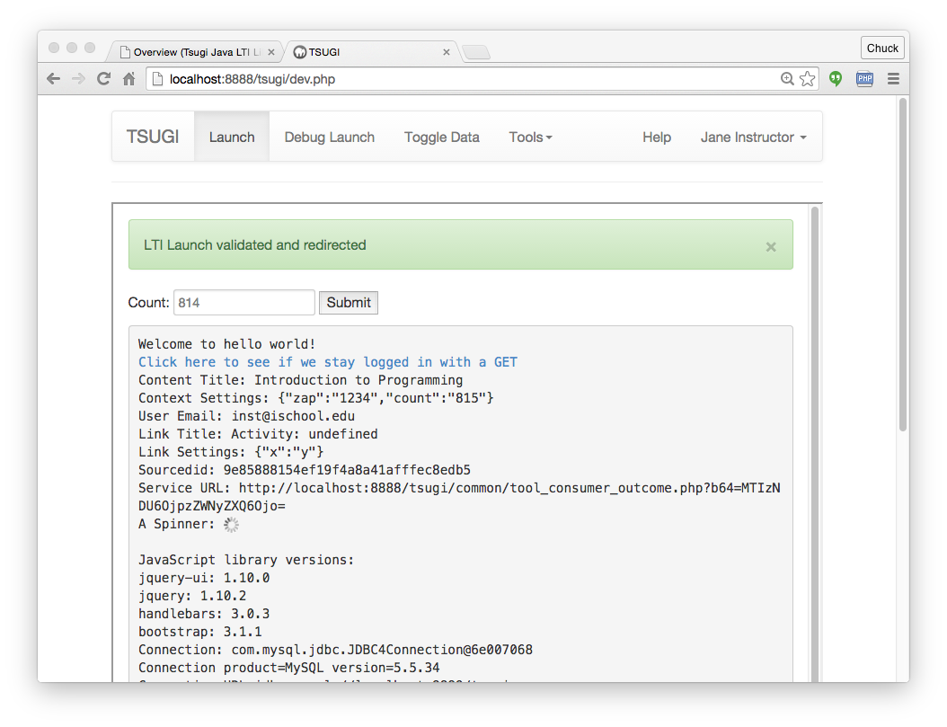

Slide 7
Online Demo PHP Tsugi
https://lti-tools.dr-chuck.com/tsugi/
Developer mode (pw = secret)
Apply for keys

Slide 8
Java Tsugi
http://csev.github.io/tsugi-java/
Currently just a library and sample servlet
APIs + factory pattern
Depends on PHP Tsugi
Database table management
Developer test harness
Shares core data tables with PHP Tsugi
More to develop
Java database/key admin
Java developer console

Slide 9
Java Tsugi
http://csev.github.io/tsugi-java/
Currently a library and sample servlet
APIs + factory pattern
Depends on PHP Tsugi
Database table management
Developer test harness
Shares core data tables with PHP Tsugi
More to develop
Java database/key admin
Java developer console

Slide 10
Node Tsugi
Still emergent
Handles LTI Launches
Expecting Alpha release June 2016
https://github.com/csev/tsugi-node-sample
https://github.com/csev/tsugi-node

