Slide 1


Building Scalable IMS LTI Tools Using the TSUGI Framework
Charles Severance
www.dr-chuck.com
www.tsugi.org

Slide 2
Standards are Getting Complex
LTI 1.x – Three pages of spec and some "hello world" code
LTI 2.x – Several specs – multiple interactions
We will need to share common implementations across instructions
And what about Caliper, Outcomes, OneRoster, Memberships, Casa, xAPI, etc. ??

Slide 3
Sir ,
I am doing a project on Tool providers for LTI 1.1
We are developing tools that would be compatible with both LTI 1.1 and LTI 2.0.
Can you help in developing a LTI 1.1 tool consumer and tool provider.
Please provide me with sample source codes and documentation on how to use it for LTI 1.1.
S. C.
Intern
IIT Bombay

Slide 4
Issues with Learning Tools
Cookies in iframes do not work well
Session hikacking
Session lifetime
Aligning look and feel with LMS UI
Asynchronous grading (instructor/peer)
Dealing with LMS outages
Batch processing
....

Slide 5
Can we make this easy?
Make building learning tools easy and fun
Engage students in open source and educational technology
Something that can be done in an undergraduate software development capstone

Slide 6
Project Tsugi
Tool Hosting Container (i.e. Like a B2)
PHP now, Java and Node in development
Based on IMS Specifications
LTI 1.x / LTI 2.x / IMS Settings / Common Cartridge / Caliper / CASA / Roster / Gradebook / ....
Tools can run on a campus hosting platform or commercial provider or cloud
Tools are "installed" into hosting containers

Slide 7
PHP Tsugi
Reduce the barriers to production
Easy to learn, easy to deploy (self-service)
Enable lots of small, learning-focused tools
Install / Configuration similar to Moodle
Multi-tenant
Cookie free (i.e. loves iframes)
Auto-ddl feature to upgrade schema
Recorded lectures – Perhaps a MOOC?
youtube.tsugi.org

Slide 8
Sample PHP Tsugi Tools
Google Map
Attendance Tool
GIFT Quiz
Peer-graded drop box
App Store
Sample auto graders
Python
PHP
SQL
HTML

Slide 9
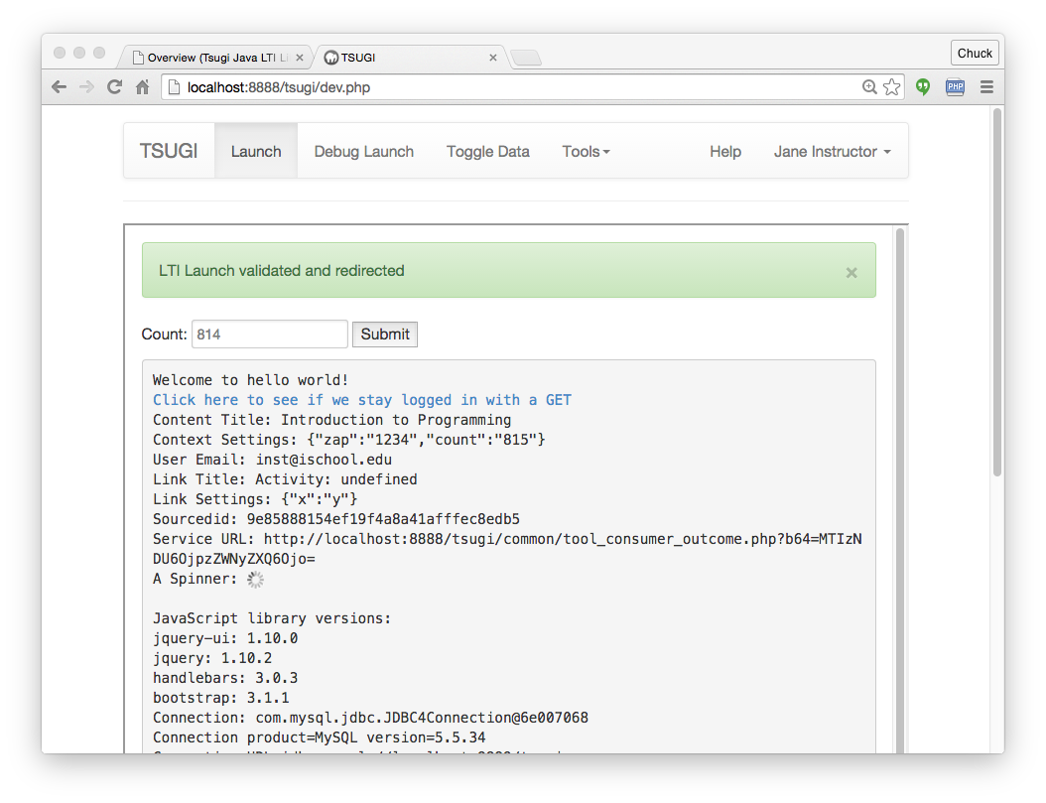

Slide 10
PHP Tsugi Components
Admin, Developer, and Management Console
https://github.com/csev/tsugi
Core PHP Library
https://github.com/csev/tsugi-php
http://do1.dr-chuck.com/tsugi/phpdoc/namespaces/Tsugi.html
Basic Module Set
https://github.com/csev/tsugi-php-mod

Slide 11
PHP Tsugi Components
Static content (shared / CDN)
https://github.com/csev/tsugi-static
Sample Tsugi Module
https://github.com/csev/tsugi-php-module
Sample Tsugi Standalone Application
https://github.com/csev/tsugi-php-standalone
Exercises for Course/Workshop
https://github.com/csev/tsugi-php-exercises

Slide 12
Online Demo PHP Tsugi
https://lti-tools.dr-chuck.com/tsugi/
Developer mode (pw = secret)
Apply for keys

Slide 13
Java Tsugi
Currently a library and sample servlet
APIs + factory pattern
Depends on PHP Tsugi
Database table management
Developer test harness
Shares core data tables with PHP Tsugi
Shares tsugi-static
Uses PHP Application Console

Slide 14
Tsugi Java
Low Level IMS API Code
https://github.com/sakaiproject/sakai/tree/master/basiclti/tsugi-util
Released in Sonatype
<groupId>org.tsugi</groupId>
<artifactId>tsugi-util</artifactId>
Java Library
https://github.com/csev/tsugi-java

Slide 15
Tsugi Java
API Documentation
http://csev.github.io/tsugi-java/apidocs/
Sample TsugiServlet / Maven / JDBC
https://github.com/csev/tsugi-java-servlet
Simple Sample Servlet / Maven / JDB
https://github.com/csev/maven-jetty-jdbc-servlet

Slide 16
Node Tsugi
Based on Node 6.x and ES6
Handles LTI Launches
Connects to the Tsugi database and maintains launch data
Uses PHP Console
Depends on the PHP Maint/Dev/Admin Console
Expecting Alpha release Summer 2016

Slide 17
Node Tsugi
Node low-Level LTI code
https://github.com/csev/tsugi-node-lti
https://www.npmjs.com/package/tsugi-node-lti
Node Library Code
https://github.com/csev/tsugi-node
http://do1.dr-chuck.com/tsugi-node/esdoc/
Node Sample Application
https://github.com/csev/tsugi-node-sample

Slide 18
Summary
Tsugi PHP is very well developed
Production ready: LTI 1.1, ContentItem
Working: LTI 2.0, LTI 2.1, CASA
Tsugi Java – Might be folded into Sakai
Tsugi Node
Expecting a summer 2016 release for standalone pattern

Slide 19


