Slide 1

Using JQuery / APIs / JSON
Dr. Charles Severance
www.php-intro.com

Slide 2
Document Object Model
JavaScript can manipulate the current HTML docment
The “Document Object Model” tells us the syntax to use to access various “bits” of the current screen to read and/or manipulate
You can even find pieces of the model by id attribute and change them
We can read and write the DOM from JavaScript
http://en.wikipedia.org/wiki/Document_Object_Model

Slide 3
DOM's are not Identical
Not all browsers represent their page exactly the same.
This makes it a challenge to keep all of your JavaScript working on all browsers
Also means you need to test your code over and over on each browser
Aargh..

Slide 4
JQuery to the rescue
While the DOM's are not particularly portable, and direct DOM manipulation is a little clunky, there are a number of JavaScript frameworks that handle the myriad of subtle differeces between browsers
http://jquery.org/
With JQuery, instead of manipulating the DOM, we use JQuery functions and everything works much better...

Slide 5
JQuery Documentation
The web is a wonderful source of JQuery documentation
  http://docs.jquery.com/Main_Page
  http://api.jquery.com/
  http://jqueryui.com/demos/
  .....

Slide 6
http://www.php-intro.com/code/jquery-01.zip
jquery-01/hello.php
<html>
<head>
<script type="text/javascript" src="jquery.min.js">
</script>
</head>
<body>
<script type="text/javascript">
$(document).ready(function(){
alert("Hello JQuery World!");
window.console && console.log('Hello JQuery..');
});
</script>
<p>Here is some awesome page content</p>
</body>

Slide 7
jquery-01/resize.php
<html>
<head>
<script type="text/javascript" src="jquery.min.js">
</script>
</head>
<body>
<script type="text/javascript">
$(window).resize(function() {
console.log('.resize() called. width='+
$(window).width()+' height='+$(window).height());
});
</script>
<p>Here is some awesome page content</p>
</body>
http://api.jquery.com/resize/

Slide 8
jquery-01/toggle.php
<p id="para">Where is the spinner?
<img id="spinner" src="spinner.gif" height="25"
style="vertical-align: middle; display:none;">
</p>
<a href="#" onclick="$('#spinner').toggle();
return false;">Toggle</a>
<a href="#" onclick="$('#para').css('background-color', 'red');
return false;">Red</a>
<a href="#" onclick="$('#para').css('background-color', 'green');
return false;">Green</a>

Slide 9
jquery-01/autoecho.php
<?php
sleep(1);
echo('You sent: '.$_POST['val']);
jquery-01/autopost.php
<form id="target">
<input type="text" name="one" value="Hello there"
style="vertical-align: middle;"/>
<img id="spinner" src="spinner.gif" height="25"
style="vertical-align: middle; display:none;">
</form>
<div id="result"></div>
...

Slide 10
jquery-01/autopost.php
<script type="text/javascript">
$('#target').change(function(event) {
event.preventDefault();
$('#spinner').show();
var form = $('#target');
var txt = form.find('input[name="one"]').val();
window.console && console.log('Sending POST');
$.post( 'autoecho.php', { 'val': txt },
function( data ) {
window.console && console.log(data);
$('#result').empty().append(data);
$('#spinner').hide();
}
).error( function() {
window.console && console.log('error');
});
return false;
});
</script>

Slide 11
JavaScript Object Notation

Slide 12
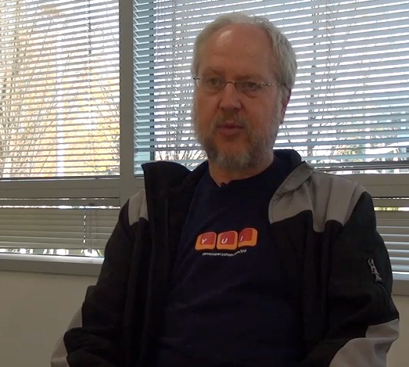
JavaScript Object Notation
Douglas Crockford - "Discovered" JSON
Object literal notation in JavaScript
https://vimeo.com/38054451
http://www.youtube.com/watch?v=-C-JoyNuQJs

Slide 13
Associative Arrays Objects
JavaScript Associative Arrays are actually objects with member variables
They can be accessed with either associative array syntax or object syntax

Slide 14
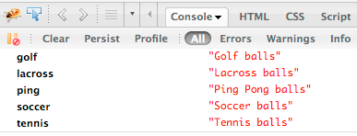
balls = {"golf": "Golf balls",
"tennis": "Tennis balls",
"ping": "Ping Pong balls"};
balls.soccer = "Soccer balls";
balls['lacross'] = "Lacross balls";
console.dir(balls);

Slide 15
JSON Syntax
who = {
'name': 'Chuck',
'age': 29,
'college': true,
'offices' : [ '3350DMC', '3437NQ' ],
'skills' : { 'fortran': 10,
'C': 10,
'C++': 5,
'python' : '7'
}
};
String
Integer
Boolean
List/Array
Object

Slide 16
json-01/syntax.php
http://www.php-intro.com/code/json-01.zip
<html><head/><body>
<script type="text/javascript">
who = {
'name': 'Chuck',
'age': 29,
'college': true,
'offices' : [ '3350DMC', '3437NQ' ],
'skills' : { 'fortran': 10, 'C': 10,
'C++': 5, 'python' : '7' }
};
window.console && console.log(who);
</script>
<p>Check out the console.log to see the cool object</p>
<pre>
....
Constant

Slide 17
json-01/index.php
...
$(document).ready( function () {
$.getJSON('json.php', function(data) {
$("#back").html(data.first);
window.console && console.log(data);
})
}
);
...
json-01/json.php
<?php
sleep(2);
header('Content-Type: application/json; charset=utf-8');
$stuff = array('first' => 'first thing',
'second' => 'second thing');
echo(json_encode($stuff));

Slide 18
<?php
session_start();
if ( isset($_POST['reset']) ) {
$_SESSION['chats'] = Array();
header("Location: index.php");
return;
}
if ( isset($_POST['message']) ) {
if ( !isset ($_SESSION['chats']) ) $_SESSION['chats'] = Array();
$_SESSION['chats'] [] = array($_POST['message'], date(DATE_RFC2822));
header("Location: index.php");
return;
}
?>
<html>
<head>
<script type="text/javascript" src="jquery.min.js">
</script>
</head>
json-02-chat/index.php

Slide 19
http://www.php-intro.com/code/json-02-chat.zip
json-02-chat/index.php
<html>
<head>
<script type="text/javascript" src="jquery.min.js">
</script>
</head>
<body>
<h1>Chat</h1>
<form method="post" action="index.php">
<p>
<input type="text" name="message" size="60"/>
<input type="submit" value="Chat"/>
<input type="submit" name="reset" value="Reset"/>
</p>
</form>
<div id="chatcontent">
<img src="spinner.gif" alt="Loading..."/>
</div>
<script type="text/javascript">
....

Slide 20
function updateMsg() {
window.console && console.log("Requesting JSON");
$.ajax({
url: "chatlist.php",
cache: false,
success: function(data){
window.console && console.log("JSON Received");
window.console && console.log(data);
$("#chatcontent").empty();
for (var i = 0; i < data.length; i++) {
entry = data[i];
$("#chatcontent").append("<p>"+entry[0] +
"<br/>&nbsp;&nbsp;"+entry[1]+"</p>\n");
}
setTimeout('updateMsg()', 4000);
}
});
}
window.console && console.log("Startup complete");
updateMsg(); // Call the first time to get things started
json-02-chat/index.php

Slide 21
json-02-chat/chatlist.php
<?php
session_start();
sleep(5);
header('Content-Type: application/json; charset=utf-8');
if ( !isset($_SESSION['chats']) ) $_SESSION['chats'] = array();
echo(json_encode($_SESSION['chats']));

Slide 22
http://www.php-intro.com/code/json-03-crud.zip
json-03-crud

