Slide 1

Using JSON
Dr. Charles Severance
www.php-intro.com
http://www.php-intro.com/code/json-01.zip
http://www.php-intro.com/code/json-02-chat.zip

Slide 2


Time
Browser
Web Server
Database Server
D
OM
Send
Request
Apache
MySql
Parse
Response
PHP
ind.php
P
D
O
JavaScript
JQuery
http://www.php-intro.com/code/rrc/

Slide 3
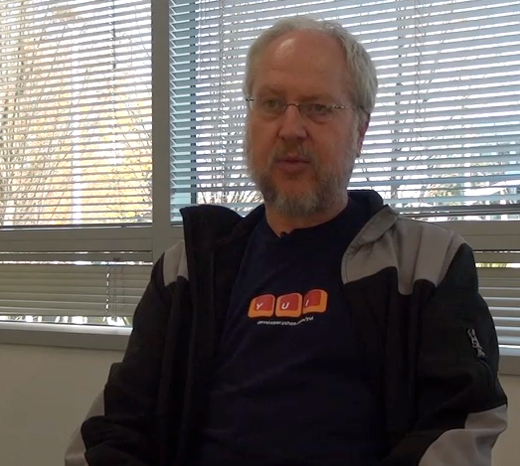
JavaScript Object Notation
Douglas Crockford - "Discovered" JSON
Object literal notation in JavaScript
https://www.youtube.com/watch?v=kc8BAR7SHJI

Slide 4
Associative Arrays Objects
JavaScript Associative Arrays are actually objects with member variables
They can be accessed with either associative array syntax or object syntax

Slide 5
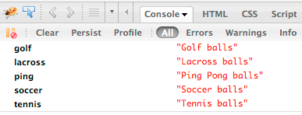
balls = {"golf": "Golf balls",
"tennis": "Tennis balls",
"ping": "Ping Pong balls"};
balls.soccer = "Soccer balls";
balls['lacross'] = "Lacross balls";
console.dir(balls);

Slide 6
who = {
"name": 'Chuck',
"age": 29,
"college" : true,
"offices" : [ '3350DMC', '3437NQ' ],
"skills" : { "fortran": 10,
"C": 10,
"C++": 5,
"python" : '7'
}
};
String
Integer
Boolean
List/Array
Object
JSON Syntax

Slide 7
json-01/syntax.php
<html><head/><body>
<script type="text/javascript">
who = {
"name": 'Chuck',
"age": 29,
"college": true,
"offices" : [ '3350DMC', '3437NQ' ],
"skills" : { 'fortran': 10, 'C': 10,
'C++': 5, 'python' : '7' }
};
window.console && console.log(who);
</script>
<p>Check out the console.log to see the cool object</p>
<pre>
....
Constant

Slide 8
<?php
sleep(2);
header('Content-Type: application/json; charset=utf-8');
$stuff = array('first' => 'first thing',
'second' => 'second thing');
echo(json_encode($stuff));
json-01/json.php
{
"first" : "first thing",
"second" : "second thing"
}
...
$(document).ready( function () {
$.getJSON('json.php', function(data) {
$("#back").html(data.first);
window.console && console.log(data);
})
}
);
...
json-01/index.php

Slide 9
<?php
session_start();
if ( isset($_POST['reset']) ) {
$_SESSION['chats'] = Array();
header("Location: index.php");
return;
}
if ( isset($_POST['message']) ) {
if ( !isset ($_SESSION['chats']) ) $_SESSION['chats'] = Array();
$_SESSION['chats'] [] = array($_POST['message'], date(DATE_RFC2822));
header("Location: index.php");
return;
}
?>
<html>
<head>
<script type="text/javascript" src="jquery.min.js">
</script>
</head>
json-02-chat/index.php

Slide 10
<body>
<h1>Chat</h1>
<form method="post" action="index.php">
<p>
<input type="text" name="message" size="60"/>
<input type="submit" value="Chat"/>
<input type="submit" name="reset" value="Reset"/>
</p>
</form>
<div id="chatcontent">
<img src="spinner.gif" alt="Loading..."/>
</div>
<script type="text/javascript" src="jquery.min.js">
</script>
<script type="text/javascript">
....
json-02-chat/index.php

Slide 11
function updateMsg() {
window.console && console.log('Requesting JSON');
$.getJSON('chatlist.php', function(rowz){
window.console && console.log('JSON Received');
window.console && console.log(rowz);
$('#chatcontent').empty();
for (var i = 0; i < rowz.length; i++) {
entry = rowz[i];
$('#chatcontent').append('<p>'+entry[0] +
'<br/>&nbsp;&nbsp;'+entry[1]+"</p>\n");
}
setTimeout('updateMsg()', 4000);
});
}
// Make sure JSON requests are not cached
$(document).ready(function() {
$.ajaxSetup({ cache: false });
updateMsg();
});
json-02-chat/index.php

Slide 12
json-02-chat/chatlist.php
<?php
session_start();
sleep(5);
header('Content-Type: application/json; charset=utf-8');
if ( !isset($_SESSION['chats']) ) $_SESSION['chats'] = array();
echo(json_encode($_SESSION['chats']));
[
["Hello","Fri, 01 Apr 2016 00:47:38 +0200"],
["Lunch?","Fri, 01 Apr 2016 00:47:53 +0200"]
]

Slide 13
json-03-crud
http://www.php-intro.com/code/json-03-crud.zip

Slide 14
Summary
JSON is very simple and powerful
It is well supported and performance in many languages
  JavaScript and PHP have excellent support

Slide 15
Additional Source Information
Image of Douglas Crockford is Copyright Charles R. Severance and licensed as CC-BY

