Slide 1

Forms and PHP
Dr. Charles Severance
www.php-intro.com

Slide 2
Forms Submit Data
<p>Guessing game...</p>
<form>
<p><label for="guess">Input Guess</label>
<input type="text" name="guess" id="guess"/></p>
<input type="submit"/>
</form>
http://www.php-intro.com/code/forms/form1.php

Slide 3
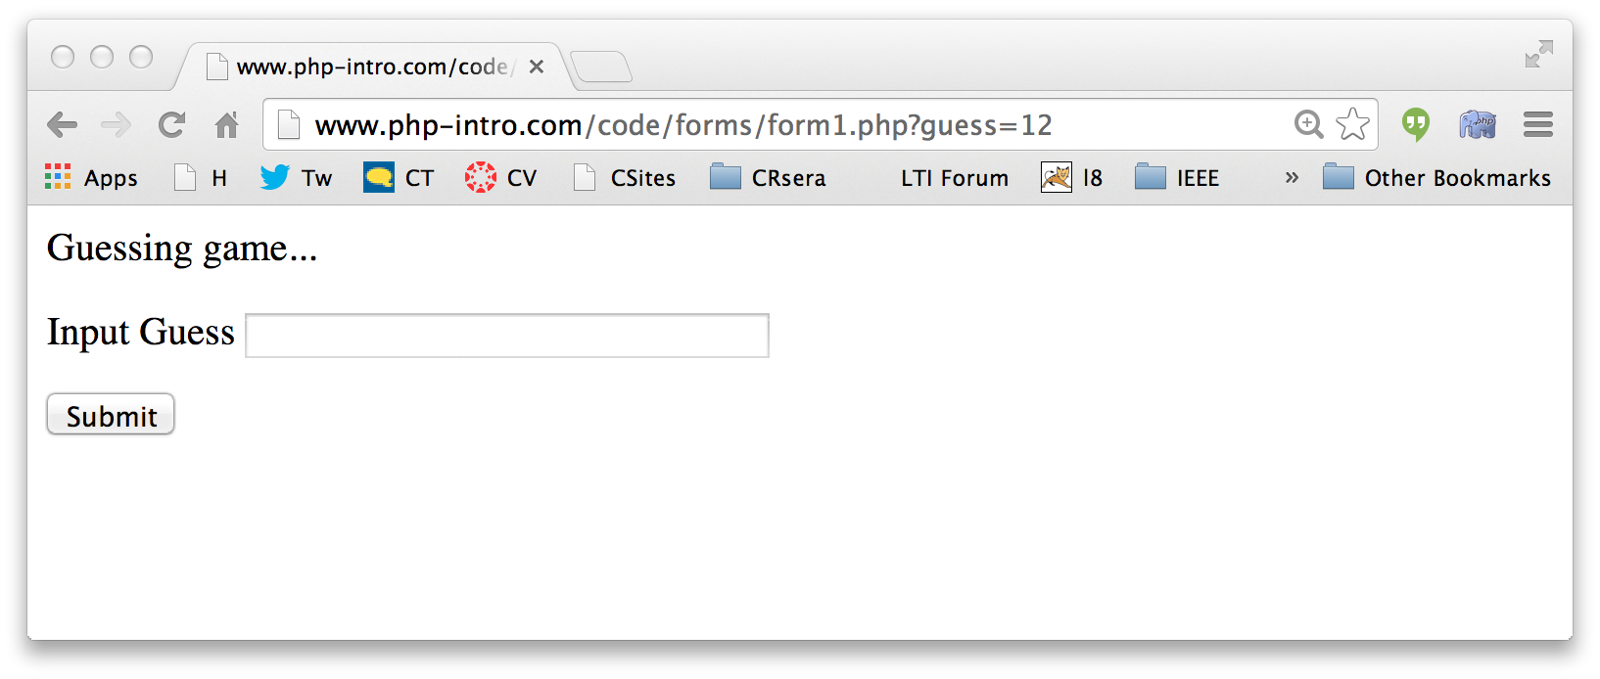
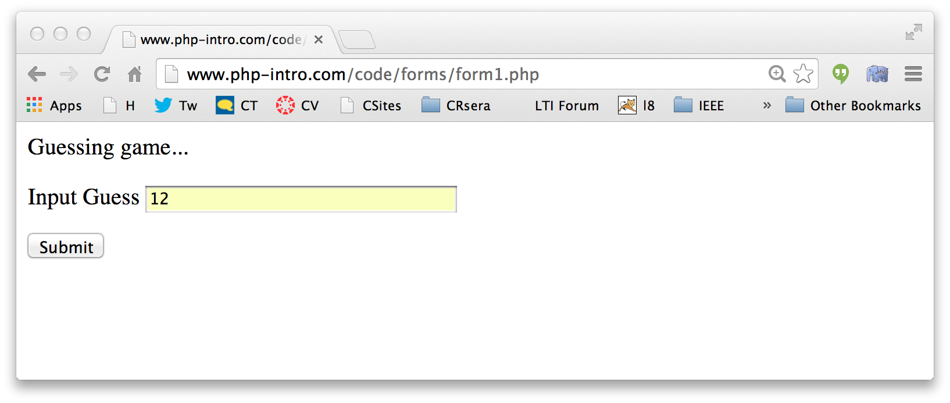
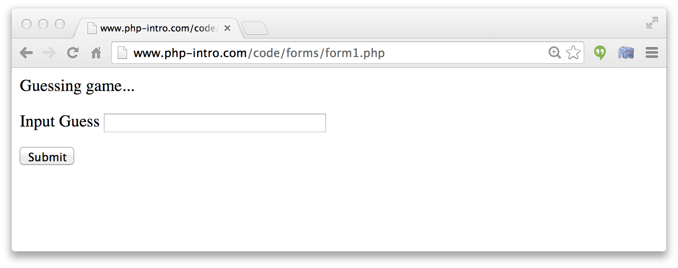
Forms Submit Data
form1.php
<p>Guessing game...</p>
<form>
<p><label for="guess">Input Guess</label>
<input type="text" name="guess" id="guess"/></p>
<input type="submit"/>
</form>

Slide 4
$_GET and $_POST
PHP loads the values for the URL parameters into an array called $_GET and the POST parameters into an array called $_POST
There is another array called $_REQUEST which merges GET and POST data

Slide 5
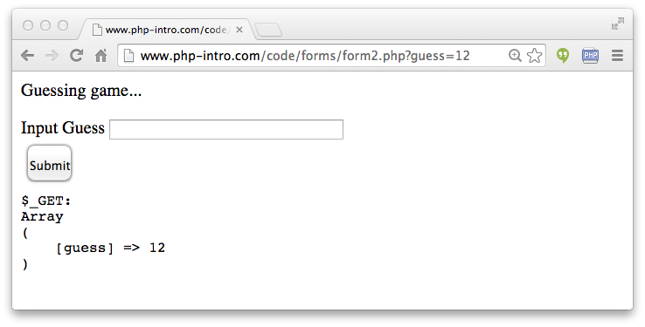
<p>Guessing game...</p>
<form>
<p><label for="guess">Input Guess</label>
<input type="text" name="guess" id="guess"/></p>
<input type="submit"/>
</form>
<pre>
$_GET:
<?php
print_r($_GET);
?>
</pre>
form2.php

Slide 6
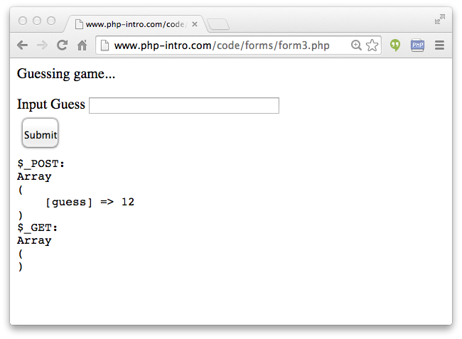
<p>Guessing game...</p>
<form method="post">
<p><label for="guess">Input Guess</label>
<input type="text" name="guess" size="40" id="guess"/></p>
<input type="submit"/>
</form>
<pre>
$_POST:
<?php
print_r($_POST);
?>
$_GET:
<?php
print_r($_GET);
?>
</pre>
form3.php

Slide 7
Forms GET .vs. POST
Two ways the browser can send parameters to the web server
  GET - Parameters are placed on the URL which is retrieved
  POST - The URL is retrieved and parameters are appended to the request in the the HTTP connection

Slide 8
Passing Parameters to The Server
GET /simpleform.html?yourname=fred
Accept: www/source
Accept: text/html
User-Agent: Lynx/2.4 libwww/2.14
Web Server
HTTP
Request
POST /simpleform.html
Accept: www/source
Accept: text/html
User-Agent: Lynx/2.4 libwww/2.14
Content-type: application/x-www-form-urlencoded
Content-length: 13
yourname=fred
Browser
<input type="text" name="yourname" id="yourid" />

Slide 9
Rules of the POST/GET Road
GET is used when your are reading or searching things
POST is used when data is being created or modified
Web search spiders will follow GET URLs but generally not POST URLs
GET Urls should be “idempotent” - the same URL should give the “same thing” each time you access it
GET has an upper limit of the number of bytes of parameters and values (think about 2K)

Slide 10
<?php
$oldguess = isset($_POST['guess']) ?
$_POST['guess'] : '';
?>
<p>Guessing game...</p>
<form method="post">
<p><label for="guess">Input Guess</label>
<input type="text" name="guess" id="guess" size="40"
<?php
echo 'value="' . $oldguess . '"';
?>
/></p>
<input type="submit"/>
</form>
form4.php
Review: Ternary Operation

Slide 11
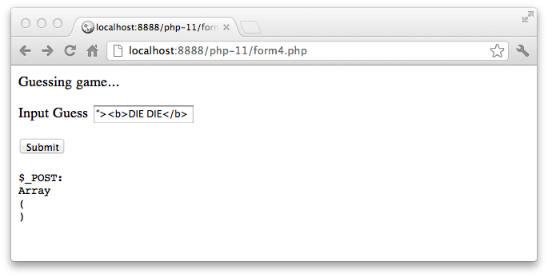
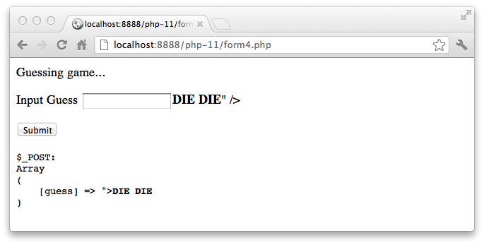
Hygene Alert!
form4.php
What happens when we use an HTML character in a form field value??

Slide 12
form4.php
<form method="post">
<p><label for="guess">Input Guess</label>
<input type="text" name="guess" id="guess"value=""><b>DIE DIE</b>" /></p>
<input type="submit"/>
</form>

Slide 13
To The Rescue: htmlentities()
<form method="post">
<p><label for="guess">Input Guess</label>
<input type="text" name="guess" id="guess"
<?php
echo 'value="' . htmlentities($oldguess) . '"';
?>
/></p>
<input type="submit"/>
</form>
form5.php

Slide 14
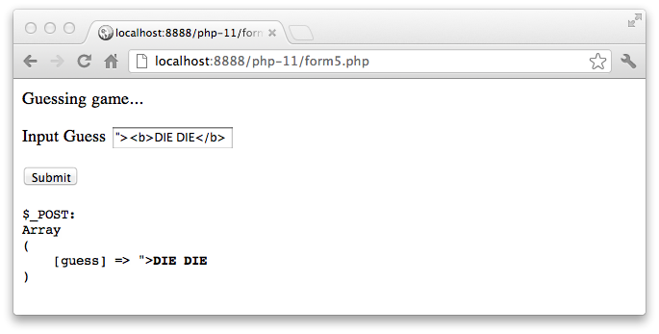
<form method="post">
<p><label for="guess">Input Guess</label>
<input type="text" name="guess" id="guess"
<?php
echo 'value="' . htmlentities($oldguess) . '"';
?>
/></p>
<input type="submit"/>
</form>
<input type="text" name="guess" id="guess"
value="&quot;&gt;&lt;b&gt;DIE DIE&lt;/b&gt;" /></p>

Slide 15
Processing POST Data
There are many patterns for handling POST data
No "rules" just "suggestions"
Completely process incoming POST data (if any) - produce no output.
<?php
$guess = '';
$message = false;
if ( isset($_POST['guess']) ) {
// Trick for integer / numeric parameters
$guess = $_POST['guess'] + 0;
if ( $guess == 42 ) {
$message = "Great job!";
} else if ( $guess < 42 ) {
$message = "Too low";
} else {
$message = "Too high...";
}
}
?>
<html>
<head>
<title>A Guessing game</title>
</head>
<body style="font-family: sans-serif;">
<p>Guessing game...</p>
<?php
if ( $message !== false ) {
echo("<p>$message</p>\n");
}
?>
<form method="post">
<p><label for="guess">Input Guess</label>
<input type="text" name="guess" id="guess" size="40"
<?php echo 'value="' . htmlentities($guess) . '"';
?>
/></p>
<input type="submit"/>
</form>
</body>
Produce the page output.
guess.php
What about frameworks?

Slide 16
<?php
$guess = '';
$message = false;
if ( isset($_POST['guess']) ) {
// Trick for integer / numeric parameters
$guess = $_POST['guess'] + 0;
if ( $guess == 42 ) {
$message = "Great job!";
} else if ( $guess < 42 ) {
$message = "Too low";
} else {
$message = "Too high...";
}
}
?>
<html>
<head>
<title>A Guessing game</title>
</head>
<body style="font-family: sans-serif;">
<p>Guessing game...</p>
<?php
if ( $message !== false ) {
echo("<p>$message</p>\n");
}
?>
<form method="post">
<p><label for="guess">Input Guess</label>
<input type="text" name="guess" id="guess" size="40"
<?php echo 'value="' . htmlentities($guess) . '"';
?>
/></p>
<input type="submit"/>
</form>
</body>
guess.php

Slide 17
<?php
$guess = '';
$message = false;
if ( isset($_POST['guess']) ) {
// Trick for integer / numeric parameters
$guess = $_POST['guess'] + 0;
if ( $guess == 42 ) {
$message = "Great job!";
} else if ( $guess < 42 ) {
$message = "Too low";
} else {
$message = "Too high...";
}
}
?>
<html>
<head>
<title>A Guessing game</title>
</head>
<body style="font-family: sans-serif;">
<p>Guessing game...</p>
<?php
if ( $message !== false ) {
echo("<p>$message</p>\n");
}
?>
<form method="post">
<p><label for="guess">Input Guess</label>
<input type="text" name="guess" id="guess" size="40"
<?php echo 'value="' . htmlentities($guess) . '"';
?>
/></p>
<input type="submit"/>
</form>
</body>
<?php
$guess = '';
$message = false;
if ( isset($_POST['guess']) ) {
// Nifty trick
$guess = $_POST['guess'] + 0;
if ( $guess == 42 ) {
$message = "Great job!";
} else if ( $guess < 42 ) {
$message = "Too low";
} else {
$message = "Too high...";
}
}
?>
<html> ...
guess.php

Slide 18
<?php
$guess = '';
$message = false;
if ( isset($_POST['guess']) ) {
// Trick for integer / numeric parameters
$guess = $_POST['guess'] + 0;
if ( $guess == 42 ) {
$message = "Great job!";
} else if ( $guess < 42 ) {
$message = "Too low";
} else {
$message = "Too high...";
}
}
?>
<html>
<head>
<title>A Guessing game</title>
</head>
<body style="font-family: sans-serif;">
<p>Guessing game...</p>
<?php
if ( $message !== false ) {
echo("<p>$message</p>\n");
}
?>
<form method="post">
<p><label for="guess">Input Guess</label>
<input type="text" name="guess" id="guess" size="40"
<?php echo 'value="' . htmlentities($guess) . '"';
?>
/></p>
<input type="submit"/>
</form>
</body>
...
?>
<html>
<head>
<title>A Guessing game</title>
</head>
<body style="font-family: sans-serif;">
<p>Guessing game...</p>
<?php if ( $message !== false ) {
echo("<p>$message</p>\n");
}
?>
<form method="post">
<p><label for="guess">Input Guess</label>
<input type="text" name="guess" id="guess" size="40" <?php echo 'value="' . htmlentities($guess) . '"';
?>
/></p>
<input type="submit"/>
</form>
</body>

Slide 19
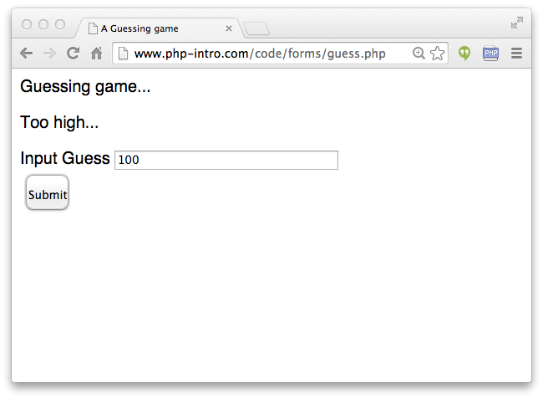
<?php
$guess = '';
$message = false;
if ( isset($_POST['guess']) ) {
// Nifty trick
$guess = $_POST['guess'] + 0;
if ( $guess == 42 ) {
$message = "Great job!";
} else if ( $guess < 42 ) {
$message = "Too low";
} else {
$message = "Too high...";
}
}
?>
<html> ...
guess.php

Slide 20
<html>
<head>
<title>A Guessing game</title>
</head>
<body style="font-family: sans-serif;">
<p>Guessing game...</p>
<?php
if ( $message !== false ) {
echo("<p>$message</p>\n");
}
?>
<form method="post">
<p><label for="guess">Input Guess</label>
<input type="text" name="guess" id="guess" size="40" <?php echo 'value="' . htmlentities($guess) . '"';
?>
/></p>
<input type="submit"/>
</form>
</body>
guess.php

Slide 21
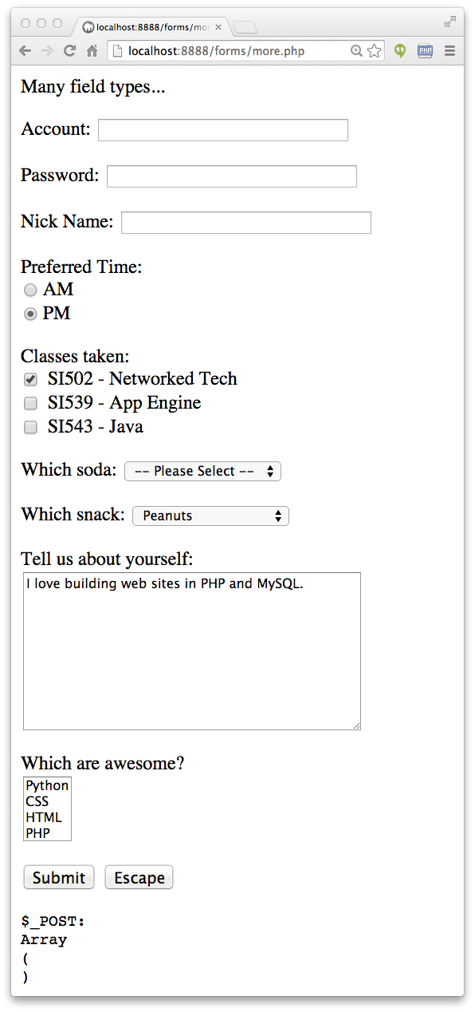
Other Input Types
Text
Password
Radio Button
Check Box
Select / Drop-Down
TextArea
http://www.php-intro.com/code/forms/more.php

Slide 22
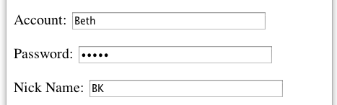
more.php
<p>Many field types...</p>
<form method="post" action="more.php">
<p><label for="inp01">Account:</label>
<input type="text" name="account" id="inp01" size="40" ></p>
<p><label for="inp02">Password:</label>
<input type="password" name="pw" id="inp02" size="40" ></p>
<p><label for="inp03">Nick Name:</label>
<input type="text" name="nick" id="inp03" size="40" ></p>
$_POST:
Array
(
[account] => Beth
[pw] => 12345
[nick] => BK
[when] => pm
...
)

Slide 23
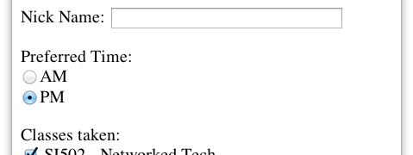
more.php
<p>Preferred Time:<br/>
<input type="radio" name="when" value="am">AM<br>
<input type="radio" name="when" value="pm" checked>PM</p>
$_POST:
Array(
...
[nick] => BK
[when] => pm
[class] => si502
...
)

Slide 24
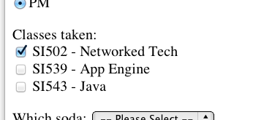
more.php
<p>Classes taken:<br/>
<input type="checkbox" name="class1" value="si502" checked>
SI502 - Networked Tech<br>
<input type="checkbox" name="class2" value="si539">
SI539 - App Engine<br>
<input type="checkbox" name="class3">
SI543 - Java<br> </p>
$_POST:
Array(
...
[when] => pm
[class1] => si502
[soda] => 0
...
)
$_POST:
Array(
...
[when] => pm
[class3] => on
[soda] => 0
...
)

Slide 25
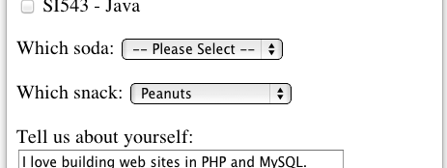
<p><label for="inp06">Which soda:
<select name="soda" id="inp06">
<option value="0">-- Please Select --</option>
<option value="1">Coke</option>
<option value="2">Pepsi</option>
<option value="3">Mountain Dew</option>
<option value="4">Orange Juice</option>
<option value="5">Lemonade</option>
</select>
</p>
more.php
$_POST:
Array(
...
[class] => si502
[soda] => 0
[snack] => peanuts
...
)
The values can be any string but numbers are used quite often.

Slide 26
more.php
<p><label for="inp07">Which snack:
<select name="snack" id="inp07">
<option value="">-- Please Select --</option>
<option value="chips">Chips</option>
<option value="peanuts" selected>Peanuts</option>
<option value="cookie">Cookie</option>
</select>
</p>
$_POST:
Array(
...
[class] => si502
[soda] => 0
[snack] => peanuts
...
)

Slide 27
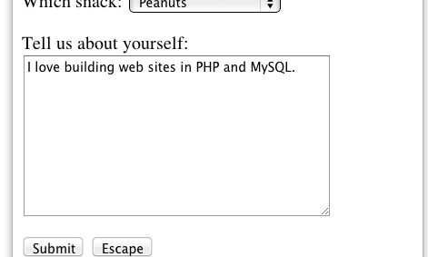
more.php
<p><label for="inp08">Tell us about yourself:<br/>
<textarea rows="10" cols="40" id="inp08" name="about">
I love building web sites in PHP and MySQL.
</textarea>
</p>
$_POST:
Array(
...
[about] => I love building web sites in PHP and MySQL.
[dopost] => Submit
...
)

Slide 28
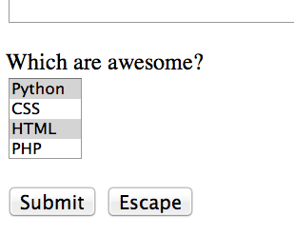
more.php
<p><label for="inp09">Which are awesome?<br/>
<select multiple="multiple" name="code[]" id="inp09">
<option value="python">Python</option>
<option value="css">CSS</option>
<option value="html">HTML</option>
<option value="php">PHP</option>
</select>
$_POST:
Array(
...
[code] => Array
(
[0] => css
[1] => html
)
[dopost] => Submit
...
)

Slide 29
more.php
<p>
<input type="submit" name="dopost" value="Submit"/>
<input type="button"
onclick="location.href='http://www.php-intro.com/'; return false;"
value="Escape">
</p>
$_POST:
Array(
...
[dopost] => Submit
...
)
On submit input types, the text is both in the UI and in $_POST.

Slide 30
HTML5 Input Types
HTML5 defines new input types
Not all browsers support all input types
The fall back to type="text"
http://www.w3schools.com/html/html5_form_input_types.asp

Slide 31
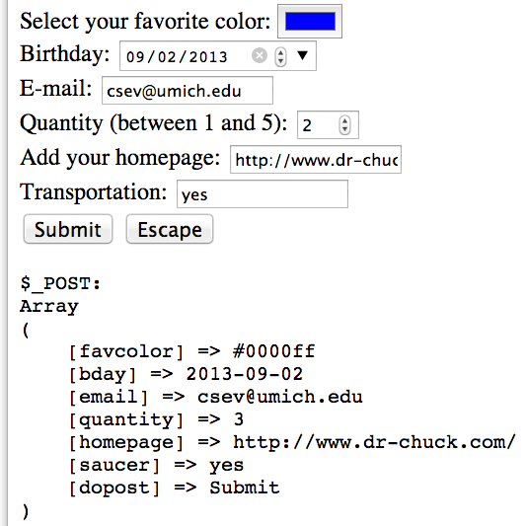
Select your favorite color:
<input type="color" name="favcolor" value="#0000ff"><br/>
Birthday:
<input type="date" name="bday" value="2013-09-02"><br/>
E-mail:
<input type="email" name="email"><br/>
Quantity (between 1 and 5):
<input type="number" name="quantity"
min="1" max="5"><br/>
Add your homepage:
<input type="url" name="homepage"><br>
Transportation:
<input type="flying" name="saucer"><br>
Validation happens when you press submit.
http://www.php-intro.com/code/forms/html5.php

Slide 32


Time
Browser
Web Server
Database Server
D
OM
HTML5
Validation
Apache
MySql
PHP
JavaScript

Slide 33
Summary
Forms, $_GET and $_POST
Sanitizing HTML
Model-View Controller
Form fields
New form fields in HTML5

Slide 34
Acknowledgements / Contributions
These slides are Copyright 2010- Charles R. Severance (www.dr-chuck.com) as part of www.php-intro.com and made available under a Creative Commons Attribution 4.0 License. Please maintain this last slide in all copies of the document to comply with the attribution requirements of the license. If you make a change, feel free to add your name and organization to the list of contributors on this page as you republish the materials.
Initial Development: Charles Severance, University of Michigan School of Information
Insert new Contributors and Translators here including names and dates
Continue new Contributors and Translators here
Notes:
Note from Chuck. Please retain and maintain this page as you remix and republish these materials. Please add any of your own improvements or contributions.

