Slide 1
Setting up a Development Server
Chapter 2
Dr. Charles Severance

Slide 2





Unless otherwise noted, the content of this course material is licensed under a Creative Commons Attribution 3.0 License.
http://creativecommons.org/licenses/by/3.0/.
Copyright 2011- Charles Severance

Slide 3
What We Need
Apache Web Server (Includes PHP)
MySql Database Server
MySql Administation Software (PhpMyAdmin)
We could install all this by hand...

Slide 4
All-In-One Pre-Packaged
LAMP - Linux, Apache, MySQL, and PHP
WAMP - Windows, Apache, MySQL, and PHP
MAMP - Mac, Apache, MySQL, and PHP
XAMPP
Prefer: MAMP on Macintosh XAMPP on Windows

Slide 5
Outline of Tasks
Install text editor
Download and install *AMP*
Create a Simple PHP file

Slide 6
Programmer Editor
Do not use Word, TextEdit, or NotePad
Programmer Editor
  Windows: NotePad++
  Macintosh: TextWrangler
Feel free to use an Integrated Development Environment such Eclipse, etc. if you have experience.

Slide 7
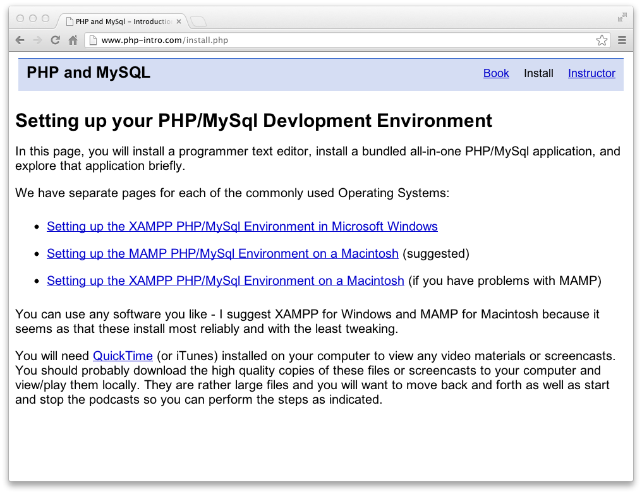
Video

Slide 8
Setting Options for Debugging
Often your PHP distributions are set to hide trace-backs and other error messages by default because it messages might inadvertently reveal security holes or sensitive information
Not seeing error is maddening when doing software development
So we want to change the default - install documentation includes a section on editing the php.ini file in each of the environments

Slide 9
Where is the php.ini file?
/Applications/XAMPP/xamppfiles/etc/php.ini
/Applications/MAMP/bin/php/php5.4.4/conf/php.ini
c:\xampp\php\php.ini
Please change this right now while we are thinking about it
  display_errors = On

Slide 10
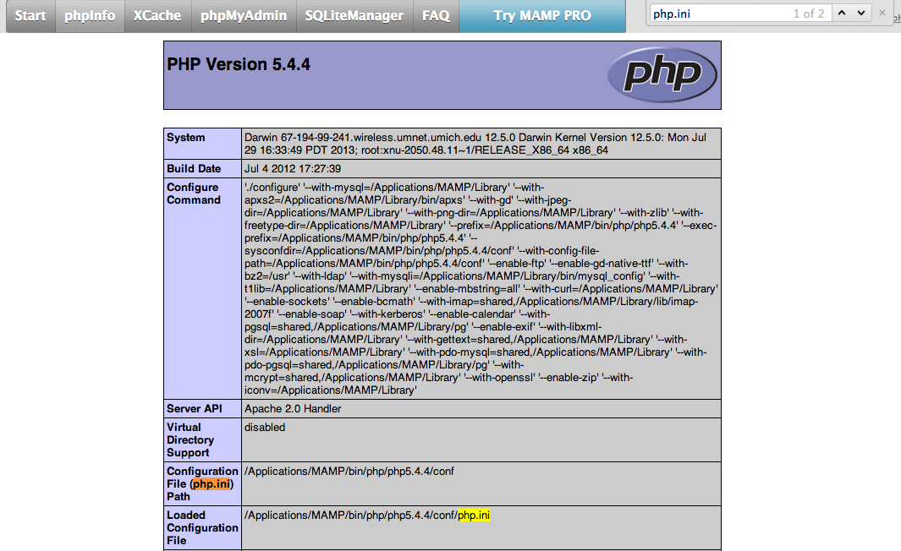

Slide 11
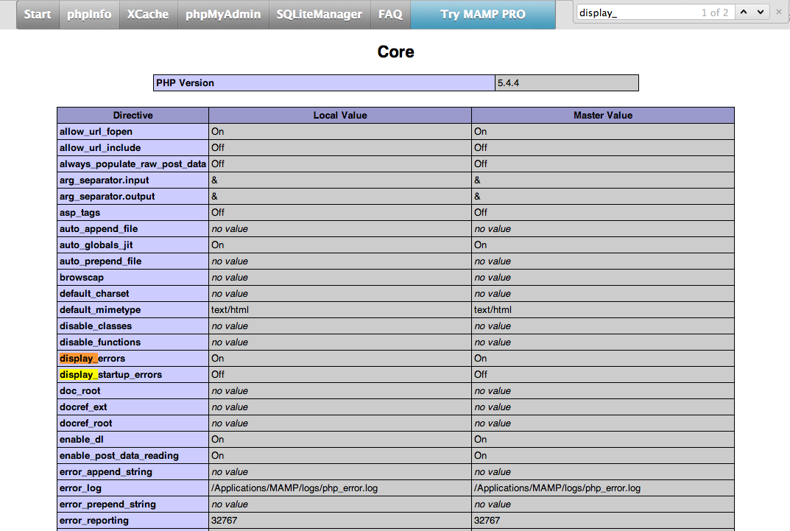

Slide 12
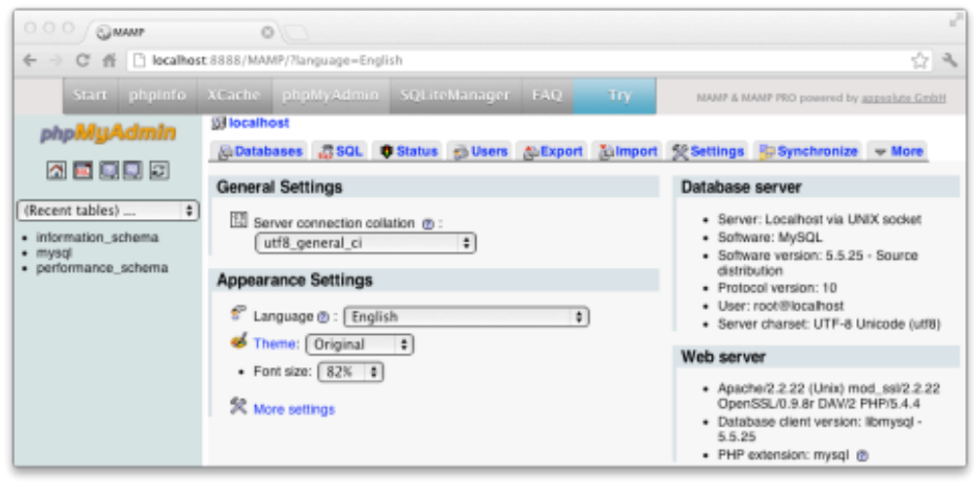
Assignment Deliverables

Slide 13
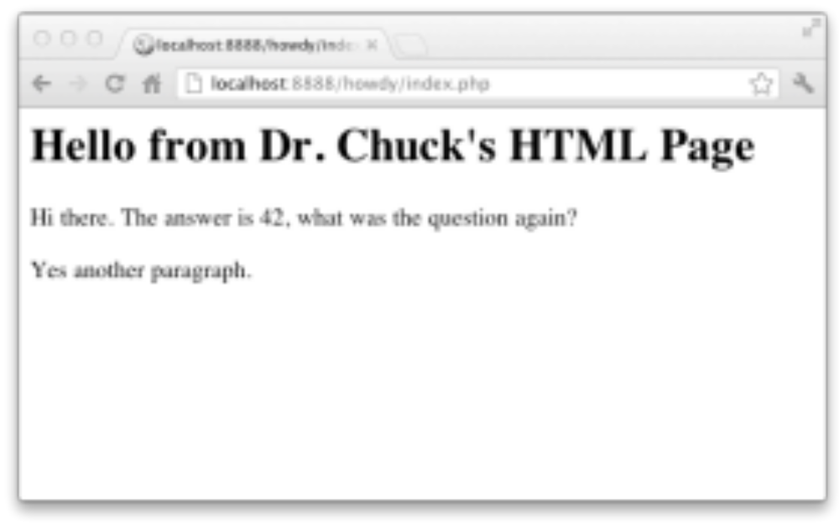
Assignment Deliverables

Slide 14
Possible Issues
Macintosh installs will require superuser password
Windows installs
  Will require superuser password
  May ask for permission to use ports
  May conflict with your firewall
  Sometimes one product (XAMPP) works and an another does not
Sometimes a port gets "stuck" and a reboot is required (mostly Windows)
Start early and get help

