Slide 1

JavaScript Functions, Objects, Array, and Control Structures
Dr. Charles Severance
www.php-intro.com

Slide 2
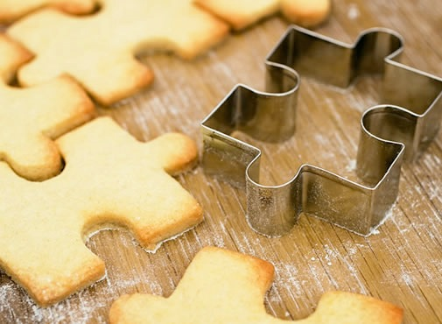
Definitions
Class - a template - Dog
Method or Message - A defined capability of a class - bark()
Object or Instance - A particular instance of a class - Lassie

Slide 3
Terminology: Class
Defines the abstract characteristics of a thing (object), including the thing's characteristics (its attributes, fields or properties) and the thing's behaviors (the things it can do, or methods, operations or features). One might say that a class is a blueprint or factory that describes the nature of something. For example, the class Dog would consist of traits shared by all dogs, such as breed and fur color (characteristics), and the ability to bark and sit (behaviors).
http://en.wikipedia.org/wiki/Object-oriented_programming

Slide 4
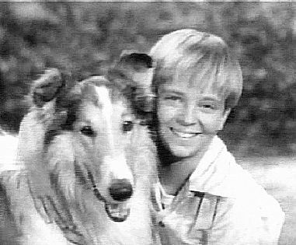
Terminology: Class
A pattern (exemplar) of a class. The class of Dog defines all possible dogs by listing the characteristics and behaviors they can have; the object Lassie is one particular dog, with particular versions of the characteristics. A Dog has fur; Lassie has brown-and-white fur.
http://en.wikipedia.org/wiki/Object-oriented_programming

Slide 5
Terminology: Instance
One can have an instance of a class or a particular object. The instance is the actual object created at runtime. In programmer jargon, the Lassie object is an instance of the Dog class. The set of values of the attributes of a particular object is called its state. The object consists of state and the behavior that's defined in the object's class.
Object and Instance are often used interchangeably.
http://en.wikipedia.org/wiki/Object-oriented_programming

Slide 6
Terminology: Method
An object's abilities. In language, methods are verbs. Lassie, being a Dog, has the ability to bark. So bark() is one of Lassie's methods. She may have other methods as well, for example sit() or eat() or walk() or save_timmy(). Within the program, using a method usually affects only one particular object; all Dogs can bark, but you need only one particular dog to do the barking
Method and Message are often used interchangeably.
http://en.wikipedia.org/wiki/Object-oriented_programming

Slide 7
Objects in JavaScript
The OO pattern in JavaScript is a little different
The function is indeed a store and reuse pattern
The function keyword returns a value which is the function itself - it makes a function!

Slide 8
First-Class Functions
In computer science, a programming language is said to have first-class functions if it treats functions as first-class citizens. Specifically, this means the language supports passing functions as arguments to other functions, returning them as the values from other functions, and assigning them to variables or storing them in data structures.
http://en.wikipedia.org/wiki/First-class_function

Slide 9
A Sample Class

Slide 10
This is the template for making PartyAnimal objects.
js01.htm
function PartyAnimal() {
this.x = 0;
this.party = function () {
this.x = this.x + 1;
console.log("So far "+this.x);
}
}
an = new PartyAnimal();
an.party();
an.party();
an.party();
Each PartyAnimal object has a bit of data.
Each PartyAnimal object has a bit of code.
Create a PartyAnimal object.
Tell the object to run the party() code.

Slide 11
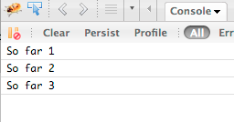
js01.htm
function PartyAnimal() {
this.x = 0;
this.party = function () {
this.x = this.x + 1;
console.log("So far "+this.x);
}
}
an = new PartyAnimal();
an.party();
an.party();
an.party();
an
x:
party()

Slide 12
Object Life Cycle
http://en.wikipedia.org/wiki/Constructor_(computer_science)

Slide 13
Object Life Cycle
Objects are created, used and discarded
Constructors are implicit in JavaScript - natural
  A constructor in a class is a special block of statements called when an object is created
Destructors are not provided by JavaScript
  http://en.wikipedia.org/wiki/Constructor_(computer_science)

Slide 14
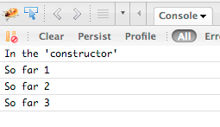
function PartyAnimal() {
this.x = 0;
console.log("In the 'constructor'");
this.party = function () {
this.x = this.x + 1;
console.log('So far '+this.x);
}
}
an = new PartyAnimal();
an.party();
an.party();
an.party();
js03.htm

Slide 15
Many Instances
We can create lots of objects - the class is the template for the object
We can store each distinct object in its own variable
We call this having multiple instances of the same class
Each instance has its own copy of the instance variables

Slide 16
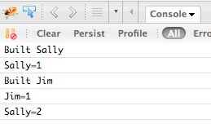
js04.htm
Constructors can have additional parameters. These can be used to setup instance variables for the particular instance of the class (i.e. for the particular obect).
function PartyAnimal(nam) {
this.x = 0;
this.name = nam;
console.log("Built "+nam);
this.party = function () {
this.x = this.x + 1;
console.log(nam+"="+this.x);
}
}
s = new PartyAnimal("Sally");
s.party();
j = new PartyAnimal("Jim");
j.party();
s.party();

Slide 17
s
function PartyAnimal(nam) {
this.x = 0;
this.name = nam;
console.log("Built "+nam);
this.party = function () {
this.x = this.x + 1;
console.log(nam+"="+this.x);
}
}
s = new PartyAnimal("Sally");
s.party();
j = new PartyAnimal("Jim");
j.party();
s.party();
x:
name:
j
x:
name:

Slide 18
Definitions
Class - a template - Dog
Method or Message - A defined capability of a class - bark()
Object or Instance - A particular instance of a class - Lassie
Constructor - A method which is called when the instance / object is created

Slide 19
Arrays

Slide 20
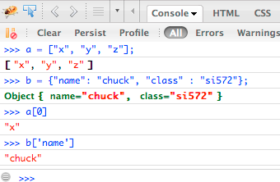
Arrays
JavaScript supports both linear arrays and associative structures, but the associative structures are actually objects

Slide 21
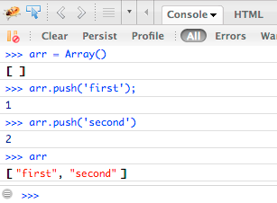
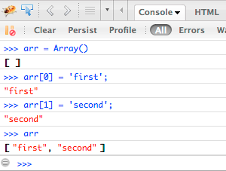
Linear Arrays

Slide 22
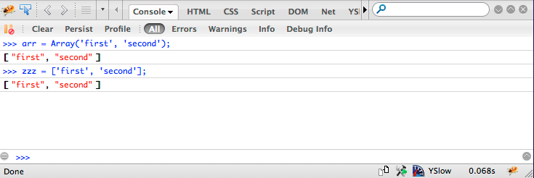
Array Constructor

Slide 23
Associative Arrays Objects
JavaScript Associative Arrays are actually objects with member variables
They can be accessed with either associative array syntax or object syntax

Slide 24
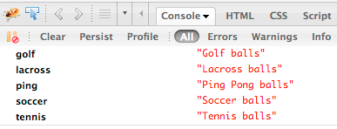
js05.htm
balls = {"golf": "Golf balls",
"tennis": "Tennis balls",
"ping": "Ping Pong balls"};
balls.soccer = "Soccer balls";
balls['lacross'] = "Lacross balls";
console.dir(balls);

Slide 25
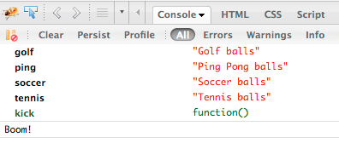
balls = {"golf": "Golf balls",
"tennis": "Tennis balls",
"ping": "Ping Pong balls"};
balls.soccer = "Soccer balls";
balls.kick = function () {
console.log('Boom!');
}
console.dir(balls);
balls.kick();
js06.htm

Slide 26
Control Structures Lite...

Slide 27
Control Structures
We use curly braces for control structure and whitespace / line ends do not matter
If statements are as you would expect
While loops are as you would expect
Counted for loops are as you would expect
In loops, break and continue are as you would expect

Slide 28
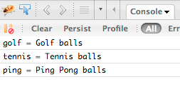
Definite Loops (for)
balls = {"golf": "Golf balls",
"tennis": "Tennis balls",
"ping": "Ping Pong balls"};
for (ball in balls) {
console.log(ball+' = '+balls[ball]);
}
js07.htm

Slide 29
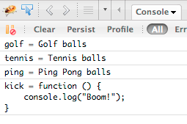
balls = {"golf": "Golf balls",
"tennis": "Tennis balls",
"ping": "Ping Pong balls"};
balls.kick = function () {
console.log('Boom!');
}
for (ball in balls) {
console.log(ball+' = '+balls[ball]);
}

Slide 30
js09.htm
balls = {"golf": "Golf balls",
"tennis": "Tennis balls",
"ping": "Ping Pong balls"};
balls.kick = function () {
console.log('Boom!');
}
for (ball in balls) {
val = balls[ball];
if ( typeof val != "string" ) continue;
console.log(ball+' = '+balls[ball]);
}

Slide 31
Acknowledgements / Contributions
These slides are Copyright 2010- Charles R. Severance (www.dr-chuck.com) as part of www.php-intro.com and made available under a Creative Commons Attribution 4.0 License. Please maintain this last slide in all copies of the document to comply with the attribution requirements of the license. If you make a change, feel free to add your name and organization to the list of contributors on this page as you republish the materials.
Initial Development: Charles Severance, University of Michigan School of Information
Insert new Contributors and Translators here including names and dates
Continue new Contributors and Translators here
Notes:
Note from Chuck. Please retain and maintain this page as you remix and republish these materials. Please add any of your own improvements or contributions.

