Slide 1

Expressions and
Control Flow in PHP
Dr. Charles Severance
www.wa4e.com
Notes:
Need to add try/catch

Slide 2
Expressions
Expressions evaluate to a value. The value can be a string, number, boolean, etc...
Expressions often use operations and function calls, and there is an order of evaluation when there is more than one operator in an expression
Expressions can also produce objects like arrays

Slide 3
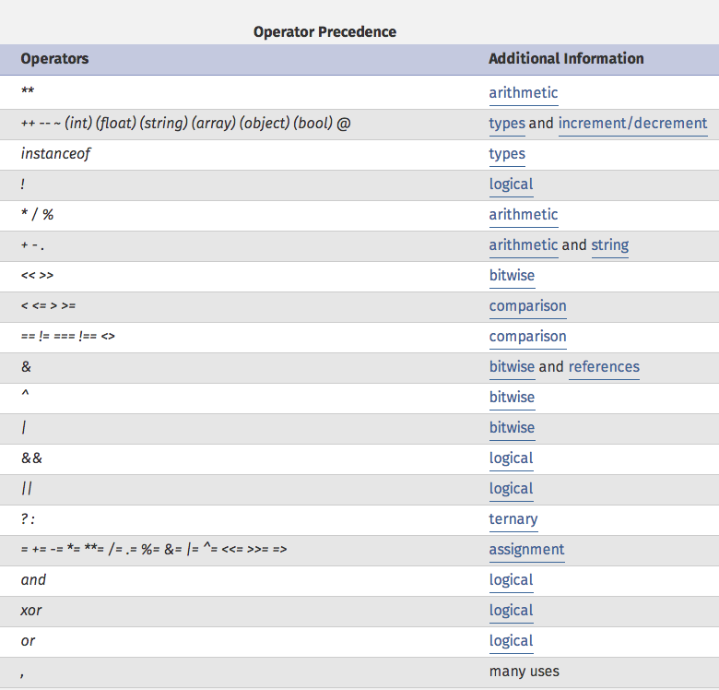
High
Low
http://php.net/manual/en/language.operators.precedence.php
Notes:
http://php.net/manual/en/language.operators.precedence.php

Slide 4
Operators of Note
Increment / Decrement ( ++ -- )
String concatenation ( . )
Equality ( == != )
Identity ( === !== )
Ternary ( ? : )
Side-effect Assignment ( += -= .= etc.)
Ignore the rarely-used bitwise operators ( >> << ^ | & )

Slide 5
Increment / Decrement
These operators allow you to both retrieve and increment / decrement a variable
They are generally avoided in civilized code.
$x = 12;
$y = 15 + $x++;
echo "x is $x and y is $y \n";
x is 13 and y is 27

Slide 6
Increment / Decrement
These operators allow you to both retrieve and increment / decrement a variable
They are generally avoided in civilized code.
$x = 12;
$y = 15 + $x;
$x = $x + 1;
echo "x is $x and y is $y \n";
x is 13 and y is 27

Slide 7
String Concatenation
PHP uses the period character for concatenation because the plus character would instructor PHP to to the best it could do to add the two things together, converting if necessary.
$a = 'Hello ' . 'World!';
echo $a . "\n";
Hello World!

Slide 8
Equality versus Identity
The equality operator (==) in PHP is far more agressive than in most other languages when it comes to data conversion during expression evaluation.
if ( 123 == "123" ) print ("Equality 1\n");
if ( 123 == "100"+23 ) print ("Equality 2\n");
if ( FALSE == "0" ) print ("Equality 3\n");
if ( (5 < 6) == "2"-"1" ) print ("Equality 4\n");
if ( (5 < 6) === TRUE ) print ("Equality 5\n");

Slide 9
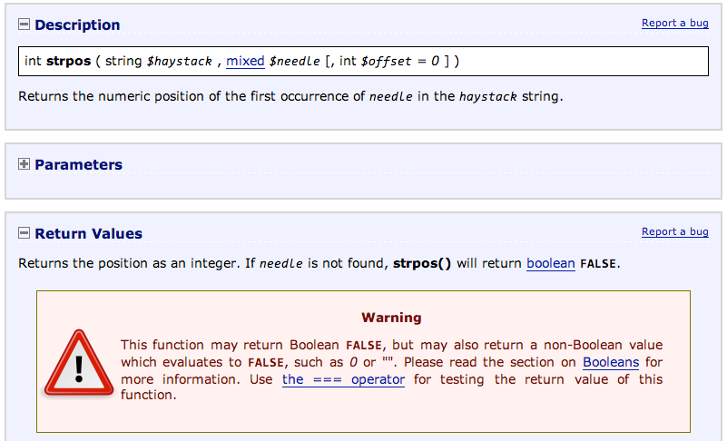
http://php.net/manual/en/function.strpos.php

Slide 10
$vv = "Hello World!";
echo "First:" . strpos($vv, "Wo") . "\n";
echo "Second: " . strpos($vv, "He") . "\n";
echo "Third: " . strpos($vv, "ZZ") . "\n";
if (strpos($vv, "He") == FALSE ) echo "Wrong A\n";
if (strpos($vv, "ZZ") == FALSE ) echo "Right B\n";
if (strpos($vv, "He") !== FALSE ) echo "Right C\n";
if (strpos($vv, "ZZ") === FALSE ) echo "Right D\n";
print_r(FALSE); print FALSE;
echo "Where were they?\n";
First:6
Second: 0
Third:
Wrong A
Right B
Right D
Where were they?
Beware FALSE variables. They are detectable but not visible...

Slide 11
Ternary
The ternary operator comes from C. It allows conditional expressions. It is like a one-line if-then-else . Like all "contraction" syntaxes, we use it carefully.
$www = 123;
$msg = $www > 100 ? "Large" : "Small" ;
echo "First: $msg \n";
$msg = ( $www % 2 == 0 ) ? "Even" : "Odd";
echo "Second: $msg \n";
$msg = ( $www % 2 ) ? "Odd" : "Even";
echo "Third: $msg \n";
First: Large
Second: Odd
Third: Odd

Slide 12
Side-Effect Assignment
These are pure contractions. Use them sparingly.
echo "\n";
$out = "Hello";
$out = $out . " ";
$out .= "World!";
$out .= "\n";
echo $out;
$count = 0;
$count += 1;
echo "Count: $count\n";
Hello World!
Count: 1

Slide 13
Control Structures

Slide 14
Two-way using else :
X = 4
no
x > 2
yes
$x = 4;
if ($x > 2) {
print "Bigger\n";
} else {
print "Smaller\n";
}
print "All done\n";
print 'Smaller'
print 'Bigger'
print 'All Done'

Slide 15
Multi-way
yes
x < 2
print 'Small'
no
$x = 7;
if ( $x < 2 ) {
print "Small\n";
} elseif ( $x < 10 ) {
print "Medium\n";
} else {
print "LARGE\n";
}
print "All done\n";
yes
x<10
print 'Medium'
no
print 'LARGE'
print 'All Done'

Slide 16
Curly Braces are not Required
if ($page == "Home") echo "You selected Home";
elseif ($page == "About") echo "You selected About";
elseif ($page == "News") echo "You selected News";
elseif ($page == "Login") echo "You selected Login";
elseif ($page == "Links") echo "You selected Links";
if ($page == "Home") { echo "You selected Home"; }
elseif ($page == "About") { echo "You selected About"; }
elseif ($page == "News") { echo "You selected News"; }
elseif ($page == "Login") { echo "You selected Login"; }
elseif ($page == "Links") { echo "You selected Links"; }

Slide 17
switch ($page)
{
case "Home":
echo "You selected Home";
break;
case "About":
echo "You selected About";
break;
case "News": echo "You selected News";
break;
case "Login": echo "You selected Login";
break;
case "Links": echo "You selected Links";
break;
}
I am not a big fan of switch

Slide 18
$page = "x";
switch($page) {
case "w":
echo "A\n";
break;
case "x":
echo "X\n";
case "y":
echo "Y\n";
break;
case "z":
echo "Z\n";
break;
case "x":
echo "XX\n";
break;
}
X
Y

Slide 19
Looping Structures

Slide 20
$fuel = 10;
while ($fuel > 1) {
print "Vroom vroom\n";
}
A while loop is a "zero-trip" loop with the test at the top. before the first iteration starts. We hand construct the iteration variable to implement a counted loop.
$fuel = 10;
while ($fuel > 1) {
print "Vroom vroom\n";
$fuel = $fuel - 1;
}

Slide 21
$count = 1;
do {
echo "$count times 5 is " . $count * 5;
echo "\n";
} while (++$count <= 5);
A do-while loop is a "one-trip" loop with the test at the bottom after the first iteration completes.
1 times 5 is 5
2 times 5 is 10
3 times 5 is 15
4 times 5 is 20
5 times 5 is 25

Slide 22
for($count=1; $count<=6; $count++ ) {
echo "$count times 6 is " . $count * 6;
echo "\n";
}
1 times 6 is 6
2 times 6 is 12
3 times 6 is 18
4 times 6 is 24
5 times 6 is 30
6 times 6 is 36
A for loop is the simplest way to construct a counted loop.

Slide 23
Loop runs while TRUE (top-test)
Run after each iteration.
Before loop starts
for($count=1; $count<=6; $count++ ) {
echo "$count times 6 is " . $count * 6;
echo "\n";
}
1 times 6 is 6
2 times 6 is 12
3 times 6 is 18
4 times 6 is 24
5 times 6 is 30
6 times 6 is 36
A for loop is the simplest way to construct a counted loop.

Slide 24
Looping Through an Array
<?php
$stuff = array("name" => "Chuck",
"course" => "SI664");
foreach($stuff as $k => $v ) {
echo "Key=",$k," Val=",$v,"\n";
}
?>
Key=name Val=Chuck
Key=course Val=SI664

Slide 25
Looping Through an Array
<?php
$stuff = array("Chuck","SI664");
foreach($stuff as $k => $v ) {
echo "Key=",$k," Val=",$v,"\n";
}
?>
Key=0 Val=Chuck
Key=1 Val=SI664

Slide 26
Counted Loop Through an Array
<?php
$stuff = array("Chuck","SI664");
for($i=0; $i < count($stuff); $i++) {
echo "I=",$i," Val=",$stuff[$i],"\n";
}
?>
I=0 Val=Chuck
I=1 Val=SI664

Slide 27
Loop Controls
Like many C-inspired languages, PHP has two control structures that work within a loop
  break - exit the loop immediately
  continue - finish the current iteration and jump to the next iteration, starting at the top of the loop

Slide 28
Breaking Out of a Loop
The break statement ends the current loop and jumps to the statement immediately following the loop
It is like a loop test that can happen anywhere in the body of the loop
for($count=1; $count<=600; $count++ ) {
if ( $count == 5 ) break;
echo "Count: $count\n";
}
echo "Done\n";
Count: 1
Count: 2
Count: 3
Count: 4
Done

Slide 29
Finishing an Iteration with continue
The continue statement ends the current iteration and jumps to the top of the loop and starts the next iteration
Count: 1
Count: 3
Count: 5
Count: 7
Count: 9
Done
for($count=1; $count<=10; $count++ ) {
if ( ($count % 2) == 0 ) continue;
echo "Count: $count\n";
}
echo "Done\n";

Slide 30
Conversion / Casting
As PHP evaluates expressions, at times values in the expression need to be converted from one type to another as the computations are done.
  PHP does aggressive implicit type conversion (casting)
  You can also make type conversion (casting) explicit with casting operators.

Slide 31
Casting
In PHP, division forces operands to be floating point. PHP converts expression values silently and agressively.
$a = 56; $b = 12;
$c = $a / $b;
echo "C: $c\n";
$d = "100" + 36.25 + TRUE;
echo "D: ". $d . "\n";
echo "D2: ". (string) $d . "\n";
$e = (int) 9.9 - 1;
echo "E: $e\n";
$f = "sam" + 25;
echo "F: $f\n";
$g = "sam" . 25;
echo "G: $g\n";
C: 4.66666666667
D: 137.25
D2: 137.25
E: 8
F: 25
G: sam25

Slide 32
PHP .vs. Python
$x = "100" + 25;
echo "X: $x\n";
$y = "100" . 25;
echo "Y: $y\n";
$z = "sam" + 25;
echo "Z: $z\n";
x = int("100") + 25
print "X:", x
y = "100" + str(25)
print "Y:", y
z = int("sam") + 25
print "Z:", z
X: 125
Y: 10025
Z: 25
X: 125
Y: 10025
Traceback:"cast.py", line 5
z = int("sam") + 25;
ValueError: invalid literal

Slide 33
Casting
The concatenation operator tries to convert its operands to strings, TRUE becomes an integer 1 and then becomes a string. FALSE is "not there" it is even "smaller" than zero. At least when it comes to width.
echo "A".FALSE."B\n";
echo "X".TRUE."Y\n";
AB
X1Y

Slide 34
Summary
Expressions
Operators
Conditional Structures
Looping Structures
Type Conversion and Casting

Slide 35
Acknowledgements / Contributions
These slides are Copyright 2010- Charles R. Severance (www.dr-chuck.com) as part of www.wa4e.com and made available under a Creative Commons Attribution 4.0 License. Please maintain this last slide in all copies of the document to comply with the attribution requirements of the license. If you make a change, feel free to add your name and organization to the list of contributors on this page as you republish the materials.
Initial Development: Charles Severance, University of Michigan School of Information
Insert new Contributors and Translators here including names and dates
Continue new Contributors and Translators here
Notes:
Note from Chuck. Please retain and maintain this page as you remix and republish these materials. Please add any of your own improvements or contributions.

