Slide 1

Using Handlebars
Dr. Charles Severance
www.php-intro.com
http://www.php-intro.com/code/handlebars.zip

Slide 2

Rendering in the Browser
Applications are starting to use JSON "back end" services and construct the View HTML in JavaScript
  www.backbonejs.org
  www.emberjs.com
  www.angular.net
  www.reactjs.net
  ...
The only correct way to write JavaScript is whatever you were not doing last week.
@ThePracticalDev

Slide 3


Time
Browser
Web Server
Database Server
DOM
Apache
MySQL
Parse
Request
Parse
Response
PHP
P
DO
JavaScript
http://www.php-intro.com/code/rrc/

Slide 4
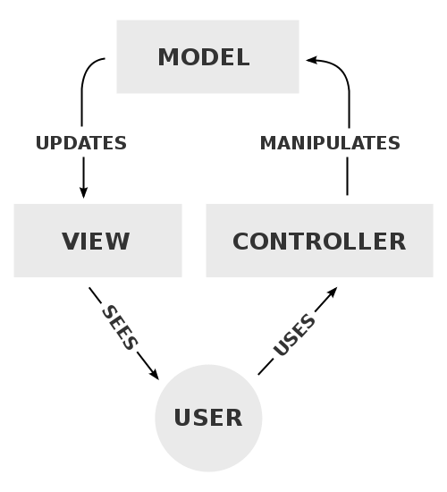
Model-View-Controller
A model that defines the elements of a web application and how they interact.
View – Produce output
Model – Handle data
Controller – Orchestration / Routing
https://en.wikipedia.org/wiki/Model-view-controller

Slide 5
<?php
$stmt = $pdo->prepare('SELECT * FROM Profile ...');
$stmt->execute(array( ':prof' => ... );
$profile = $stmt->fetch(PDO::FETCH_ASSOC);
if ( $profile === false ) {
$_SESSION['error'] = "Could not load profile";
header('Location: index.php');
return;
}
if ( isset($_POST['first_name']) && ... ) {
...
$stmt = $pdo->prepare('UPDATE Profile SET ...');
$stmt->execute(array( ':pid' => ... );
$_SESSION['success'] = "Profile updated";
header("Location: index.php");
return;
}
?>
<html>
...
<form method="post" action="edit.php">
<p>First Name:
<input type="text" name="first_name" size="60"
value="<?= htmlentities($profile['first_name']); ?>"
/></p>
...
<input type="submit" value="Save">
<input type="submit" name="cancel" value="Cancel">
</p>
</form>
...
Model
Controller
Context
View
edit.php

Slide 6
Time
Browser
Web Server
Database Server
DOM
Apache
MySQL
Parse
Request
Parse
Response
PHP
Model
Controller
P
DO
JavaScript
Context
View
Pure PHP

Slide 7
Handlebars.js
Templates with curly braces
  Adapted from Django / AppEngine
Hot spots accept data from the context
<div class="entry">
<h1>{{title}}</h1>
<div class="body">
{{body}}
</div>
</div>
<div class="entry">
<h1>Equations</h1>
<div class="body">
guess &lt; 42
</div>
</div>
Context
+
=

Slide 8
<div id="stuff"><img src="spinner.gif"></div>
<script id="entry-template" type="text/x-handlebars-template">
<div class="entry">
<h1>{{title}}</h1>
<div class="body">
{{body}}
</div>
</div>
</script>
<script>
var raw_tempate = $("#entry-template").html();
var template = Handlebars.compile(raw_template);
var context = {title: "Equations", body: "guess < 42"};
var rendered = template(context);
alert('Check out the sweet spinner..:)');
$('#stuff').html(rendered);
</script>
hand-01.htm

Slide 9
Time
Browser
Web Server
Database Server
DOM
Apache
MySQL
Parse
Request
Parse
Response
PHP
JavaScript
P
DO
Context
View
Hybrid PHP / Handlebars

Slide 10
Time
Browser
Web Server
Database Server
DOM
Apache
MySQL
Parse
Request
Parse
Response
PHP
Model
P
DO
JavaScript
Context
Controller
View
Hybrid PHP / Handlebars

Slide 11
hand-02.htm
<div id="stuff"><img src="spinner.gif"></div>
<script id="entry-template" type="text/x-handlebars-template">
<div class="entry">
<h1>{{title}}</h1>
<div class="body">
{{body}}
</div>
</div>
</script>
<script>
var raw_tempate = $("#entry-template").html();
var template = Handlebars.compile(raw_template);
$.getJSON('hand-02-json.php', function (context) {
var rendered = template(context);
$('#stuff').replaceWith(rendered);
});
</script>
<?php
header('Content-Type: ...');
$stuff = array(
'title' => 'Mathematics',
'body' => 'guess > 42');
echo(json_encode($stuff));
{ "title":"Mathematics",
"body":"guess > 42" }

Slide 12
Handlebars Application

Slide 13
index.php
<script id="list-template" type="text/x-handlebars-template">
{{#if profiles.length}}
<p><table border="1">
<tr><th>Name</th><th>Headline</th>
{{#if loggedin}}<th>Action</th>{{/if}}</tr>
{{#each profiles}}
<tr><td><a href="view.php?profile_id={{profile_id}}">
{{first_name}} {{last_name}}</a>
</td><td>{{headline}}</td>
{{#if ../loggedin}}
<td>
<a href="form.php?profile_id={{profile_id}}">Edit</a>
<a href="delete.php?profile_id={{profile_id}}">Delete</a>
</td>
{{/if}}
</tr>
{{/each}}
</table></p>
{{/if}}
</script>
res-handlebars

Slide 14
index.php
<div id="list-area"><img src="spinner.gif"></div>
....
<script>
$(document).ready(function(){
$.getJSON('profiles.php', function(profiles) {
window.console && console.log(profiles);
var source = $("#list-template").html();
var template = Handlebars.compile(source);
var context = {};
context.loggedin =
<?= isset($_SESSION['user_id']) ? 'true' : 'false' ?>;
context.profiles = profiles;
$('#list-area').replaceWith(template(context));
}).fail( function() { alert('getJSON fail'); } );
});
</script>

Slide 15
profiles.php
<?php
// This script works even if you are not logged in
require_once 'pdo.php';
header("Content-type: application/json; charset=utf-8");
$stmt = $pdo->query('SELECT * FROM Profile');
$profiles = $stmt->fetchAll(PDO::FETCH_ASSOC);
echo(json_encode($profiles, JSON_PRETTY_PRINT));

Slide 16
profiles.php
[
{
"profile_id": "5",
"user_id": "1",
"first_name": "Chuck",
"last_name": "Severance",
"email": "csev@example.com",
"headline": "Python Rulez",
"summary": "Python",
"updated_at": "2016-04-04 21:15:27"
},
{
"profile_id": "6",
"user_id": "1",
"first_name": "Colleen",
"last_name": "van Lent",
"email": "colleen@example.com",
"headline": "Responsive Design Rulez",
"summary": "HTML5!",
"updated_at": "2016-04-04 21:16:12"
}
]

Slide 17
Time
Browser
Web Server
Database Server
DOM
Apache
MySQL
Parse
Request
Parse
Response
PHP
Model
P
DO
JavaScript
Context
Controller
View
Pure Single Page Application / ReactJS / AngularJS

Slide 18
Summary
With JavaScript ES6 on the way and significant browser improvements on the horizon, it is likely that the "best practice" both on the server and the client will continue to evolve
It will continue to be important to understand how web applications work "all the way down" so you can work with these new innovations.
The only correct way to write JavaScript is whatever you were not doing last week.
@ThePracticalDev

