Slide 1

PHP Namespaces
(in progress)
Dr. Charles Severance
www.wa4e.com

Slide 2
Namespaces and Frameworks

Slide 3
PHP has many "Frameworks"
There are many PHP Frameworks with large code bases
Each framework cannot define a global function called "setup" or they would overwrite each other
We need a naming convention to keep these large code bases from stepping on each other so that applications can use more than one framework

Slide 4
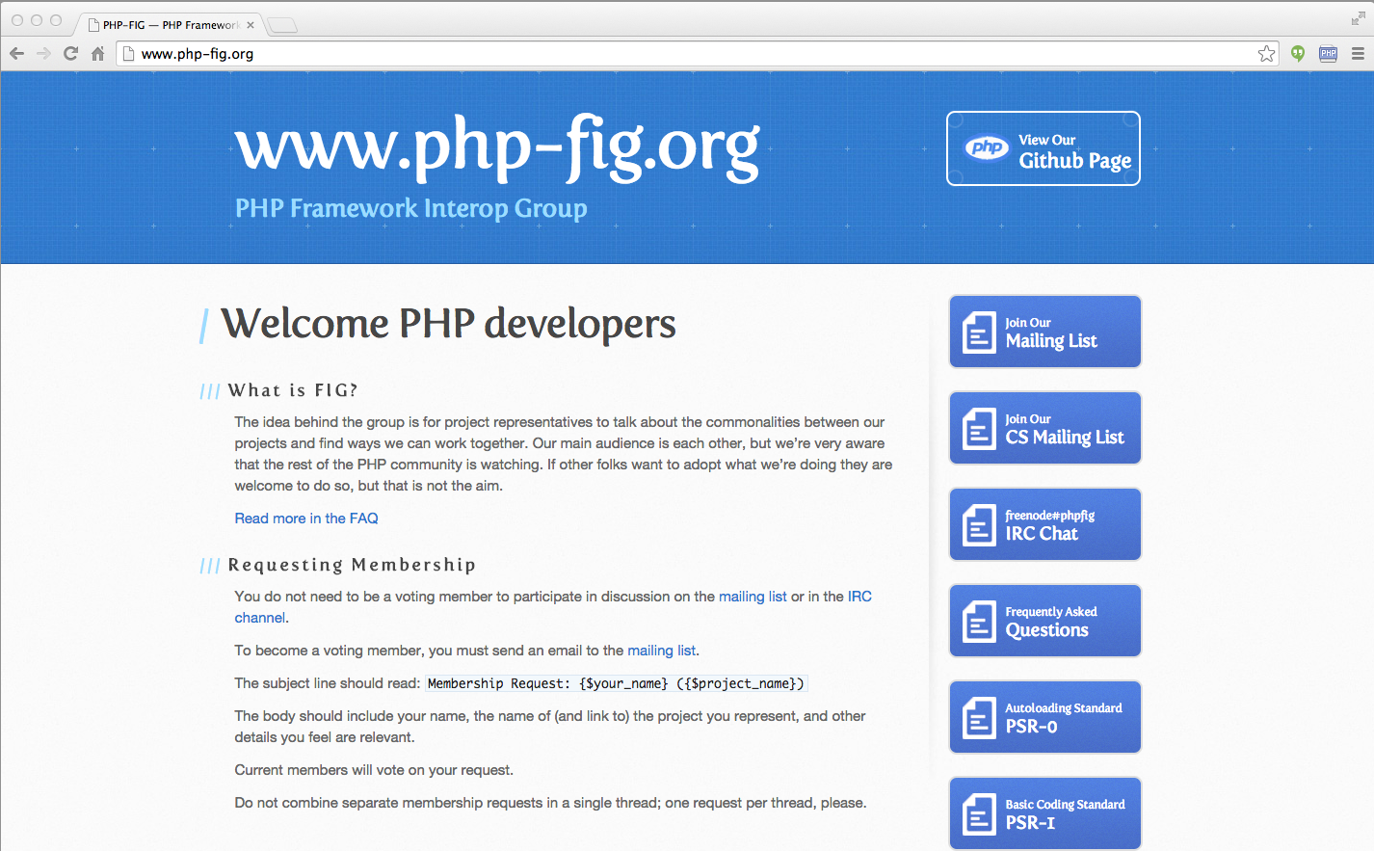

Slide 5
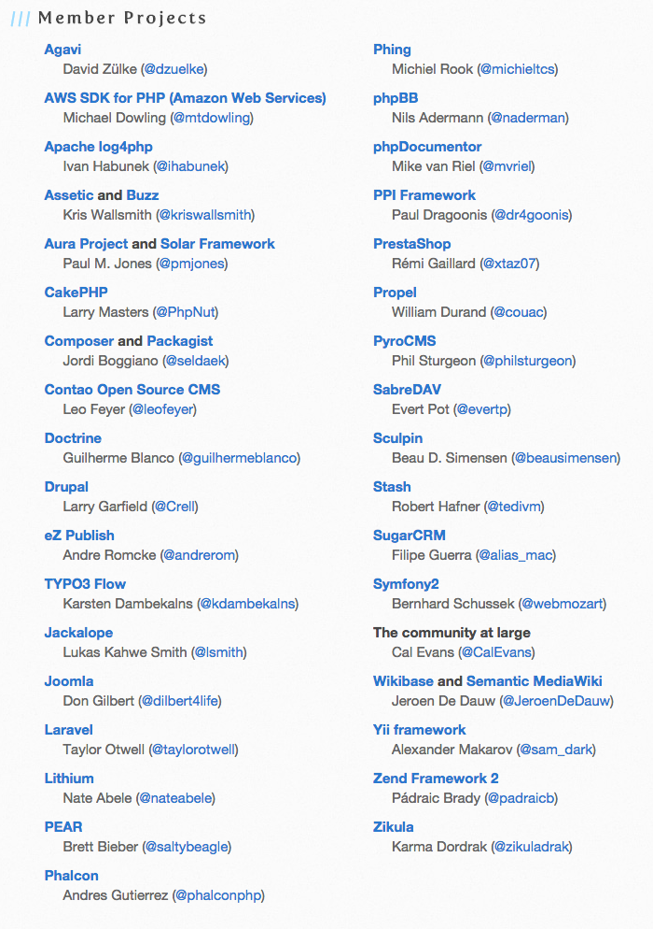
www.php-fig.org

Slide 6
PHP-FIG Standards
What to name classes and where to place them in the source directory
  http://www.php-fig.org/psr/psr-0/
How to properly namespace classes to avoid collission
  http://www.php-fig.org/psr/psr-1/

Slide 7
OO In Frameworks
OO allows us to avoid clashes for global function names
  $date = DateTime::createFromFormat('j-M-Y', '15-Feb-2009');
We also want to avoid clashes on class names as well

Slide 8
Name Spaces
The PHP namespace directive lets us "silo" all of our classes in a file within a global "namespace"
tsugi/lib/vendor/Tsugi/Core/User.php
<?php
namespace Tsugi\Core;
class User {
...
$d = new \DateTime('today +1 week')
}
Fully-qualified class name:
\Tsugi\Core\User

Slide 9
Accessing a Class in a Namespace
To get the class we want – we must indicate which the name space we want
<?php
...
$USER = new \Tsugi\Core\User();
<?php
use \Tsugi\Core\User;
$USER = new User();
tsugi/lib/vendor/Tsugi/Core/LTIX.php

Slide 10
Auto Loader for Classes
Normally we put class definition in files and then include them do the classes are defined for our code
<?php
...
require_once("vendor/Tsugi/Core/User.php");
require_once("vendor/Tsugi/Core/Context.php");
require_once("vendor/Tsugi/Core/Link.php");
require_once("vendor/Tsugi/Core/LTIX.php");
...
tsugi/lib/lms_lib.php

Slide 11
Auto Loader for Classes
With large PHP frameworks like Symfony, we may have many hundreds of classes that are used very rarely
PHP has the ability to auto-load classes when code tries to "new" a class that is not yet loaded
But standards are needed because it is best if there is one autoloader across all frameworks
http://www.php-fig.org/psr/psr-4/
http://api.symfony.com/

Slide 12
Folder and Class Naming
So that PHP auto loaders can be interoperable, there are rules about class names and folder names and you are only supposed to put one class in a file
\Tsugi\Core\User tsugi/lib/vendor/Tsugi/Core/User.php
\Tsugi\Core\Context tsugi/lib/vendor/Tsugi/Core/Context.php
\Tsugi\Core\Settings tsugi/lib/vendor/Tsugi/Core/Settings.php
http://www.php-fig.org/psr/psr-4/

Slide 13
Summary
There is a trend away from global class names and toward namespaces and namespace conventions

Slide 14

Acknowledgements / Contributions
These slides are Copyright 2010- Charles R. Severance (www.dr-chuck.com) as part of www.wa4e.com and made available under a Creative Commons Attribution 4.0 License. Please maintain this last slide in all copies of the document to comply with the attribution requirements of the license. If you make a change, feel free to add your name and organization to the list of contributors on this page as you republish the materials.
Initial Development: Charles Severance, University of Michigan School of Information
Insert new Contributors and Translators here including names and dates
Continue new Contributors and Translators here
Notes:
Note from Chuck. Please retain and maintain this page as you remix and republish these materials. Please add any of your own improvements or contributions.

