Slide 1

Cookies and Sessions
Dr. Charles Severance
www.wa4e.com
http://www.wa4e.com/code/sessions.zip
Notes:
Add cookie-less sessions...

Slide 2

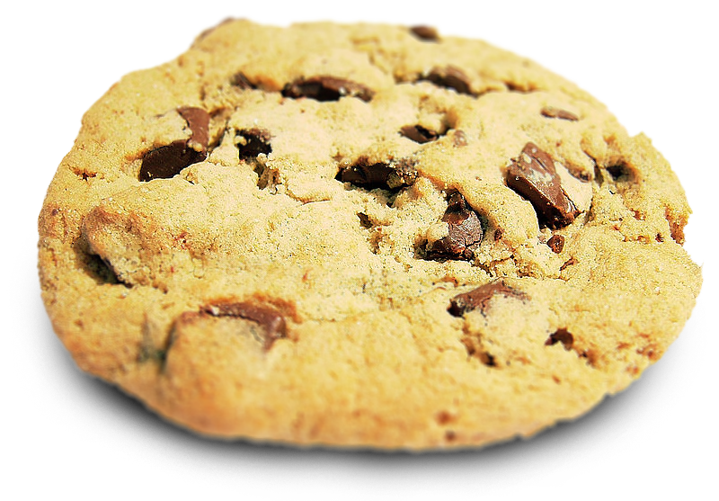
HTTP Cookies

Slide 3


Time
Browser
Web Server
Database Server
D
OM
MySql
Send
Request
Apache
Parse
Response
PHP
sessfun.php
P
D
O
JavaScript
RRC/HTTP
SQL

Slide 4
Multi-User / Multi-Browser
When a server is interacting with many different browsers at the same time, the server needs to know *which* browser a particular request came from
Request / Response initially was stateless - all browsers looked identical - this was really bad and did not last very long at all.

Slide 5
Web Cookies to the Rescue
Technically, cookies are arbitrary pieces of data chosen by the Web server and sent to the browser. The browser returns them unchanged to the server, introducing a state (memory of previous events) into otherwise stateless HTTP transactions. Without cookies, each retrieval of a Web page or component of a Web page is an isolated event, mostly unrelated to all other views of the pages of the same site.
http://en.wikipedia.org/wiki/HTTP_cookie

Slide 6
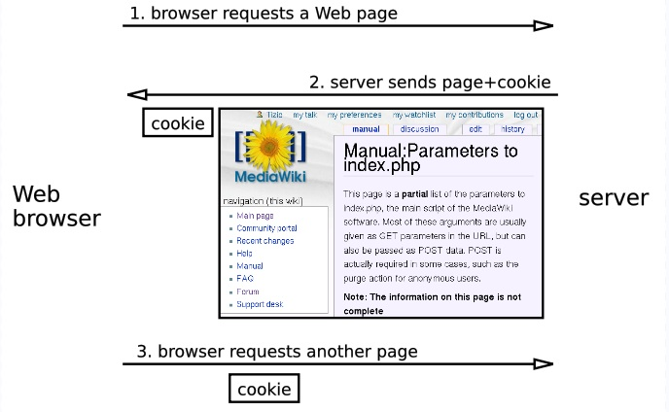
http://en.wikipedia.org/wiki/HTTP_cookie

Slide 7
Cookies In the Browser
Cookies are marked as to the web addresses they come from - the browser only sends back cookies that were originally set by the same web server
Cookies have an expiration date - some last for years - others are short-term and go away as soon as the browser is closed

Slide 8
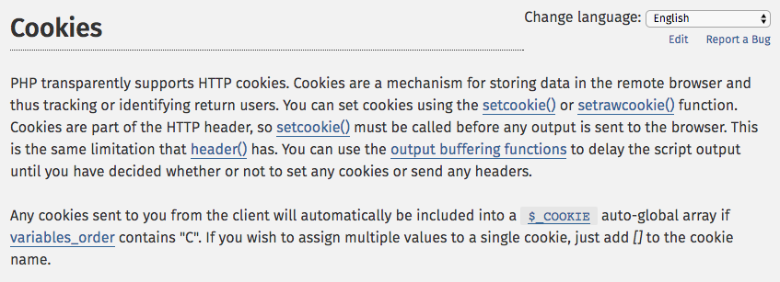
http://php.net/manual/en/features.cookies.php

Slide 9
<?php
// Note - cannot have any output before setcookie
if ( ! isset($_COOKIE['zap']) ) {
setcookie('zap', '42', time()+3600);
}
?>
<pre>
<?php print_r($_COOKIE); ?>
</pre>
<p><a href="cookie.php">Click Me!</a> or press Refresh</p>
http://www.wa4e.com/code/sessions/cookie.php

Slide 10
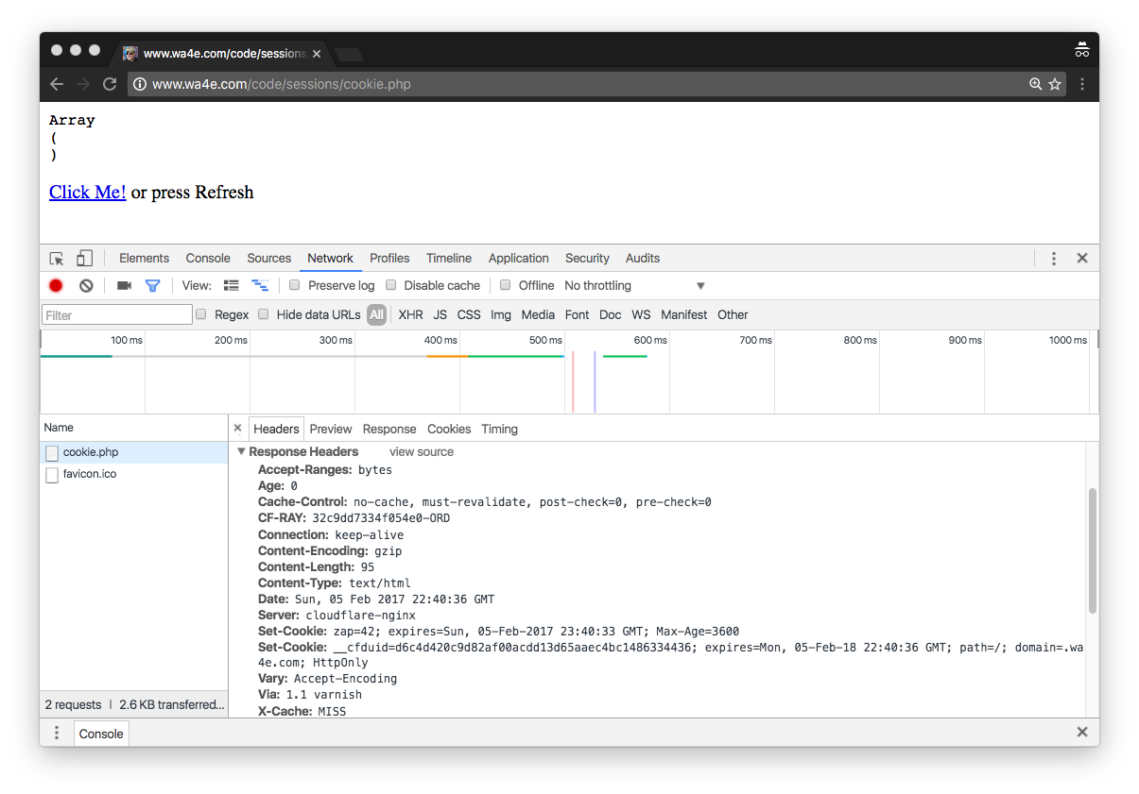
http://www.wa4e.com/code/sessions/cookie.php
In a fresh/incognito browser.

Slide 11
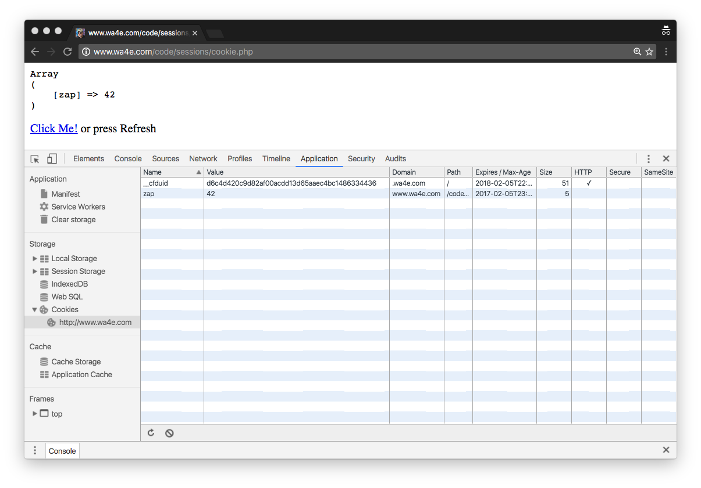
http://www.wa4e.com/code/sessions/cookie.php
In a fresh/incognito browser.
Examine Cookies

Slide 12
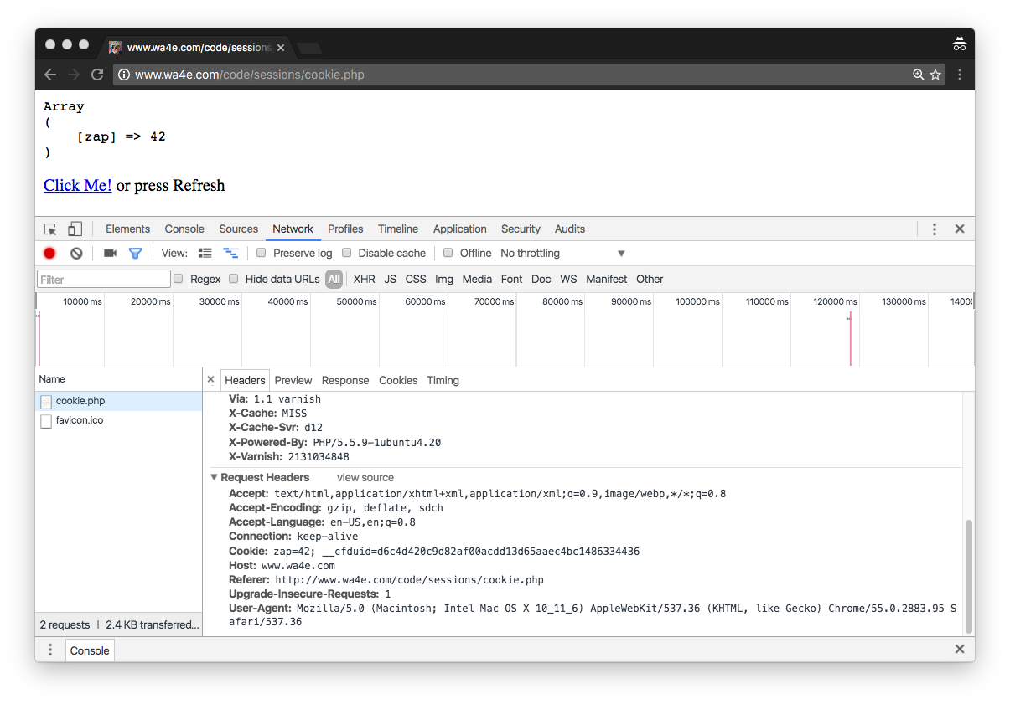
http://www.wa4e.com/code/sessions/cookie.php
In a fresh/incognito browser.
Press Refresh

Slide 13
Time
Browser
Browser zap=42
Browser zap=42
Browser zap=42
zap=42
Apache
setcookie()
$_COOKIE
$_COOKIE
$_COOKIE
PHP
Code

Slide 14
PHP Sessions
http://www.wa4e.com/code/sessions.zip

Slide 15
Time
Browser
Web Server
Database Server
D
OM
Sessions:
42
6f
3e
MySql
Send
Request
Apache
Parse
Response
PHP
sessfun.php
P
D
O
JavaScript
RRC/HTTP
SQL

Slide 16
In The Server - Sessions
In most server applications, as soon as we meet a new (unmarked) browser - we create a session
We set a session cookie to be stored in the browser which indicates the session id in use – give this browser a unique "mark"
The creation and destruction of sessions is handled by a web framework or some utility code that we use in our applications

Slide 17
Session Identifier
A large, random number that we place in a browser cookie the first time we encounter a browser.
This number is used to pick from the many sessions that the server has active at any one time.
Server software stores data in the session which it wants to have from one request to another from the same browser.
  Shopping cart or login information is stored in the session in the server

Slide 18
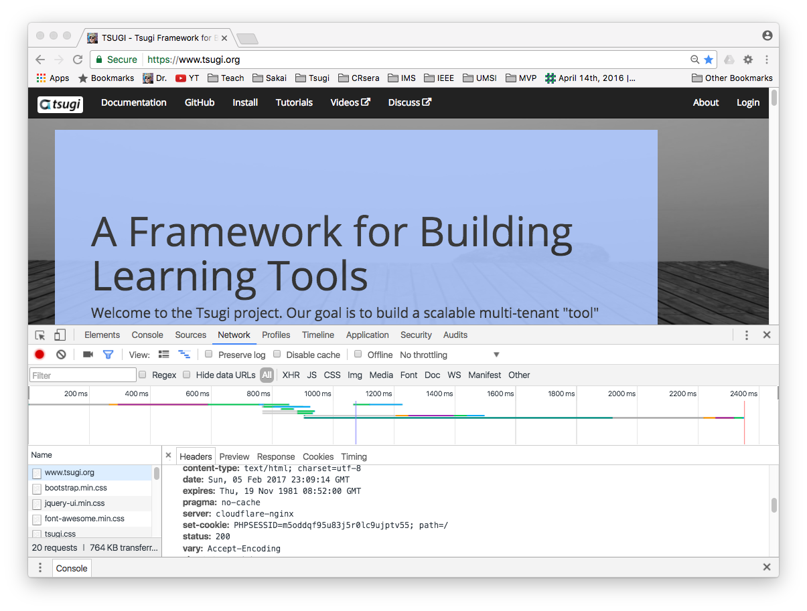
Fresh browser
Turn on network tab of developer console
Go to www.tsugi.org
Find the first page retrieved
Look at the response headers and find set-cookie

Slide 19
Space
Browser S=A123
Browser S=B345
Browser S=C678
Web Server
PHP
PHP
Code
A123
B345
C678

Slide 20
PHP Sessions
We can establish / initialize a PHP Session by calling session_start() before any output has come out
If the user has cookies set, we can use the array $_SESSION to store data from one request to the next with a particular browser
We have a bit of data that persists from one request to the next
By default these are stored in a temporary folder on disk

Slide 21
Time
Browser S=C123
Browser S=C123
Browser S=C123
Browser S=C123
Apache
PHP
$_POST
$_SESSION
PHP
$_GET
$_SESSION
PHP
$_POST
$_SESSION
...
PHP
$_POST
$_SESSION
PHP
Code
C123

Slide 22
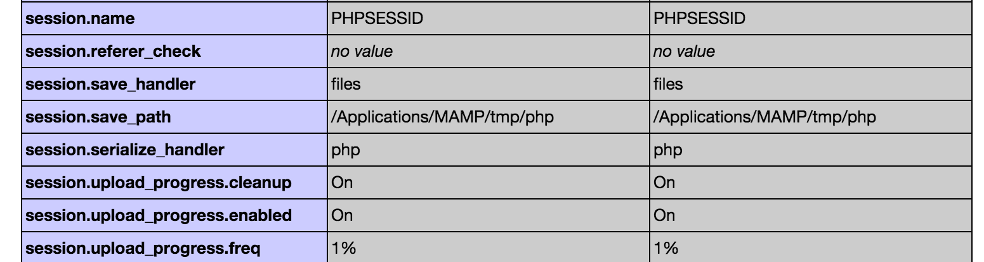
PHPInfo – session.save_path

Slide 23
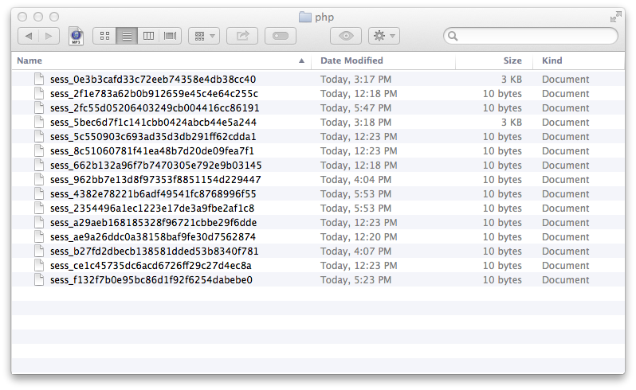
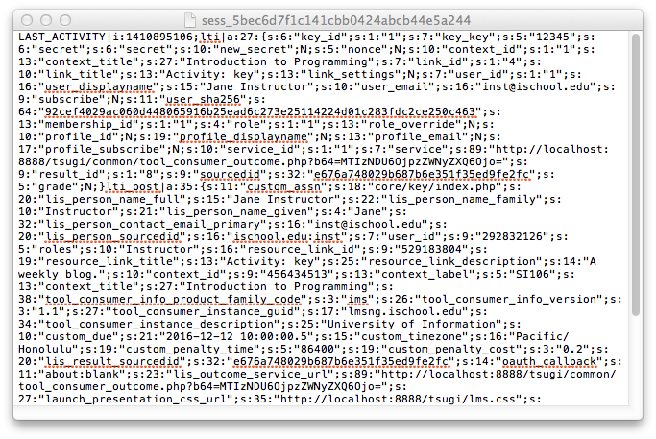
(On a Mac) /Applications/MAMP/tmp/php

Slide 24
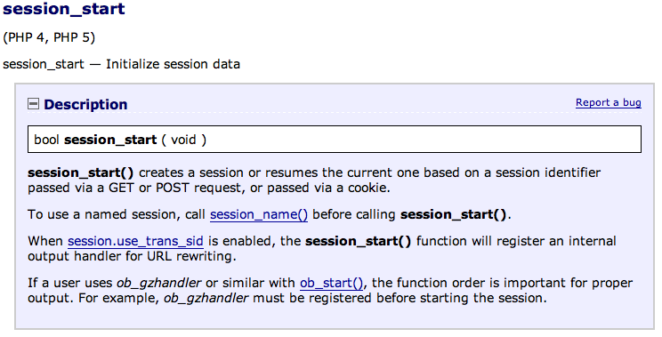
http://php.net/manual/en/function.session-start.php

Slide 25
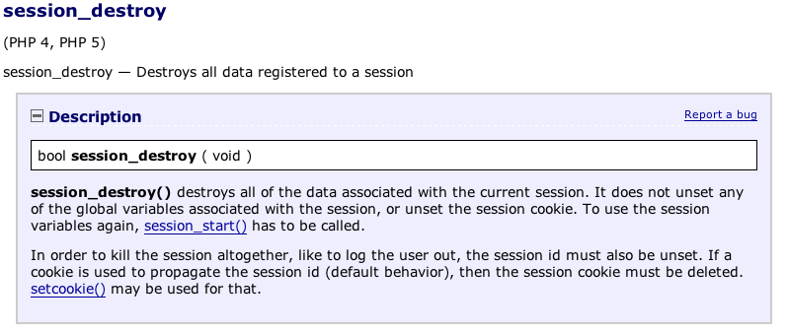
http://php.net/manual/en/function.session-destroy.php

Slide 26
<?php
// Note - cannot have any output before this
session_start();
if ( ! isset($_SESSION['value']) ) {
echo("<p>Session is empty</p>\n");
$_SESSION['value'] = 0;
  } else if ( $_SESSION['value'] < 3 ) {
$_SESSION['value'] = $_SESSION['value'] + 1;
echo("<p>Added one...</p>\n");
} else {
session_destroy();
session_start();
echo("<p>Session Restarted</p>\n");
}
?>
<p><a href="sessfun.php">Click Me!</a></p>
<p>Our Session ID is: <?php echo(session_id()); ?></p>
<pre>
<?php print_r($_SESSION); ?>
</pre>
http://www.wa4e.com/code/sessions/sessfun.php

Slide 27
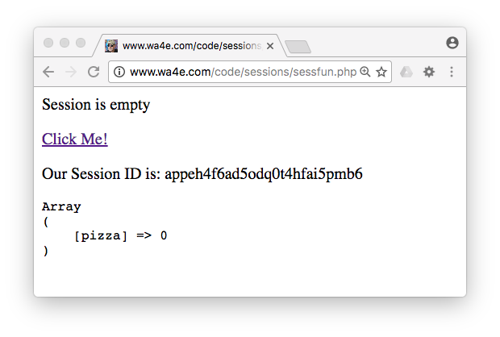
http://www.wa4e.com/code/sessions/sessfun.php

Slide 28
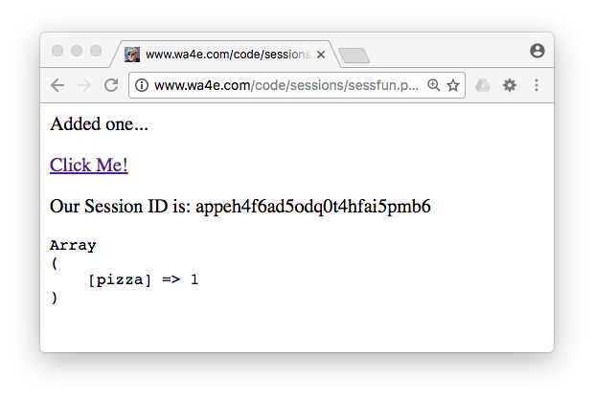


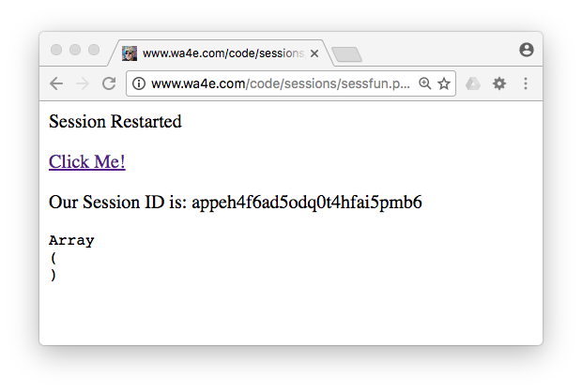
http://www.wa4e.com/code/sessions/sessfun.php

Slide 29
Sessions Without Cookies

Slide 30
PHP Sessions Without Cookies
For a simple application handling login, logout, and shopping cart like information, cookie sessions are sufficient
But if an application needs to function within an iframe, or have more than one session active (i.e. multiple tabs to the same site) we cannot use session cookies
PHP has nice support for maintaining a sessions without a cookie
Notes:
As an aside...

Slide 31
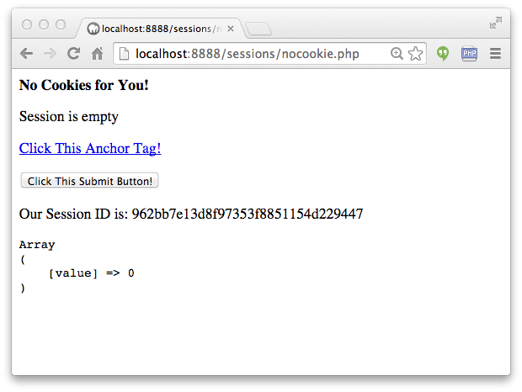
nocookie.php

Slide 32
<?php
// Tell PHP we won't be using cookies for the session
ini_set('session.use_cookies', '0');
ini_set('session.use_only_cookies',0);
ini_set('session.use_trans_sid',1);
session_start();
// Start the view
?>
<p><b>No Cookies for You!</b></p>
nocookie.php

Slide 33
<p><b>No Cookies for You!</b></p>
<?php
if ( ! isset($_SESSION['value']) ) {
echo("<p>Session is empty</p>\n");
$_SESSION['value'] = 0;
} else if ( $_SESSION['value'] < 3 ) {
$_SESSION['value'] = $_SESSION['value'] + 1;
echo("<p>Added one \$_SESSION['value']=".$_SESSION['value'].
"</p>\n");
} else {
session_destroy();
session_start();
echo("<p>Session Restarted</p>\n");
}
?>
<p><a href="nocookie.php">Click This Anchor Tag!</a></p>
nocookie.php

Slide 34
?>
<p><a href="nocookie.php">Click This Anchor Tag!</a></p>
<p>
<form action="nocookie.php" method="post">
<input type="submit" name="click" value="Click This Submit Button!">
</form>
<p>Our Session ID is: <?php echo(session_id()); ?></p>
<pre>
<?php print_r($_SESSION); ?>
</pre>
nocookie.php

Slide 35
A whole host of issues...
Session id is not automatically added in JavaScript, Ajax, Redirect, or other elements of HTML
With the session id on the URL, folks can email URLs or even bookmark them and be logged in
We will come back to these...

Slide 36
Summary
HTTP Cookies
Sessions
Using Sessions in PHP

Slide 37

Acknowledgements / Contributions
These slides are Copyright 2010- Charles R. Severance (www.dr-chuck.com) as part of www.wa4e.com and made available under a Creative Commons Attribution 4.0 License. Please maintain this slide in all copies of the document to comply with the attribution requirements of the license. If you make a change, feel free to add your name and organization to the list of contributors on this page as you republish the materials.
Initial Development: Charles Severance, University of Michigan School of Information
Insert new Contributors and Translators here including names and dates
Continue new Contributors and Translators here
Notes:
Note from Chuck. Please retain and maintain this page as you remix and republish these materials. Please add any of your own improvements or contributions.

Slide 38
Copyright Attribution
Cookie Image: By brainloc on sxc.hu (Bob Smith) (stock.xchng) [CC BY 2.5 (http://creativecommons.org/licenses/by/2.5)], via Wikimedia Commons

