Slide 1

Making our HTML Look Nicer
Cascading Style Sheets
Dr. Charles Severance
https://www.wa4e.com/code/css.zip
Notes:
Note from Chuck. If you are using these materials, you can remove my name and URL from this replace it with your own, but please retain the CC-BY logo on the first page as well as retain the entire last page when you remix and republish these slides.

Slide 2


Time
Browser
Web Server
Database Server
D
OM
Apache
static
files
MySql
Parse
Request
Parse
Response
PHP
php
code
JavaScript
RRC/HTTP
SQL

Slide 3
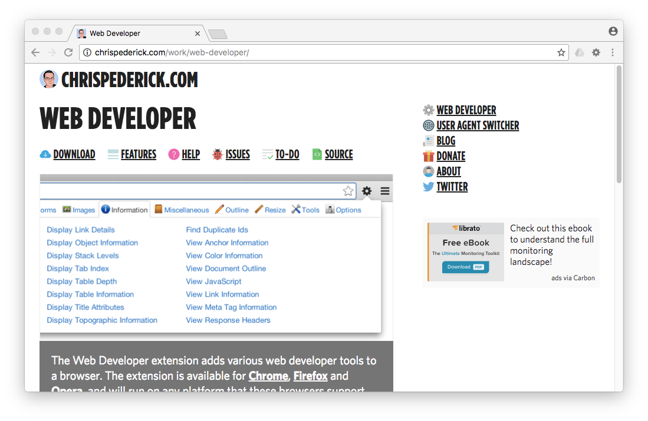
More than Developer Console
http://chrispederick.com/work/web-developer/

Slide 4
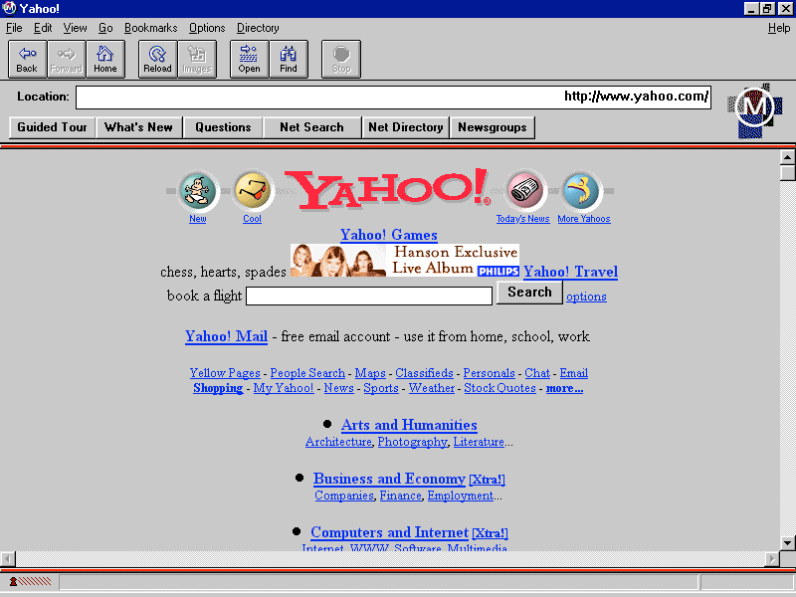
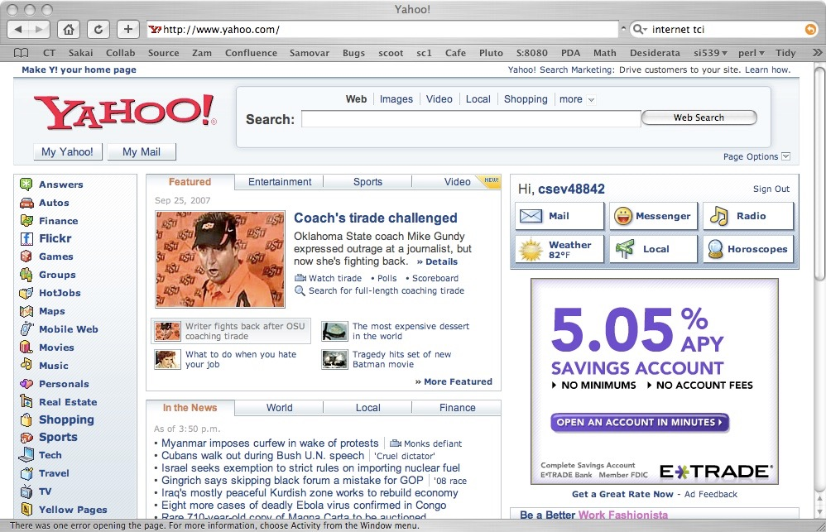
HTML has evolved a *lot* over the years - as computers and networks have gotten faster.
1995
2007

Slide 5
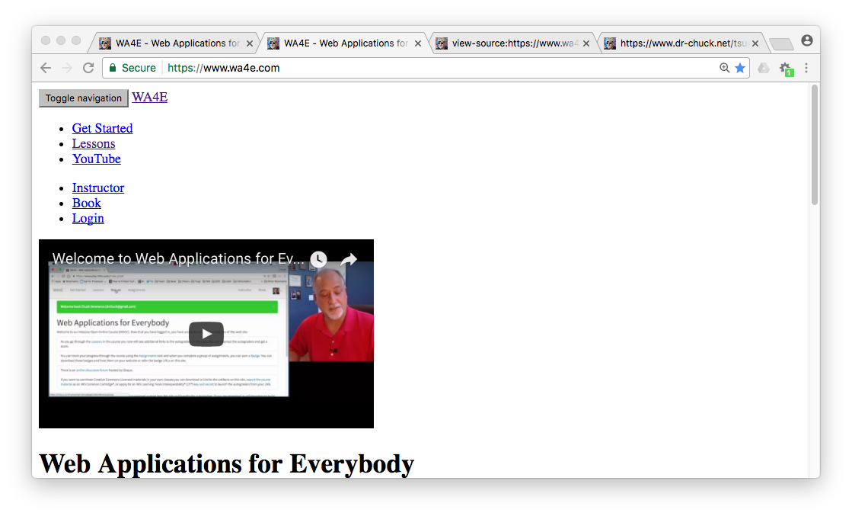
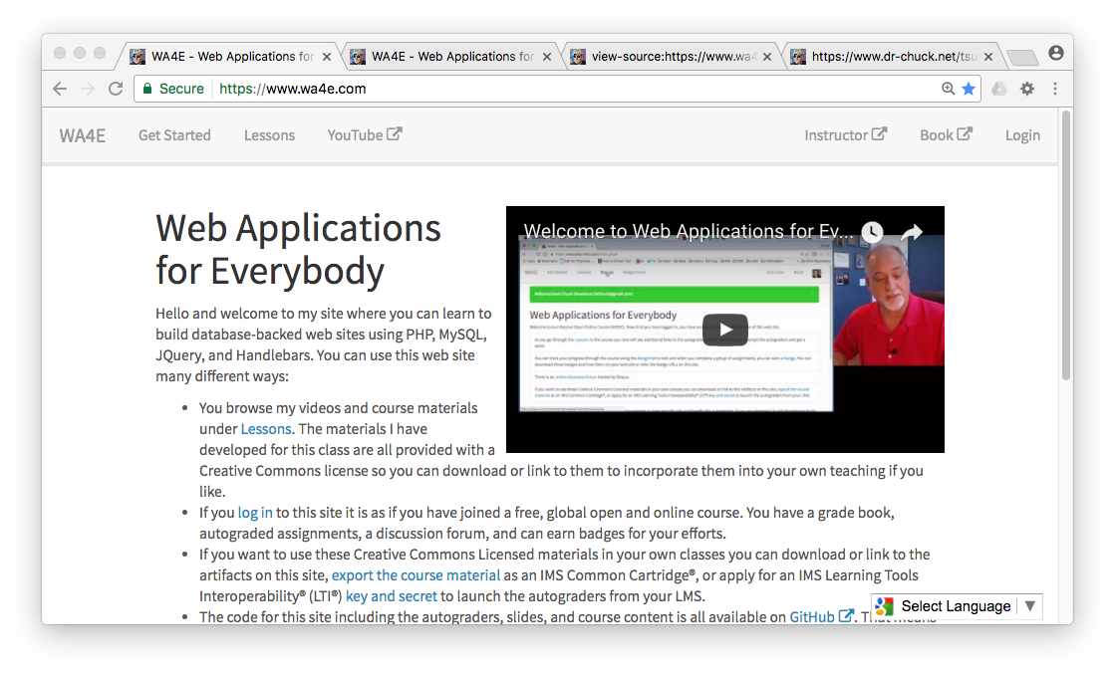
Without CSS
With CSS

Slide 6
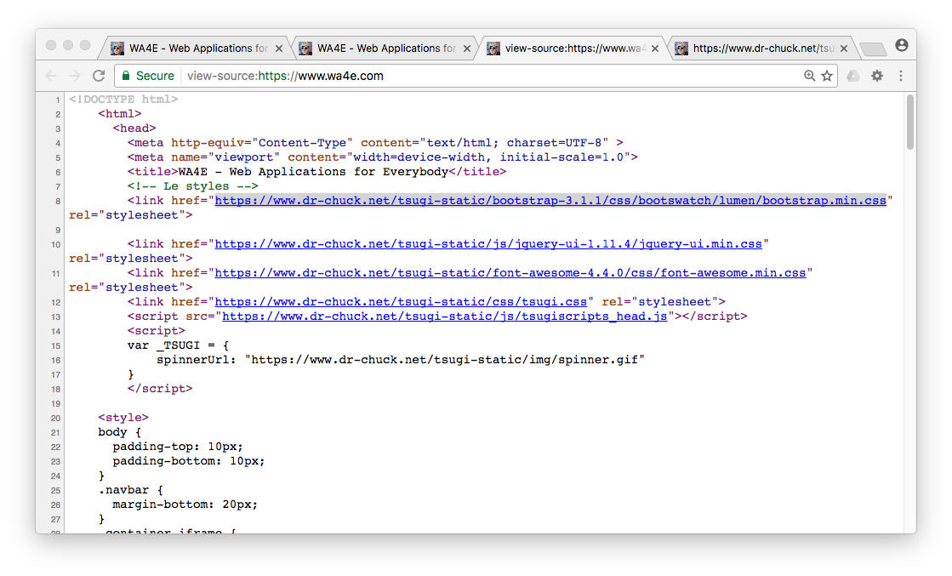
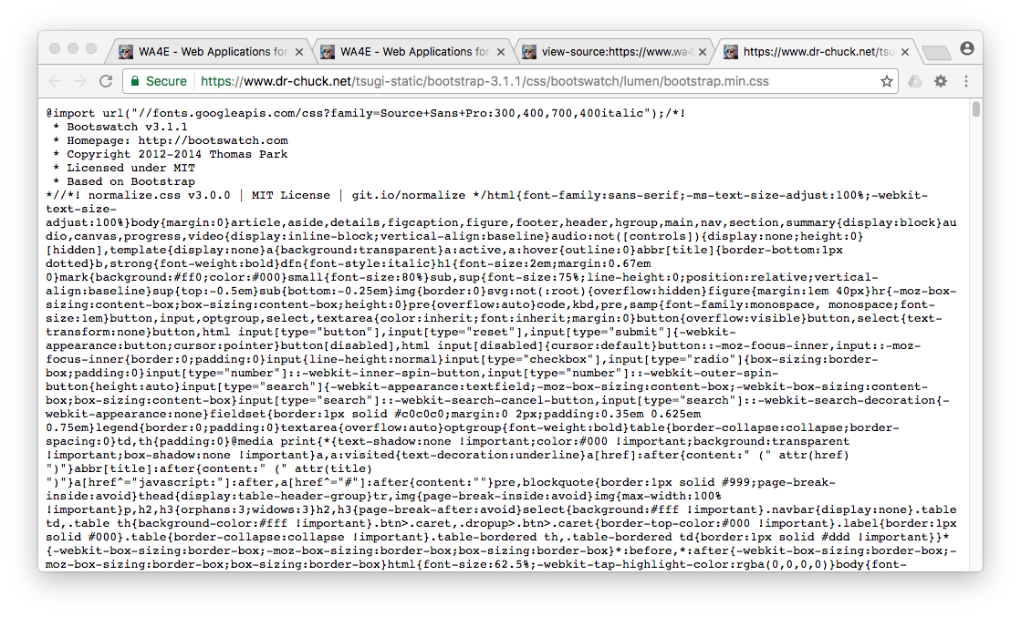
HTML
CSS

Slide 7
Separation of concerns / specialization
Developer
Designer
<html>
<head>
<title>Including CSS From a File</title>
<link type="text/css" rel="stylesheet" href="rules.css">
</head>
<body>
<h1>A Header</h1>
<p>
By putting the CSS rules into a separate file,
it can be included many different web pages
with a single "link" tag, usually in the
"head" of the document.
</p>
body {
font-family: arial, sans-serif;
}
h1 {
color: blue;
}
p {
border-style: solid;
border-color: red;
border-width: 5px;
}
a {
color: green;
background-color: lightgray;
text-decoration: none;
}
Everyone needs to know some HTML and some CSS and some programming - but to be truly skilled at a professional level requires deep understanding and specialization.

Slide 8
CSS Syntax
CSS Syntax is very different than HTML
CSS is a set of “rules” which in include a “selector” and one or more “properties” and “values” as well as some punctuation...
body {
font-family: arial, sans-serif;
}

Slide 9
Anatomy of a CSS Rule
selector - which part of the document does this rule apply to
body {
font-family: arial, sans-serif;
font-size: 100%;
}
property - which aspect of CSS are we changing
value - What are we setting the property to.

Slide 10
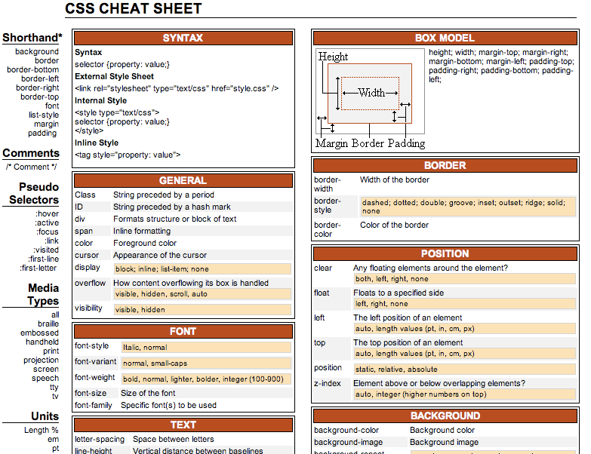
http://www.lesliefranke.com/files/reference/csscheatsheet.html

Slide 11
Partial List of CSS Properties
color
background-color
visibility (visible/hidden)
font-family (arial, sans-serif)
font-size
font-style (italic, normal)
font-weight (bold, normal)
text-align
vertical-align
text-transform (lowercase, etc)
text-decoration
border-width
border-style
border-color
margin
border
padding
float (left, right, none)
left / top
position (static, relative, absolute)
z-index
http://www.lesliefranke.com/files/reference/csscheatsheet.html

Slide 12
Applying CSS to our HTML
Inline - right on an HTML tag - using the style= attribute
An embedded style sheet in the <head> of the document
As external style sheet in a separate file

Slide 13
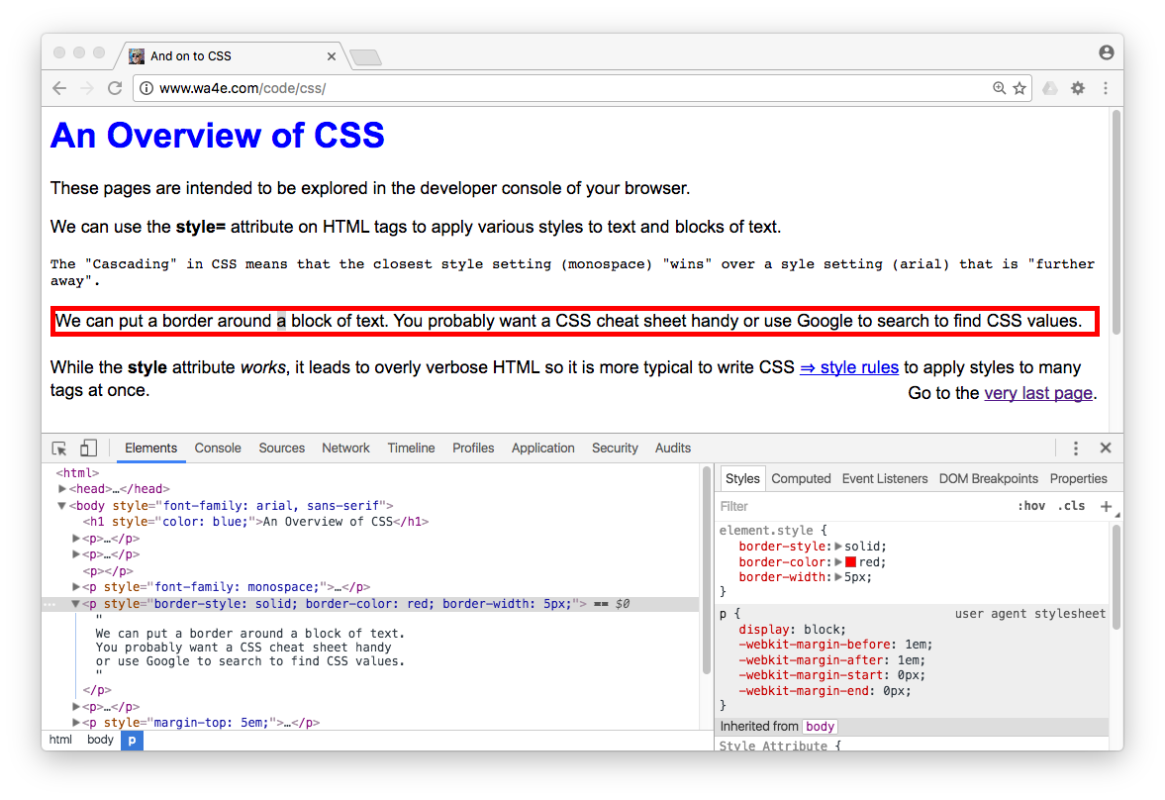

Slide 14
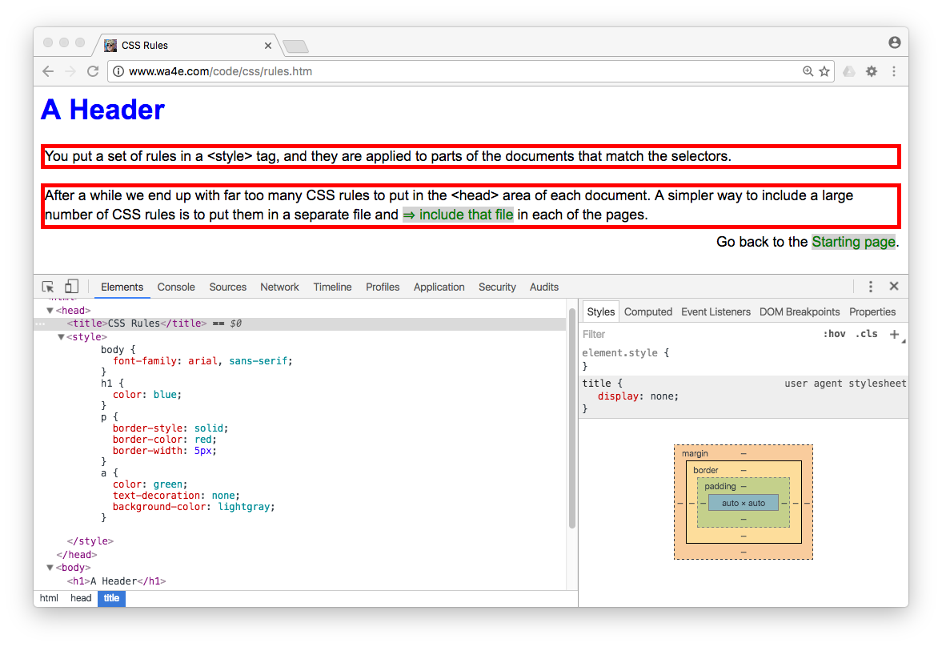

Slide 15
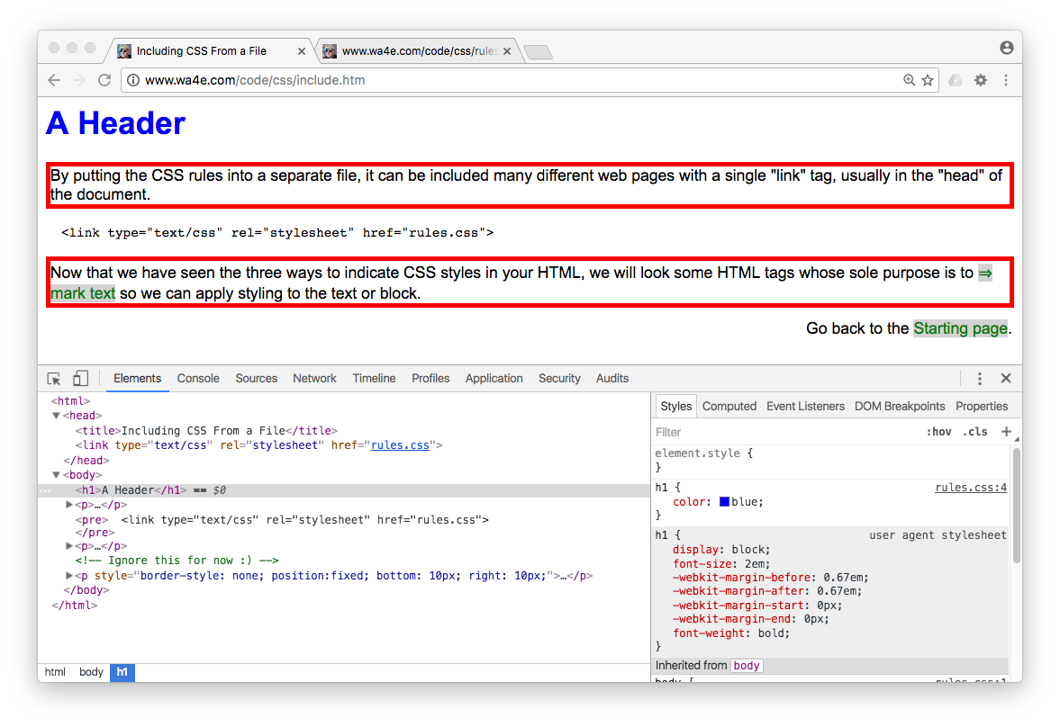

Slide 16
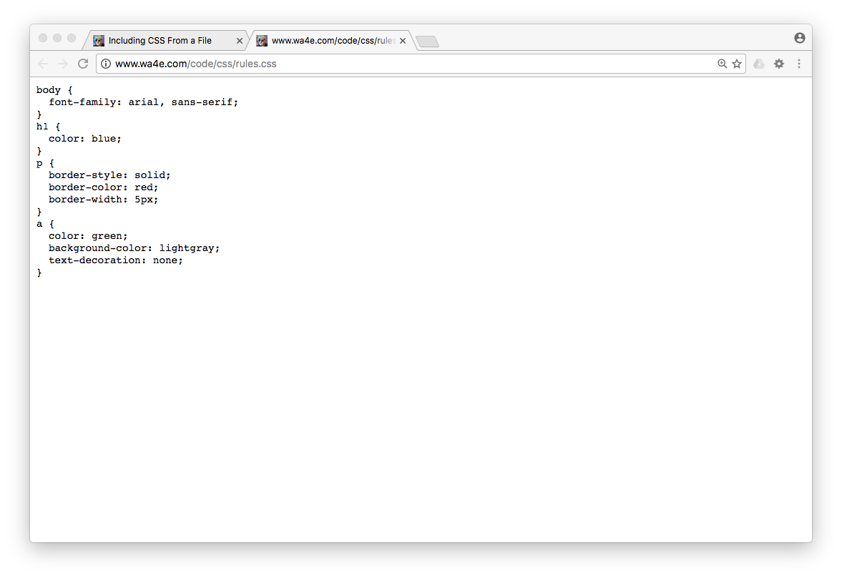

Slide 17
<html>
<head>
<title>Including CSS From a File</title>
<link type="text/css" rel="stylesheet" href="rules.css">
</head>
<body>
<h1>A Header</h1>
csev $ ls -l
total 32
-rw-r--r-- 1 csev staff 44 Dec 19 06:06 rules.css
-rw-r--r-- 1 csev staff 679 Dec 19 06:07 index.htm
-rw-r--r-- 1 csev staff 883 Dec 19 05:59 include.htm
-rw-r--r-- 1 csev staff 679 Dec 19 05:59 colors.htm
csev $

Slide 18
<p style="border: 1px green solid;">
With CSS we wanted some tags that had no pre-existing
style. So the <span style="color: green;">span</span>
tag was invented as the new "inline" tag with no styling.
</p>
<div style="border: 1px blue solid;">
And the <strong>div</strong> tag is a new unstyled
block tag with no padding, margin, background-color,
or anything else. So you could mark blocks with
the div tag and not inherit any default style.
<div style="border: 1px orange solid;">
And the <strong>div</strong> tags can be nested as well.
Adding the 1 pixel borders does take up a pixel of space.
</div>
You can add some text in the outer div.
</div>

Slide 19
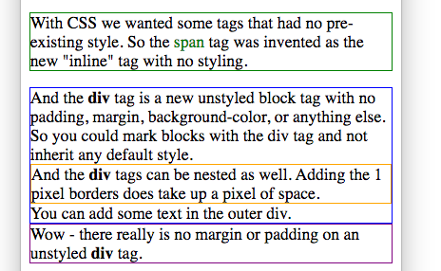
<p style="border: 1px green solid;">
With CSS we wanted some tags that had no pre-existing
style. So the <span style="color: green;">span</span>
tag was invented as the new "inline" tag with no styling.
</p>
<div style="border: 1px blue solid;">
And the <strong>div</strong> tag is a new unstyled
block tag with no padding, margin, background-color,
or anything else. So you could mark blocks with
the div tag and not inherit any default style.
<div style="border: 1px orange solid;">
And the <strong>div</strong> tags can be nested as well.
Adding the 1 pixel borders does take up a pixel of space.
</div>
You can add some text in the outer div.
</div>

Slide 20
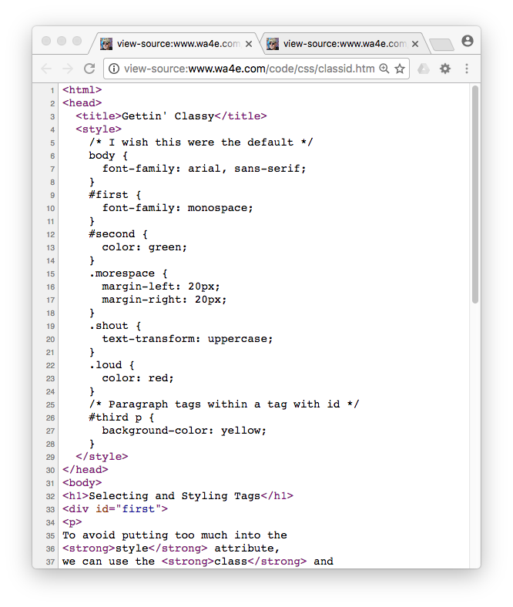
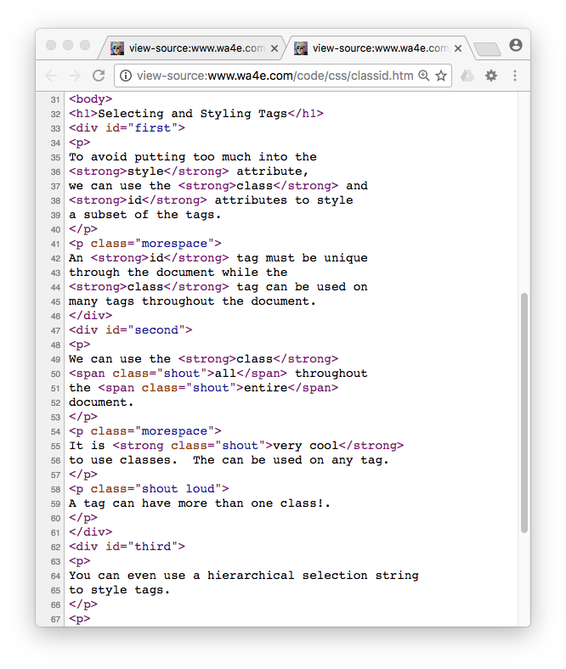

Slide 21
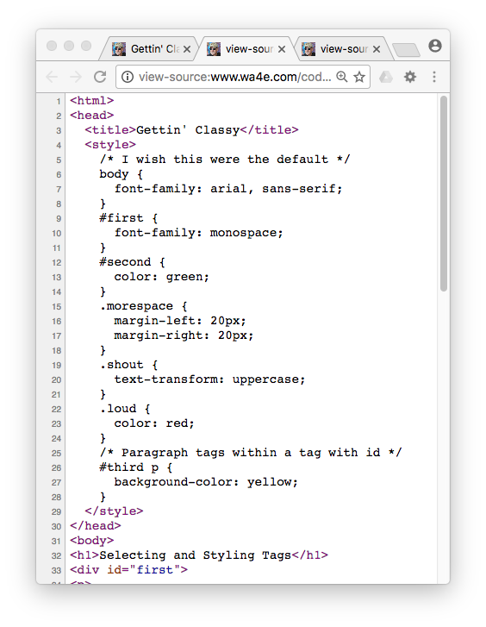
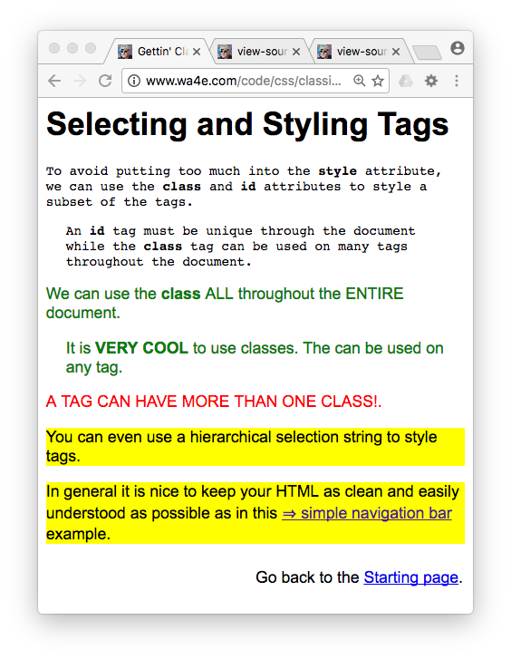
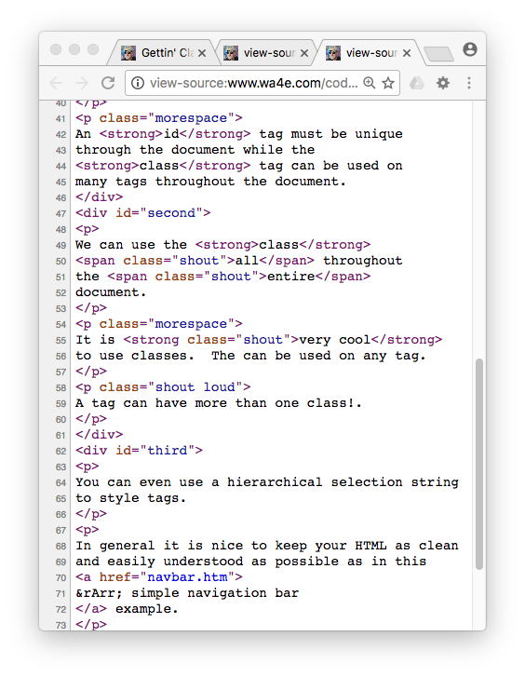

Slide 22
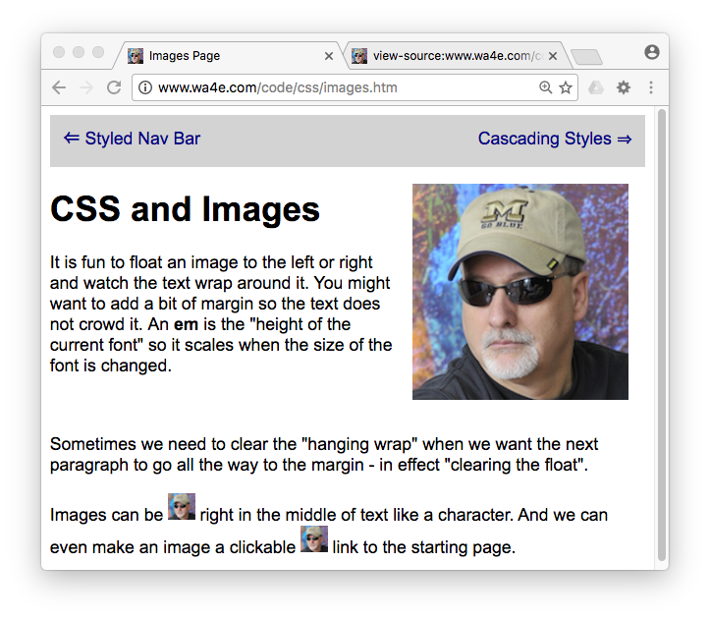
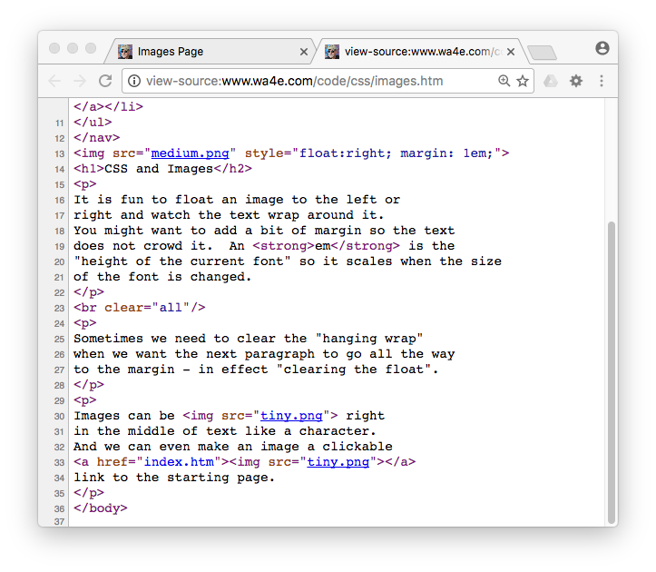

Slide 23
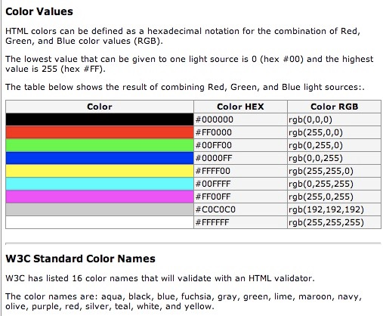
Color Names
W3C has listed 16 color names that will validate with an HTML validator.
The color names are: aqua, black, blue, fuchsia, gray, green, lime, maroon, navy, olive, purple, red, silver, teal, white, and yellow.
http://www.w3schools.com/html/html_colors.asp

Slide 24
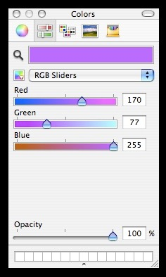
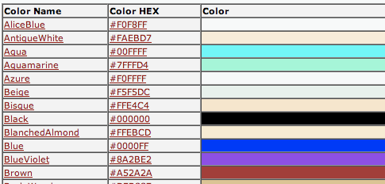
Advanced Colors...
Three Numbers, Red, Green , and Blue - each from 00 - FF (Hexidecimal)
#e2edff
#ffffff = white
#000000 = black
#ff0000 = red
#00ff00 = green
#0000ff = blue
http://www.w3schools.com/css/css_colornames.asp
Web-safe
colors

Slide 25

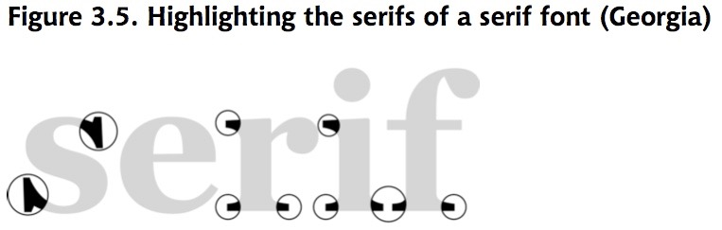
Fonts
Default fonts are ugly and they have Serifs - which make them harder to read on a screen
So the first thing I usually want to do is override the font in my document
And I want to do this everywhere.

Slide 26
Fonts
Most Favourite
Least Favourite
body {
font-family: "Trebuchet MS", Helvetica, Arial, sans-serif;
font-size: x-large;
}
Fallback fonts: serif, sans-serif, monospace, cursive and fantasy.

Slide 27
Font Factors
font-size:
xx-small
x-small
small
medium
large
x-large
xx-large
14px
font-weight: bold or normal
font-style: normal or italic
text-decoration: none, underline, overline, or line-through

Slide 28

Styling for Links
Post-Click:
Downright Ugly!

Slide 29
Styling Links
a {
font-weight: bold;
}
a:link {
color: black;
}
a:visited {
color: gray;
}
a:hover {
text-decoration: none;
color: white;
background-color: navy;
}
a:active {
color: aqua;
background-color: navy;
}
link - before a visit
visited - after it has been visited
hover - when your mouse is over it but you have not clicked
active - you have clicked it and you have not yet see the new page
Browser default styling for links is downright ugly!

Slide 30
CSS Summary
CSS Layout is its own art and science
CSS Basics are well established and well supported in all modern browsers
Site layout and markup is further evolving - mostly to make it increasingly possible to support desktop like experiences on the web.
These innovations will naturally cause incompatibilities - which make things interesting and frustrating at times.

Slide 31
Acknowledgements / Contributions
These slides are Copyright 2010- Charles R. Severance (www.dr-chuck.com) as part of www.wa4e.com and made available under a Creative Commons Attribution 4.0 License. Please maintain this last slide in all copies of the document to comply with the attribution requirements of the license. If you make a change, feel free to add your name and organization to the list of contributors on this page as you republish the materials.
Initial Development: Charles Severance, University of Michigan School of Information
Insert new Contributors and Translators here including names and dates
Continue new Contributors and Translators here
Notes:
Note from Chuck. Please retain and maintain this page as you remix and republish these materials. Please add any of your own improvements or contributions.

