Slide 1

PHP Functions / Modularity
Dr. Charles Severance
www.php-intro.com

Slide 2
Why Functions?
PHP has lots of built-in functions that we use all the time
We write out own functions when our code reaches a certain level of complexity

Slide 3
To function or not to function...
Organize your code into “paragraphs” - capture a complete thought and “name it”
Don’t repeat yourself - make it work once and then reuse it
If something gets too long or complex, break up logical chunks and put those chunks in functions
Make a library of common stuff that you do over and over - perhaps share this with your friends...

Slide 4
Built-In Functions...
Much of the power of PHP comes from its built-in functions
Many modeled after C string library functions (i.e. strlen())
echo strrev(" .dlrow olleH"); echo str_repeat("Hip ", 2); echo strtoupper("hooray!");
echo strlen("intro");
echo "\n";
Hello world.
Hip Hip
HOORAY!
5

Slide 5
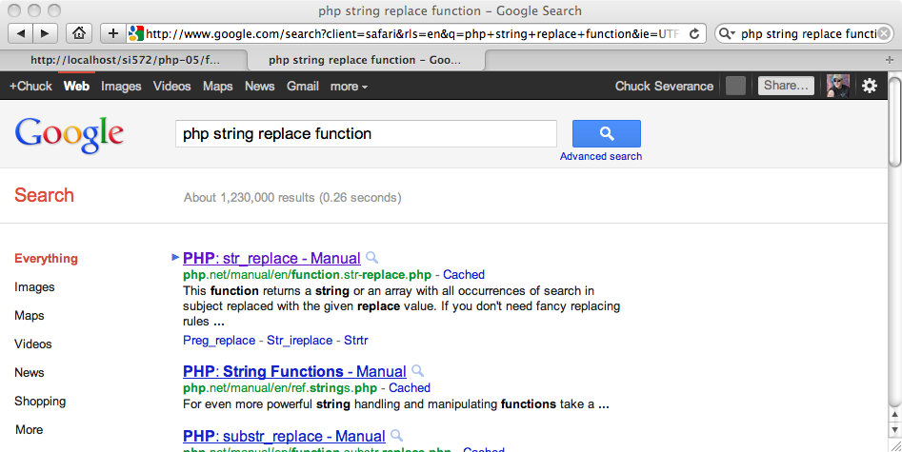
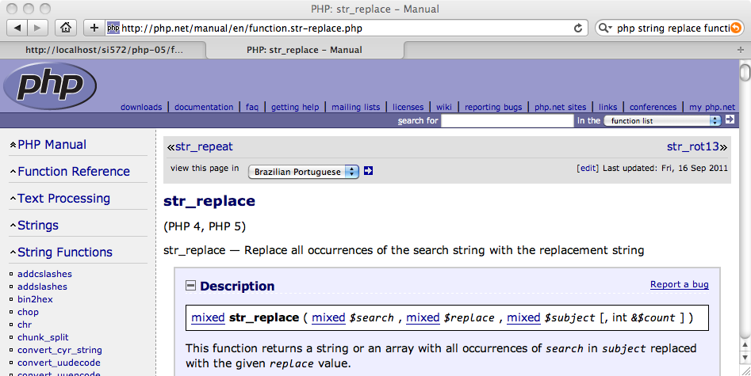
PHP Documentation - Google

Slide 6
One Heck of a Function.
PHP is a very configurable system and has lots of capabilities that can be plugged in.
The phpinfo() function prints out the internal configuration capabilities of your particular PHP installation
<?php
phpinfo();
?>

Slide 7
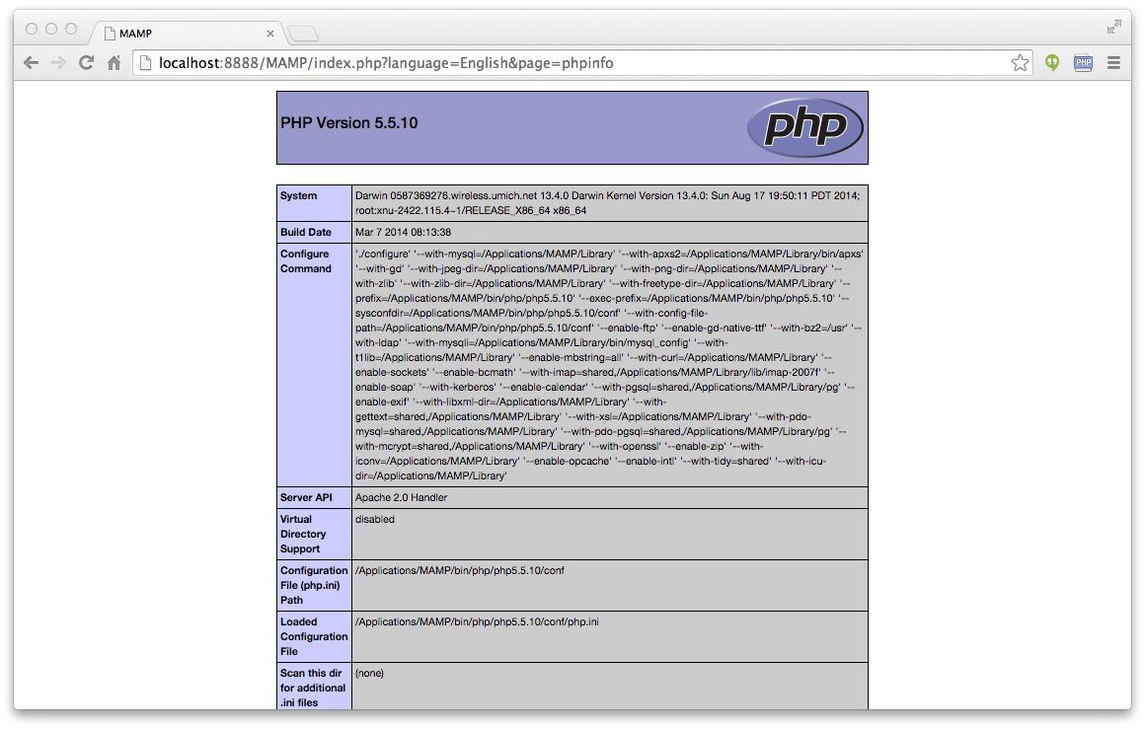
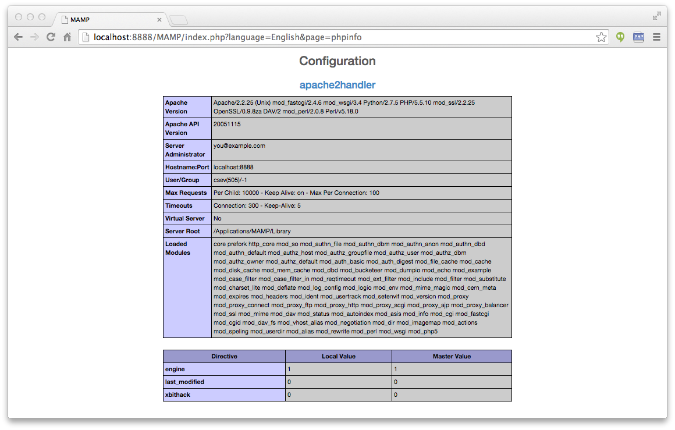
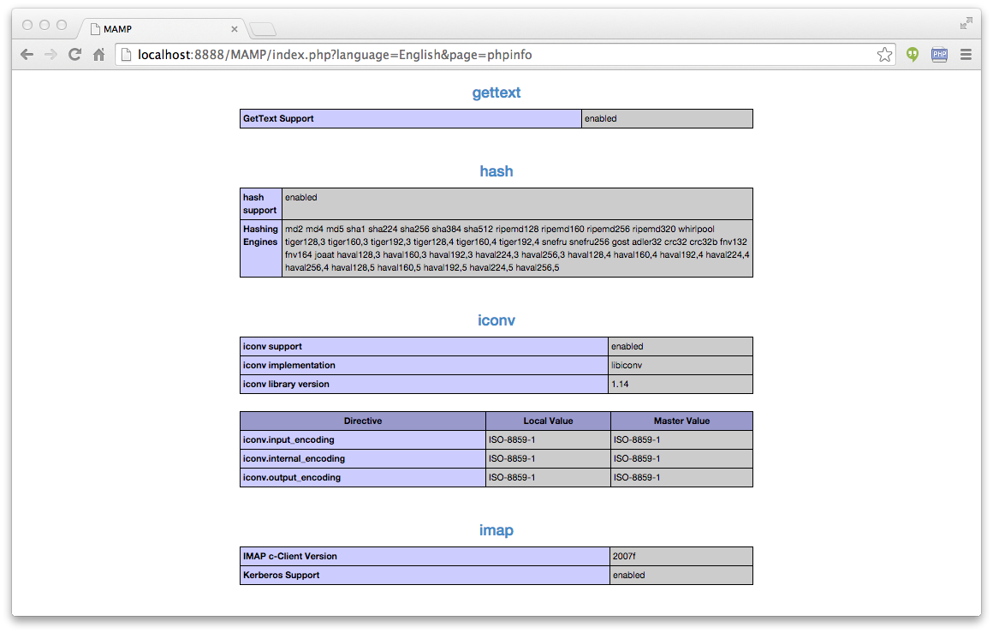

Slide 8
Defining Your Own Functions
We use the function keyword to define a function, we name the function and take optional argument variables. The body of the function is in a block of code { }
function greet() {
print "Hello\n";
}
greet();
greet();
greet();
Hello
Hello
Hello

Slide 9
Choosing Function Names
Much like variable names - but do not start with a dollar sign
  Start with a letter or underscore - consist of letters, numbers, and underscores ( _ )
Avoid built in function names
Case does not matter – but please do not take advantage of this

Slide 10
Return Values
Often a function will take its arguments, do some computation and return a value to be used as the value of the function call in the calling expression. The return keyword is used for this.
function greeting() {
return "Hello";
}
print greeting() . " Glenn\n";
print greeting() . " Sally\n";
Hello Glenn
Hello Sally

Slide 11
Arguments
Functions can choose to accept optional arguments. Within the function definition the variable names are effectively "aliases" to the values passed in when the function is called.
function howdy($lang) {
if ( $lang == 'es' ) return "Hola";
if ( $lang == 'fr' ) return "Bonjour";
return "Hello";
}
print howdy('es') . " Glenn\n";
print howdy('fr') . " Sally\n";
Hola Glenn
Bonjour Sally

Slide 12
Optional Arguments
Arguments can have defaults and so can be omitted
function howdy($lang='es') {
if ( $lang == 'es' ) return "Hola";
if ( $lang == 'fr' ) return "Bonjour";
return "Hello";
}
print howdy() . " Glenn\n";
print howdy('fr') . " Sally\n";
Hola Glenn
Bonjour Sally

Slide 13
Call By Value
The argument variable within the function is an "alias" to the actual variable
But even further, the alias is to a *copy* of the actual variable in the function call
function double($alias) {
$alias = $alias * 2;
return $alias;
}
$val = 10;
$dval = double($val);
echo "Value = $val Doubled = $dval\n";
Value = 10 Doubled = 20

Slide 14
Call By Reference
Sometimes we want a function to change one of its arguments - so we indicate that an argument is "by reference" using ( & )
function triple(&$realthing) {
$realthing = $realthing * 3;
}
$val = 10;
triple($val);
echo "Triple = $val\n";
Triple = 30

Slide 15
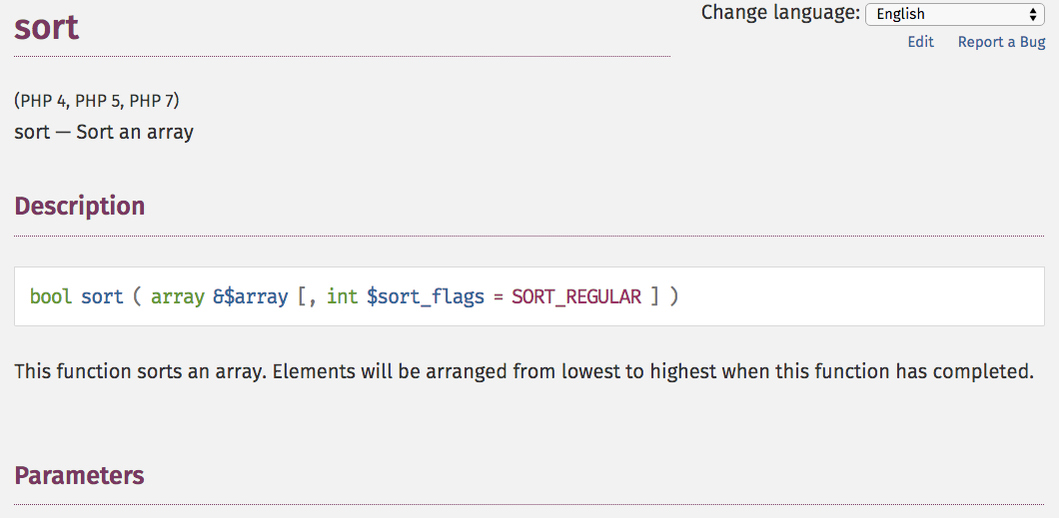
http://php.net/manual/en/function.sort.php

Slide 16
Variable Scope
In general, variable names used inside of function code, do not mix with the variables outside of the function to avoid "unexpected" side effects if two programmers use the same variable name in different parts of the code.
We call this "name spacing" the variables. The function variables are in one "name space" whilst the main variables are in another "name space"
http://php.net/manual/en/language.variables.scope.php

Slide 17
Normal Scope (isolated)
function tryzap() {
$val = 100;
}
$val = 10;
tryzap();
echo "TryZap = $val\n";
TryZap = 10
Except for $_GET
http://php.net/manual/en/language.variables.superglobals.php

Slide 18
Global Scope (common)
function dozap() {
global $val;
$val = 100;
}
$val = 10;
dozap();
echo "DoZap = $val\n";
DoZap = 100
Use this wisely, young Jedi...

Slide 19
Global Variables – Use Rarely
Passing variable in as parameter
Passing value back as return value
Passing variable in by reference
If you use Global Variables use really long names with nice unique prefixes
global $LastOAuthBodyBaseString;
global $LAST_OAUTH_BODY_BASE_STRING;

Slide 20
Programming in Multiple Files

Slide 21
Including files in PHP
include "header.php"; - Pull the file in here
include_once "header.php"; - Pull the file in here unless it has already been pulled in before
require "header.php"; - Pull in the file here and die if it is missing
require_once "header.php"; - You can guess what this means...
These can look like functions - require_once("header.php");

Slide 22
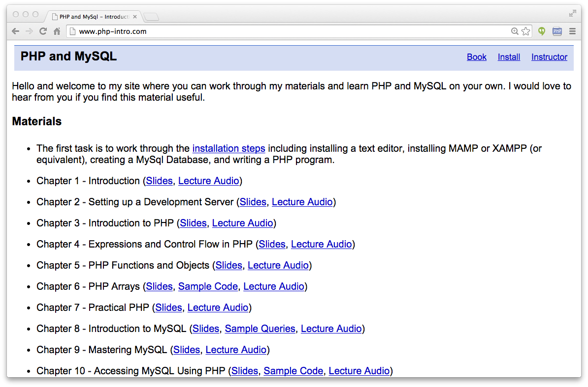
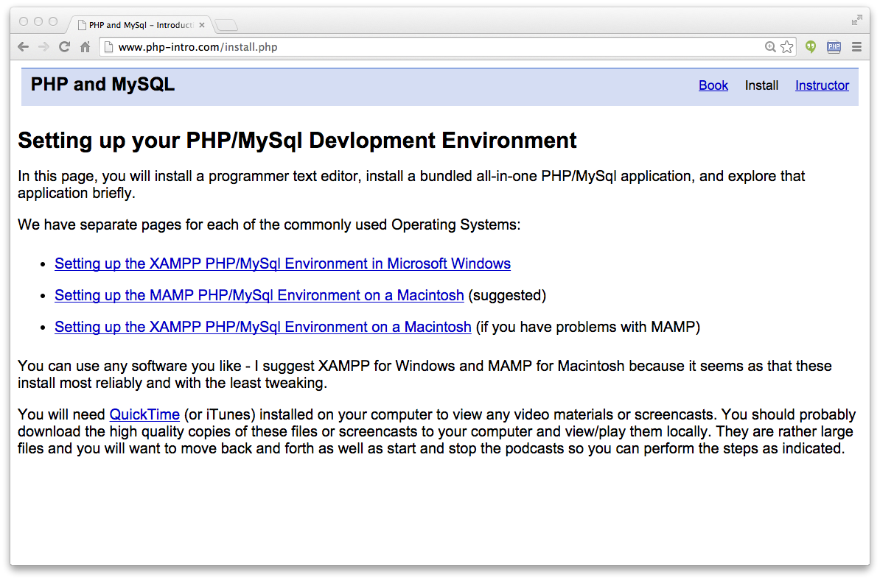
http://www.php-intro.com/
https://github.com/csev/php-intro

Slide 23
<html>
<head>
<?php include("header.php"); ?>
</head>
<body>
<?php include("nav.php"); ?>
<div id="main">
.
.
.
</div>
<?php include("footer.php"); ?>
</body>
</html>
index.php

Slide 24
<html>
<head>
<?php include("header.php"); ?>
</head>
<body>
<?php include("nav.php"); ?>
<div id="main">
<iframeheight="4600" width="100%" frameborder="0" marginwidth="0"marginheight="0" scrolling="auto"src="software.php"></iframe>
</div>
<?php include("footer.php"); ?>
</body>
</html>
install.php

Slide 25
Coping with Missing Bits
Sometimes depending on the version or configuration of a particular PHP instance, some functions may be missing. We can check that.
if (function_exists("array_combine")){
echo "Function exists";
} else {
echo "Function does not exist";
}
This allows for evolution...

Slide 26
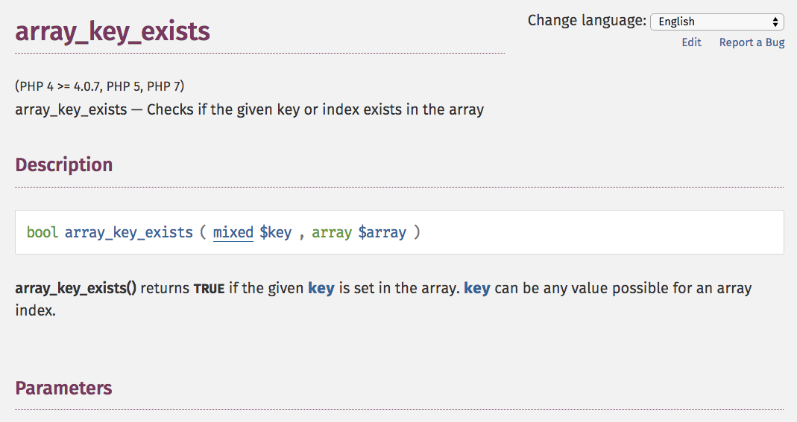
http://php.net/manual/en/function.array-key-exists.php

Slide 27
Summary
Built-in functions
Making new functions
Arguments - pass by value and pass by reference
Including and requiring files
Checking to see if functions are present...

Slide 28
Acknowledgements / Contributions
These slides are Copyright 2010- Charles R. Severance (www.dr-chuck.com) as part of www.php-intro.com and made available under a Creative Commons Attribution 4.0 License. Please maintain this last slide in all copies of the document to comply with the attribution requirements of the license. If you make a change, feel free to add your name and organization to the list of contributors on this page as you republish the materials.
Initial Development: Charles Severance, University of Michigan School of Information
Insert new Contributors and Translators here including names and dates
Continue new Contributors and Translators here
Notes:
Note from Chuck. Please retain and maintain this page as you remix and republish these materials. Please add any of your own improvements or contributions.

