Slide 1

Forms and PHP
Dr. Charles Severance
www.php-intro.com
http://www.php-intro.com/code/forms
http://www.php-intro.com/code/forms.zip

Slide 2
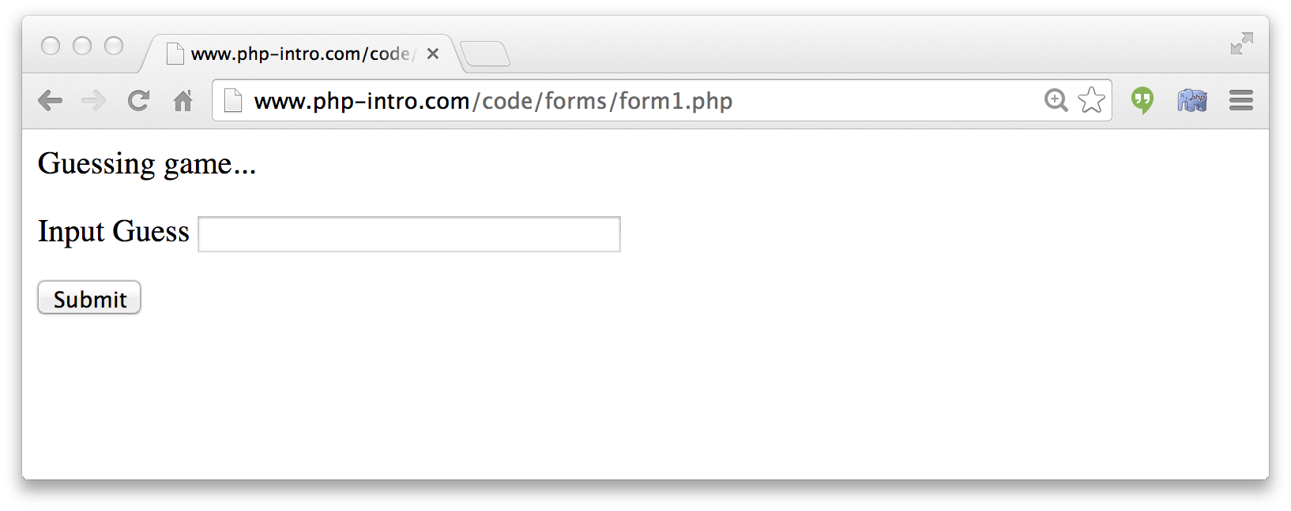
Forms – User Input / Action
<p>Guessing game...</p>
<form>
<p><label for="guess">Input Guess</label>
<input type="text" name="guess" id="guess"/></p>
<input type="submit"/>
</form>
http://www.php-intro.com/code/forms/form1.php

Slide 3


Time
Browser
Web Server
Database Server
D
OM
Apache
MySql
Parse
Request
Parse
Response
PHP
ind.php
JavaScript

Slide 4
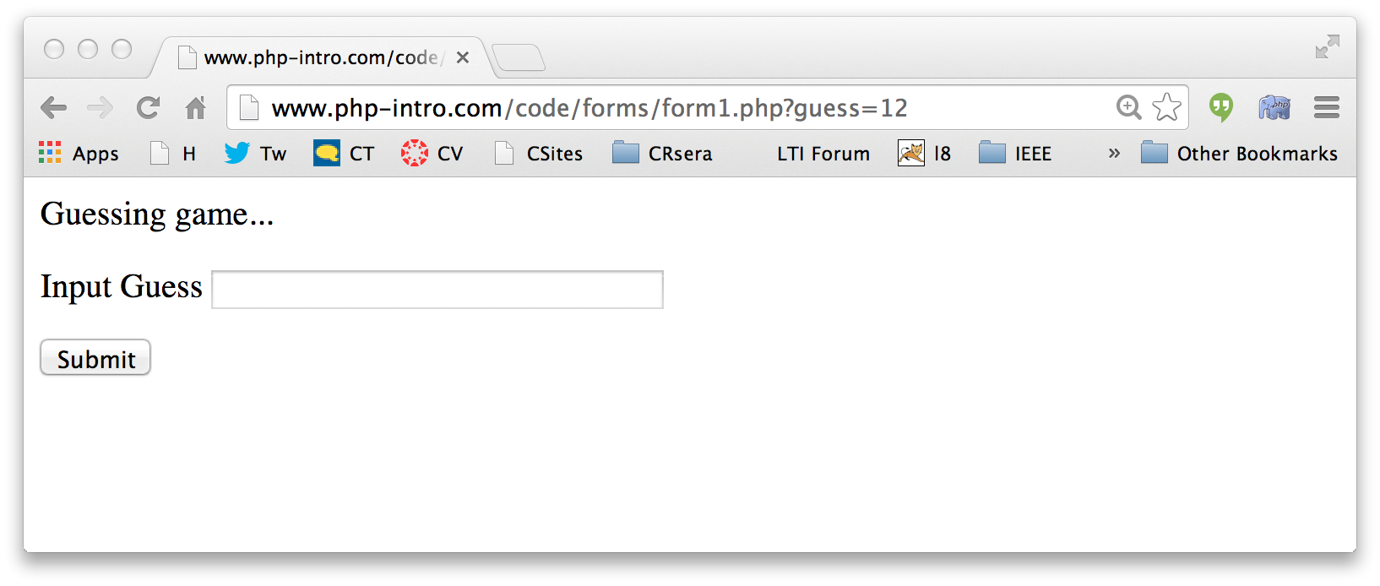
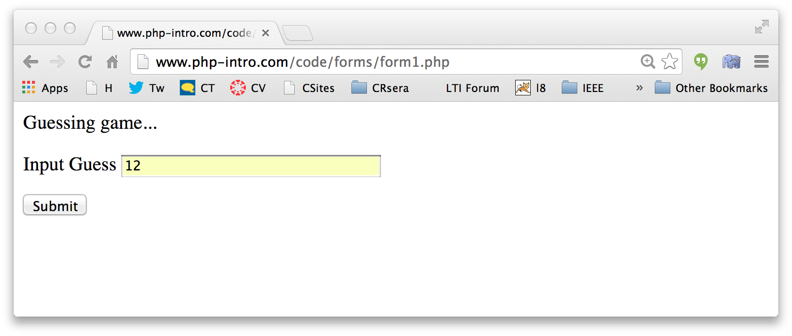
Forms Submit Data
form1.php
<p>Guessing game...</p>
<form>
<p><label for="guess">Input Guess</label>
<input type="text" name="guess" id="guess"/></p>
<input type="submit"/>
</form>

Slide 5
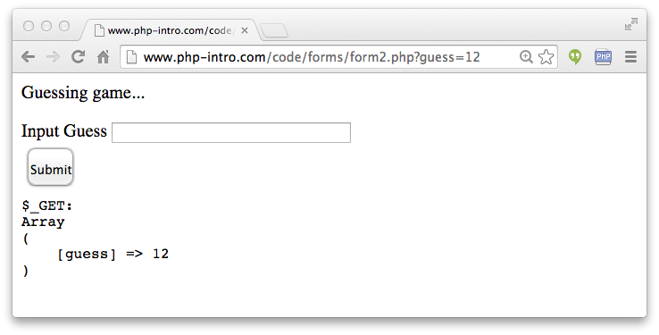
<p>Guessing game...</p>
<form>
<p><label for="guess">Input Guess</label>
<input type="text" name="guess" id="guess"/></p>
<input type="submit"/>
</form>
<pre>
$_GET:
<?php
print_r($_GET);
?>
</pre>
form2.php

Slide 6
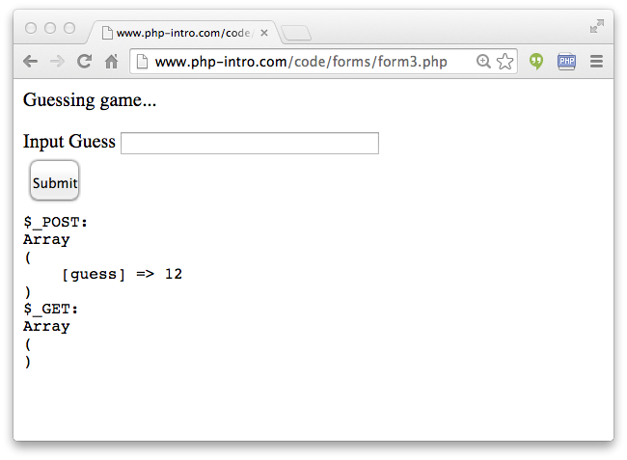
<p>Guessing game...</p>
<form method="post">
<p><label for="guess">Input Guess</label>
<input type="text" name="guess" size="40" id="guess"/></p>
<input type="submit"/>
</form>
<pre>
$_POST:
<?php
print_r($_POST);
?>
$_GET:
<?php
print_r($_GET);
?>
</pre>
form3.php

Slide 7
Forms GET .vs. POST
Two ways the browser can send parameters to the web server
  GET - Parameters are placed on the URL which is retrieved
  POST - The URL is retrieved and parameters are appended to the request in the the HTTP connection

Slide 8
Passing Parameters to The Server
GET /form1.php?guess=42
Accept: text/html
User-Agent: Lynx/2.4 libwww/2.14
Web Server
HTTP
Request
POST /form3.php
Accept: text/html
User-Agent: Lynx/2.4 libwww/2.14
Content-type: application/x-www-form-urlencoded
Content-length: 13
guess=42
Browser
<input type="text" name="guess" id="yourid" />

Slide 9
Time
Browser
Web Server
Database Server
D
OM
Apache
MySql
Parse
Request
Parse
Response
$_POST
PHP
ind.php
JavaScript

Slide 10
Rules of the POST/GET Choice
GET is used when your are reading or searching things
POST is used when data is being created or modified
Web search spiders will follow GET URLs but generally not POST URLs
GET Urls should be “idempotent” - the same URL should give the “same thing” each time you access it
GET has an upper limit of the number of bytes of parameters and values (think about 2K)

Slide 11
<?php
$oldguess = isset($_POST['guess']) ? $_POST['guess'] : '';
?>
<p>Guessing game...</p>
<form method="post">
<p><label for="guess">Input Guess</label>
<input type="text" name="guess" id="guess"
size="40" value="<?= $oldguess ?>"/></p>
<input type="submit"/>
</form>
Persisting
Form Data
Across
Requests
<?= $oldguess ?>
<?php echo($oldguess); ?>
form4.php
Review: Ternary Operation

Slide 12
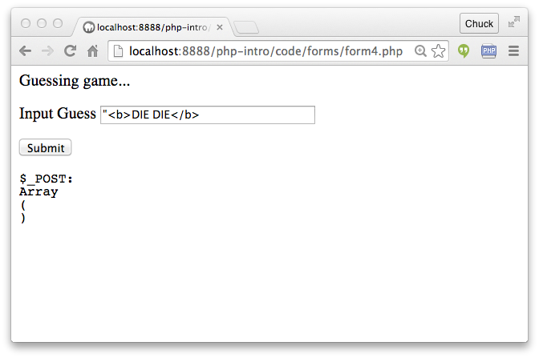
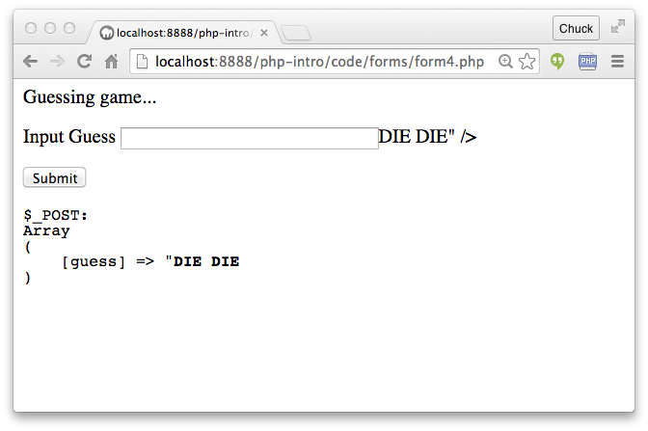
Hygene Alert!
form4.php
What happens when we use an HTML character in a form field value??

Slide 13
form4.php
<form method="post">
<p><label for="guess">Input Guess</label>
<input type="text" name="guess" id="guess
size="40" "value=""><b>DIE DIE</b>" /></p>
<input type="submit"/>
</form>

Slide 14
To The Rescue: htmlentities()
<form method="post">
<p><label for="guess">Input Guess</label>
<input type="text" name="guess" id="guess"
size="40" value="<?= htmlentities($oldguess) ?>"/></p>
<input type="submit"/>
</form>
form5.php

Slide 15
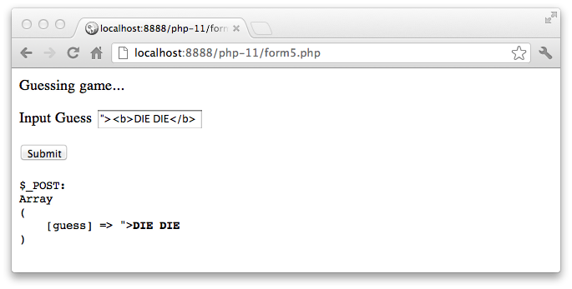
<form method="post">
<p><label for="guess">Input Guess</label>
<input type="text" name="guess" id="guess"
size="40" value="<?= htmlentities($oldguess) ?>"/></p>
<input type="submit"/>
</form>
<input type="text" name="guess" id="guess"
value="&quot;&gt;&lt;b&gt;DIE DIE&lt;/b&gt;" /></p>

Slide 16
Pattern: Processing POST Data
There are many patterns for handling POST data
No "rules" just "suggestions"
Completely process incoming data (if any) - produce no output.
<?php
$guess = '';
$message = false;
if ( isset($_POST['guess']) ) {
// Trick for integer / numeric parameters
$guess = $_POST['guess'] + 0;
if ( $guess == 42 ) {
$message = "Great job!";
} else if ( $guess < 42 ) {
$message = "Too low";
} else {
$message = "Too high...";
}
}
?>
<html>
<head>
<title>A Guessing game</title>
</head>
<body style="font-family: sans-serif;">
<p>Guessing game...</p>
<?php
if ( $message !== false ) {
echo("<p>$message</p>\n");
}
?>
<form method="post">
<p><label for="guess">Input Guess</label>
<input type="text" name="guess" id="guess" size="40"
<?php echo 'value="' . htmlentities($guess) . '"';
?>
/></p>
<input type="submit"/>
</form>
</body>
Produce the page output.
guess.php
What about frameworks?

Slide 17
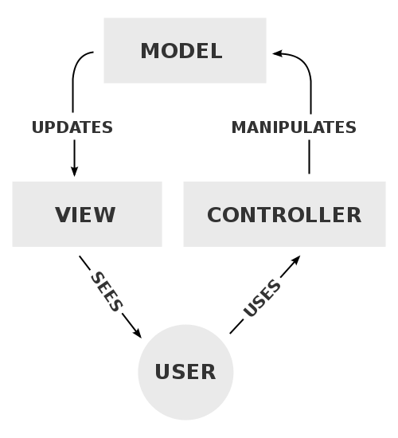
Model-View-Controller
A model that defines the elements of a web application and how they interact.
View – Produce output
Model – Hande data
Controller – Orchestration / Routing
https://en.wikipedia.org/wiki/Model-view-controller

Slide 18
<?php
$guess = '';
$message = false;
if ( isset($_POST['guess']) ) {
// Trick for integer / numeric parameters
$guess = $_POST['guess'] + 0;
if ( $guess == 42 ) {
$message = "Great job!";
} else if ( $guess < 42 ) {
$message = "Too low";
} else {
$message = "Too high...";
}
}
?>
<html>
<head>
<title>A Guessing game</title>
</head>
<body style="font-family: sans-serif;">
<p>Guessing game...</p>
<?php
if ( $message !== false ) {
echo("<p>$message</p>\n");
}
?>
<form method="post">
<p><label for="guess">Input Guess</label>
<input type="text" name="guess" id="guess" size="40"
value="<?= htmlentities($oldguess) ?></p>
<input type="submit"/>
</form>
</body>
Model
Context
Controller
View
guess.php

Slide 19
<?php
$guess = '';
$message = false;
if ( isset($_POST['guess']) ) {
// Trick for integer / numeric parameters
$guess = $_POST['guess'] + 0;
if ( $guess == 42 ) {
$message = "Great job!";
} else if ( $guess < 42 ) {
$message = "Too low";
} else {
$message = "Too high...";
}
}
?>
<html>
<head>
<title>A Guessing game</title>
</head>
<body style="font-family: sans-serif;">
<p>Guessing game...</p>
<?php
if ( $message !== false ) {
echo("<p>$message</p>\n");
}
?>
<form method="post">
<p><label for="guess">Input Guess</label>
<input type="text" name="guess" id="guess" size="40"
value="<?= htmlentities($oldguess) ?></p>
<input type="submit"/>
</form>
</body>
No
HTML
Context
Controller
No
Database
guess.php

Slide 20
<?php
$guess = '';
$message = false;
if ( isset($_POST['guess']) ) {
// Trick for integer / numeric parameters
$guess = $_POST['guess'] + 0;
if ( $guess == 42 ) {
$message = "Great job!";
} else if ( $guess < 42 ) {
$message = "Too low";
} else {
$message = "Too high...";
}
}
?>
<html>
<head>
<title>A Guessing game</title>
</head>
<body style="font-family: sans-serif;">
<p>Guessing game...</p>
<?php
if ( $message !== false ) {
echo("<p>$message</p>\n");
}
?>
<form method="post">
<p><label for="guess">Input Guess</label>
<input type="text" name="guess" id="guess" size="40"
value="<?= htmlentities($oldguess) ?></p>
<input type="submit"/> <input type="submit"/>
</form>
</body>
<?php
$guess = '';
$message = false;
if ( isset($_POST['guess']) ) {
// Nifty trick
$guess = $_POST['guess'] + 0;
if ( $guess == 42 ) {
$message = "Great job!";
} else if ( $guess < 42 ) {
$message = "Too low";
} else {
$message = "Too high...";
}
}
?>
<html> ...
guess.php

Slide 21
<?php
$guess = '';
$message = false;
if ( isset($_POST['guess']) ) {
// Trick for integer / numeric parameters
$guess = $_POST['guess'] + 0;
if ( $guess == 42 ) {
$message = "Great job!";
} else if ( $guess < 42 ) {
$message = "Too low";
} else {
$message = "Too high...";
}
}
?>
<html>
<head>
<title>A Guessing game</title>
</head>
<body style="font-family: sans-serif;">
<p>Guessing game...</p>
<?php
if ( $message !== false ) {
echo("<p>$message</p>\n");
}
?>
<form method="post">
<p><label for="guess">Input Guess</label>
<input type="text" name="guess" id="guess" size="40"
value="<?= htmlentities($oldguess) ?></p>
<input type="submit"/>
</form>
</body>
...
?>
<html>
<head>
<title>A Guessing game</title>
</head>
<body style="font-family: sans-serif;">
<p>Guessing game...</p>
<?php if ( $message !== false ) {
echo("<p>$message</p>\n");
}
?>
<form method="post">
<p><label for="guess">Input Guess</label>
<input type="text" name="guess" id="guess" size="40"
value="<?= htmlentities($oldguess) ?></p>
<input type="submit"/>
</form>
</body>

Slide 22
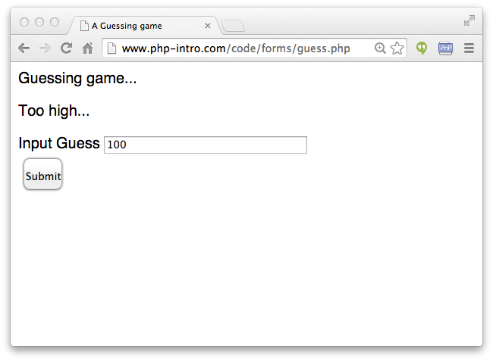
<?php
$guess = '';
$message = false;
if ( isset($_POST['guess']) ) {
// Nifty trick
$guess = $_POST['guess'] + 0;
if ( $guess == 42 ) {
$message = "Great job!";
} else if ( $guess < 42 ) {
$message = "Too low";
} else {
$message = "Too high...";
}
}
?>
<html> ...
guess.php
Note: This code is a little sloppy in terms of its data validation

Slide 23
<html>
<head>
<title>A Guessing game</title>
</head>
<body style="font-family: sans-serif;">
<p>Guessing game...</p>
<?php
if ( $message !== false ) {
echo("<p>$message</p>\n");
}
?>
<form method="post">
<p><label for="guess">Input Guess</label>
<input type="text" name="guess" id="guess" size="40"
value="<?= htmlentities($oldguess) ?></p>
<input type="submit"/>
</form>
</body>
guess.php

Slide 24
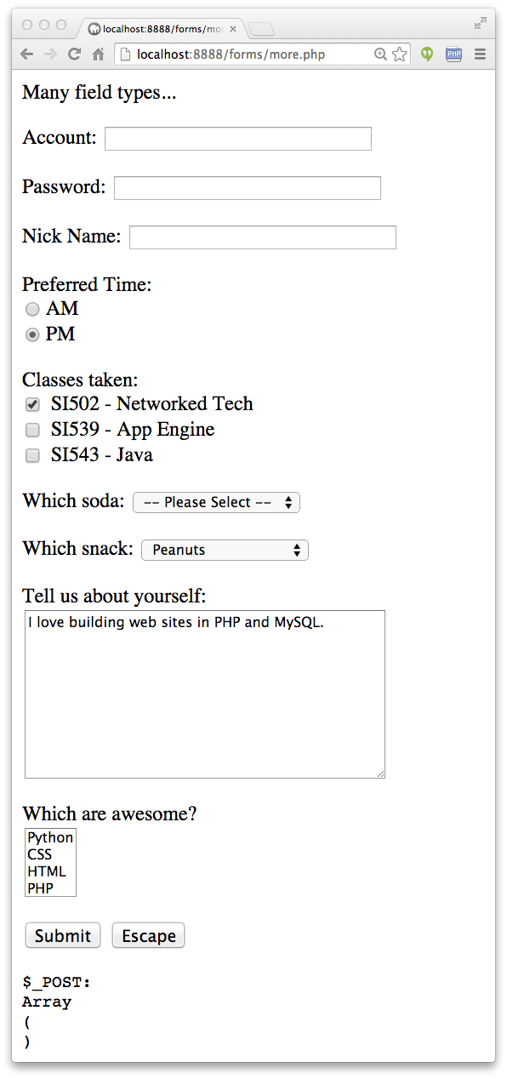
Other Input Types
Text
Password
Radio Button
Check Box
Select / Drop-Down
TextArea
http://www.php-intro.com/code/forms/more.php

Slide 25
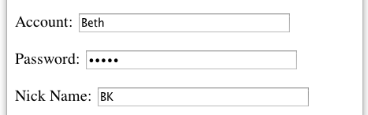
more.php
<p>Many field types...</p>
<form method="post" action="more.php">
<p><label for="inp01">Account:</label>
<input type="text" name="account" id="inp01" size="40" ></p>
<p><label for="inp02">Password:</label>
<input type="password" name="pw" id="inp02" size="40" ></p>
<p><label for="inp03">Nick Name:</label>
<input type="text" name="nick" id="inp03" size="40" ></p>
$_POST:
Array
(
[account] => Beth
[pw] => 12345
[nick] => BK
[when] => pm
...
)

Slide 26
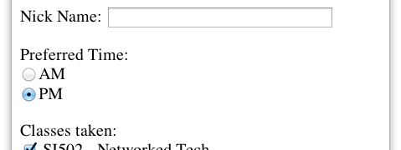
more.php
<p>Preferred Time:<br/>
<input type="radio" name="when" value="am">AM<br>
<input type="radio" name="when" value="pm" checked>PM</p>
$_POST:
Array(
...
[nick] => BK
[when] => pm
[class] => si502
...
)

Slide 27
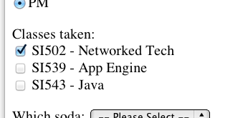
more.php
<p>Classes taken:<br/>
<input type="checkbox" name="class1" value="si502" checked>
SI502 - Networked Tech<br>
<input type="checkbox" name="class2" value="si539">
SI539 - App Engine<br>
<input type="checkbox" name="class3">
SI543 - Java<br> </p>
$_POST:
Array(
...
[when] => pm
[class1] => si502
[soda] => 0
...
)
$_POST:
Array(
...
[when] => pm
[class3] => on
[soda] => 0
...
)

Slide 28
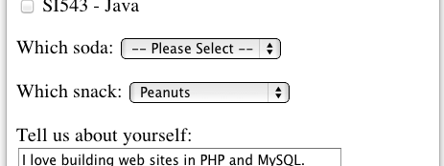
<p><label for="inp06">Which soda:
<select name="soda" id="inp06">
<option value="0">-- Please Select --</option>
<option value="1">Coke</option>
<option value="2">Pepsi</option>
<option value="3">Mountain Dew</option>
<option value="4">Orange Juice</option>
<option value="5">Lemonade</option>
</select>
</p>
more.php
$_POST:
Array(
...
[class] => si502
[soda] => 0
[snack] => peanuts
...
)
The values can be any string but numbers are used quite often.

Slide 29
more.php
<p><label for="inp07">Which snack:
<select name="snack" id="inp07">
<option value="">-- Please Select --</option>
<option value="chips">Chips</option>
<option value="peanuts" selected>Peanuts</option>
<option value="cookie">Cookie</option>
</select>
</p>
$_POST:
Array(
...
[class] => si502
[soda] => 0
[snack] => peanuts
...
)

Slide 30
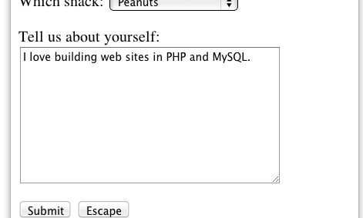
more.php
<p><label for="inp08">Tell us about yourself:<br/>
<textarea rows="10" cols="40" id="inp08" name="about">
I love building web sites in PHP and MySQL.
</textarea>
</p>
$_POST:
Array(
...
[about] => I love building web sites in PHP and MySQL.
[dopost] => Submit
...
)

Slide 31
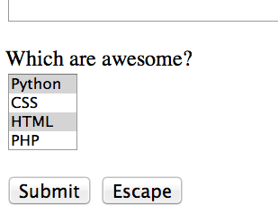
more.php
<p><label for="inp09">Which are awesome?<br/>
<select multiple="multiple" name="code[]" id="inp09">
<option value="python">Python</option>
<option value="css">CSS</option>
<option value="html">HTML</option>
<option value="php">PHP</option>
</select>
$_POST:
Array(
...
[code] => Array
(
[0] => css
[1] => html
)
[dopost] => Submit
...
)

Slide 32
more.php
<p>
<input type="submit" name="dopost" value="Submit"/>
<input type="button"
onclick="location.href='http://www.php-intro.com/'; return false;"
value="Escape">
</p>
$_POST:
Array(
...
[dopost] => Submit
...
)
On submit input types, the text is both in the UI and in $_POST.

Slide 33
HTML5 Input Types
HTML5 defines new input types
Not all browsers support all input types
The fall back to type="text"
http://www.w3schools.com/html/html5_form_input_types.asp

Slide 34
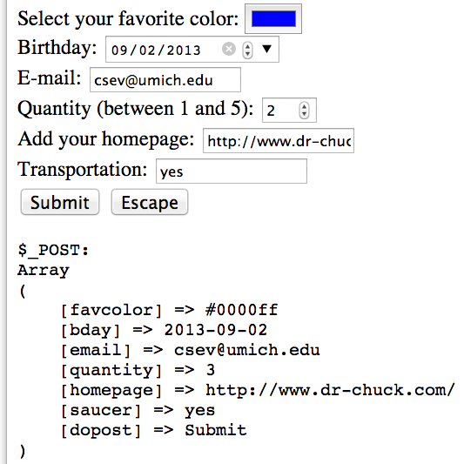
Select your favorite color:
<input type="color" name="favcolor" value="#0000ff"><br/>
Birthday:
<input type="date" name="bday" value="2013-09-02"><br/>
E-mail:
<input type="email" name="email"><br/>
Quantity (between 1 and 5):
<input type="number" name="quantity"
min="1" max="5"><br/>
Add your homepage:
<input type="url" name="homepage"><br>
Transportation:
<input type="flying" name="saucer"><br>
Validation happens when you press submit.
http://www.php-intro.com/code/forms/html5.php

Slide 35
Time
Browser
Web Server
Database Server
D
OM
Apache
MySql
Parse
Request
Parse
Response
PHP
ind.php
JavaScript

Slide 36
Summary
Forms, $_GET and $_POST
Sanitizing HTML
Model-View Controller
Form fields
New form fields in HTML5

Slide 37
Acknowledgements / Contributions
These slides are Copyright 2010- Charles R. Severance (www.dr-chuck.com) as part of www.php-intro.com and made available under a Creative Commons Attribution 4.0 License. Please maintain this last slide in all copies of the document to comply with the attribution requirements of the license. If you make a change, feel free to add your name and organization to the list of contributors on this page as you republish the materials.
Initial Development: Charles Severance, University of Michigan School of Information
Insert new Contributors and Translators here including names and dates
Continue new Contributors and Translators here
Notes:
Note from Chuck. Please retain and maintain this page as you remix and republish these materials. Please add any of your own improvements or contributions.

