Slide 1

HTML
Dr. Charles Severance
www.wa4e.com
Notes:
Note from Chuck. If you are using these materials, you can remove my name and URL from this replace it with your own, but please retain the CC-BY logo on the first page as well as retain the entire last page when you remix and republish these slides.

Slide 2
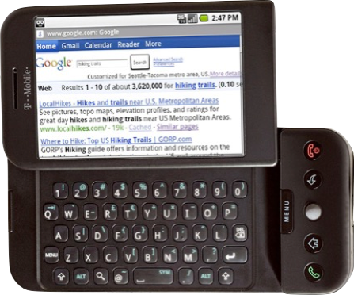

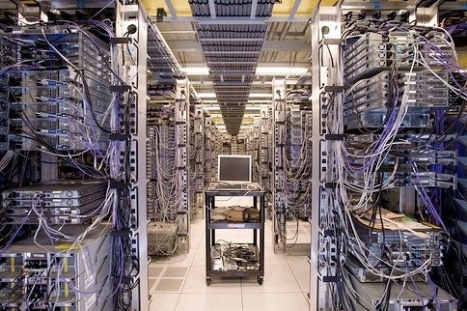
Internet
HTTP
Request
Python
HTML
JavaScript
Response
GET
Data Store
AJAX
Templates
memcache
CSS
POST

Slide 3
HTML
A way of marking up text to indicate that some text is different than other text
We “tag” portions of the text to communicate meaning
<h1>Google App Engine: About</h1>
<p>Welcome to the site dedicated to learning the Google Application Engine. We hope you find www.appenginelearn.com useful.</p>

Slide 4
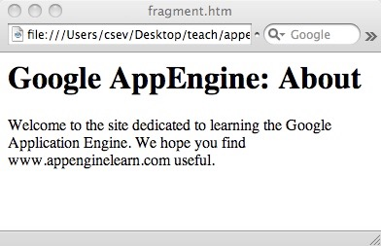
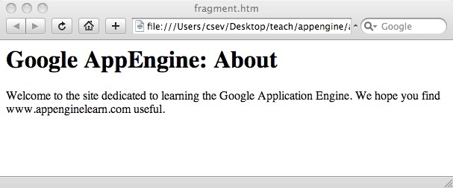
<h1>Google App Engine: About</h1>
<p>Welcome to the site dedicated to learning the Google Application Engine. We hope you find www.appenginelearn.com useful.</p>
Whitespace and line wrapping.

Slide 5
Tags have a beginning and end...
<h1>Google App Engine: About</h1>
<p>Welcome to the site dedicated to learning the Google Application Engine. We hope you find www.appenginelearn.com useful.</p>

Slide 6
HTML Tag Basics
Start tag
End tag
<h1>Hello World</h1>
Tags “mark up” the HTML document. The tags are read and interpreted by the browser - but now shown.
Attribute
<img src="x.gif" />
A self closing tag does not need a corresponding end tag.
Self-closing tag

Slide 7
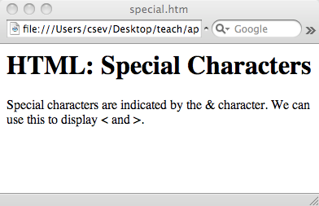
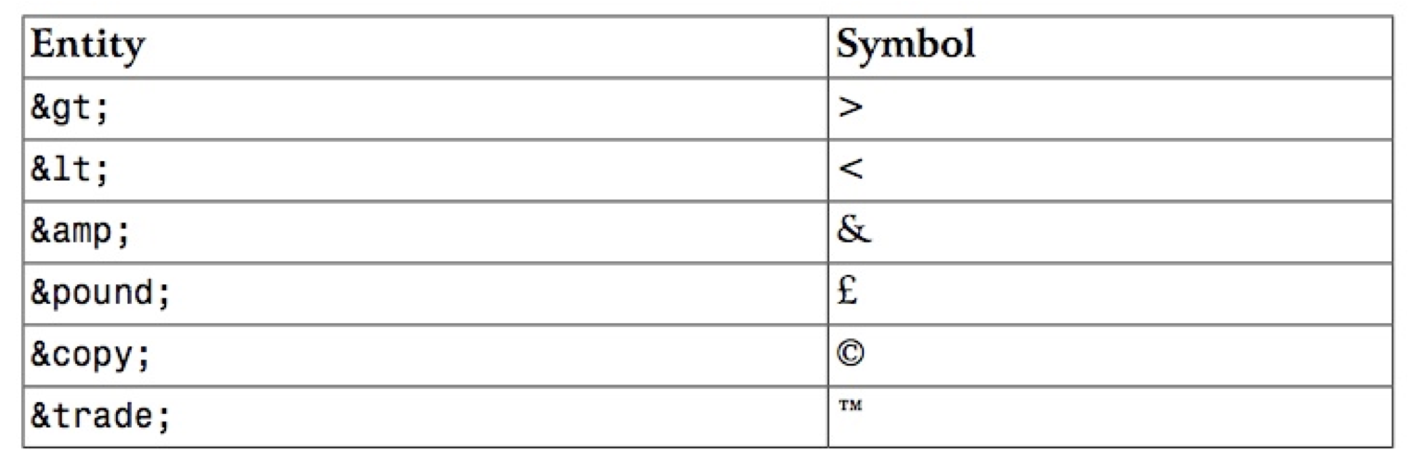
What about < ‘s in HTML?
<h1>HTML: Special Characters</h1>
<p>
Special characters are indicated by
the &amp; character. We can use this
to display &lt; and &gt;.
</p>

Slide 8
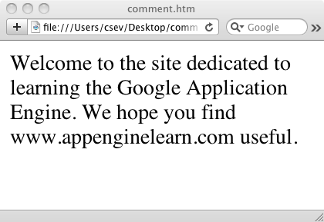
HTML Comments
<p>Welcome to the site
dedicated to learning the
<!-- Really
Awesome -->
Google Application Engine.
We hope you find
www.appenginelearn.com
useful.</p>

Slide 9
HTML Links
One of the key things about HTML is making a set of pages and making “hypertext” links amongst those pages
Links are what make the “web” a “web” - it is a web of interlinked documents.
The interlinked nature of the web leads to the “knowledge “ the search engines like Google appear to have "intelligence"

Slide 10
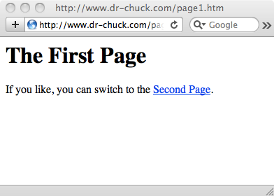
<h1>The First Page</h1>
<p>
If you like, you can switch to the
<a href="http://www.dr-chuck.com/page2.htm">
Second Page</a>.
</p>
A link is a “hot spot” on the page. It can be text or an image. Often it is visually marked to make it easier to “notice” so as to engouage users to click!
“a” is short for “anchor” and “href” is short for “hypertext reference”

Slide 11
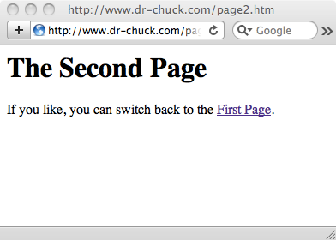
<h1>The Second Page</h1>
<p>
If you like, you can switch back to the
<a href="page1.htm">
First Page</a>.
</p>
A link is a “hot spot” on the page. It can be text or an image. Often it is visually marked to make it easier to “notice” so as to encourage users to click!
“a” is short for “anchor” and “href” is short for “hypertext reference”

Slide 12
Absolute Reference
<a href="http://www.dr-chuck.com/page2.htm">Second Page</a>
End
tag
Start
tag
Where to
go if clicked.
Clickable
Text
<a href="page1.htm">First Page</a>
Relative Reference

Slide 13
Absolute .vs. Relative
<a href="http://www.dr-chuck.com/page2.htm">Second Page</a>
Hypertext references can be a full URL - and refer to some other page on anywhere on the Internet.
<a href="page1.htm">First Page</a>
Or the reference can be a file name that is assumed to be in the same folder as the current document (relative reference).

Slide 14
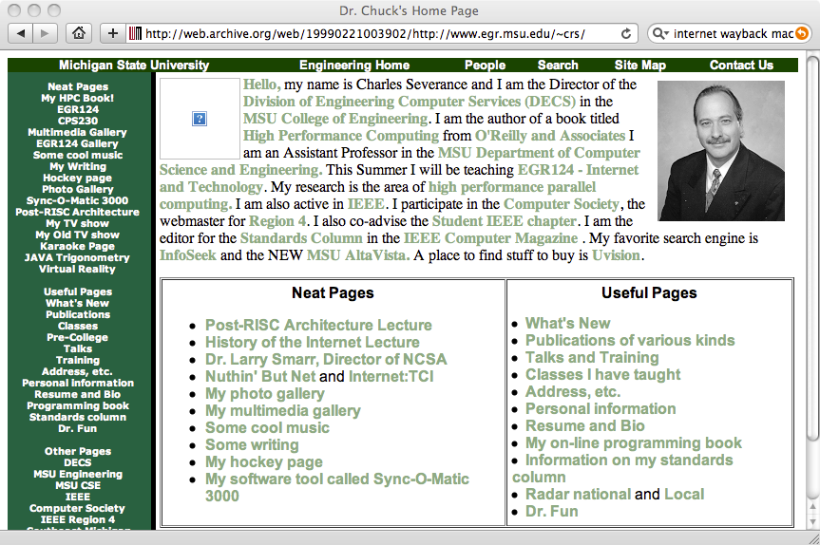
Images are fun!

Slide 15
Images
Which image to display - image file must be in the same folder as the HTML file.
Begin Tag
<img src="appengine.jpg"
width="142" height="109"
alt="Google App Engine Logo" />
Optional - makes display quicker. Will resize to fit.
End Tag
Show this when hovering, images are off, or for screen readers.
All information is communicated through the attributes of the img tag.
Begin Tag
Begin Tag

Slide 16
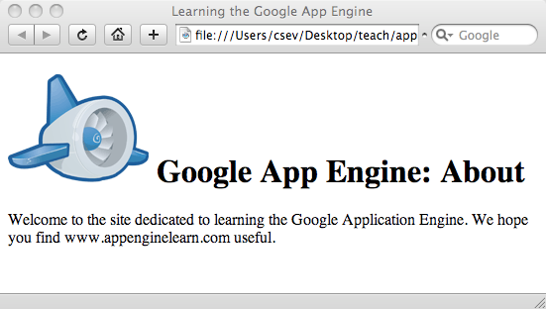
Images
<h1>
<img src="appengine.jpg" width="142" height="109"
alt="Google App Engine Logo" />
Google App Engine: About</h1>
<p>
Welcome to the site dedicated to
learning the Google Application Engine.
We hope you find
www.appenginelearn.com useful.
</p>

Slide 17
Wrapping text around images is Fun!

Slide 18
Images
Which image to display
Begin Tag
Optional - makes display quicker. Will resize to fit.
<img src="appengine.jpg"
width="142" height="109"
alt="Google App Engine Logo"
style="float:right" />
End Tag
Show this when hovering, images are off, or for screen readers.
Put the image on the right and wrap text around it.
All information is communicated through the attributes of the img tag.
Begin Tag
Begin Tag

Slide 19
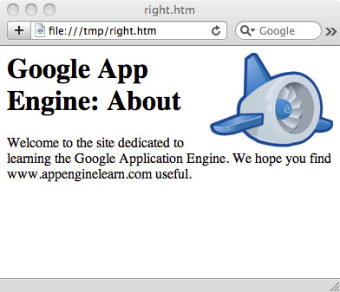
<h1>
<img src="appengine.jpg" width="142" height="109"
alt="Google App Engine Logo"
style="float:right"/>
Google App Engine: About</h1>
<p>
Welcome to the site dedicated to
learning the Google Application Engine.
We hope you find
www.appenginelearn.com useful.
</p>

Slide 20
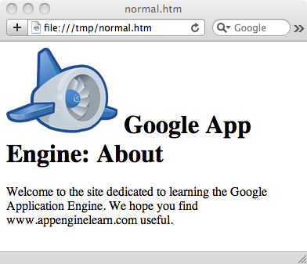
<h1>
<img src="appengine.jpg" width="142" height="109"
alt="Google App Engine Logo"
style="float:right"/>
Google App Engine: About</h1>
<p>
Welcome to the site dedicated to
learning the Google Application Engine.
We hope you find www.appenginelearn.com useful.
</p>
<h1>
<img src="appengine.jpg" width="142" height="109"
alt="Google App Engine Logo" />
Google App Engine: About</h1>
<p>
Welcome to the site dedicated to
learning the Google Application Engine.
We hope you find www.appenginelearn.com useful.
</p>

Slide 21
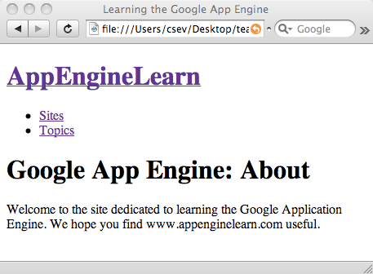
A List ...
<h1><a href="index.htm">AppEngineLearn</a></h1>
<ul>
<li><a href="sites.htm">Sites</a></li>
<li><a href="topics.htm" >Topics</a></li>
</ul>
<h1>Google App Engine: About</h1>
<p>
Welcome to the site dedicated to
learning the Google Application Engine.
We hope you find www.appenginelearn.com
useful.
</p>
Bulleted List

Slide 22
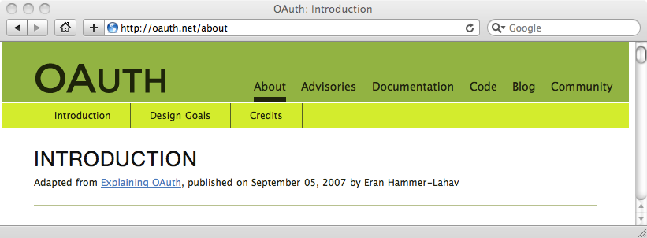
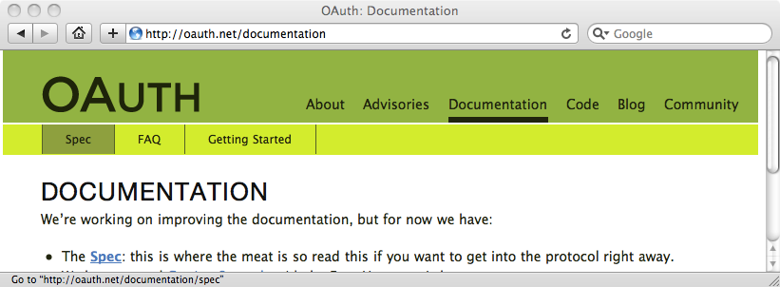
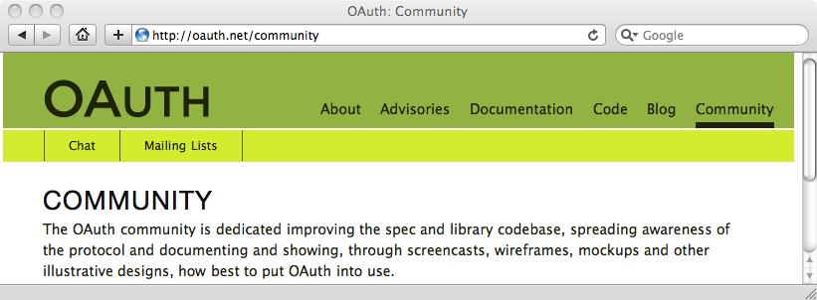
Links as Navigation
Sometimes we want to make a menu that provides our users consistent navigation across page.

Slide 23
A List of Links...
<h1><a href="index.htm">AppEngineLearn</a></h1>
<ul>
<li><a href="sites.htm">Sites</a></li>
<li><a href="topics.htm" >Topics</a></li>
</ul>
<h1>Google App Engine: About</h1>
<p>
Welcome ...
Links
http://www.appenginelearn.com/html/nostyle/index.htm

Slide 24
Multiple Files
We can put multiple files in the same directory and then use them in relative links.
csev$ ls -l
-rw-r--r-- 1 csev staff 618 Dec 18 22:56 index.htm
-rw-r--r-- 1 csev staff 883 Dec 18 22:57 sites.htm
-rw-r--r-- 1 csev staff 679 Dec 18 22:57 topics.htm
csev$
http://www.appenginelearn.com/html/nostyle/index.htm

Slide 25
<h1><a href="index.htm">AppEngineLearn</a></h1>
<ul>
<li><a href="sites.htm">Sites</a></li>
<li><a href="topics.htm" >Topics</a></li>
</ul>
csev$ ls -l
-rw-r--r-- 1 csev staff 618 Dec 18 22:56 index.htm
-rw-r--r-- 1 csev staff 883 Dec 18 22:57 sites.htm
-rw-r--r-- 1 csev staff 679 Dec 18 22:57 topics.htm
csev$
Navigation
http://www.appenginelearn.com/html/nostyle/index.htm

Slide 26
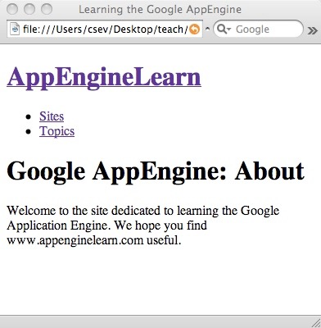
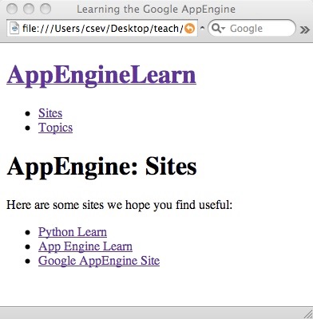
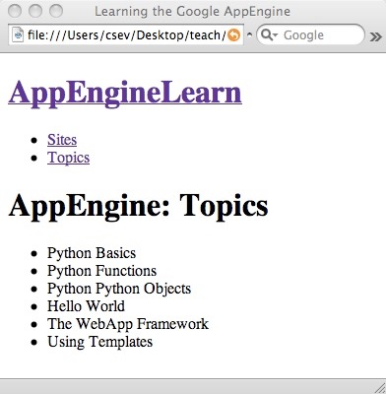
We create the appearance of a fixed “menu” by including the navigation at the same place in each page.
csev$ ls -l
-rw-r--r-- 1 csev staff 618 Dec 18 22:56 index.htm
-rw-r--r-- 1 csev staff 883 Dec 18 22:57 sites.htm
-rw-r--r-- 1 csev staff 679 Dec 18 22:57 topics.htm
csev$

Slide 27
Structure of an HTML Document
<!DOCTYPE >
<html>
<head>
meta-data....
</head>
<body>
Page content....
</body>
</html>
Contract about the HTML style used the page.
Metadata about the page.
Displayable content of the page.

Slide 28
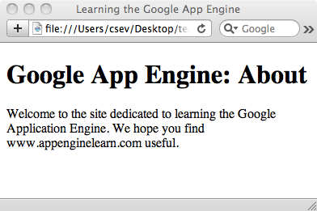
A Simple but Modern Page
<!DOCTYPE HTML PUBLIC "-//W3C//DTD HTML 4.01//EN"
"http://www.w3.org/TR/html4/strict.dtd">
<html>
<head>
<title>Learning the Google App Engine</title>
</head>
<body>
<h1>Google App Engine: About</h1>
<p>
Welcome to the site dedicated to
learning the Google Application Engine.
We hope you find www.appenginelearn.com useful.
</p>
</body>
</html>

Slide 29
Special File Names
When a URL points to a directory in your web server, it looks for a file with a special name:
  index.html, index.htm, index.php, etc..
While there is a convention, the “default file” is configurable - so nothing is “sure”
Usually index.htm or index.html is a safe bet
This only works when viewing through a web server - when viewing from disk, you must view the file.

Slide 30
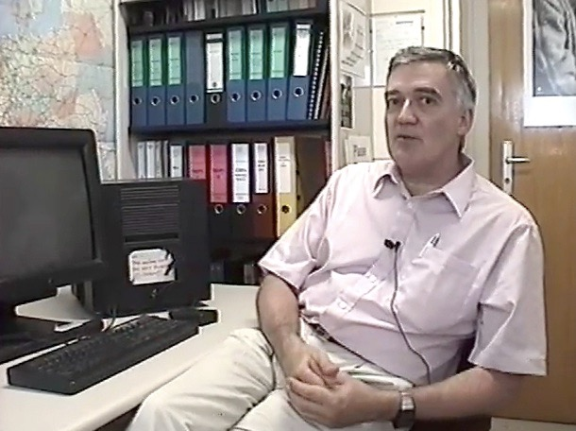
The Web is a Young Technology
Invented in early 1990’s
Popular in 1994
Robert Cailliau - coFounder of the World-Wide-Web
http://www.dr-chuck.com/media.php?id=70

Slide 31
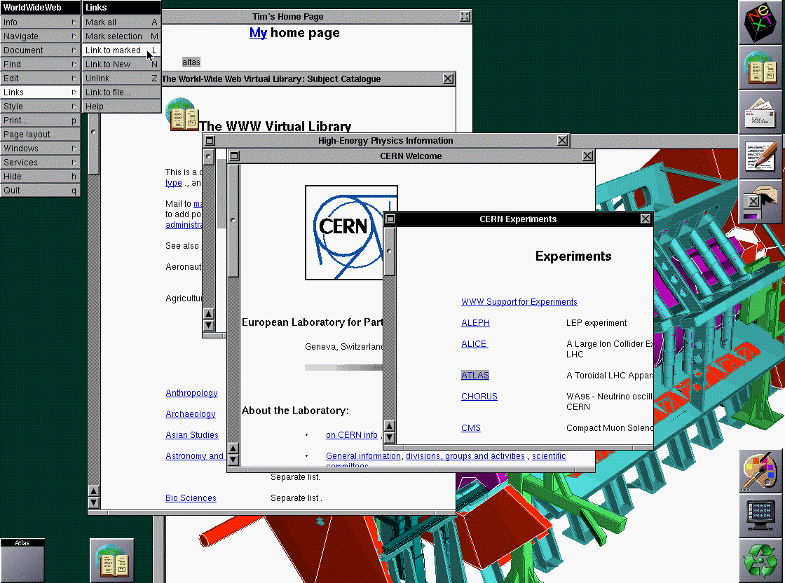
http://www.w3.org/History/1994/WWW/Journals/CACM/screensnap2_24c.gif

Slide 32
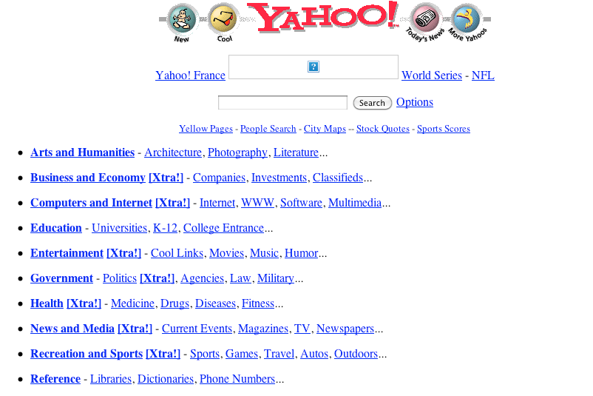
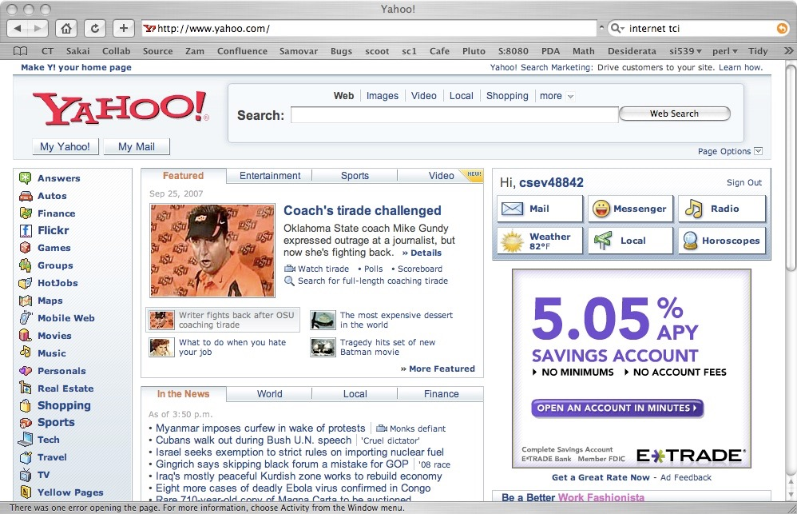
HTML has evolved a *lot* over the years - as computers and networks have gotten faster.
1996
http://replay.waybackmachine.org/19961022175643/http://www10.yahoo.com/
2007

Slide 33


HTML has evolved a *lot* over the years - as computers and networks have gotten faster.
1996
2010
http://web.archive.org/web/19961219003000/http://www.umich.edu/

Slide 34
An Iterative Engineering Process
Designers want to do something
They figure out how to do it with current generation browsers
We figure out requirements - but HMTL gets uglier and quirkier - then the HTML starts to break
We develop new standards that handle new requirements in an elegant manner
New Browsers arrive in the marketplace with the new standard

Slide 35
The Good Old Days
In the good old days you wrote HTML and browsers displayed it - since we wrote it by hand - and modems were slow - it was never too long and never too complex. The browser was never the rate limiting factor.
Writing HTML was like using a simple, weak word processor. The tags acted as formatting commands to the browser.
<H1>Hello World</H1>
Hi there.
<p><img src=x.gif>
A Paragraph
<ul>
<li>List one
<li>List 2
</ul>

Slide 36
Following the Rules
Tags must be lower-case
Attributes must be enclosed in quotes
Tags must be closed
<h1>Hello World</h1>
Hi there.
<p><img src="x.gif"/>
A Paragraph </p>
<ul>
<li>List one</li>
<li>List 2</li>
</ul>

Slide 37

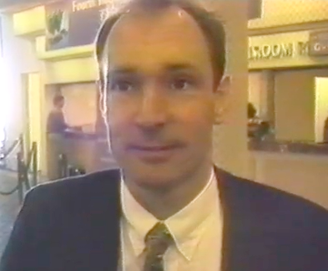
World-Wide-Web Consortium
Formed by Tim Berners-Lee of MIT (formerly CERN)
Founded to develop standards around HTML, CSS, XML, etc
Insure that the web was based on open standards rather than proprietary vendor products - a bit like cat herding
http://www.w3.org/Consortium/facts

Slide 38
Summary
HTML has gone through many changes and evolutions
  It started clean and simple - then got ugly and nasty - now we are back to a clean and simple approach
A key to modern/clean HTML is that formatting is handled using CSS - Cascading Style Sheets

Slide 39
Acknowledgements / Contributions
These slides are Copyright 2010- Charles R. Severance (www.dr-chuck.com) as part of www.wa4e.com and made available under a Creative Commons Attribution 4.0 License. Please maintain this last slide in all copies of the document to comply with the attribution requirements of the license. If you make a change, feel free to add your name and organization to the list of contributors on this page as you republish the materials.
Initial Development: Charles Severance, University of Michigan School of Information
Insert new Contributors and Translators here including names and dates
Continue new Contributors and Translators here
Notes:
Note from Chuck. Please retain and maintain this page as you remix and republish these materials. Please add any of your own improvements or contributions.

