Slide 1

Making our HTML Look Nicer
Cascading Style Sheets
Dr. Charles Severance
www.wa4e.com
Notes:
Note from Chuck. If you are using these materials, you can remove my name and URL from this replace it with your own, but please retain the CC-BY logo on the first page as well as retain the entire last page when you remix and republish these slides.

Slide 2
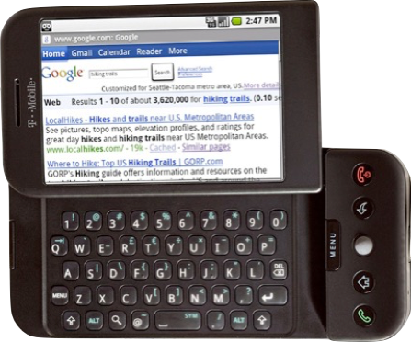


Internet
HTTP
Request
Python
HTML
JavaScript
Response
GET
Data Store
AJAX
Templates
memcache
CSS
POST

Slide 3
CSS Already?
Back in the ancient days (i.e. before 2007) we got used to thinking that CSS was “advanced HTML” and that it was “difficult”
With modern browsers, we should never bother with the old ways to change font, color, alignment, etc etc.
CSS - Just Do It!

Slide 4
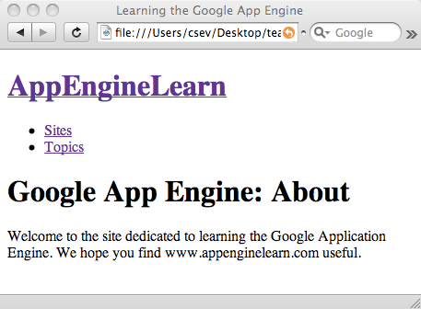
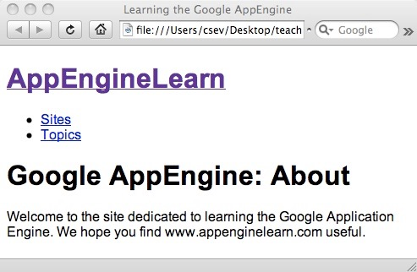
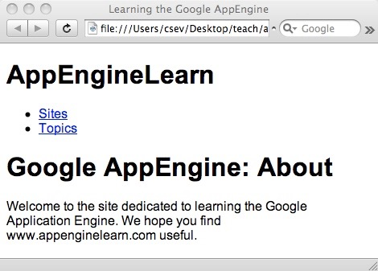
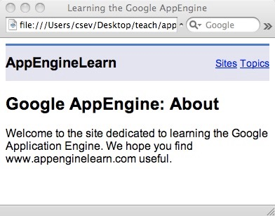
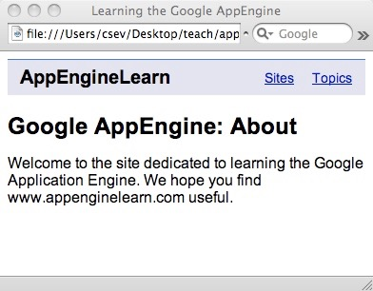
http://www.appenginelearn.com/html/nostyle/index.htm
From Simple to Advanced CSS with no changes to the HTML
http://www.appenginelearn.com/html/block4/index.htm

Slide 5

The big picture...
<!DOCTYPE html PUBLIC "-//W3C//DTD XHTML 1.0 Strict//EN" "http://www.w3.org/TR/xhtml1/DTD/xhtml1-strict.dtd">
<html xmlns="http://www.w3.org/1999/xhtml" xml:lang="en">
<head>
<title>University of Michigan</title>
....
@import "/CSS/graphical.css"/**/;
p.text strong, .verbose, .verbose p, .verbose h2{text-indent:-876em;position:absolute}
p.text strong a{text-decoration:none}
p.text em{font-weight:bold;font-style:normal}
div.alert{background:#eee;border:1px solid red;padding:.5em;margin:0 25%}
a img{border:none}
.hot br, .quick br, dl.feature2 img{display:none}
div#main label, legend{font-weight:bold}
In the modern era of web design we represent content and meaning in HTML an formatting and layout in CSS.

Slide 6
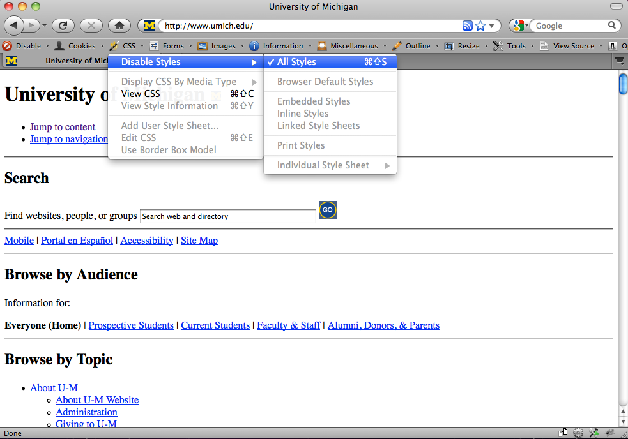
http://chrispederick.com/work/web-developer/

Slide 7
Separation of concerns / specialization
Developer
Designer
<!DOCTYPE html PUBLIC "-//W3C//DTD XHTML 1.0 Strict//EN" "http://www.w3.org/TR/xhtml1/DTD/xhtml1-strict.dtd">
<html xmlns="http://www.w3.org/1999/xhtml" xml:lang="en">
<head>
<title>University of Michigan</title>
....
@import "/CSS/graphical.css"/**/;
p.text strong, .verbose, .verbose p, .verbose h2{text-indent:-876em;position:absolute}
p.text strong a{text-decoration:none}
p.text em{font-weight:bold;font-style:normal}
div.alert{background:#eee;border:1px solid
...
Everyone needs to know some HTML and some CSS and some programming - but to be truly skilled at a professional level requires deep understanding and specialization.

Slide 8
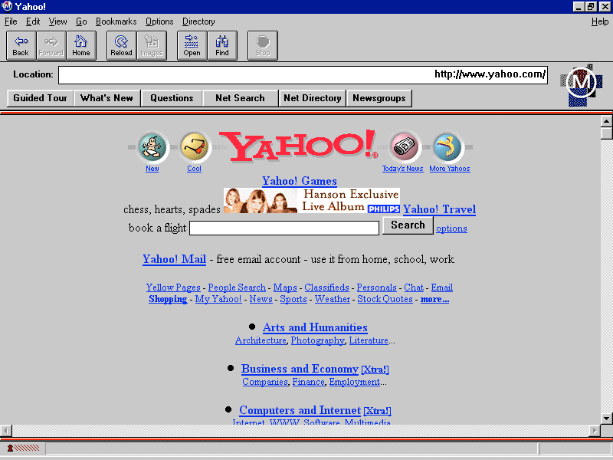
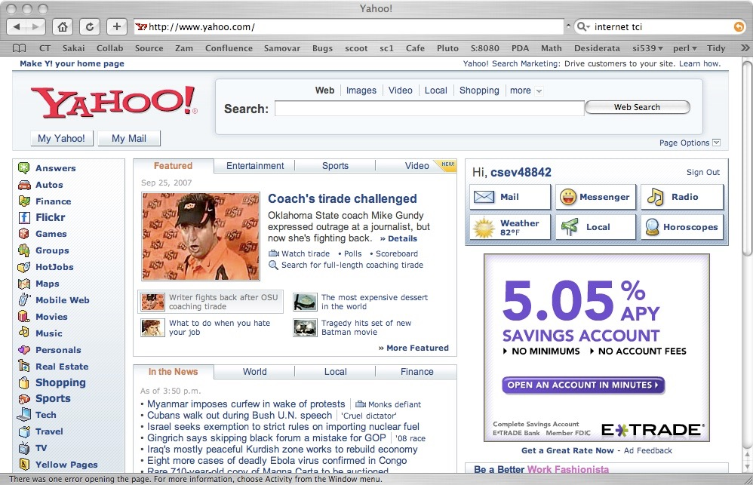
HTML has evolved a *lot* over the years - as computers and networks have gotten faster.
1995
2007

Slide 9
CSS Syntax
CSS Syntax is very different than HTML
CSS is a set of “rules” which in include a “selector” and one or more “properties” and “values” as well as some punctuation...
body {
font-family: arial, sans-serif;
}

Slide 10
Anatomy of a CSS Rule
selector - which part of the document does this rule apply to
body {
font-family: arial, sans-serif;
font-size: 100%;
}
property - which aspect of CSS are we changing
value - What are we setting the property to.

Slide 11
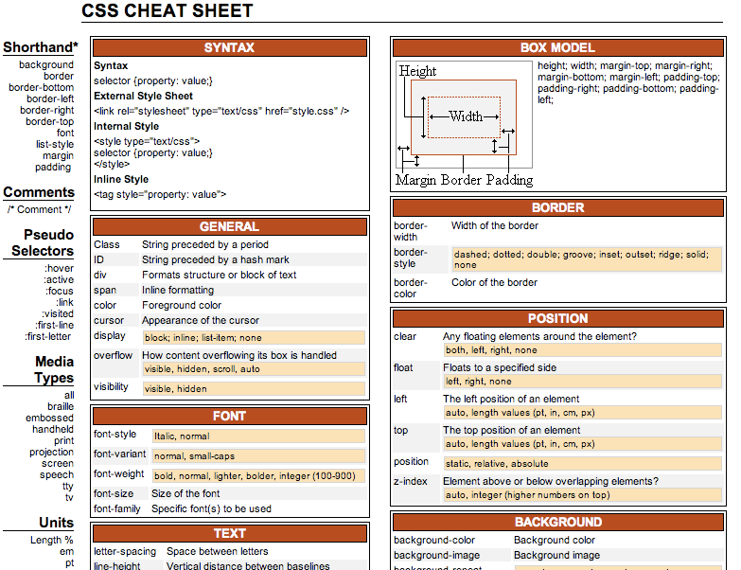
http://www.lesliefranke.com/files/reference/csscheatsheet.html

Slide 12
Partial List of CSS Properties
text-decoration
border-width
border-style
border-color
margin
border
padding
float (left, right, none)
left / top
position (static, relative, absolute)
z-index
color
background-color
visibility (visible/hidden)
font-family (arial, sans-serif)
font-size
font-style (italic, normal)
font-weight (bold, normal)
text-align
vertical-align
text-transform (lowercase, etc)
http://www.lesliefranke.com/files/reference/csscheatsheet.html

Slide 13
Applying CSS to our HTML
Inline - right on an HTML tag - using the style= attribute
An embedded style sheet in the <head> of the document
As external style sheet in a separate file

Slide 14
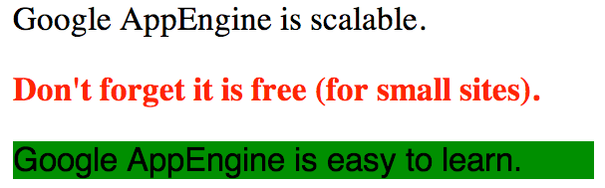
Inline Styles
<p>Google AppEngine is scalable.</p>
<p style="color: red; font-weight: bold;">
Don't forget it is free (for small sites).</p>
<p style="font-family: sans-serif;
background-color: green">
Google AppEngine is easy to learn.</p>
We add a style= attribute to a tag. We can have one or more properties and values. The styling applies for the scope of the tag.

Slide 15
<head>
<title>Learning the Google App Engine</title>
<style type="text/css">
body {
font-family: arial, sans-serif;
}
</style>
</head>
<body>
<h1><a href="index.htm">
AppEngineLearn</a></h1>
.....
</body>
The selector in the CSS rule indicates where in the displayed content is to be “styled” according to the properties.
http://www.appenginelearn.com/html/style1/index.htm

Slide 16
External Style Sheet
Preferred because it allows easy switching of style across many files.
On larger teams, it also allows separation of concerns between the developer (HTML) and designer (CSS)

Slide 17
<head>
<title>Learning the Google App Engine</title>
<link type="text/css" rel="stylesheet" href="glike.css">
</head>
<body>
....
csev $ ls -l
total 32
-rw-r--r-- 1 csev staff 44 Dec 19 06:06 glike.css
-rw-r--r-- 1 csev staff 679 Dec 19 06:07 index.htm
-rw-r--r-- 1 csev staff 883 Dec 19 05:59 sites.htm
-rw-r--r-- 1 csev staff 679 Dec 19 05:59 topics.htm
csev $

Slide 18
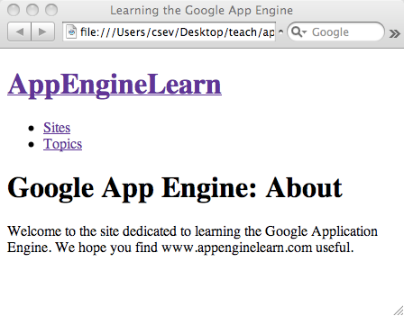
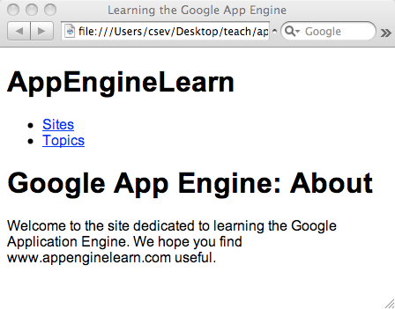
First: Just work with the tags and fix fonts / colors
http://www.appenginelearn.com/html/nostyle/index.htm
http://www.appenginelearn.com/html/style1/index.htm

Slide 19
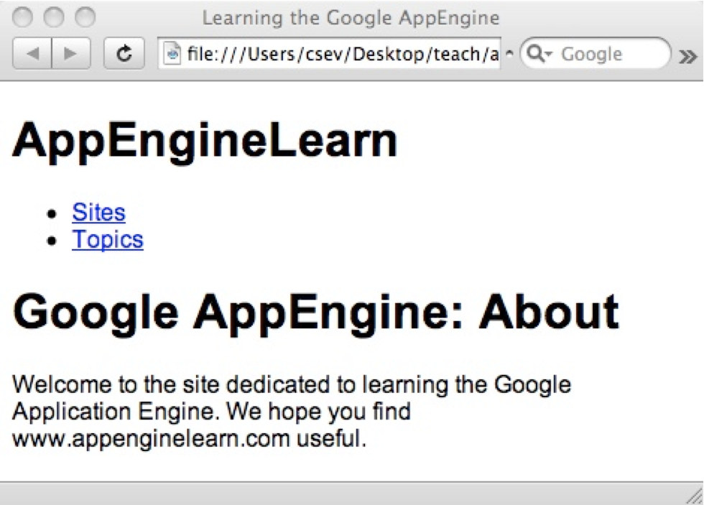
<head>
<title>Learning the Google App Engine</title>
<link type="text/css" rel="stylesheet" href="glike.css">
</head>
<body>
....
body {
font-family: arial, sans-serif;
}
a {
color: blue;
}
h1 a {
text-decoration: none;
color: black;
}

Slide 20
<head>
<title>Learning the Google App Engine</title>
<link type="text/css" rel="stylesheet" href="glike.css">
</head>
<body>
<h1><a href="index.htm">
AppEngineLearn</a></h1>
<ul>
<li><a href="sites.htm">Sites</a></li>
<li><a href="topics.htm" >Topics</a></li>
</ul>
<h1>Google App Engine: About</h1>
a {
color: blue;
}
Select all “a” tags in the document.

Slide 21
<head>
<title>Learning the Google App Engine</title>
<link type="text/css" rel="stylesheet" href="glike.css">
</head>
<body>
<h1><a href="index.htm">
AppEngineLearn</a></h1>
<ul>
<li><a href="sites.htm">Sites</a></li>
<li><a href="topics.htm" >Topics</a></li>
</ul>
<h1>Google App Engine: About</h1>
h1 a {
text-decoration: none;
color: black;
}
Select tags where “a” is inside “h1”.

Slide 22
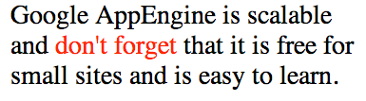
The “marking only tag” <span>
<p>Google AppEngine is scalable
and <span style="color: red">don't
forget</span> that it is free
for small sites and is easy to learn.</p>
Span does not break word wrapping - it simply allows us to apply styling to a segment of text within a paragraph.

Slide 23
Making Some Tags Special
<head>
<style type="text/css">
.abc {
color: red;
}
</style>
</head>
<body>
<p class="abc">First paragraph</p>
<p class="def">Second Paragraph</p>
<p>Third <a href="http://www.cnn.com">linky</a> paragraph</p>
<p>Fourth <a class="abc" href="http://www.cnn.com">linky</a> paragraph</p>
</body>
We can use the class= to mark tags and then apply styling specifically to those tags.
We style these sections by writing a rule which starts with a period followed by the name of the class

Slide 24
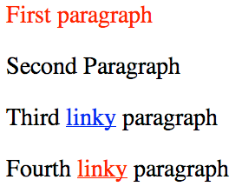
Making Some Tags Special
<head>
<style type="text/css">
.abc {
color: red;
}
</style>
</head>
<body>
<p class="abc">First paragraph</p>
<p class="def">Second Paragraph</p>
<p>Third <a href="http://www.cnn.com">linky</a> paragraph</p>
<p>Fourth <a class="abc" href="http://www.cnn.com">linky</a> paragraph</p>
</body>

Slide 25
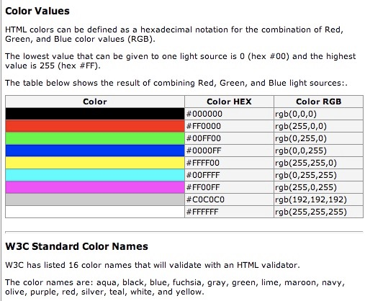
Color Names
W3C has listed 16 color names that will validate with an HTML validator.
The color names are: aqua, black, blue, fuchsia, gray, green, lime, maroon, navy, olive, purple, red, silver, teal, white, and yellow.
http://www.w3schools.com/html/html_colors.asp

Slide 26
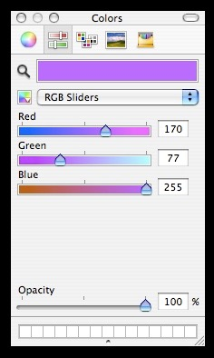
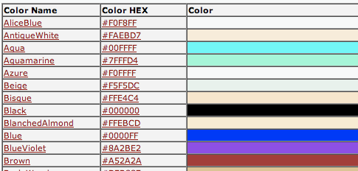
Advanced Colors...
Three Numbers, Red, Green , and Blue - each from 00 - FF (Hexidecimal)
#e2edff
#ffffff = white
#000000 = black
#ff0000 = red
#00ff00 = green
#0000ff = blue
Web-safe
colors
http://www.w3schools.com/css/css_colornames.asp

Slide 27
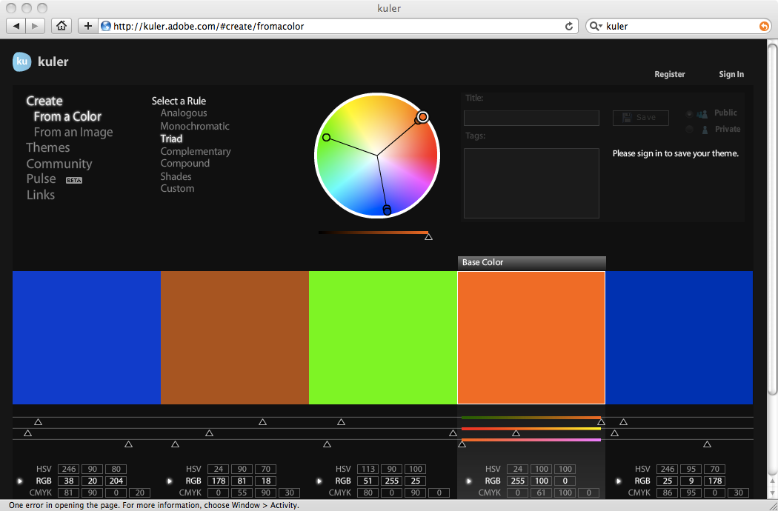

Slide 28

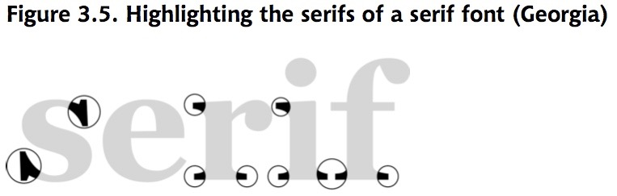
Fonts
Default fonts are ugly and they have Serifs - which make them harder to read on a screen
So the first thing I usually want to do is override the font in my document
And I want to do this everywhere.

Slide 29
Fonts
Most Favourite
Least Favourite
body {
font-family: "Trebuchet MS", Helvetica, Arial, sans-serif;
font-size: x-large;
}
Fallback fonts: serif, sans-serif, monospace, cursive and fantasy.

Slide 30
Font Factors
font-size:
xx-small
x-small
small
medium
large
x-large
xx-large
14px
font-weight: bold or normal
font-style: normal or italic
text-decoration: none, underline, overline, or line-through

Slide 31

Styling for Links
Post-Click:
Downright Ugly!

Slide 32
Styling Links
a {
font-weight: bold;
}
a:link {
color: black;
}
a:visited {
color: gray;
}
a:hover {
text-decoration: none;
color: white;
background-color: navy;
}
a:active {
color: aqua;
background-color: navy;
}
link - before a visit
visited - after it has been visited
hover - when your mouse is over it but you have not clicked
active - you have clicked it and you have not yet see the new page
Browser default styling for links is downright ugly!

Slide 33
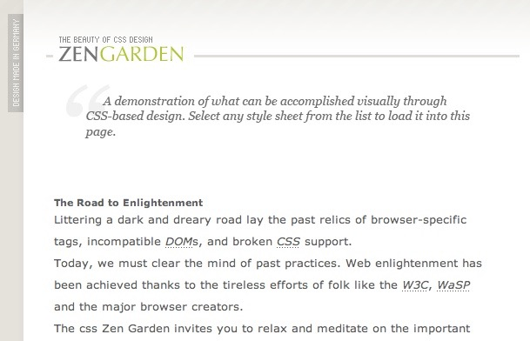

Zen Garden
A social site where CSS designers show their “stuff”
The HTML never changes - only the CSS
Inspiration for us designers
http://www.csszengarden.com/

Slide 34
CSS Summary
CSS Layout is its own art and science
CSS Basics are well established and well supported in all modern browsers
Site layout and markup is further evolving - mostly to make it increasingly possible to support desktop like experiences on the web.
These innovations will naturally cause incompatibilities - which make things interesting and frustrating at times.

Slide 35
Acknowledgements / Contributions
These slides are Copyright 2010- Charles R. Severance (www.dr-chuck.com) as part of www.wa4e.com and made available under a Creative Commons Attribution 4.0 License. Please maintain this last slide in all copies of the document to comply with the attribution requirements of the license. If you make a change, feel free to add your name and organization to the list of contributors on this page as you republish the materials.
Initial Development: Charles Severance, University of Michigan School of Information
Insert new Contributors and Translators here including names and dates
Continue new Contributors and Translators here
Notes:
Note from Chuck. Please retain and maintain this page as you remix and republish these materials. Please add any of your own improvements or contributions.

