Slide 1

Redirect, Routing, and Authentication
Dr. Charles Severance
www.wa4e.com
http://www.wa4e.com/code/route.zip
Notes:
Add cookie-less sessions...

Slide 2


Time
Browser
Web Server
Database Server
DOM
MySql
Send
Request
Apache
Parse
Response
PHP
sessfun.php
JavaScript
PDO
RRC/HTTP
SQL

Slide 3
HTTP Status Codes
http://www.dr-chuck.com/page1.htm - 200 OK
http://www.wa4e.com/nowhere.htm - 404 Not Found
http://www.drchuck.com/ - 302 Found / Moved
  Also known as “redirect”
https://en.wikipedia.org/wiki/List_of_HTTP_status_codes

Slide 4
HTTP Location Header
If your application has not yet sent any data, it can send a special header as part of the HTTP Response.
The redirect header includes a URL that the browser is supposed to forward itself to.
It was originally used for web sites that moved from one URL to another.
http://en.wikipedia.org/wiki/URL_redirection

Slide 5
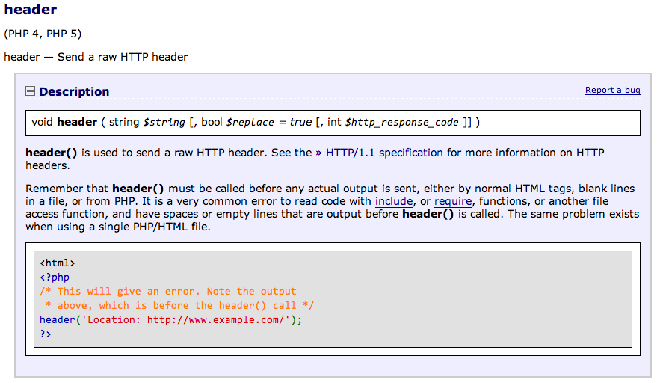
<= Error
http://php.net/manual/en/function.header.php

Slide 6
<?php
session_start();
if ( isset($_POST['where']) ) {
if ( $_POST['where'] == '1' ) {
header("Location: redir1.php");
return;
} else if ( $_POST['where'] == '2' ) {
header("Location: redir2.php?parm=123");
return;
} else {
header("Location: http://www.dr-chuck.com");
return;
}
}
?>
<html>
<body style="font-family: sans-serif;">
<p>I am Router Two...</p>
<form method="post">
<p><label for="inp9">Where to go? (1-3)</label>
<input type="text" name="where" id="inp9" size="5"></p>
<input type="submit"/></form>
</body>
http://www.wa4e.com/code/route/redir1.php

Slide 7
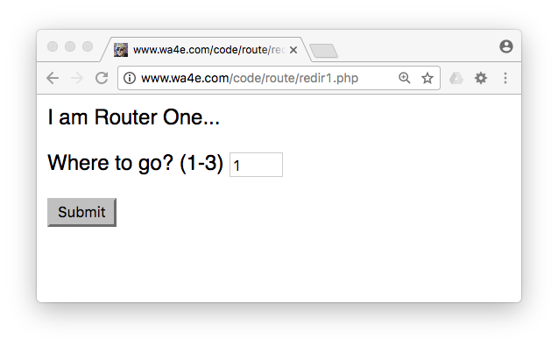



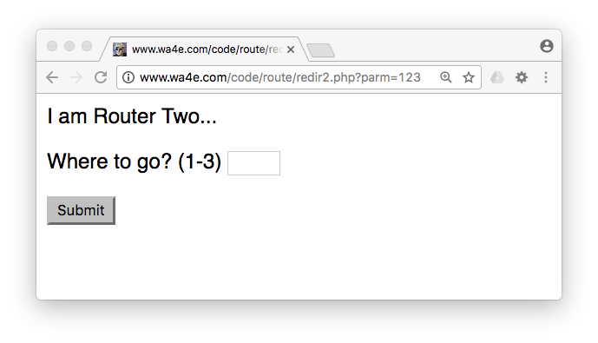
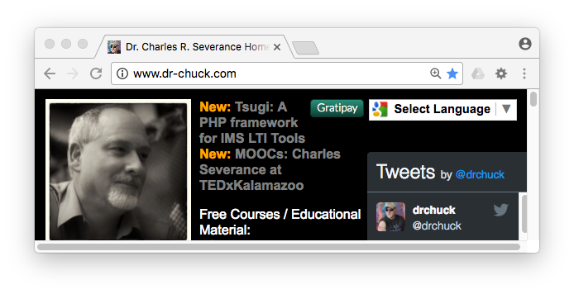

Slide 8
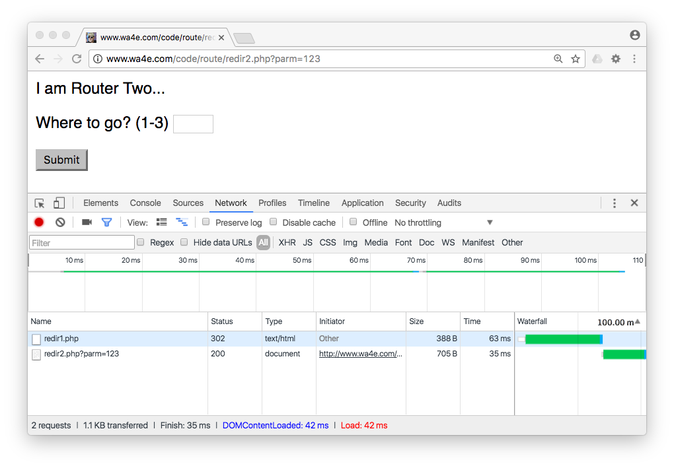
After we entered "2" and pressed "Submit"
Two pages were retrieved

Slide 9
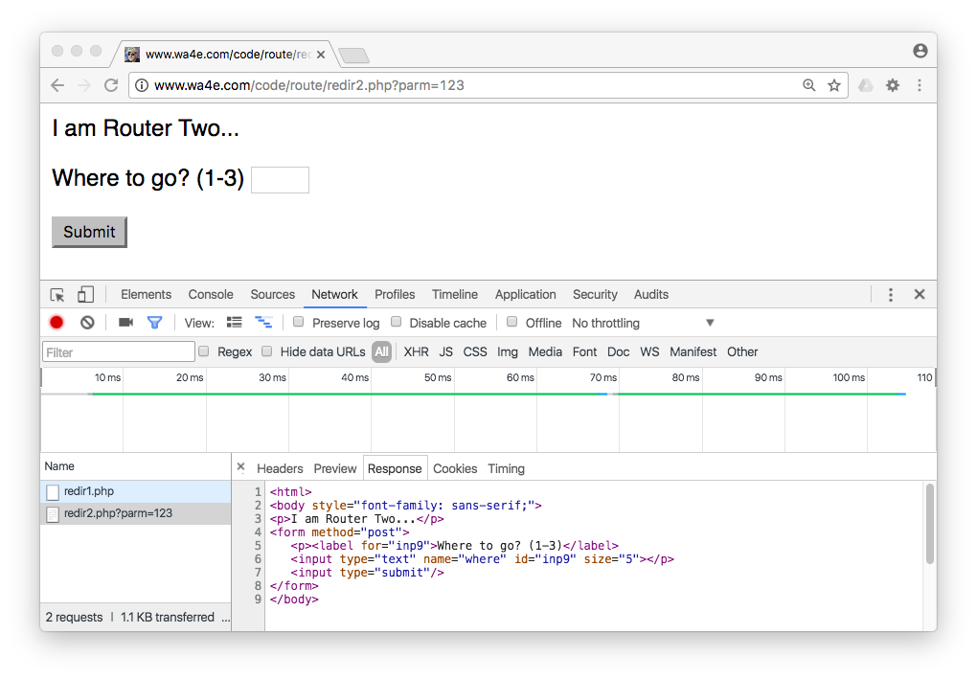
Second page

Slide 10
POST / Redirect / GET

Slide 11
POST / Refresh / ☹
Once you do a POST, if you refresh, the browser will re-send the POST data a second time.
The user gets a pop-up that tries to explain what is about to happen.

Slide 12
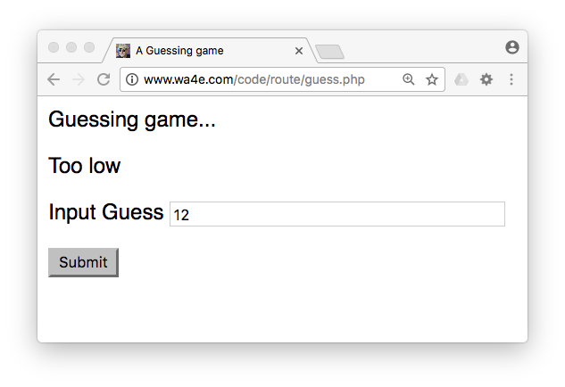
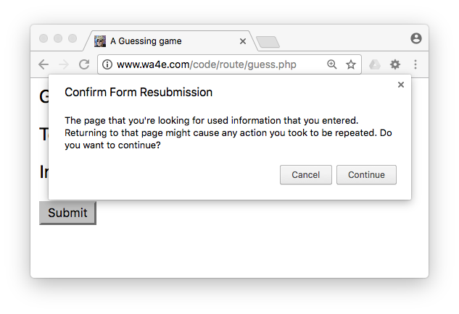
Press Submit then Refresh
guess.php

Slide 13
No Double Posts
Typically POST requests are adding or modifying data whilst GET requests view data
It may be dangerous to do the same POST twice (say withdrawing funds from a bank account)
So the browser insists on asking the user (out of your control)
Kind of an ugly UX / bad usability

Slide 14
POST Redirect Rule
The simple rule for pages intended for a browser is to never generate a page with HTML content when the app receives POST data
Must redirect somewhere - even to the same script - forcing the browser to make a GET after the POST

Slide 15
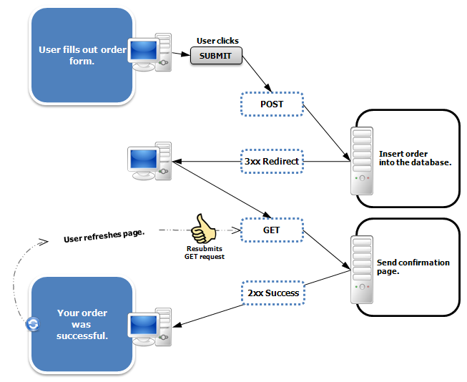
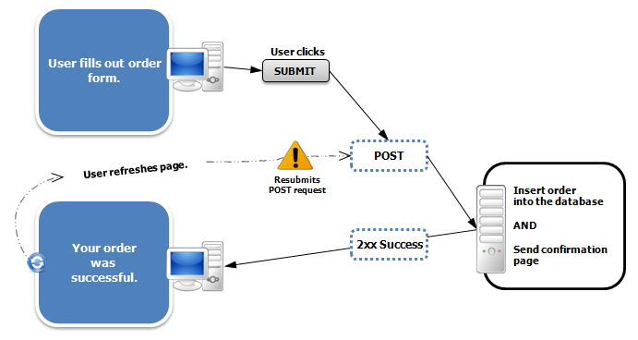
https://en.wikipedia.org/wiki/Post/Redirect/Get

Slide 16
<?php
$guess = '';
$message = false;
if ( isset($_POST['guess']) ) {
// Trick for integer / numeric parameters
$guess = $_POST['guess'] + 0;
if ( $guess == 42 ) {
$message = "Great job!";
} else if ( $guess < 42 ) {
$message = "Too low";
} else {
$message = "Too high...";
}
}
?>
<html>
<head>
<title>A Guessing game</title>
</head>
<body style="font-family: sans-serif;">
<p>Guessing game...</p>
<?php
if ( $message !== false ) {
echo("<p>$message</p>\n");
}
?>
<form method="post">
<p><label for="guess">Input Guess</label>
<input type="text" name="guess" id="guess" size="40"
<?php echo 'value="' . htmlentities($guess) . '"';
?>
/></p>
<input type="submit"/>
</form>
</body>
(Review)
http://www.wa4e.com/code/sessions/guess.php

Slide 17
<?php
$guess = '';
$message = false;
if ( isset($_POST['guess']) ) {
// Trick for integer / numeric parameters
$guess = $_POST['guess'] + 0;
if ( $guess == 42 ) {
$message = "Great job!";
} else if ( $guess < 42 ) {
$message = "Too low";
} else {
$message = "Too high...";
}
}
?>
<html>
<head>
<title>A Guessing game</title>
</head>
<body style="font-family: sans-serif;">
<p>Guessing game...</p>
<?php
if ( $message !== false ) {
echo("<p>$message</p>\n");
}
?>
<form method="post">
<p><label for="guess">Input Guess</label>
<input type="text" name="guess" id="guess" size="40"
<?php echo 'value="' . htmlentities($guess) . '"';
?>
/></p>
<input type="submit"/>
</form>
</body>
<?php
$guess = '';
$message = false;
if ( isset($_POST['guess']) ) {
// Nifty trick
$guess = $_POST['guess'] + 0;
if ( $guess == 42 ) {
$message = "Great job!";
} else if ( $guess < 42 ) {
$message = "Too low";
} else {
$message = "Too high...";
}
}
?>
<html> ...
(Review)

Slide 18
<?php
$guess = '';
$message = false;
if ( isset($_POST['guess']) ) {
// Trick for integer / numeric parameters
$guess = $_POST['guess'] + 0;
if ( $guess == 42 ) {
$message = "Great job!";
} else if ( $guess < 42 ) {
$message = "Too low";
} else {
$message = "Too high...";
}
}
?>
<html>
<head>
<title>A Guessing game</title>
</head>
<body style="font-family: sans-serif;">
<p>Guessing game...</p>
<?php
if ( $message !== false ) {
echo("<p>$message</p>\n");
}
?>
<form method="post">
<p><label for="guess">Input Guess</label>
<input type="text" name="guess" id="guess" size="40"
<?php echo 'value="' . htmlentities($guess) . '"';
?>
/></p>
<input type="submit"/>
</form>
</body>
...
?>
<html>
<head>
<title>A Guessing game</title>
</head>
<body style="font-family: sans-serif;">
<p>Guessing game...</p>
<?php if ( $message !== false ) {
echo("<p>$message</p>\n");
}
?>
<form method="post">
<p><label for="guess">Input Guess</label>
<input type="text" name="guess" id="guess" size="40" <?php echo 'value="' . htmlentities($guess) . '"';
?>
/></p>
<input type="submit"/>
</form>
</body>
(Review)

Slide 19
<?php
session_start();
if ( isset($_POST['guess']) ) {
$guess = $_POST['guess'] + 0;
$_SESSION['guess'] = $guess;
if ( $guess == 42 ) {
$_SESSION['message'] = "Great job!";
} else if ( $guess < 42 ) {
$_SESSION['message'] = "Too low";
} else {
$_SESSION['message'] = "Too high...";
}
header("Location: guess2.php");
return;
}
?>
<html>
(Improved)
http://www.wa4e.com/code/sessions/guess2.php

Slide 20
<html>
<head>
<title>A Guessing game</title>
</head>
<body style="font-family: sans-serif;">
<?php
$guess = isset($_SESSION['guess']) ? $_SESSION['guess'] : '';
$message = isset($_SESSION['message']) ? $_SESSION['message'] : false;
?>
<p>Guessing game...</p>
<?php
if ( $message !== false ) {
echo("<p>$message</p>\n");
}
?>
<form method="post">
<p><label for="guess">Input Guess</label>
<input type="text" name="guess" id="guess" size="40"
<?php echo 'value="' . htmlentities($guess) . '"';?>
/></p>
<input type="submit"/>
</form>
</body>
guess2.php

Slide 21
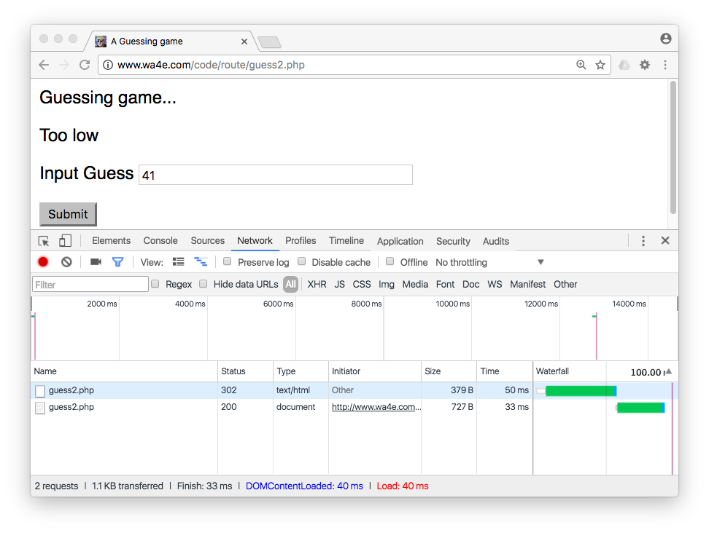
Enter "41" and press "Submit"

Slide 22
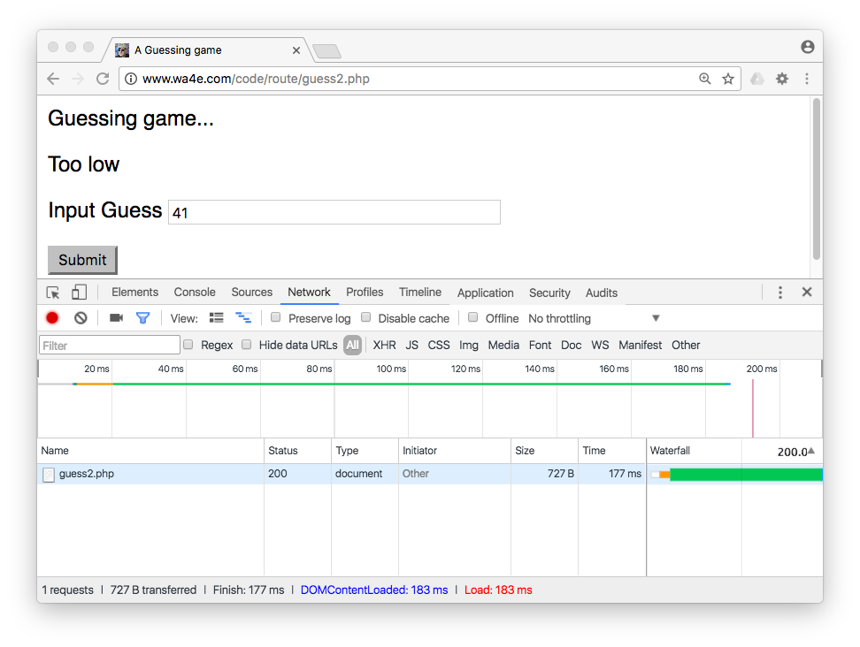
Press "Refresh"

Slide 23
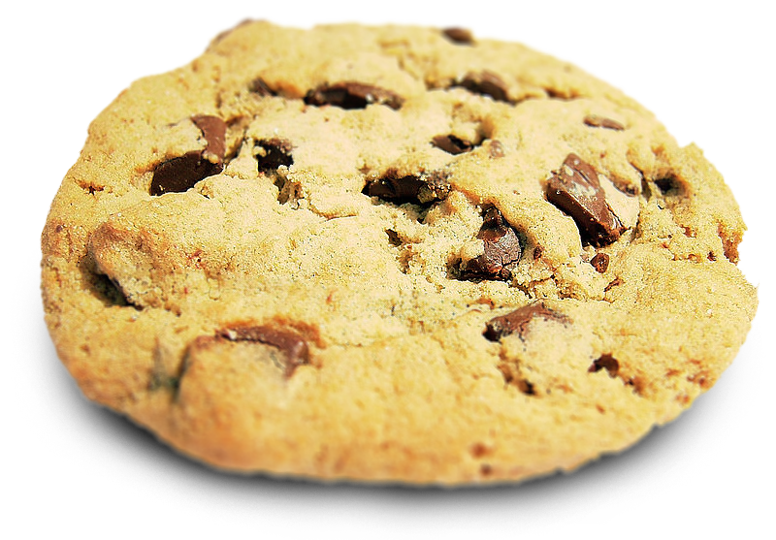
Time
Browser
Web Server
Database Server
DOM
Sessions:
42
6f
3e
MySql
Send
Request
Apache
Parse
Response
PHP
sessfun.php
PDO
JavaScript
RRC/HTTP
SQL

Slide 24
Login and Logout Using Session

Slide 25
Session / Authentication
Having a session is not the same as being logged in.
Generally you have a session the instant you connect to a web site.
The Session ID cookie is set when the first page is delivered.
Login puts user information in the session (stored in the server).
Logout removes user information from the session.

Slide 26
Time
Browser
Web Server
Database Server
DOM
Sessions:
42
6f
3e
MySql
Send
Request
Apache
Parse
Response
PHP
sessfun.php
PDO
JavaScript
RRC/HTTP
SQL

Slide 27
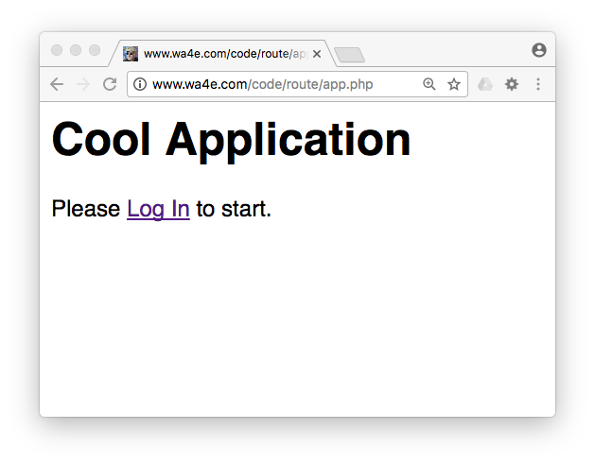
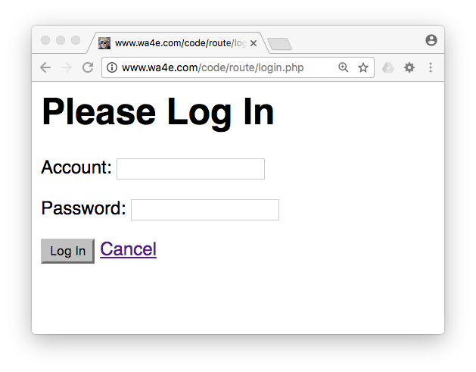
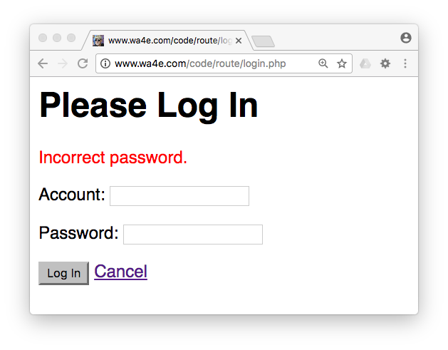
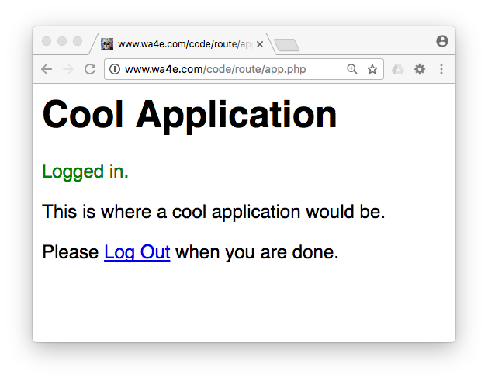
Simple application with login, logout, and flash using session
http://www.wa4e.com/code/route/app.php
http://www.wa4e.com/code/route.zip

Slide 28
login.php
<body style="font-family: sans-serif;">
<h1>Please Log In</h1>
<?php
if ( isset($_SESSION["error"]) ) {
echo('<p style="color:red">'.$_SESSION["error"]."</p>\n");
unset($_SESSION["error"]);
}
if ( isset($_SESSION["success"]) ) {
echo('<p style="color:green">'.$_SESSION["success"]."</p>\n");
unset($_SESSION["success"]);
}
?>
<form method="post">
<p>Account: <input type="text" name="account" value=""></p>
<p>Password: <input type="text" name="pw" value=""></p>
<!-- password is umsi -->
<p><input type="submit" value="Log In">
<a href="app.php">Cancel</a></p>
</form>
</body>

Slide 29
<?php
session_start();
if ( isset($_POST["account"]) && isset($_POST["pw"]) ) {
unset($_SESSION["account"]); // Logout current user
if ( $_POST['pw'] == 'umsi' ) {
$_SESSION["account"] = $_POST["account"];
$_SESSION["success"] = "Logged in.";
header( 'Location: app.php' ) ;
return;
} else {
$_SESSION["error"] = "Incorrect password.";
header( 'Location: login.php' ) ;
return;
}
}
?>
<html>
http://www.wa4e.com/code/sessions/login.php

Slide 30
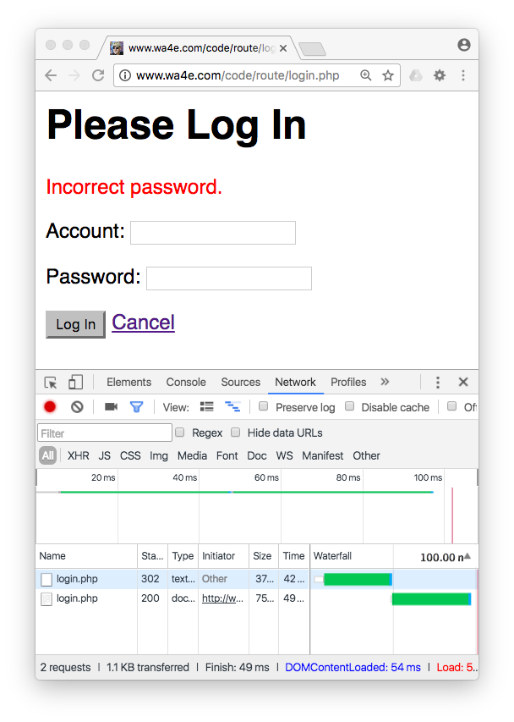
POST-Redirect-GET-Flash
POST detects error in input data and puts a message into $_SESSION and redirects
GET sees the message in the session, displays it and then deletes it
Flash = “Seen once”

Slide 31
Time
Browser C123
Redirect
Apache
login.php
$_POST
$_SESSION (S123)
Bad PW

Slide 32
Time
Browser C123
Browser C123
Apache
login.php
$_POST
login.php
$_SESSION (S123)
Bad PW

Slide 33
Time
Browser C123
Browser C123
Flash
Bad PW
Apache
login.php
$_POST
login.php
$_SESSION (S123)

Slide 34
Time
Browser C123
Browser C123
Browser C123
Refresh
Bad PW
Apache
login.php
$_POST
login.php
login.php
$_SESSION (C123)

Slide 35
<?php
session_start();
if ( isset($_POST["account"]) && isset($_POST["pw"]) ) {
unset($_SESSION["account"]); // Logout current user
if ( $_POST['pw'] == 'umsi' ) {
$_SESSION["account"] = $_POST["account"];
$_SESSION["success"] = "Logged in.";
header( 'Location: app.php' ) ;
return;
} else {
$_SESSION["error"] = "Incorrect password.";
header( 'Location: login.php' ) ;
return;
}
}
?>
<html>
http://www.wa4e.com/code/sessions/login.php

Slide 36
<html><head></head><body style="font-family: sans-serif;">
<h1>Cool Application</h1>
<?php
if ( isset($_SESSION["success"]) ) {
echo('<p style="color:green">'.$_SESSION["success"]."</p>\n");
unset($_SESSION["success"]);
}
// Check if we are logged in!
if ( ! isset($_SESSION["account"]) ) { ?>
<p>Please <a href="login.php">Log In</a> to start.</p>
<?php } else { ?>
<p>This is where a cool application would be.</p>
<p>Please <a href="logout.php">Log Out</a> when you are done.</p>
<?php } ?>
</body></html>
http://www.wa4e.com/code/sessions/app.php

Slide 37
Time
Browser C123
Redirect
Apache
login.php
$_POST
$_SESSION (S123)
account
Logged In

Slide 38
Time
Browser C123
Browser C123
Apache
login.php
$_POST
app.php
$_SESSION (S123)
account
Logged In

Slide 39
Time
Browser C123
Browser C123
Flash
Login
Apache
login.php
$_POST
app.php
$_SESSION (S123)
account

Slide 40
Time
Browser C123
Browser C123
Browser C123
Refresh
Login
Apache
login.php
$_POST
app.php
app.php
$_SESSION (C123)
account

Slide 41
logout.php
<?php
session_start();
session_destroy();
header("Location: app.php");

Slide 42
<html><head></head><body style="font-family: sans-serif;">
<h1>Cool Application</h1>
<?php
if ( isset($_SESSION["success"]) ) {
echo('<p style="color:green">'.$_SESSION["success"]."</p>\n");
unset($_SESSION["success"]);
}
// Check if we are logged in!
if ( ! isset($_SESSION["account"]) ) { ?>
<p>Please <a href="login.php">Log In</a> to start.</p>
<?php } else { ?>
<p>This is where a cool application would be.</p>
<p>Please <a href="logout.php">Log Out</a> when you are done.</p>
<?php } ?>
</body></html>
http://www.wa4e.com/code/sessions/app.php

Slide 43
Summary
Redirect
Post-Redirect-Get
Flash Messages
Sessions and Login / Logout

Slide 44

Acknowledgements / Contributions
These slides are Copyright 2010- Charles R. Severance (www.dr-chuck.com) as part of www.wa4e.com and made available under a Creative Commons Attribution 4.0 License. Please maintain this slide in all copies of the document to comply with the attribution requirements of the license. If you make a change, feel free to add your name and organization to the list of contributors on this page as you republish the materials.
Initial Development: Charles Severance, University of Michigan School of Information
Insert new Contributors and Translators here including names and dates
Continue new Contributors and Translators here
Notes:
Note from Chuck. Please retain and maintain this page as you remix and republish these materials. Please add any of your own improvements or contributions.

Slide 45
Copyright Attribution
Cookie Image: By brainloc on sxc.hu (Bob Smith) (stock.xchng) [CC BY 2.5
  (http://creativecommons.org/licenses/by/2.5)], via Wikimedia Commons

