Slide 1
HTTP Parameters and Arrays

Slide 2
PHP Global Variables
Part of the goal of PHP is to make interacting with HTTP and HTML as easy as possible
PHP processes the incoming HTTP Request based on the protocol specifications and drops the data into various super global variables (usually arrays)

Slide 3
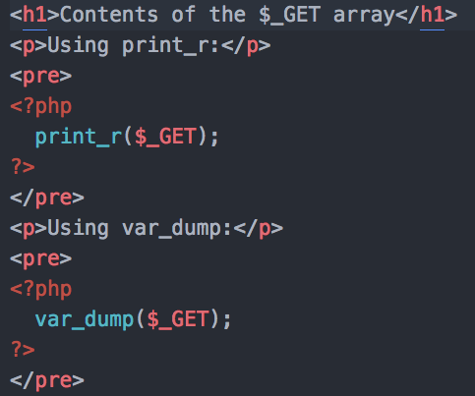
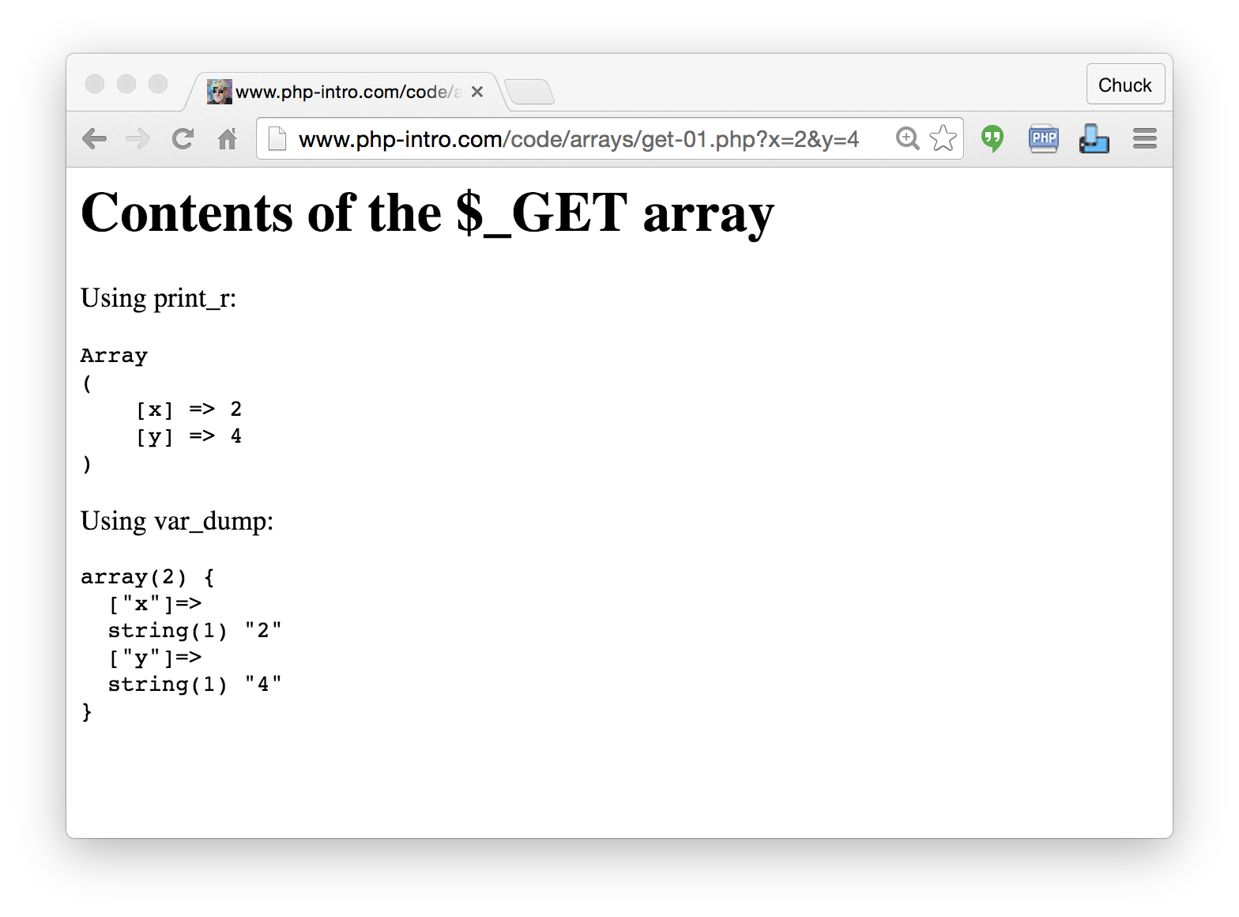
http://www.wa4e.com/code/arrays/get-01.php

Slide 4
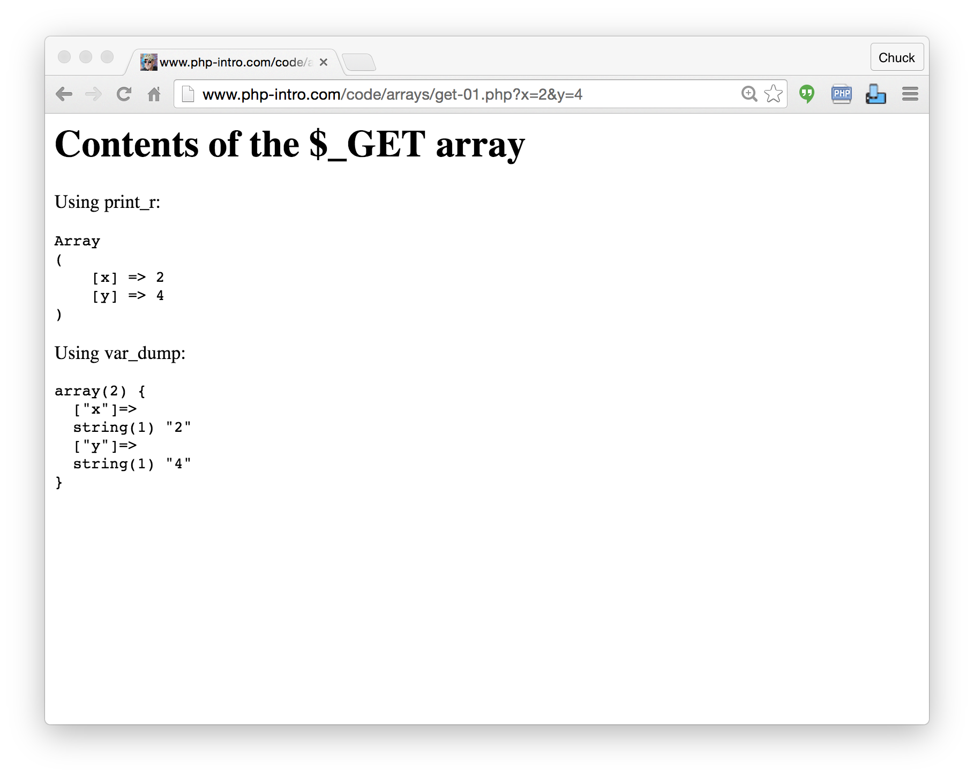

Slide 5
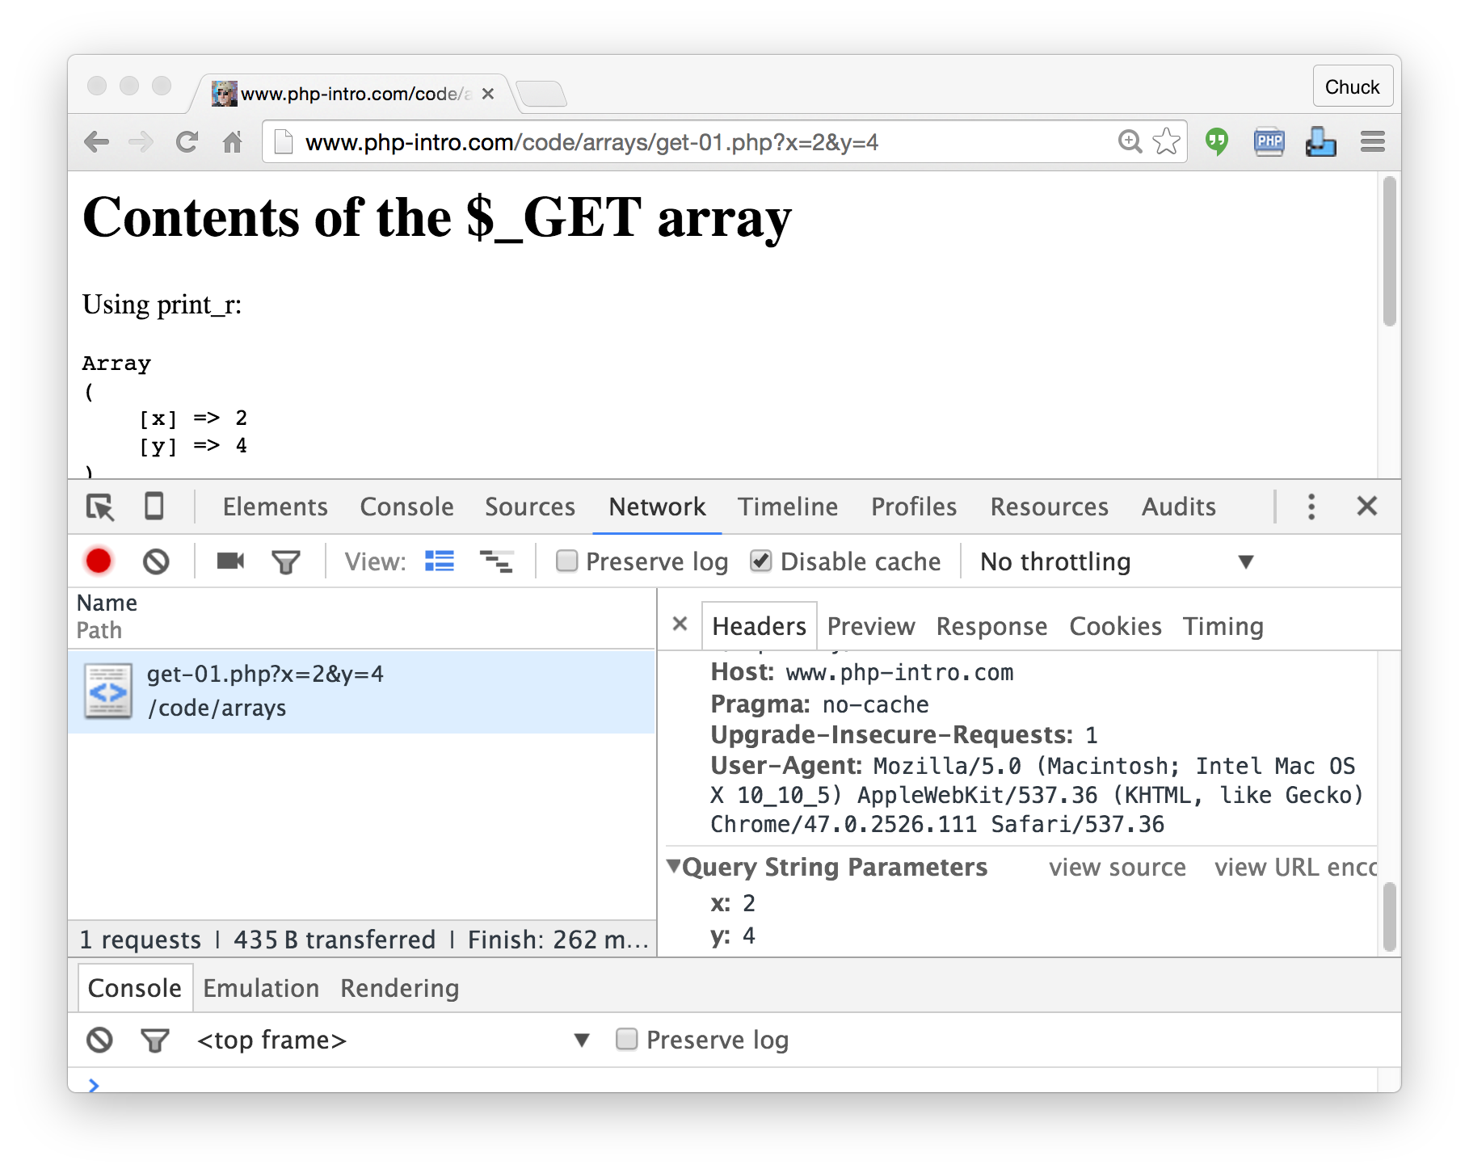

Slide 6
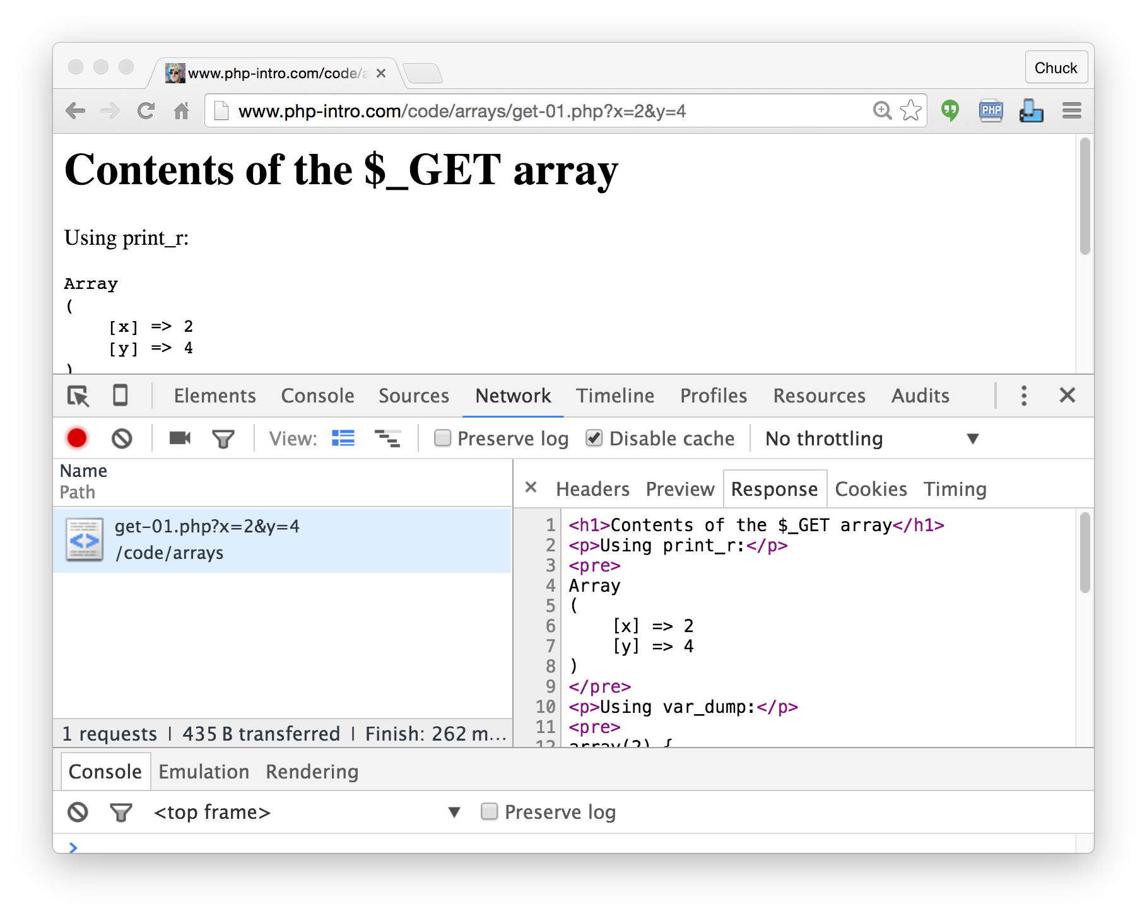

Slide 7


Time
Browser
Web Server
Database Server
D
OM
Apache
static
files
MySql
Parse
Request
Parse
Response
$_GET
PHP
php
code
ind.php
JavaScript
RRC/HTTP
SQL

Slide 8
Validation
Making sure all user data is present and the correct format before proceeding
  Non empty strlen($var) > 0
  A number is_numeric($var)
  An email address strpos($var, '@') > 0
  ....

Slide 9
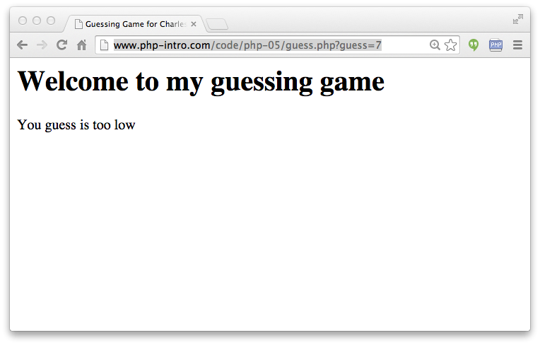
http://www.wa4e.com/code/arrays/guess.php?guess=7

Slide 10
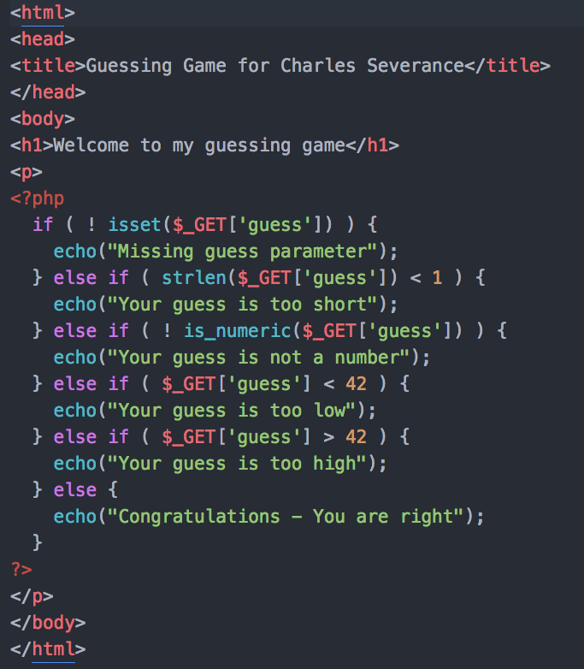
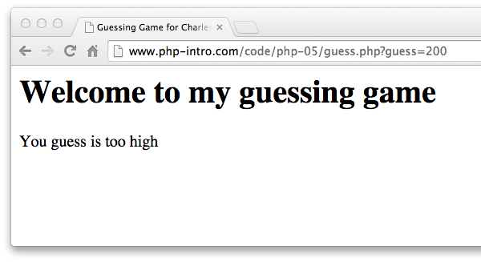
http://www.wa4e.com/code/arrays/guess.php?guess=200

Slide 11
Summary
PHP arrays are a very powerful associative array as they can be indexed by integers like a list, or use keys to look values up like a hash map or dictionary
PHP arrays maintain order and there are many options for sorting
We can use explode() to split a string into an array of strings
HTTP Information is pre-processed and placed in super global arrays

Slide 12

Acknowledgements / Contributions
These slides are Copyright 2010- Charles R. Severance (www.dr-chuck.com) as part of www.wa4e.com and made available under a Creative Commons Attribution 4.0 License. Please maintain this last slide in all copies of the document to comply with the attribution requirements of the license. If you make a change, feel free to add your name and organization to the list of contributors on this page as you republish the materials.
Initial Development: Charles Severance, University of Michigan School of Information
Insert new Contributors and Translators here including names and dates
Continue new Contributors and Translators here
Notes:
Note from Chuck. Please retain and maintain this page as you remix and republish these materials. Please add any of your own improvements or contributions.

