Slide 1

PHP Arrays
Dr. Charles Severance
www.php-intro.com
Notes:
Note from Chuck. If you are using these materials, you can remove my name and URL from this replace it with your own, but please retain the CC-BY logo on the first page as well as retain the entire last page when you remix and republish these slides.

Slide 2
PHP Arrays Rock!
Better than Python Dictionaries
Better than Java Hash Maps
PHP Arrays have all the benefits of Python Dictionaries but they can also maintain the order of the items in the array
http://en.wikipedia.org/wiki/Associative_array

Slide 3
Associative Arrays
Like Python Dictonaries - but more powerful
Can be key => value or simply indexed by numbers
Ignore two-dimensional arrays for now...
http://en.wikipedia.org/wiki/Associative_array

Slide 4
Integer Indices
<?php
$stuff = array("Hi", "There");
echo $stuff[1], "\n";
?>
There

Slide 5
Key / Value
<?php
$stuff = array("name" => "Chuck",
"course" => "PHPIntro");
echo $stuff["course"], "\n";
?>
PHPIntro

Slide 6
Dumping an Array
The function print_r() dumps out PHP data - it is used mostly for debugging
<?php
$stuff = array("name" => "Chuck",
"course" => "PHPIntro");
print_r($stuff);
?>
Array(
[name] => Chuck
[course] => PHPIntro
)

Slide 7
Building up an Array
You can allocate a new item in the array and add a value at the same time using empty square braces [] on the right hand side of an assignment statement
$va = array();
$va[] = "Hello";
$va[] = "World";
print_r($va);
Array(
[0] => Hello
[1] => World
)

Slide 8
Building up an Array
You can also add new items in an array using a key as well
$za = array();
$za["name"] = "Chuck";
$za["course"] = "PHPIntro";
print_r($za);
Array(
[name] => Chuck
[course] => PHPIntro
)

Slide 9
Looping Through an Array
<?php
$stuff = array("name" => "Chuck",
"course" => "PHPIntro");
foreach($stuff as $k => $v ) {
echo "Key=",$k," Val=",$v,"\n";
}
?>
Key=name Val=Chuck
Key=course Val=PHPIntro

Slide 10
Arrays of Arrays
$products = array(
'paper' => array(
'copier' => "Copier & Multipurpose",
'inkjet' => "Inkjet Printer",
'laser' => "Laser Printer",
'photo' => "Photographic Paper"),
'pens' => array(
'ball' => "Ball Point",
'hilite' => "Highlighters",
'marker' => "Markers"),
'misc' => array(
'tape' => "Sticky Tape",
'glue' => "Adhesives",
'clips' => "Paperclips")
);
The elements of an array can be many things other than a string or integer. You can even have objects or other arrays.
echo $products["pens"]["marker"];
Markers

Slide 11
Array Functions

Slide 12
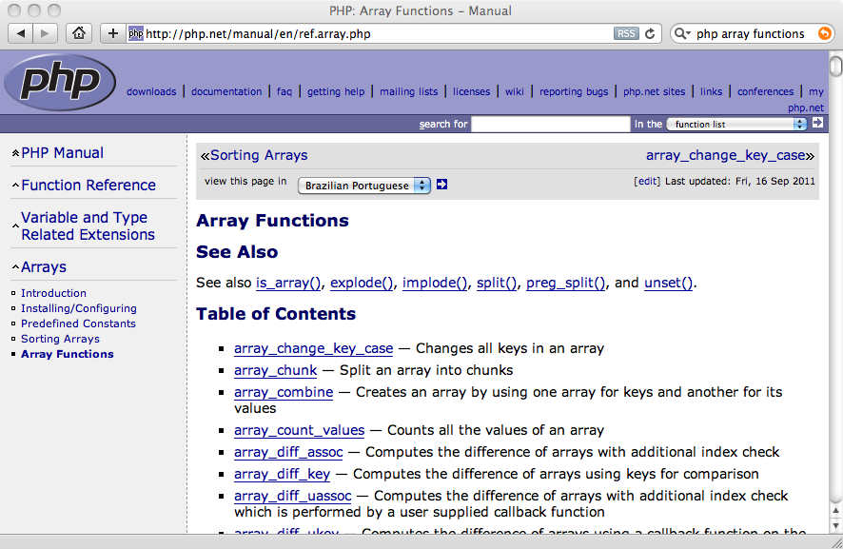
Array Functions

Slide 13
Array Functions
count($ar) - How many elements in an array
is_array($ar) - Returns TRUE if a variable is an array
isset($ar['key']) - Returns TRUE if key is set in the array
sort($ar) - Sorts the array values (loses key)
ksort($ar) - Sorts the array by key
asort($ar) - Sorts array by value, keeping key association
shuffle($ar) - Shuffles the array into random order

Slide 14
Count: 2
$za Is an array
name is set
addr is not set
$za = array();
$za["name"] = "Chuck";
$za["course"] = "PHPIntro";
print "Count: " . count($za) . "\n";
if ( is_array($za) ) {
echo '$za Is an array' . "\n";
} else {
echo '$za Is not an array' . "\n";
}
echo isset($za['name']) ? "name is set\n" : "name is not set\n";
echo isset($za['addr']) ? "addr is set\n" : "addr is not set\n";

Slide 15
Array(
[name] => Chuck
[course] => PHPIntro
[topic] => PHP
)
Array(
[0] => Chuck
[1] => PHP
[2] => PHPIntro
)
$za = array();
$za["name"] = "Chuck";
$za["course"] = "PHPIntro";
$za["topic"] = "PHP";
print_r($za);
sort($za);
print_r($za);

Slide 16
Array(
[name] => Chuck
[course] => PHPIntro
[topic] => PHP
)
Array(
[course] => PHPIntro
[name] => Chuck
[topic] => PHP
)
Array(
[name] => Chuck
[topic] => PHP
[course] => PHPIntro
)
$za = array();
$za["name"] = "Chuck";
$za["course"] = "PHPIntro";
$za["topic"] = "PHP";
print_r($za);
ksort($za);
print_r($za);
asort($za);
print_r($za);

Slide 17
Arrays and Strings
$inp = "This is a sentence with seven words";$temp = explode(' ', $inp);
print_r($temp);
Array(
[0] => This
[1] => is
[2] => a
[3] => sentence
[4] => with
[5] => seven
[6] => words
)

Slide 18
HTTP Parameters and Arrays

Slide 19
PHP Global Variables
Part of the goal of PHP is to make interacting with HTTP and HTML as easy as possible
PHP processes the incoming HTTP Request based on the protocol specifications and drops the data into various super global variables (usually arrays)

Slide 20
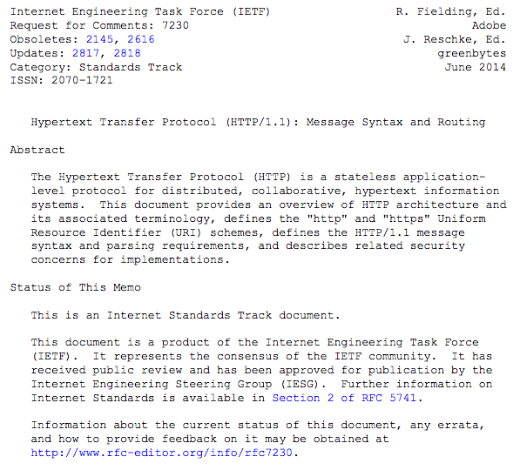
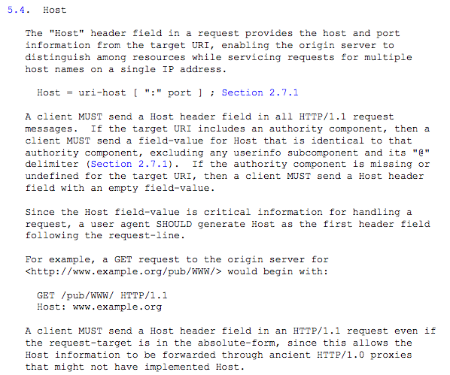
https://tools.ietf.org/html/rfc7230 (1 of several – 89 pages)

Slide 21
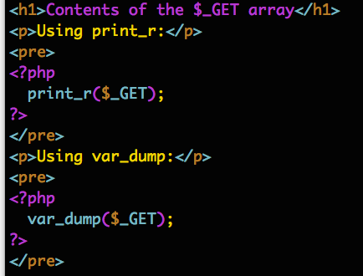
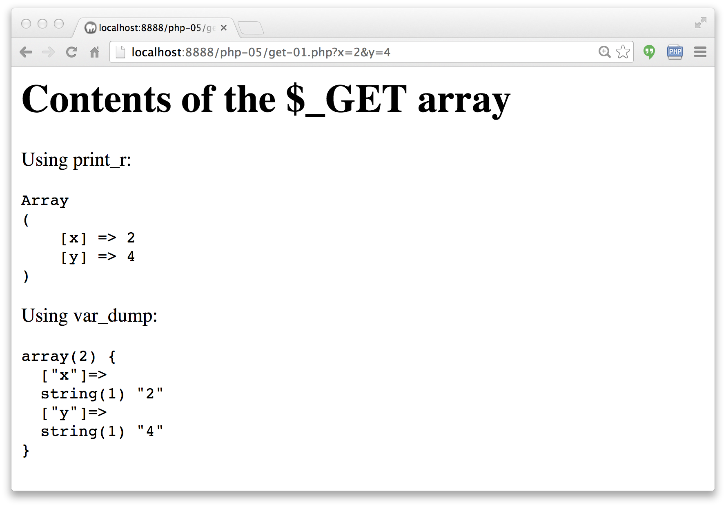
http://www.php-intro.com/code/php-05/get-01.php

Slide 22
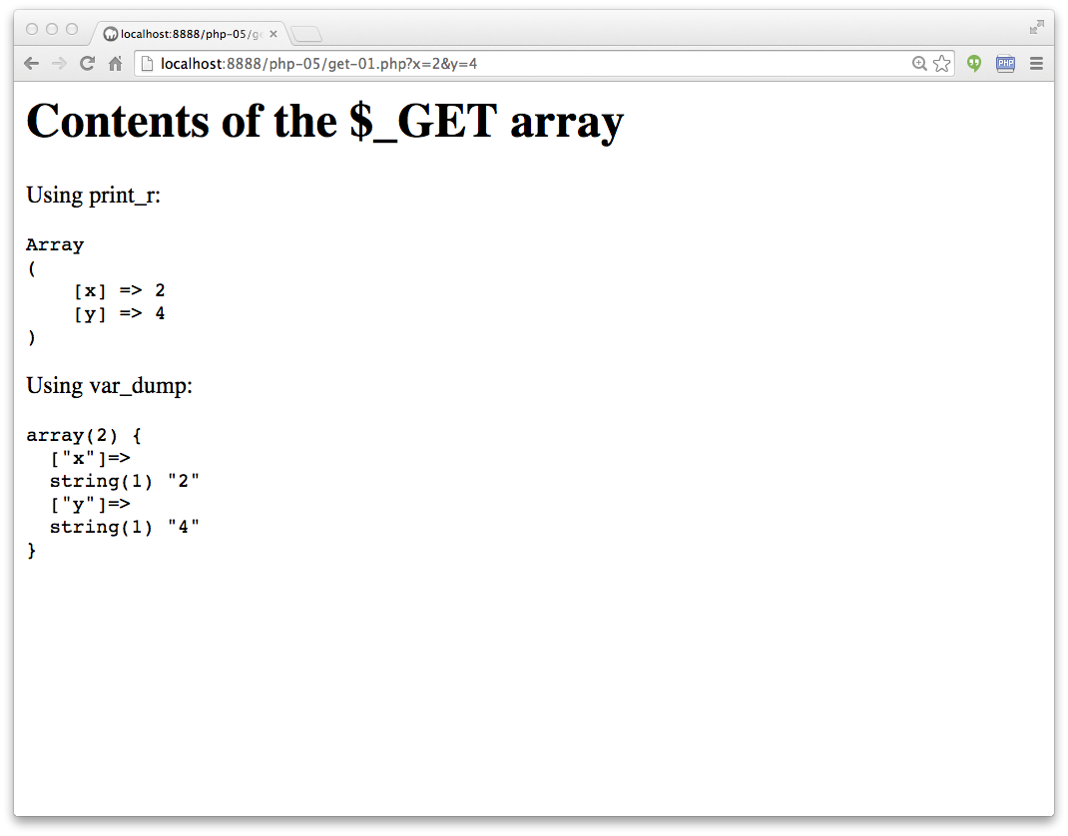

Slide 23
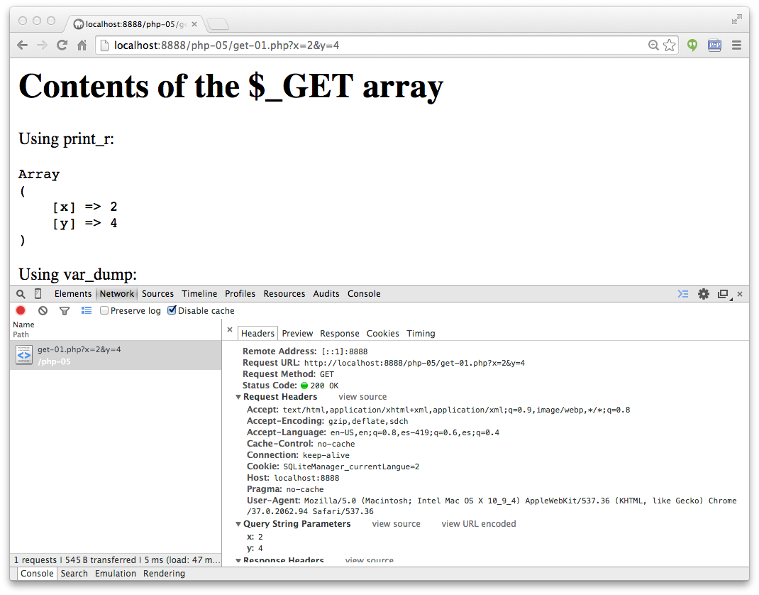

Slide 24
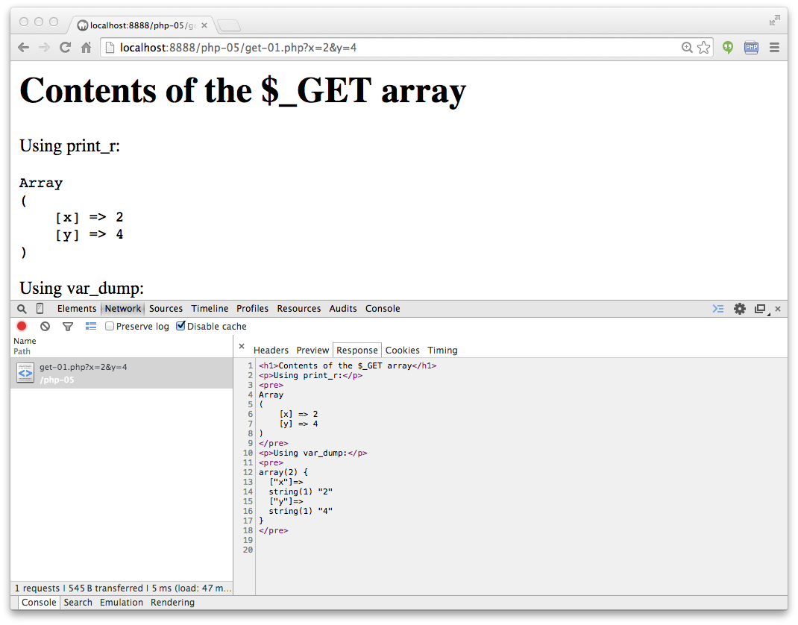

Slide 25
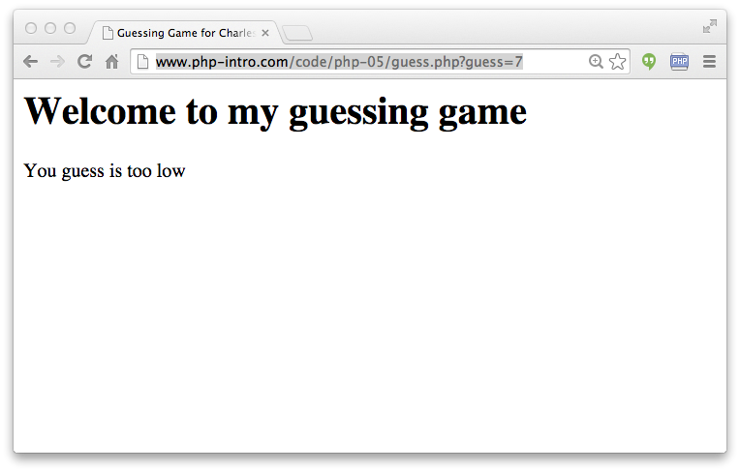
http://www.php-intro.com/code/php-05/guess.php?guess=7

Slide 26
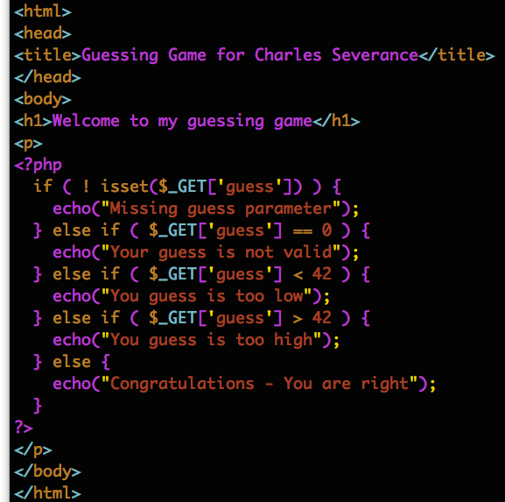
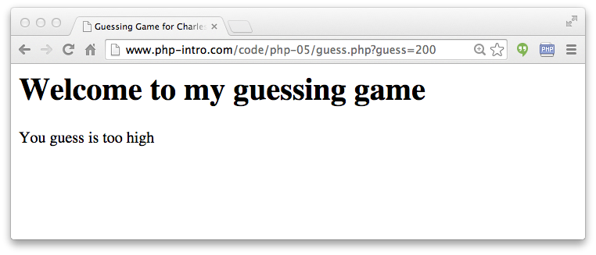
http://www.php-intro.com/code/php-05/guess.php?guess=200

Slide 27
Summary
PHP arrays are a very powerful associative array as they can be indexed by integers like a list, or use keys to look values up like a hash map or dictionary
PHP arrays maintain order and there are many options for sorting
We can use explode() to split a string into an array of strings
HTTP Information is pre-processed and placed in super global arrays

Slide 28
Acknowledgements / Contributions
These slides are Copyright 2010- Charles R. Severance (www.dr-chuck.com) as part of www.php-intro.com and made available under a Creative Commons Attribution 4.0 License. Please maintain this last slide in all copies of the document to comply with the attribution requirements of the license. If you make a change, feel free to add your name and organization to the list of contributors on this page as you republish the materials.
Initial Development: Charles Severance, University of Michigan School of Information
Insert new Contributors and Translators here including names and dates
Continue new Contributors and Translators here
Notes:
Note from Chuck. Please retain and maintain this page as you remix and republish these materials. Please add any of your own improvements or contributions.

