Slide 1

Practical PHP
Chapter 7
Dr. Charles Severance
  To be used in association with the book:
  PHP, MySql, and JavaScript by Robin Nixon

Slide 2




Unless otherwise noted, the content of this course material is licensed under a Creative Commons Attribution 3.0 License.
http://creativecommons.org/licenses/by/3.0/.
Copyright 2011- Charles Severance

Slide 3
Miscellaneous Useful Stuff
String formatting
Date Functions
File Handling

Slide 4
String Formatting
Most languages inspired by C have a feature similar to C's printf() function that gives a high level of control over formatted output when variables are converted to strings.
$x = 1.0 / 3.0;
echo "x = $x\n";
printf ("x = %5.2f\n",$x);
x = 0.333333333333
x = 0.33
http://php.net/manual/en/function.printf.php

Slide 5
$x = 1.0 / 3.0;
echo "x = $x\n";
printf ("x = %5.2f\n",$x);
printf ("x = %08.4f\n",$x);
$y = 120;
$z = 1;
$a = 1000;
printf("%8d\n",$y);
printf("%8d\n",$z);
printf("%8d\n",$a);
x = 0.333333333333
x = 0.33
x = 000.3333
120
1
1000
http://php.net/manual/en/function.printf.php

Slide 6
$x = 1.0 / 3.0;
echo "x = $x\n";
printf ("x = %5.2f\n",$x);
printf ("x = %08.4f\n",$x);
$y = 120;
$z = 1;
$a = 1000;
printf("%8d\n",$y);
printf("%8d\n",$z);
printf("%8d\n",$a);
x = 0.333333333333
x = 0.33
x = 000.3333
120
1
1000
http://php.net/manual/en/function.printf.php

Slide 7
printf ("x = %5.2f\n",$x);
x = 0.33
http://php.net/manual/en/function.printf.php

Slide 8
Floating point number
Five Characters wide
printf ("x = %5.2f\n",$x);
Two digits after the decimal place.
Begin format code
x = b0.33
Five Characters wide
http://php.net/manual/en/function.printf.php

Slide 9
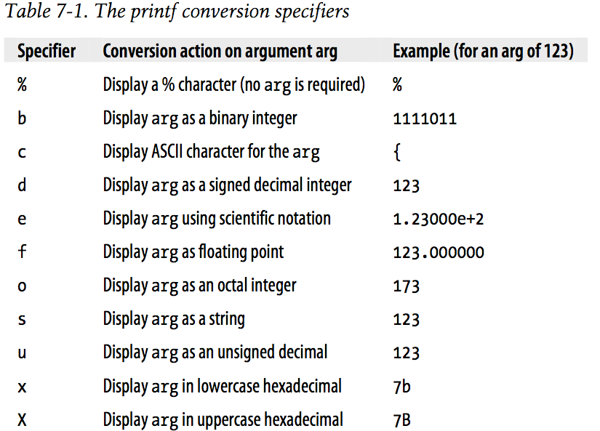

Slide 10
Multiple Format Codes
The string can have multiple format codes and needs one argument after the format string for each of the codes
printf("My name is %s. I'm %d years old, which is %X in hexadecimal\n",
'Simon', 33, 33);
My name is Simon. I'm 33 years old, which is 21 in hexadecimal

Slide 11
Formatted Print to a String
Often we want to format a string printf() style but instead, have the formatted result in a variable to put in a database field or send across a networks, etc.
$hexstring = sprintf("%X%X%X", 65, 127, 245);
echo "Hex = " . $hexstring . "\n";
Hex = 417FF5

Slide 12
Date and Time

Slide 13
Date and Time
Time is an integer number of seconds since January 1, 1970
  Can do relative computations by adding a number of seconds
  There might be a problem around 2038.....
The date() function is used to produce various string-formatted representations of the date
http://en.wikipedia.org/wiki/Year_2038_problem

Slide 14
echo "Time = " . time() . "\n";
$nextWeek = time() + (7 * 24 * 60 * 60);
// 7 days; 24 hours; 60 mins; 60secs
echo 'Now: '. date('Y-m-d') ."\n";
echo 'Next Week: '. date('Y-m-d', $nextWeek) ."\n";
Time = 1316400842
Now: 2011-09-19
Next Week: 2011-09-26
http://php.net/manual/en/function.time.php

Slide 15
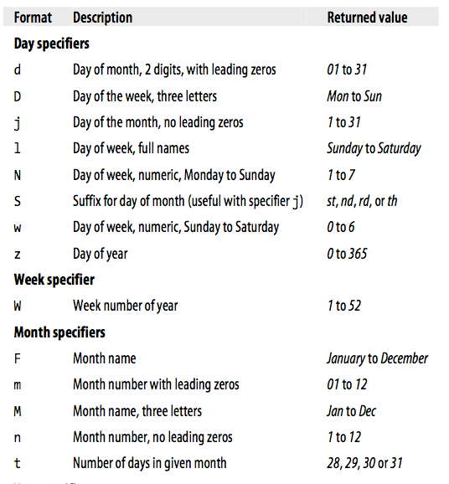
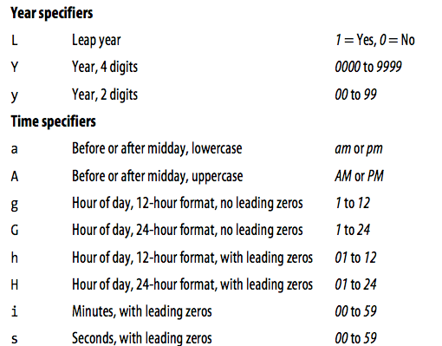
http://lpmj.net/

Slide 16
Date Formats
Different Web protocols need different date formats
ISO8601 is a popular format becuase it is simple and in UTC / GMT
echo "ISO 8601 = " . gmDate("Y-m-d\TH:i:s\Z") . "\n";
ISO 8601 = 2011-09-19T11:47:14Z
http://php.net/manual/en/class.datetime.php

Slide 17
Reading and Writing Files

Slide 18
Checking for Existence
if (file_exists("names.txt")) echo "names.txt exists\n";
names.txt exists

Slide 19
Reading all the lines in a file..
$fh = fopen("names.txt", "r");
while(true)
{
$line = fgets($fh);
if($line == null)break;
echo $line;
}
fclose($fh);
# First, last, email, age
Granny,Smith,gsmith@umich.edu,29
Mariela,Bischoff,mb@umich.edu,29
Harry,Spitz,hs@umich.edu,29
Roni Callaghan,rc@umich.edu,29
Latanya,Hosmer,lh@umich.edu,29
Tyson,Bortz,tb@umich.edu,29
Charity,Sato,cs@umich.edu,29
Jaymie,Valencia,jv@umich.edu,29
Una,Mcalister,um@umich.edu,29
Adella,Gries,ag@umich.edu,29
Cathleen,Mclaughlin,cm@umich.edu,29

Slide 20
Summary
Formatting
Dates
Files...

